Slide 1
The Community Geodetic Model (CGM)
Jessica Murray, U.S. Geological Survey (SCEC4)
Rowena Lohman, Cornell University (SCEC4)
David Sandwell, Scripps Institute of Oceanography (SCEC4.5)
Gareth Funning, University of California, Riverside (SCEC5)
With substantial contributions from
Thomas Herring and Michael Floyd, Massachusetts Institute of Technology
Adrian Borsa and Eric Lindsey, Scripps Institute of Oceanography
Xiaopeng Tong, University of Washington
Approximately 25 scientists are involved in the development of the CGM with expertise
in continuous GPS time series, campaign GPS, InSAR analysis, and kinematic/dynamic models. Analysis and integration of results is done through virtual and in-person workshops.
January 12, 2016
Notes:
This slide provides information on who is involved in this effort. In addition it shows that the leadership is constantly undergoing transition.

Slide 2
The Community Geodetic Model (CGM)
Science Objectives:
estimate interseismic stress loading rate within the seismogenic zone as well as the interiors of crustal blocks
estimate hydrologic stress loading in the upper crust from natural and anthropogenic forcing
estimate co- and post-seismic stress changes from earthquakes
monitor and understand seismic transients (e.g., ETS)
stress = strain X rheology
Notes:
This slide is not really needed but reminds the presenter of the science objectives and expected signals.

Slide 3
The Community Geodetic Model (CGM)
CGM Requirements:
secular 3-D surface deformation at 1-2 mm/yr accuracy on 500m to 2000 km length scales
deformation time series at better than seasonal temporal resolution at ~1 km spatial resolution
ancillary water loading and atmospheric delay information
Available data sets:
continuous GPS from PBO with 3 components at daily sampling
targeted campaign GPS surveys to improve spatial resolution in complex areas
InSAR data from ERS-1/2, Envisat, ALOS-1 to provide secular time series at ~500 spatial resolution
LIDAR and optical imagery for near-fault co-seismic studies
Notes:
This slide is not really needed but provides the presenter with the spatial and temporal requirements for a combined GPS/InSAR model.
- time series are now long enough to accurately resolve vertical deformation - spatial resolution is limited by 10-20 km station spacing

Slide 4
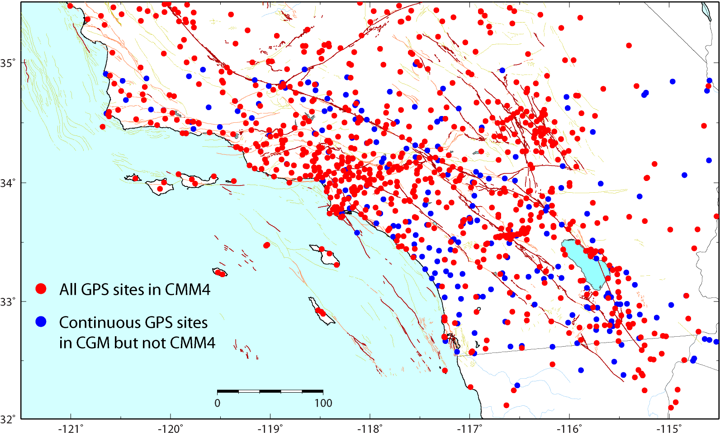
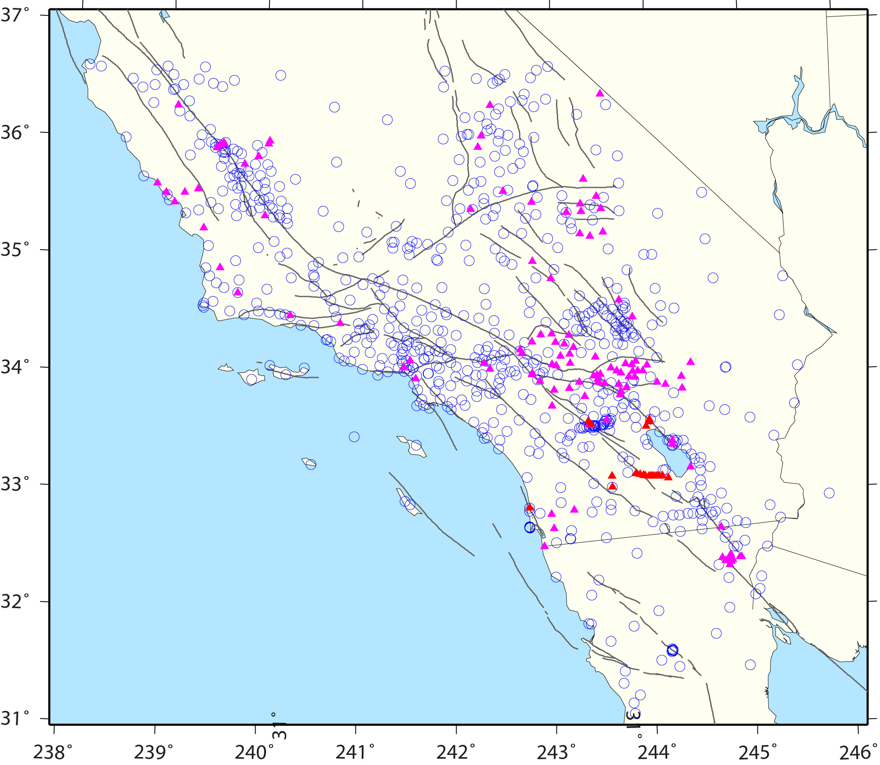
  CGM development:
  Include GPS data collected since CMM4
PBO continuous GPS (CGPS) sites incorporated
All CMM4 GPS
CGPS in CGM but not CMM4
SCEC-funded campaign GPS data being migrated to UNAVCO archive (M. Floyd, D. Agnew, Fran Boler)
All campaign GPS data (1986 – 2014) and global tracking stations reprocessed in consistent manner using modern techniques (Z.-K. Shen)
New campaign GPS sites from
CSU San Bernardino & U. of AZ
UC Riverside
Scripps Institute of Oceanography
USGS
Notes:
One of the main SCEC4 highlights

Slide 5
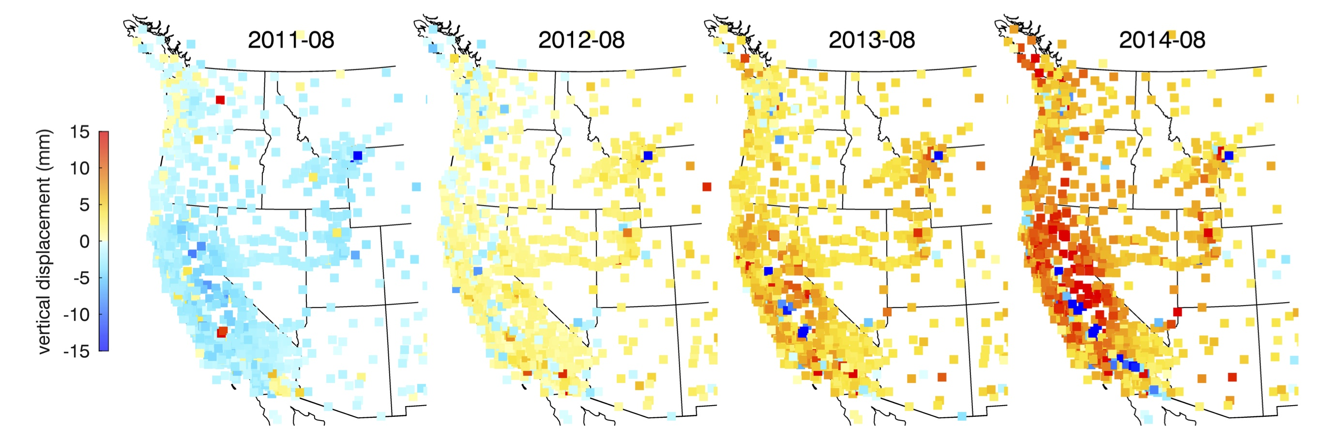
  CGM development:
  Understand large-scale hydrologic loading effect on vertical velocity estimates
PBO continuous GPS (CGPS) sites incorporated
hydrological loading signals: 1mm ~ 1cm
drought (unloading) leads to uplift since 2013
One can correct vertical positions with a best-fitting hydrological loading model, offering possible path to improved vertical velocity estimates.
Figures courtesy Adrian Borsa
Notes:
One of the main SCEC4 highlights.

Slide 6
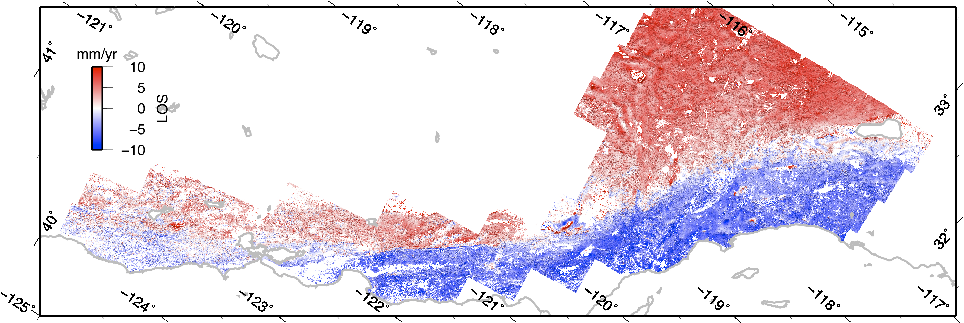
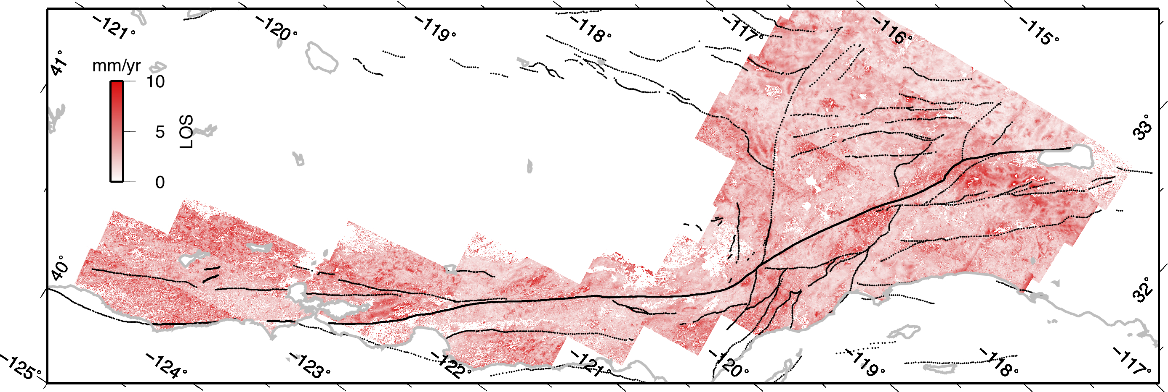
  CGM development:
  Large scale integration InSAR-GPS LOS velocity field and standard deviation
InSAR Mean LOS Velocity
from ALOS-1 Ascending & far-field GPS constraint
North
Radar Look direction
Provides high spatial resolution creep observations, but with ambiguity between horizontal and vertical
Standard Deviation
Tong et al., JGR, 2013
Notes:
One of the main SCEC4 highlights

Slide 7
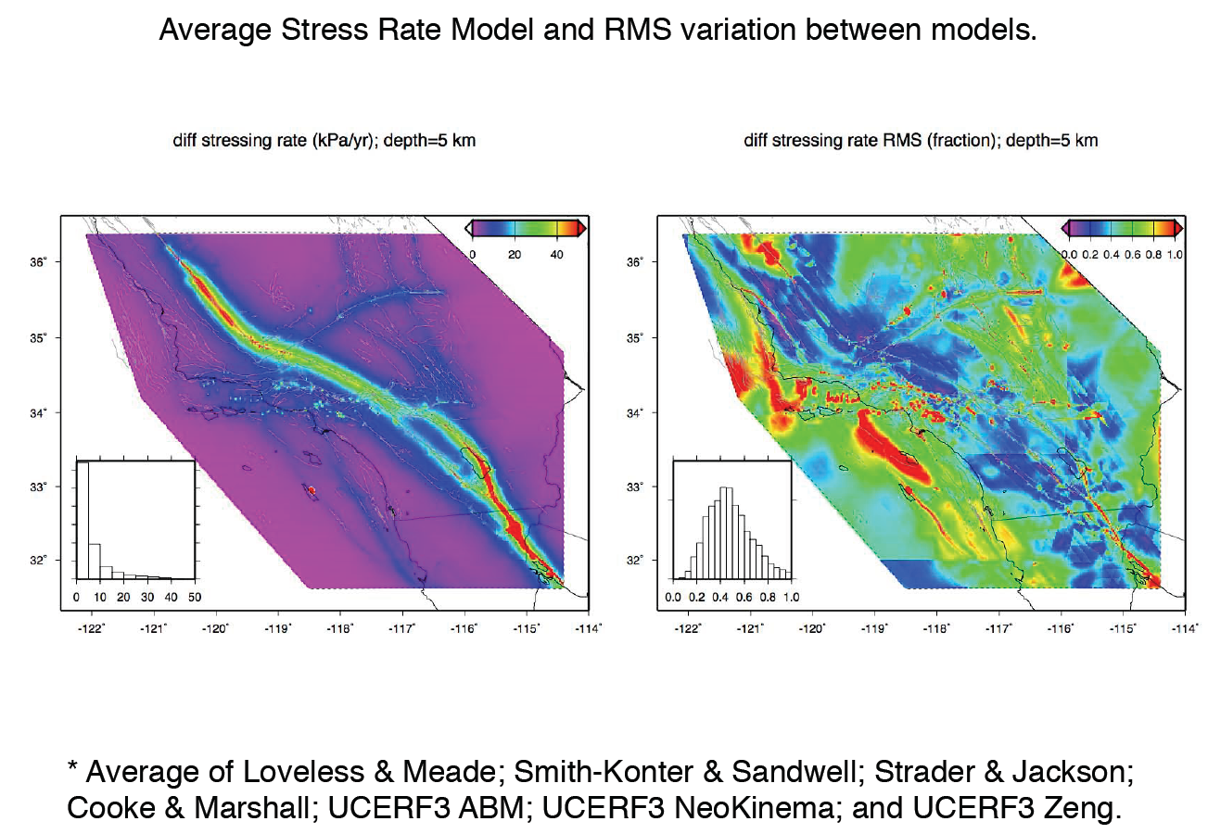
  SCEC4 Fundamental Problems of Earthquake Physics:
  Stress-mediated fault interactions and earthquake clustering: evaluation of mechanisms
Geodetic crustal velocities constrain regional tectonic stressing rate models for the CSM
  → Requires well-constrained velocities with broad regional coverage
Average stress rate model and RMS variation between models
kPA/yr
fraction
5 km depth
Models: Loveless & Meade, Smith-Konter & Sandwell, Strader & Jackson, Cooke & Marshall, UCERF3 ABM, UCERF3 NeoKinema, UCERF3 Zeng
Figure courtesy Jeanne Hardebeck
Notes:
An average of several strain rate models compiled under the CGM was used to develop an average stress rate model as well as the rms variation among models. The BIG assumption here is a uniform elastic model was used. Peter Bird’s analysis shows how the strain rate is dramatically influenced by the rheology. So in SCEC 5 we need to include rheological models which are founded in temperature models

Slide 8
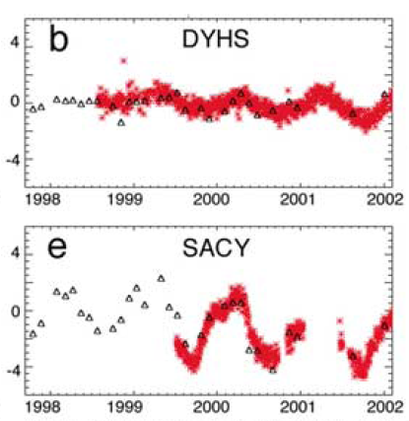
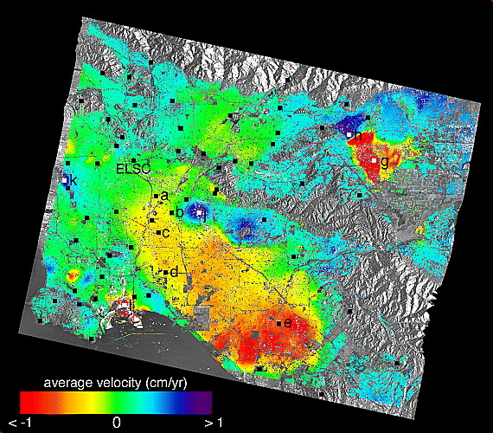
  CGM development:
  Best practices in development of InSAR time series
InSAR time series analysis techniques using small-baseline (SBAS).
Recovered time-varying motion agrees well with GPS under certain assumptions (e.g., temporal/spatial smoothness).
Accuracy: ~5-10 mm displacement, ~1-2 mm/yr rate
Example: L.A. Basin aquifer effects
Lanari et al. (2004)
Notes:
There are a few areas with good InSAR coverage and good coherence and large hydrologic signals where InSAR times series adequately resolve seasonal signals in comparison with GPS (red). We would like to do this throughout the SCEC region but the current InSAR data lack cadence and have poor baseline control. At a SCEC workshop several groups compared methods and results and arrived at best practices for InSAR time series construction when we finally get the required data from Sentinel-1a/b and ALOS-2.

Slide 9
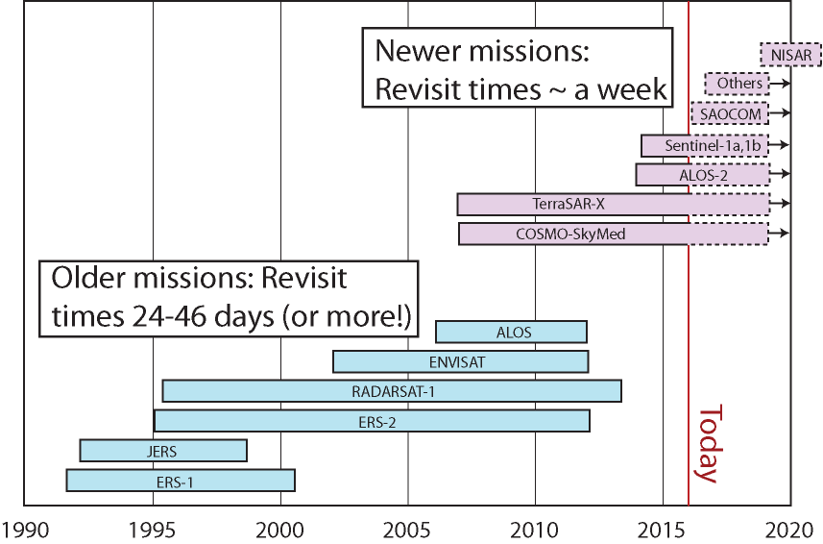
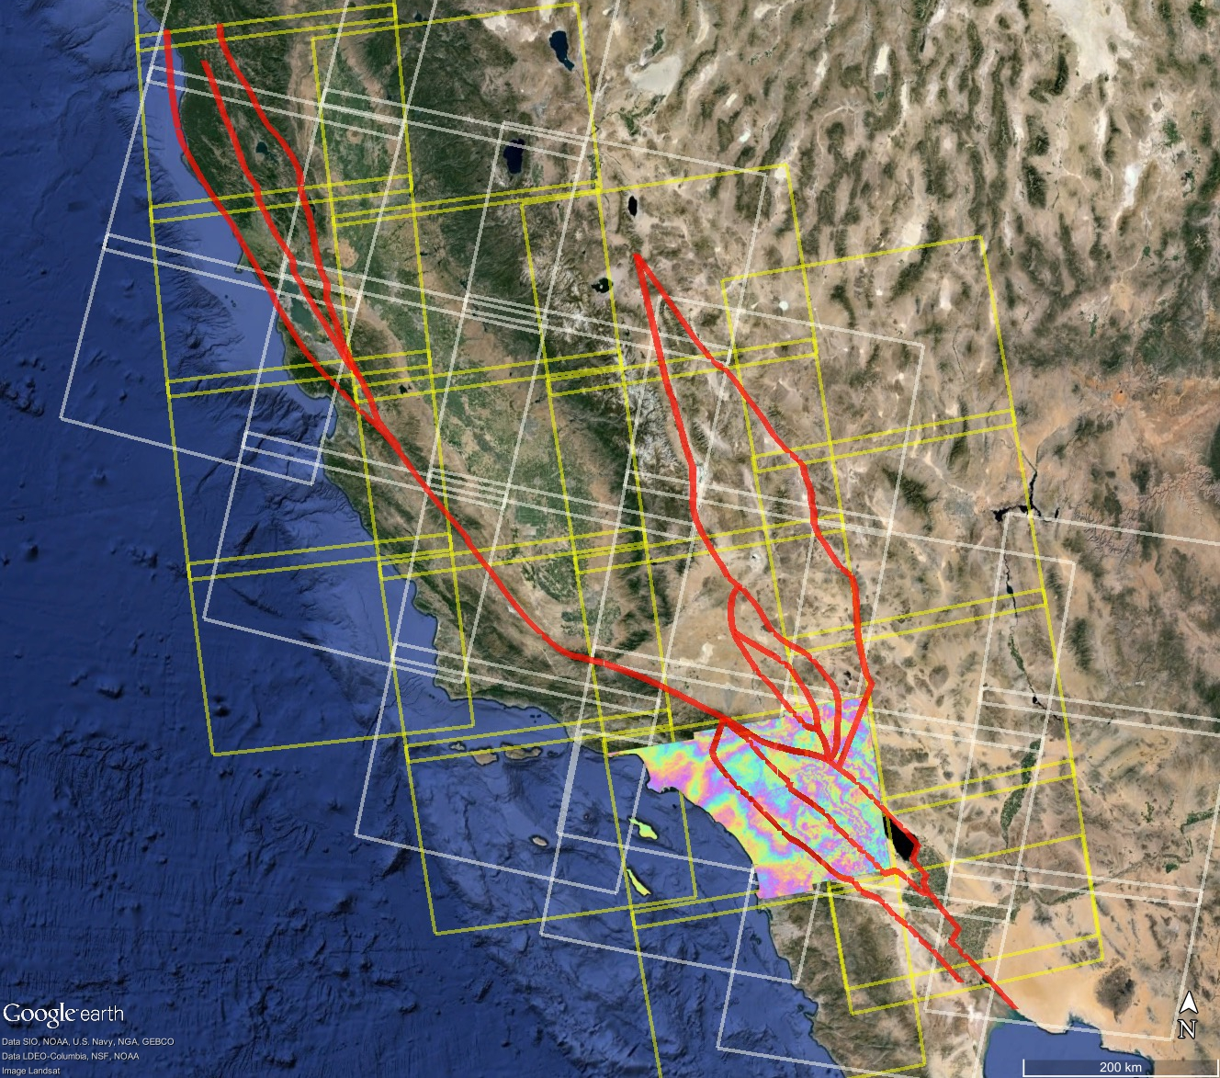
  New geodetic data and analysis techniques for SCEC5:
  More frequent repeat passes, ascending and descending orbits, and better baseline control on the horizon.
Sentinel-1A SAF coverage – currently 35 repeats/frame
Notes:
More details about the new InSAR satellites. I checked today and a point in Banning already has 72 S1A acquisitions so this is very real.

Slide 10
The Community Geodetic Model (CGM)
SCEC4 Achieved:
increased GPS station density from new campaign acquisitions and compilations
processed all CGPS and campaign GPS in a consistent way for improved vertical accuracy
contributed averaged block model to UCERF3 and CSM
integrated GPS and InSAR for secular model at 500 m resolution
developed best practices for InSAR time series
SCEC5 Proposed:
focus on time series for recovery of postseismic, transient, and hydrologic signals
increase vertical precision of multi-decade GPS time series
construct InSAR time series for recovery of seasonal signals at 1 km resolution from multiple look directions
deliver combined GPS/InSAR strain rate maps for CSM development
Notes:
I took these ideas out of the proposal but there may be something missing and I added my own filter.

