Slide 1
The Community Geodetic Model (CGM) Workshop
September 6, 2014, 10:00AM – 6:00 PM, Palm Springs Hilton
Jessica Murray, U.S. Geological Survey
Rowena Lohman, Cornell University
David Sandwell, Scripps Institute of Oceanography
GPS Working Group Topics:
campaign data compilation and reprocessing
comparison of CGPS time series solutions from 5 centers
approaches for combining solutions at the time series level
next steps
InSAR Working Group
standard data set used in InSAR exercise
individual approaches to InSAR time series
comparison of results
best practices for InSAR time series
January 28, 2016

Slide 2
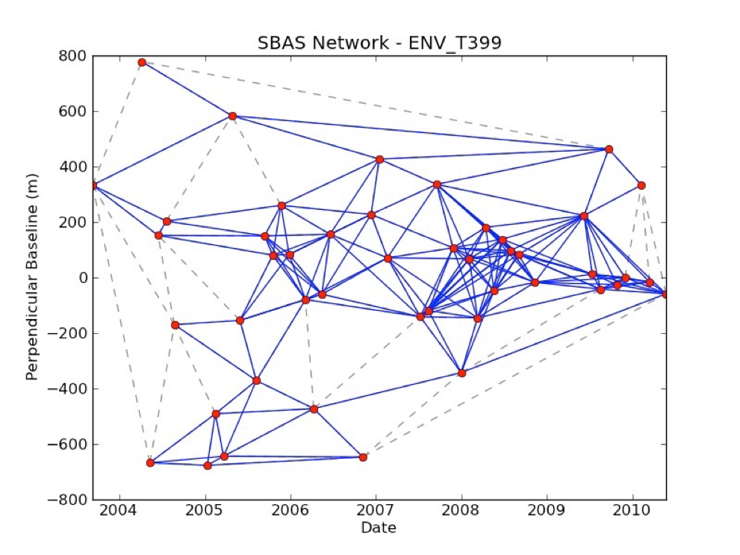
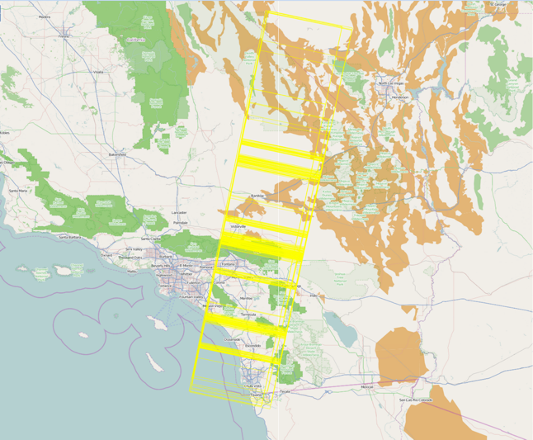
InSAR (CGM) Exercise - 2014
Scott Baker
Data Set
Envisat – T399 F2907-2925
47 acquisitions
Participants:
Ekaterina Tymofyeyeva
Chris Johnson
Estelle Chaussard
Zhen Liu
Brian Riel
Manoochehr Shirzaei
Xiaopeng Tong
Rowena Lohman
January 28, 2016

Slide 3
InSAR (CGM) Highlights - 2014
Tymofyeyeva / Fialko
January 28, 2016

Slide 4
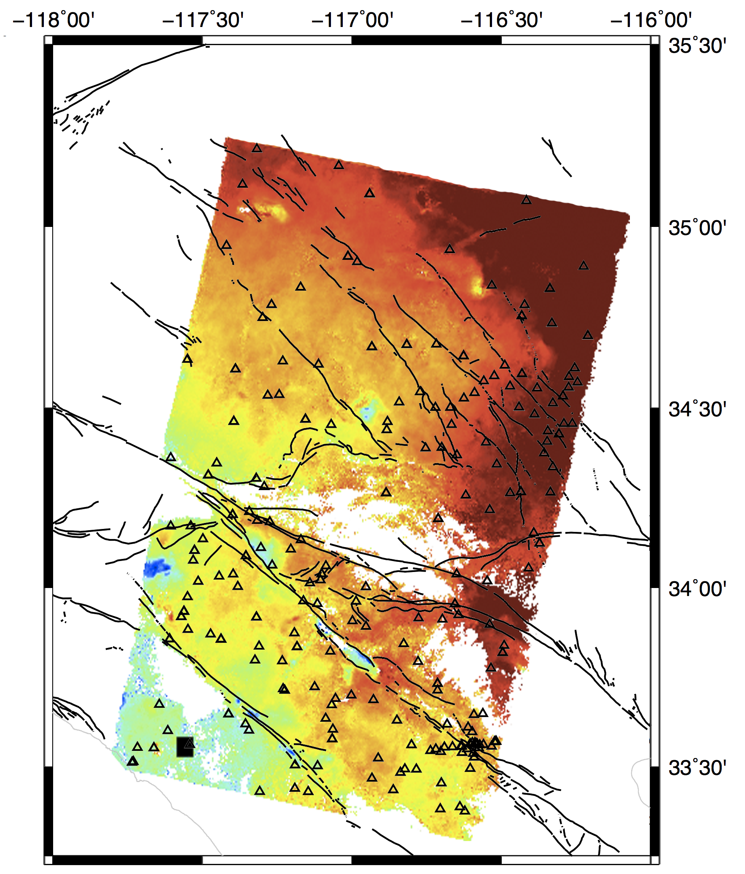
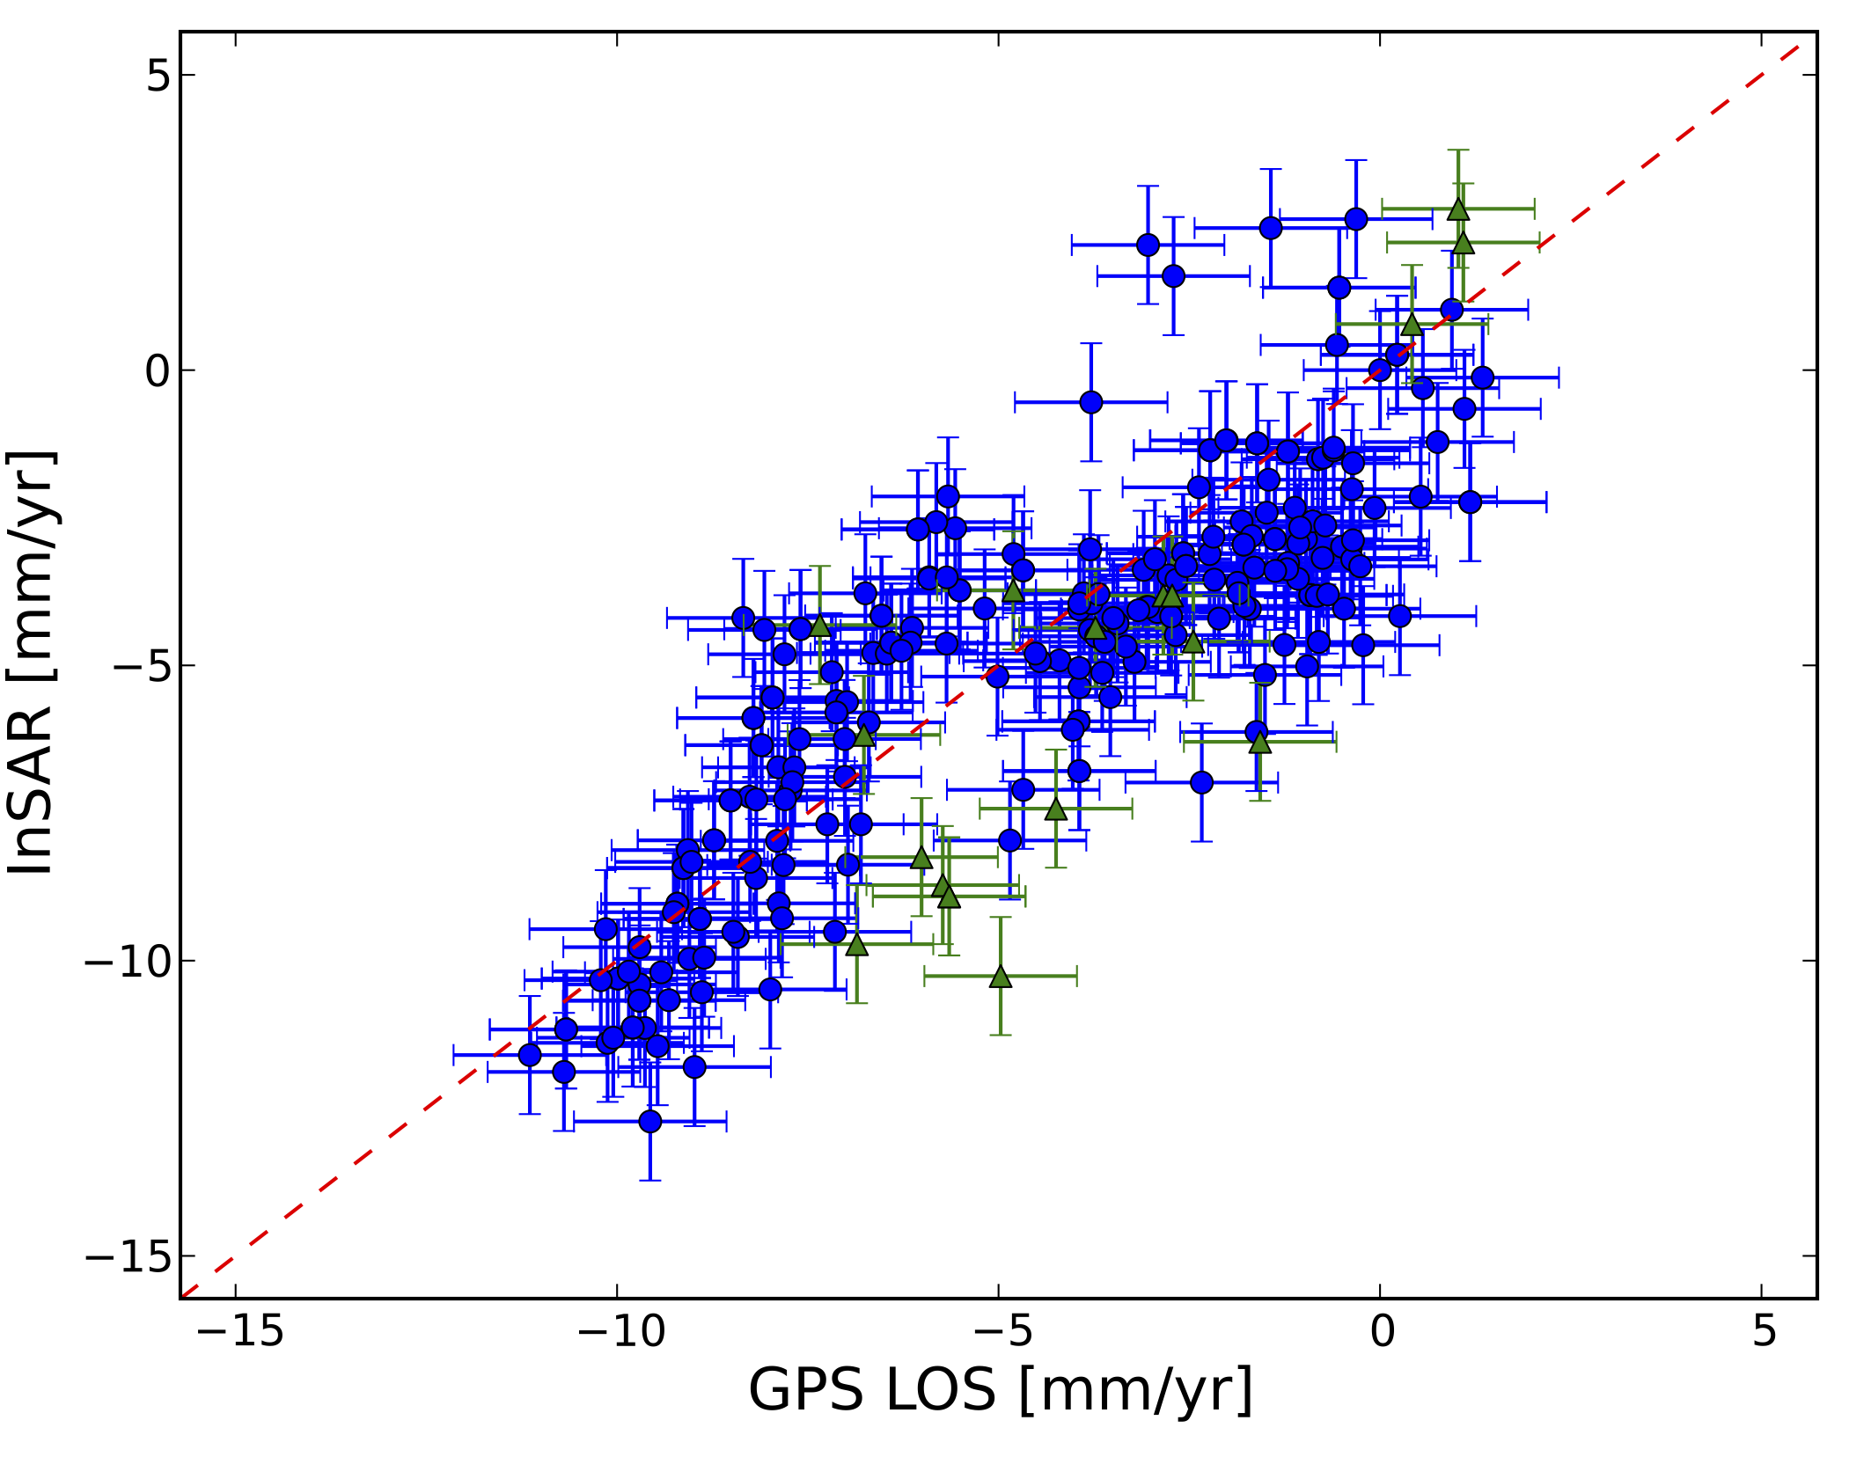
InSAR (CGM) Highlights - 2014
AAD = 1.6 mm/yr
Corr = 0.83
Estelle Chaussard
Chris Johnson
Good agreement for
LOS velocity
Mixed results for time
series comparison

Slide 5
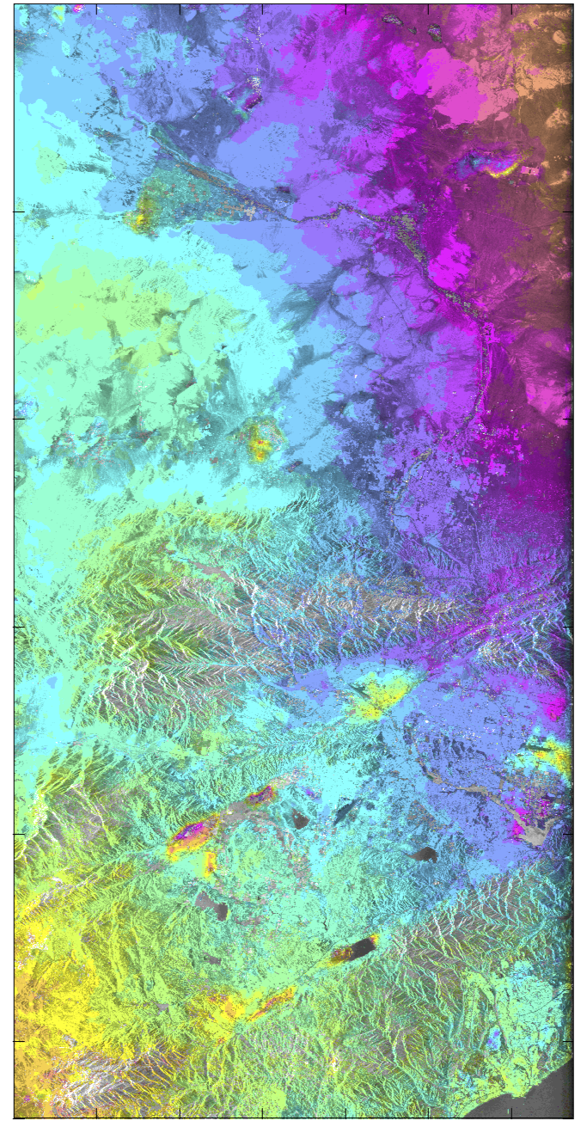
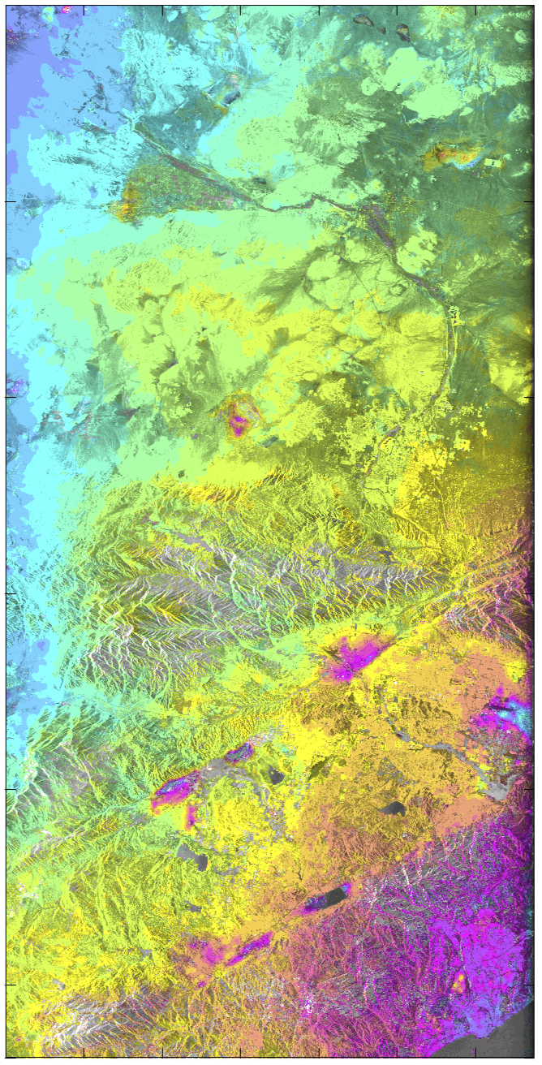
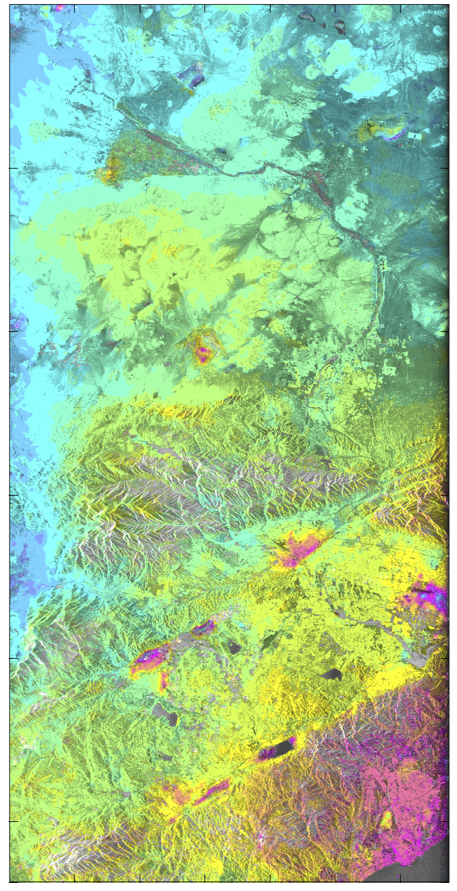
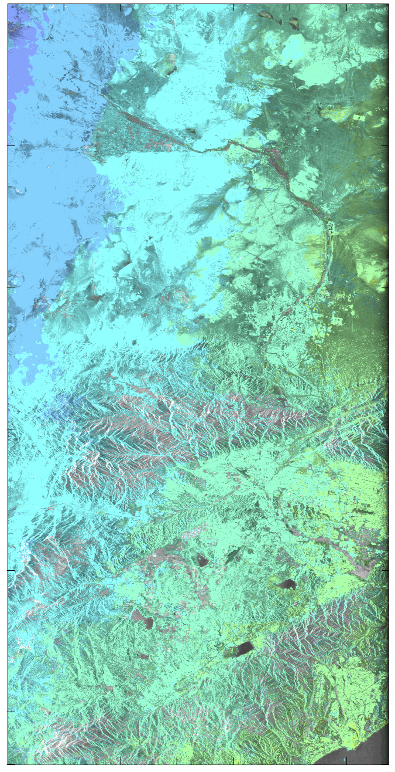

Correction of Envisat Local Oscillator Drift
Zhen Liu
Original
Emp. corrected
Model corrected
Diff. of emp.-model corr
Notes:
local oscillator (LO) frequency drift of Envisat ASAR sensor that is slow and
correlated in time [Marinkovic & Larsen, 2013].
Use 2-arc DEM

Slide 6
InSAR (CGM) Highlights - 2014
Brian Riel

Slide 7
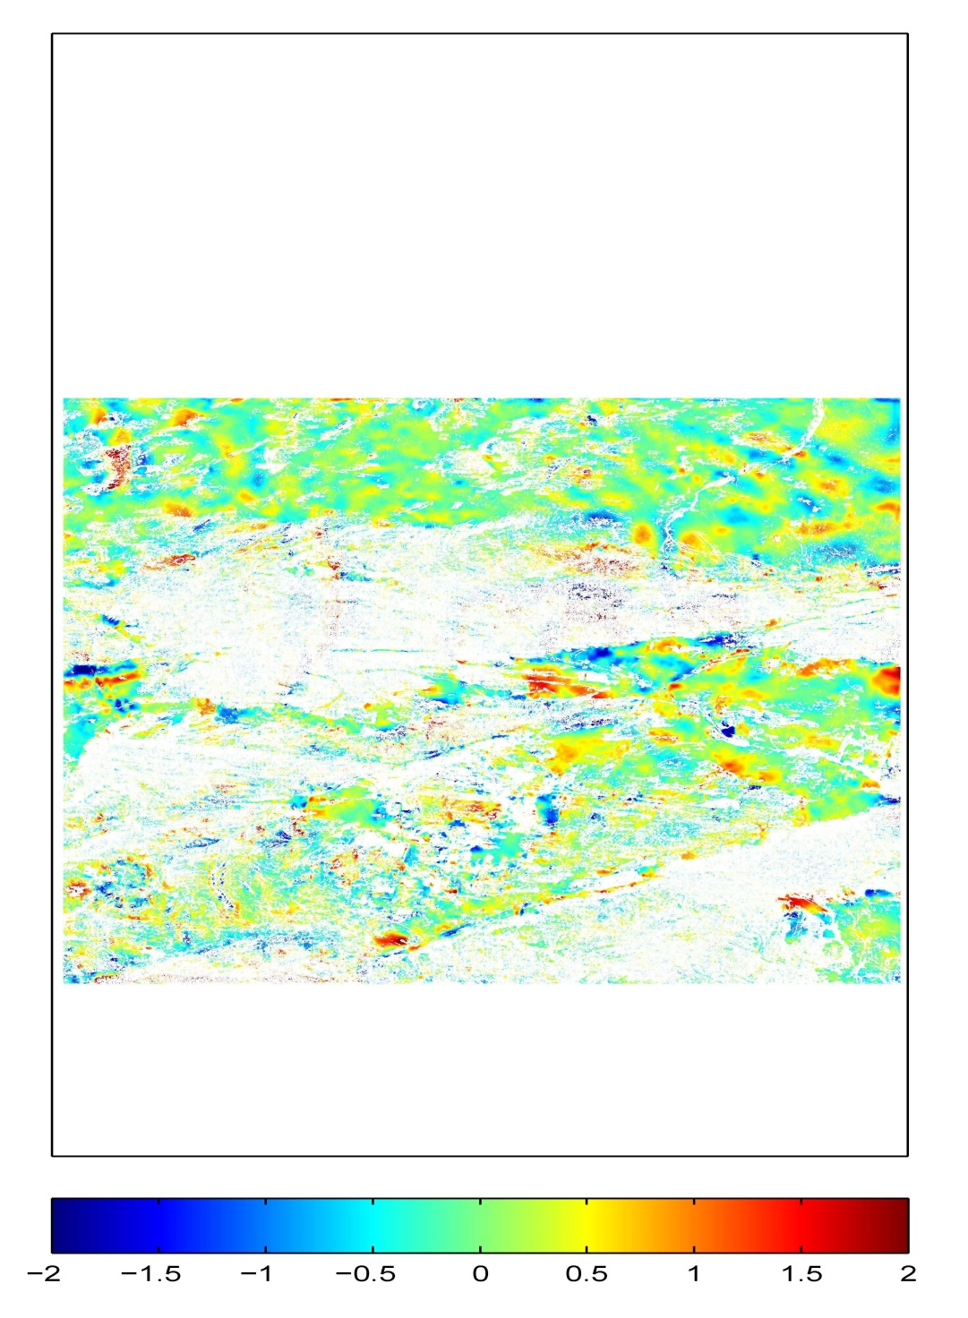
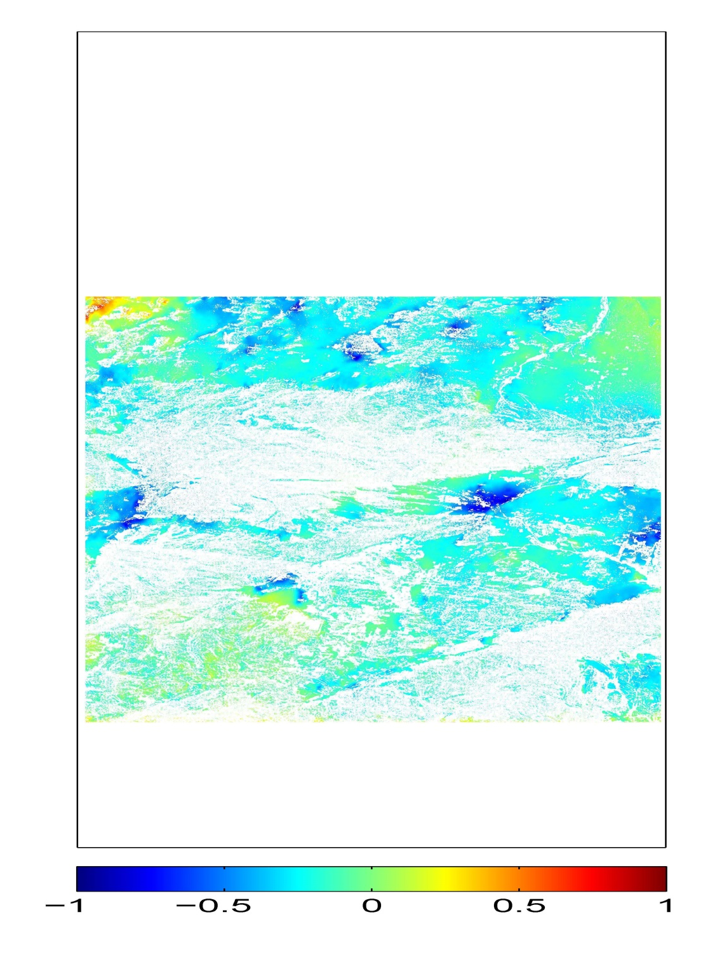

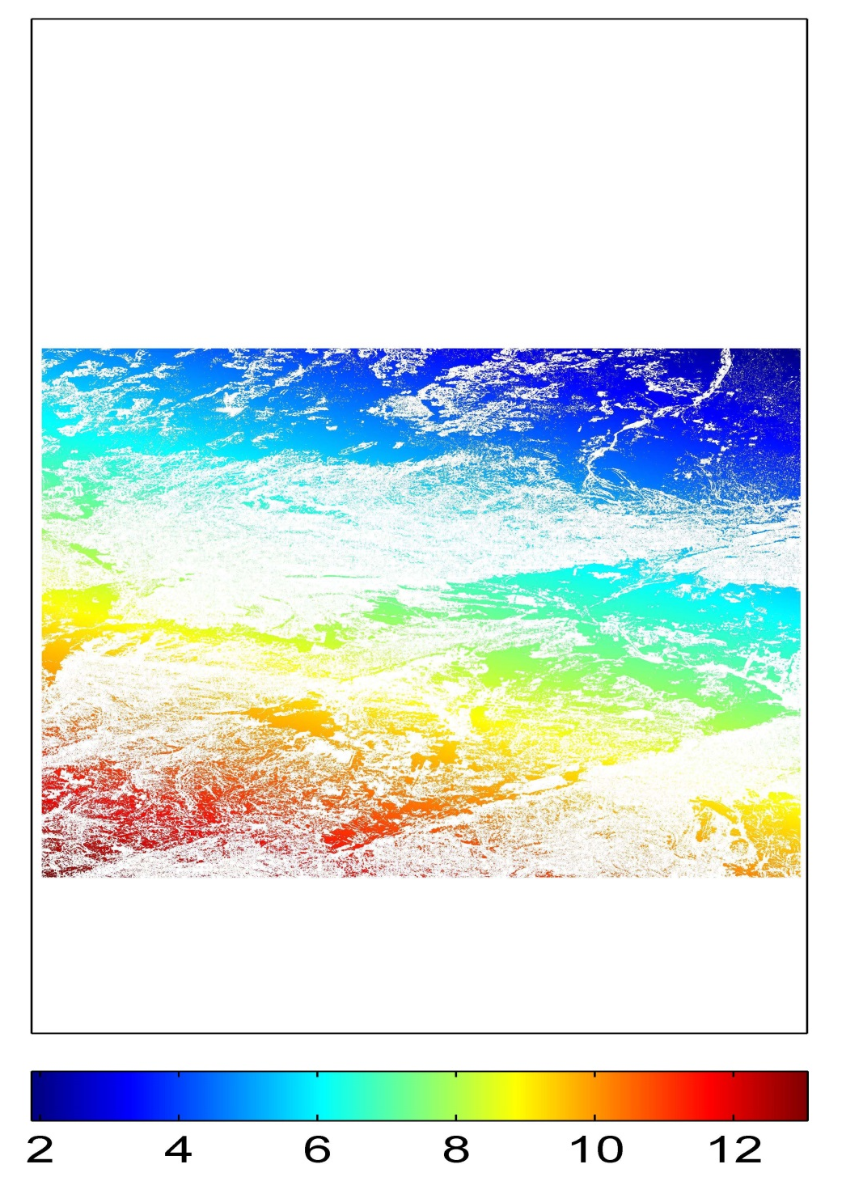
InSAR (CGM) Highlights - 2014
Shirzaei & Burgmann
DEM Error (m)
ATM Error (Rad)
Orbital Error (Rad)
LOS Linear Velocity (cm/yr)
Shirzaei & Burgmann, 2013, JGR
January 28, 2016

Slide 8
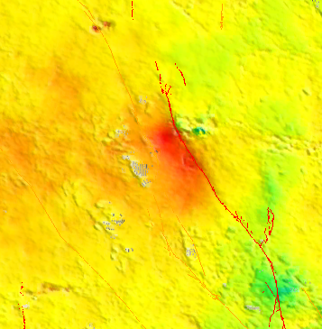
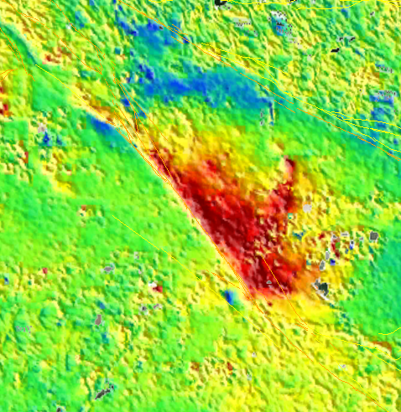
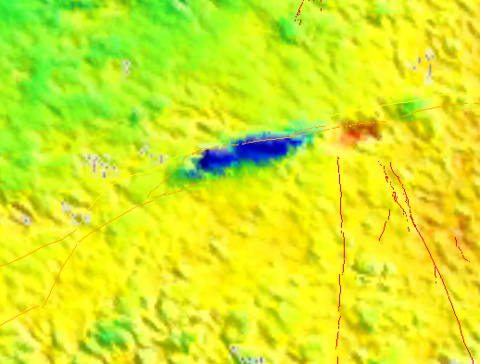
Mean velocity from InSAR only
Hector Mine
Tong
San Jacinto Fault
Pinto Mt Fault
Range increase
(Subsidence)

Slide 9
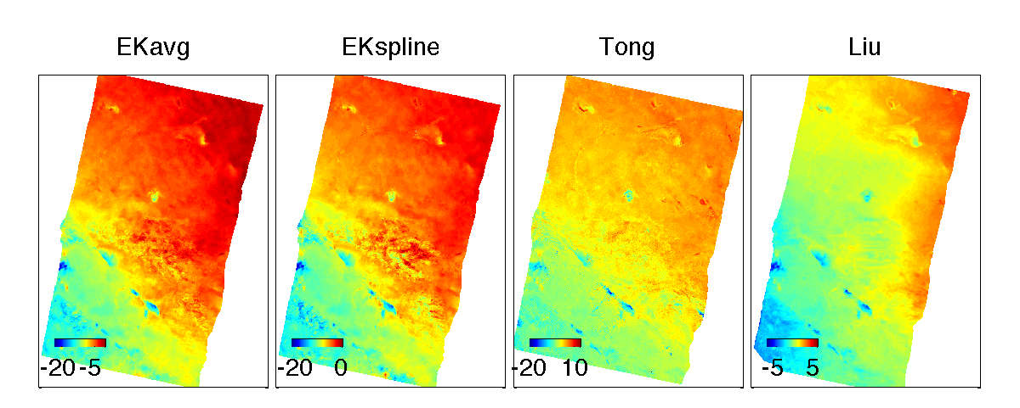
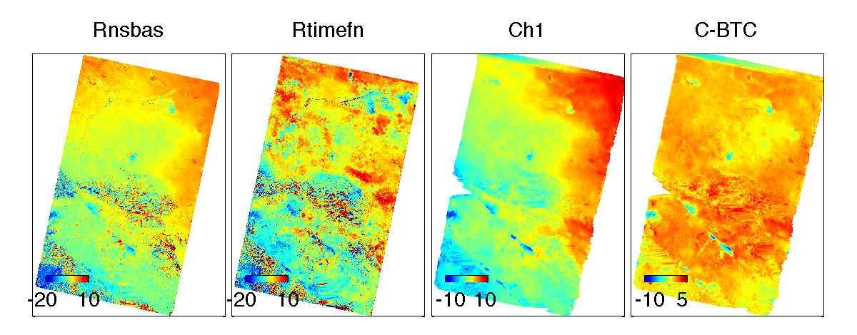
InSAR (CGM) Comparisons
Lohman

Slide 10
InSAR (CGM) Best Practices
Is the LOD correction important? Do other satellites have a similar drift problem?
YES
2) What is the maximum baseline for this type of analysis (250 to 400 m)?
~300 m
3) Does everyone do phase unwrapping prior to time series analysis?
YES
4) At what point in the processing does one move from radar to geographic coordinates?
Most did the SBAS analysis in radar but some in geographic.
5) Do the atmospheric models (e.g. ECMWF) improve the accuracy of the time series? How much? Under what circumstances?
Most of the participants found that the ECMWF models made no improvement in their analysis. Models have low spatial resolution ~10 km.
6) Is SBAS the best approach? What about temporal templates?
All participants used SBAS.
Notes:
1) Is the LOD correction important? Do other satellites have a similar drift problem?
Yes the local oscillator drift (LOD) in ENVISAT data is an important correction that is easy to apply. Other satellites probably have this type of drift but it has not been characterized yet.
2) What is the maximum baseline for this type of analysis (250 to 400 m)?
For this type of interseismic deformation the maximum usable baseline is about 300 m. For the older satellites this greatly limits the number of interferograms
3) Does everyone do phase unwrapping prior to time series analysis?
All participants used the Small Baseline Subset (SBAS) method and therefore unwrapped phase prior to the time series analysis.
4) At what point in the processing does one move from radar to geographic coordinates?
Most participants did the SBAS analysis in radar coordinates because the geocoding introduces errors that could smooth sharp signals such as fault creep.
5) Do the atmospheric models (e.g. ECMWF) improve the accuracy of the time series? How much? Under what circumstances?
Most of the participants found that the ECMWF models made no improvement in their analysis. Some participants found a marginal improvement but also noted that this particular area does not have large atmospheric signals. The correction may be important in other areas.
6) Is SBAS the best approach? What about temporal templates?
All participants used SBAS as the basis for the construction of the time series but there was a wide variation in the methods and extent of spatial and temporal smoothing. Some participants used templates others used wavelets or least-squares smoothing.

Slide 11
InSAR (CGM) Best Practices
7) What is the long-wavelength (i.e. >100km) error in an InSAR only average velocity model?
Many different methods were used to recover the long-wavelength signal.
8) If GPS data (or a GPS-based model) are available, what is the best crossover length scale for combining the two data sets?
This depends on the ultimate accuracy of the desired time-dependent velocity model. The optimal combination method continues to be an active area of research.
9) What is the optimal length scale (~600 m?) for smoothing the InSAR velocity or time series model to compare with GPS point time series?
The main issue in answering this question is that resolution means different things to different people. The approaches that generated the best fit to GPS data used smoothing over ½ wavelength of ~500 m or more. A lesser amount of smoothing is needed to recover the sharp signals associated with fault creep. A better question may involve the consideration of the “down-stream” users and the appropriate spatial resolution for their use, rather than the somewhat artificial construct of optimizing the fit to GPS.
Notes:
This slide provides information on who is involved in this effort. In addition it shows that the leadership is constantly undergoing transition.

Slide 12
InSAR (CGM) Best Practices
10) The InSAR/GPS comparisons are worse when the vertical GPS component is included? Why? Will this improve with refined GPS data?
Including the vertical GPS component sometimes increases the LOS misfit with the InSAR although it seems to depend on the quality of the GPS and whether the postseismic signals were removed from the GPS. The InSAR researchers don’t always understand the “corrections” that go into the large variety of GPS products.
11) What is the best temporal smoothing to use? Will the temporal smoothing effect the estimate of the secular velocity? Or should it?
There was no consensus on this issue. It depends on the type of temporal signal under investigation (e.g., secular, annual, atmospheric, or co-seismic).
12) Given the phase measurements contain three major components: deformation, topographic error, and atmospheric error? Can we quantify the percentage of each component in the phase data in terms of RMS reduction?
The two participants who answered this question both said that the percentage of each component could be estimated especially when ground-truth GPS data are available.
Notes:
10) The InSAR/GPS comparisons are worse when the vertical GPS component is included? Why? Will this improve with refined GPS data?
Including the vertical GPS component sometimes increases the LOS misfit with the InSAR although it seems to depend on the quality of the GPS and whether the postseismic signals were removed from the GPS. The InSAR researchers don’t always understand the “corrections” that go into the large variety of GPS products.
11) What is the best temporal smoothing to use? Will the temporal smoothing effect the estimate of the secular velocity? Or should it?
There was no consensus on this issue. It depends on the type of temporal signal under investigation (e.g., secular, annual, atmospheric, or co-seismic).
12) Given the phase measurements contain three major components: deformation, topographic error, and atmospheric error? Can we quantify the percentage of each component in the phase data in terms of RMS reduction?
The two participants who answered this question both said that the percentage of each component could be estimated especially when ground-truth GPS data are available.

Slide 13
Backup Slides

Slide 14
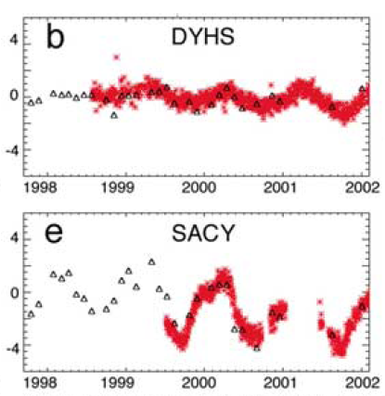
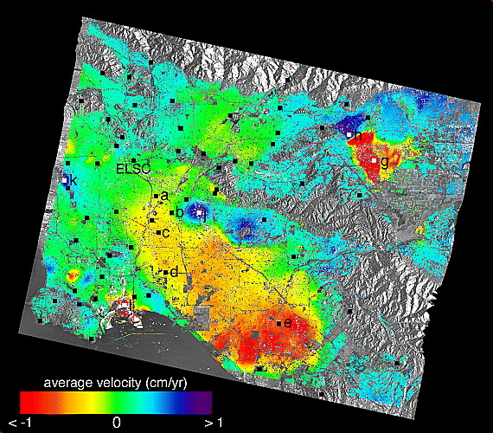
  CGM development:
  Best practices in development of InSAR time series
InSAR time series analysis techniques using small-baseline (SBAS).
Recovered time-varying motion agrees well with GPS under certain assumptions (e.g., temporal/spatial smoothness).
Accuracy: ~5-10 mm displacement, ~1-2 mm/yr rate
Example: L.A. Basin aquifer effects
Lanari et al. (2004)
Notes:
There are a few areas with good InSAR coverage and good coherence and large hydrologic signals where InSAR times series adequately resolve seasonal signals in comparison with GPS (red). We would like to do this throughout the SCEC region but the current InSAR data lack cadence and have poor baseline control. At a SCEC workshop several groups compared methods and results and arrived at best practices for InSAR time series construction when we finally get the required data from Sentinel-1a/b and ALOS-2.

Slide 15
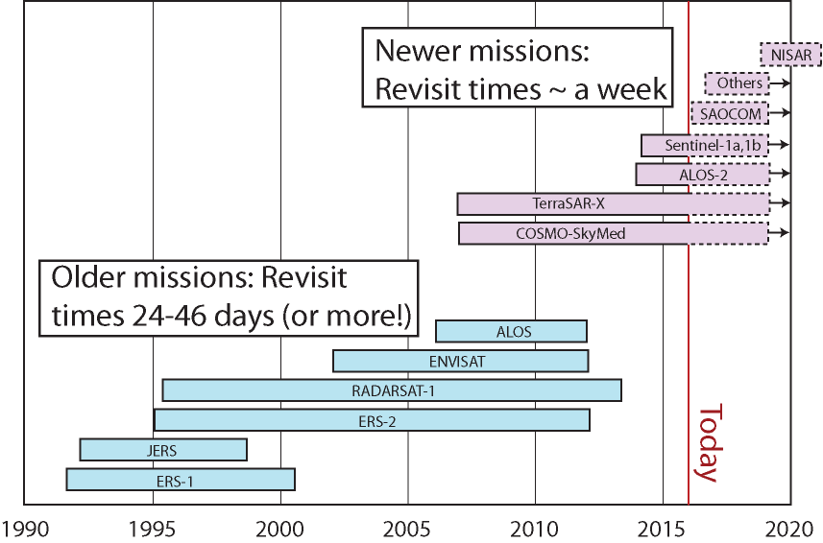
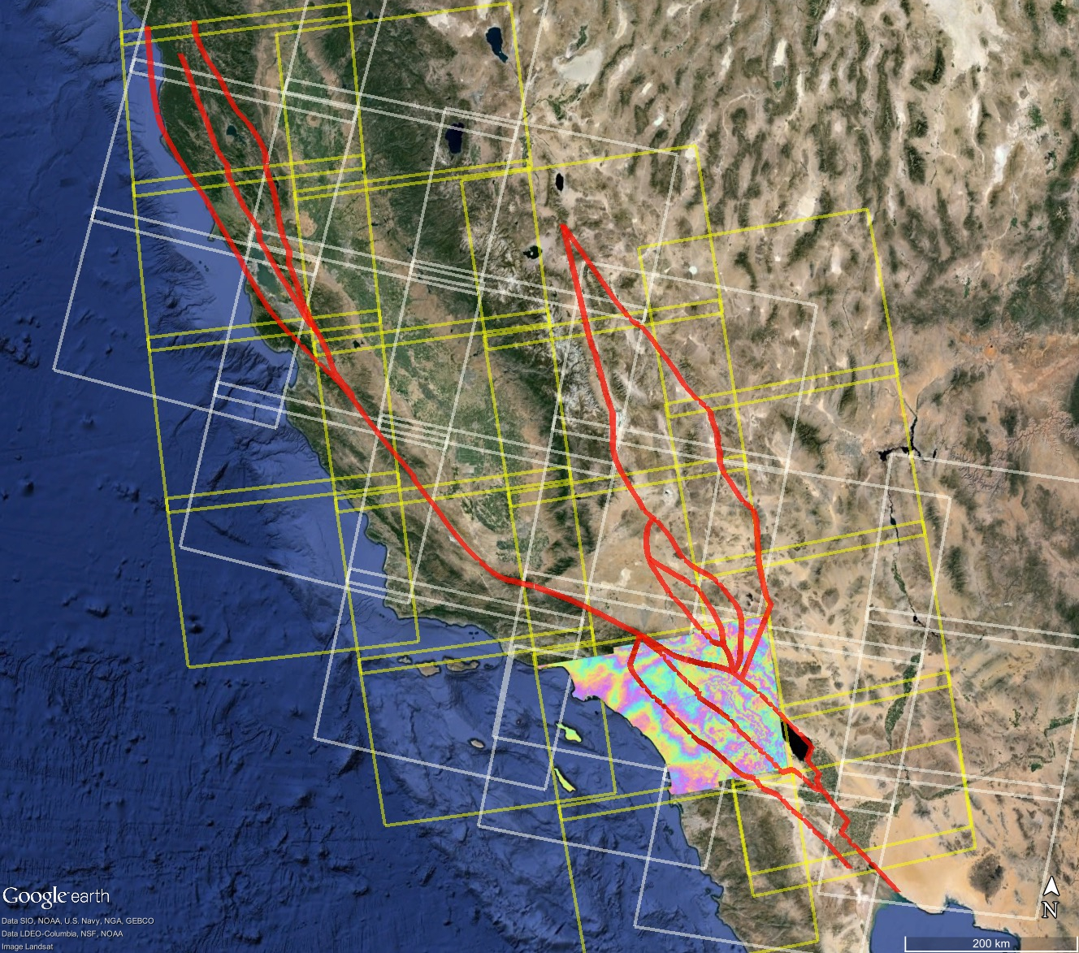
  New geodetic data and analysis techniques for SCEC5:
  More frequent repeat passes, ascending and descending orbits, and better baseline control on the horizon.
Sentinel-1A SAF coverage – currently 35 repeats/frame
Notes:
More details about the new InSAR satellites. I checked today and a point in Banning already has 72 S1A acquisitions so this is very real.

Slide 16
The Community Geodetic Model (CGM)
SCEC4 Achieved:
increased GPS station density from new campaign acquisitions and compilations
processed all CGPS and campaign GPS in a consistent way for improved vertical accuracy
contributed averaged block model to UCERF3 and CSM
integrated GPS and InSAR for secular model at 500 m resolution
developed best practices for InSAR time series
SCEC5 Proposed:
focus on time series for recovery of postseismic, transient, and hydrologic signals
increase vertical precision of multi-decade GPS time series
construct InSAR time series for recovery of seasonal signals at 1 km resolution from multiple look directions
deliver combined GPS/InSAR strain rate maps for CSM development
Notes:
I took these ideas out of the proposal but there may be something missing and I added my own filter.

