Slide 1



Crustal Deformation along San Andreas Fault System revealed by GPS and Sentinel-1 InSAR
AGU Fall Meeting 2017
G34A-05
Xiaohua Xu & David Sandwell
University of California San Diego
Scripps Institution of Oceanography
Institute of Geophysics and Planetary Physics
Notes:
Good afternoon, Thank you for coming to my thesis defense. The title of me thesis is earthquake cycle study with geodetic tools. These are my committee members, sitting in the very front row, ready to grill me. OK let’s do this.

Slide 2
Combining InSAR and GPS
Construct InSAR time-series and horizontal GPS model in ITRF using gpsgridder
[Sandwell and Wessel, 2016]
Project horizontal GPS model to line-of-sight and remove it from the InSAR measurement
Further correct elevation-dependent atmospheric delay.
Correct the long wavelength errors with low pass filtered vertical GPS
Restore the horizontal GPS model and compute a long-term velocity
Xu and Sandwell, in prep
Notes:
We developed this method to combine InSAR and GPS. There are already a number of studies that performs combination of InSAR and GPS.
The some difference is
1, we are doing time-series
2, we included vertical GPS for correction,
3, this hasn’t been realized yet, but we are gonna push this further we combine InSAR with time-dependent GPS models, instead of one velocity map. This is the first time to do deformation time-series for such a large region.

Slide 3
Results
The San Andreas
  Sentinel-1 data for California 2014.10 – 2017.8
  5 descending tracks of 20 bursts long; 37-62 repeats
  1,066 large interferograms (250 km X 450 km) with total time-span of 58,597 days.
flight
look
LOS velocity map
Xu and Sandwell, in prep
Notes:
The colorscale is ..
Blue colors compared to red colors moves further away from the satellite
This boundary you see here is caused by the look angle change of the satellites.
You can see that InSAR is adding significant amount of details

Slide 4
Results
Xu and Sandwell, in prep
Notes:
There are other places, like near San Jose, the ground is uplifting, we believe it’s due to recharging or just water injection. Also this uplift signal is separated by this quaternary fault. It’s not active any more but sort act like a ground water barrier. This is the creeping section, a sharp change in velocity, remember this is also a place where GPS models has a large uncertainty. Also this is Elsinore fault, san josanto fault, a little subsidence at the fault step over.

Slide 5
Results
Xu and Sandwell, in prep
Notes:
Again it is time series so it is able to reveal time-dependent changes. Here is an example of central valley.

Slide 6
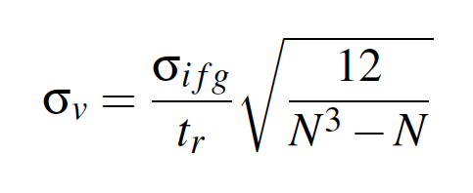
Expectations
Emardson et al. 2003
Xu and Sandwell, in prep

Slide 7
Conclusions
GPS models cannot resolve 100 nanostrain over lengths scales < 40 km.
Developed new method to absolutely connect phase in long InSAR time series.
Developed an approach to combine InSAR and GPS data (including vertical) for deformation time-series analysis.
SAFS deformation time series reveals both large scale and small scale tectonic and anthropogenic signals.
Three more years of Sentinel-1 data will be needed to resolve 100 nanostrain zone at 10 km resolution.

