Slide 1
OUTLINE
LOS Velocity
  1.1 GPS provides long wavelengths (> 40 km) and InSAR provides short wavelengths
  1.2 L-band ALOS-1 provides only one LOS direction but complete coverage.
  1.3 C-band (ERS and Envisat) provides 2 look directions but incomplete coverage.
  1.4 Contributions to CGM - have standard format – at UNAVCO – need more contributions
LOS Time Series
  2.1 SBAS and PS methods are well developed
  2.2 SBAS works well in LA-basin – large seasonal signals
  2.3 SCEC InSAR time series comparisons came up with best practices
  2.4 current baseline time sampling is poor
Future – S1A/B and ALOS-2
  3.1 Wide swath offers short repeat interval 12 and 14 days
  3.2 Examples of California coverage today.
  3.3 Takes 3 years to achieve accuracy requirements
  3.3 Improved baseline control enables systematic processing for monthly time series to capture seasonal effect.
  3.4 The SCEC CGM will evolve to wide area monthly time series that match point GPS measurements

Slide 2
GPS/InSAR Community Geodetic Models
Velocity model based on campaign and continuous (CGPS) plus line-of-sight (LOS) displacement-rate data from stacks of interferograms. Current SoCAL examples:
Tong, X., D. T. Sandwell, and B. Smith-Konter, High-resolution interseismic velocity data along the San Andreas Fault from GPS and InSAR, J. Geophys. Res.; Solid Earth, 118, doi:10.1029/2012JB009442, 2013.
Lindsey, E. O., Y. Fialko, Y. Bock, D. T. Sandwell, and R. Bilham, Localized and distributed creep along the southern San Andreas Fault, J. Geophys. Res. Solid Earth, 119, 7909–7922, doi:10.1002/2014JB011275, 2014.
Time series model based on CGPS time series plus LOS time series from InSAR. Current examples include:
  Lanari, R., Lundgren, P., Manzo, M., & Casu, F. (2004). Satellite radar interferometry time series analysis of surface deformation for Los Angeles, California. Geophysical Research Letters, 31(23), 2014.

Slide 3
GPS velocity data
North
N. America
Pacific
San Francisco
  1989 horizontal velocity measurements from PBO, SCIGN, CMM4
  Combined for UCERF3 exercise [Herring, 2013]
  GPS velocity is initially in North America reference frame, then is rotated and translated [Wdowinski et al., 2007] to be used in the dislocation model
GPS provides high accuracy vector measurements but does not resolve the small-scale (< 20 km).

Slide 4
InSAR data from L-band ALOS-1
Time span: middle 2006 to the beginning of 2011
14 tracks, 50 frames, 1100 interferograms (~2 TB)
Data from Alaska Satellite Facility (ASF) and NASA
Covering the San Andreas Fault system
Provide Line-of-sight velocity: 35% of plate-boundary deformation
InSAR provides high spatial resolution scalar measurements but has large scale errors.

Slide 5
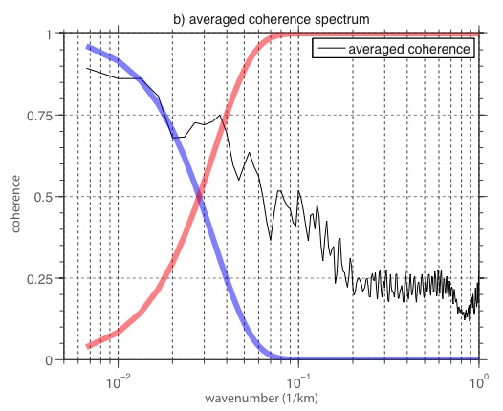
InSAR/GPS Integration Approach
Develop a complete surface velocity field based on a kinematic model constrained by GPS secular velocity data.
Refine the kinematic model using biharmonic spline correction from GPS misfits.
Stack InSAR interferograms to derive an InSAR secular velocity.
Remove the GPS model from the InSAR velocity
High-pass filter the InSAR residual velocity.
Restore the GPS model to the InSAR residual velocity.
InSAR
GPS

Slide 6
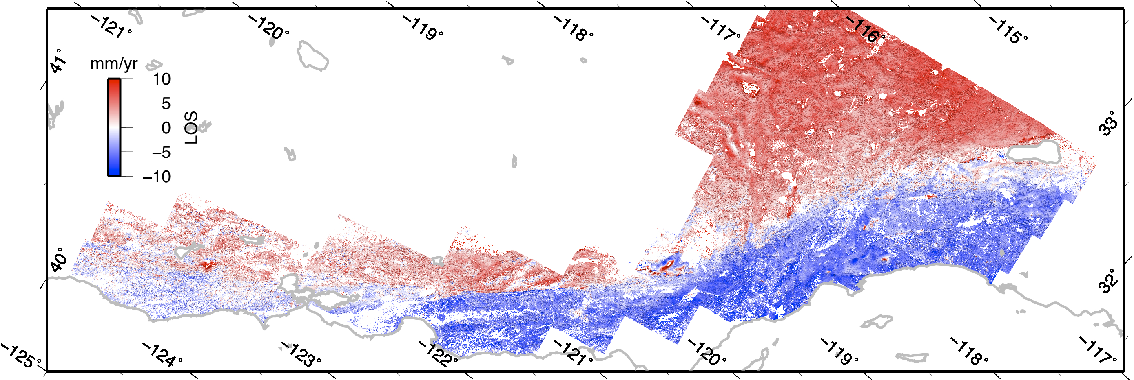
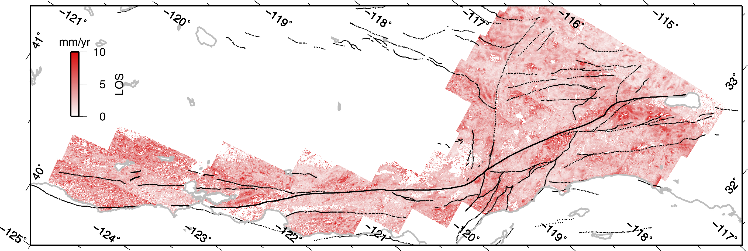
InSAR Mean LOS Velocity
from ALOS-1 Ascending
North
Radar Look direction
[Tong et al., 2012]
Standard Deviation

Slide 7
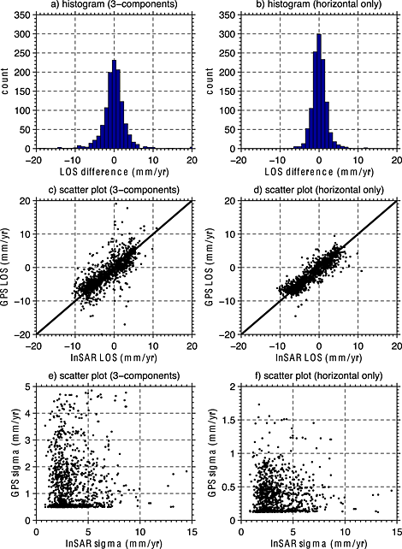
Misfit of InSAR to GPS
The misfit between InSAR line-of-sight velocity and the projected point GPS horizontal velocities is 1.5 mm/yr.
The misfit increases to 2.1 mm/yr when considering the vertical component of GPS velocities.
(Note for wavelength > 40 km the InSAR LOS data are constrained to agree with the GPS data.)

Slide 8
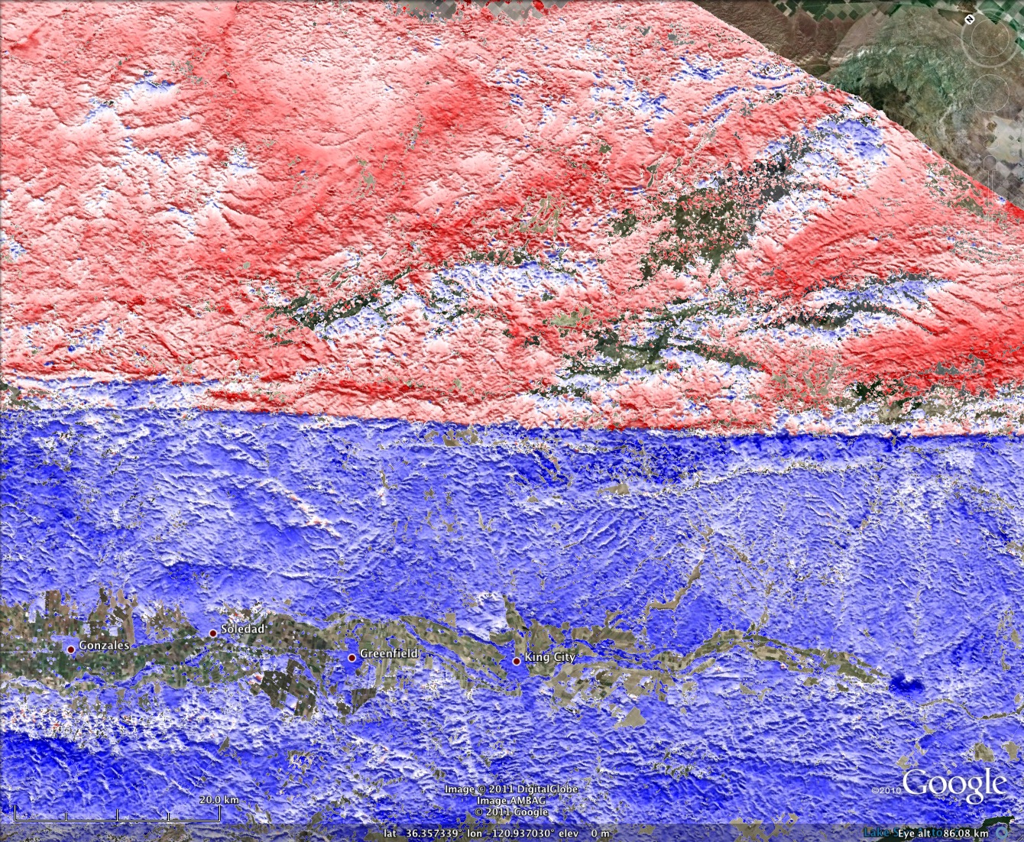
What is New from InSAR?
Creeping SAF
red 10 mm/yr
blue -10mm/yr

Slide 9
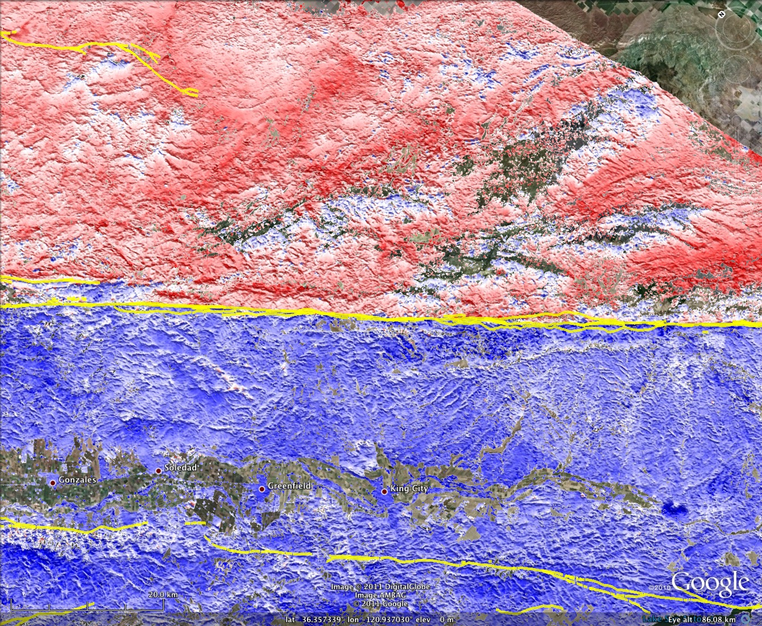
What is New from InSAR?
Creeping SAF
red 10 mm/yr
blue -10mm/yr
Near-fault creep
Fluid extraction

Slide 10
Fault Creep from ALOS vs. creep meters
right slip (mm/yr)
Latitude (degree)
[Tong et al., 2012
UCERF3 – Appendix D]
Notes:
Mention more about this figure comparison, why it’s same or different?

Slide 11
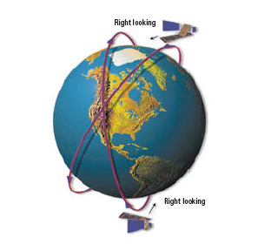

ALOS-1 has only one LOS direction
Need 2 or more to separate horizontal from vertical
We have two independent Line-of-Sight observations
From GPS, we also know the direction of horizontal motion
We can use this information to extract two components of motion: Vertical and Fault-Parallel

Slide 12
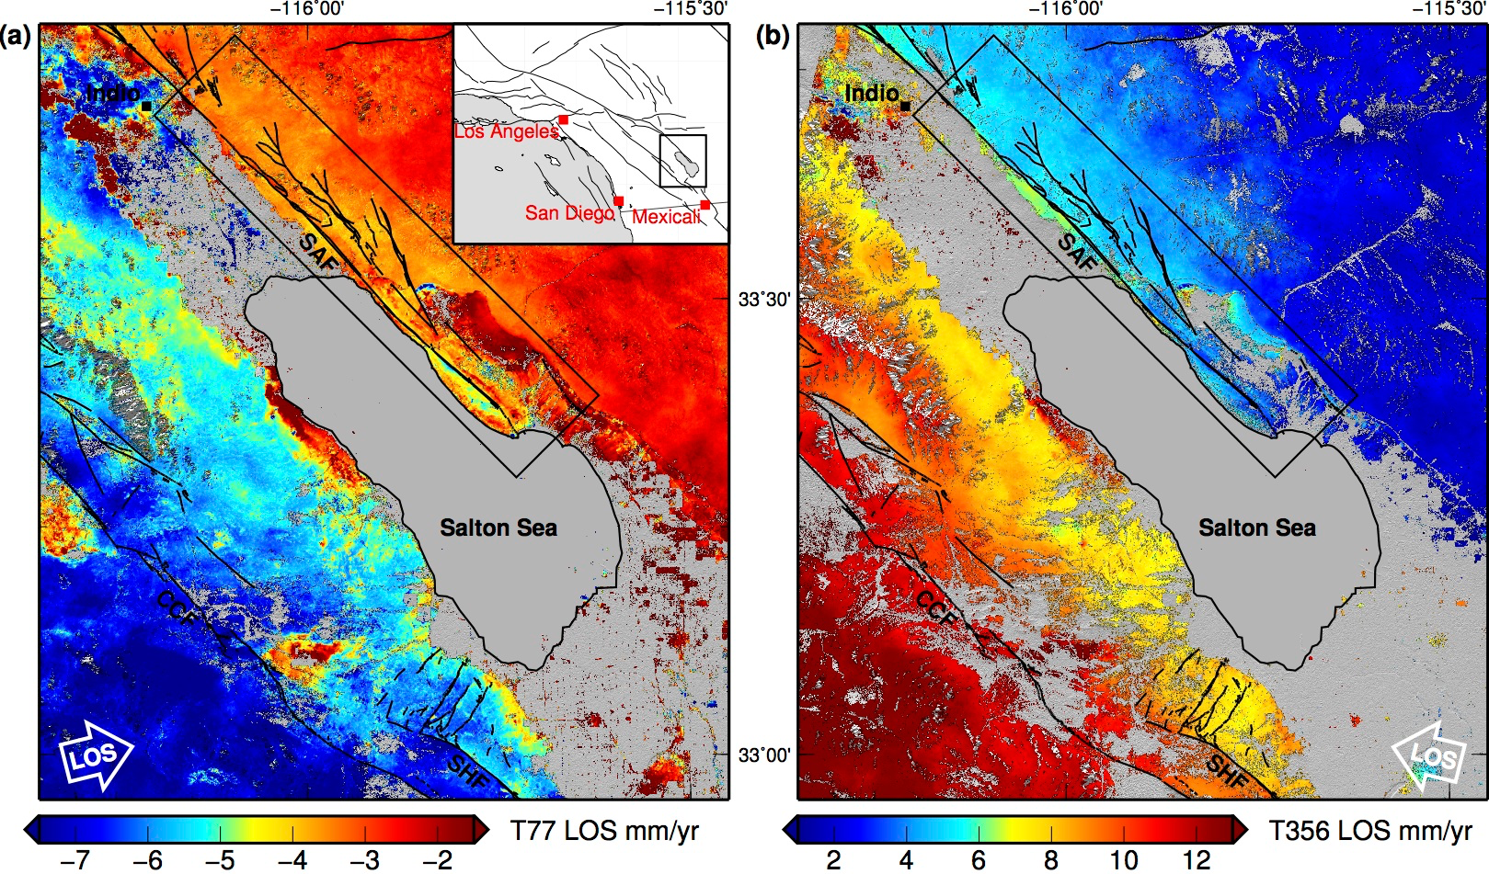
Southern San Andreas fault
Envisat Track 77 (Ascending)
Track 356 (Descending)
Lindsey et al. (JGR, 2014)

Slide 13
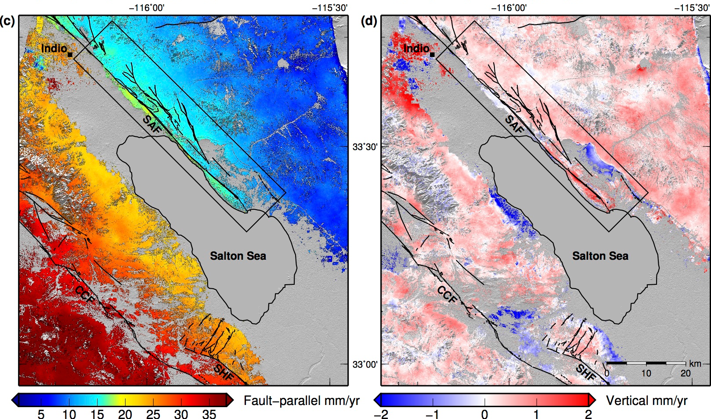
Southern San Andreas fault
Fault-parallel velocity
Vertical velocity
Lindsey et al. (JGR, 2014)

Slide 14
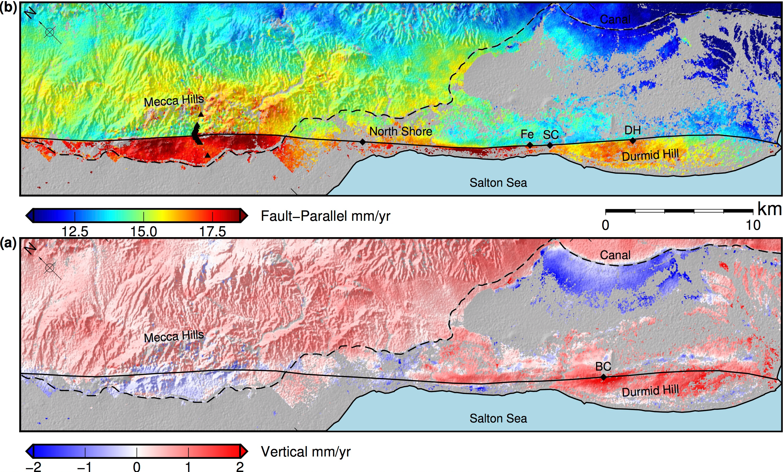
Southern San Andreas fault
Lindsey et al. (JGR, 2014)

Slide 15
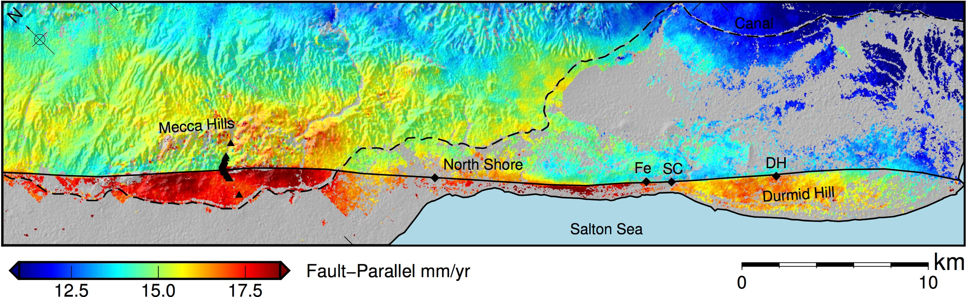
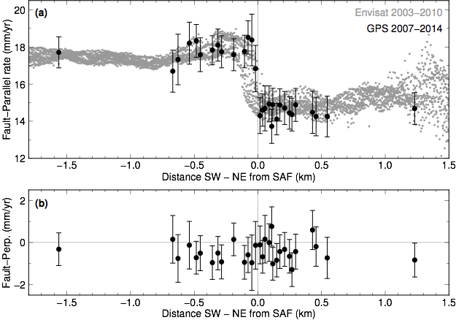
Southern San Andreas fault
Lindsey et al. (JGR, 2014)

Slide 16
Data Availability
This slide explains the GPS and LOS data formats. These are grids or files packed into an HDF5 container. Velocity is in North America Fixed. We will assemble the Tong et al. model and the Lindsey et al. model in the same format call these the CGM-Velocity Model
Notes:
Xiaopeng and Eric are working on this slide

Slide 17
OUTLINE
LOS Velocity
  1.1 GPS provides long wavelengths (> 40 km) and InSAR provides short wavelengths
  1.2 L-band ALOS-1 provides only one LOS direction but complete coverage.
  1.3 C-band (ERS and Envisat) provides 2 look directions but incomplete coverage.
  1.4 Contributions to CGM - have standard format – at UNAVCO – need more contributions
LOS Time Series
  2.1 SBAS and PS methods are well developed
  2.2 SBAS works well in LA-basin – large seasonal signals
  2.3 SCEC InSAR time series comparisons came up with best practices
  2.4 current baseline time sampling is poor
Future – S1A/B and ALOS-2
  3.1 Wide swath offers short repeat interval 12 and 14 days
  3.2 Examples of California coverage today.
  3.3 Takes 3 years to achieve accuracy requirements
  3.3 Improved baseline control enables systematic processing for monthly time series to capture seasonal effect.
  3.4 The SCEC CGM will evolve to wide area monthly time series that match point GPS measurements
Notes:
This section on time series is very incomplete

Slide 18
The SBAS algorithm: key idea
To produce deformation times-series from a SAR data sequence:
using interferograms characterized by a “small baseline” in order to mitigate noise (decorrelation) phenomena;
properly “linking” possible interferometric SAR data subsets separated by large baselines. In particular, for each coherent pixel, the deformation time-series is computed by searching for an LS solution with a minimum norm constraint (the SVD method is applied).
Perpendicular Baseline
Subset 1
Subset 2
Time
Berardino et al., 2002, IEEE Trans. Geosci. Remote Sens.
Notes:
18
Slide from Lanari

Slide 19
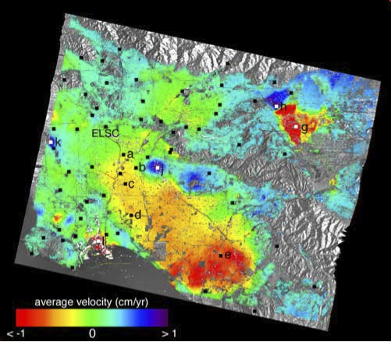
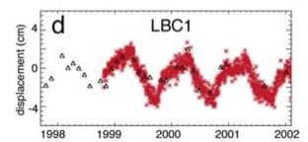
Annual Time Series in LA-Basin from ERS-1/2
resolve/remove annual signals
> 12 acquisitions/yr.
baseline control < 500 m
2 look directions.
automated processing of ScanSAR
time series software
[Lanari et al., 2004]
Notes:
First really successful InSAR time series analysis and comparison with CGPS.

Slide 20
Need some slides discussing the CGM time series exercise

Slide 21
CGM Workshop 6 September 2014
Review results of GPS time series comparisons and InSAR comparision exercise
Discuss best approaches for next steps (GPS, InSAR, and jointly)
Develop list of action items
GPS action items
  Data compilation and processing
        Reprocess campaign GPS data in self consistent manner*
    Migrate data from SCEC archive to UNAVCO*
    Systematically and quantitatively evaluate where further campaign data are required
  Combine CGPS time series; incorporate campaign time series
    Get full statistics from CGPS time series comparison*
    Compare results of time series averaging to other combination methods
  Analyze time series to obtain derived quantities
    Compare results from different approaches common mode noise removal
    Compare derived quantities (e.g., secular rate, seasonal signals, coseismic and postseismic) and estimated uncertainties using different approaches
    Choose and apply a time series analysis method and generate CGM GPS products
InSAR action items
*ongoing
Notes:
The workshop focused on reviewing results from various data comparisons that the GPS and InSAR groups have carried out as well as discussing next steps needed to produce a consensus GPS time series dataset, derived quantities from GPS (like secular rates, seasonal, and earthquake-related terms), and InSAR LOS velocities. We also talked about follow-on work for SCEC5 and writing 1 – 2 publications summarizing the CGM effort and results.

Slide 22
Best Practices from Time Series Workshop Participants
1) What is the maximum baseline for this type of analysis? (250 to 400 m)
2) Does everyone do phase unwrapping prior to time series analysis? All participants used SBAS and unwrapped phase.
3) At what point in the processing does one move from radar to geographic coordinates? Most did SBAS in radar coordinates.
4) Do the atmospheric models (e.g. ECMWF) improve the accuracy of the time series? How much? Under what circumstances?
Most participants found that the atmospheric models did not make significant improvement in this area - other areas could be different.
5) Is SBAS the best approach? What is the best temporal smoothing to use? What about temporal templates?
6) What is the long-wavelength (i.e. 2 frames) error in a InSAR only average velocity model? Many different methods were used to constrain the long-wavelength InSAR error.
7) If GPS data (or a GPS-based model) are available, what is the best crossover length scale for combining the two data sets?
No consensus on this.
8) What is the optimal length scale (~600 m?) for smoothing the InSAR velocity or time series model to compare with GPS point time series?
No consensus on how or when the spatial smoothing should be applied.
9) The InSAR/GPS comparisons are worse when the vertical GPS component is included? Why? Will this improve with refined GPS data?
There was no consensus. The InSAR group wants a variety of well-documented GPS products to experiment with.
10) Given the phase measurements contain three major components: deformation, topographic error, and atmospheric error? Can we quantify the percentage of each component in the phase data in terms of RMS reduction?
Two participants said yes if sufficient GPS data are available.
Notes:
Slide summarizing answers from 2014 Workshop Participants

Slide 23
ALOS
Interferograms
drifting orbital baseline
reduces the number of
possible interferograms
T213
optimal baseline control
need improved baseline control < 500 m
need a minimum of two look directions
Notes:
InSAR time series is difficult with current ERS, ENVISAT, and ALOS-1 data because of two things. 1) The cadence of acquisitions is irregular and frequency two low. 2) The baselines are not well controlled so one cannot make massively redundant interferograms for atmospheric correction.

Slide 24
OUTLINE
LOS Velocity
  1.1 GPS provides long wavelengths (> 40 km) and InSAR provides short wavelengths
  1.2 L-band ALOS-1 provides only one LOS direction but complete coverage.
  1.3 C-band (ERS and Envisat) provides 2 look directions but incomplete coverage.
  1.4 Contributions to CGM - have standard format – at UNAVCO – need more contributions
LOS Time Series
  2.1 SBAS and PS methods are well developed
  2.2 SBAS works well in LA-basin – large seasonal signals
  2.3 SCEC InSAR time series comparisons came up with best practices
  2.4 current baseline time sampling is poor
Future – S1A/B and ALOS-2
  3.1 Wide swath offers short repeat interval 12 and 14 days
  3.2 Examples of California coverage today.
  3.3 Takes 3 years to achieve accuracy requirements
  3.3 Improved baseline control enables systematic processing for monthly time series to capture seasonal effect.
  3.4 The SCEC CGM will evolve to wide area monthly time series that match point GPS measurements
Notes:
New satellites have neem collecting data for more than a year now. The future is bright. We should be able to do regular time series.

Slide 25
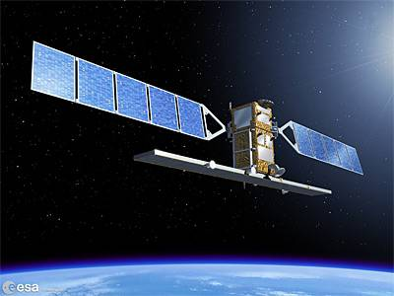
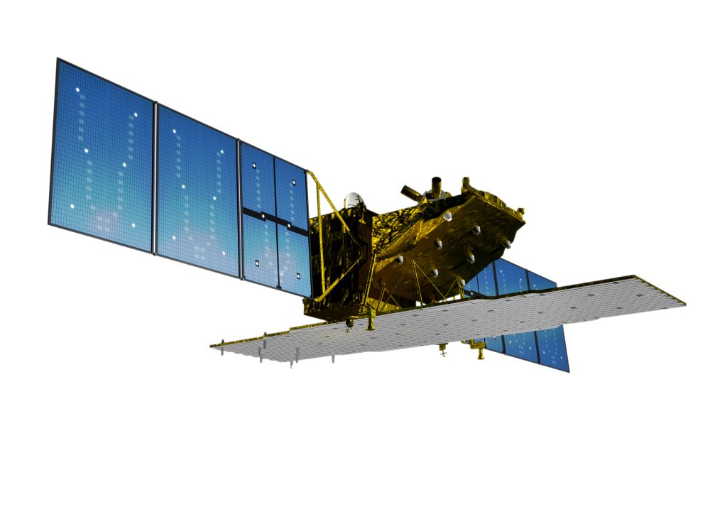
New Missions
Sentinel-1A (ESA) was successfully April 3, 2014, SAR collecting data!
  C-band , 12-day repeat
  Mostly ScanSAR coverage of the SAF, ascending and descending
  completely open data access – finally!!
  Sentinel-1B to be launched 2016 and will provide 6-day repeat interval
ALOS-2 (JAXA) was successfully launched May 24, 2014, SAR collecting data!
  L-band, 14-day repeat
  Mostly ScanSAR coverage of the SAF on descending and swath-mode on ascending
  PI proposal needed for data access
  limited quantities per PI
Notes:
Important characteristics of new missions.

Slide 26
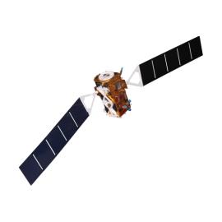
Sentinel-1 Constellation
Sentinel-1A
Sentinel-1B
Sentinel-1A
6 days
Time
12 days
Sensor spatial resolution: 15 x 4 m
Spatial coverage: ∼ 250 x 250 km
C-band
Global coverage
Notes:
When S1b is launched in 2016 the acquisition rate will double!!
26

Slide 27
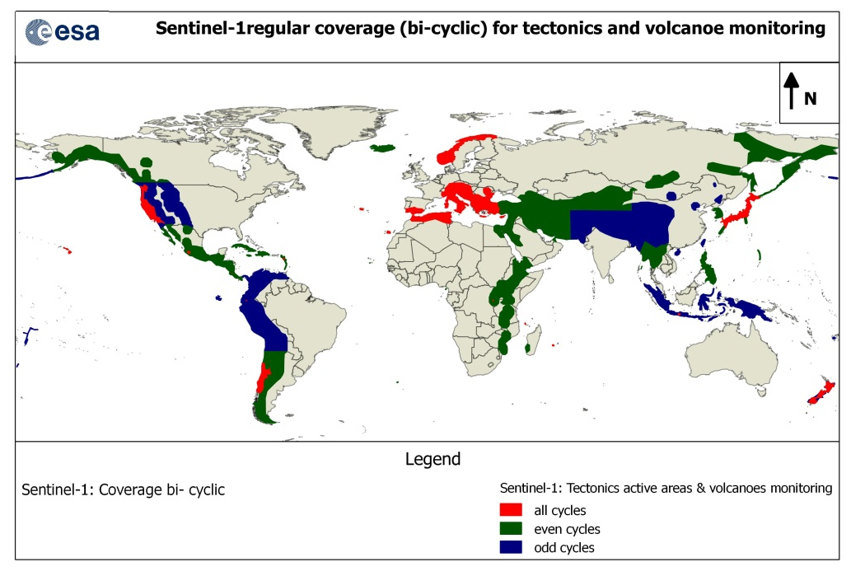
Notes:
San Andreas coverage should be every 12 days bit is actually 24 days.

Slide 28
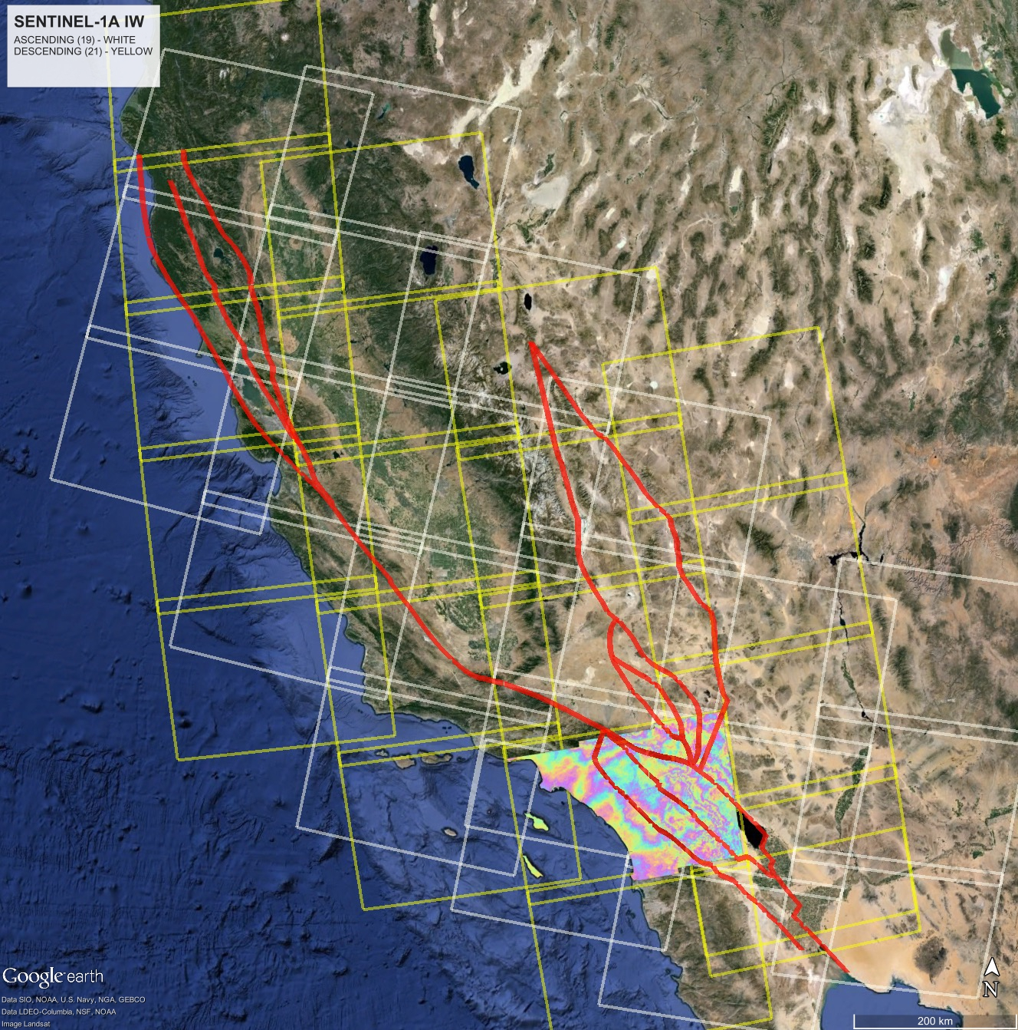
Coverage of the
San Andreas Fault
System from Sentinel-1
Today each frame
has 15 repeats on a
24-day cadence.
Each interferogram is
250 km by 200 km.
Notes:
Most of the Sentinel-1a data are collected in wide-swath mode. Note the interferogram of the LA basin. This was constructed using the free and open software from the Sentinel-1 Toolbox.

Slide 29
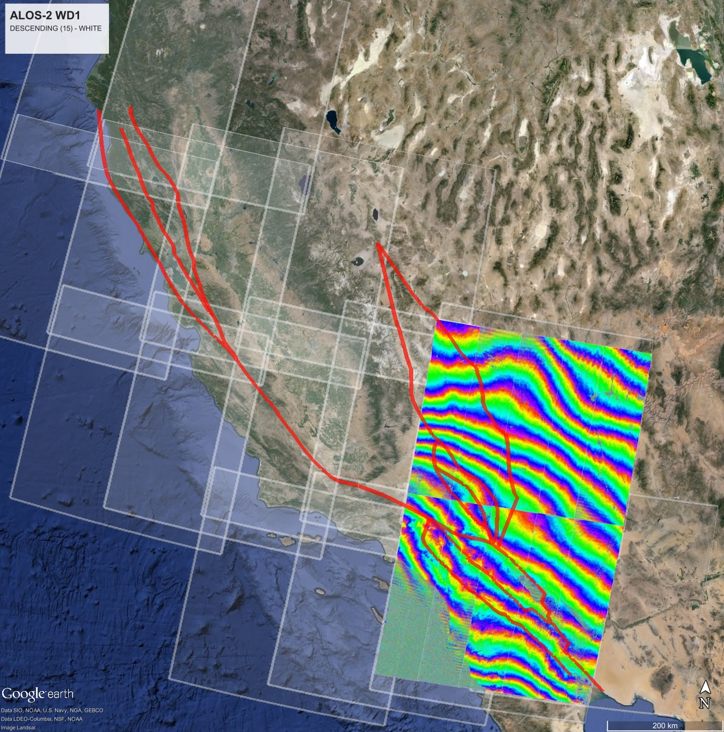
Coverage of the
San Andreas Fault
System from ALOS-2
Today each frame
has 9 repeats on a
42-day cadence.
Each ALOS-2 interogram
is 350 km by 350 km
Notes:
Along descending tracks ALOS-2 operates in this wide swath mode. Each interferogram here is 9 times larger than the old ALOS-2 interferogram. The community will order these data bacause it takes only 15 scenes to cover the SAF and each PI has only 50 (or 100) scenes/yr. UNAVCO is organizing the ordering.
We don’t understand the large trends in these L-band interferograms. Could be ionosphere and/or orbit error.

Slide 30
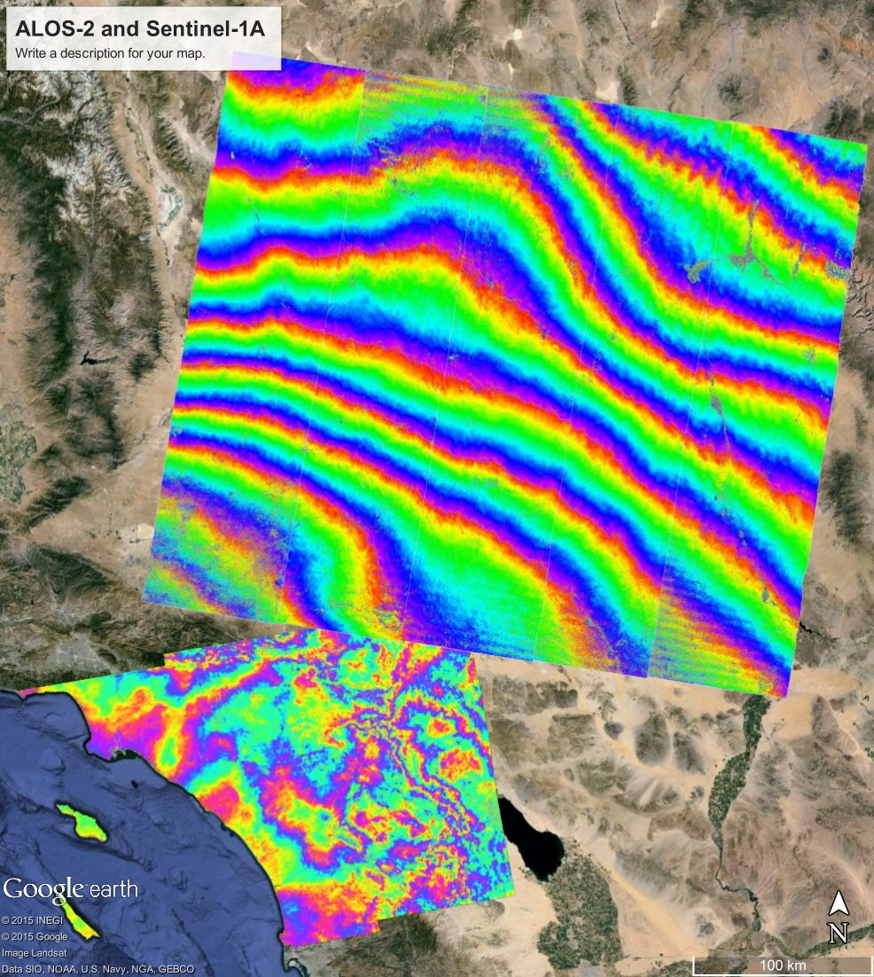
Example interferograms
from ALOS-2 and
Sentinel-1A.
New processing methods
are needed to achieve
seamless coverage.
Large trends in ALOS-2
InSAR may reflect spatial
variations in ionosphere
TEC.

Slide 31
Expected velocity error
from Sentinel-1a
observations at 12-day
intervals. Assumes
atmospheric error model
of Emardson et al., [2003].
1 mm/yr accuracy can be
achieved in 3 years for areas
with ~20 km GPS spacing
and in 5 years with ~100 km
GPS spacing.
(Tim Wright, personal
communication, 2015)
Notes:
This slide was computed by Tim Wright and is based on a 12-day acquisition interval and a “red” spectrum atmospheric model.
The accuracy is measured between two points over a length scale. InSAR is very precise over short length scales and not precise over long length scales.
We have better than 20 km CGPS spacing in California so we can rely on the GPS over longer length scales. A combined GPS/InSAR velocity map
will be accurate to 1 mm/yr in just 3 years.

Slide 32
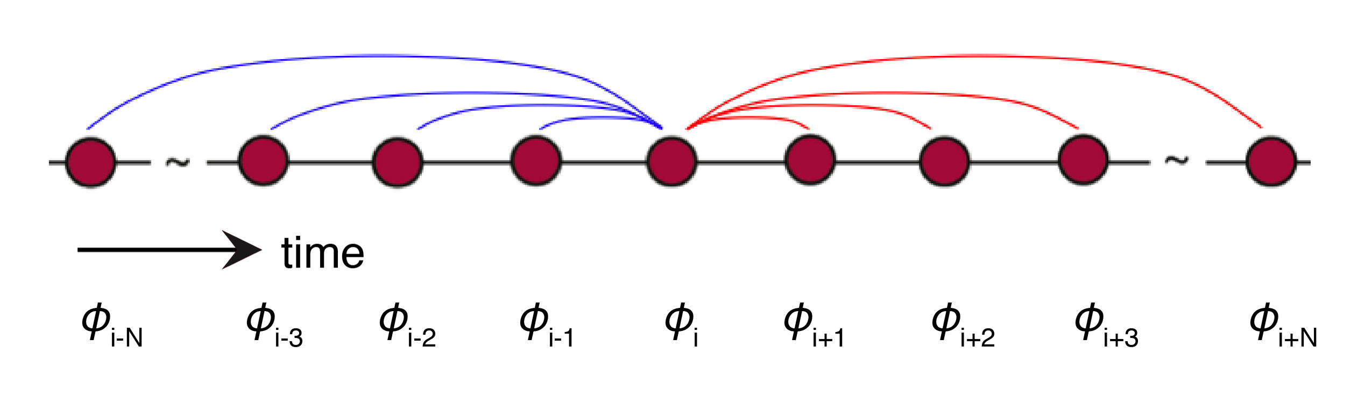
Recovering low-amplitude deformation signals with InSAR time series
InSAR estimation of low-amplitude deformation signals is significantly limited by the phase perturbations due to the troposphere and ionosphere.
With dense data catalogs and regular repeat times, it is possible to estimate propagation delays due to the atmosphere with an iterative common point stacking method, taking advantage of the fact that all interferograms that share a common date must share the same atmospheric contribution.
Propagation delays can be calculated for each scene, and subtracted from corresponding interferograms prior to forming time series to improve estimates of deformation.
Tymofyeyeva and Fialko, 2015
Notes:
One can do even better with these regular and short baseline acquisitions because with redundant interferograms one can estimate and remove the atmospheric/ionospheric error from each SAR image.

Slide 33
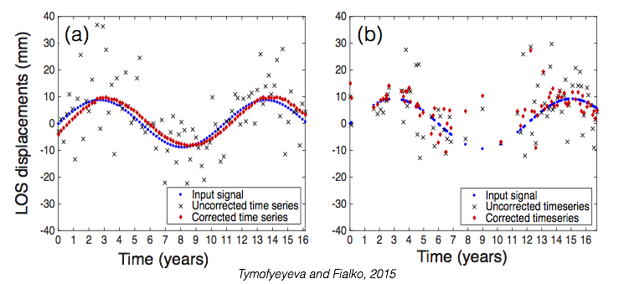
Recovering low-amplitude deformation signals with InSAR time series
Results of synthetic data tests
(a) Data that assume regular acquisition intervals and small baselines characteristic of current and future InSAR missions (Sentinel-1, ALOS-2, NISAR).
(b) Data that mimic the distribution of baselines and acquisition intervals of ERS1/2 and ENVISAT missions.
Notes:
Here is an example where synthetic SAR images are corrupted by atmospheric errors. Then one tries to estimate and correct the atmospheric error in each image using the redundancy.
(left) is regular and frequent sampling and the recovery is excellent
(right) is sparse and less frequent sampling and the recovery is poor.

Slide 34
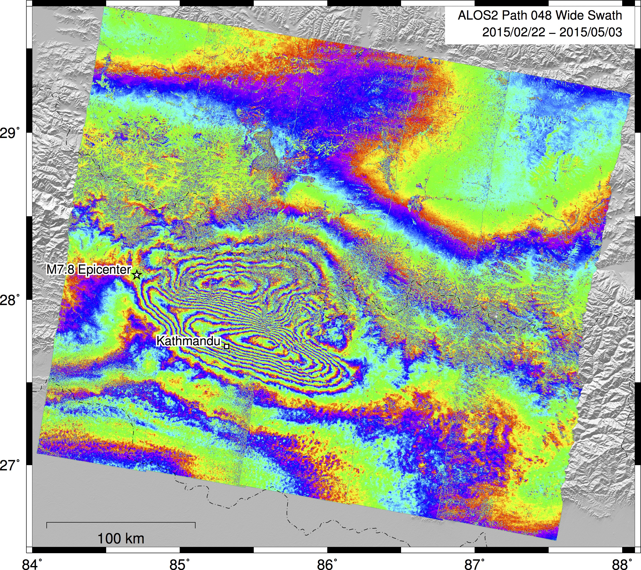
Single 350km
by 350 km
interferogram.
Note phase is
continuous
across the
subswath
boundaries
with NO
adjustments!
Note adequate
phase coherence
even in snow-
capped
mountains.
http://topex.ucsd.edu/nepal
Notes:
These are extra slides showing that if there is a large earthquake in CA, it will be observed by the new InSAR satellites even in the mountains and snow-covered areas.

Slide 35
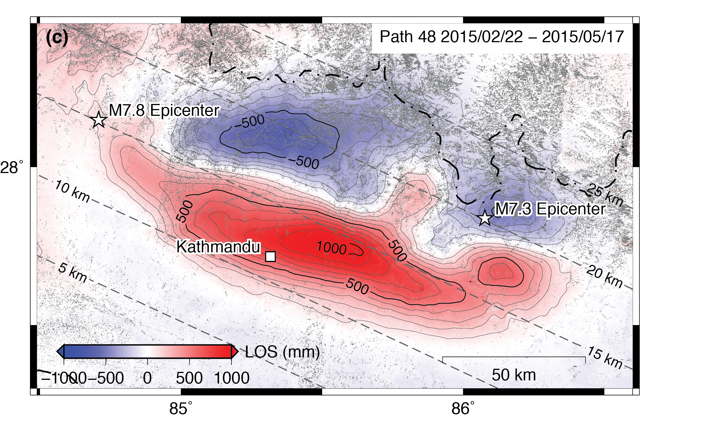
LOS displacement for M7.8 + M7.3 - Descending - detrended
http://topex.ucsd.edu/nepal
Notes:
Moreover at L-band, phase unwrapping is easy.

Slide 36
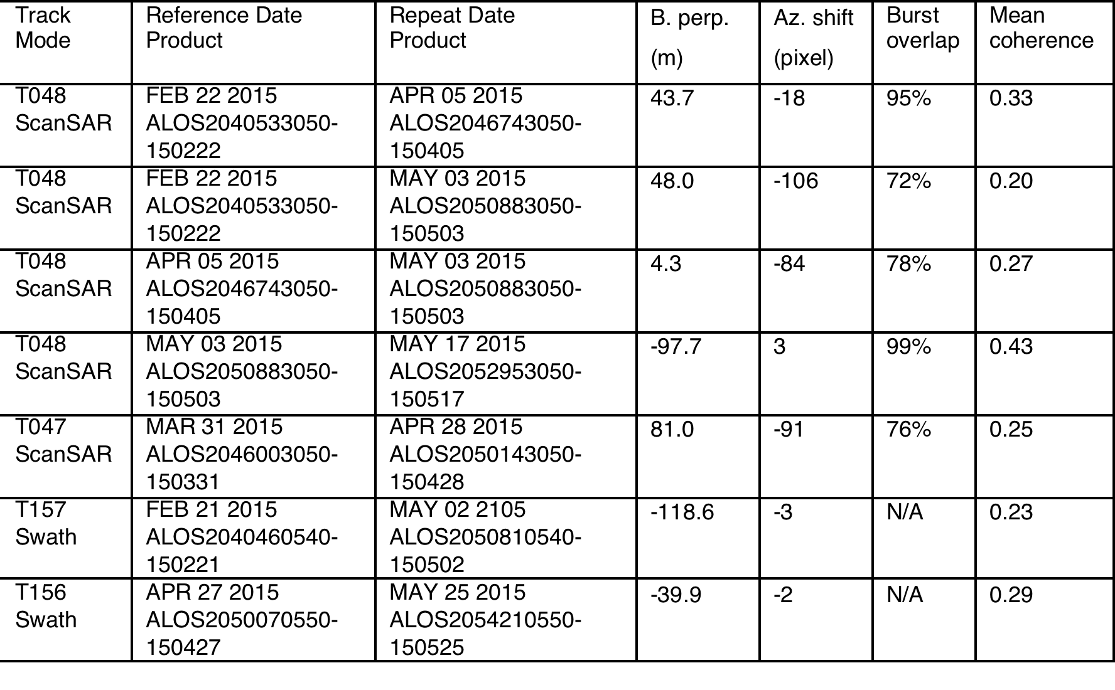
Co-seismic interferograms used in this study. Note small baselines and
large burst overlap.
Notes:
This shows the baseline and burst overlap control of ALOS-2. Baselines are generally less than 100 m and commonly less than 50 m.
The burst overlap is adequate but not perfect (yet0.

