Slide 1
Summary
MODIS has 36 spectral bands ranging from 0.41 to 14.38 μm
communication_rate = #bands X swath_width X ground_velocity/(spatial resolution)²
Science teams develop algorithms to construct higher level products from linear combinations of various bands.
DATA LEVELS
L0 - raw telemetry from the satellite in engineering units (e.g., volts)
L1 - data converted from engineering units (volts) into physical units (e.g., radiance)
L1b - also geometrically corrected in an Earth reference frame (e.g., lat, lon, height)
L2 - derived higher-level product derived from multiple bands plus ancillary data (e.g., environmental data records EDR).
L3 - gridded product constructed from a long time-series of L2 data.
Scientists usually work with L1b or L2 data although the original L0 or L1 data are stored in a long-term archive.

Slide 2
The Moderate Resolution Imaging Spectroradiometer (MODIS): Potential
Applications for Climate Change and Modeling Studies
Menas Kafatos, CEOSR, George Mason University
Jim McManus, CEOSR, GMU and GES DISC DAAC
John Qu, CEOSR, GES DISC DAAC
George Serafino, GES DISC DAAC

Slide 3
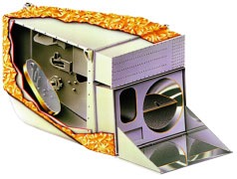
MODIS Sensor Summary
One of key instruments on NASA, Terra & Aqua satellites (EOS
mission) Terra was launched in 1999 (descending node, 10:30
a.m. ) and Aqua to be launched in 2002 (ascending node, 1:30
p.m. ) with 705 km polar orbits
Sensor Characteristics:
2300 km (cross track) and 2000 km (5 min. granule along track)
36 spectral bands ranging from 0.41 to 14.385 µm
Spatial resolutions:
250 m (bands 1 - 2)
500 m (bands 3 - 7)
1000 m (bands 8 - 36)

Slide 4
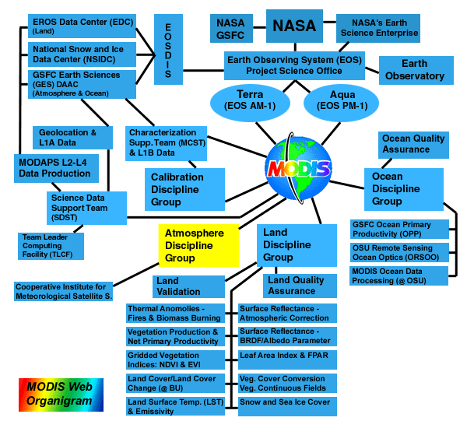
MODIS -An Interdisciplinary Remote Sensing Sensor
MODIS is the
first interdisciplinary
instrument which can
be used to monitor
Earth’s lands, oceans and
atmosphere, including
snow/ice.

Slide 5
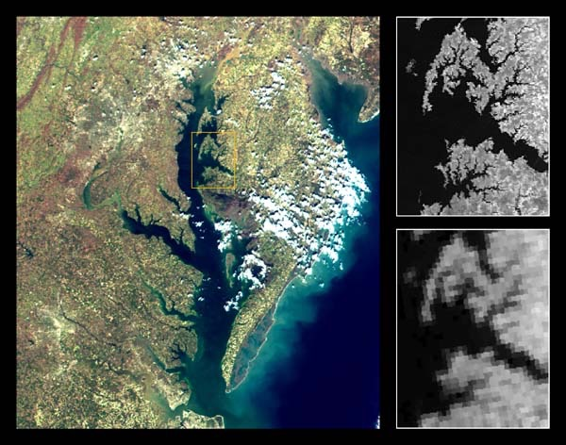
MODIS Improved Spatial Resolution
The MODIS 250m-resolution
multi-spectral observations
clearly discriminate different
types of vegetation and
urban areas in this image.
The subsets show MODIS
near-infrared band 2 (859nm)
at 250m resolution (top right)
and the corresponding NOAA14
AVHRR 1km band 2 (bottom
right) over the Choptank River
and the Cambridge area,
in the Delmarva Peninsula.
The improved spatial resolution
of MODIS data over the heritage
AVHRR data is apparent.

Slide 6
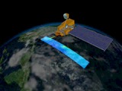
MODIS Overview--1
MODIS Basic Specifications
Orbit: 705 km, 10:30 a.m. descending node (AM-1) or 1:30 p.m. ascending node (PM-1),
sun-synchronous, near-polar, circular
Scan Rate: 20.3 rpm, cross track
Swath Dimensions: 2330 km (cross track) by 10 km (along track at nadir)
Size: 1.0 x 1.6 x 1.0 m
Weight: 228.7 kg
Power: 162.5 W (single orbit average)
Data Rate: 10.6 Mbps (peak daytime); 6.1 Mbps (orbital average)
Spatial Resolution: 250 m (bands 1-2) 500 m (bands 3-7) 1000 m (bands 8-36)
Design Life: 6 years
Credit: Susan Gonnelli, NASA TV GSFC

Slide 7
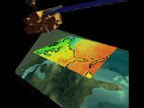
MODIS Overview--2
MODIS Primary Land/Clould/Aerosol Channels
Primary Use Band Bandwidth Spectral Radiance* Required SNR**
Land/Cloud/Aerosols/ 1 620 - 670 nm 21.8 128
Boundaries 2 841 - 876 nm 24.7 201
Land/Cloud/Aerosols/ 3 459 - 479 nm 35.3 243
Properties 4 545 - 565 nm 29.0 228
5 1230 - 1250 nm 5.4 74
6 1628 - 1652 nm 7.3 275
7 2105 - 2155 nm 1.0 110
* Spectral Radiance values are (W/m² -µm-sr)
**SNR = Signal-to-noise ratio
Credit: Susan Gonnelli, NASA TV GSFC

Slide 8
MODIS Overview--3
MODIS Primary Ocean Channels
Primary Use Band Bandwidth Spectral Radiance* Required SNR**
Ocean Color/ 8 405 - 420 nm 44.9 880
Phytoplankton/ 9 438 - 448 nm 41.9 838
Biogeochemistry 10 483 - 493 nm 32.1 802
11 526 - 536 nm 27.9 754
12 546 - 556 nm 21.0 750
13 662 - 672 nm 9.5 910
14 673 - 683 nm 8.7 1087
15 743 - 753 nm 10.2 586
16 862 - 877 nm 6.2 516
* Spectral Radiance values are (W/m² -µm-sr)
**SNR = Signal-to-noise ratio

Slide 9
MODIS Overview--4
MODIS Primary Atmospheric Channels
Primary Use Band Bandwidth Spectral Radiance* Required SNR**
Atmospheric Water Vapor 17 890 - 920 nm 10.0 167
18 931 - 941 nm 3.6 57
19 915 - 965 nm 15.0 250
Required NE[delta]T(K)***
Surface/Cloud Temperature 20 3.660 - 3.840 µm 0.45(300K) 0.05
21 3.929 - 3.989 µm 2.38(335K) 2.00
22 3.929 - 3.989 µm 0.67(300K) 0.07
23 4.020 - 4.080 µm 0.79(300K) 0.07
Atmospheric Temperature 24 4.433 - 4.498 µm 0.17(250K) 0.25
25 4.482 - 4.549 µm 0.59(275K) 0.25
** NE(delta)T = Noise-equivalent temperature difference

Slide 10
MODIS Overview--5
MODIS Primary Atmospheric Channels
Primary Use Band Bandwidth Spectral Radiance* Required NE[delta]T(K)***
Cirrus Clouds Water Vapor 26 1.360 - 1.390 µm 6.00 150(SNR)
27 6.535 - 6.895 µm 1.16(240K) 0.25
28 7.175 - 7.475 µm 2.18(250K) 0.25
Cloud Properties 29 8.400 - 8.700 µm 9.58(300K) 0.05
Ozone 30 9.580 - 9.880 µm 3.69(250K) 0.25
Cloud Top Altitude 33 13.185 - 13.485 µm 4.52(260K) 0.25
34 13.485 - 13.785 µm 3.76(250K) 0.25
35 13.785 - 14.085 µm 3.11(240K) 0.25
36 14.085 - 14.385 µm 2.08(220K) 0.35
*** NE(delta)T = Noise-equivalent temperature difference

Slide 11
MODIS Atmospheric Parameter list
ESDT Name Parameter Name Parameter Description
MOD04_L2 Aerosol Aerosol type, aerosol optical thickness, particle size distribution,
aerosol mass concentration, optical properties, and radiative forcing
MOD05_L2 Water Vapor Atmospheric water vapor and perceptible water
MOD06 _L2 Cloud Physical and radiative properties of clouds including cloud particle
phase (ice vs. water, clouds vs. snow), effective cloud particle radius,
cloud optical thickness, cloud shadow effects, cloud top temperature,
cloud top height, effective emissivity, cloud phase (ice vs. water,
opaque vs. non-opaque), and cloud fraction under both daytime and nighttime conditions
MOD07_L2 Atmosphere Profile Atmospheric temperature and moisture,atmospheric stability, and
total ozone burden
MOD08_D3 Gridded Global Joint/ Contain different time periods (one day, eight-day and month)
MOD08_E3 Product statistical datasets derived from Level-2 MODIS Atmosphere
MOD08_M3 parameters.
MOD35_L2 Cloud Mask Cloud presence including the cirrus clouds, ice/snow, and sunglint
contamination. Finally flags denoting day/night and land/water
All the MODIS atmosphere data are archived in the GSFC Earth Sciences (GES) Data and Information
Services Center (GDISC)

Slide 12
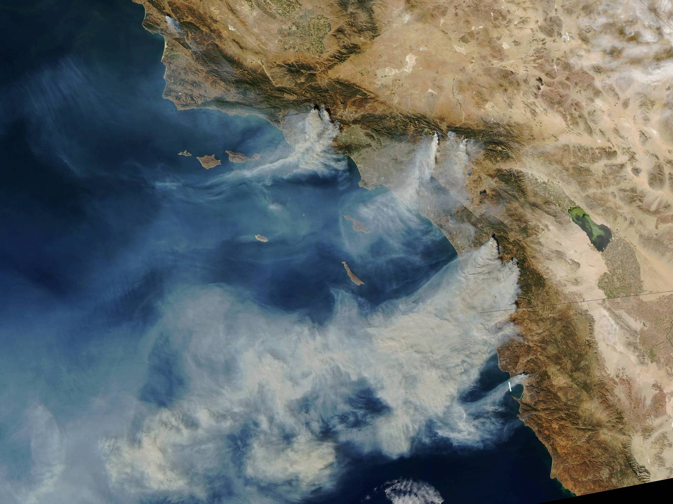
The International EOS Direct Broadcast Users Conference
Hapuna Beach, Hawaii – November 17, 2003
The International Scope, Systems and Software Available from SeaSpace
R. L. Bernstein
Chief Technology Officer
and
J. Fahle
V.P. of R & D
SeaSpace
SeaSpace Corporation is a wholly-owned subsidiary of Allied Defense Group, Inc.
MODIS - October 27, 2003 - University of Wisconsin - 4.5m TeraScan X-band System

Slide 13
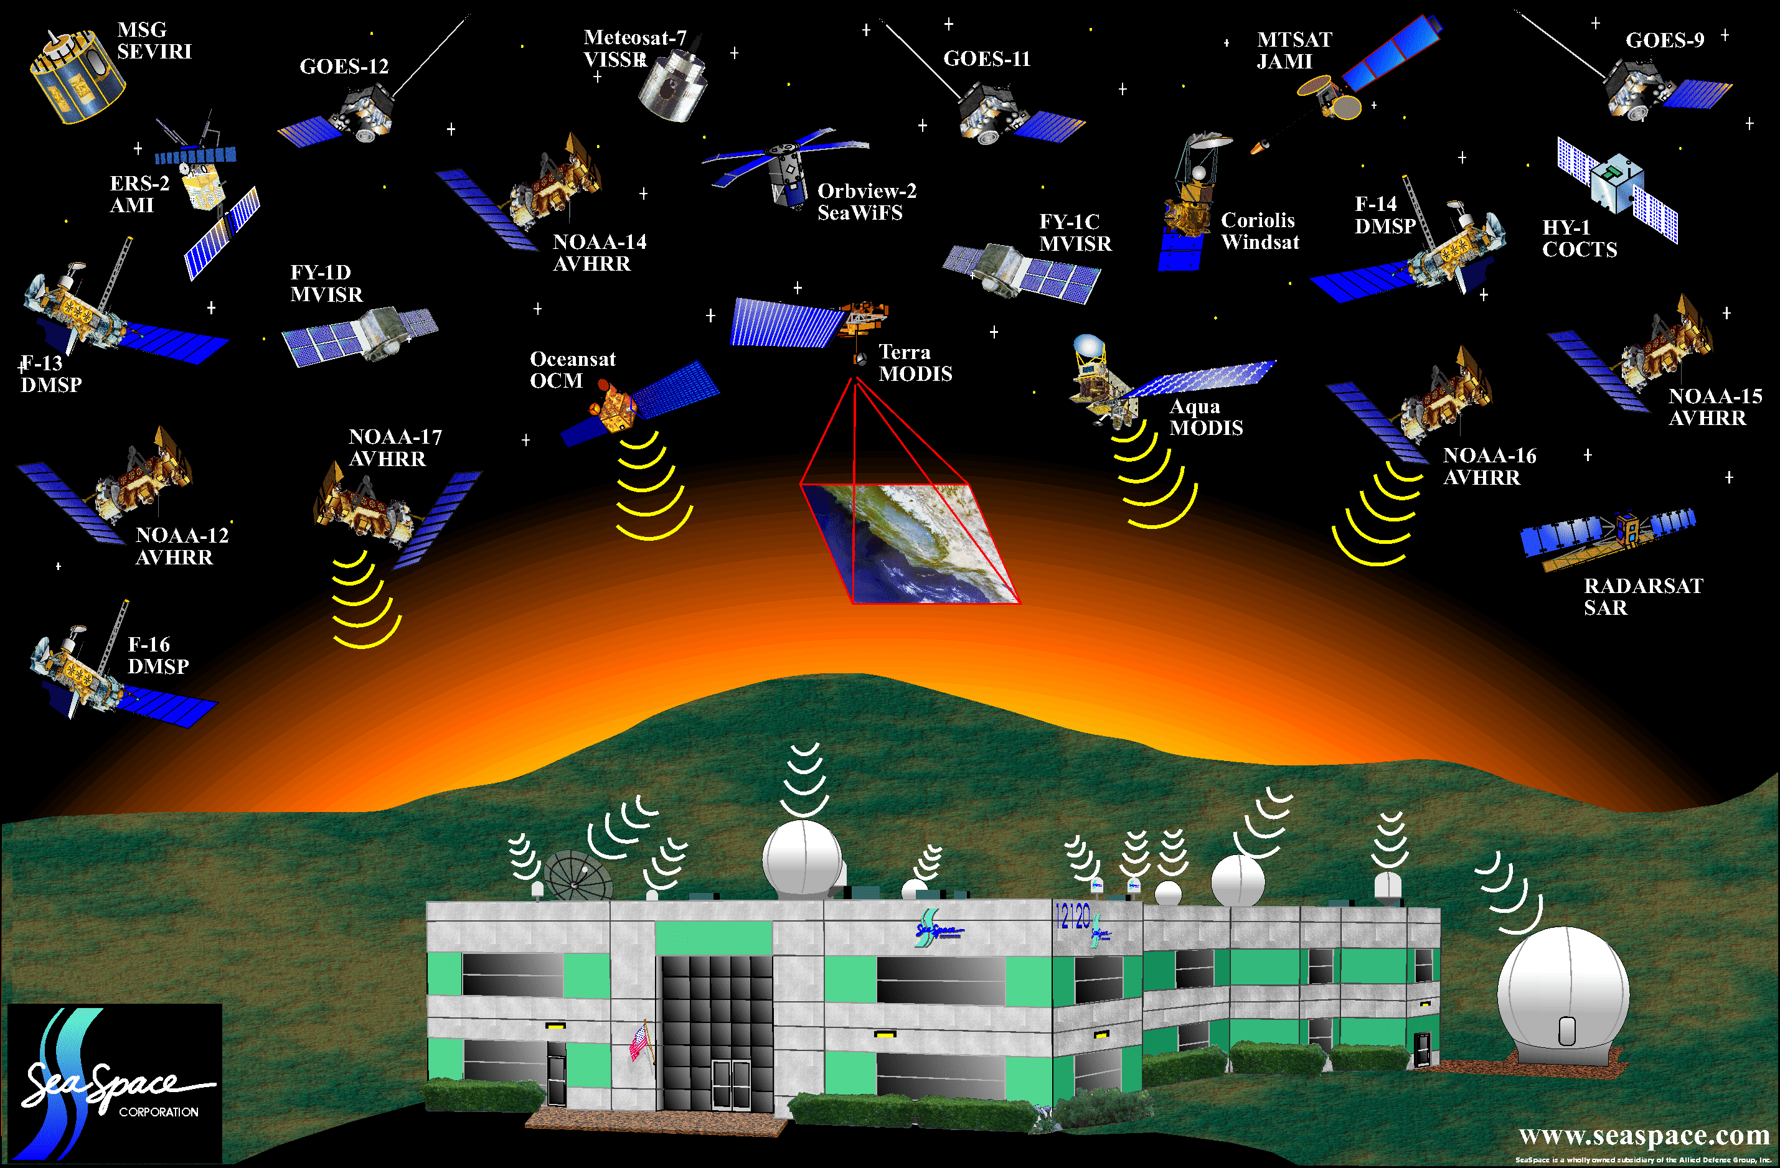
Satellite Platforms Currently Tracked at SeaSpace

Slide 14
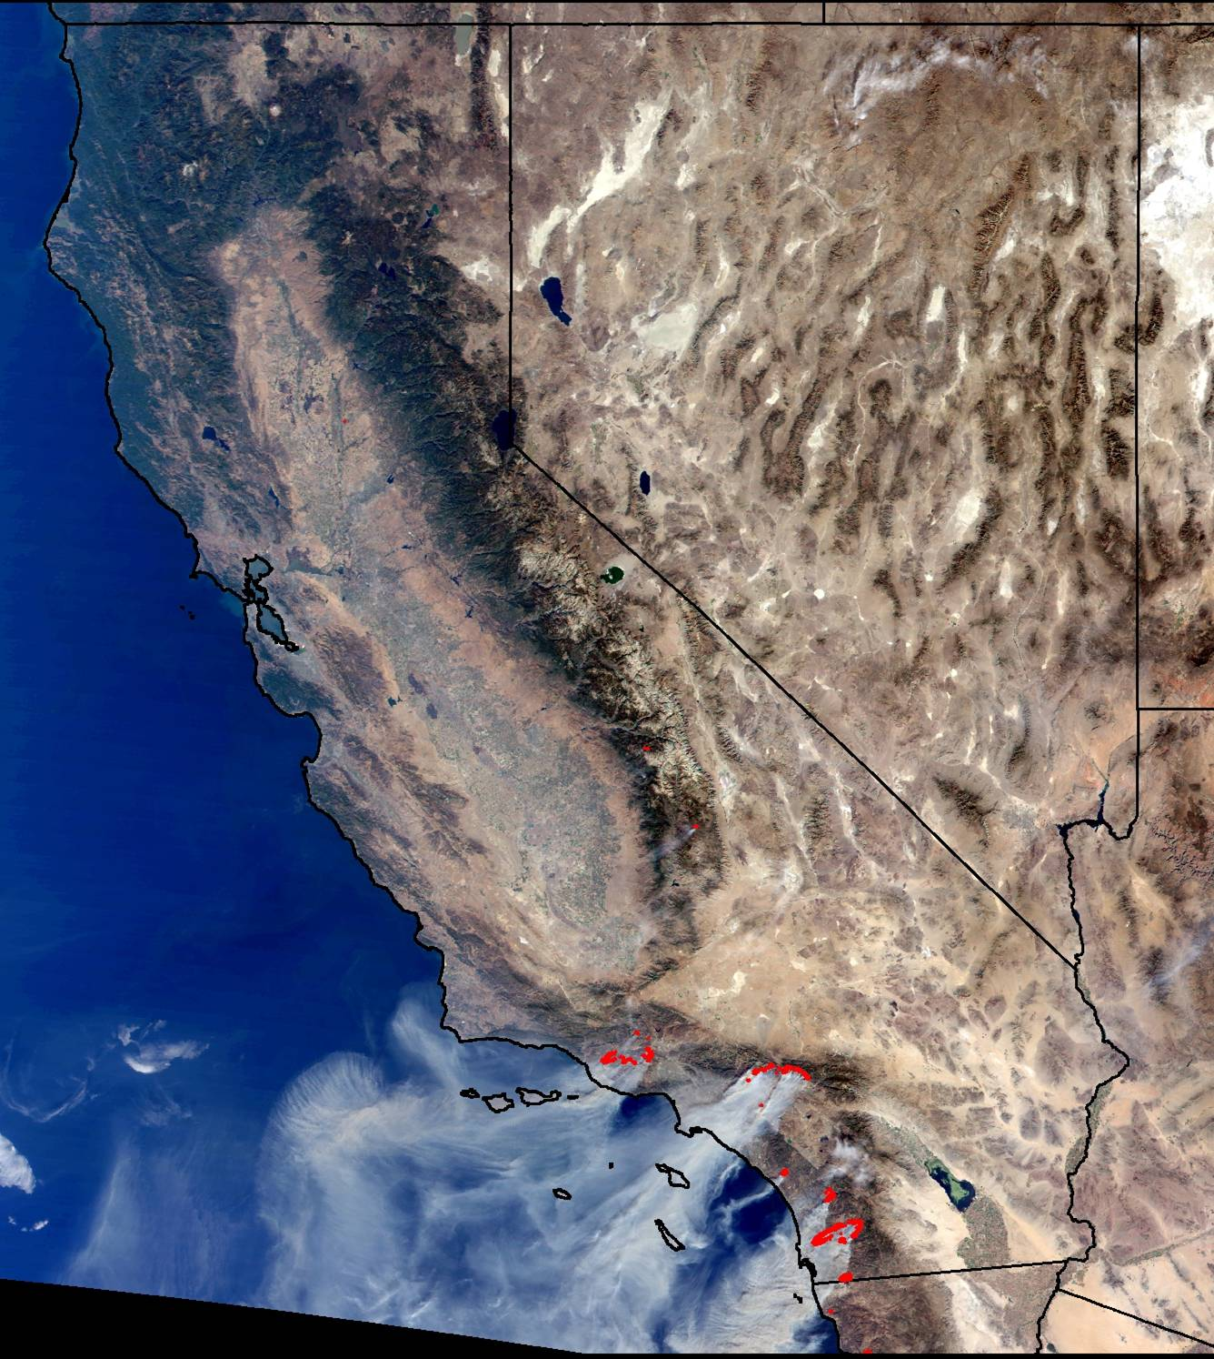
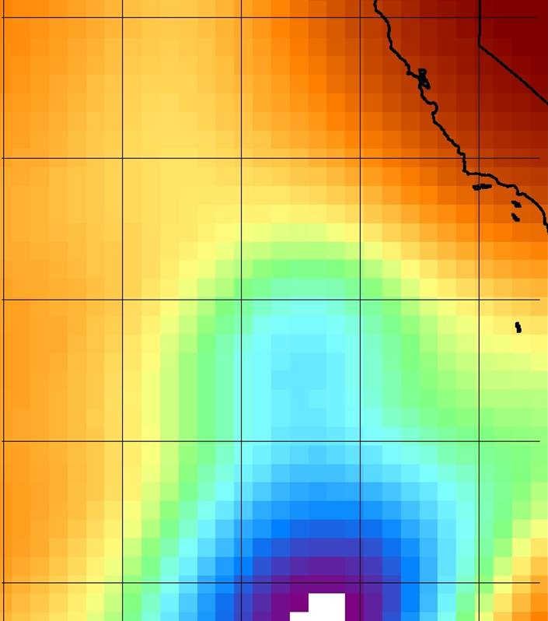
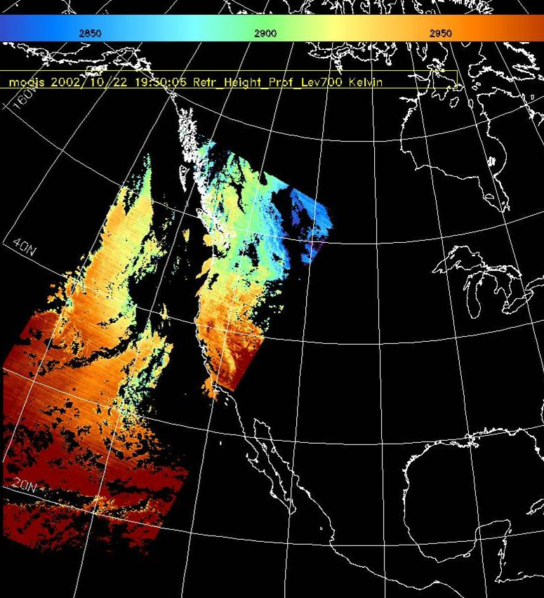
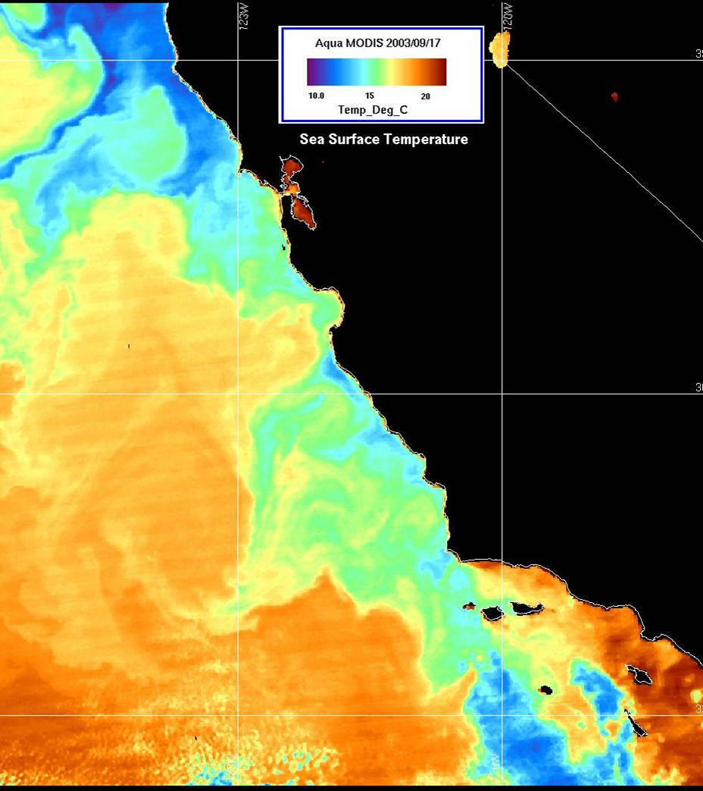
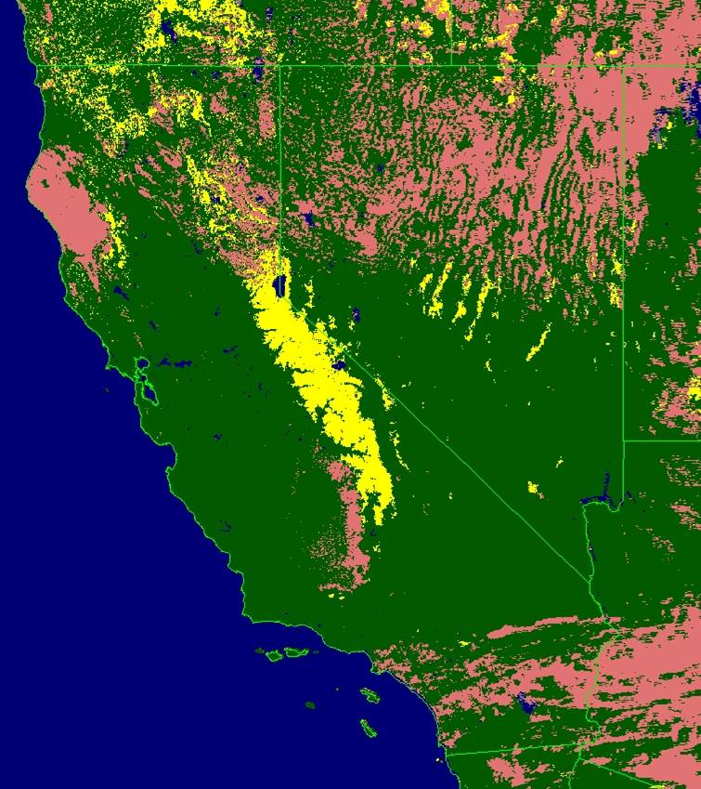
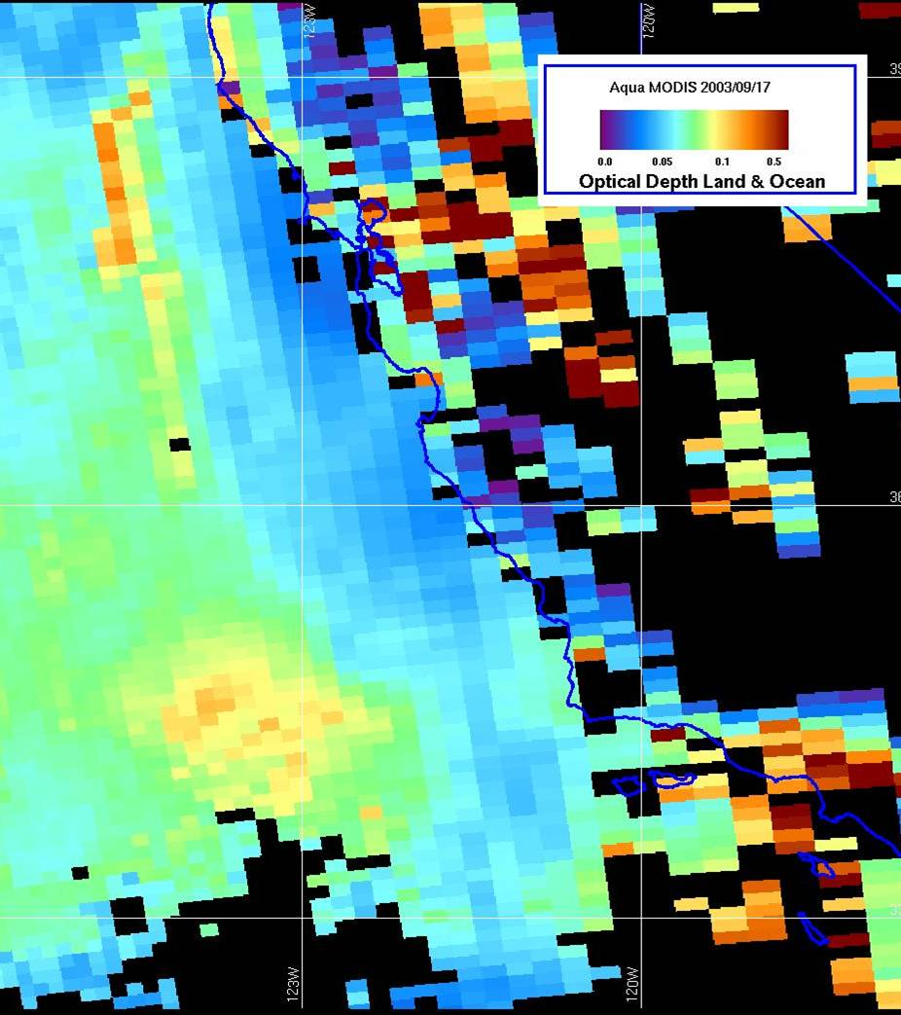
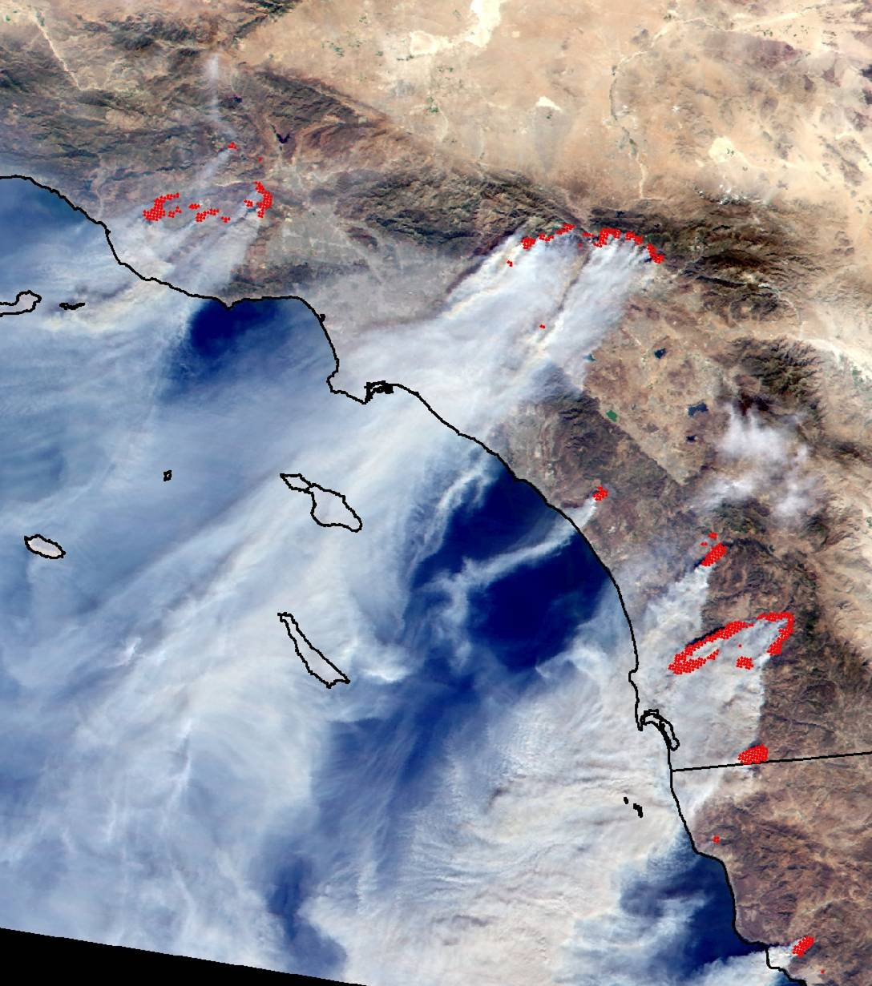
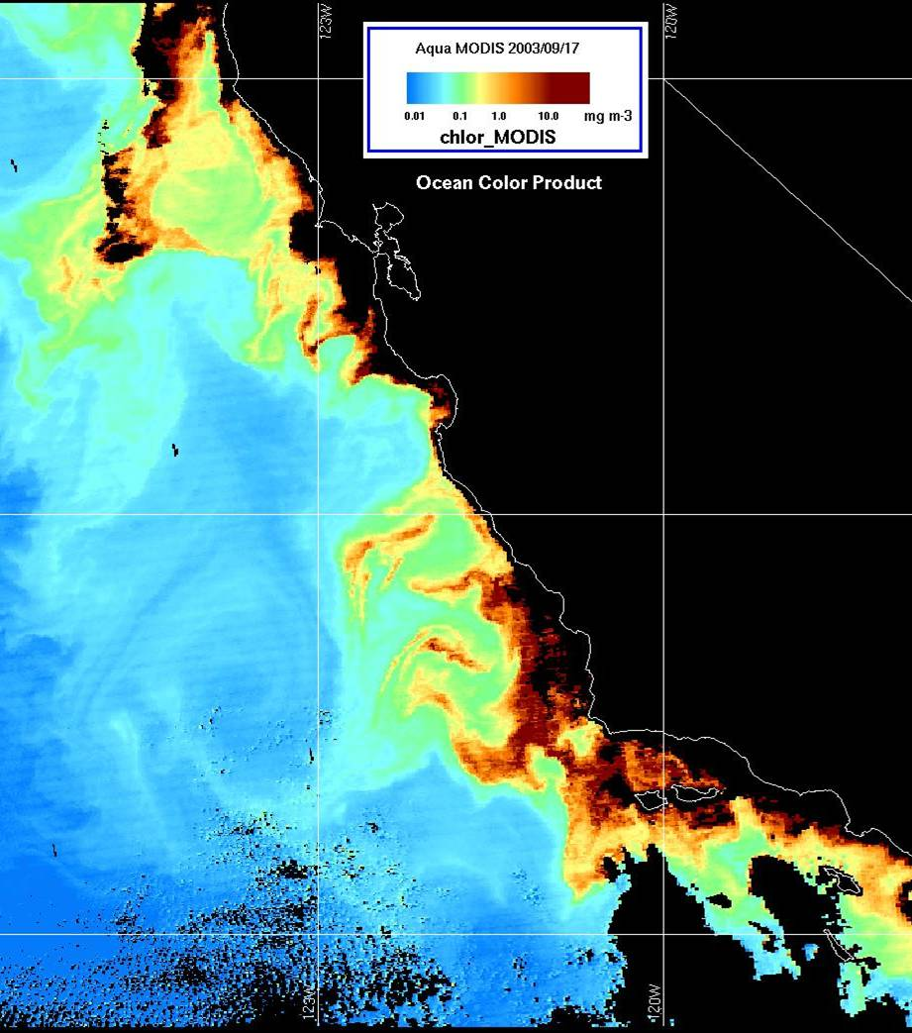
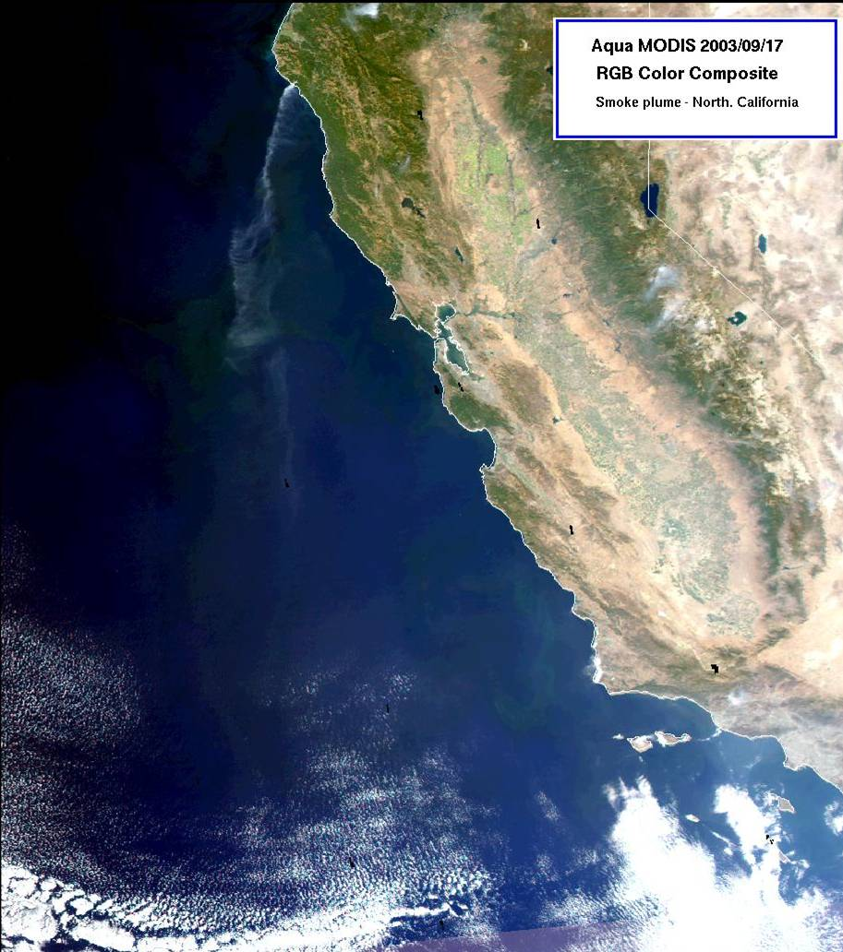
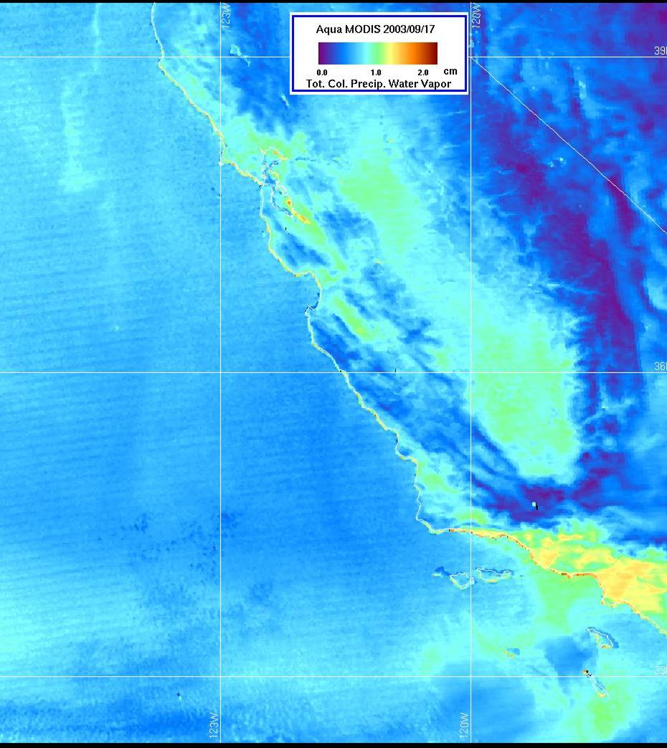
AMSU on Aqua –9/17/03
Ch. 15 (89 GHz) - Temp. (ºK)
New tools
MODIS/AIRS Processing Algorithms
MODIS Enhanced
Vegetation Index
I. IMAPP MODIS modules
MOD01/2/3 - Level 1B
MOD18 – Ocean Color
MOD28 – SST
MOD07 - Atmospheric Profiles
MOD14 - Fire Detection
MOD06 – Cloud top Products
MOD35 – Cloud mask
II. IMAPP AIRS/AMSU-A modules
AMSU-A Level 1B
AIRS Level 1B
MODIS Enhanced
Vegetation Index
I. IMAPP MODIS modules
MOD01/2/3 - Level 1B
MOD18 – Ocean Color
MOD28 – SST
MOD07 - Atmospheric Profiles
MOD14 - Fire Detection
MOD06 – Cloud top Products
MOD35 – Cloud mask
II. IMAPP AIRS/AMSU-A modules
AMSU-A Level 1B
AIRS Level 1B
I. IMAPP MODIS modules
MOD01/2/3 - Level 1B
MOD18 – Ocean Color
MOD28 – SST
MOD07 - Atmospheric Profiles
MOD14 - Fire Detection
MOD06 – Cloud top Products
MOD35 – Cloud mask
II. IMAPP AIRS/AMSU-A modules
AMSU-A Level 1B
AIRS Level 1B
I. IMAPP MODIS modules
MOD01/2/3 - Level 1B
MOD18 – Ocean Color
MOD28 – SST
MOD07 - Atmospheric Profiles
MOD14 - Fire Detection
MOD06 – Cloud top Products
MOD35 – Cloud mask
II. IMAPP AIRS/AMSU-A modules
AMSU-A Level 1B
AIRS Level 1B
I. IMAPP MODIS modules
MOD01/2/3 - Level 1B
MOD18 – Ocean Color
MOD28 – SST
MOD07 - Atmospheric Profiles
MOD14 - Fire Detection
MOD06 – Cloud top Products
MOD35 – Cloud mask
II. IMAPP AIRS/AMSU-A modules
AMSU-A Level 1B
AIRS Level 1B
I. IMAPP MODIS modules
MOD01/2/3 - Level 1B
MOD18 – Ocean Color
MOD28 – SST
MOD07 - Atmospheric Profiles
MOD14 - Fire Detection
MOD06 – Cloud top Products
MOD35 – Cloud mask
II. IMAPP AIRS/AMSU-A modules
AMSU-A Level 1B
AIRS Level 1B
I. IMAPP MODIS modules
MOD01/2/3 - Level 1B
MOD18 – Ocean Color
MOD28 – SST
MOD07 - Atmospheric Profiles
MOD14 - Fire Detection
MOD06 – Cloud top Products
MOD35 – Cloud mask
II. IMAPP AIRS/AMSU-A modules
AMSU-A Level 1B
AIRS Level 1B
I. IMAPP MODIS modules
MOD01/2/3 - Level 1B
MOD18 – Ocean Color
MOD28 – SST
MOD07 - Atmospheric Profiles
MOD14 - Fire Detection
MOD06 – Cloud top Products
MOD35 – Cloud mask
II. IMAPP AIRS/AMSU-A modules
AMSU-A Level 1B
AIRS Level 1B
I. IMAPP MODIS modules
MOD01/2/3 - Level 1B
MOD18 – Ocean Color
MOD28 – SST
MOD07 - Atmospheric Profiles
MOD14 - Fire Detection
MOD06 – Cloud top Products
MOD35 – Cloud mask
II. IMAPP AIRS/AMSU-A modules
AMSU-A Level 1B
AIRS Level 1B
I. IMAPP MODIS modules
MOD01/2/3 - Level 1B
MOD18 – Ocean Color
MOD28 – SST
MOD07 - Atmospheric Profiles
MOD14 - Fire Detection
MOD06 – Cloud top Products
MOD35 – Cloud mask
II. IMAPP AIRS/AMSU-A modules
AMSU-A Level 1B
AIRS Level 1B
I. IMAPP MODIS modules
MOD01/2/3 - Level 1B
MOD18 – Ocean Color
MOD28 – SST
MOD07 - Atmospheric Profiles
MOD14 - Fire Detection
MOD06 – Cloud top Products
MOD35 – Cloud mask
II. IMAPP AIRS/AMSU-A modules
AMSU-A Level 1B
AIRS Level 1B
I. IMAPP MODIS modules
MOD01/2/3 - Level 1B
MOD18 – Ocean Color
MOD28 – SST
MOD07 - Atmospheric Profiles
MOD14 - Fire Detection
MOD06 – Cloud top Products
MOD35 – Cloud mask
II. IMAPP AIRS/AMSU-A modules
AMSU-A Level 1B
AIRS Level 1B
40N
NV
NV
210 220 230 240 250 260 270
Grand Prix
Fire
MODIS 2002/10/22 19:50:06 Retr_Height_Prof_Lev700 Kelvin
CA
Piru Fire
CA
Coastal Range
San
Francisco
San Francisco
San Francisco
San Francisco
San
Francisco
Los
Angeles
Sierra Nevada Mts.
Reno
30N
San Francisco
San Francisco
Oakland
Roblar
Fire
San Francisco
30N
San Francisco
Sierra Nevada Mts.
III. NASA DAAC
MOD01/2/3 - Level 1B
MOD18 – Ocean Color
MOD28 - SST
MOD04 - Aerosol products
MOD05 - Precipitable water
MOD14 – Fire Detection
MOD10 - Snow Cover
MOD12 – Enhanced Veg Index
MOD09 - Land Sfc Reflectance
MOD07 - Atmospheric profiles
MOD35 – Cloud Mask
San
Francisco
Bay
III. NASA DAAC
MOD01/2/3 - Level 1B
MOD18 – Ocean Color
MOD28 - SST
MOD04 - Aerosol products
MOD05 - Precipitable water
MOD14 – Fire Detection
MOD10 - Snow Cover
MOD12 – Enhanced Veg Index
MOD09 - Land Sfc Reflectance
MOD07 - Atmospheric profiles
MOD35 – Cloud Mask
III. NASA DAAC
MOD01/2/3 - Level 1B
MOD18 – Ocean Color
MOD28 - SST
MOD04 - Aerosol products
MOD05 - Precipitable water
MOD14 – Fire Detection
MOD10 - Snow Cover
MOD12 – Enhanced Veg Index
MOD09 - Land Sfc Reflectance
MOD07 - Atmospheric profiles
MOD35 – Cloud Mask
III. NASA DAAC
MOD01/2/3 - Level 1B
MOD18 – Ocean Color
MOD28 - SST
MOD04 - Aerosol products
MOD05 - Precipitable water
MOD14 – Fire Detection
MOD10 - Snow Cover
MOD12 – Enhanced Veg Index
MOD09 - Land Sfc Reflectance
MOD07 - Atmospheric profiles
MOD35 – Cloud Mask
III. NASA DAAC
MOD01/2/3 - Level 1B
MOD18 – Ocean Color
MOD28 - SST
MOD04 - Aerosol products
MOD05 - Precipitable water
MOD14 – Fire Detection
MOD10 - Snow Cover
MOD12 – Enhanced Veg Index
MOD09 - Land Sfc Reflectance
MOD07 - Atmospheric profiles
MOD35 – Cloud Mask
III. NASA DAAC
MOD01/2/3 - Level 1B
MOD18 – Ocean Color
MOD28 - SST
MOD04 - Aerosol products
MOD05 - Precipitable water
MOD14 – Fire Detection
MOD10 - Snow Cover
MOD12 – Enhanced Veg Index
MOD09 - Land Sfc Reflectance
MOD07 - Atmospheric profiles
MOD35 – Cloud Mask
III. NASA DAAC
MOD01/2/3 - Level 1B
MOD18 – Ocean Color
MOD28 - SST
MOD04 - Aerosol products
MOD05 - Precipitable water
MOD14 – Fire Detection
MOD10 - Snow Cover
MOD12 – Enhanced Veg Index
MOD09 - Land Sfc Reflectance
MOD07 - Atmospheric profiles
MOD35 – Cloud Mask
III. NASA DAAC
MOD01/2/3 - Level 1B
MOD18 – Ocean Color
MOD28 - SST
MOD04 - Aerosol products
MOD05 - Precipitable water
MOD14 – Fire Detection
MOD10 - Snow Cover
MOD12 – Enhanced Veg Index
MOD09 - Land Sfc Reflectance
MOD07 - Atmospheric profiles
MOD35 – Cloud Mask
III. NASA DAAC
MOD01/2/3 - Level 1B
MOD18 – Ocean Color
MOD28 - SST
MOD04 - Aerosol products
MOD05 - Precipitable water
MOD14 – Fire Detection
MOD10 - Snow Cover
MOD12 – Enhanced Veg Index
MOD09 - Land Sfc Reflectance
MOD07 - Atmospheric profiles
MOD35 – Cloud Mask
III. NASA DAAC
MOD01/2/3 - Level 1B
MOD18 – Ocean Color
MOD28 - SST
MOD04 - Aerosol products
MOD05 - Precipitable water
MOD14 – Fire Detection
MOD10 - Snow Cover
MOD12 – Enhanced Veg Index
MOD09 - Land Sfc Reflectance
MOD07 - Atmospheric profiles
MOD35 – Cloud Mask
III. NASA DAAC
MOD01/2/3 - Level 1B
MOD18 – Ocean Color
MOD28 - SST
MOD04 - Aerosol products
MOD05 - Precipitable water
MOD14 – Fire Detection
MOD10 - Snow Cover
MOD12 – Enhanced Veg Index
MOD09 - Land Sfc Reflectance
MOD07 - Atmospheric profiles
MOD35 – Cloud Mask
III. NASA DAAC
MOD01/2/3 - Level 1B
MOD18 – Ocean Color
MOD28 - SST
MOD04 - Aerosol products
MOD05 - Precipitable water
MOD14 – Fire Detection
MOD10 - Snow Cover
MOD12 – Enhanced Veg Index
MOD09 - Land Sfc Reflectance
MOD07 - Atmospheric profiles
MOD35 – Cloud Mask
P A C I F I C
Paradise
Fire
Las Vegas
Las Vegas
SeaSpace
Cedar
Fire
20N
San Diego
Land
Monterey
Los
Angeles
Water
Los
Angeles
Mt. Baldy
Los
Angeles
Los Angeles
Cloud
Los Angeles
Los Angeles
Terra - MODIS RGB with
Fire Detection Overlaid
October 26, 2003
(University of Texas at Austin
4.5m TeraScan X-Band System)
Otay Fire
Terra - MODIS RGB with
Fire Detection Overlaid
October 26, 2003
(University of Texas at Austin
4.5m TeraScan X-Band System)
Los Angeles
Snow
San Jose
MODIS Snow Product
February 18, 2003
San Diego
20N
San Diego
140W
130W
130W
120W
120W

Slide 15
Summary
MODIS has 36 spectral bands ranging from 0.41 to 14.38 μm
communication_rate = #bands X swath_width X ground_velocity/(spatial resolution)²
Science teams develop algorithms to construct higher level products from linear combinations of various bands.
DATA LEVELS
L0 - raw telemetry from the satellite in engineering units (e.g., volts)
L1 - data converted from engineering units (volts) into physical units (e.g., radiance)
L1b - also geometrically corrected in an Earth reference frame (e.g., lat, lon, height)
L2 - derived higher-level product derived from multiple bands plus ancillary data (e.g., environmental data records EDR).
L3 - gridded product constructed from a long time-series of L2 data.
Scientists usually work with L1b or L2 data although the original L0 or L1 data are stored in a long-term archive.

Slide 16
Lab 6 - Image Classification Supervised vs. Unsupervised Approaches
Supervised - image analyst "supervises" the selection of spectral classes that represent patterns or land cover features that the analyst can recognize Prior Decision
Unsupervised - statistical "clustering" algorithms used to select spectral classes inherent to the data, more computer-automated Posterior Decision
[R. Lathrop, 2006]

Slide 17
Image Classification
Why classify?
Make sense of a landscape
Place landscape into categories (classes)
Forest, Agriculture, Water, etc
Classification scheme = structure of classes
Depends on needs of users

Slide 18
Example Uses
Provide context
Landscape planning or assessment
Research projects
Drive models
Global carbon budgets
Meteorology
Biodiversity

Slide 19
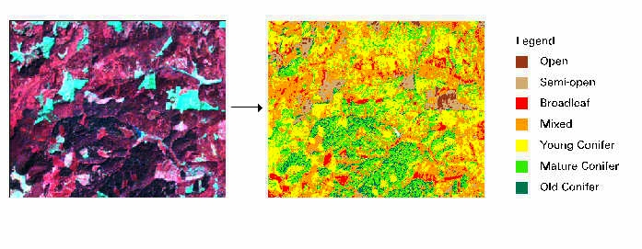
Example: Near Mary’s Peak
Derived from a 1988 Landsat TM image
Distinguish types of forest

Slide 20
Basic Strategy: How do you do it?
Use radiometric properties of remote sensor
Different objects have different spectral signatures

Slide 21
Basic Strategy: How do you do it?
In an easy world, all “Vegetation” pixels would have exactly the same spectral signature
Then we could just say that any pixel in an image with that signature was vegetation
We’d do the same for soil, etc. and end up with a map of classes

Slide 22
Basic Strategy: How do you do it?
But in reality, that isn’t the case. Looking at several pixels with vegetation, you’d see variety in spectral signatures.
The same would happen for other types of pixels, as well.

Slide 23
The Classification Trick: Deal with variability
Different ways of dealing with the variability lead to different ways of classifying images
To talk about this, we need to look at spectral signatures a little differently

Slide 24
Think of a pixel’s reflectance in 2-dimensional space. The pixel occupies a point in that space.
The vegetation pixel and the soil pixels occupy different points in 2-d space

Slide 25
In a Landsat scene, instead of two dimensions, we have 7 spectral dimensions
Each pixel represents a point in 7-dimensional space
To be generic to any sensor, we say “n-dimensional” space
For examples that follow, we use 2-d space to illustrate, but principles apply to any n-dimensional space

Slide 26
Basic Strategy: Dealing with variability
With variability, the vegetation pixels now occupy a region, not a point, of n-dimensional space
Soil pixels occupy a different region of n-dimensional space

Slide 27
Basic strategy: Dealing with variability
Classification:
Delineate boundaries of classes in n-dimensional space
Assign class names to pixels using those boundaries

Slide 28
Supervised Classification (Machine Learning)
Supervised classification requires the analyst to select training areas where he/she knows what is on the ground and then digitize a polygon within that area…
Mean Spectral Signatures
The computer then creates...
Conifer
Known Conifer Area
Water
Known Water Area
Deciduous
Known Deciduous Area
Digital Image

Slide 29
Supervised Classification
Mean Spectral Signatures
Information
Multispectral Image
(Classified Image)
Conifer
Deciduous
Water
Unknown
Spectral Signature of Next Pixel to be Classified

Slide 30
The Result is Information--in this case a Land Cover map...
Land Cover Map
Legend:
Water
Conifer
Deciduous

Slide 31
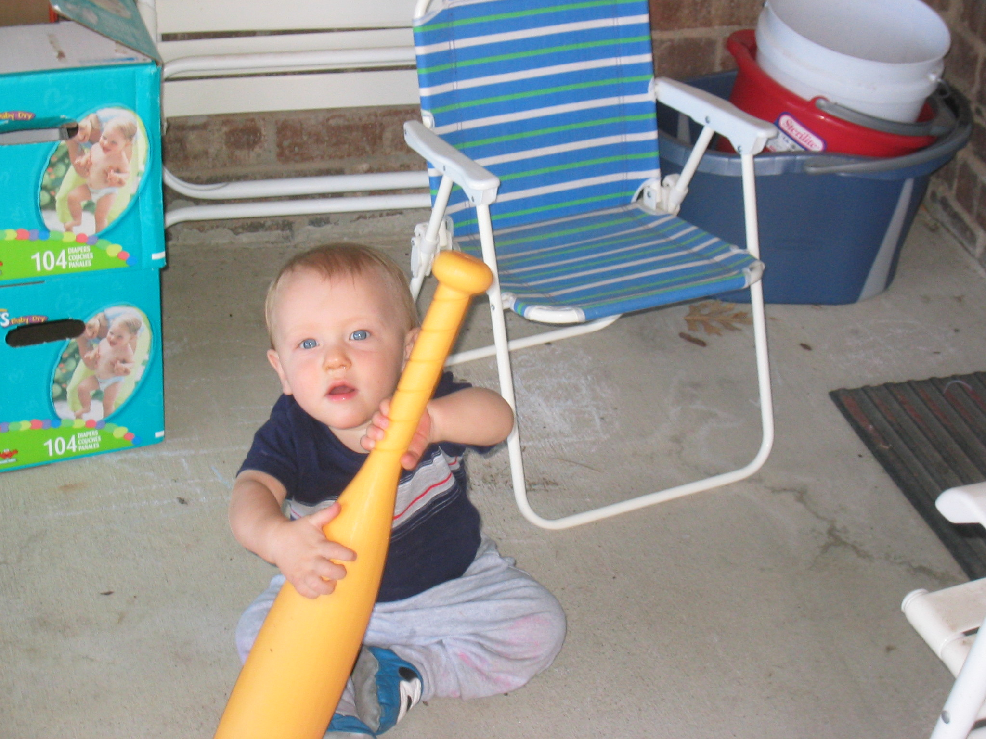
Lab 6 Demo

