Slide 1
Some Comparisons
Data Products
Zhen: Phase_RA, Corr_RA, Unwrap_RA, Unwrap_GEO (ESD) -- ISCE
Gareth: Unwrap_RA, Unwrap_GEO (ESD?) -- ISCE + ?
Manoo: Phase_GEO, Corr_GEO, Unwrap_GEO on T64 -- GMTSAR+ESA-codes
Xiaohua (Eric): Phase_RA, Corr_RA, Unwrap_RA, Phase_GEO, Corr_GEO, Unwrap_GEO (NO ESD) -- GMTSAR
Wes: Same as Eric on T71 (ESD) -- GMTSAR
Most product are not in the same coordinates/of the same size/using the same format. (extra bursts, different boundary and sampling space in geo-coordinates, etc.)
Products are re-registered with GMT xyz2grd, grdsample and grdcut.
Testing: Closure in phase, difference in phase, unwrapped phase, coherence. between participants and Xiaohua (Eric)

Slide 2
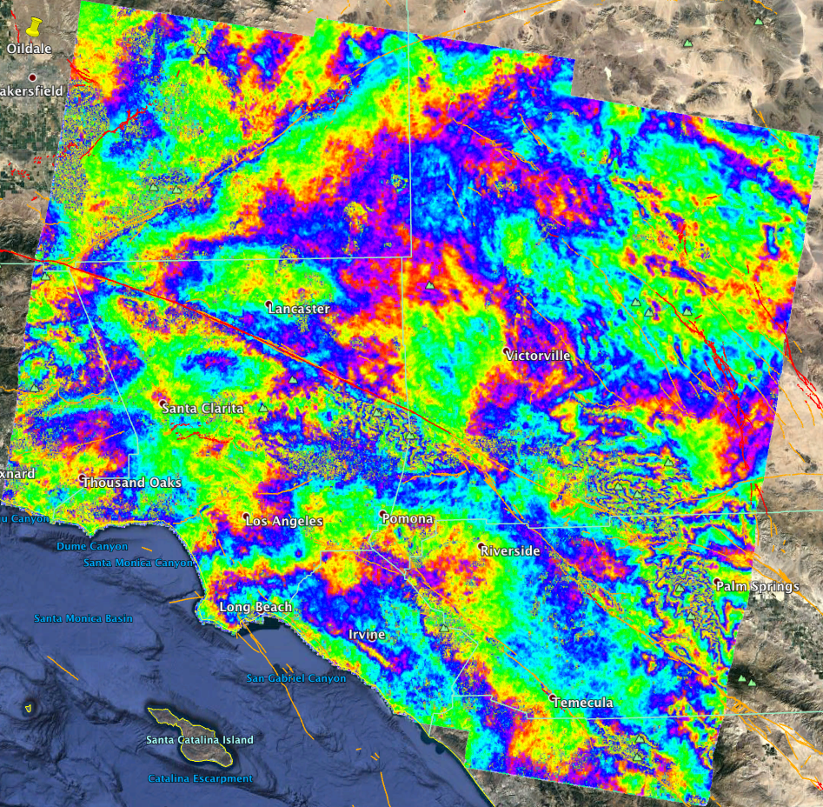
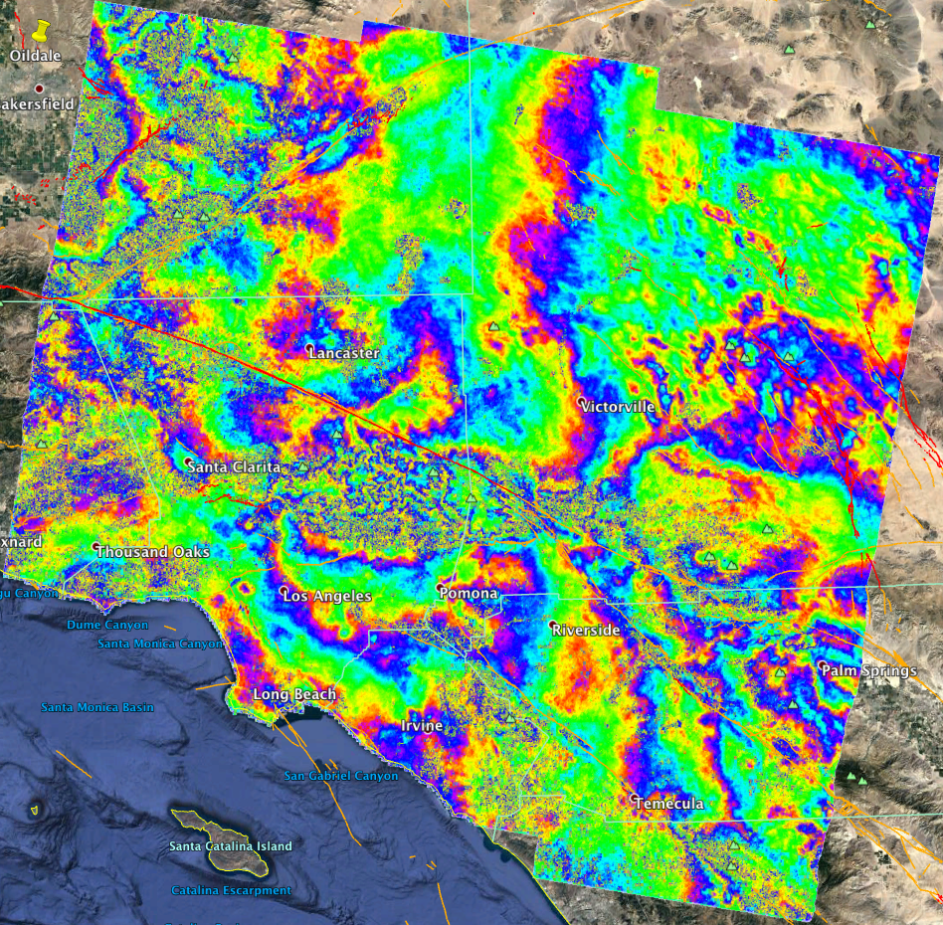
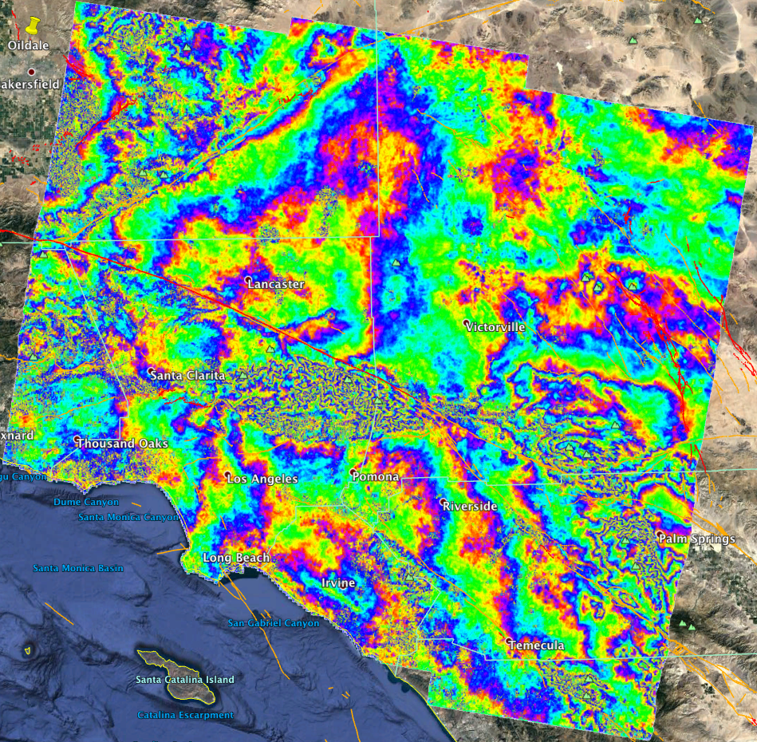
Overview
T71 – Phase P1: 20150725 P2: 20160812 P3:20170620
P12 P13 P23

Slide 3
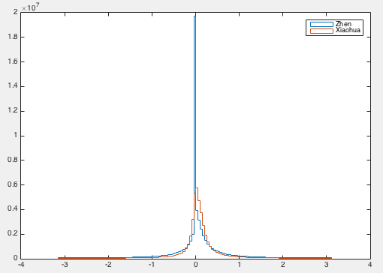
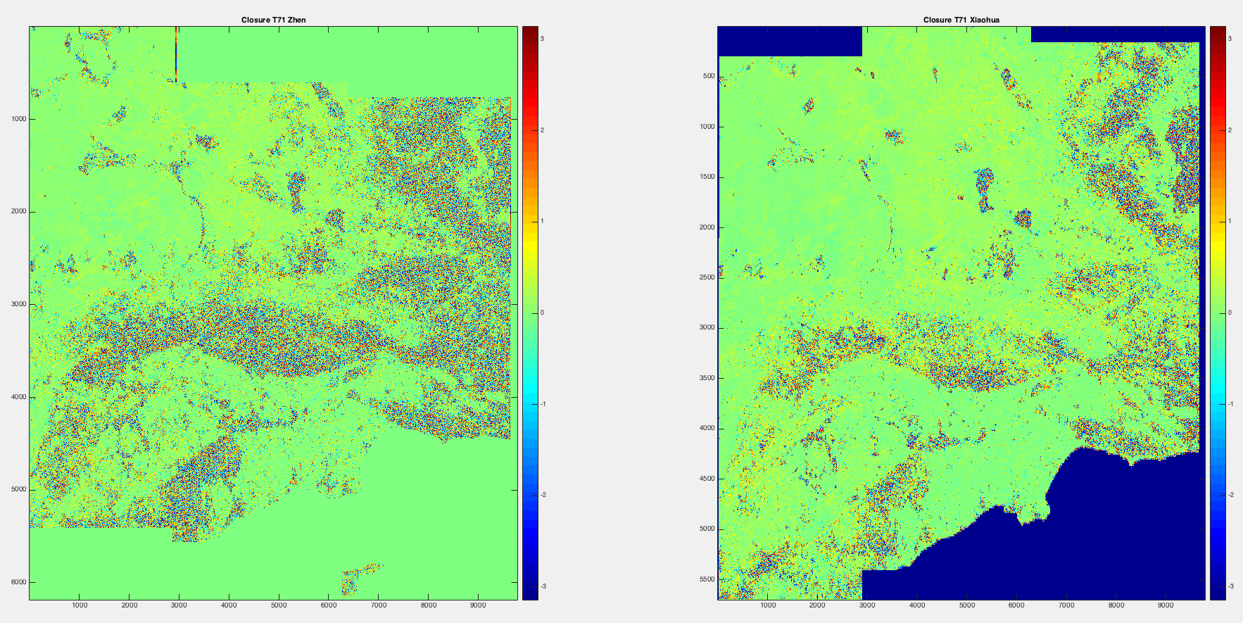
Some Comparisons
Zhen and Xiaohua -- T71 Closure Test on Phase

Slide 4
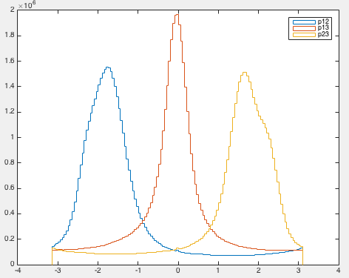
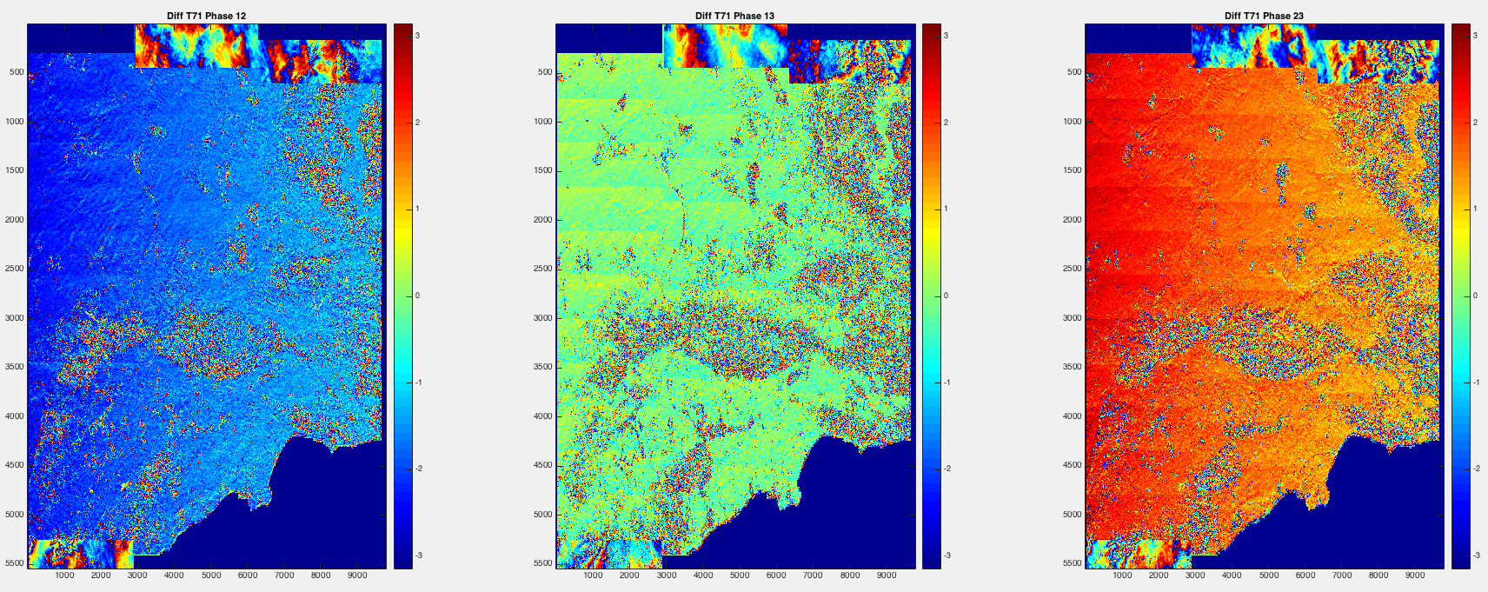
Some Comparisons
Zhen and Xiaohua -- T71 Phase (shifted by hand)
B_p = -69, -1, 68

Slide 5
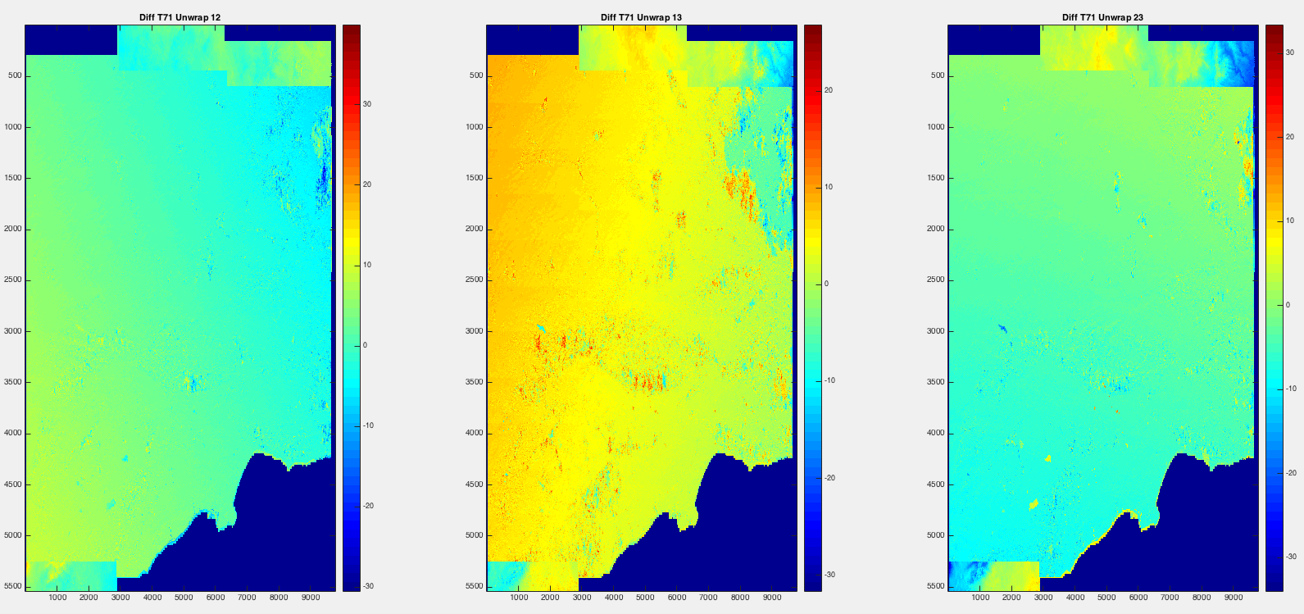
Some Comparisons
Zhen and Xiaohua – T71 Unwrap

Slide 6
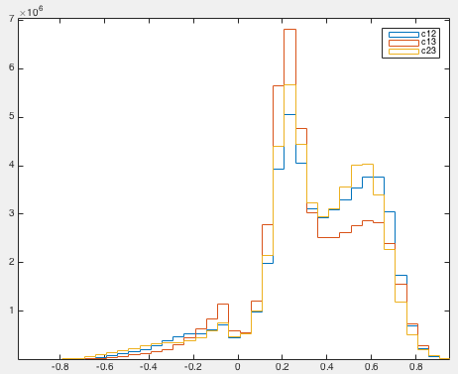
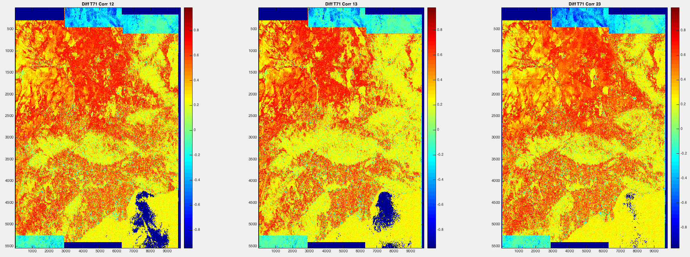
Some Comparisons
Zhen and Xiaohua – T71 Corr

Slide 7
Some Comparisons
Zhen and Xiaohua – T71 Pha-sig Corr v.s. Corr

Slide 8
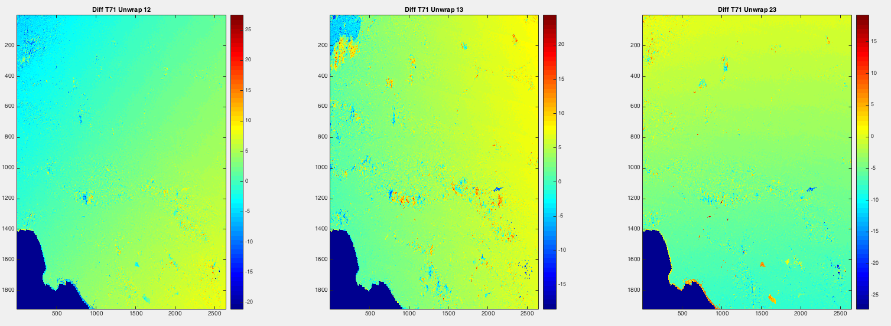
Some Comparisons
Zhen and Xiaohua – T71 Geo Unwrap

Slide 9
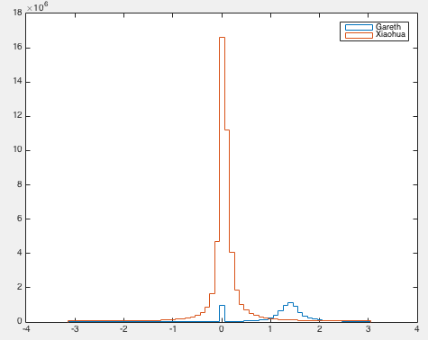
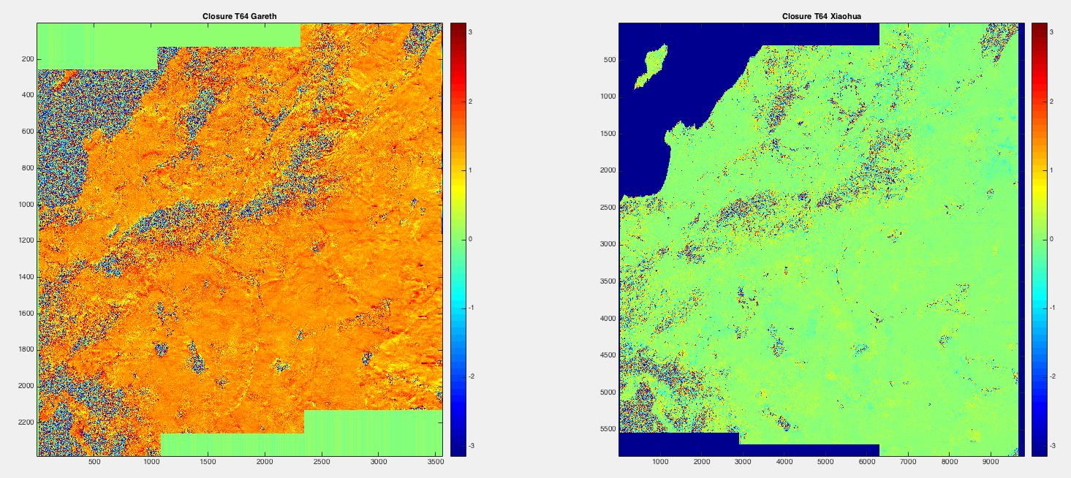
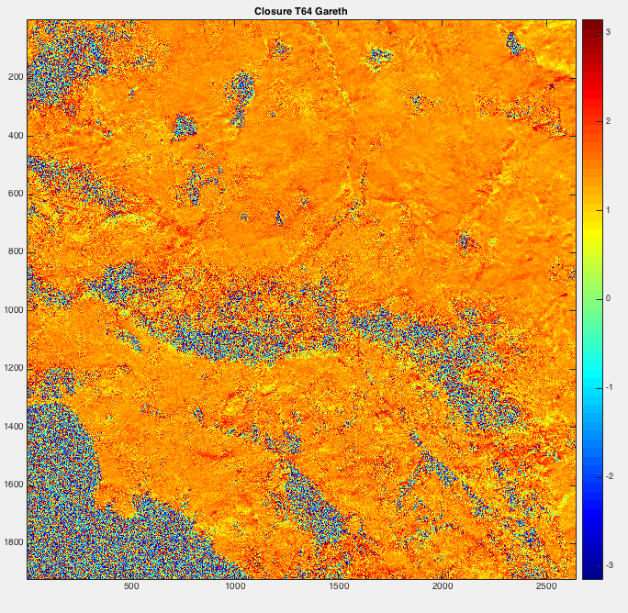
Some Comparisons
Gareth and Xiaohua – T64 Closure Unwrap

Slide 10
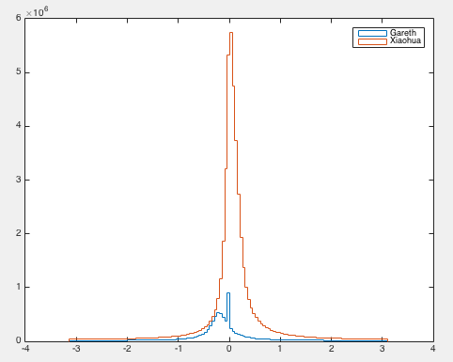
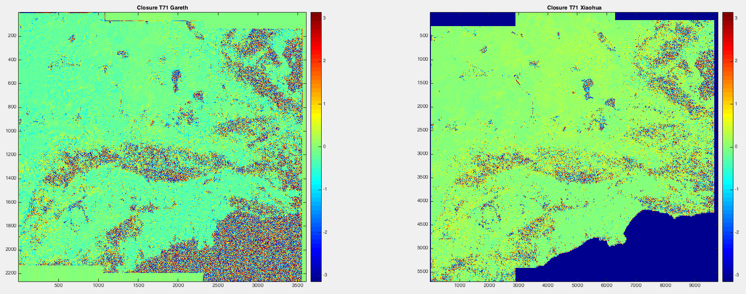
Some Comparisons
Gareth and Xiaohua – T71 Closure Unwrap

Slide 11
Some Comparisons
Gareth and Xiaohua and Zhen – T64 Geo Phase ??

Slide 12
Some Comparisons
Gareth and Xiaohua and Zhen– T71 Geo Phase ??

Slide 13
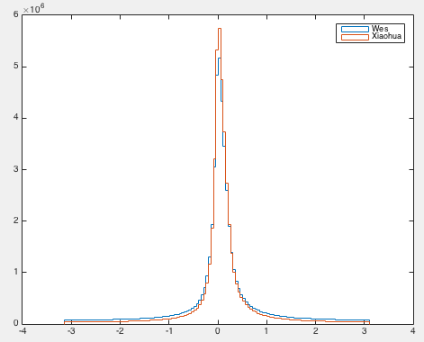
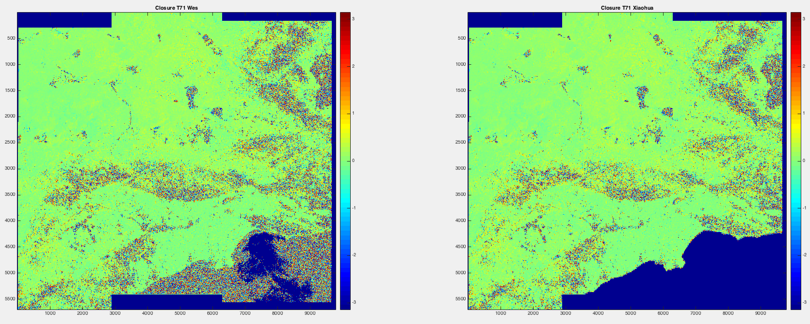
Some Comparisons
Wes and Xiaohua – T71 Closure

Slide 14
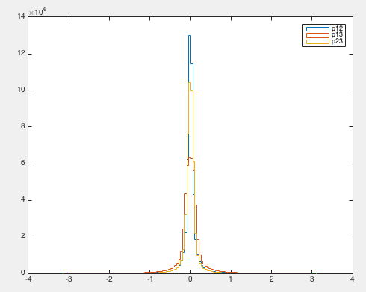
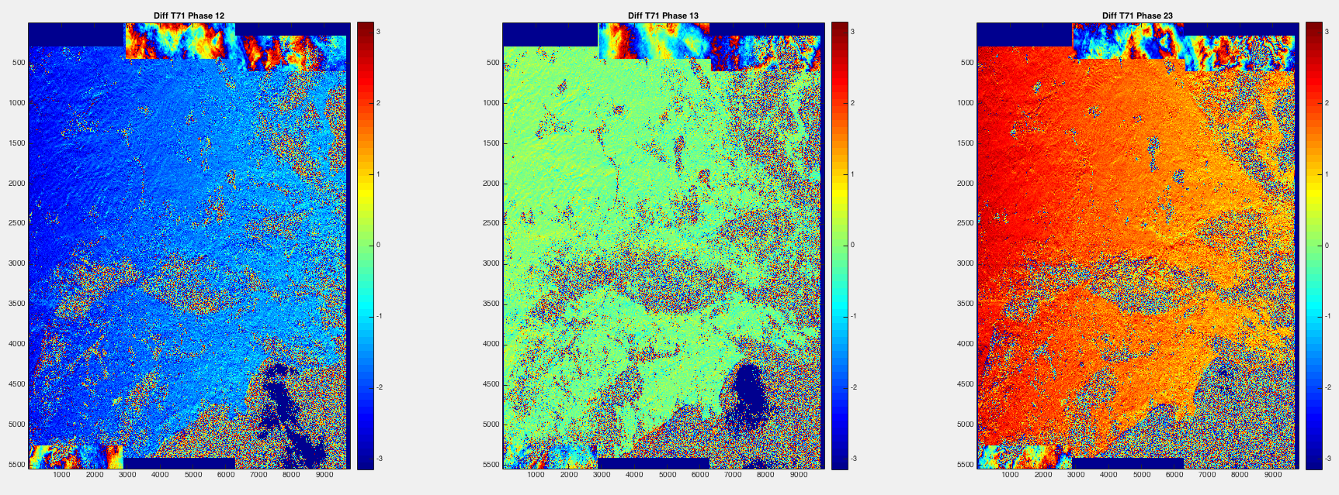
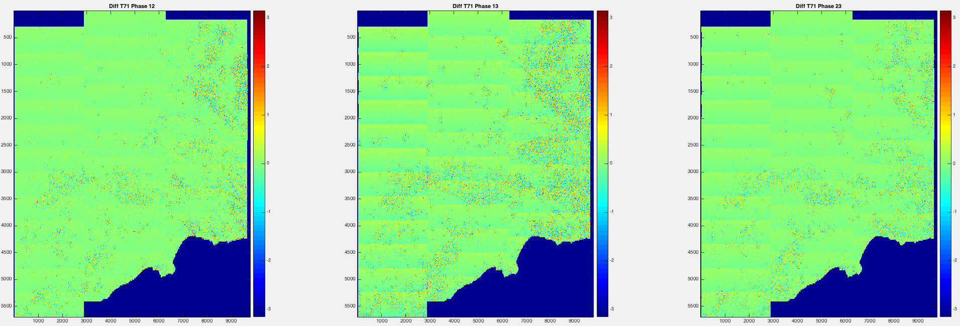
Some Comparisons
Wes and Xiaohua and Zhen – T71 Phase

Slide 15
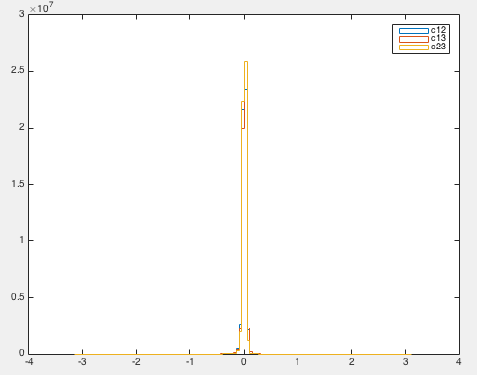
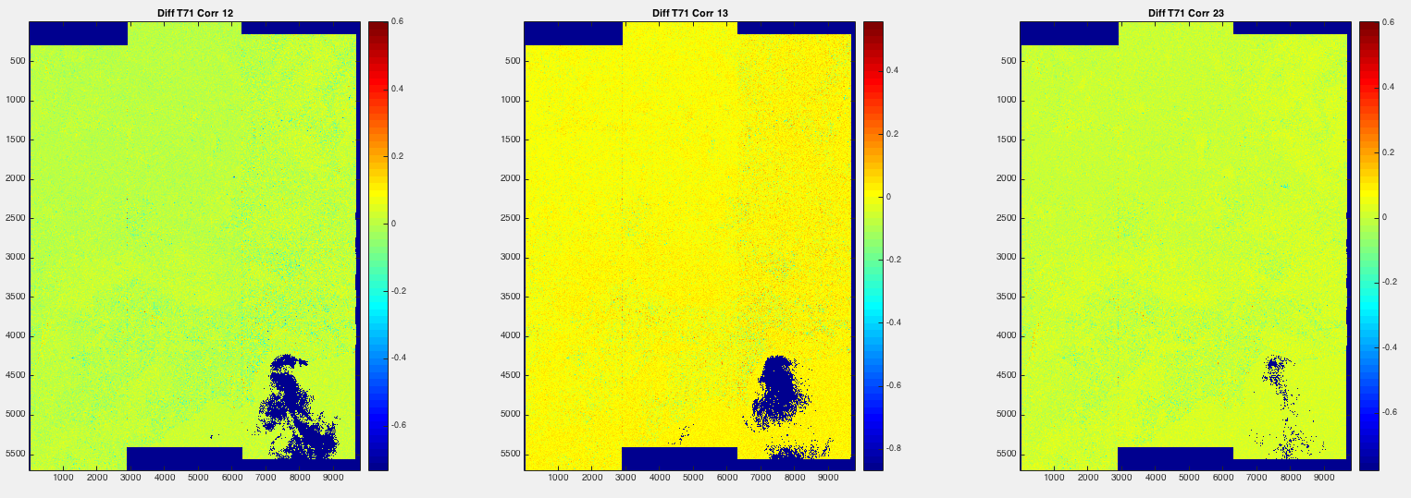
Some Comparisons
Wes and Xiaohua – T71 Corr

Slide 16
Some Thoughts
Possible reasons ISCE and GMTSAR does not agree (large scale ramp)
Precision of baseline computation ? (How is baseline computed?)
GMTSAR: ??
ISCE: ??
Residual range stretch when remove drho?
found this with a 40 intf long closure
added to phasediff (GMTSAR version 413 )
important for batch processing
most times you can get away on closure
supremaster
master
slave
Range shift
Range stretch along range?
Range stretch along azimuth?

Slide 17
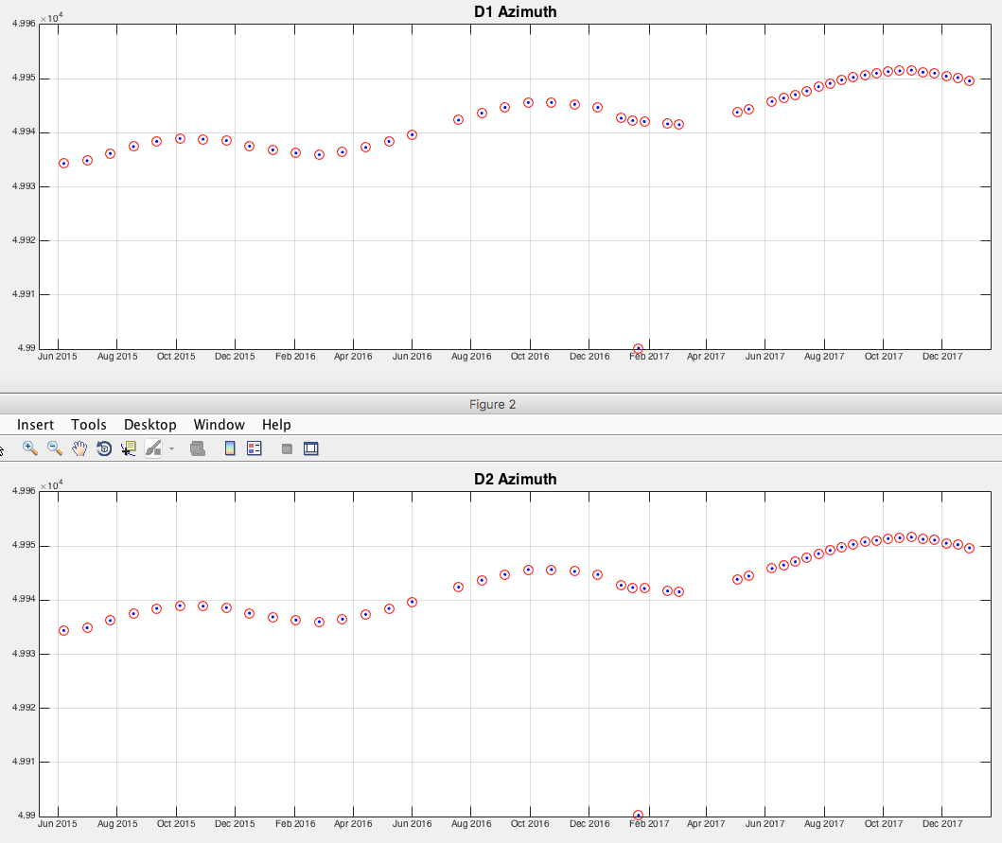
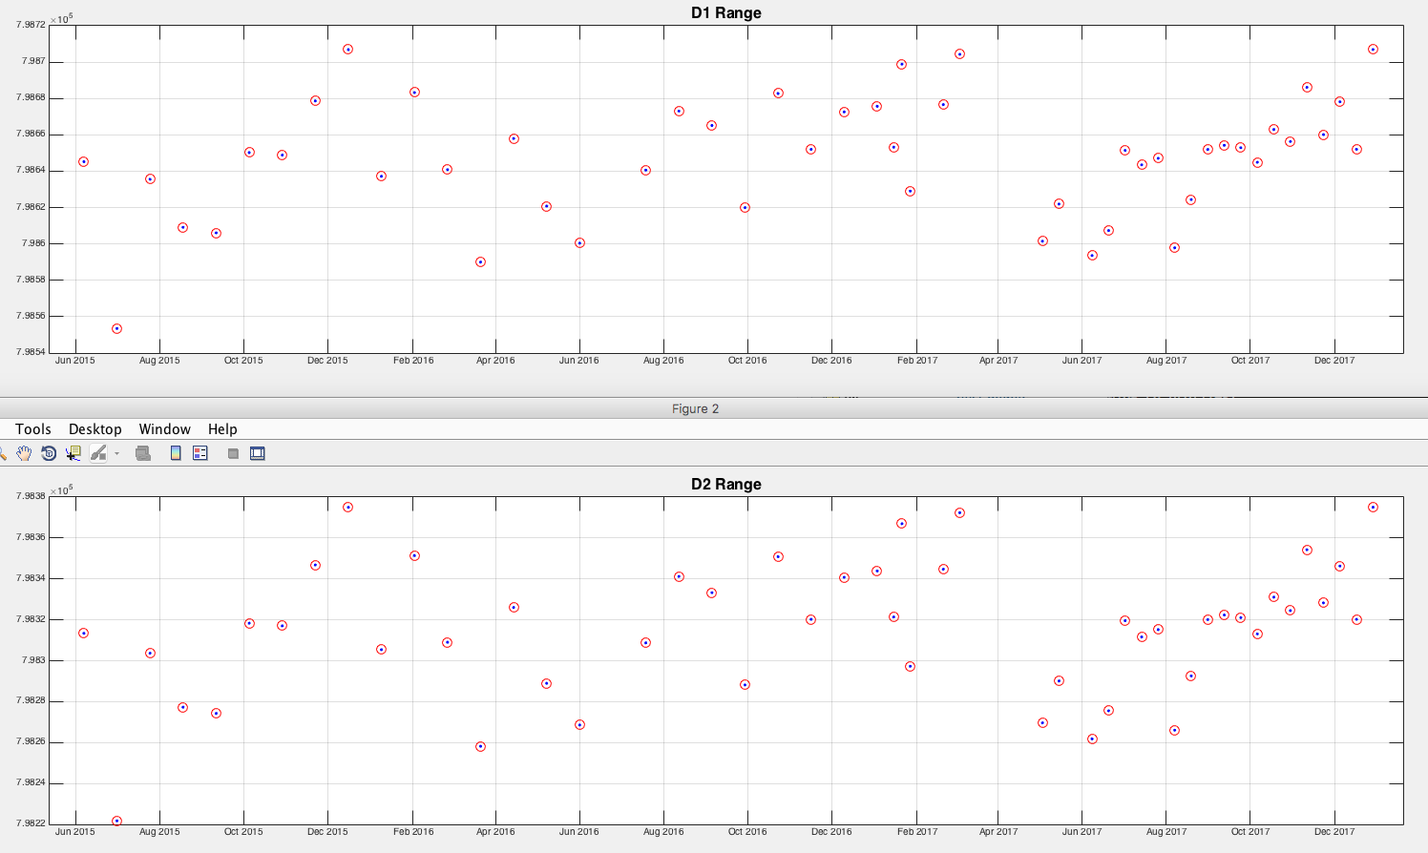
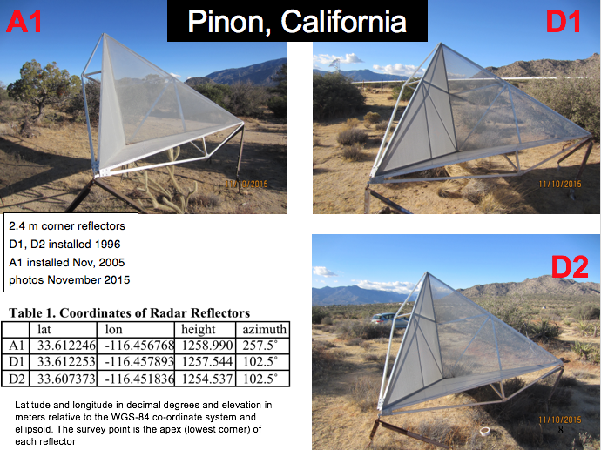
Ramp between ISCE and GMTSAR
Resolving the ramp between GMTSAR and ISCE Collaboration between Xiaohua, David (GMTSAR) and Piyush, Heresh (ISCE)

Slide 18
Some Comparisons
Resolving the ramp between GMTSAR and ISCE

Slide 19
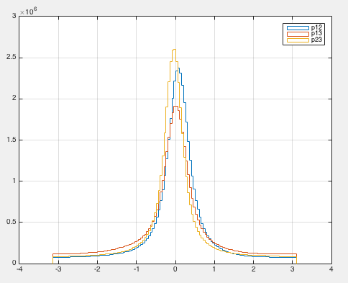
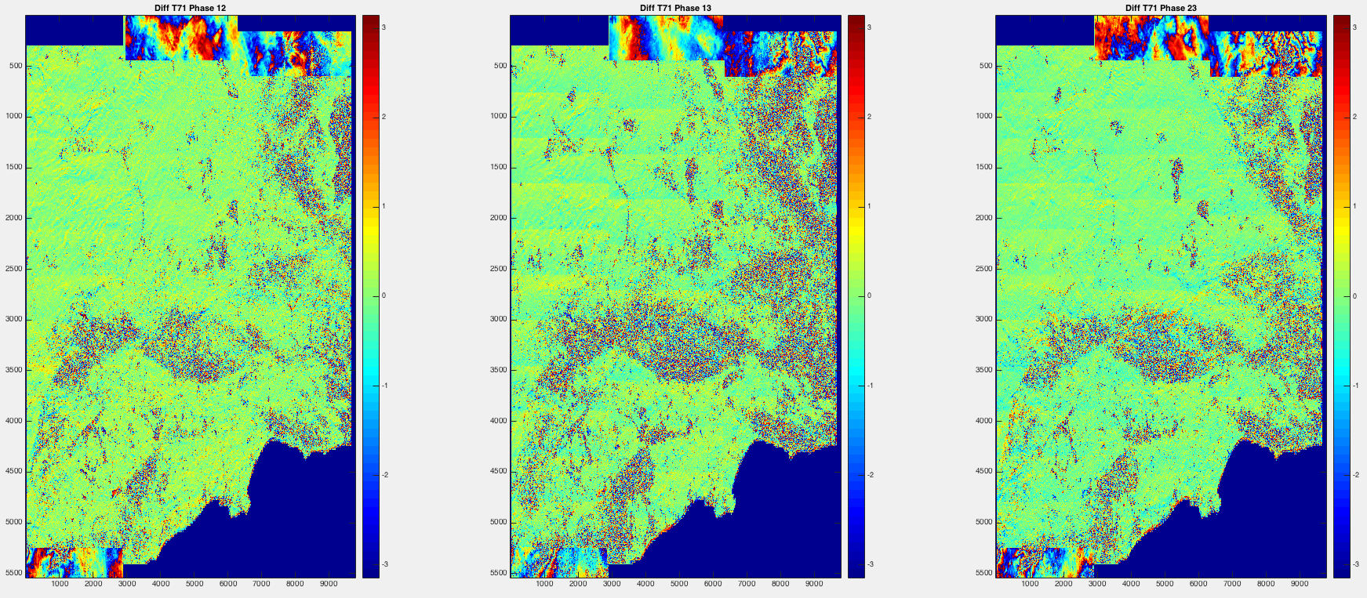
Some Comparisons
Zhen and Xiaohua -- T71 Phase (shifted by hand)

Slide 20
Some More Comparisons
Time Series (TS) Products
Zhen: TS for T71 and T64, no GPS correction -- ISCE
Xiaohua (Eric): TS for T71 and T64, all available GPS -- GMTSAR
Wes: Same as Eric on T71 (ESD) and different method -- GMTSAR
Kang: Velocity of T71 and T64 + APS -- GMTSAR+MATLAB
Have comparisons using 5(6) positions with GPS and 5 random positions without GPS

Slide 21
Q & A Xiaohua Xu:
Start your discussion with a brief overview of how your time series were constructed:
What interferograms were used? Selected intfs based on 150m baseline 90 day temporal baseline 232 intfs for T71 and 434 intfs for T64
How did you unwrap the phase? Masked water, did neareast neighbor interpolation and unwrapped with SNAPHU
Were GPS data, or a GPS velocity model, used to flatten the interferograms? Generated a GPS model with GMT gpsgridder, combined with InSAR
How did you construct the time series (e.g., spas, PS, . . .)? Coherence-based SBAS with atmospheric correction + combinantion with GPS model
How do the results compare with the GPS time series? Next slides
What about the time series in the locations with no GPS data ? Next next slides

Slide 22
Combining InSAR and GPS Algorithm Xiaohua Xu:
Assume we have unwrapped and ambiguity-corrected phase.
Create horizontal GPS model with GMT gpsgridder using PBO horizontal velocity vectors (converted to ITRF)
Project H-GPS model to LOS
Remove H-GPS model from InSAR LOS velocity
Remove elevation dependent signal (masking out parts that has strong vertical, e.g. central valley)
Compute difference between LOS residual velocity and V-GPS data at each station, interpolate this difference and remove from the LOS residual velocity
Restore H-GPS model
Calibrate the time-series with velocity change from the correction

Slide 23
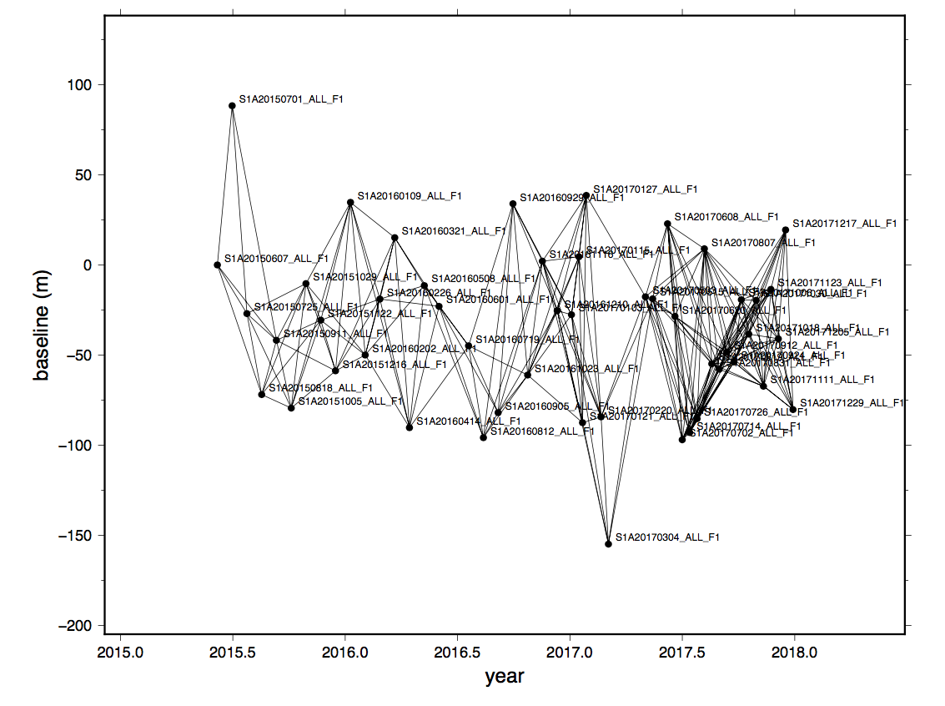
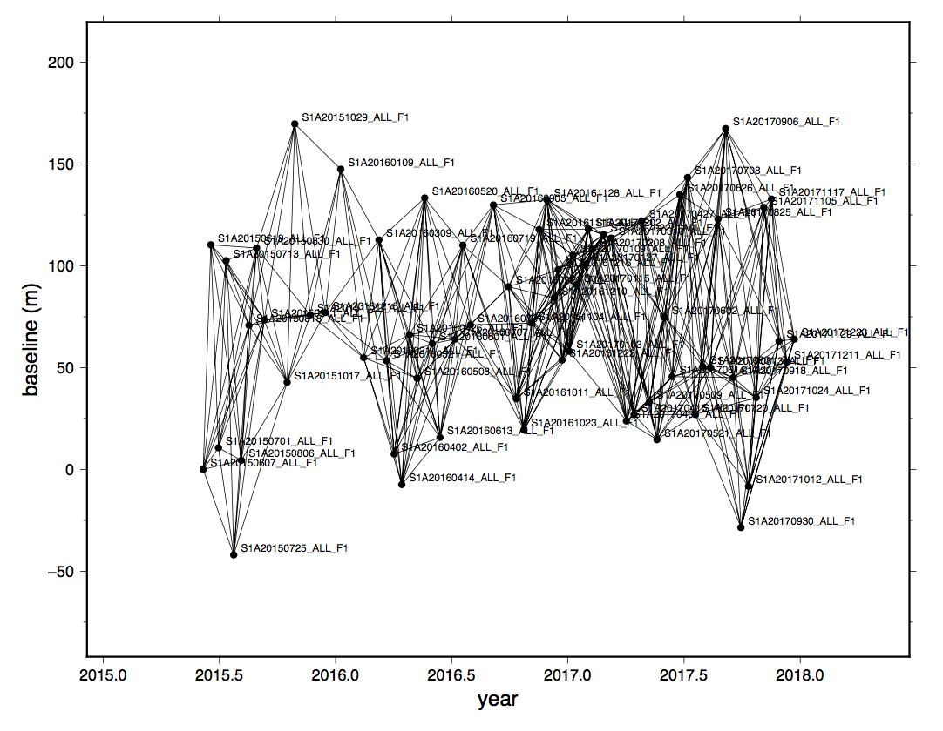
T71
T64

Slide 24
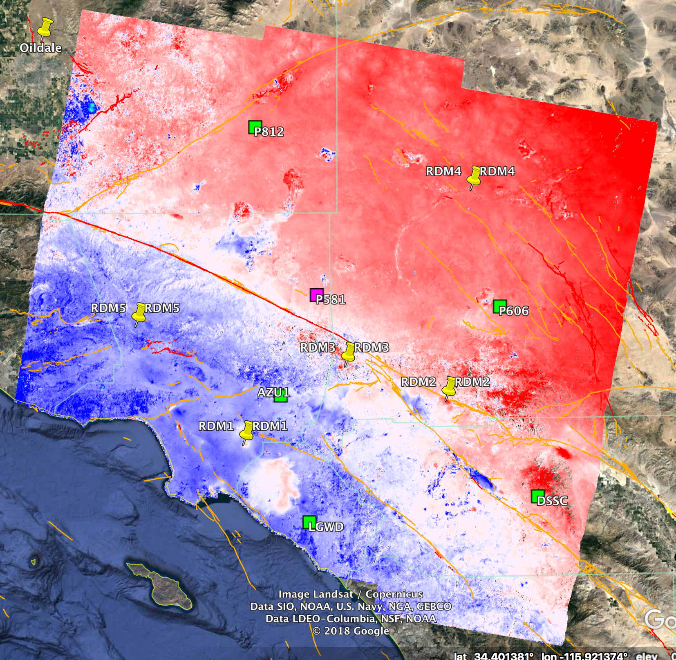
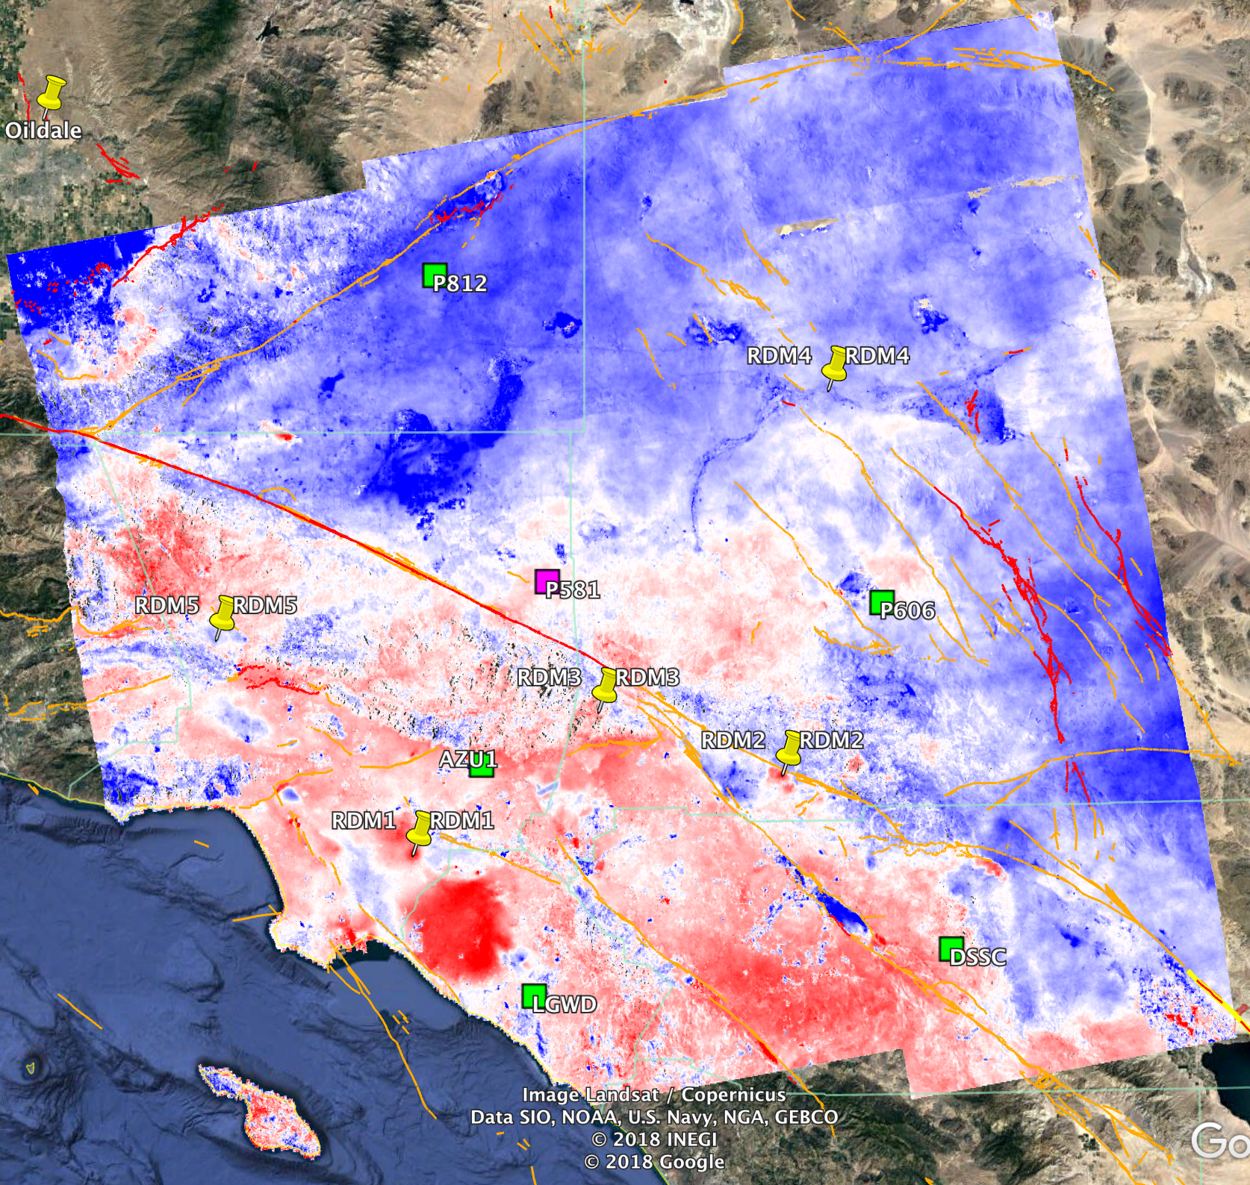
Time Series Comparison
Overview – LOS Velocity in ITRF
Blue - Red [-5 -35] mm/yr
Blue - Red [8 28] mm/yr
T71 ~6:00am
T64 ~6:00pm

Slide 25
Q & A Zhen Liu:
Stack processor in ISCE [Heresh et al., 2017]
Unwrap – mcf
Filtering strength: 0.5
Time series method: SBAS with DEM error correction, and spatial and temporal filtering; coherence threshold: 0.5.
Time series done in geo-coordinates in the box region
Spatial spacing: 0.001 deg in geocoded interferograms
GPS data or GPS velocity model are not used in the processing or time series analysis (Pinned Down P581?)

Slide 26
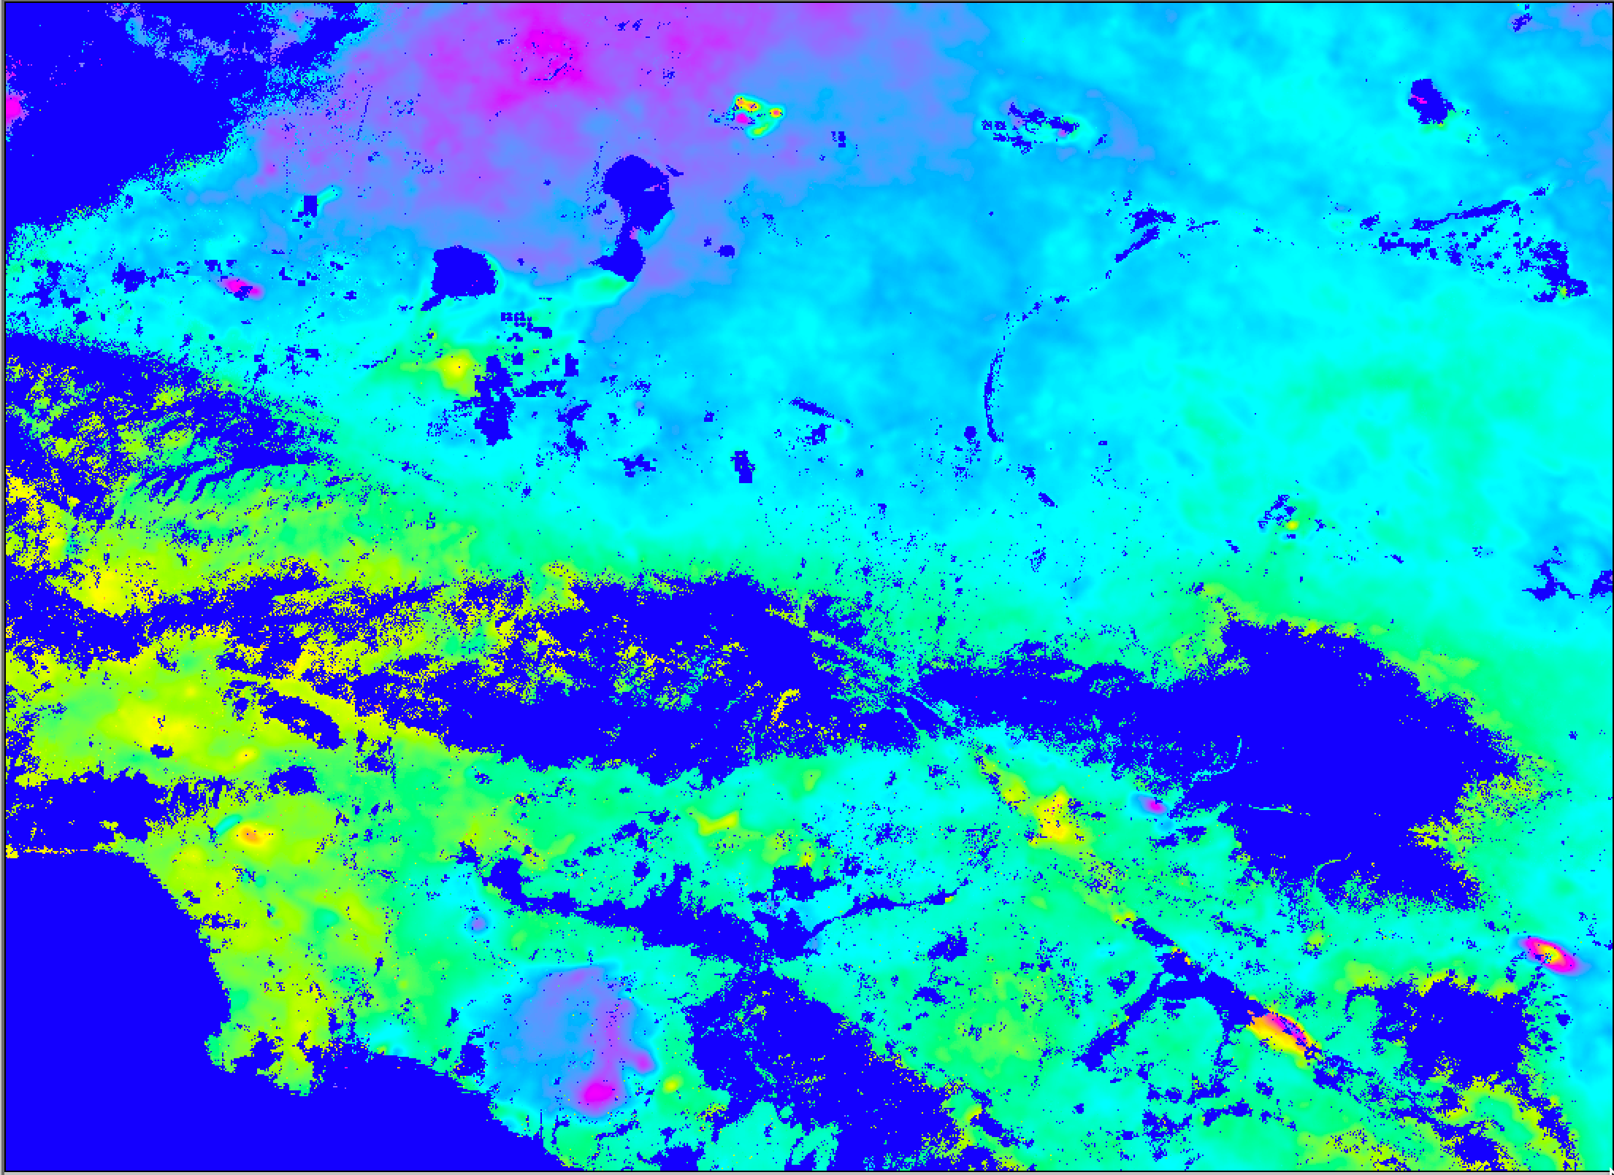
D71
Average velocity
Zhen Liu
Wrapped at 3cm/yr

Slide 27
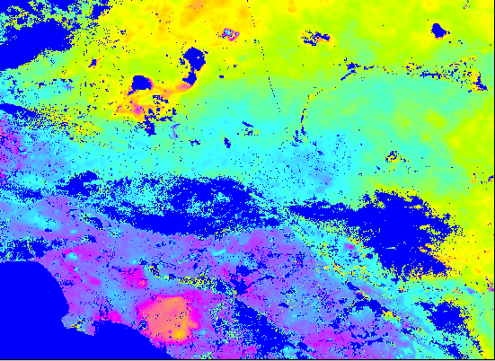
A64
average velocity
Zhen Liu
Wrapped at 3cm/yr

Slide 28
Q & A Wesley Neely
GMTSAR: v5.22
Master: 20160719
ESD
Filter wavelength: 300 m
Range_dec: 7
Azimuth_dec: 3
Threshold_snaphu: 0.05
Defomax: 0.0001
Threshold_geocode: 0.01
Perpendicular baseline: < 250 m
Temporal baseline: 50 days

Slide 29
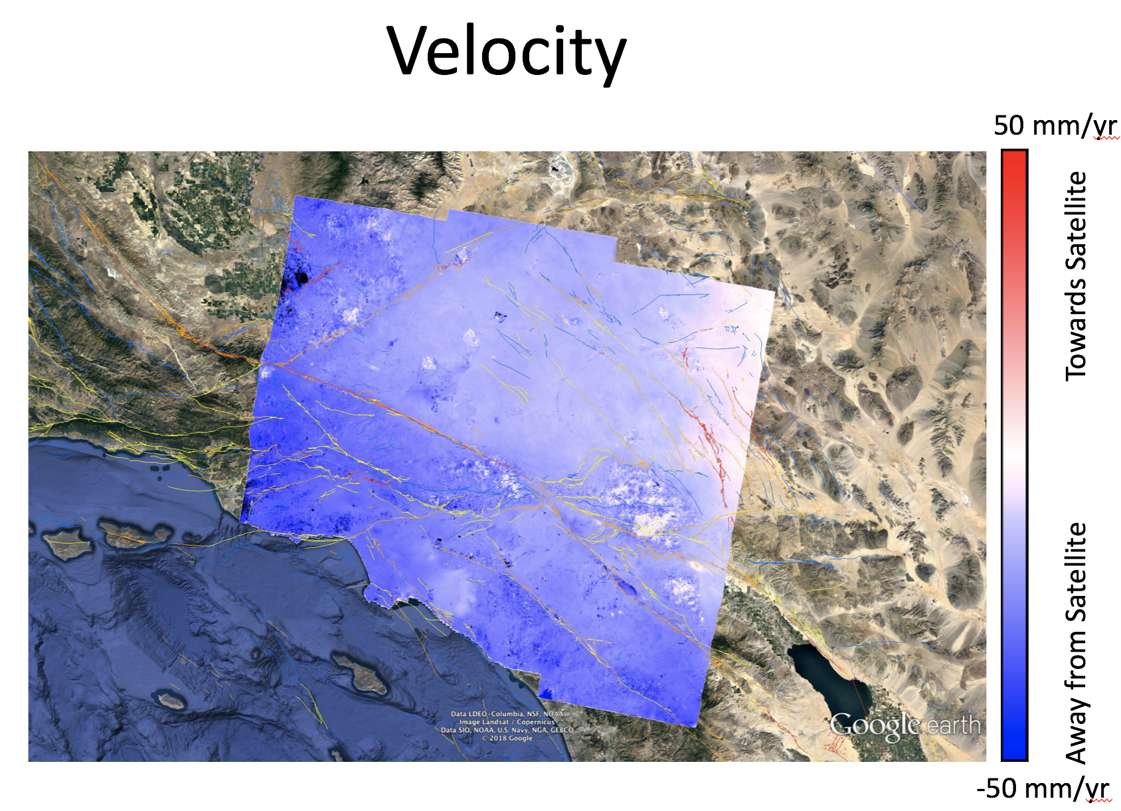
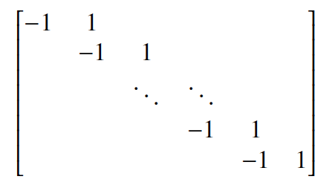
Wesley Neely
Background
Methodology
Results
Conclusions
Modified Argus method applied to suite of interferograms (276) and used for recovering the temporal evolution of surface deformation at every pixel.
+
=
L₁ =

Slide 30
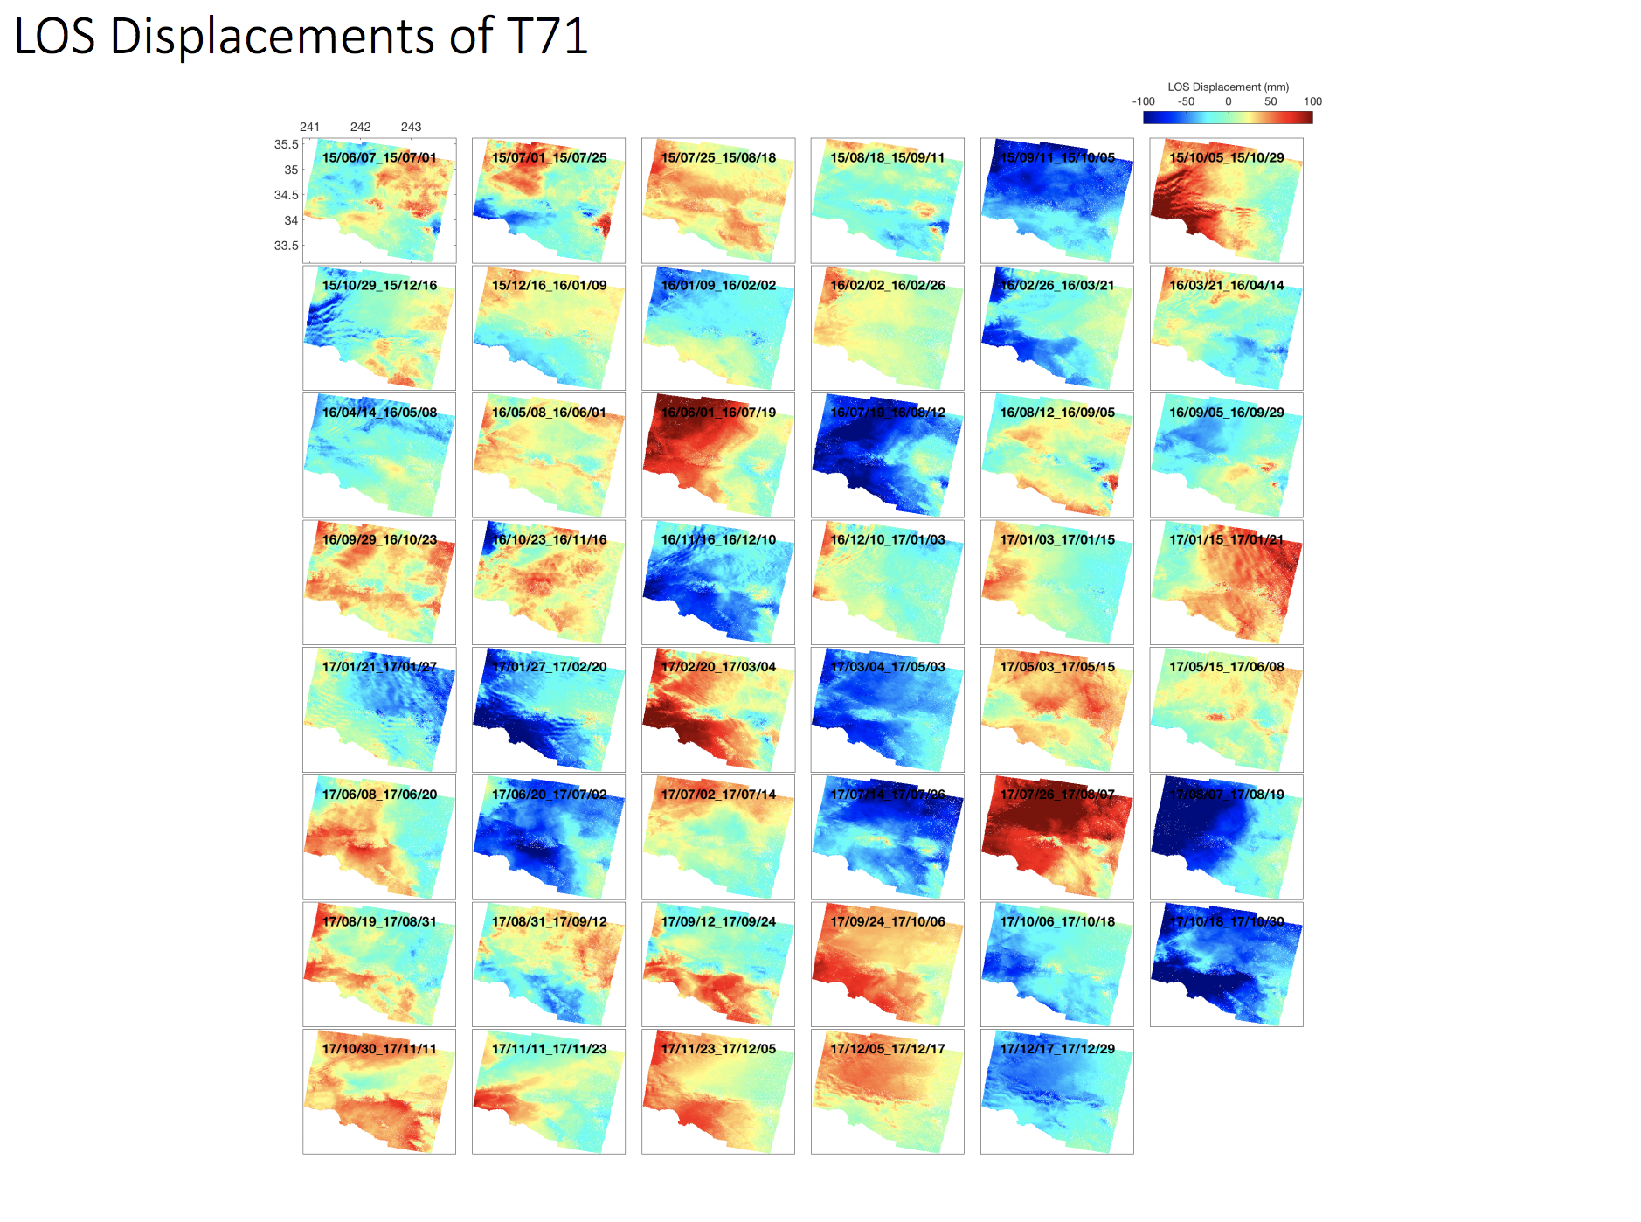
Kang Wang

Slide 31
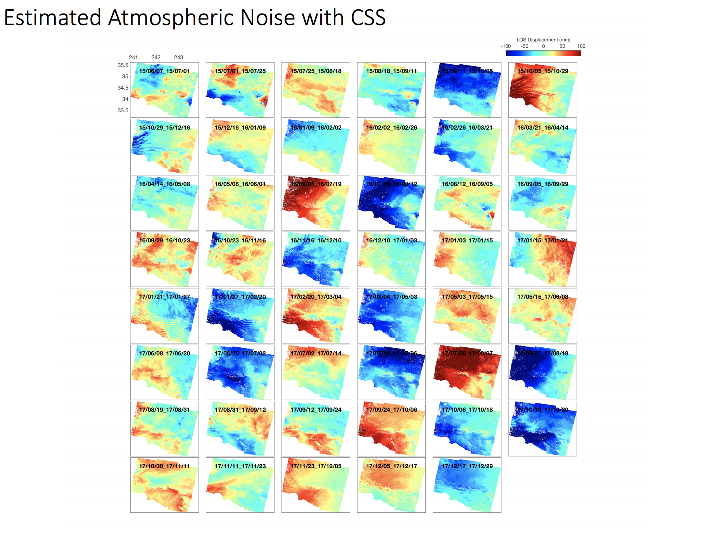
Kang Wang

Slide 32
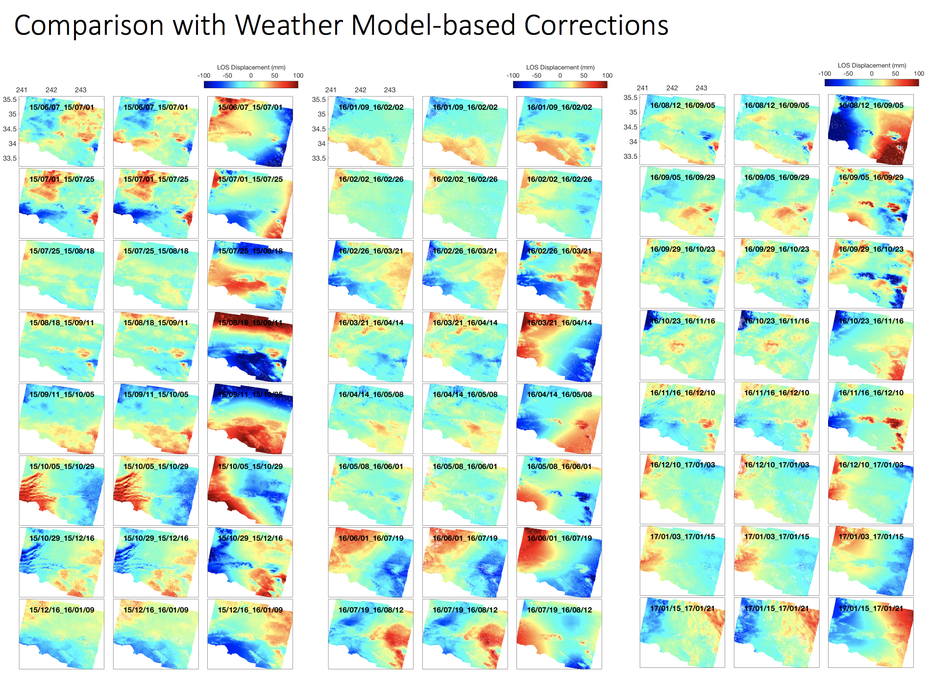
Kang Wang

Slide 33
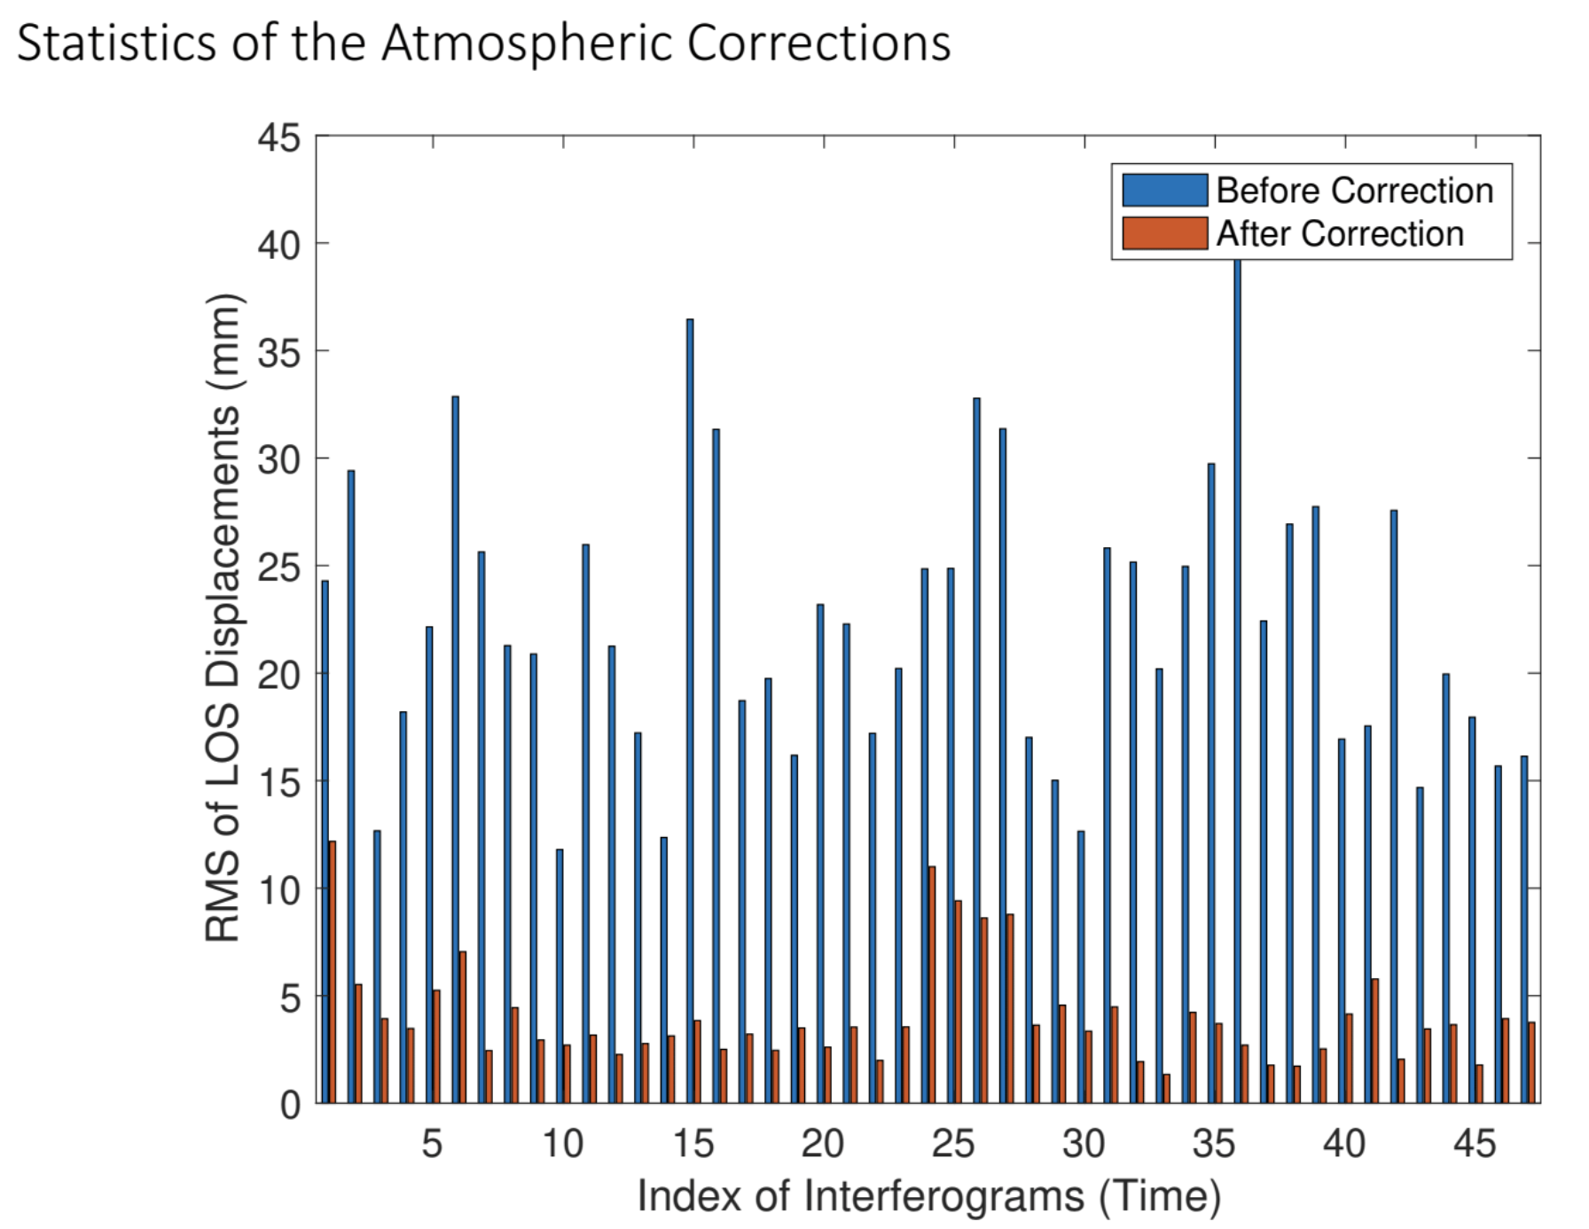
Kang Wang

Slide 34
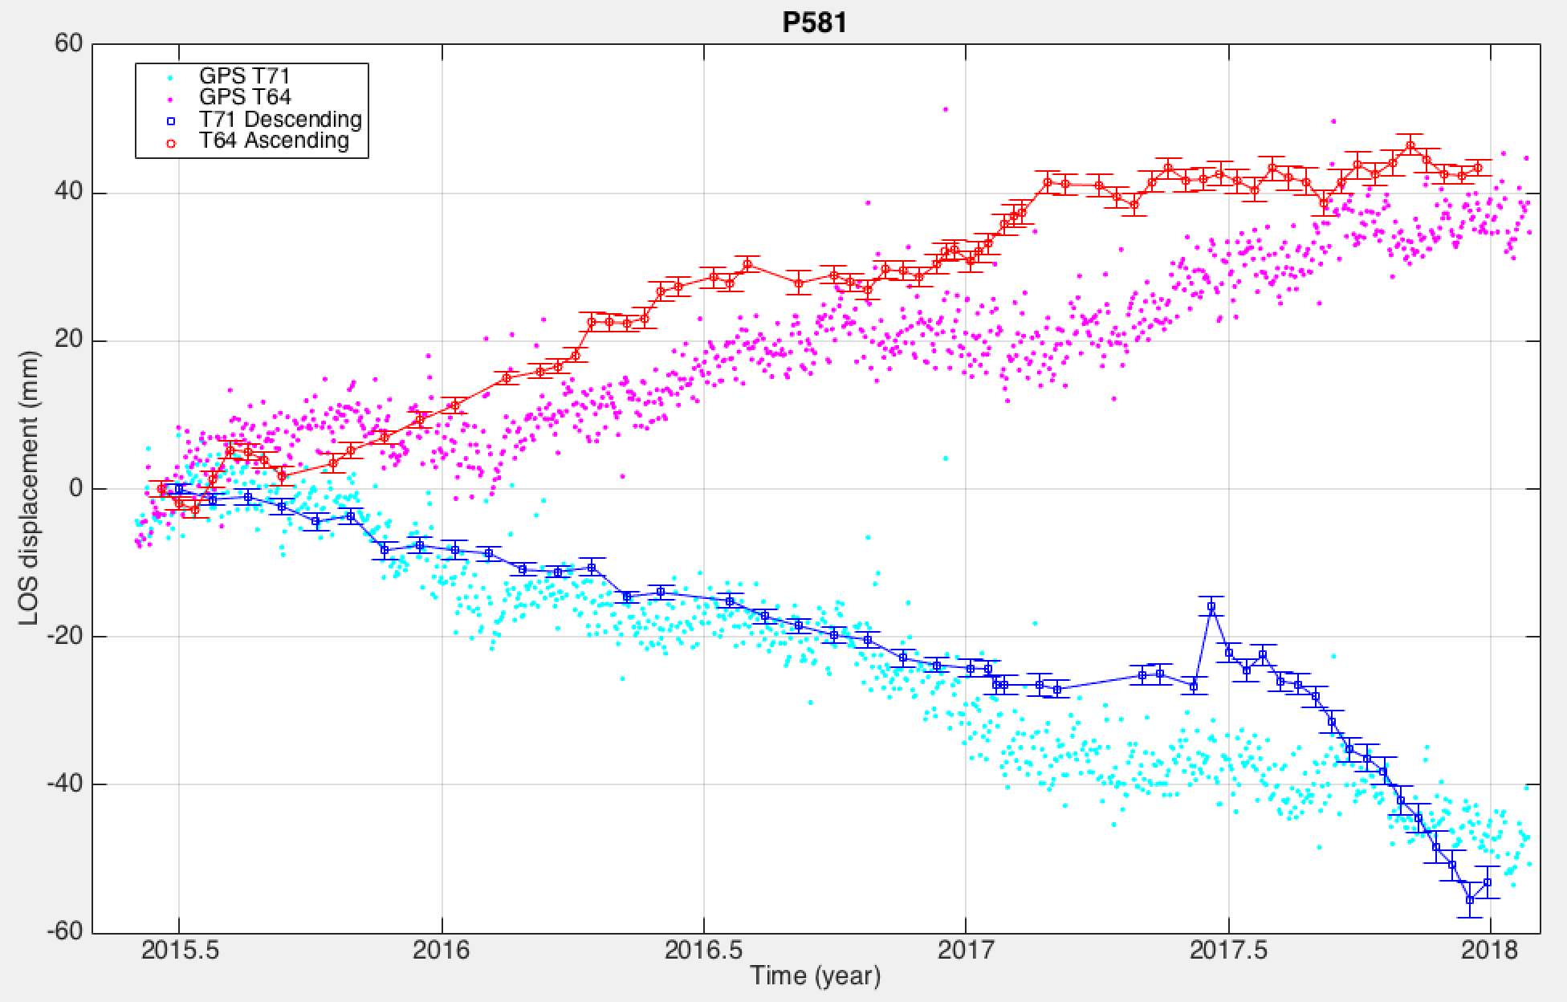
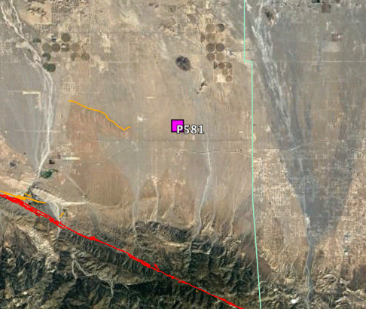
Time Series Comparison
Comparison with GPS – P581

Slide 35
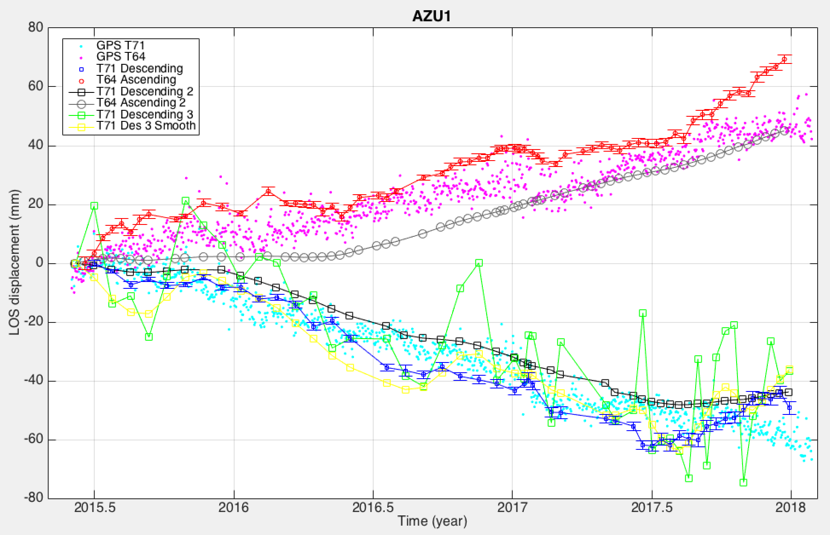
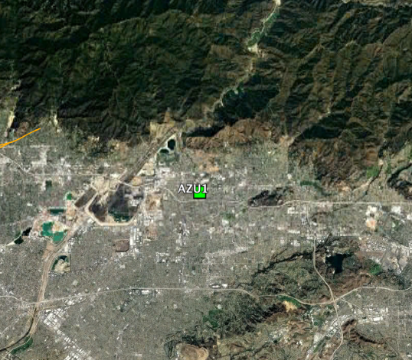
Time Series Comparison
Comparison with GPS – AZU1

Slide 36
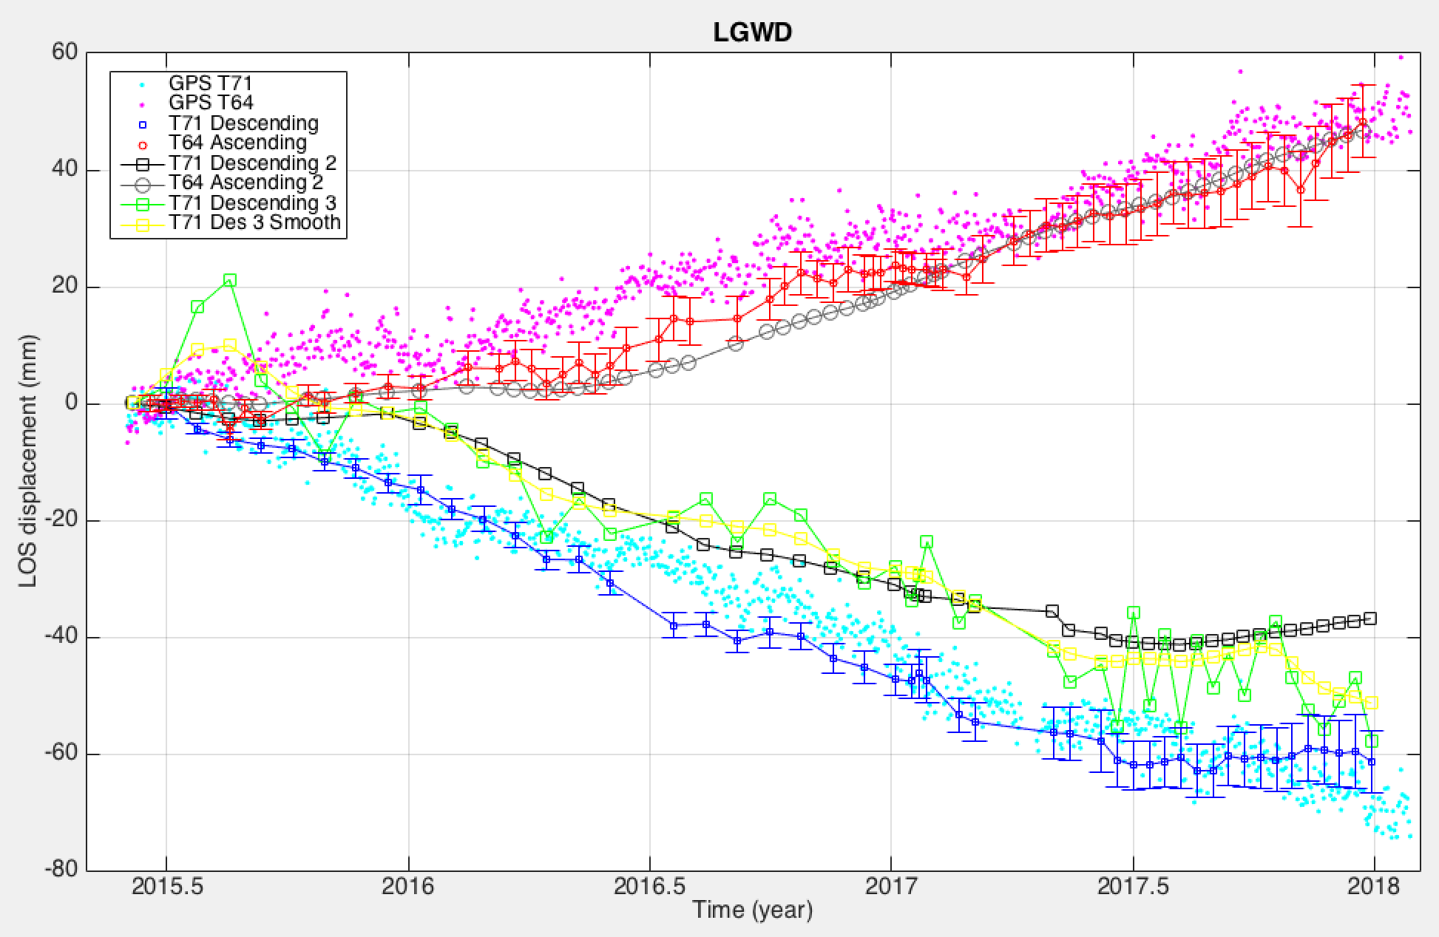
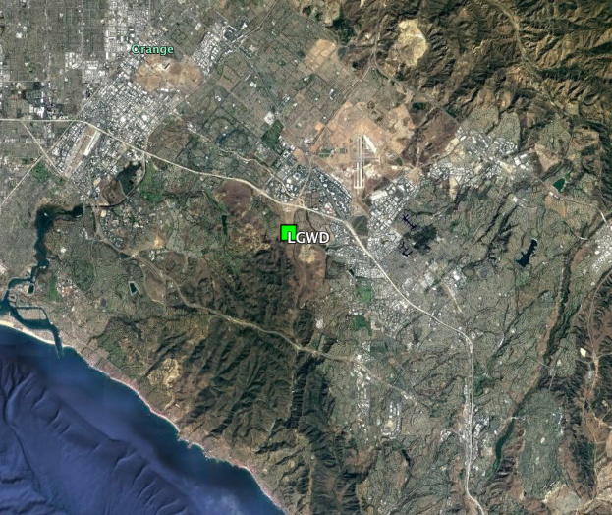
Time Series Comparison
Comparison with GPS – LGWD

Slide 37
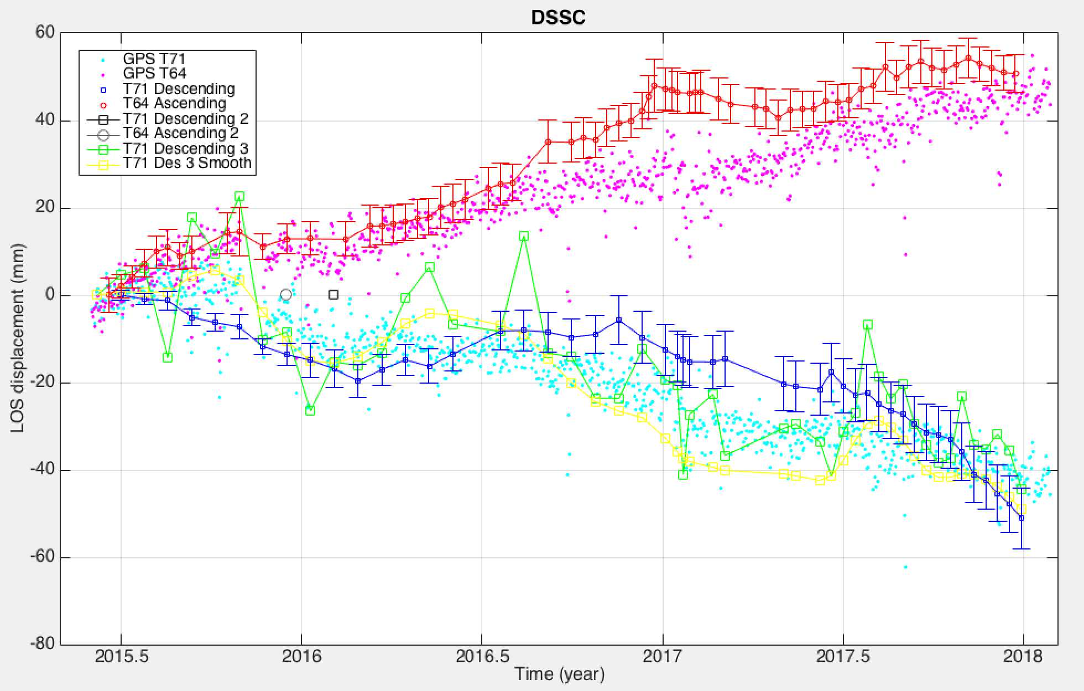
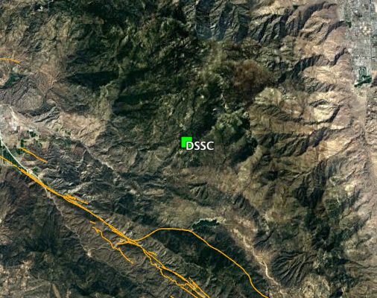
Time Series Comparison
Comparison with GPS – DSSC snow?

Slide 38
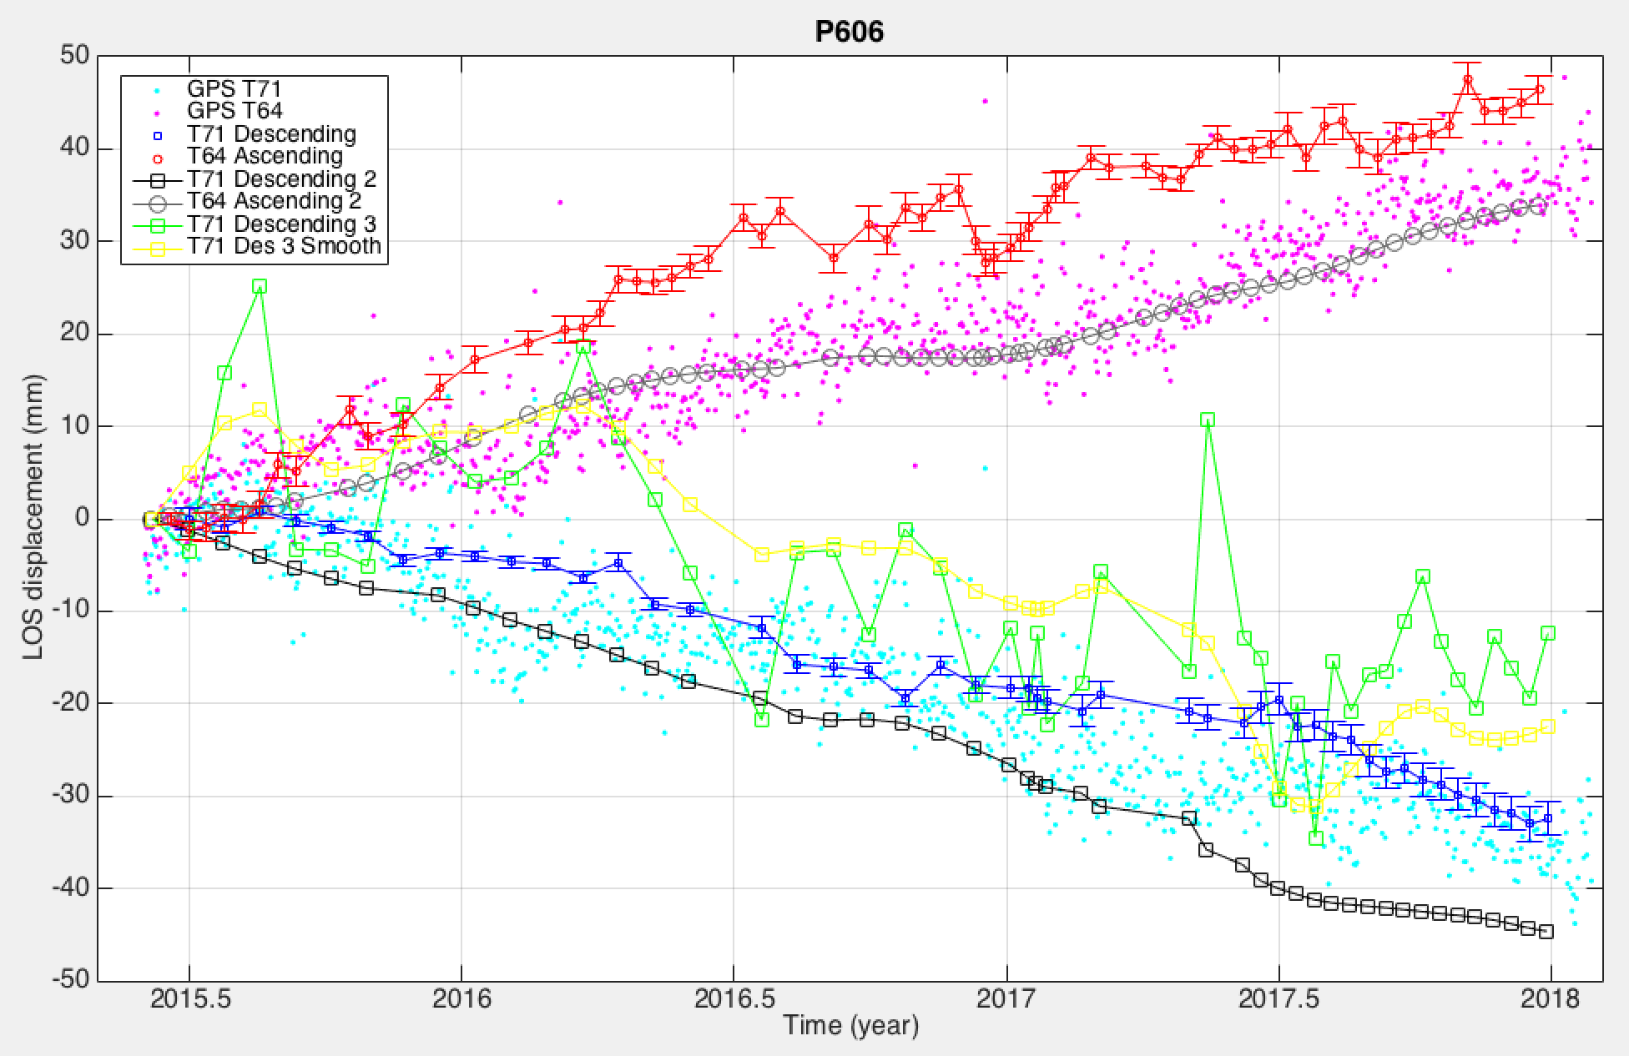
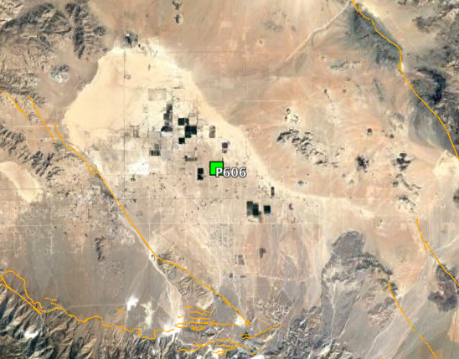
Time Series Comparison
Comparison with GPS – P606

Slide 39
Time Series Comparison
Comparison with GPS – P812

Slide 40
Time Series Comparison
InSAR only RDM1

Slide 41
Time Series Comparison
InSAR only RDM2

Slide 42
Time Series Comparison
InSAR only RDM3 snow?

Slide 43
Time Series Comparison
InSAR only RDM4

Slide 44
Time Series Comparison
InSAR only RDM5

Slide 46
D71 – comparison with GPS LOS time series
DSSC
P812
LGWD
P606
AZU1
- GPS time series are with regard to P581

Slide 47
D71 – output at RDM1-5
RDM1
RDM2
RDM3
RDM4
RDM5

Slide 48
A64 – comparison with GPS LOS time series
DSSC
P812
LGWD
P606
AZU1

Slide 49
A64 – output at RDM1-5
RDM1
RDM2
RDM3
RDM4
RDM5

