Slide 1
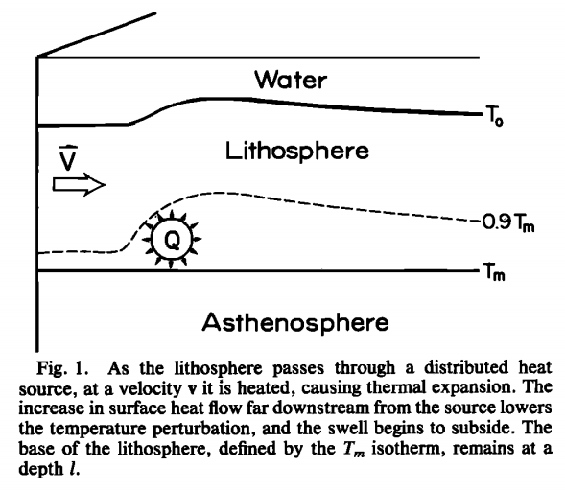
HEAT FLOW DUE TO PLUME
Sandra Slead
Madison Ghiz

Slide 2
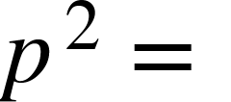
TEMPERATURE & SURFACE HEAT FLOW
FOR SOURCE THAT VARIES AS A GAUSSIAN FUNCTION
TEMPERATURE
x = (x,y)
k = (k_{x},k_{y})
(1)
(2)
Fourier Transform of (2)

Slide 3
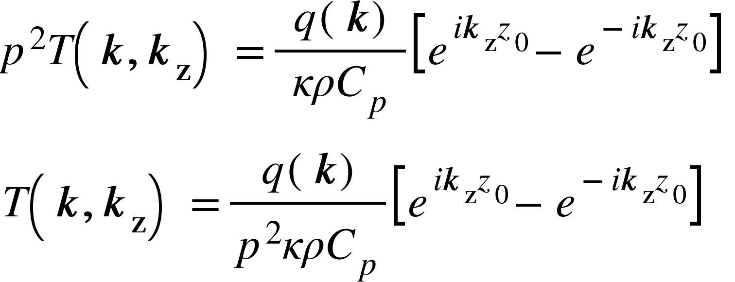
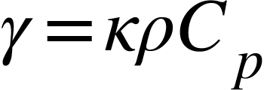
TEMPERATURE & SURFACE HEAT FLOW
FOR SOURCE THAT VARIES AS A GAUSSIAN FUNCTION
(3)
Inverse Fourier Transform of (3) in k_{z} direction only
(4)
Solve for (4), with poles at -ip, ip
(5)

Slide 4
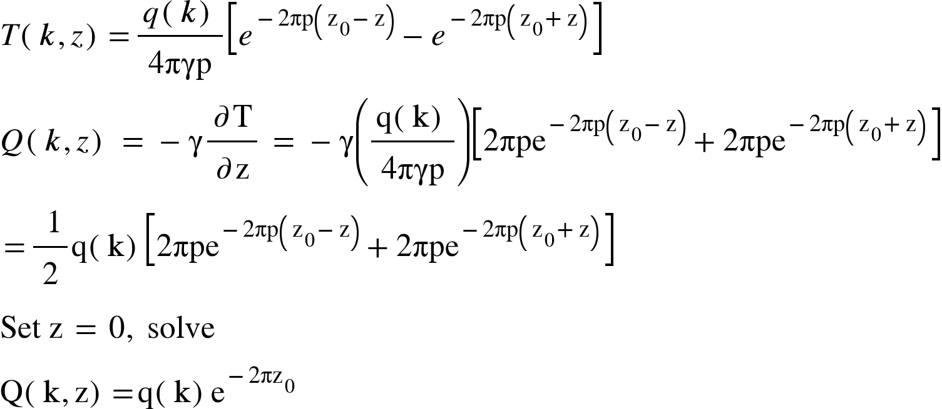
TEMPERATURE & SURFACE HEAT FLOW
FOR SOURCE THAT VARIES AS A GAUSSIAN FUNCTION
SURFACE HEAT FLOW

Slide 5
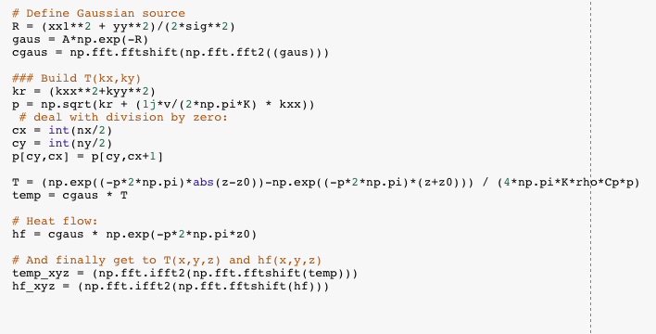
Python Code
https://colab.research.google.com/drive/1JH3s182ZDOK9InWAEHc1UAIkID5O0dpM
Parameters used:
plate velocity (v):
2.566e-8 m/second
(speed of Pacific plate)
thermal diffusivity (K) :
10e-6 m^2/second
density (rho):
3300 kg/m^3
(typical value for the mantle)
specific heat (Cp):
1172 Watts*seconds
(typical value for granite)
half-width of source (sig):
100 km
Strength of source (A):
0.94 Watts/m^3

Slide 6
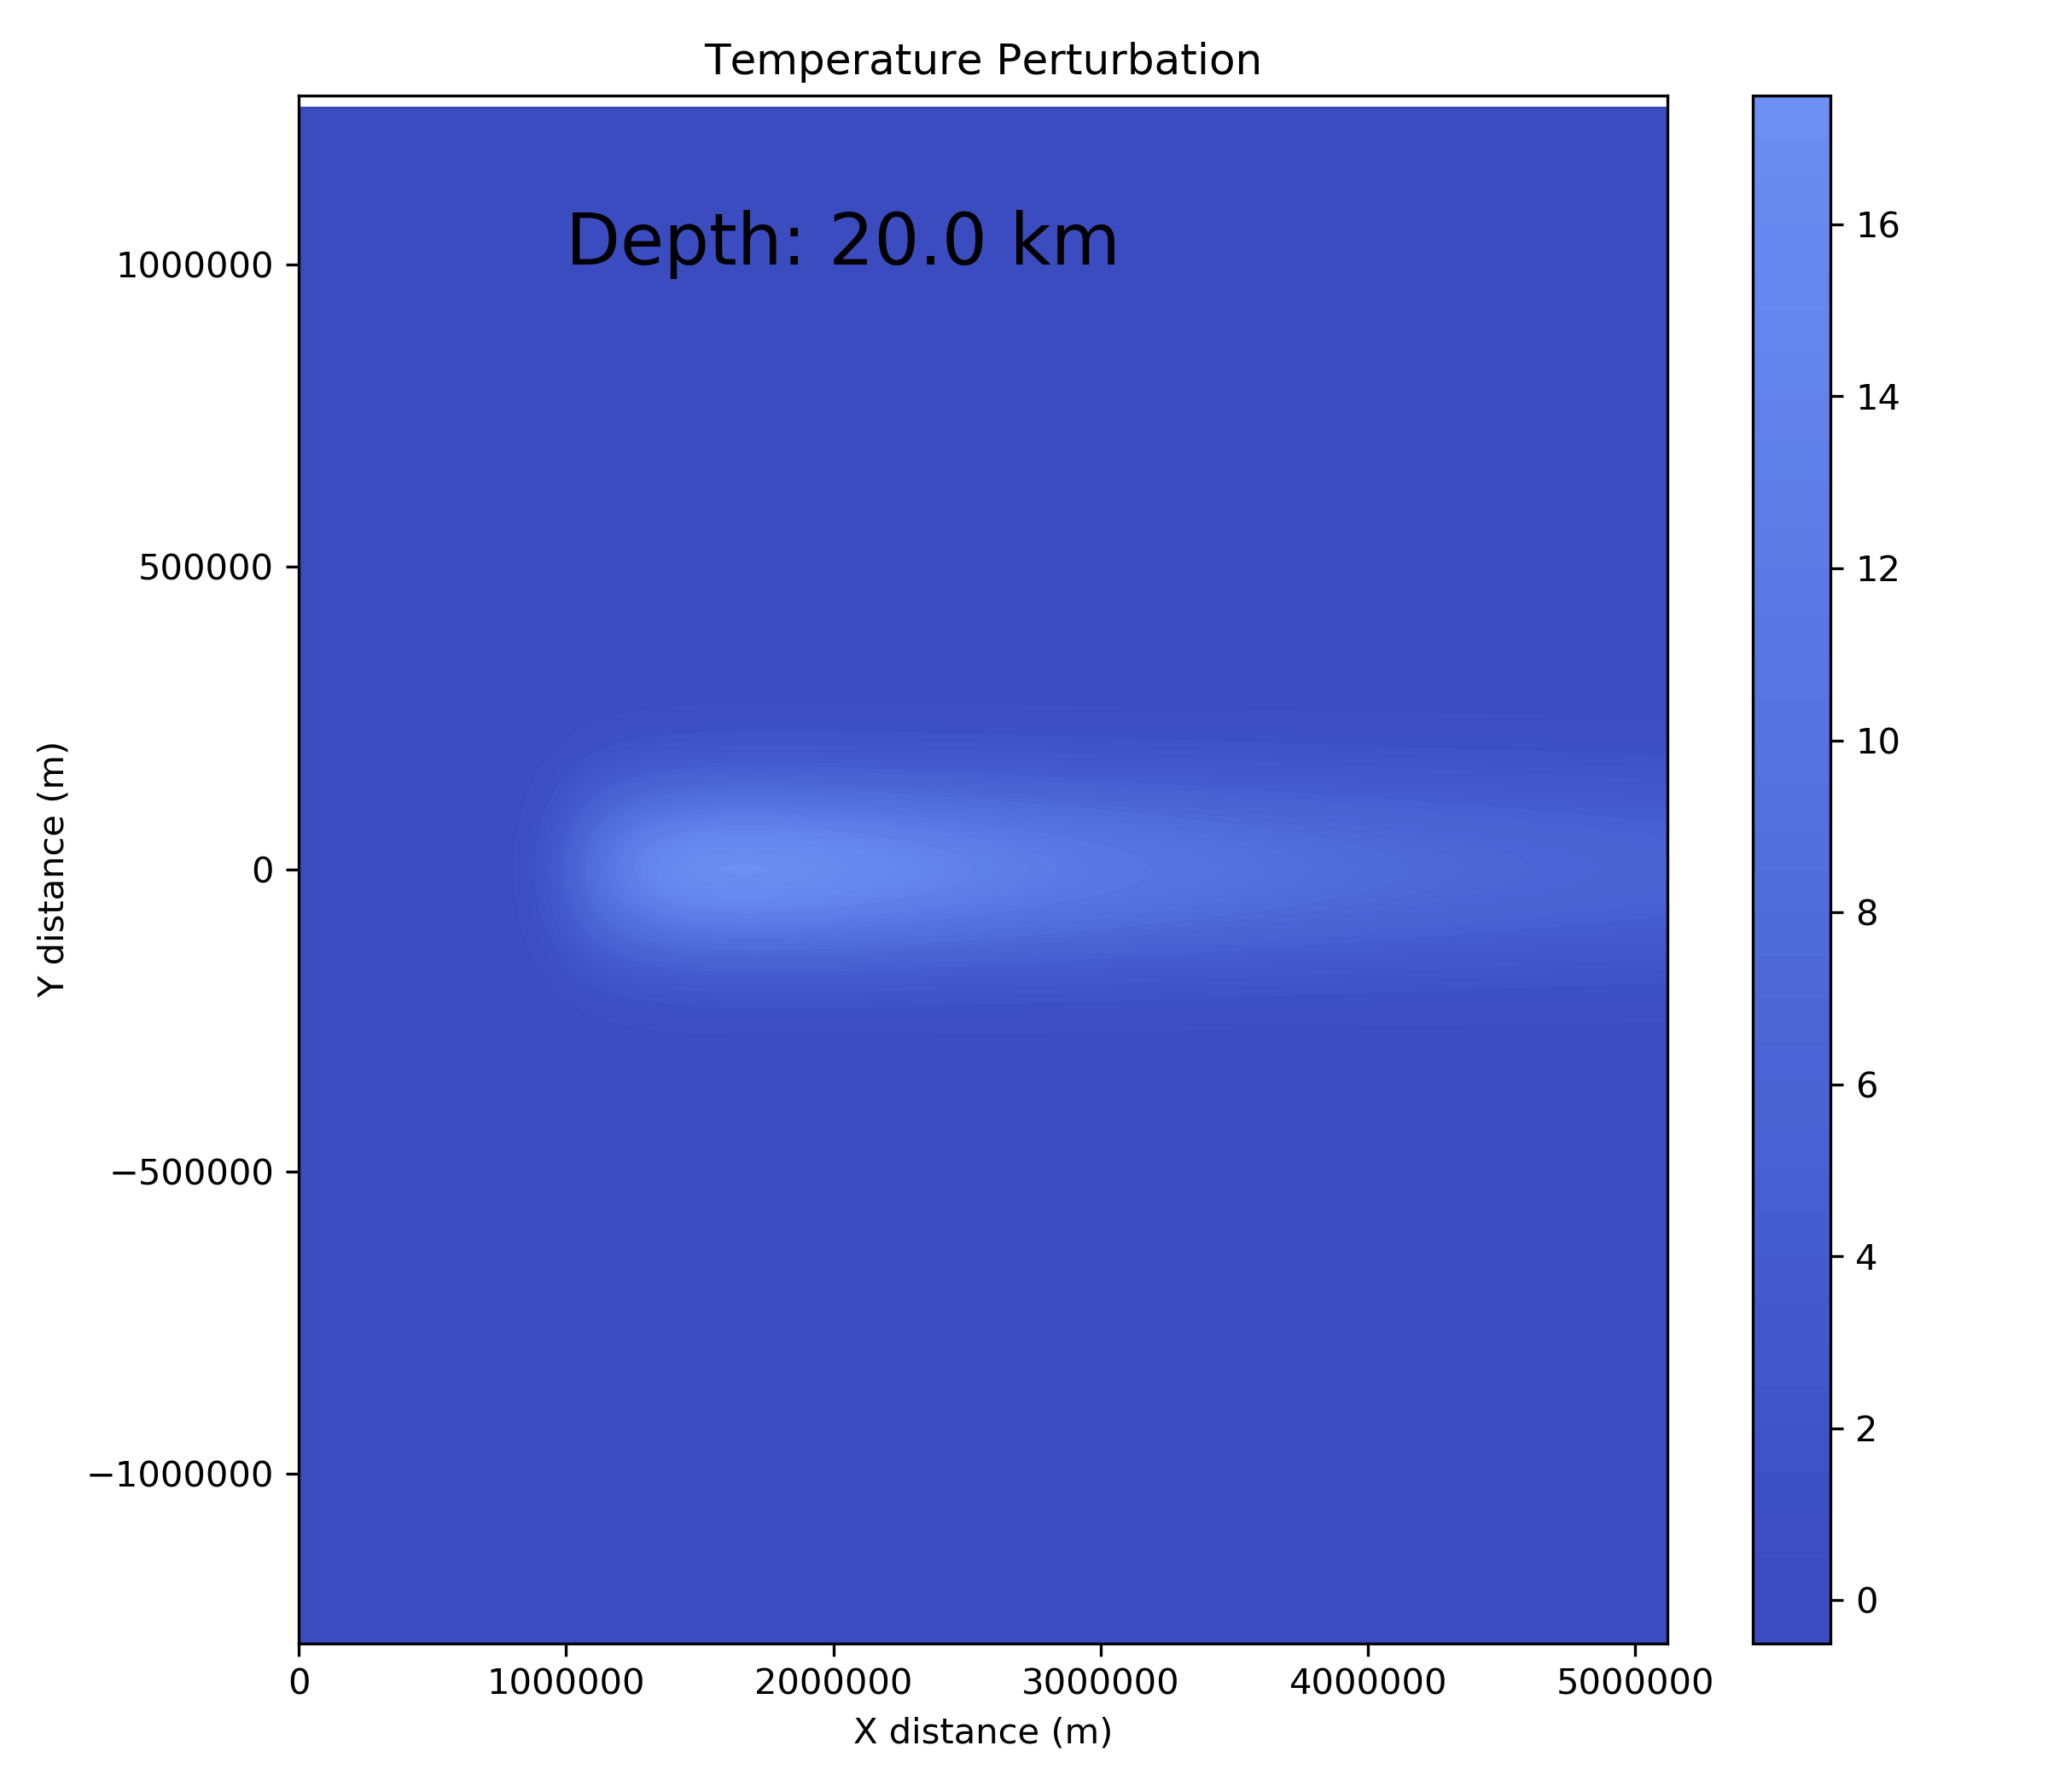
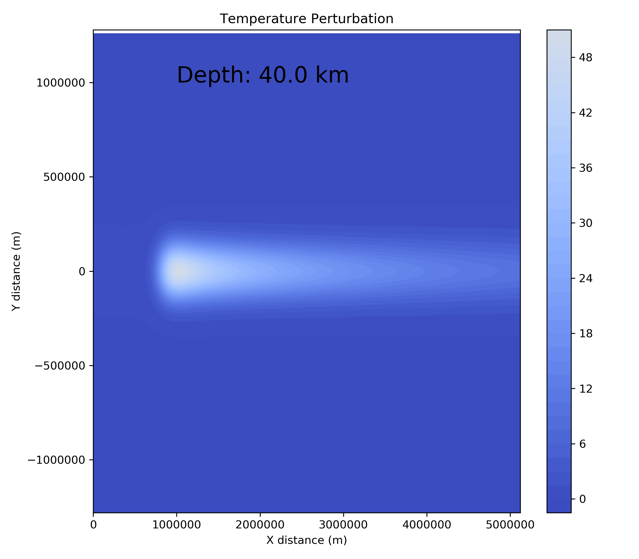
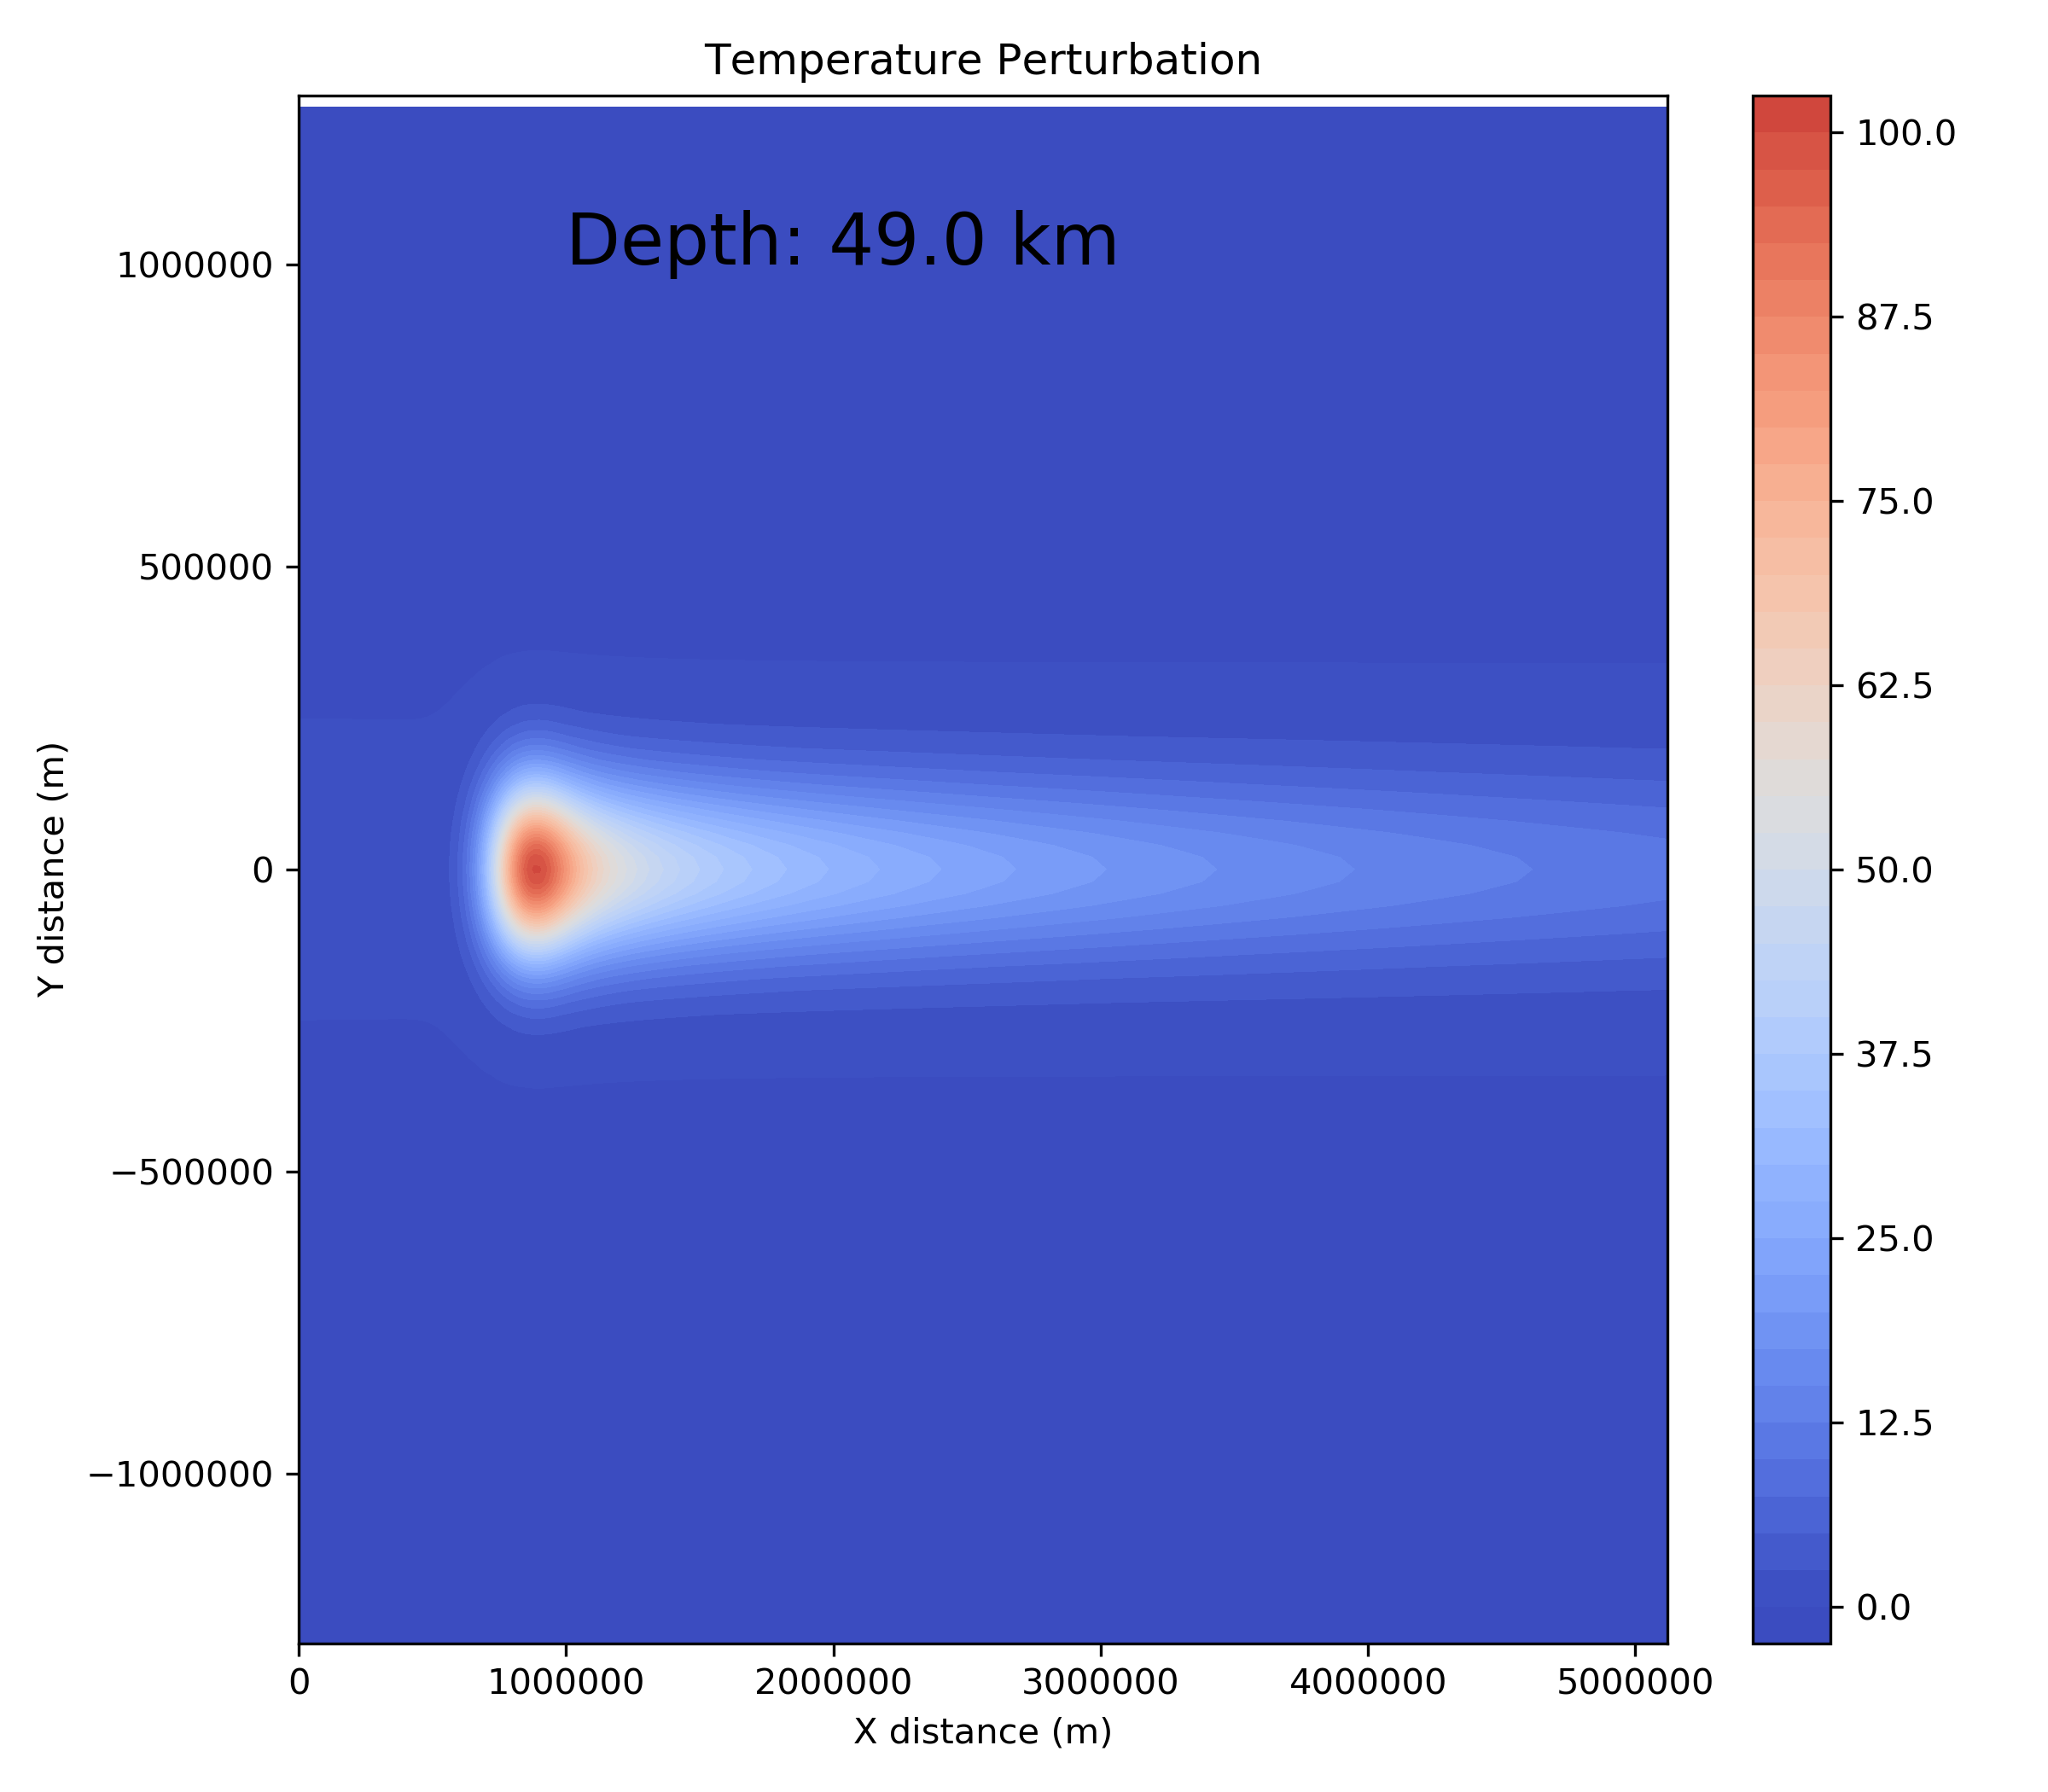
Temperature perturbations as a function of
depth (source located at 50 km)
The isotherms get “swept downstream” as the plate moves across the source.
As we go deeper toward the heat source, the temperature perturbations get larger and more concentrated above the source.

Slide 7
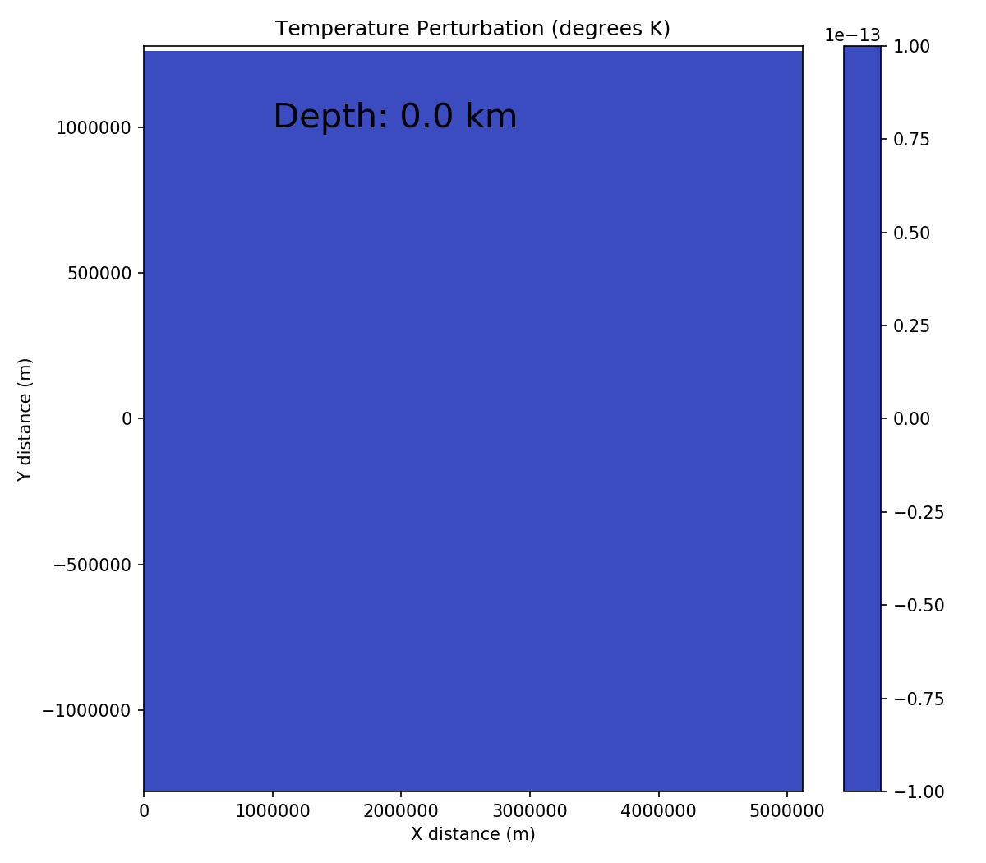

Slide 8
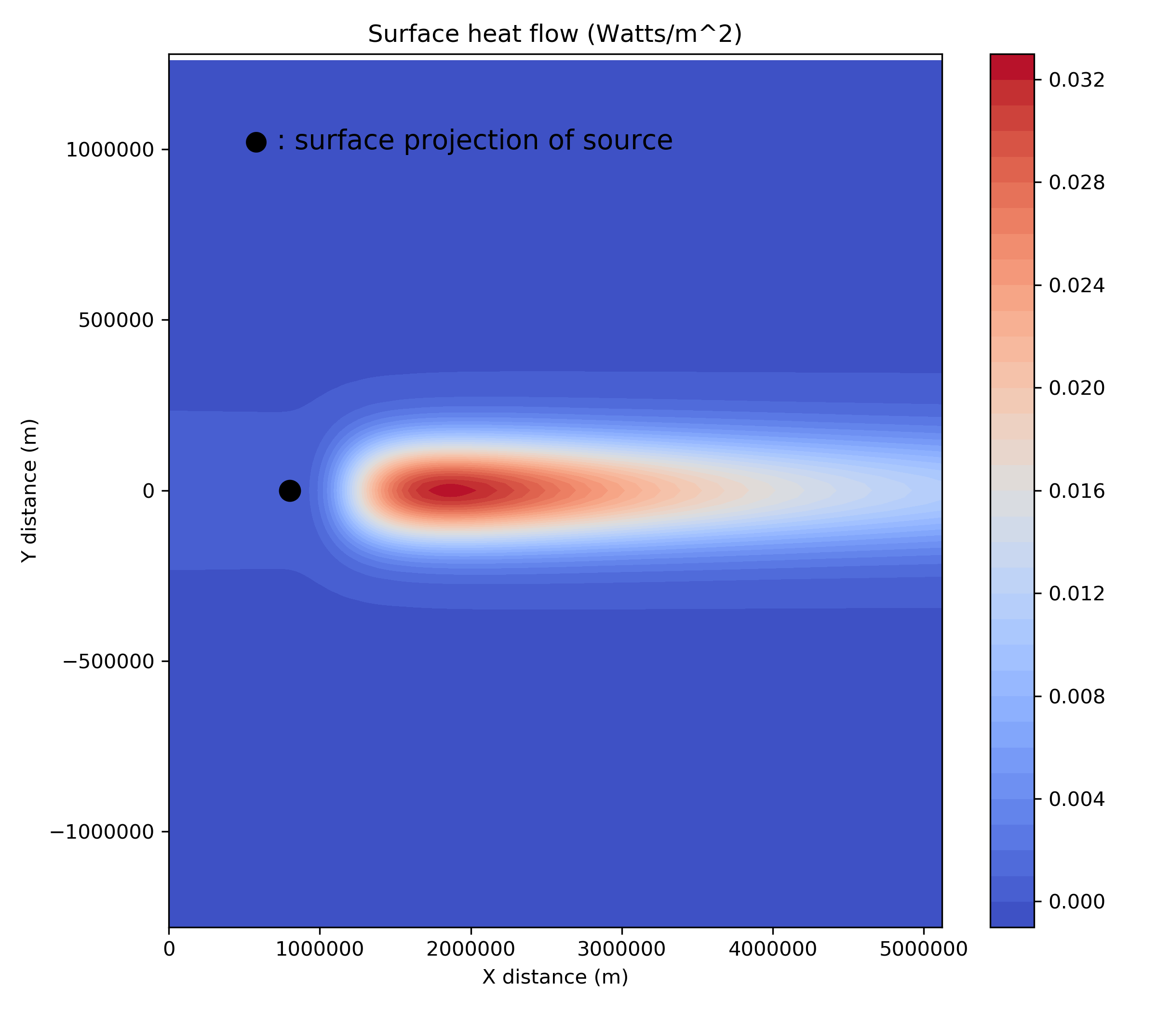
Surface Heat Flow
View of heat flow on the surface of the lithosphere from the top down:

