Slide 1
Elastic deformation due to surface point load in isotropic half space “The Boussinesq Problem”
A very brief introduction to
Nicholas Lau
9th November, 2018

Slide 2
Elastic Materials
Strain (deformation) when stress is applied
Reversible deformation
Can we characterize deformation on Earth as being elastic?
What happens when vertical stress is applied to a surface of an isotropic halfspace?
Boussinesq’s problem
$$τ_{n}$$
Cerruti’s problem
$$τ_{s}$$
Half space

Slide 3
Conservation of
linear momentum
Hooke’s Law
(No material derivative)
(No body force)
Navier-Cauchy equation

Slide 4
The Galerkin vector: a fictitious “vector” that relates a potential that can be related to displacement with differential operators.
Turns into biharmonic equation
Fourier transform on (x,y) dimension
Reduces to ODE “Helmholtz diff. eq.”

Slide 5
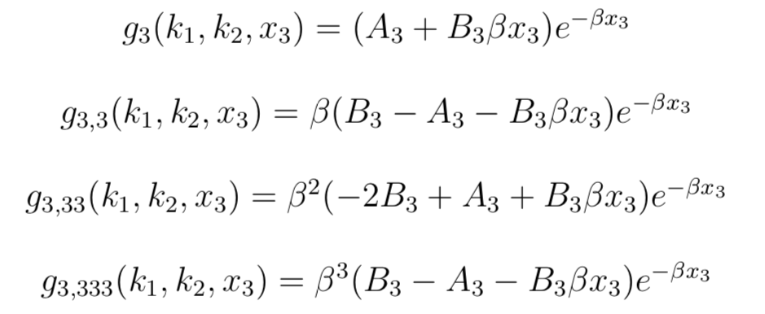
General solutions
and its derivatives in Fourier domain
Find A by equating Shear stress = 0
Find B by equating normal stress with restoring force

Slide 6
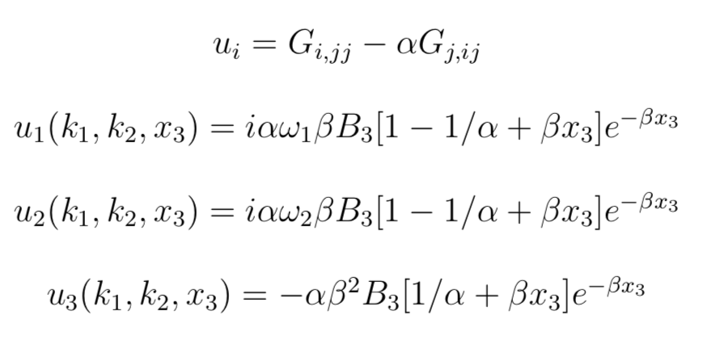
Displacement in Fourier domain
Displacement in space domain

Slide 7
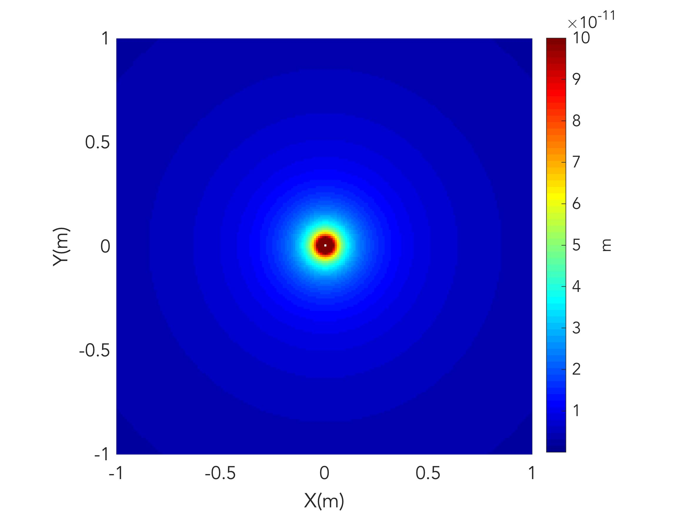

Slide 8
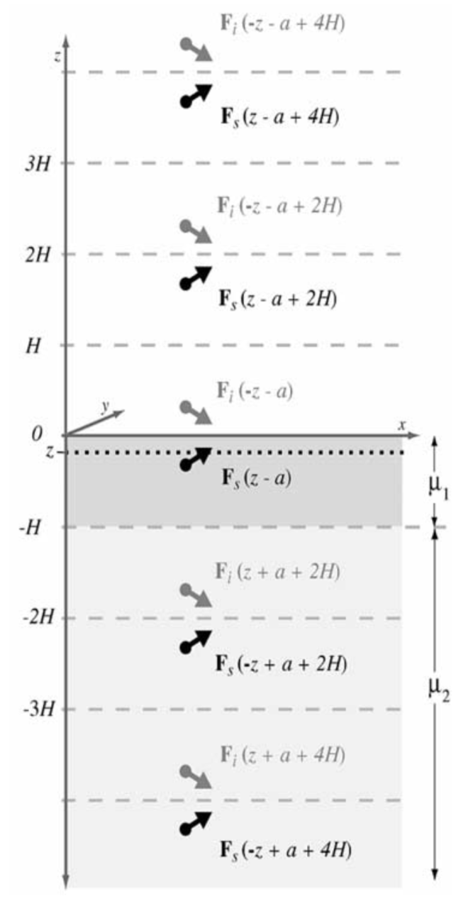
Different ways to arrive at the same result
Galerkin vector
Method of images
Papkovich-Neuber potential
0-size disk load
System of linear equations
Consider how to construct a problem
Nature of the problem
Discretization
Computation efficiency
General/specific solutions
Smith and Sandwell, 2004

Slide 10
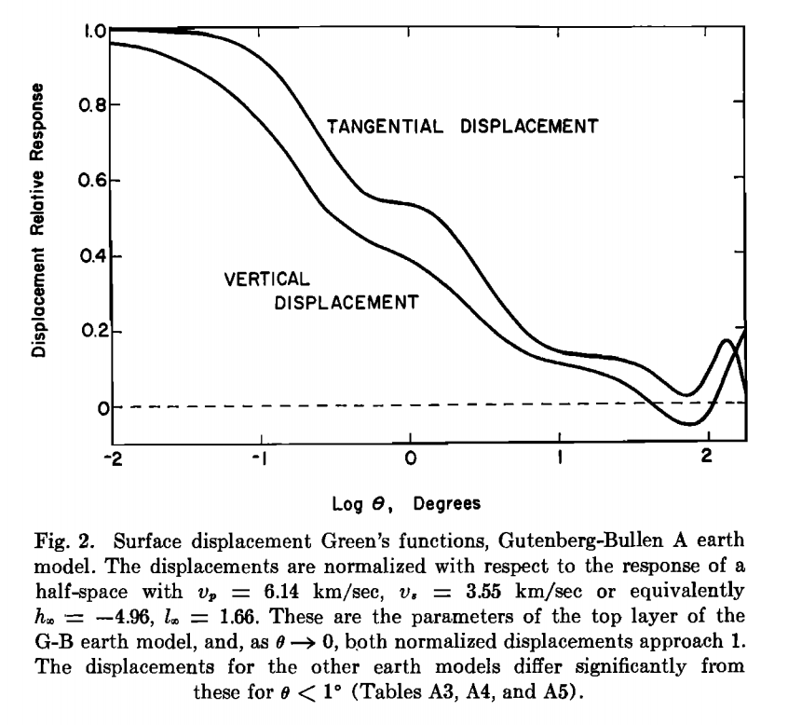
Beyond point load…
More complex load: point > disk > elliptic > Cerruti + Boussinesq = arbitrary load
More complex structure: half space > layered > sphere > Earth structure
More complex physics: static > spatially dependent > time dependent load
More parameters: Love numbers
Farrell 1952
Argus et al., GRL, 2014

Slide 11
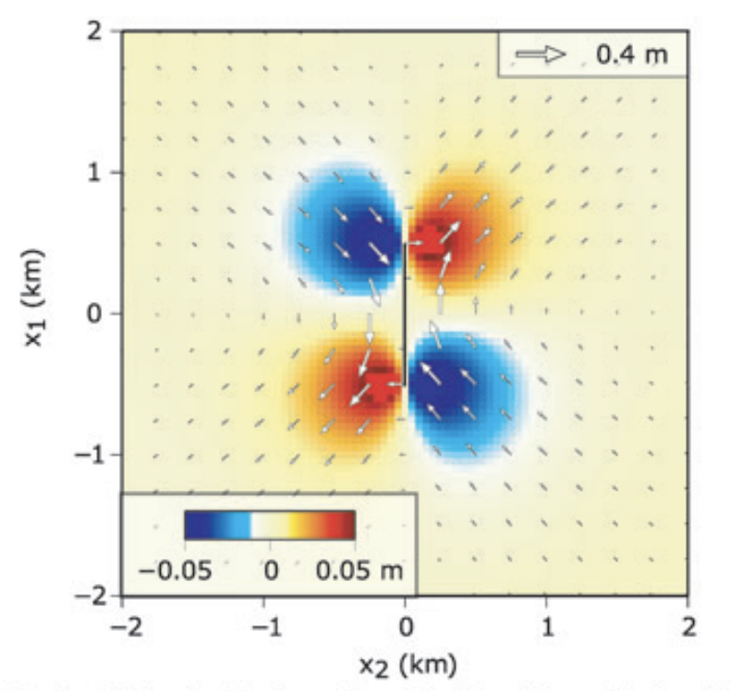
Elastic loading due to melting of glaciers
using Farrell’s elastic Green’s function
Deriving Okada slip model using similar technique
Barbot and Fialko, 2010

Slide 12
Further reading
Love, A.E.H. A Treatise on the Mathematical Theory of Elasticity, 1892.
Westergaard, H.M. Theory of Elasticity and Plasticity, 1952.
Steketee, J.A. On Volterra’s dislocations in a semi-infinite elastic medium. Canadian Journal of Geophysics, 1958.
Farrell, W.E. Deformation of the Earth by Surface Loads. Review of Geophysics and Space Physics, 1972.
Smith, B. and Sandwell, D. A three-dimensional semianalytic viscoelastic model for time-dependent analyses of the earthquake cycle, 2004.
Barbot, S. and Fialko, Y. Fourier-domain Green's function for an elastic semi-infinite solid under gravity, with applications to earthquake and volcano deformation, 2010.

Slide 13
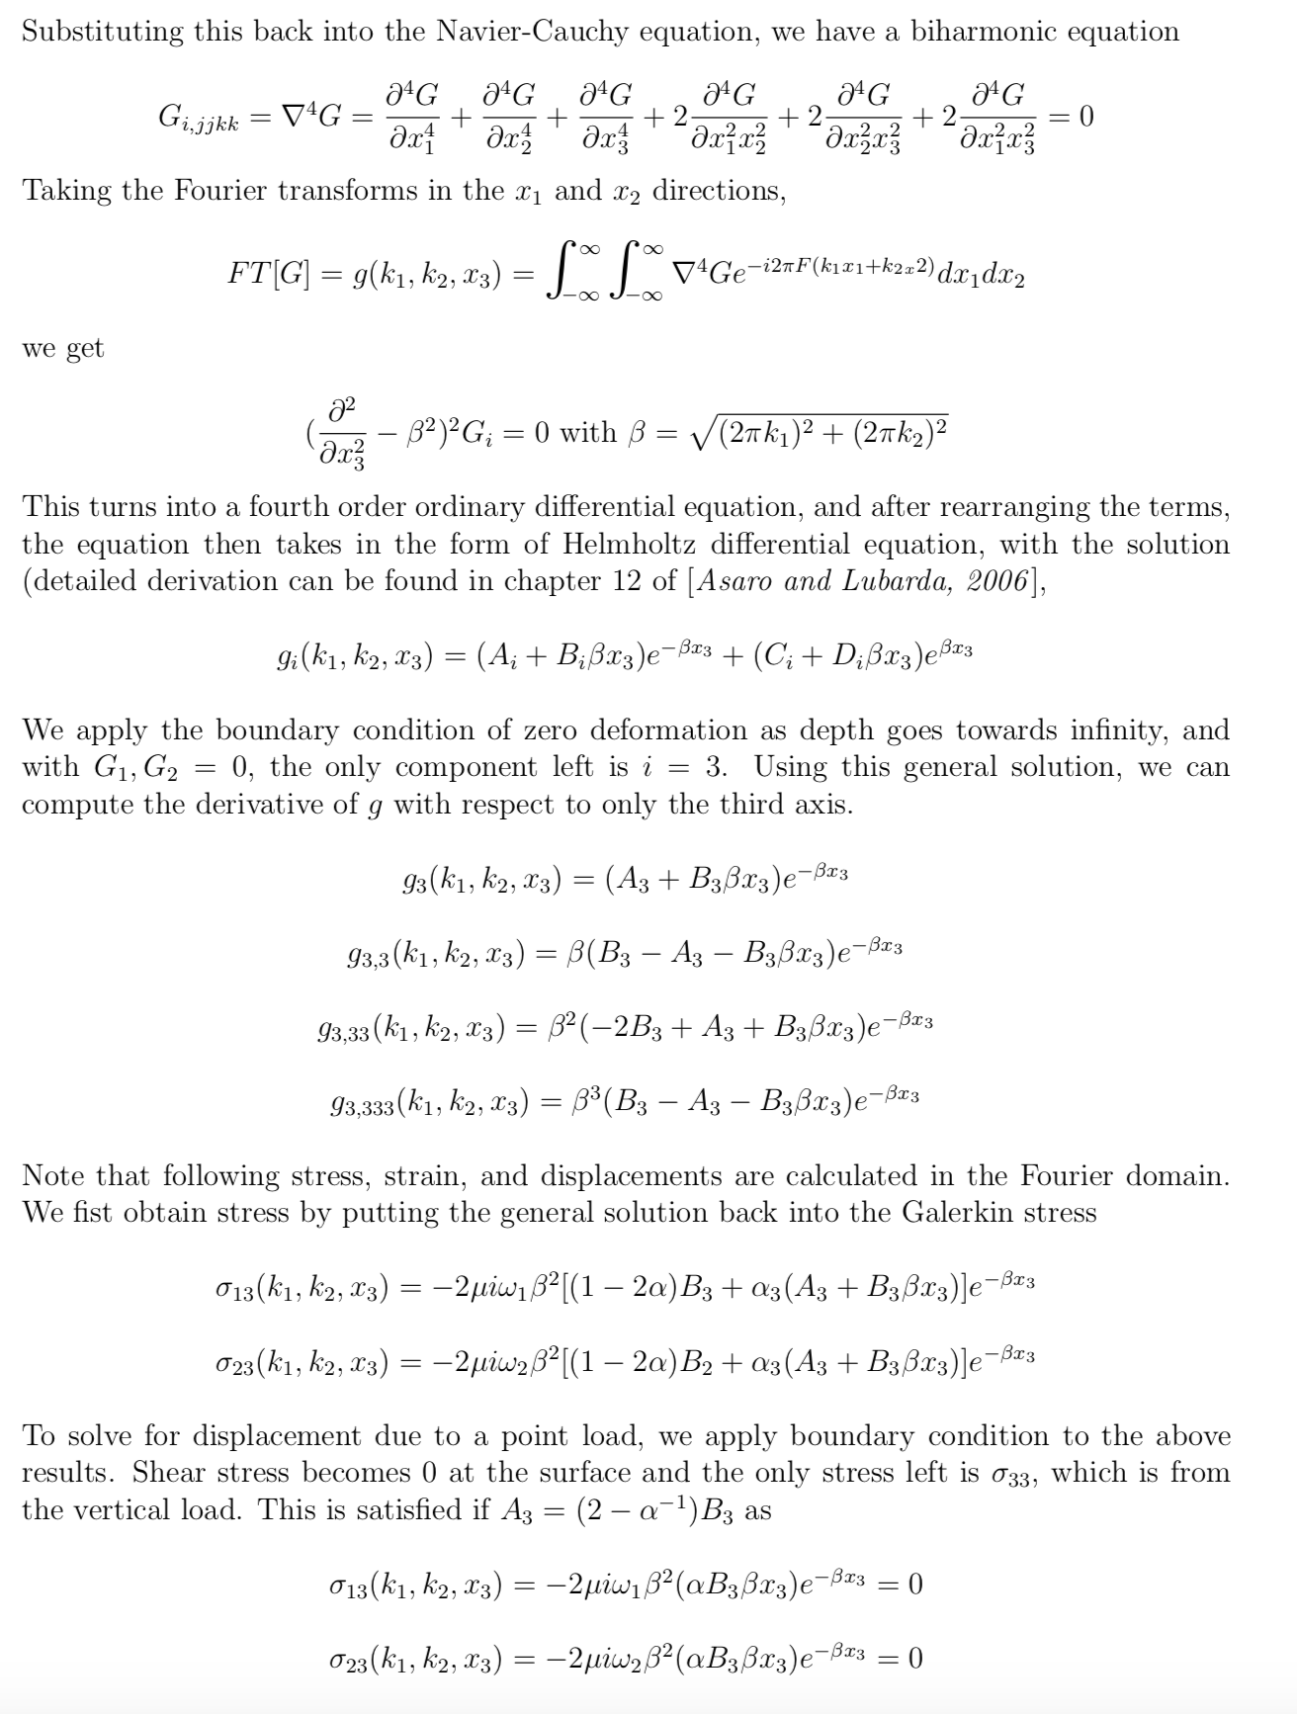
Appendix: More detailed derivation

Slide 14
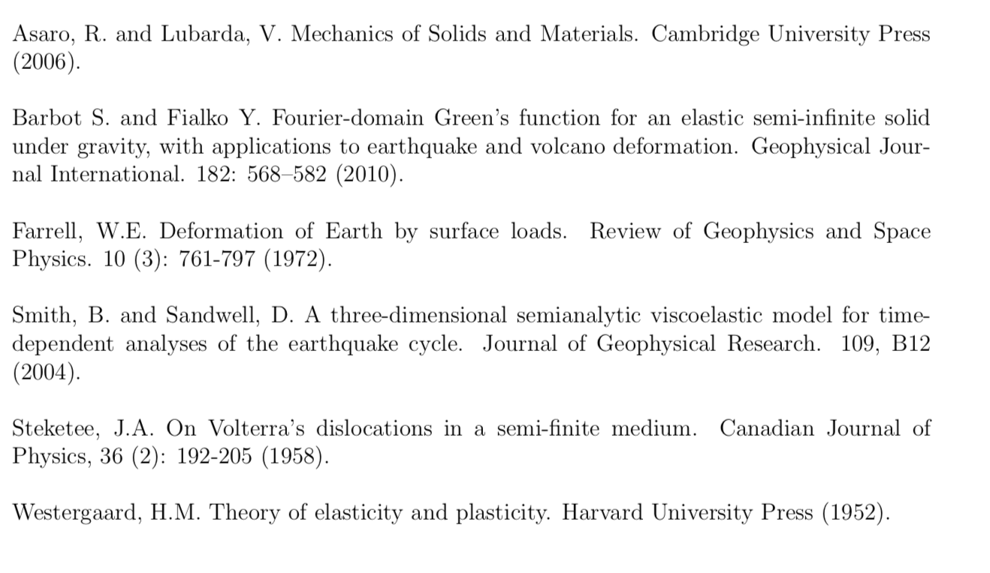
References

