Slide 1
GNSS Field Work & Processing Lessons learned from North Shore Surveys
Yehuda Bock
Space Geodesy – SIO 237
February 21, 2020
Notes:
/

Slide 2
Outline
Project Focus and Siting
Monumentation
Pre-survey
Survey
Post-survey
Pre-processing
Processing (RTD, GAMIT)
Archiving

Slide 3
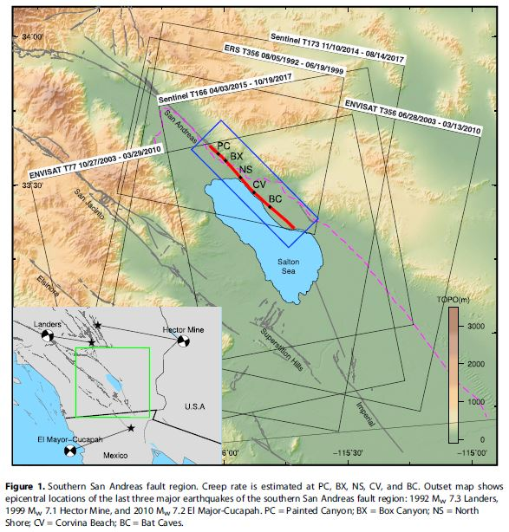
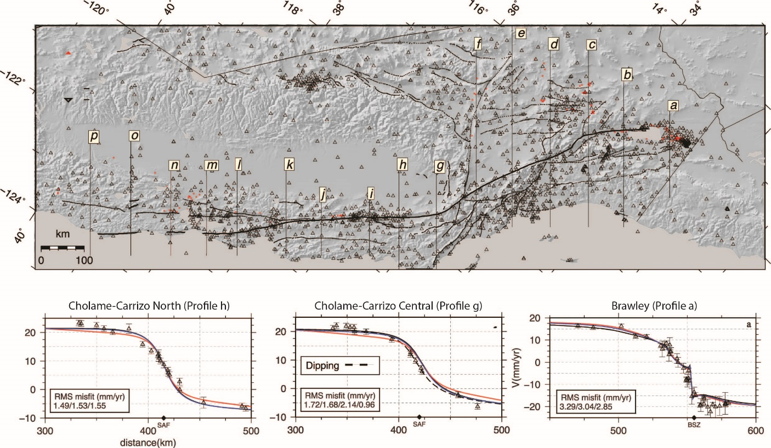
Project Focus, Network Design, Siting
Active geologic faults in California. (Top) The San Andreas fault system and other geological faults overlain topography. GPS stations are denoted by triangles. The numbered lines indicate fault transects. Three examples are shown below the map. Note that the Cholame-Carrizo north transect near Parkfield most closely resembles an arctangent function with a velocity of about 32 mm/yr (Figure 14). The Brawley transect in southern California indicates a more complex tectonic environment including fault creep at the Brawley-Seismic zone. Adapted from (Tong et al. 2014).

Slide 4
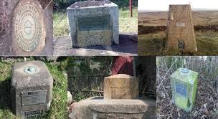
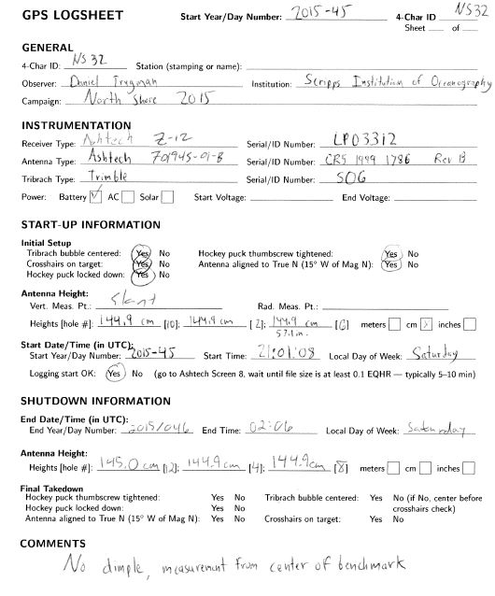
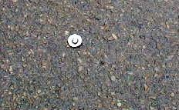
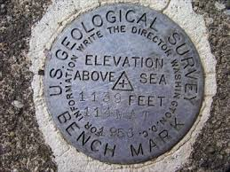
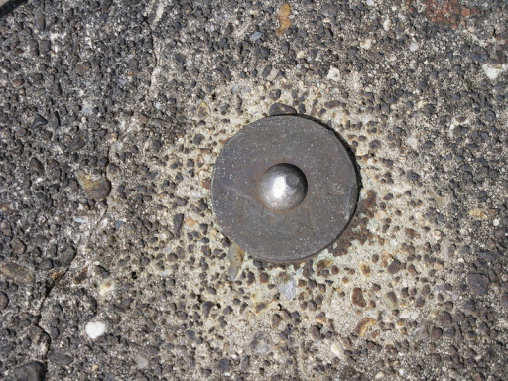
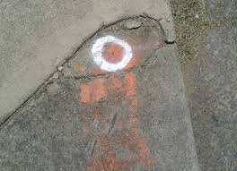
Monumentation
Mark needs to be well identified (< 1mm)
Needs to be robust, last several years & be recoverable

Slide 5
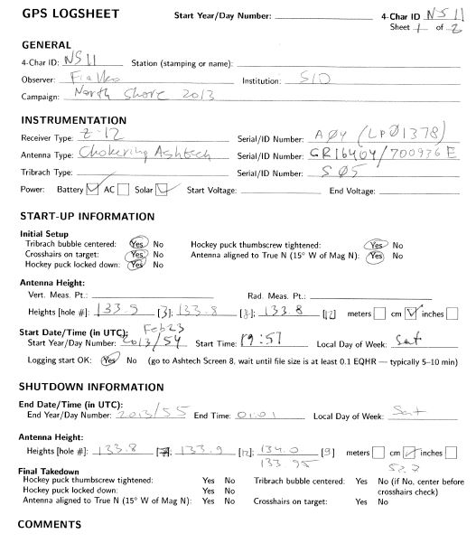
Pre-survey
In the lab
Check & inventory equipment
Calibrate tribrachs, compasses, height rods
Practice set up: tripod over mark, lock hockey puck
Assign teams
Survey plan
Contingency plans
Prepare log sheets, paper/electronic – fill in as much info as available ahead of time
Receiver settings (sample rate, elevation angle, time span, …)
Logistics
Points of contact
Water/food/snacks/drinks
Hats, sunscreen, shoes
Accommodations
Communications
Transportation
First aid kit
Full name
training

Slide 6
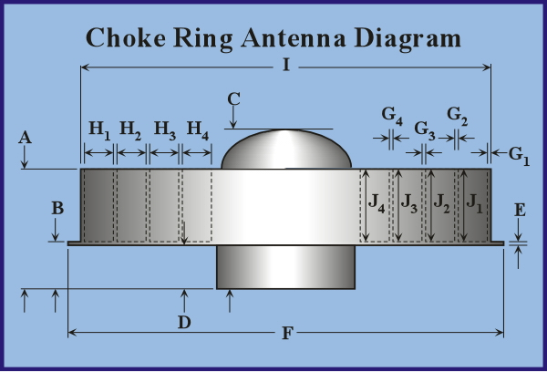
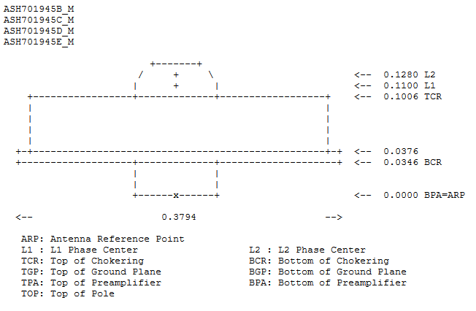
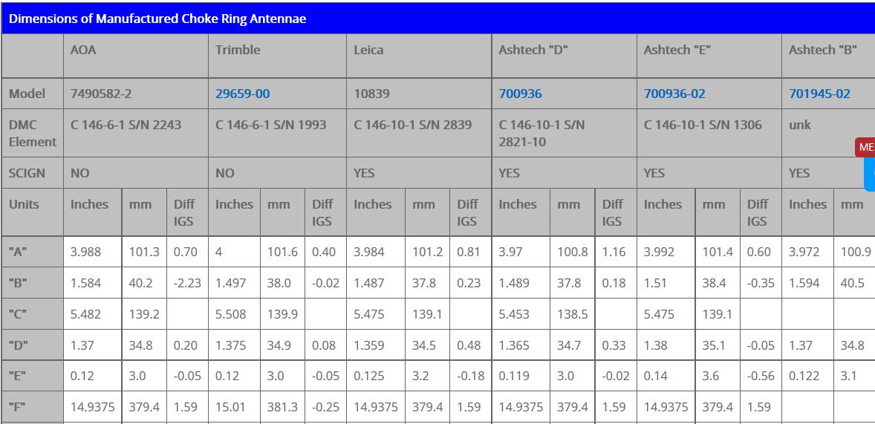
Antenna Dimensions
TCR
BCR
ARP
C
Diameter (D)
Vertical height (H)
Slant height (S)
https://kb.unavco.org/kb/article/choke-ring-antenna-calibrations-311.html
H= (S²-(D/2)²)^{1/2}-C

Slide 7
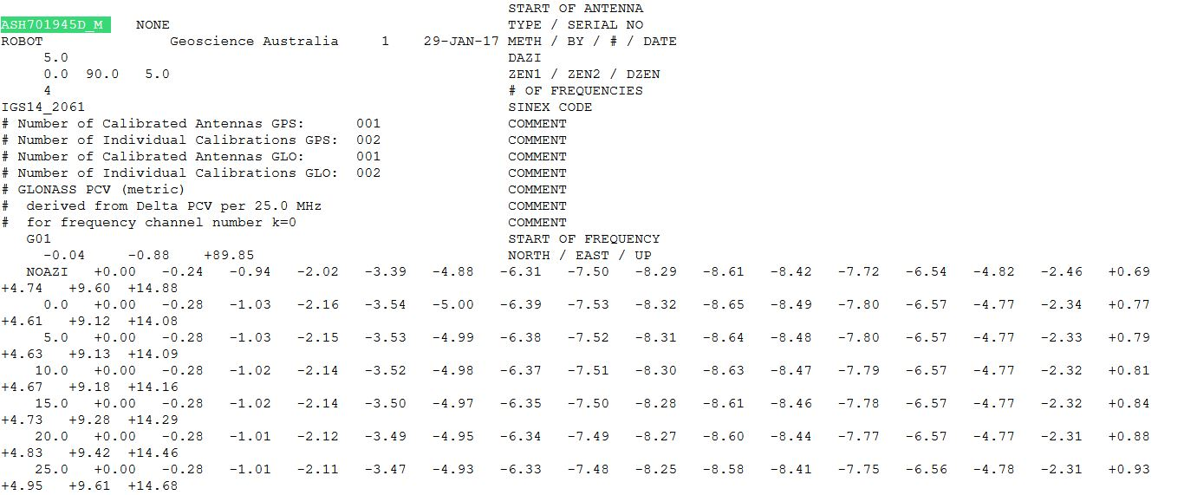
Antenna Calibration
ftp://garner.ucsd.edu/pub/gamit/tables/igs_08.atx

Slide 8
IGPP Antenna Inventory
Most Important

Slide 9
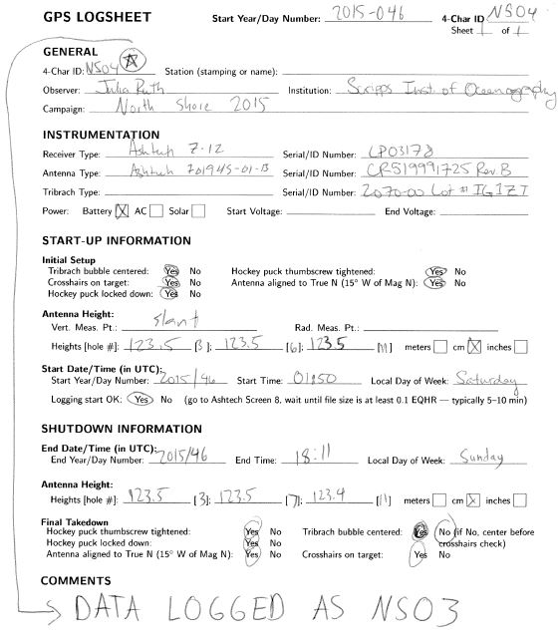
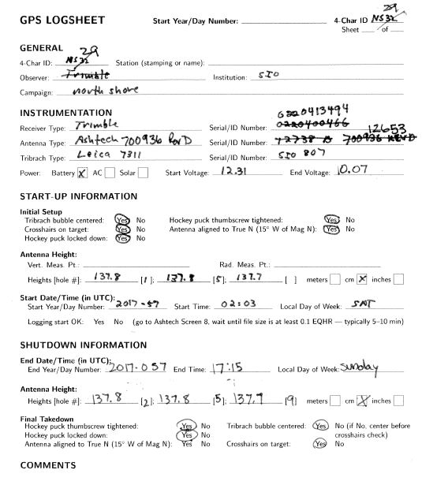
Survey
Confusing
Anonymous
Set up at correct location/monument
Tripod set up – centering and leveling
Proper antenna height measurements
Data download – in field if possible
Record metadata
Conversion to RINEX data – if possible
Be careful during RINEX stage with mis-named files!

Slide 10
Field and Data Issues – North Shore Surveys
2013
NS12,NS13,NS19 have one epoch overlap - deleted last data point in first day's RINEX files.
2015
NS29 mislabeled as NS25; short session ~20 minutes (could disregard)
NS01,NS06,NS21,NS32, have one epoch overlap in 2015, remove last epoch on day 45
2017
(1) NS13, NS21 and NS22 RINEX data are missing although there are log sheets
(2) NS19 and NS25 not available in 2017 (no log sheets)
(3) NS11 & NS13 antenna serial numbers are incomplete in log sheet 2017
(4) NS19 first session is actually NS18 (renamed RINEX file and changed NS19 to NS18 in file)
(5) NS03 second and third sessions are actually NS04 (renamed RINEX file and changed NS03 to NS04 in file itself)
(6) NS11 was mislabeled NS12 (renamed RINEX file and changed NS12 to NS11 in file)

Slide 11
General Issues – North Shore Surveys
2017
NS12 | -2327610.92213 | -4786514.78371 |+3502635.06658| +33.52535 | +244.06703 | -78.28239
| -5432.75956 | +27297.92198 | -143.24975| +0.37525 | -9.95986 | -0.80017
| +27833.64854
1469 solutions with 0 outliers ( 0.0%) (1 non-solutions)
North IQR = 0.00891, East IQR = 0.00682, Up IQR = 0.02668
North StdDev = 0.00689, East StdDev = 0.00492, Up StdDev = 0.02096
North StdDevMean = 0.00387, East StdDevMean = 0.00277, Up StdDevMean = 0.01178
2015 (short data set ~ 30 minutes, looks likes set on wrong station - ignore this data set)
NS12 | -2327628.41036 | -4786504.62682 |+3502634.70779| +33.52535 | +244.06682 | -79.71949
| -5432.22838 | +27277.69597 | -144.68270| +0.89701 | -30.12894 | -2.23734
| +27813.71905
112 solutions with 0 outliers ( 0.0%) (0 non-solutions)
North IQR = 0.00527, East IQR = 0.00520, Up IQR = 0.03449
North StdDev = 0.00464, East StdDev = 0.00365, Up StdDev = 0.03125
North StdDevMean = 0.00324, East StdDevMean = 0.00255, Up StdDevMean = 0.02183
2013
NS12 | -2327602.34760 | -4786519.92578 |+3502635.19594| +33.52534 | +244.06714 | -77.48192
| +1.29739 | -75.70326 | -4.36120| +0.00009 | -0.00001 | +0.00031
| +75.83988
3503 solutions with 14 outliers ( 0.4%) (8 non-solutions)
North IQR = 0.00570, East IQR = 0.00517, Up IQR = 0.02732
North StdDev = 0.00432, East StdDev = 0.00387, Up StdDev = 0.02240
North StdDevMean = 0.00230, East StdDevMean = 0.00205, Up StdDevMean = 0.01190
(1) NS15 spans most of the overall survey 2/14-2/15 in 2013 and 2015 so useful as reference station for short-baseline processing
[Two stations (NS17, NS20) go into next day 2/16 but have sufficient data prior so that these data can be ignored]
(2) Multiple sampling rates (1 s and 5 s). Reference station should have higher sampling rate or some data lost in processing
(3) Note that NS12 gives a significantly different result for all three years. Remove NS12 from 2015 solutions (see below)

Slide 12
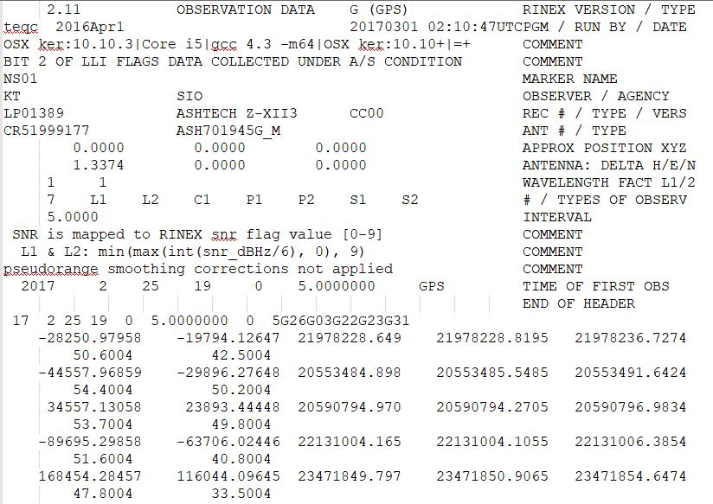
NS01 North Shore Survey 2017
Approx. Position?
Post-Survey
Who is this?
Stage data and log sheets in one location
Check metadata – record anomalies
Calculate vertical antenna heights – dependent on type of antenna
Download data
Cross check data with survey plan
Create RINEX files with complete headers
Check for correct RINEX filenames
Store data and metadata in a secure location – two copies

Slide 13
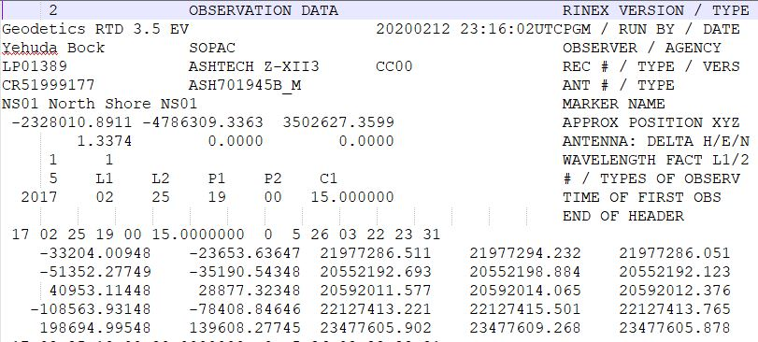
Pre-processing – RINEX file decimation
RINEX data decimated to 15 seconds using RTD software (could use teqc) for GAMIT processing

Slide 14
Pre-Processing
Collect RINEX data in a single directory per …
Collect satellite orbit files spanning the survey
Check metadata file
Set coordinate constraints
Decide on type of processing – software
Choose reference stations and observation strategy
Calculate true of survey date coordinates (ITRF) for continuous GPS reference stations – SECTOR utility
Calculate approximate coordinates for survey stations using SCOUT utility
Date Converter:
http://sopac-old.ucsd.edu/convertDate.shtml#Date%20converter
http://sopac-old.ucsd.edu/sector.shtml
http://sopac-old.ucsd.edu/scout.shtml

Slide 15
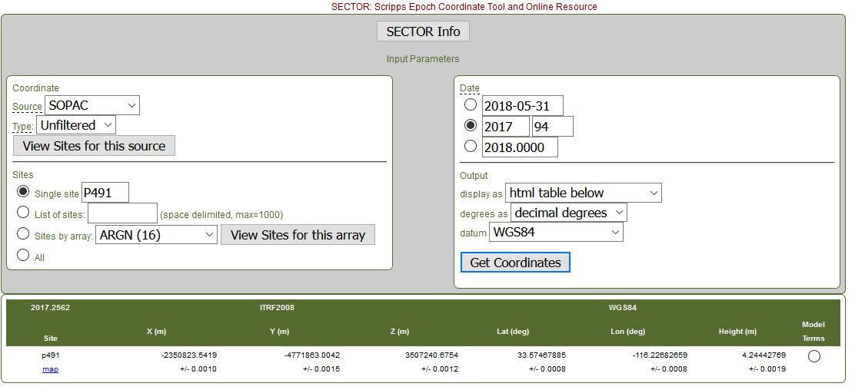
SECTOR
Calculate true of date coordinates of reference station P491
http://sopac-old.ucsd.edu/scout.shtml

Slide 16
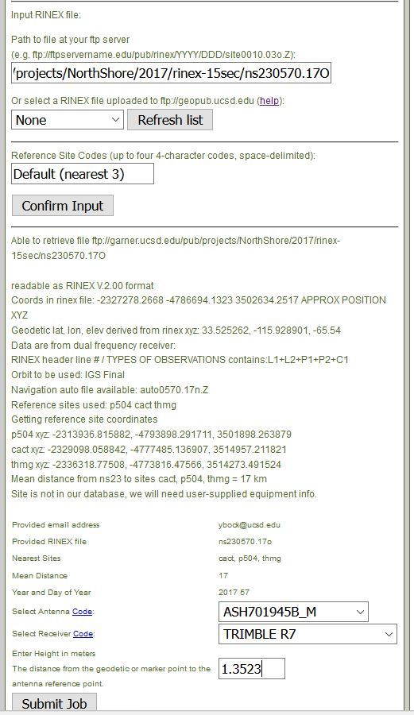
SCOUT – calculate true of date coordinates of NS23
http://sopac-old.ucsd.edu/scout.shtml

Slide 17
SCOUT – calculate coordinates of NS23
From: SIO GPS Processing <gpsproc@geocpu03.ucsd.edu> Sent: Thursday, February 20, 2020 3:08 PM To: ybock@ucsd.edu Subject: SOPAC Analysis report, ns230570.17o, job 201796
**********************************************************************
SOPAC Automatic Analysis Solution Report Job number: 201796 geocpu17.ucsd.edu
**********************************************************************
The multi-station analysis of ns230570.17o using CACT P504 THMG, resulted in the following mean coordinates for NS23, valid on reference epoch 2017.156 (2017 057):
Site Latitude (d) Longitude (d) Height (m)
Stdev. (m) Stdev. (m) Stdev. (m)
NS23 33.34829953 -115.92890054 6371.5863 WGS84
0.0290 0.0290 0.0587
X (m) Y (m) Z (m)
Stdev. (m) Stdev. (m) Stdev. (m)
NS23 -2327278.2682 -4786694.1517 3502634.2699 ITRF2014
0.0345 0.0480 0.0403
The average baseline length is 16.74749 kilometers.
Orbit used: gpgga7.057.
Notes: coordinates are valid at the geodetic reference point (GRP). The distance between the GRP and the antenna reference point is the site antenna height. WGS84 geodetic coordinates are referenced to ITRF2014, using the WGS84 semi-major axis and inverse flattening.
WGS84 semimajor=6378137.0 and 1/f=298.257223563 Questions with respect to this solution may be found in SCOUT FAQ http://sopac.ucsd.edu/scoutFAQ.html.
Please refer to job number 201796 when posting.
http://sopac-old.ucsd.edu/scout.shtml

Slide 18
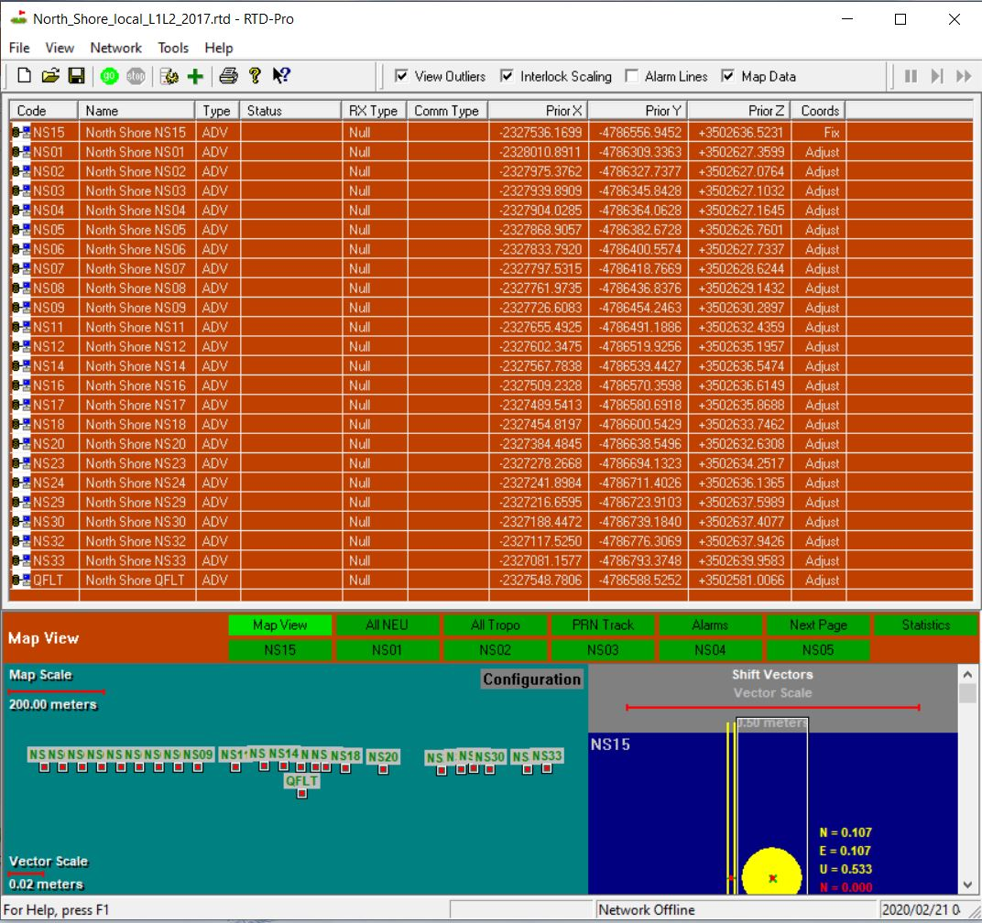
RTD post-processing demonstration
(instantaneous network positioning)
Set project work area directory
Stage RINEX files – link to top directory
Add in stations one at a time – point to RINEX directory
Calculate start and end times
Read metadata off of RINEX headers (otherwise interactively)
Read in station coordinates from database, interactively, or iterate
Choose Master station
Set satellite orbit collection (.sp3 files)
Choose coordinate constraints
Choose processing mode (L1/L2; LC)
Go
Solutions & uncertainties in stats file
North_Shore_local_L1L2_2017_stats_2020_02
In “logs” directory

Slide 19
GAMIT: Software Input Files
Do not require user interaction
Metadata
igs_08.atx : Antenna phase center map models (elevation and azimuth)
rcvant.dat : receiver and antenna type tables
Note: Antenna and receivers used in survey must match with a table value
Inertial and Earth-fixed reference frame specific
ut1.usno : UT1 – Earth rotation angle
Pole.usno : Polar motion (“wobble”)
Solar ephemeris
Lunar ephemeris
Nutation tables
Leap seconds (difference between GPS time and UTC time)
Tidal models
Precession
http://sopac-csrc.ucsd.edu/index.php/gambit-globk/

Slide 20
GAMIT: Software Input Files
Specific to each survey
Station.info : Metadata (from RINEX headers for surveys; from SOPAC database for cGPS stations)
Sestbl: Models and run-time settings (minimal changes for surveys)
Sittbl: Coordinate constraints (N,E,U)
tight on cGPS reference stations, 0.005 m
loose on survey points, 1 m
elevation angle (15 degrees, default)
Session.info: total time span of survey
Satellite orbits (IGS “.sp3” files)
(needs to span the survey period)
Input coordinates: “L-file”
[ftp://garner.ucsd.edu/pub/products/2090/]
GPS Week Number
http://sopac-old.ucsd.edu/convertDate.shtml#Date%20converter

Slide 21
GAMIT: Installation
Copy gamit software to your machine:
type 'scp dgolriz@igpp17grad6.ucsd.edu:/Users/dgolriz/gamit.1070.tar .'
enter password ..
untar files:
type 'tar -xf /foo/bar/gamit.1070.tar'
type 'tar -xf /foo/bar/na23.1940000.tar’
Install gamit;
type 'cd /foo/bar/gamit.1070'
type './install_software'
Change paths in gamit software:
type 'cd /foo/bar/na00.0562000'
type 'relink.pl -o /usr/local/processing -n /Users/dgolriz’
*if needed, relink 'arc' as well

Slide 22
GAMIT: Installation
Copy earthquake example to your machine:
type 'scp dgolriz@igpp17grad6.ucsd.edu:/Users/dgolriz/gamit.1070/na23.1940000.tar .'
enter password ..
Run gamit:
type 'csh bna007.bat’\
Check solution:
type 'grep Pre qna*'
typical “Postfit.nrms” values are below 0.5
Find solutions
Open 'qPPPPa.DOY’ [PPPP is project name, and DOY is day-of-year]
Inside the file, look for 'labels’
Look for “Biases Fixed” solutions Estimated coordinates solutions in XYZ is under 'lqPPPPa.DOY’
Use utility 'tform' (inside working directory) in order to other types of coordinates

Slide 23
Project Archive
ftp://garner.ucsd.edu/pub/projects/NorthShore/
ftp://garner.ucsd.edu/pub/projects/NorthShore/2017/
ftp://garner.ucsd.edu/pub/projects/NorthShore/2017/analysis/
ftp://garner.ucsd.edu/pub/projects/NorthShore/2017/rinex-15sec/
ftp://garner.ucsd.edu/pub/projects/NorthShore/2017/rinex-full_plus_orbits/

