Slide 1
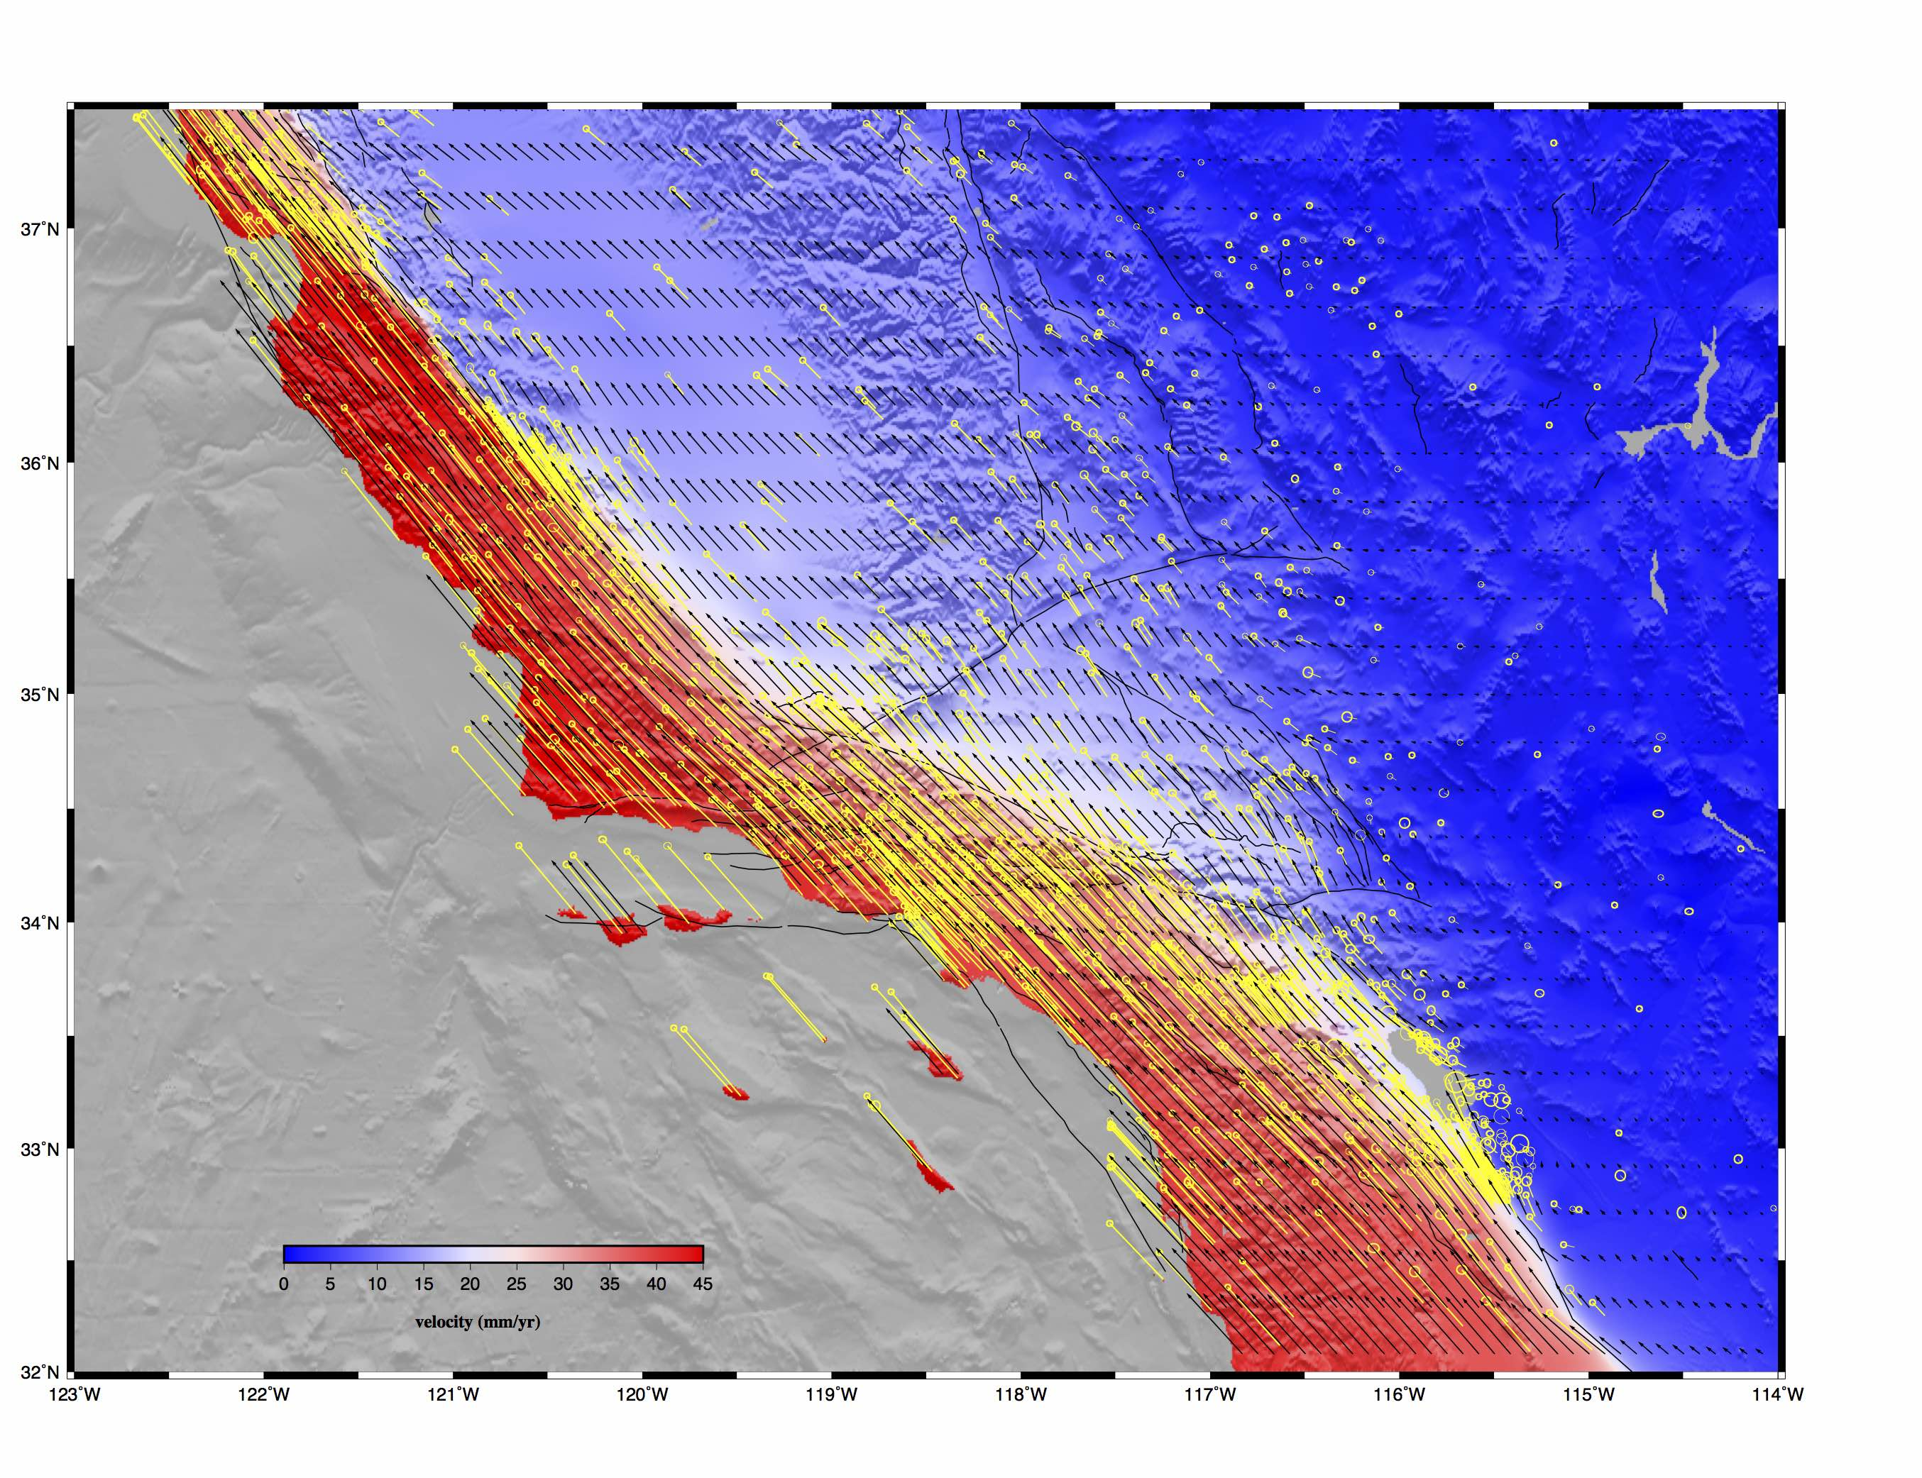
Community Geodetic Model V1 - GPS Secular Velocity Grid
GPS velocities from:
PBO
reprocessing of campaign data
[Zeng and Shen, 2016]
other dense GPS data
[Crowell et al., 2013; McCaffrey et al., 2013]
Interpolation to 0.01˚ grid:
10 contributed models
regridded to fit GPS data
computed mean and standard deviation
mean model matched GPS to 0.92 mm/yr.
Uses:
constrain InSAR at long wavelengths
expose areas of inadequate GPS coverage
assessment of off-fault strain rate
poster 141

Slide 2
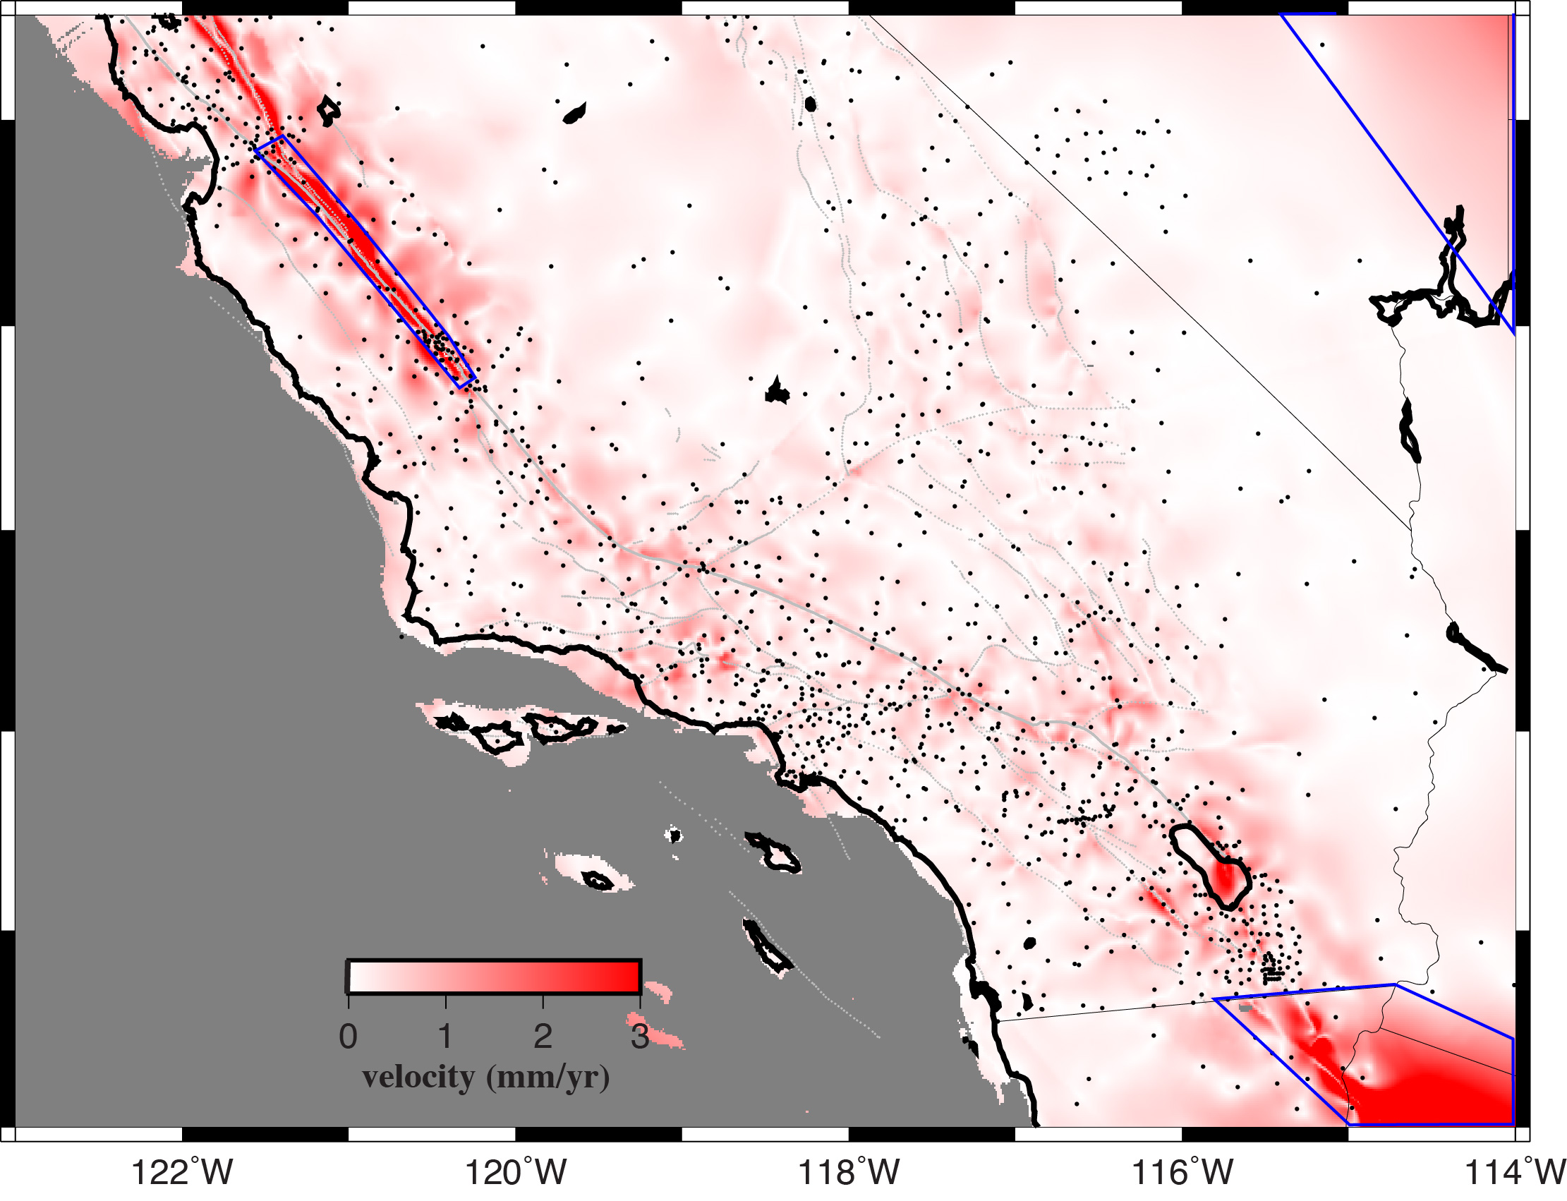
Community Geodetic Model V1 - GPS Secular Uncertainty Grid
GPS velocities from:
PBO
reprocessing of campaign data
[Zeng and Shen, 2016]
other dense GPS data
[Crowell et al., 2013; McCaffrey et al., 2013]
Interpolation to 0.01˚ grid:
10 contributed models
regridded to fit GPS data
computed mean and standard deviation
mean model matched GPS to 0.92 mm/yr.
Uses:
constrain InSAR at long wavelengths
expose areas of inadequate GPS coverage
assessment of off-fault strain rate
poster 141

Slide 3
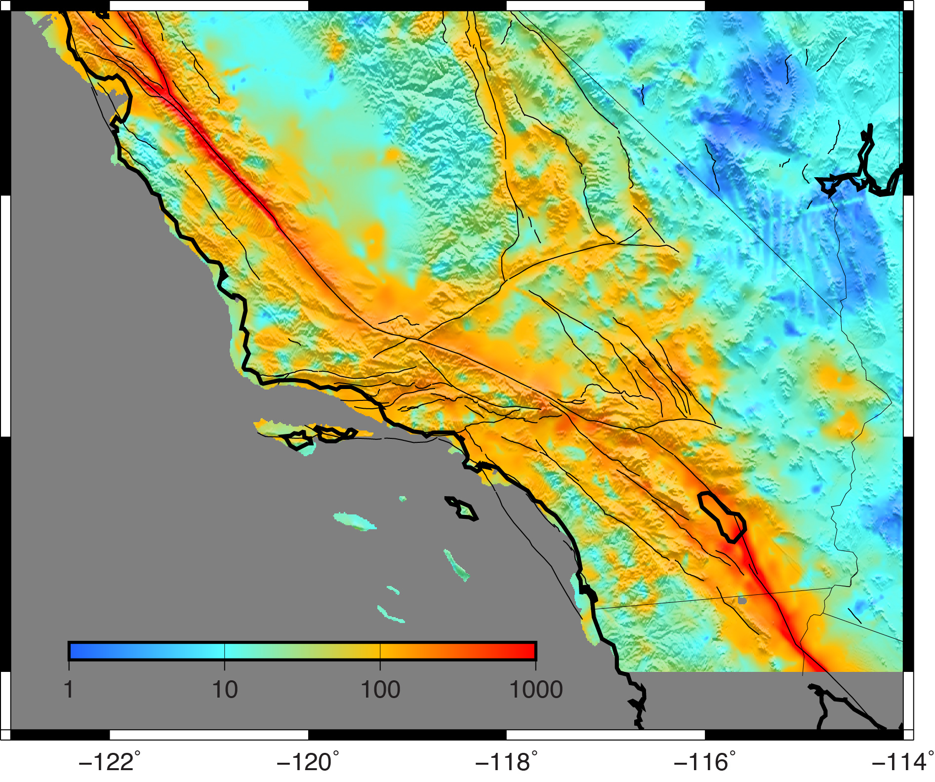
Community Geodetic Model V1 - GPS Strain Rate Grid
GPS velocities from:
PBO
reprocessing of campaign data
[Zeng and Shen, 2016]
other dense GPS data
[Crowell et al., 2013; McCaffrey et al., 2013]
Interpolation to 0.01˚ grid:
10 contributed models
regridded to fit GPS data
computed mean and standard deviation
mean model matched GPS to 0.92 mm/yr.
Uses:
constrain InSAR at long wavelengths
expose areas of inadequate GPS coverage
assessment of off-fault strain rate
poster 141

