Slide 1
MSS CNES_CLS2022 = MSS CNES_CLS2021 plus MSS LEADS in Arctic aera.
Leads come from S3A (20 Hz), Cryosat-2 (20 Hz), and AltiKa (40 Hz) over 2016/07 – 2020/07 period
These data are filtered at 5 Hz to reduce the noise and corrected from the oceanic seasonal and interannual variability using DUACS Map of SLA.
The next steps are similar to those of the MSS 2021:
Determination of a first-guess using Leads & MSS 21 (where is no leads) for λ>50 km
Analysis of the error budget (withe noise, residual effect of oceanic variability, long wavelength bias)
Optimal interpolation of Leads (above the « first guess »)
Combination of the new Leads MSS & CNES_CLS2021 MSS.

Slide 2
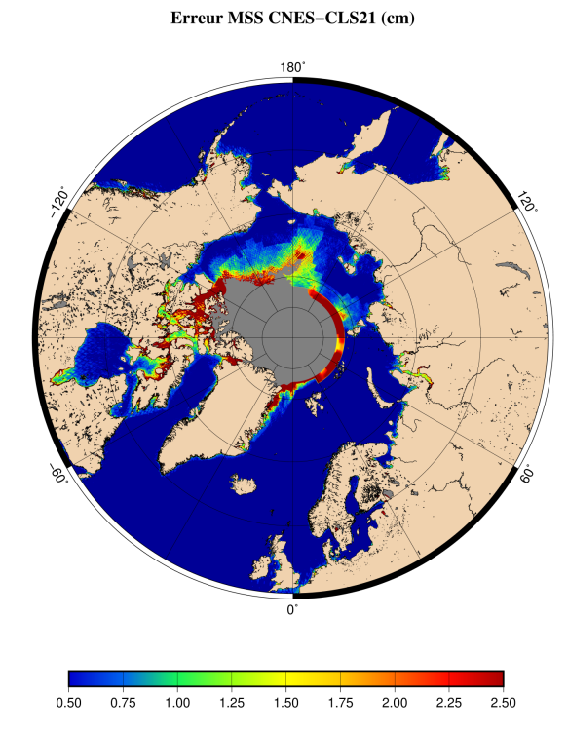
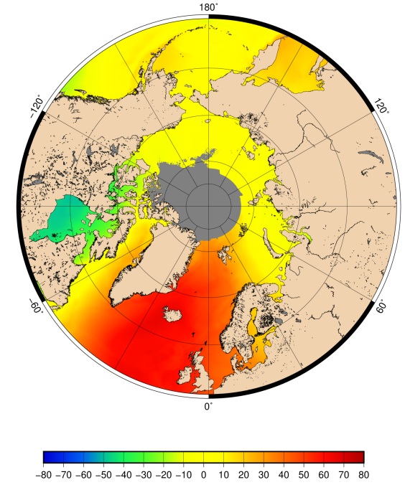
Goal was to fill the area in "gray" of the 2021 MSS
and/or also for the error > 1,75 cm
SMO CNES-CLS21 H(m)

Slide 3
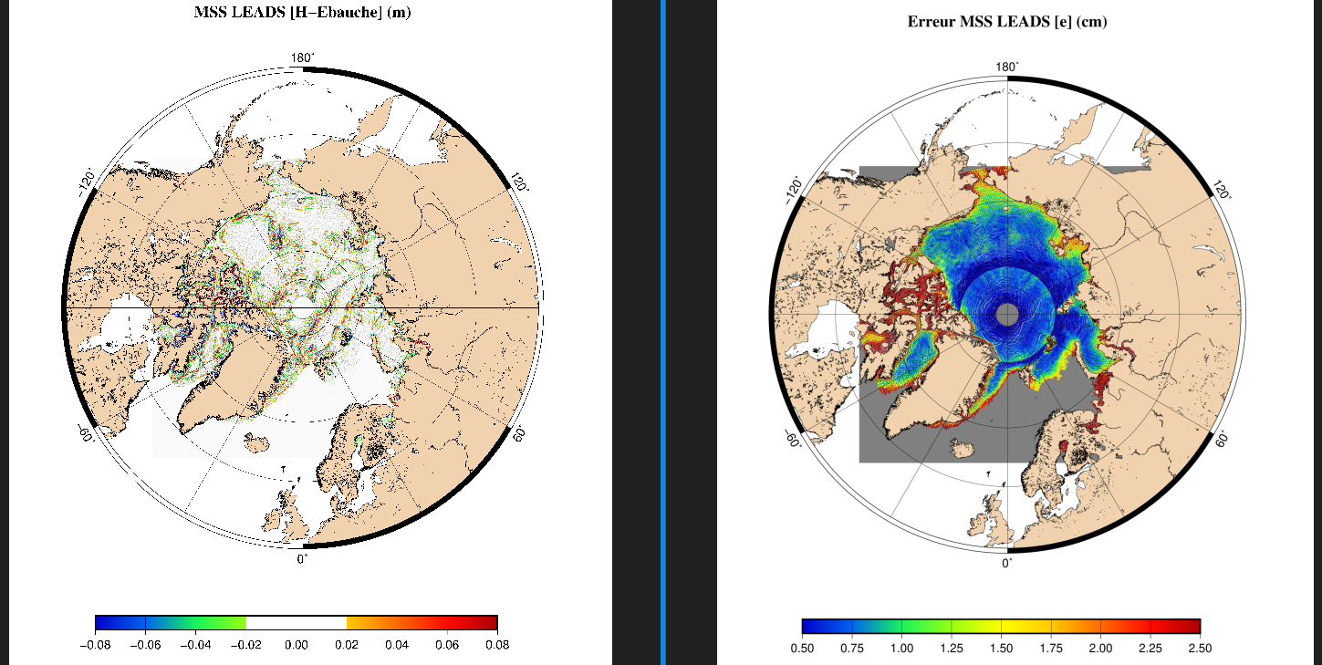
Here is a view of the LEADS MSS ad its associated error
We note the increase of the error between the Canadian islands caused by a lower spatial coverage (no C2 and not much Altika)
Ebauche=First Guess

Slide 4
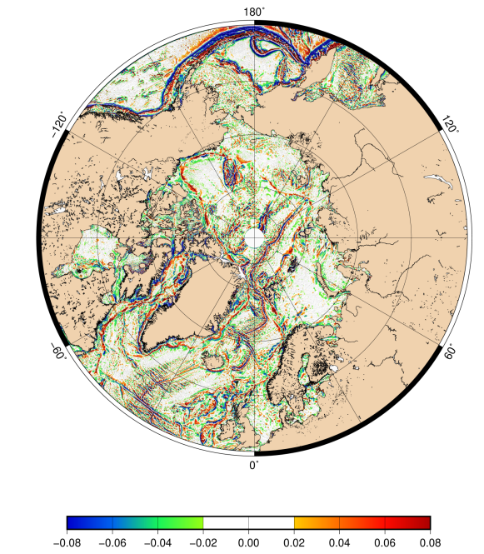
Here is a view of the new combined MSS for wavelength λ < 50 km
H_Fg (m)

