Slide 1
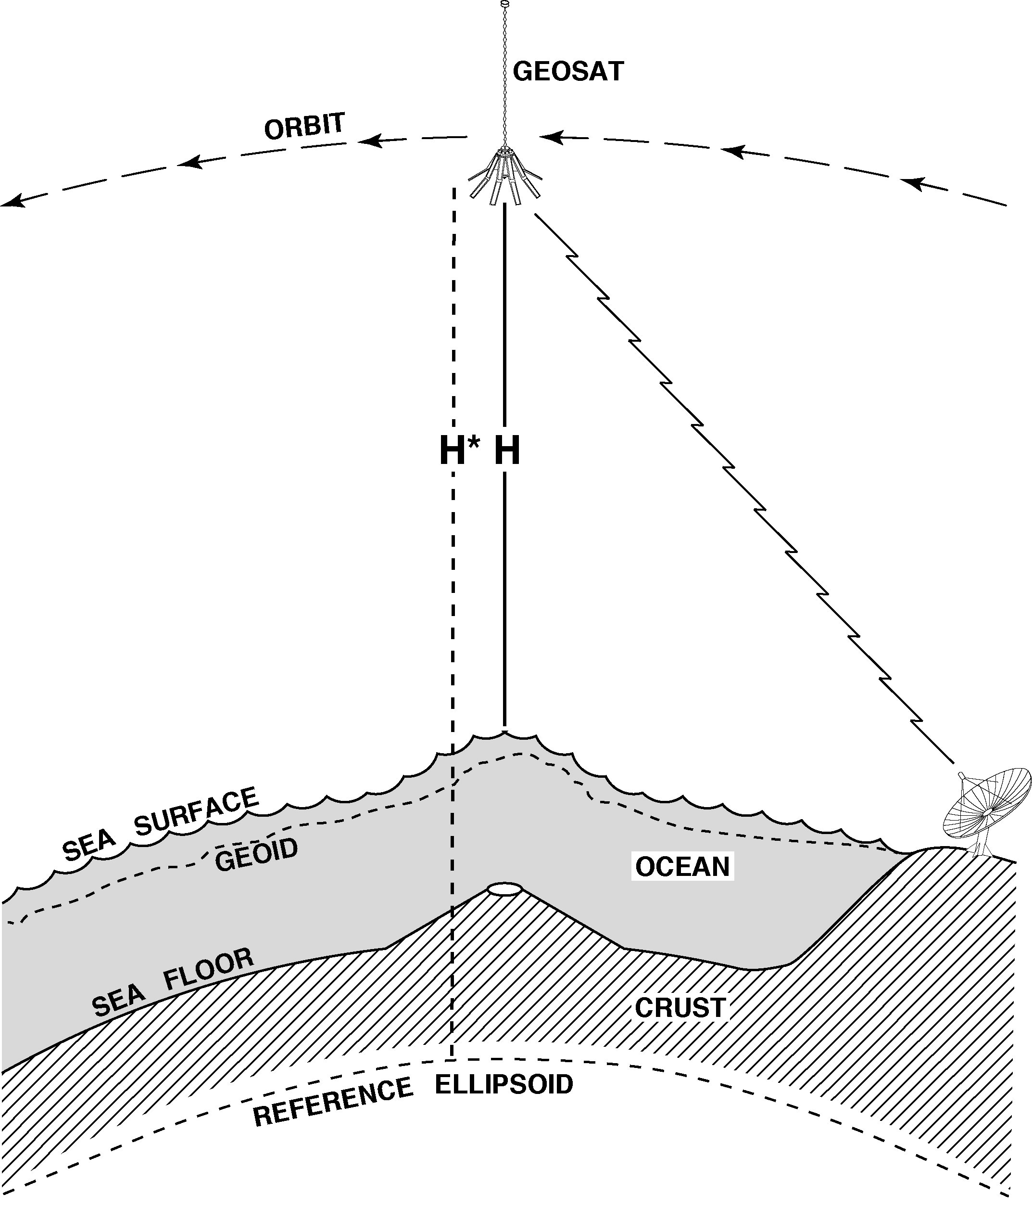
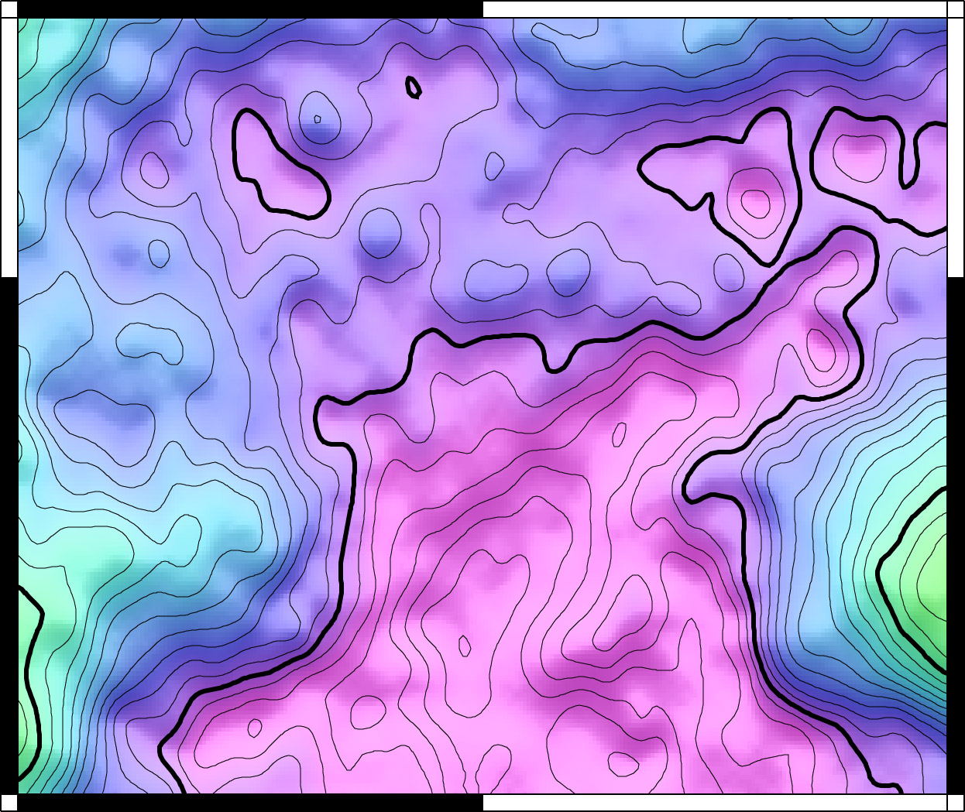
Towards 1 mGal Global
Marine Gravity from
CryoSat, Envisat, and Jason-1
David Sandwell, Emmanuel Garcia, Kahlid Soofi,
Paul Wessel, and Walter H. F. Smith
higher accuracy = improved range precision + improved coverage
retracking CryoSat, Envisat, and Jason-1 waveforms
current gravity accuracy (V21.1 grid)
contributions from Jason-1
Is ship gravity from the academic fleet less accurate than satellite gravity?
expected gravity improvements over the next 2 years
funding from: ConocoPhillips, NSF, and ONR

Slide 2
Achieving 1 mGal Gravity Accuracy
Improved range precision -- A factor of 2 or more improvement in altimeter range precision, with respect to Geosat and ERS-1, is needed to reduce the noise due to ocean waves.
Fine cross-track spacing and long mission duration -- A ground track spacing of 6 km or less is required.
Moderate inclination -- Current non-repeat-orbit altimeter data have high inclination and thus poor accuracy of the E-W slope at the equator.
Near-shore tracking -- For applications near coastlines, the ability to track the ocean surface close to shore is desirable.

Slide 3
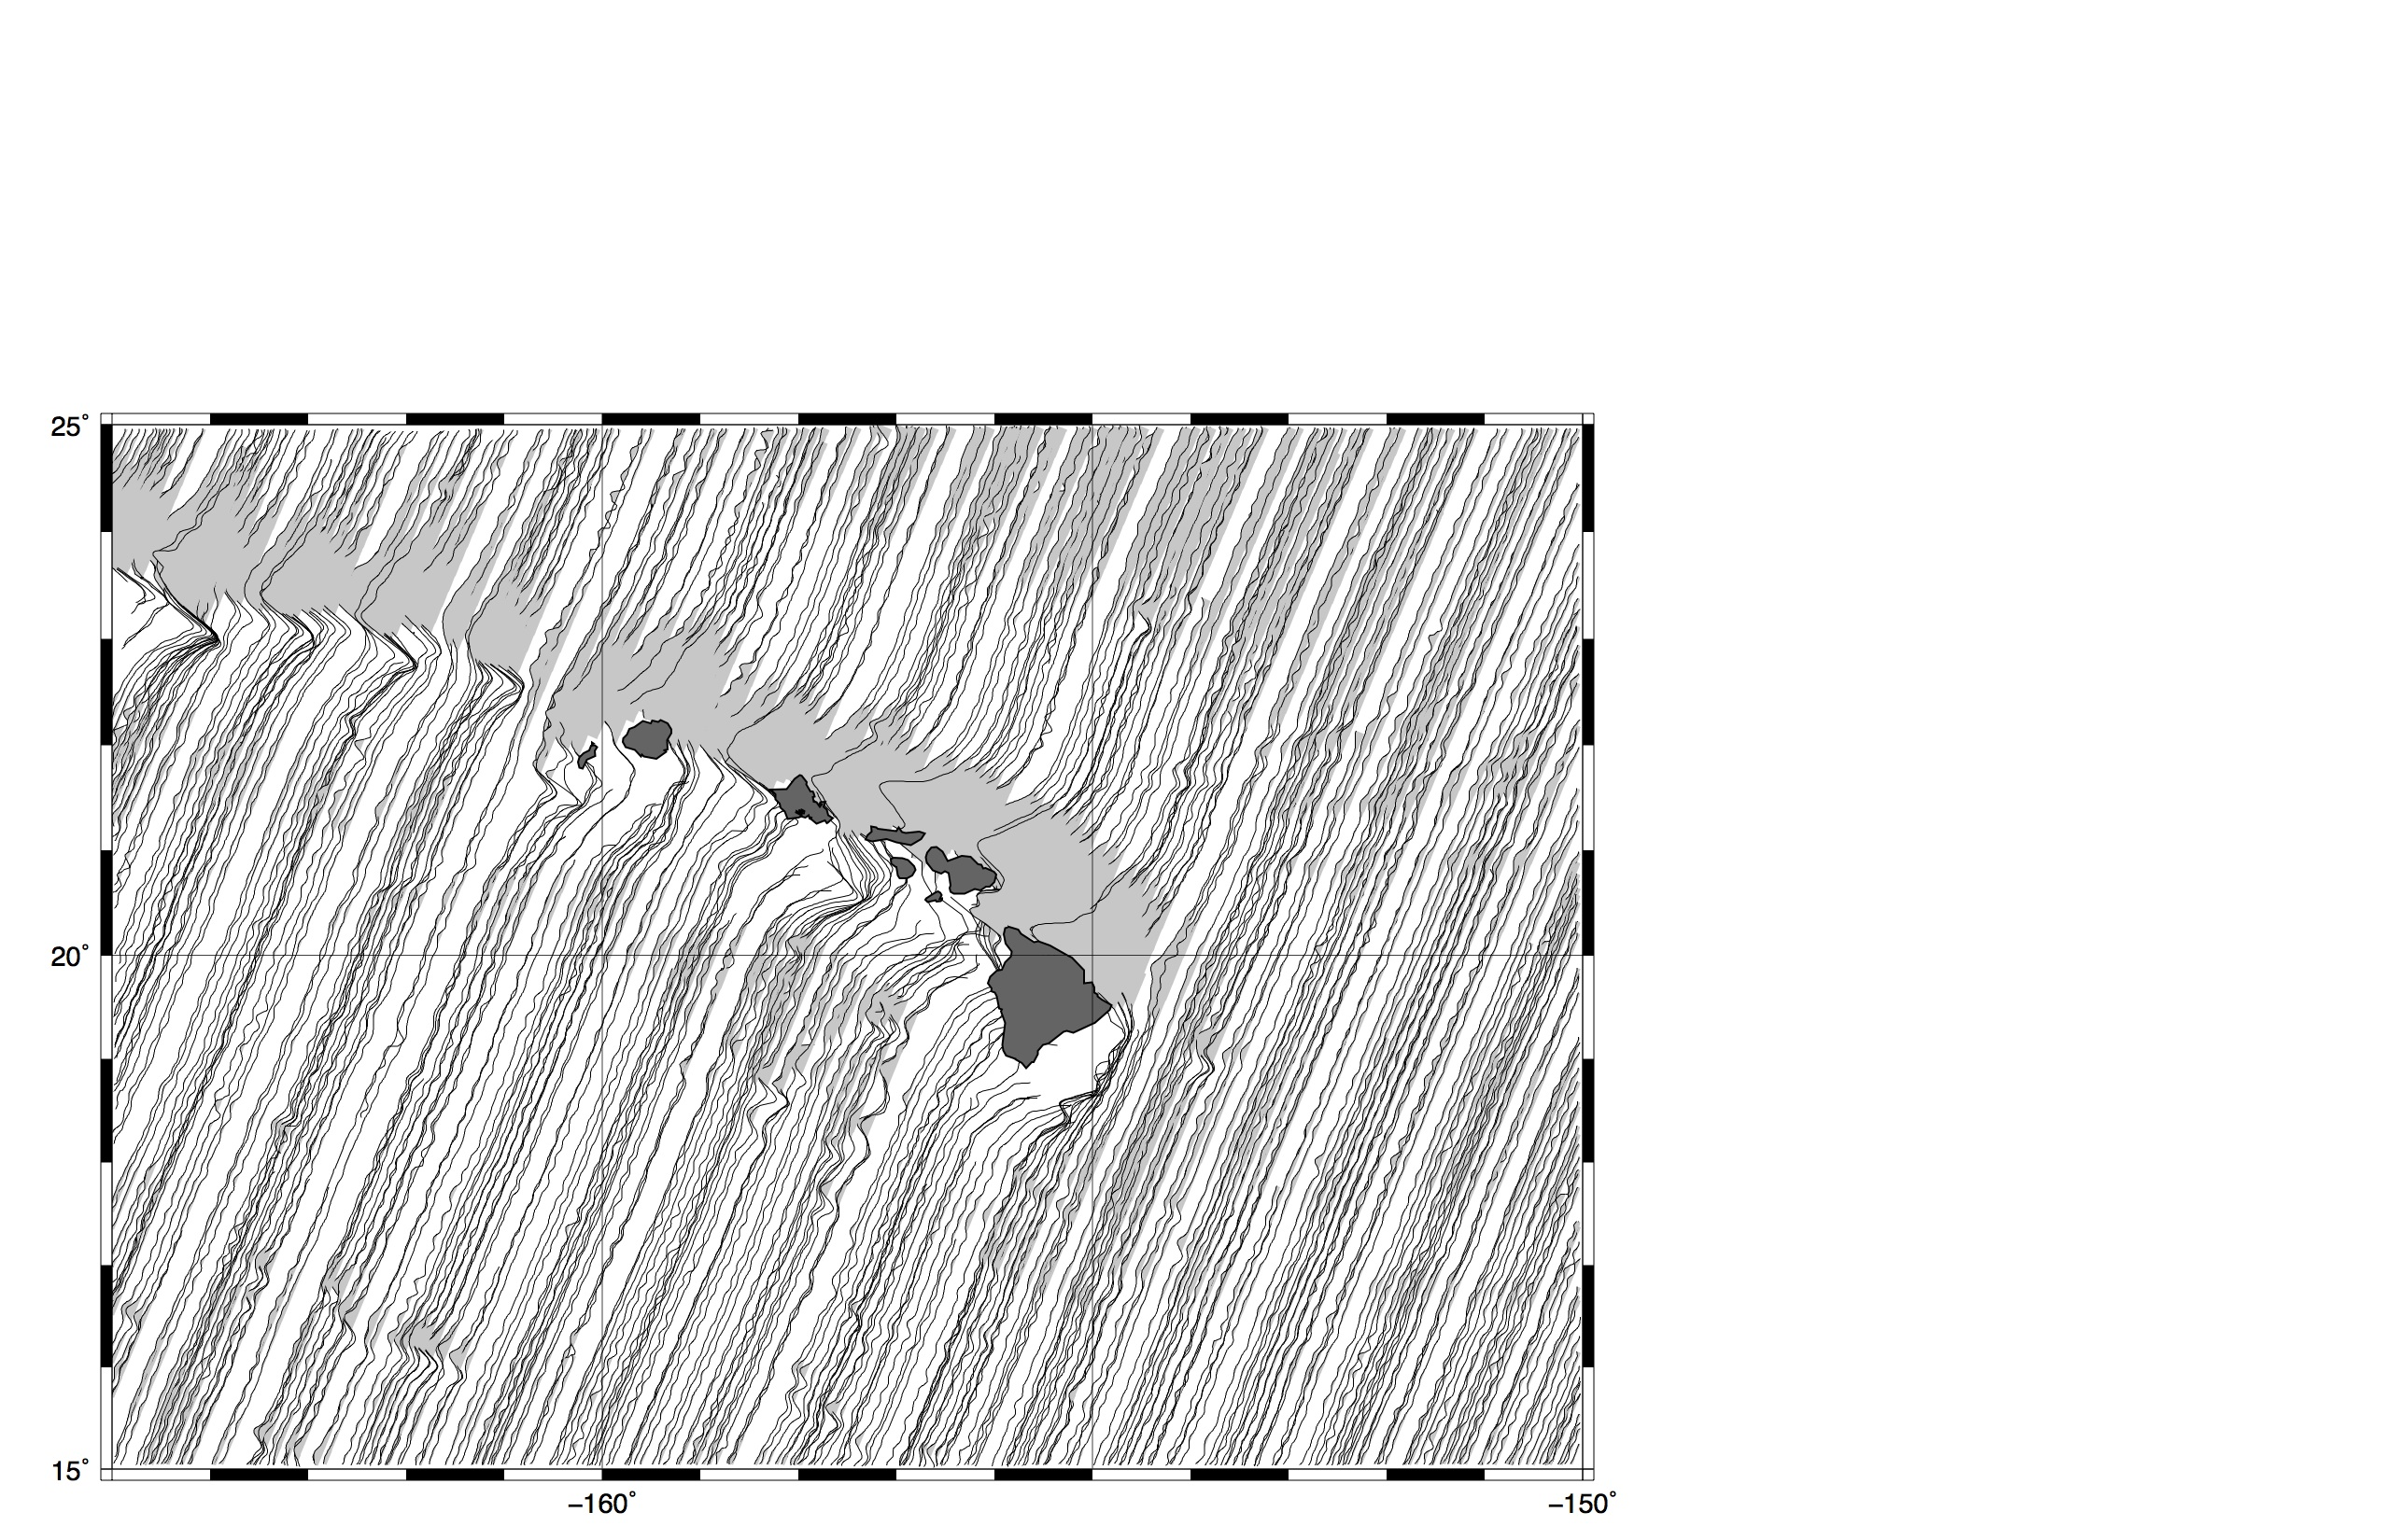
Geosat/GM (old)

Slide 4
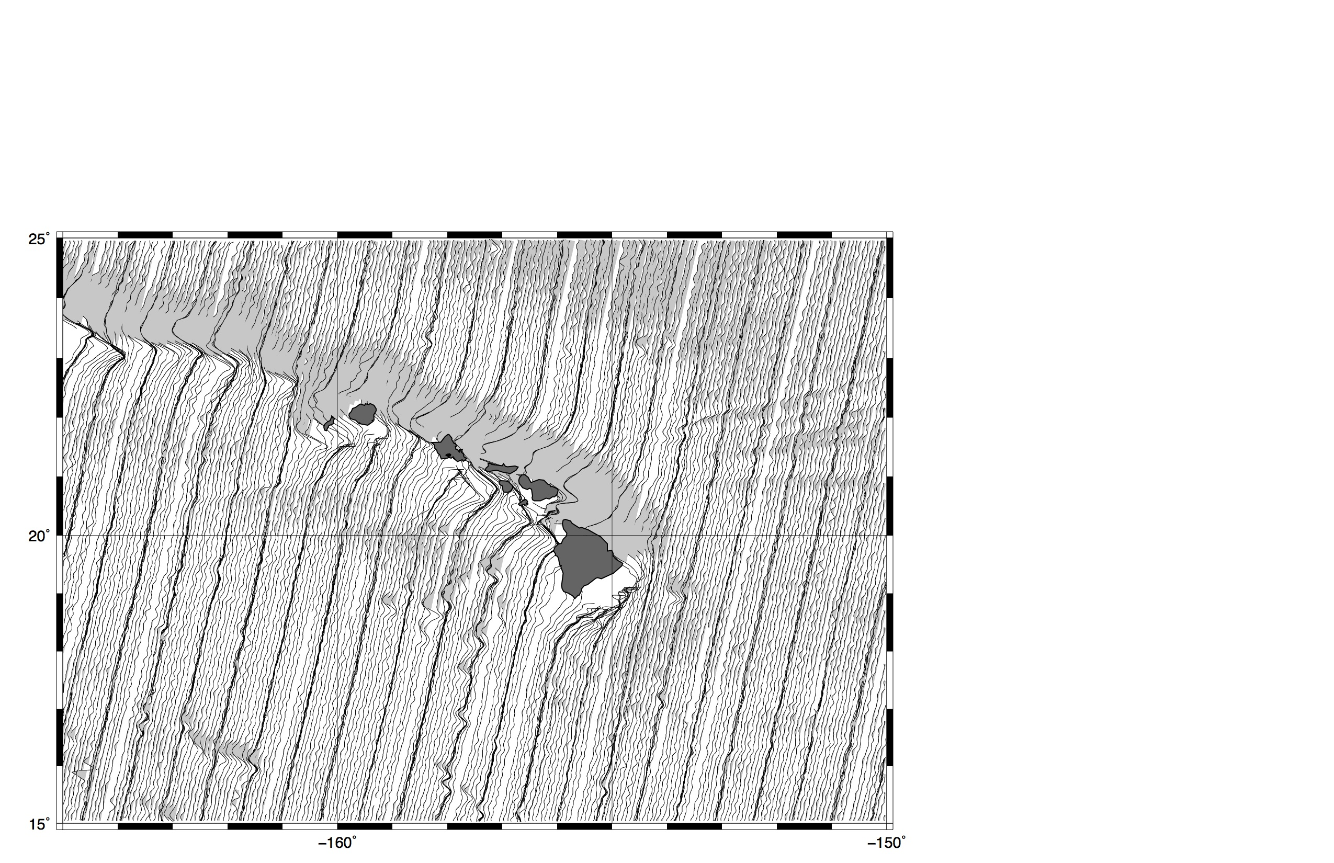
ERS-1/GM (old)

Slide 5
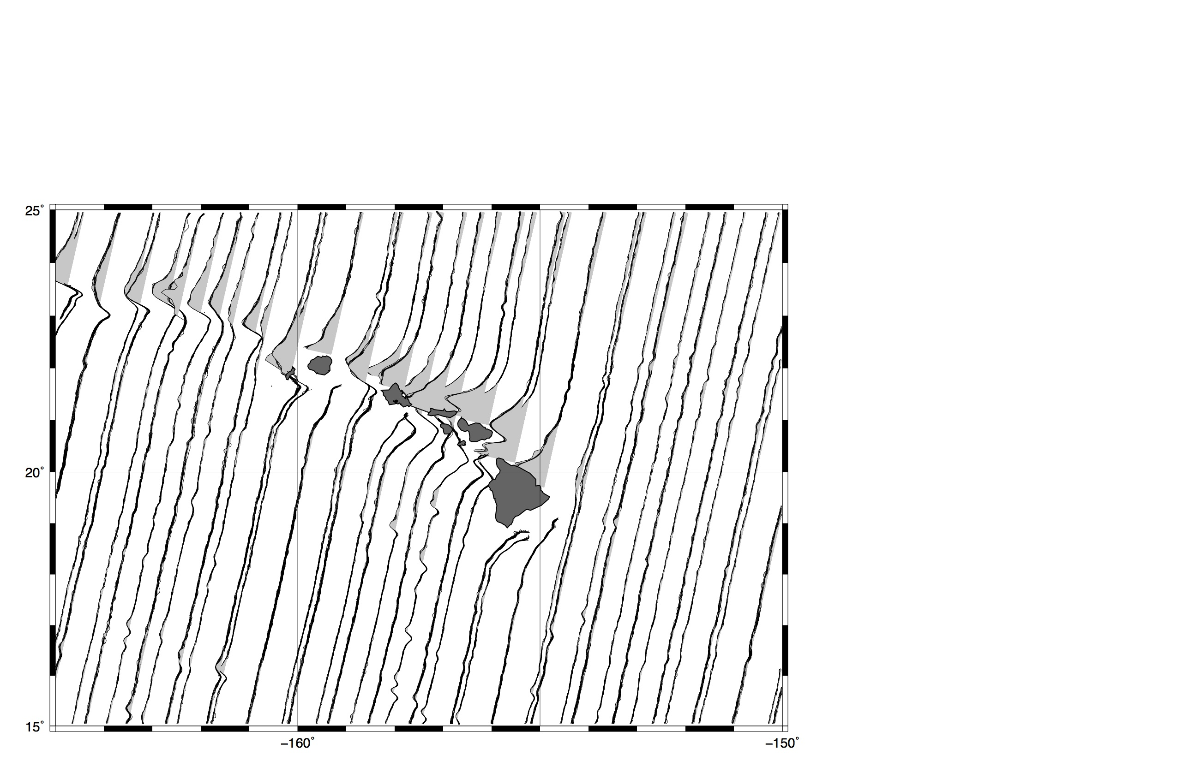
Envisat (new)

Slide 6
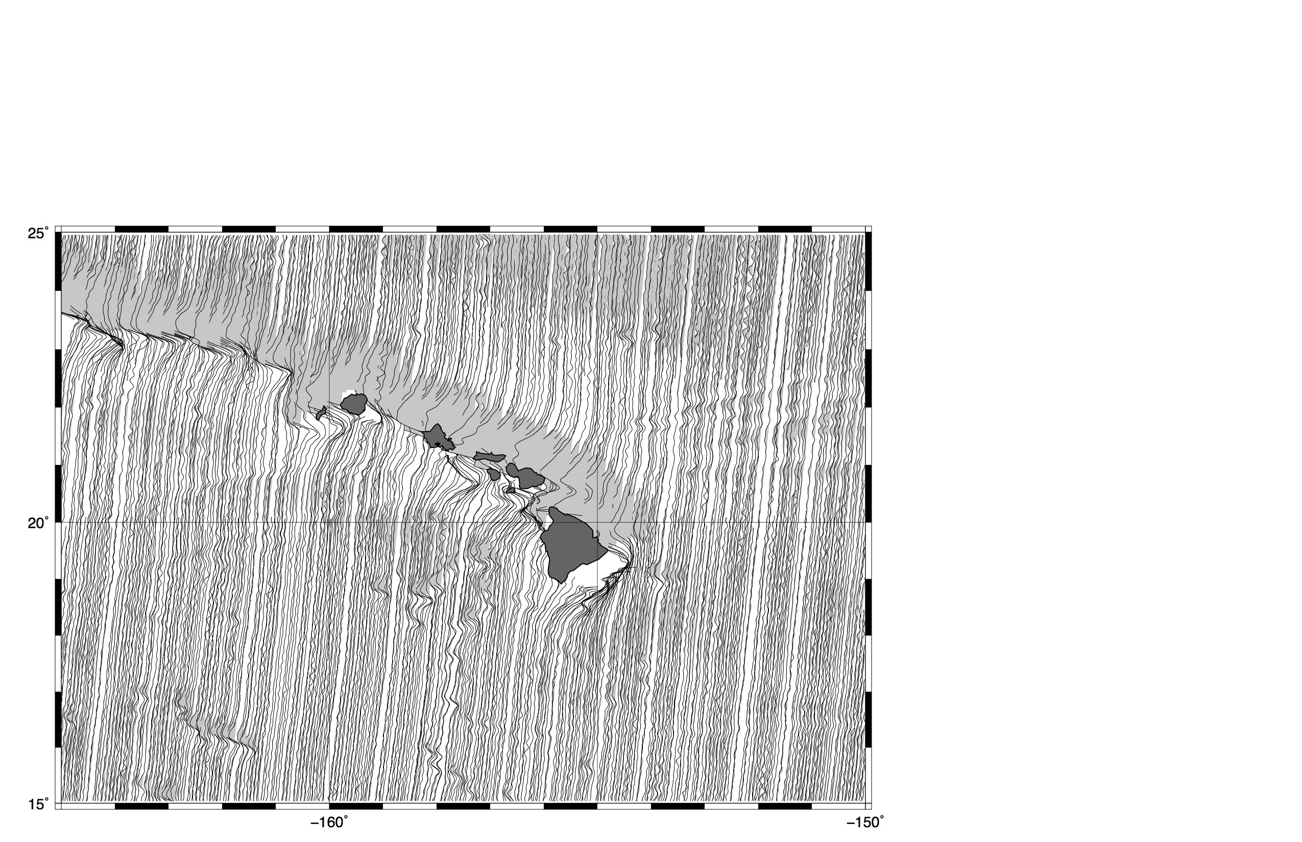
CyoSat (new – 24 mo.)

Slide 7
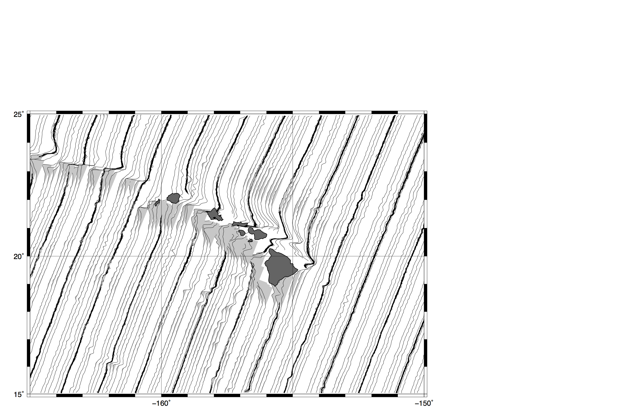
Jason-1 + GM (new - 120 days)

Slide 8
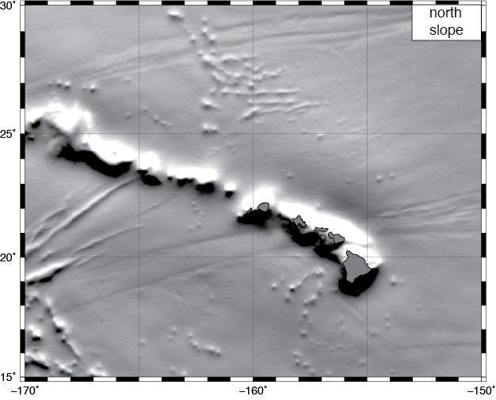
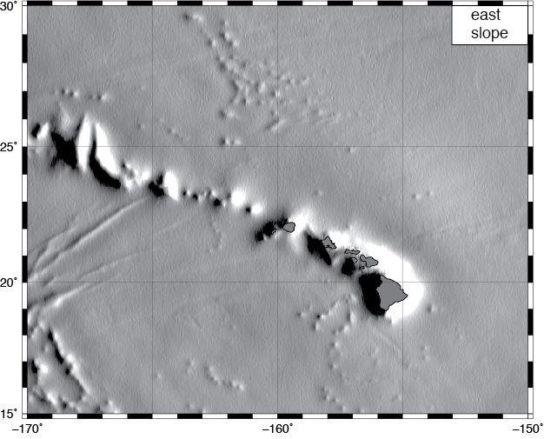
north and east slope
  combine along-track slopes from all available satellite altimeters to form north and east slope grids.
current altimeters provide ~2 x higher noise in the east slope than in the north slope because of their high inclination orbits.

Slide 9
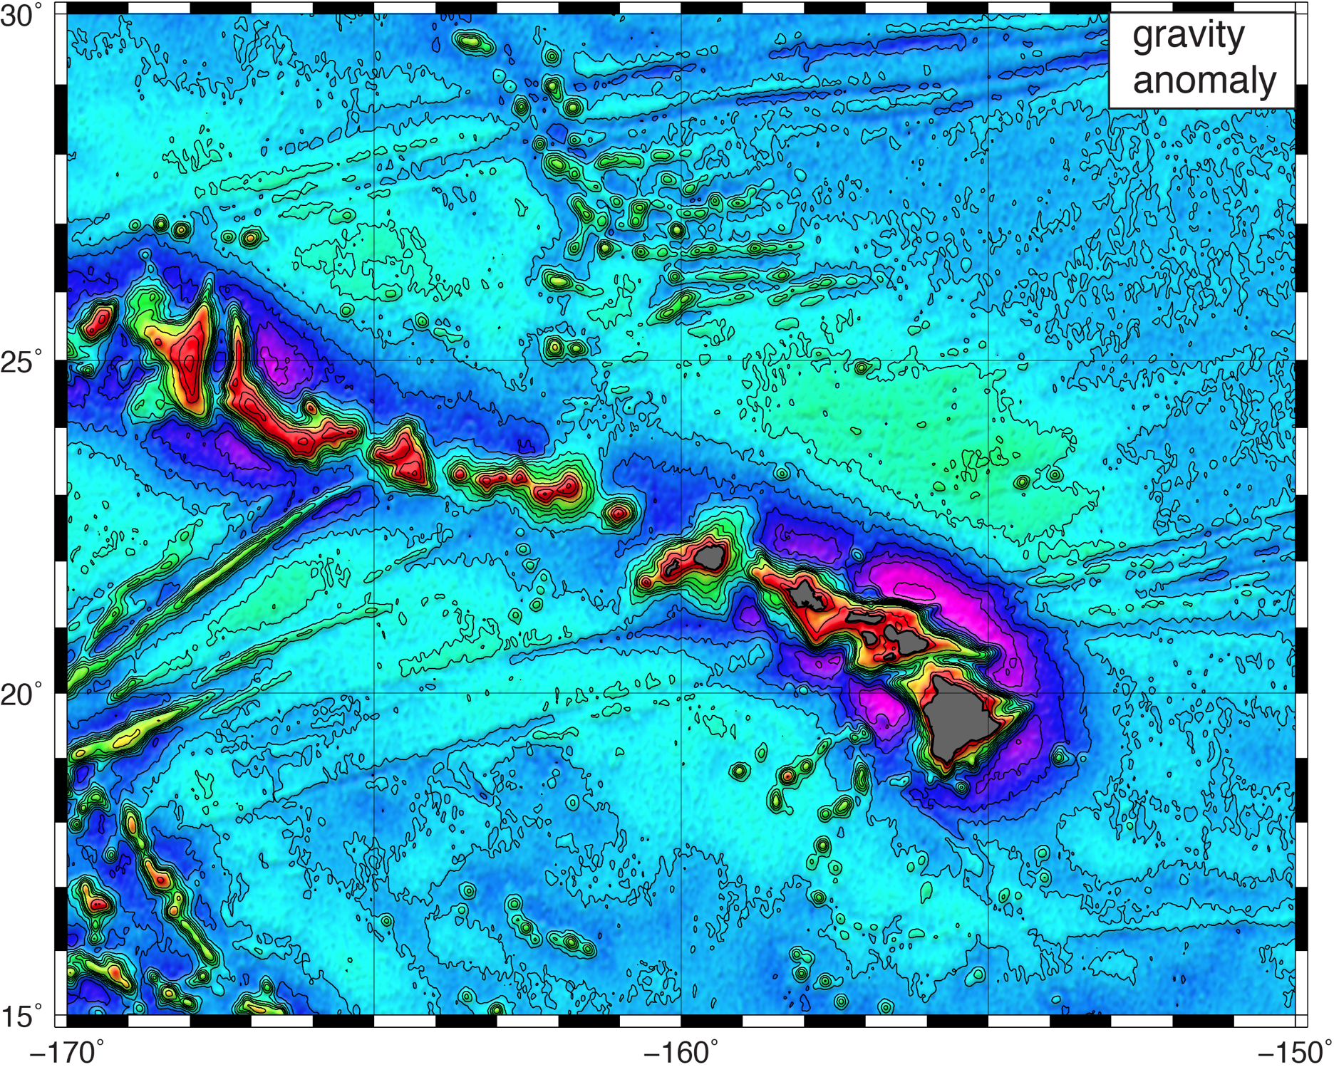
gravity anomaly
  use Laplace equation to convert slopes to gravity anomaly.
  restore long-λ gravity model.

Slide 10
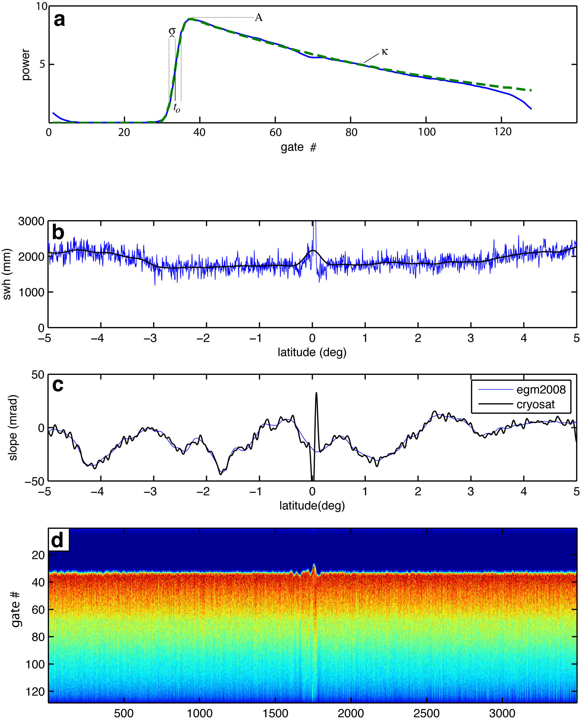
2-pass retracking to improve range precision
retrack waveforms with standard 3-parameter model
smooth wave height and amplitude over 40-km
retrack waveforms with 2-parameter model
Note: this assumes wave height varies smoothly along track.
[Sandwell and Smith, GJI, 2005]

Slide 11
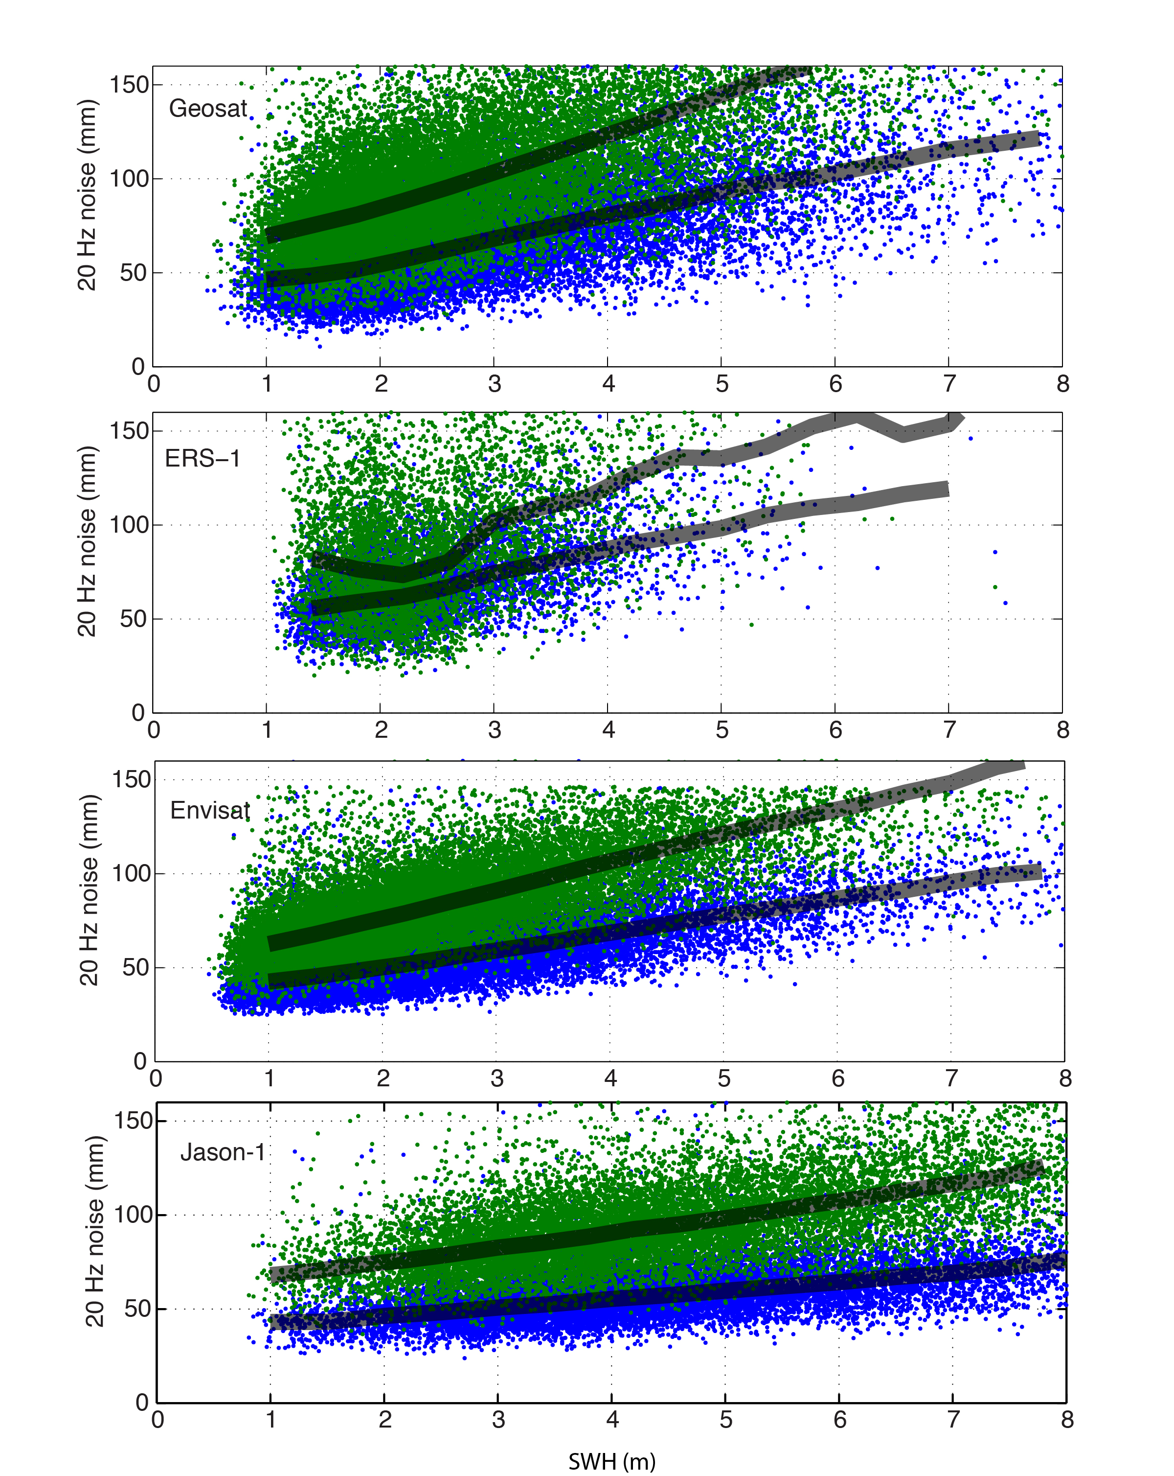
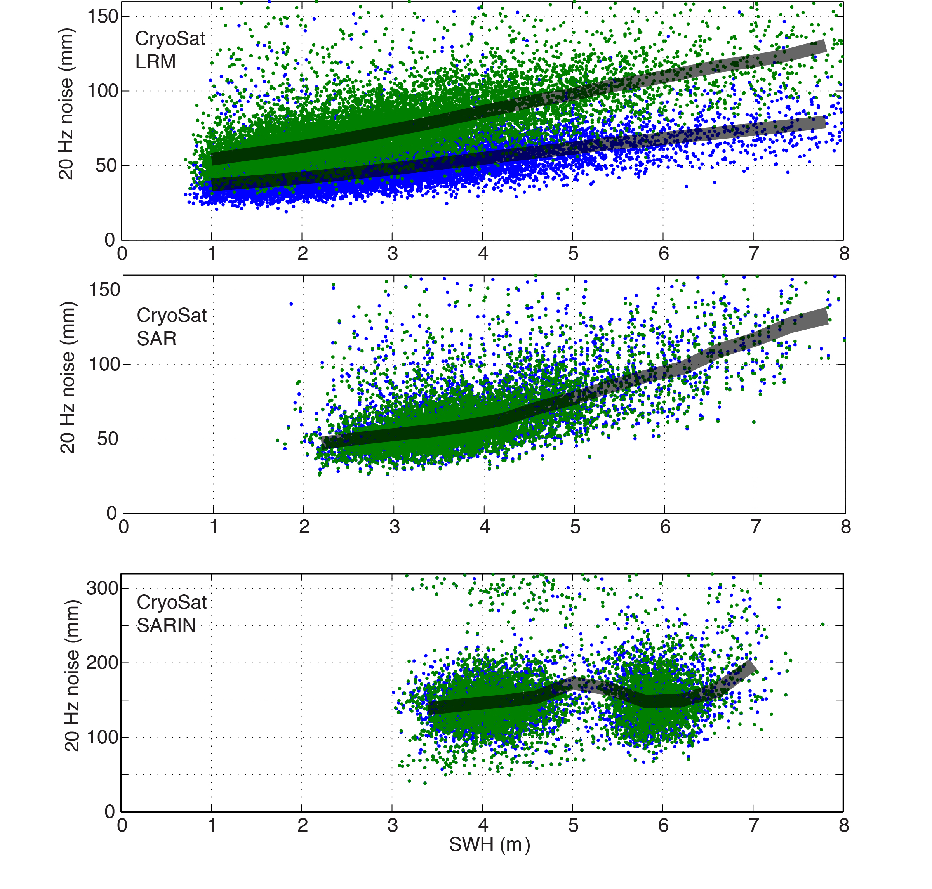
20 Hz noise of all altimeters
3-parameter
2-parameter

Slide 12
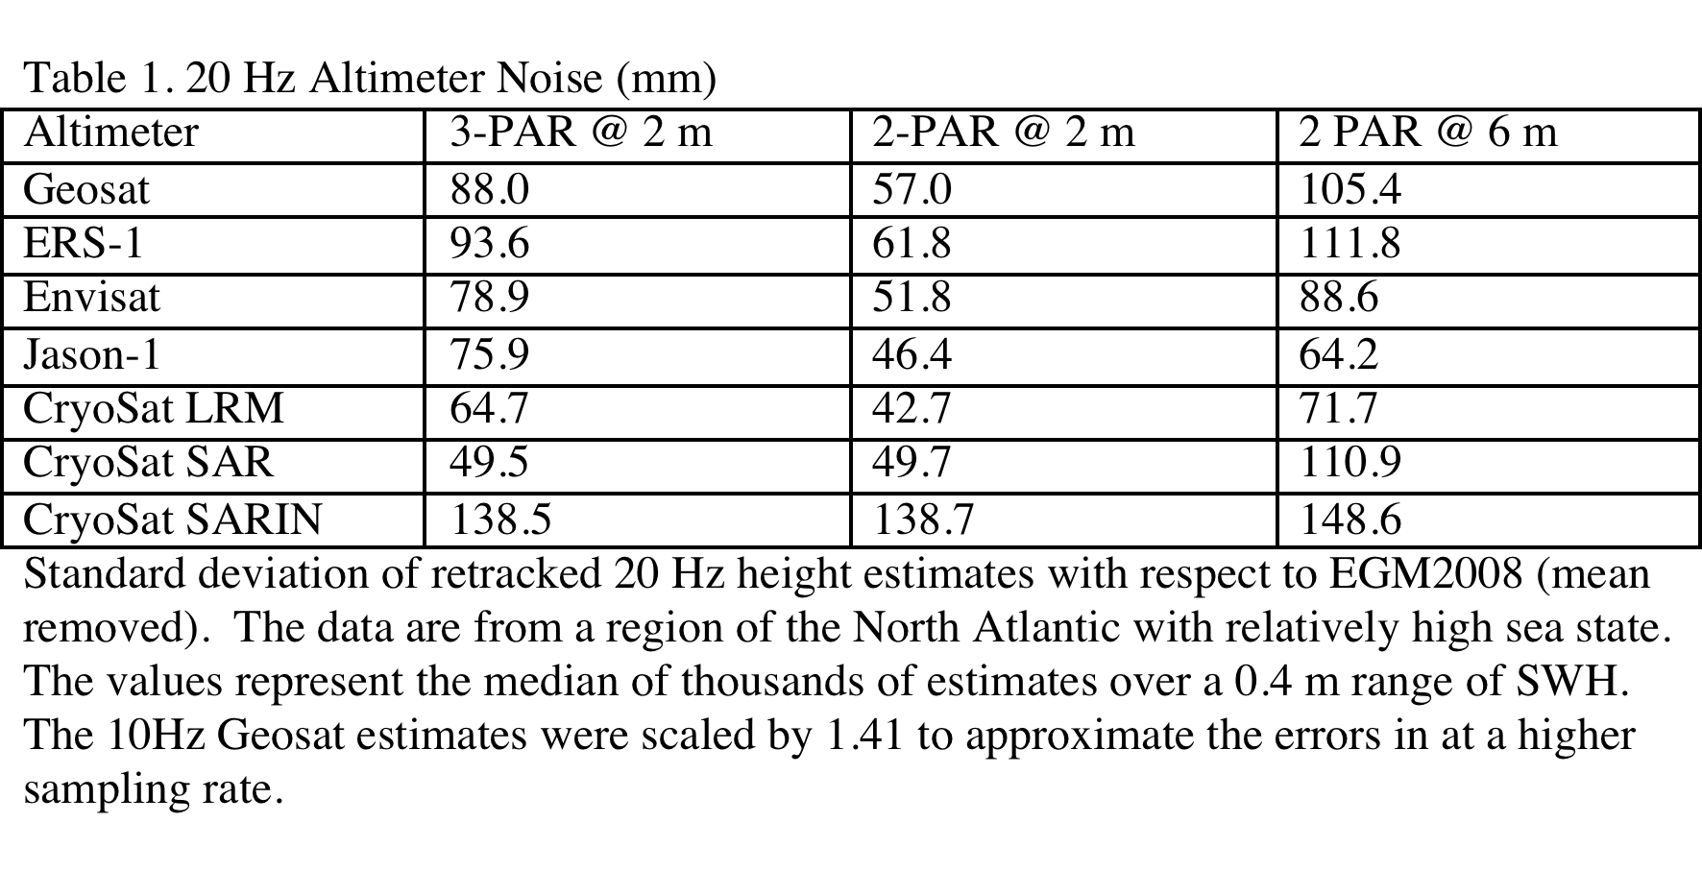
why retracking is essential
improvement
factor
1.56
1.54
1.54
1.52
1.63
1.52
0.996
0.998

Slide 13
Global Gravity Anomaly V21.1

Slide 14
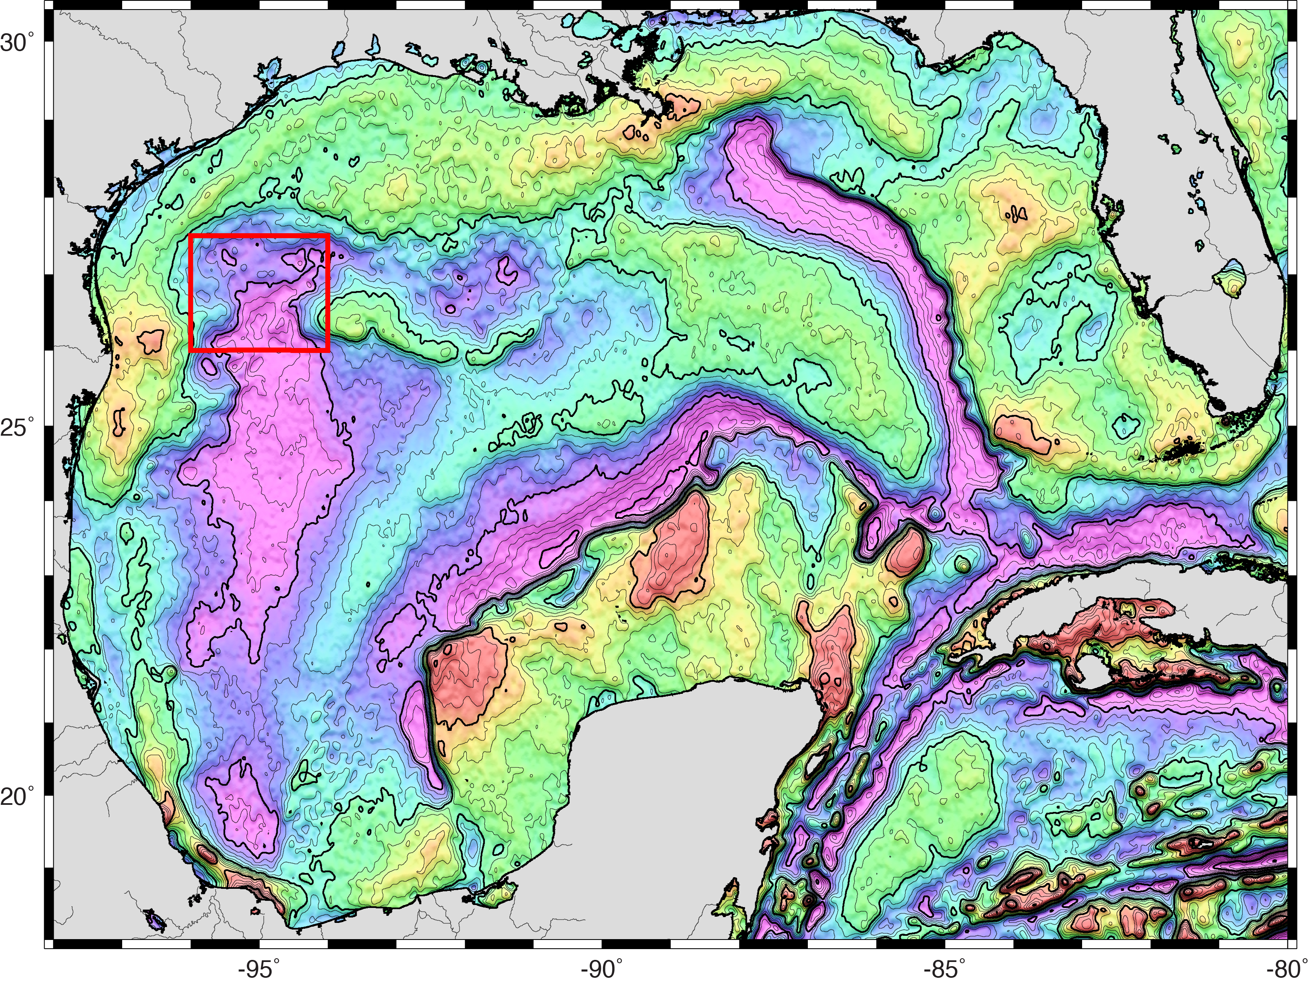
Gravity Anomaly V21.1 (10 mGal contours)

Slide 15
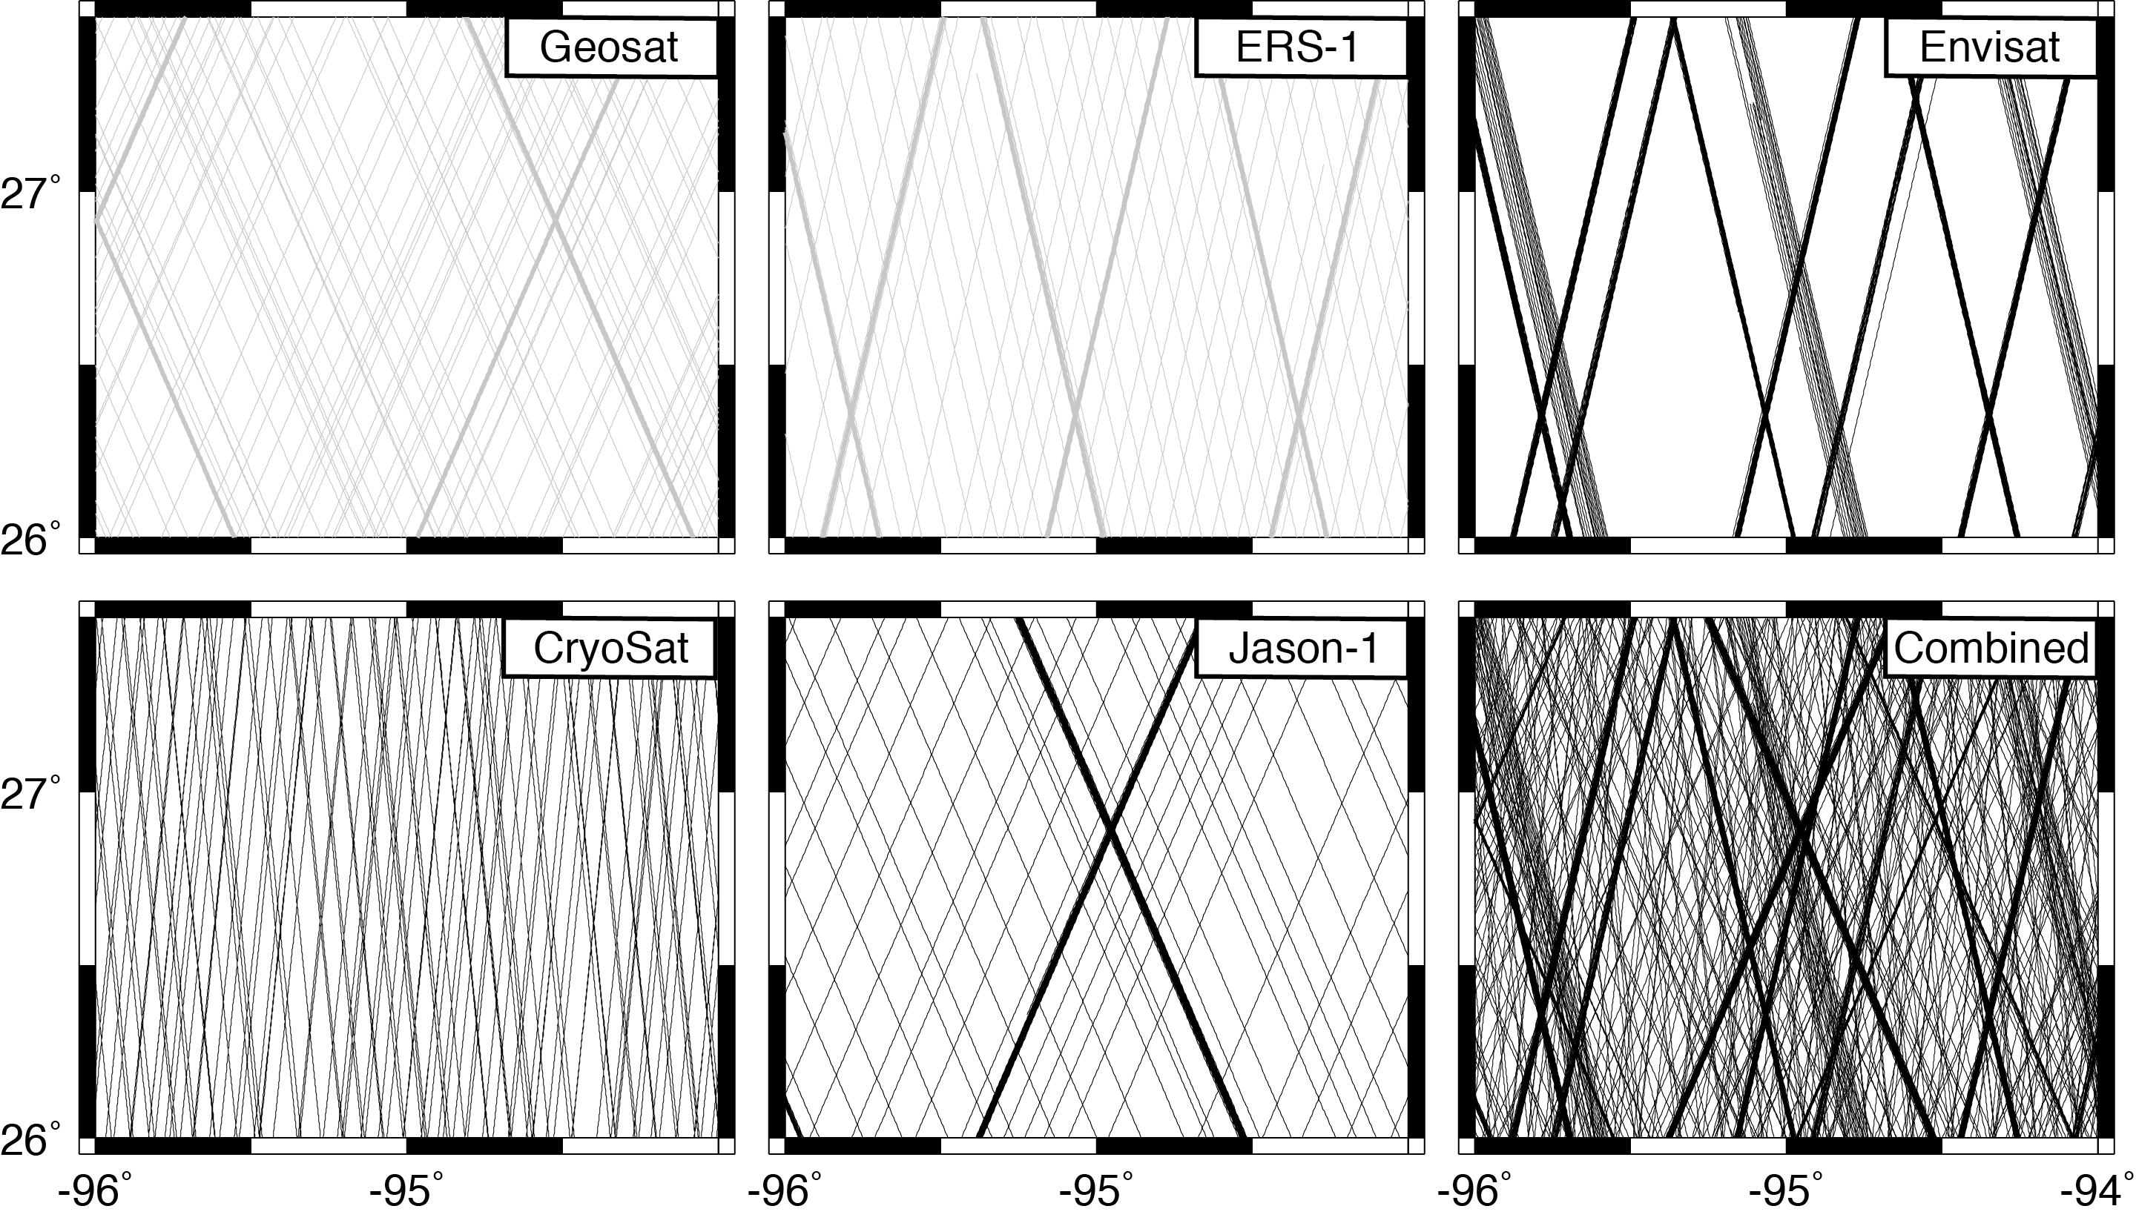
satellite tracks in the Gulf of Mexico

Slide 16
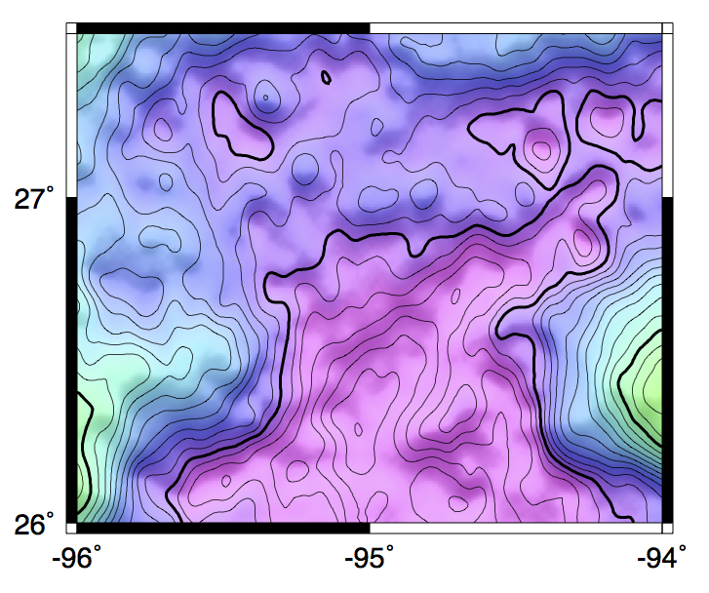
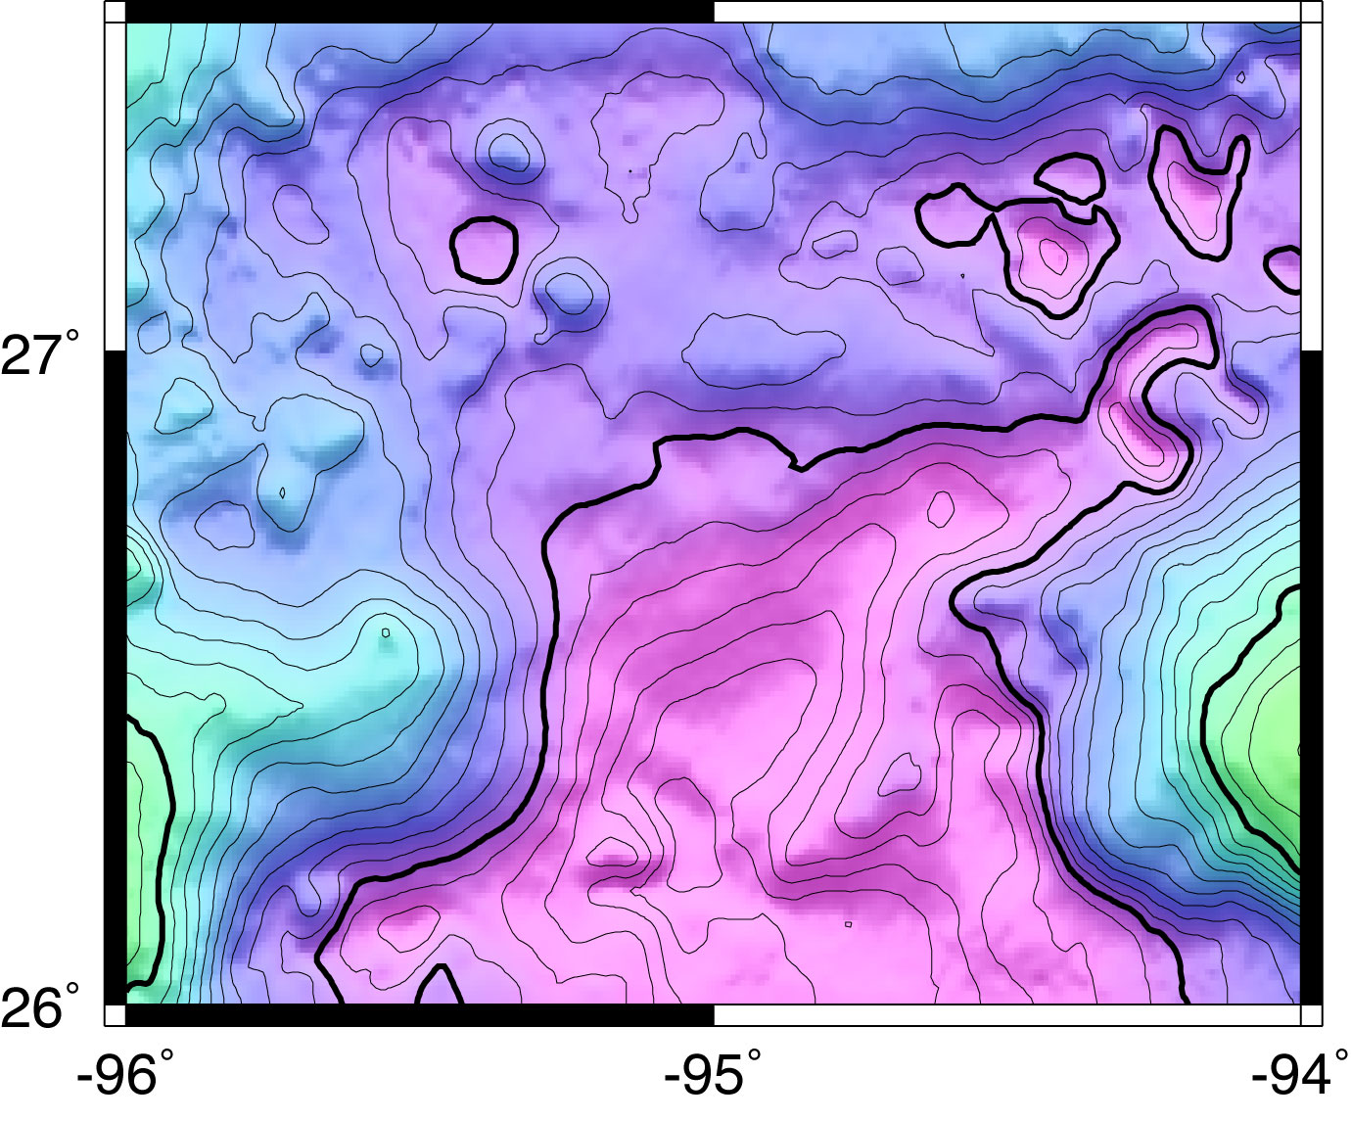
comparisons in the Gulf of Mexico
satellite gravity
with CryoSat LRM, Envisat and Jason-1
ship gravity
source: EDCON
5 mGal contour interval

Slide 17
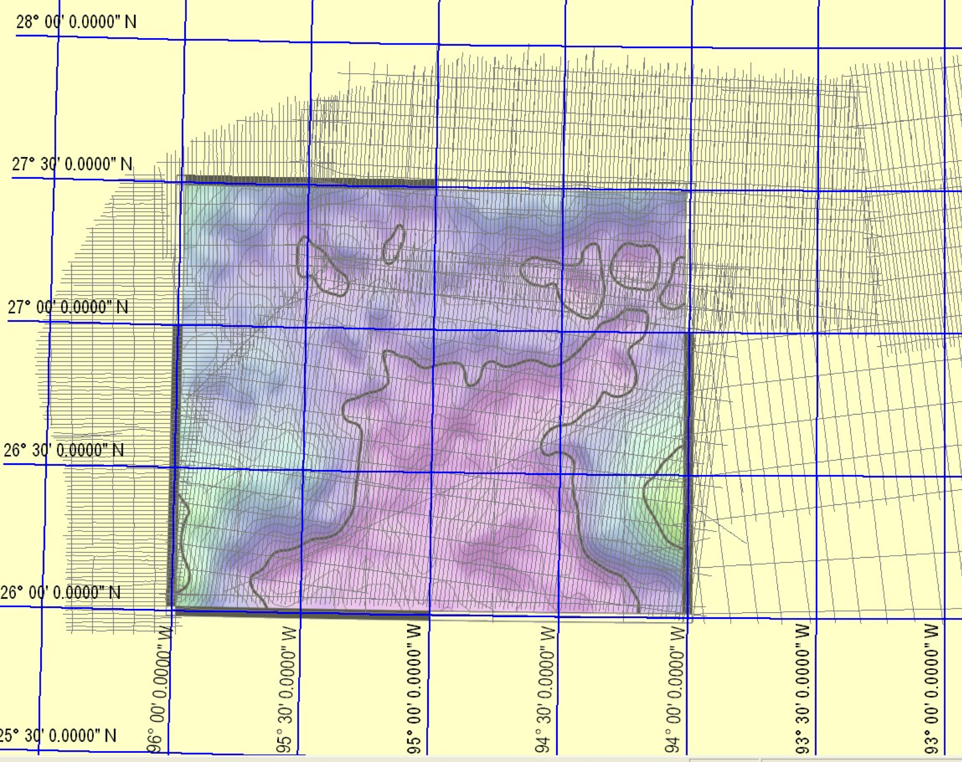
GPS Navigated Gravity survey of Alaminos Canyon
(Alan Herring, personal communication, Dec. 2011.)

Slide 18
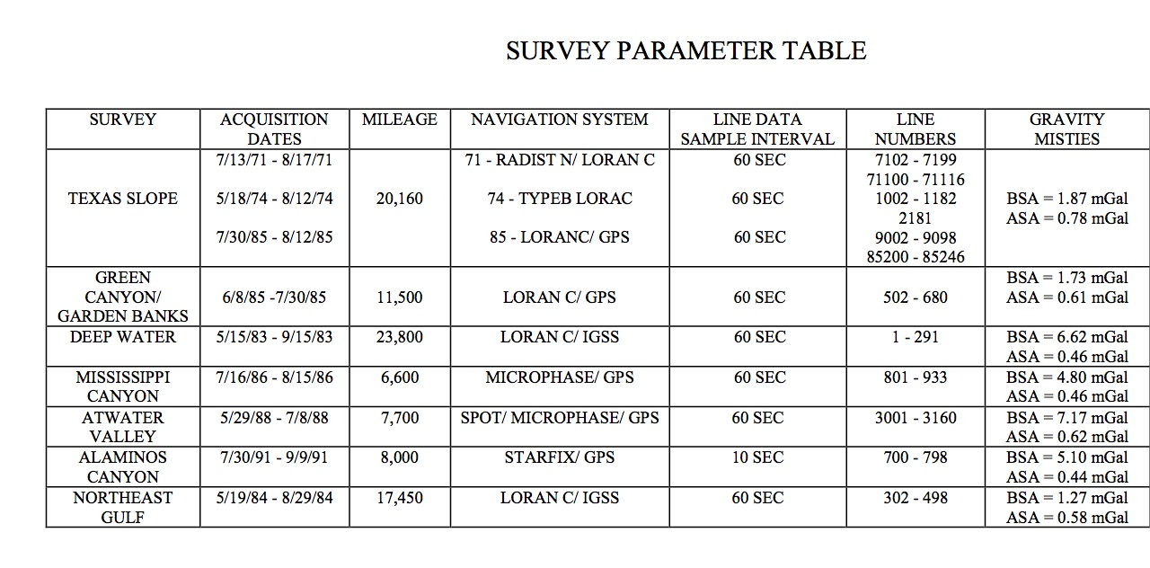
Error in EDCON gravity 5 mGal before crossover adjustment or 0.5 mGal
after crossover adjustment? – Probably closer to 0.5 mGal?

Slide 19
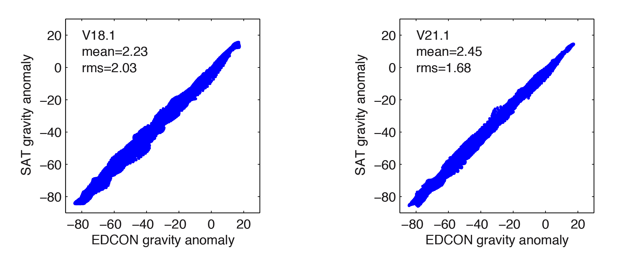
comparisons in the Gulf of Mexico
We don’t yet know the noise contribution from the EDCON data.

Slide 20
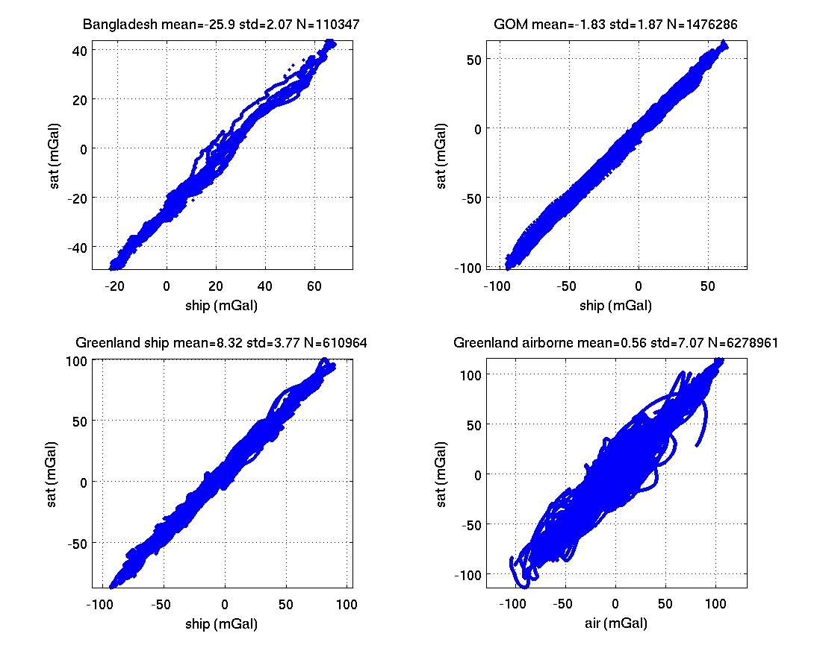
blind tests performed at ConocoPhillips
tests with V19.1
no Jason data

Slide 21
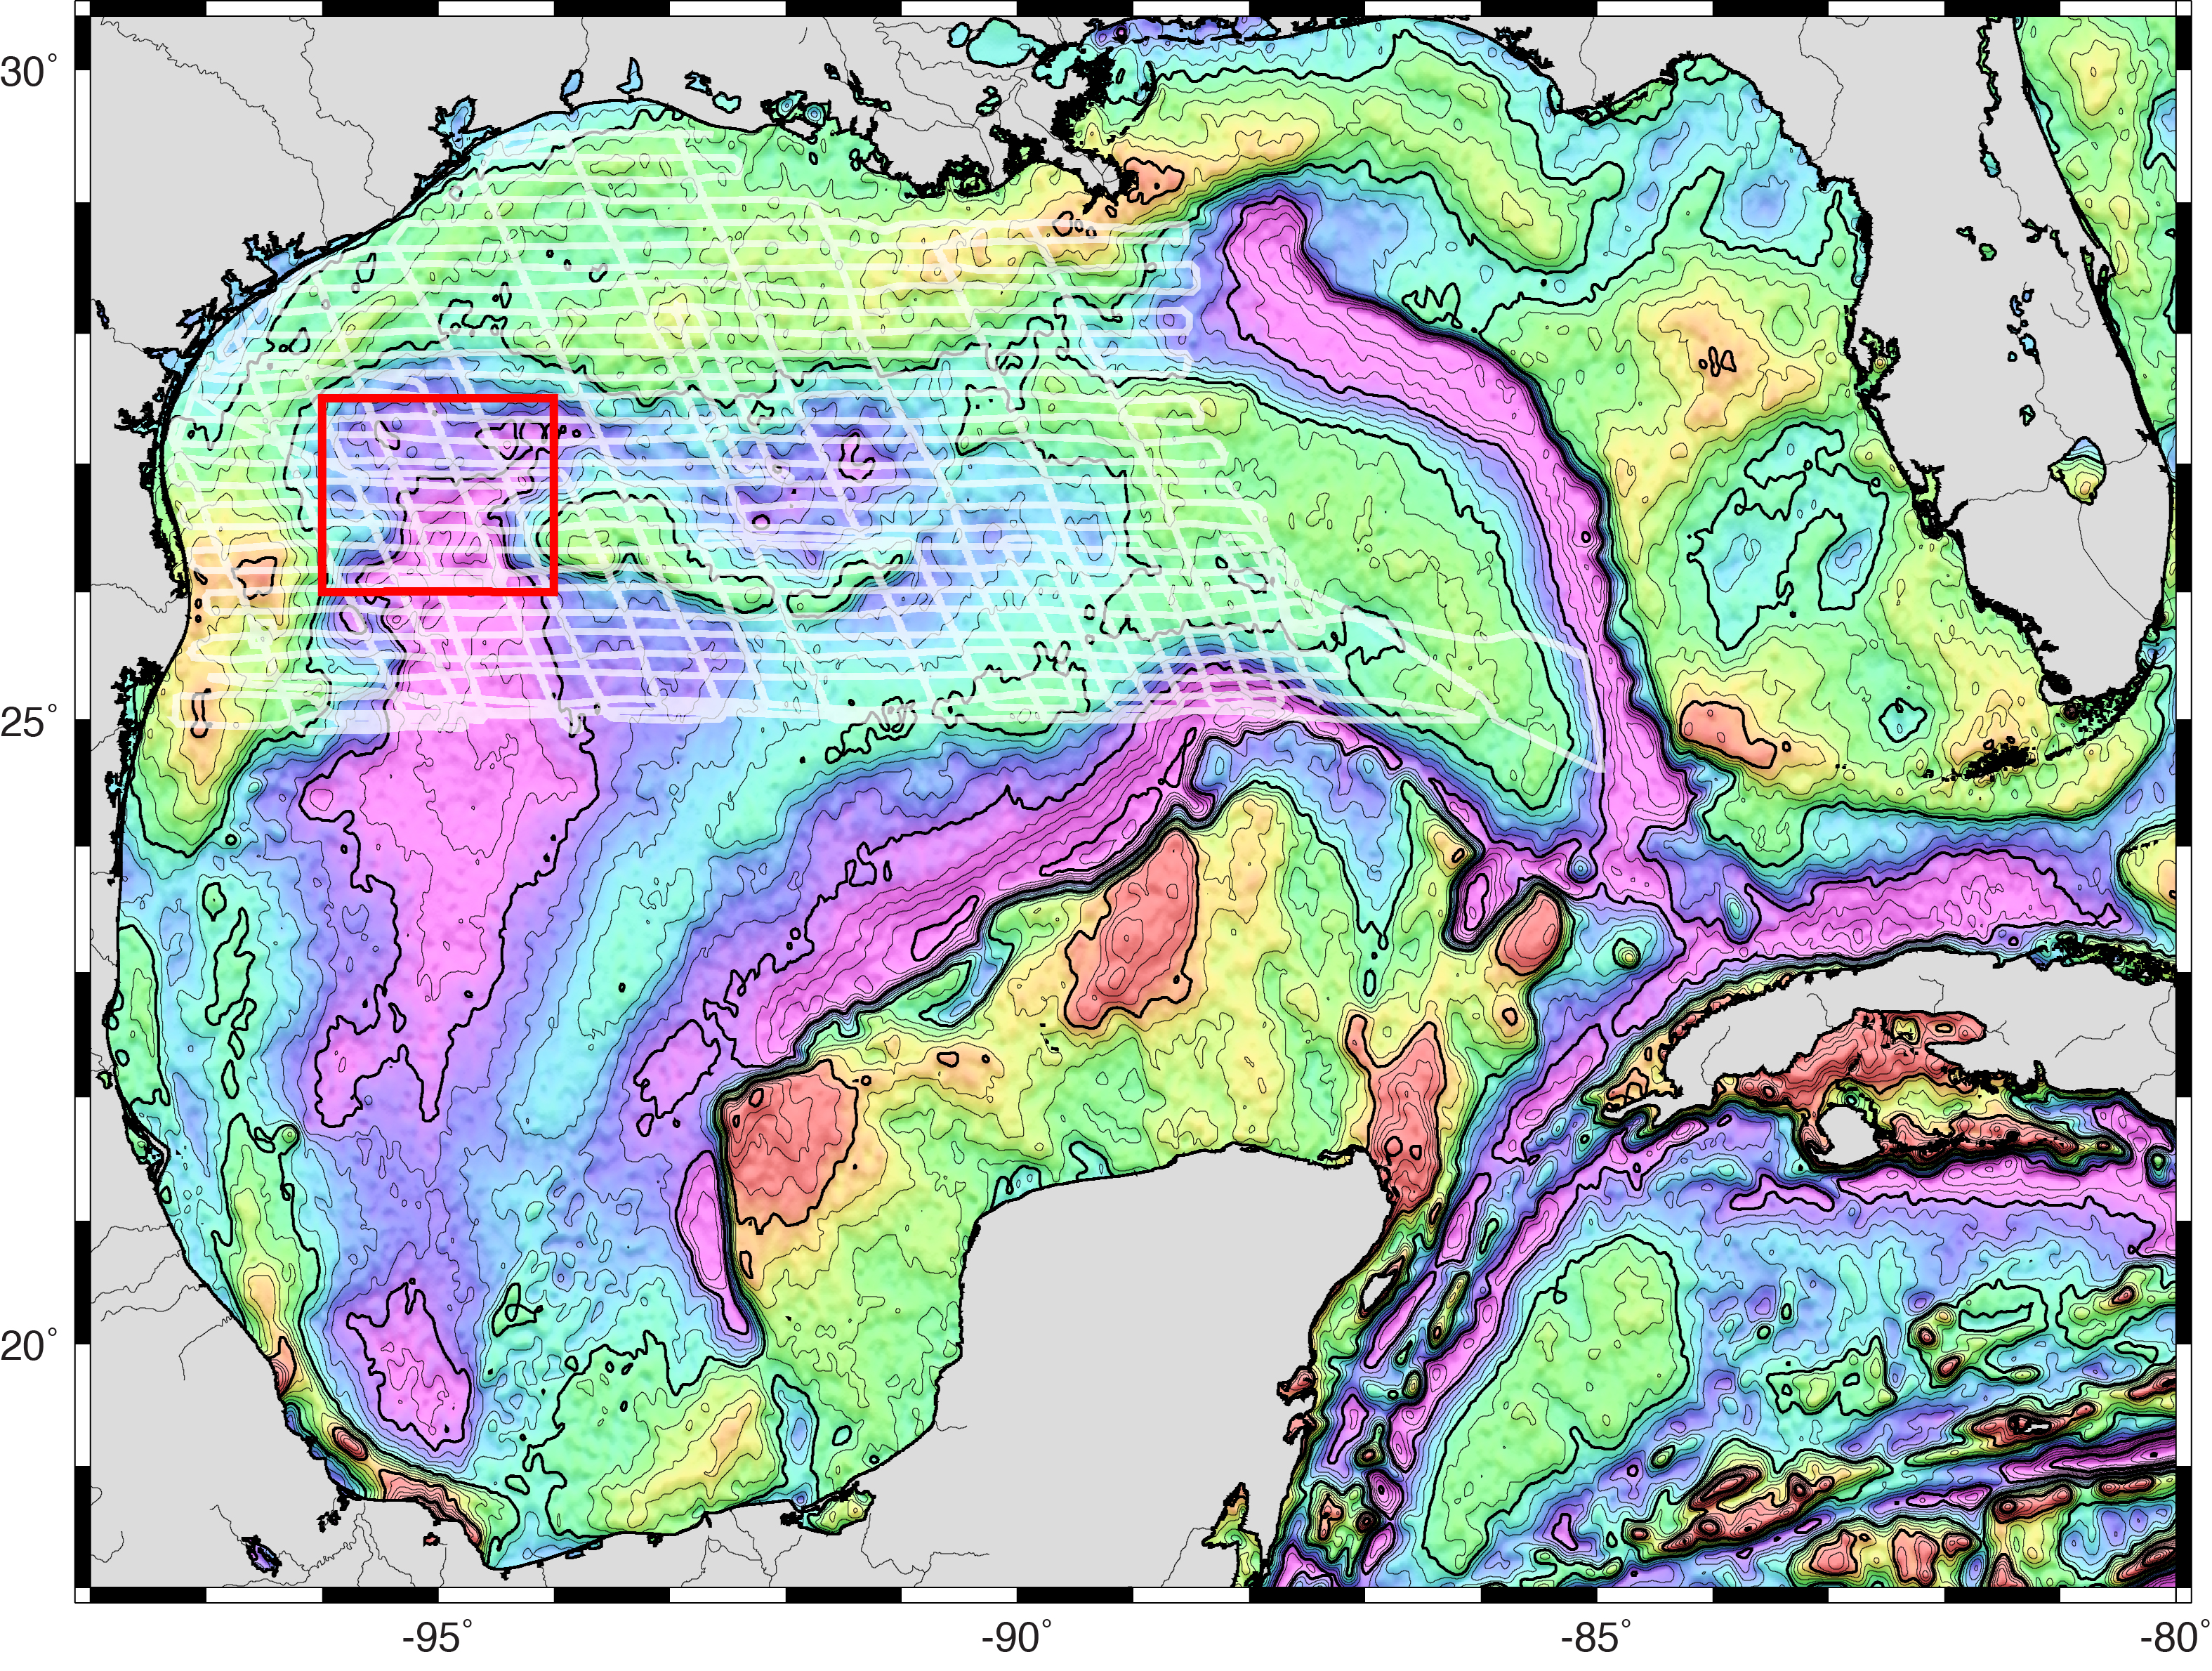
Gravity Anomaly V21.1 (10 mGal contours)

Slide 22
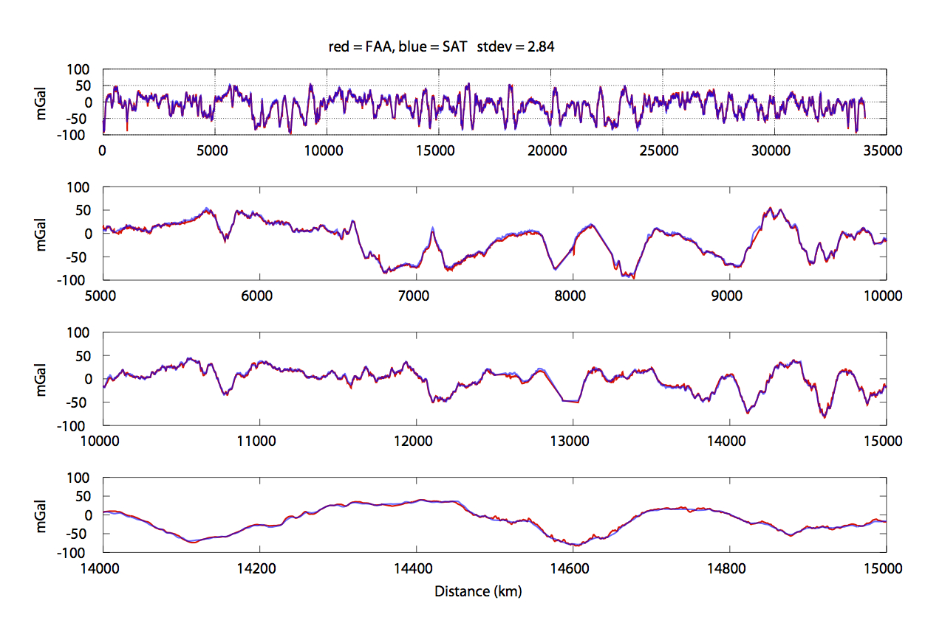

Slide 23
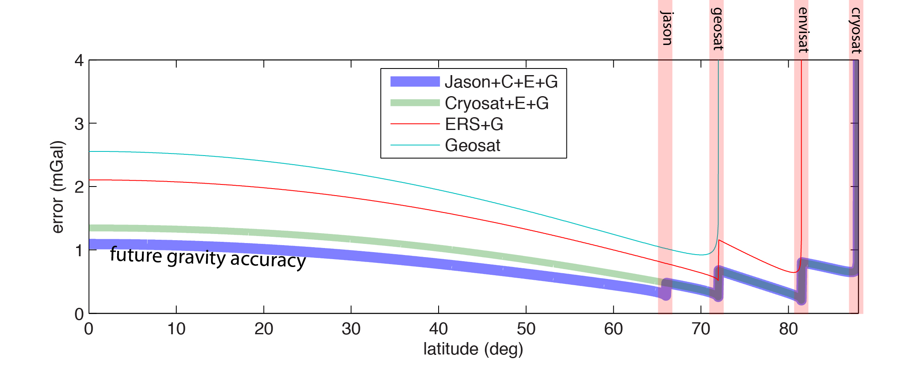
predicted gravity improvement
4 years of CryoSat and 409 days of Jason
Error in north and east components were averaged.

Slide 24
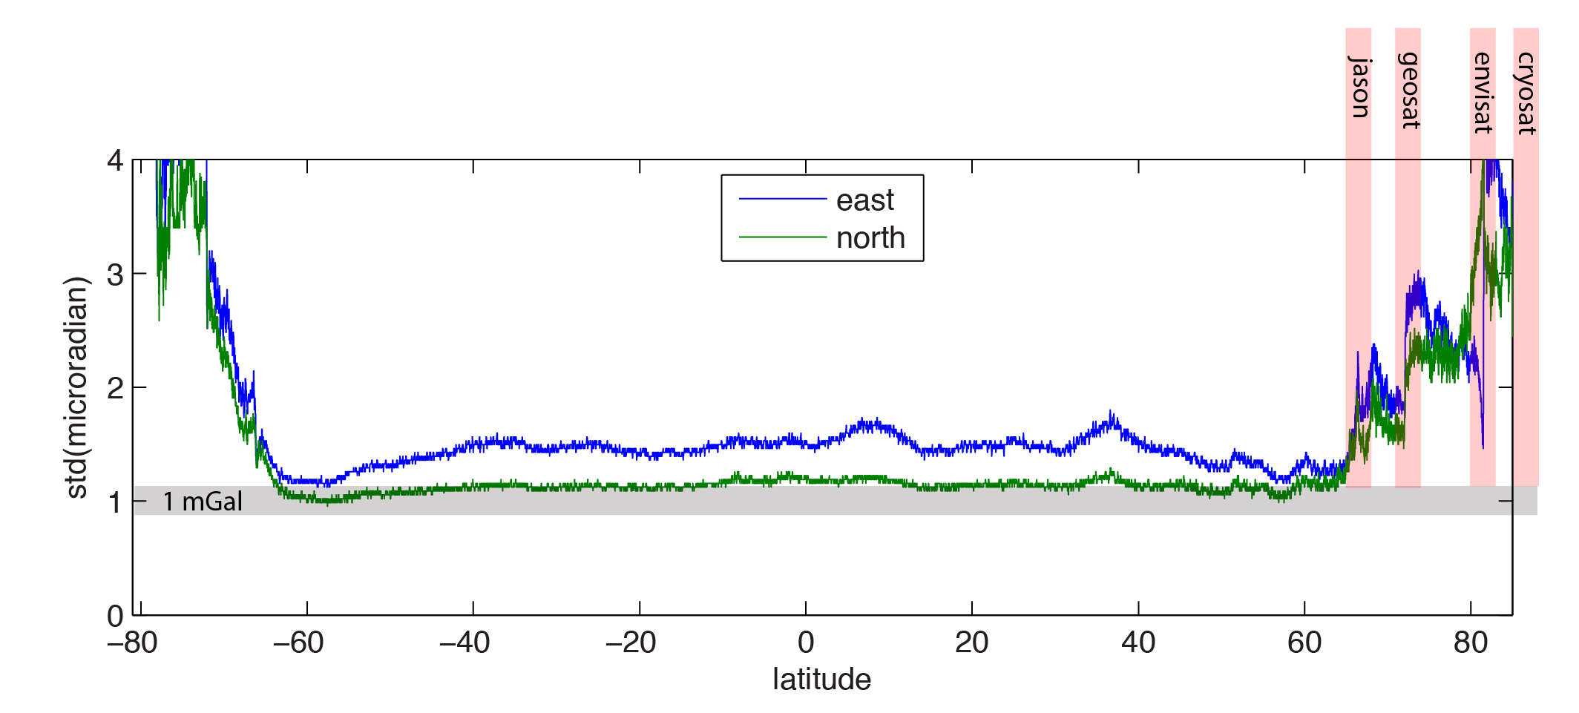
current gravity accuracy
(bootstrap estimate from 6 models)

Slide 25
Orbit Inclination Controls Error Anisotropy: (north-south error versus east-west error)
north
slope
θ
east
slope
Error propagation
  θ - local inclination of track
  σ - error in along-track slope
  σ_{x} - error in east slope
  σ_{y} - error in north slope
Jason-1 provides better east-west data than any other altimeter, due to its lower inclination.
Because the required measurement is along-track sea surface slope, not sea surface height, the radiometer, C-band altimeter, and precise orbit are not required.
Ku altimetry and a crude orbit are enough to measure the slope.

Slide 26
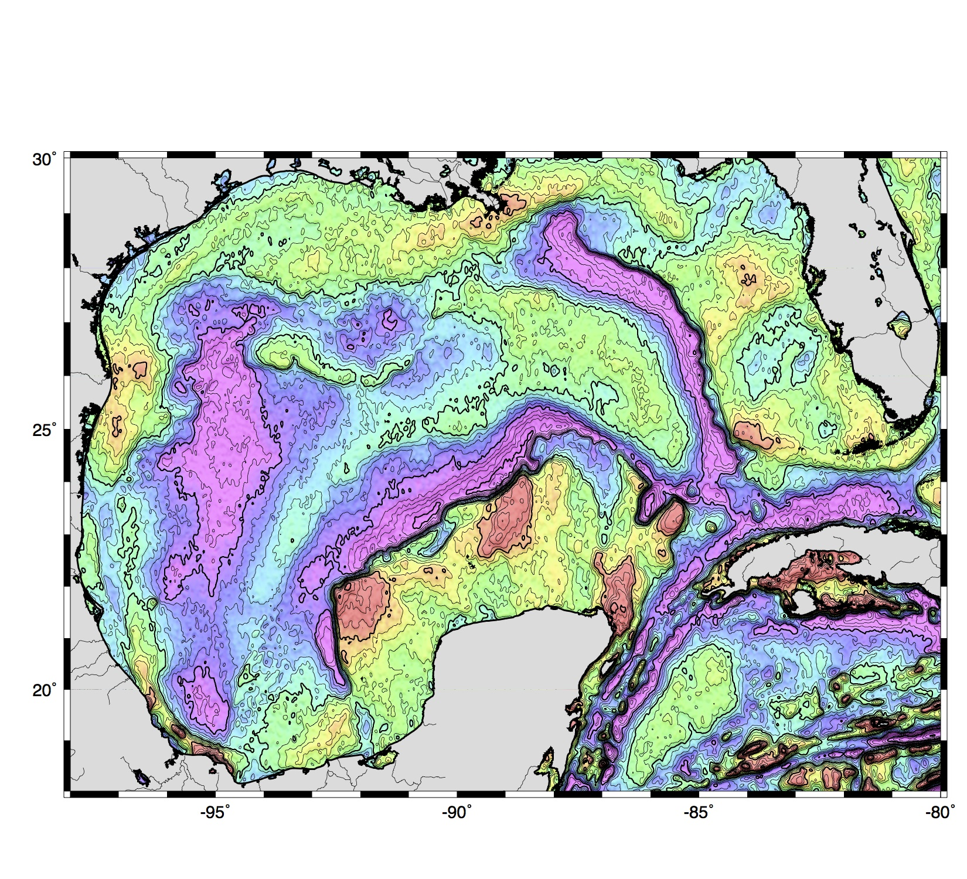
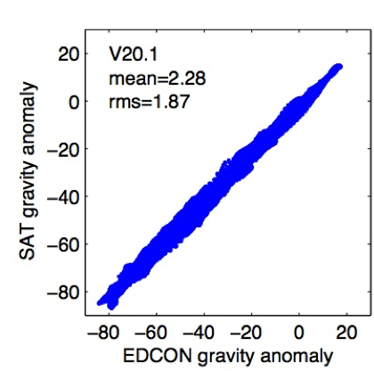
Gravity Anomaly, all data except Jason-1 (10 mGal contours)
Notes:
The area shown by the red box is covered with a very accurate in situ gravity survey by an oil industry contractor, “EDCON”.
The inset at lower right shows the EDCON in situ measurements (x axis) versus the satellite altimetry solution (y axis).

Slide 27
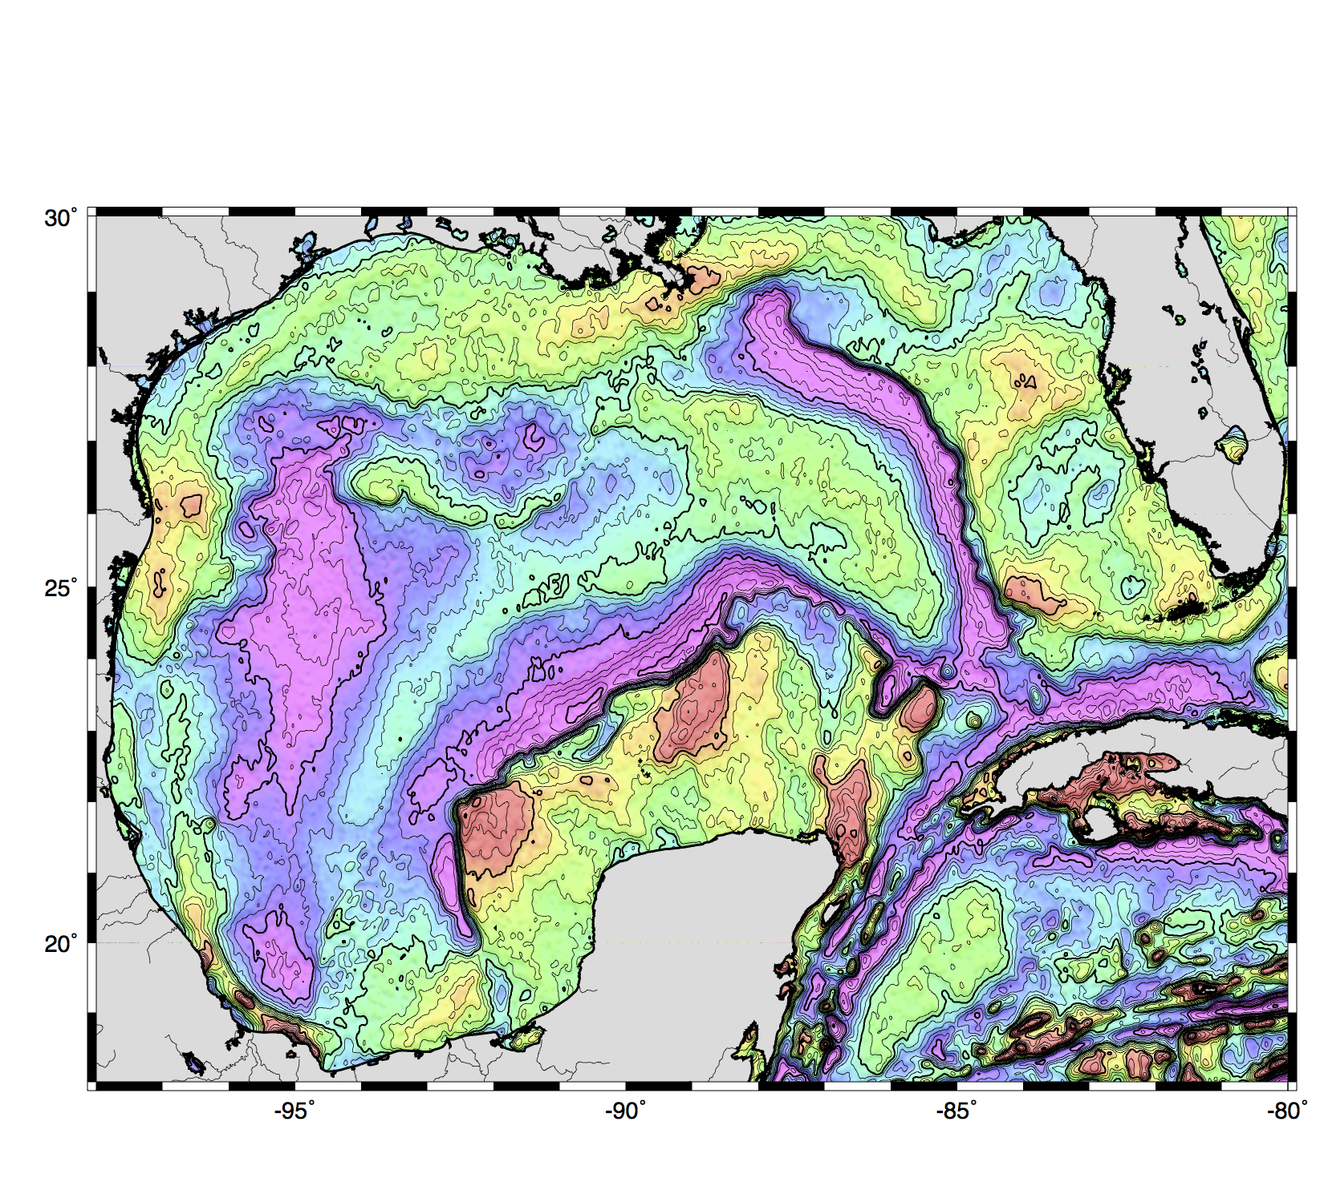
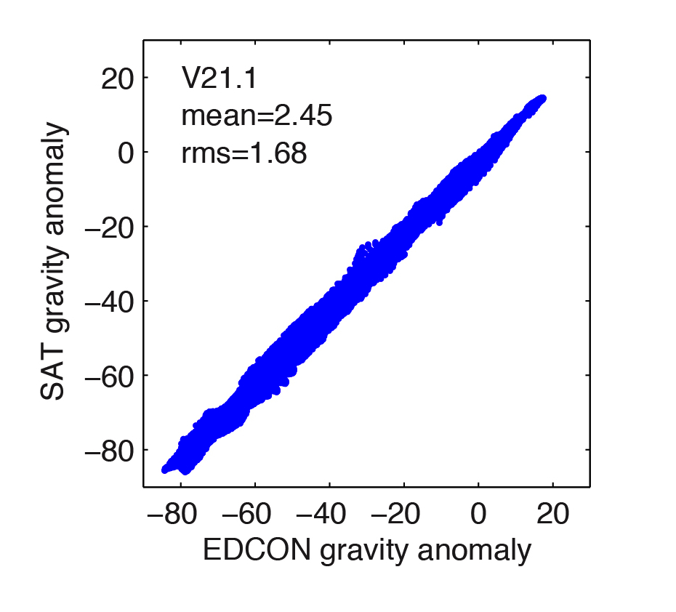
Gravity Anomaly, all data including Jason-1 (10 mGal contours)
The map shows 19% reduction in noise due to J-1 from <½ of GM.
Notes:
The area shown by the red box is covered with a very accurate in situ gravity survey by an oil industry contractor, “EDCON”.
The inset at lower right shows the EDCON in situ measurements (x axis) versus the satellite altimetry solution (y axis).

Slide 28
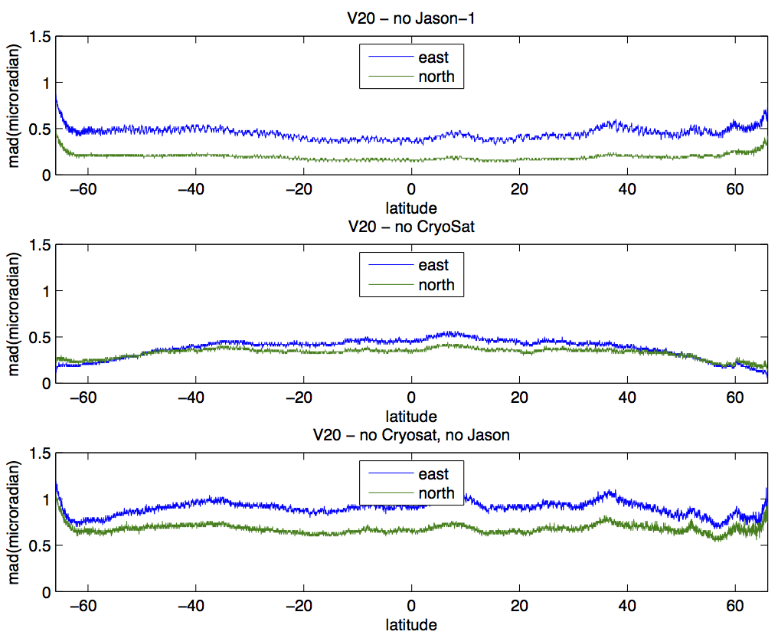
Contributions of Jason-1 and CryoSAT. J-1 is most significant. Greatest improvement is in east-west component.
Noise improvement from 4 months of Jason-1 data
Noise improvement from 24 months of CryoSat data
Noise improvement from combined Jason-1 and CryoSat
Latitude-averaged median absolute difference (“mad”) between global marine gravity constructed from all available altimetry (“v20”) versus models constructed by holding back Jason-1 (top), CryoSat2 (middle), or both J1 and CS2 (bottom). The mad curves may be a proxy for the importance of the J-1 and CS2 data sets. J1 is clearly having more impact East-West than North-South, as expected. 4 months of J-1 are about equally important to 2 years of CS2 (about 0.5 μrad in each case). Together, they make about 1 μrad of difference (bottom), indicating that each has independent information.

Slide 29
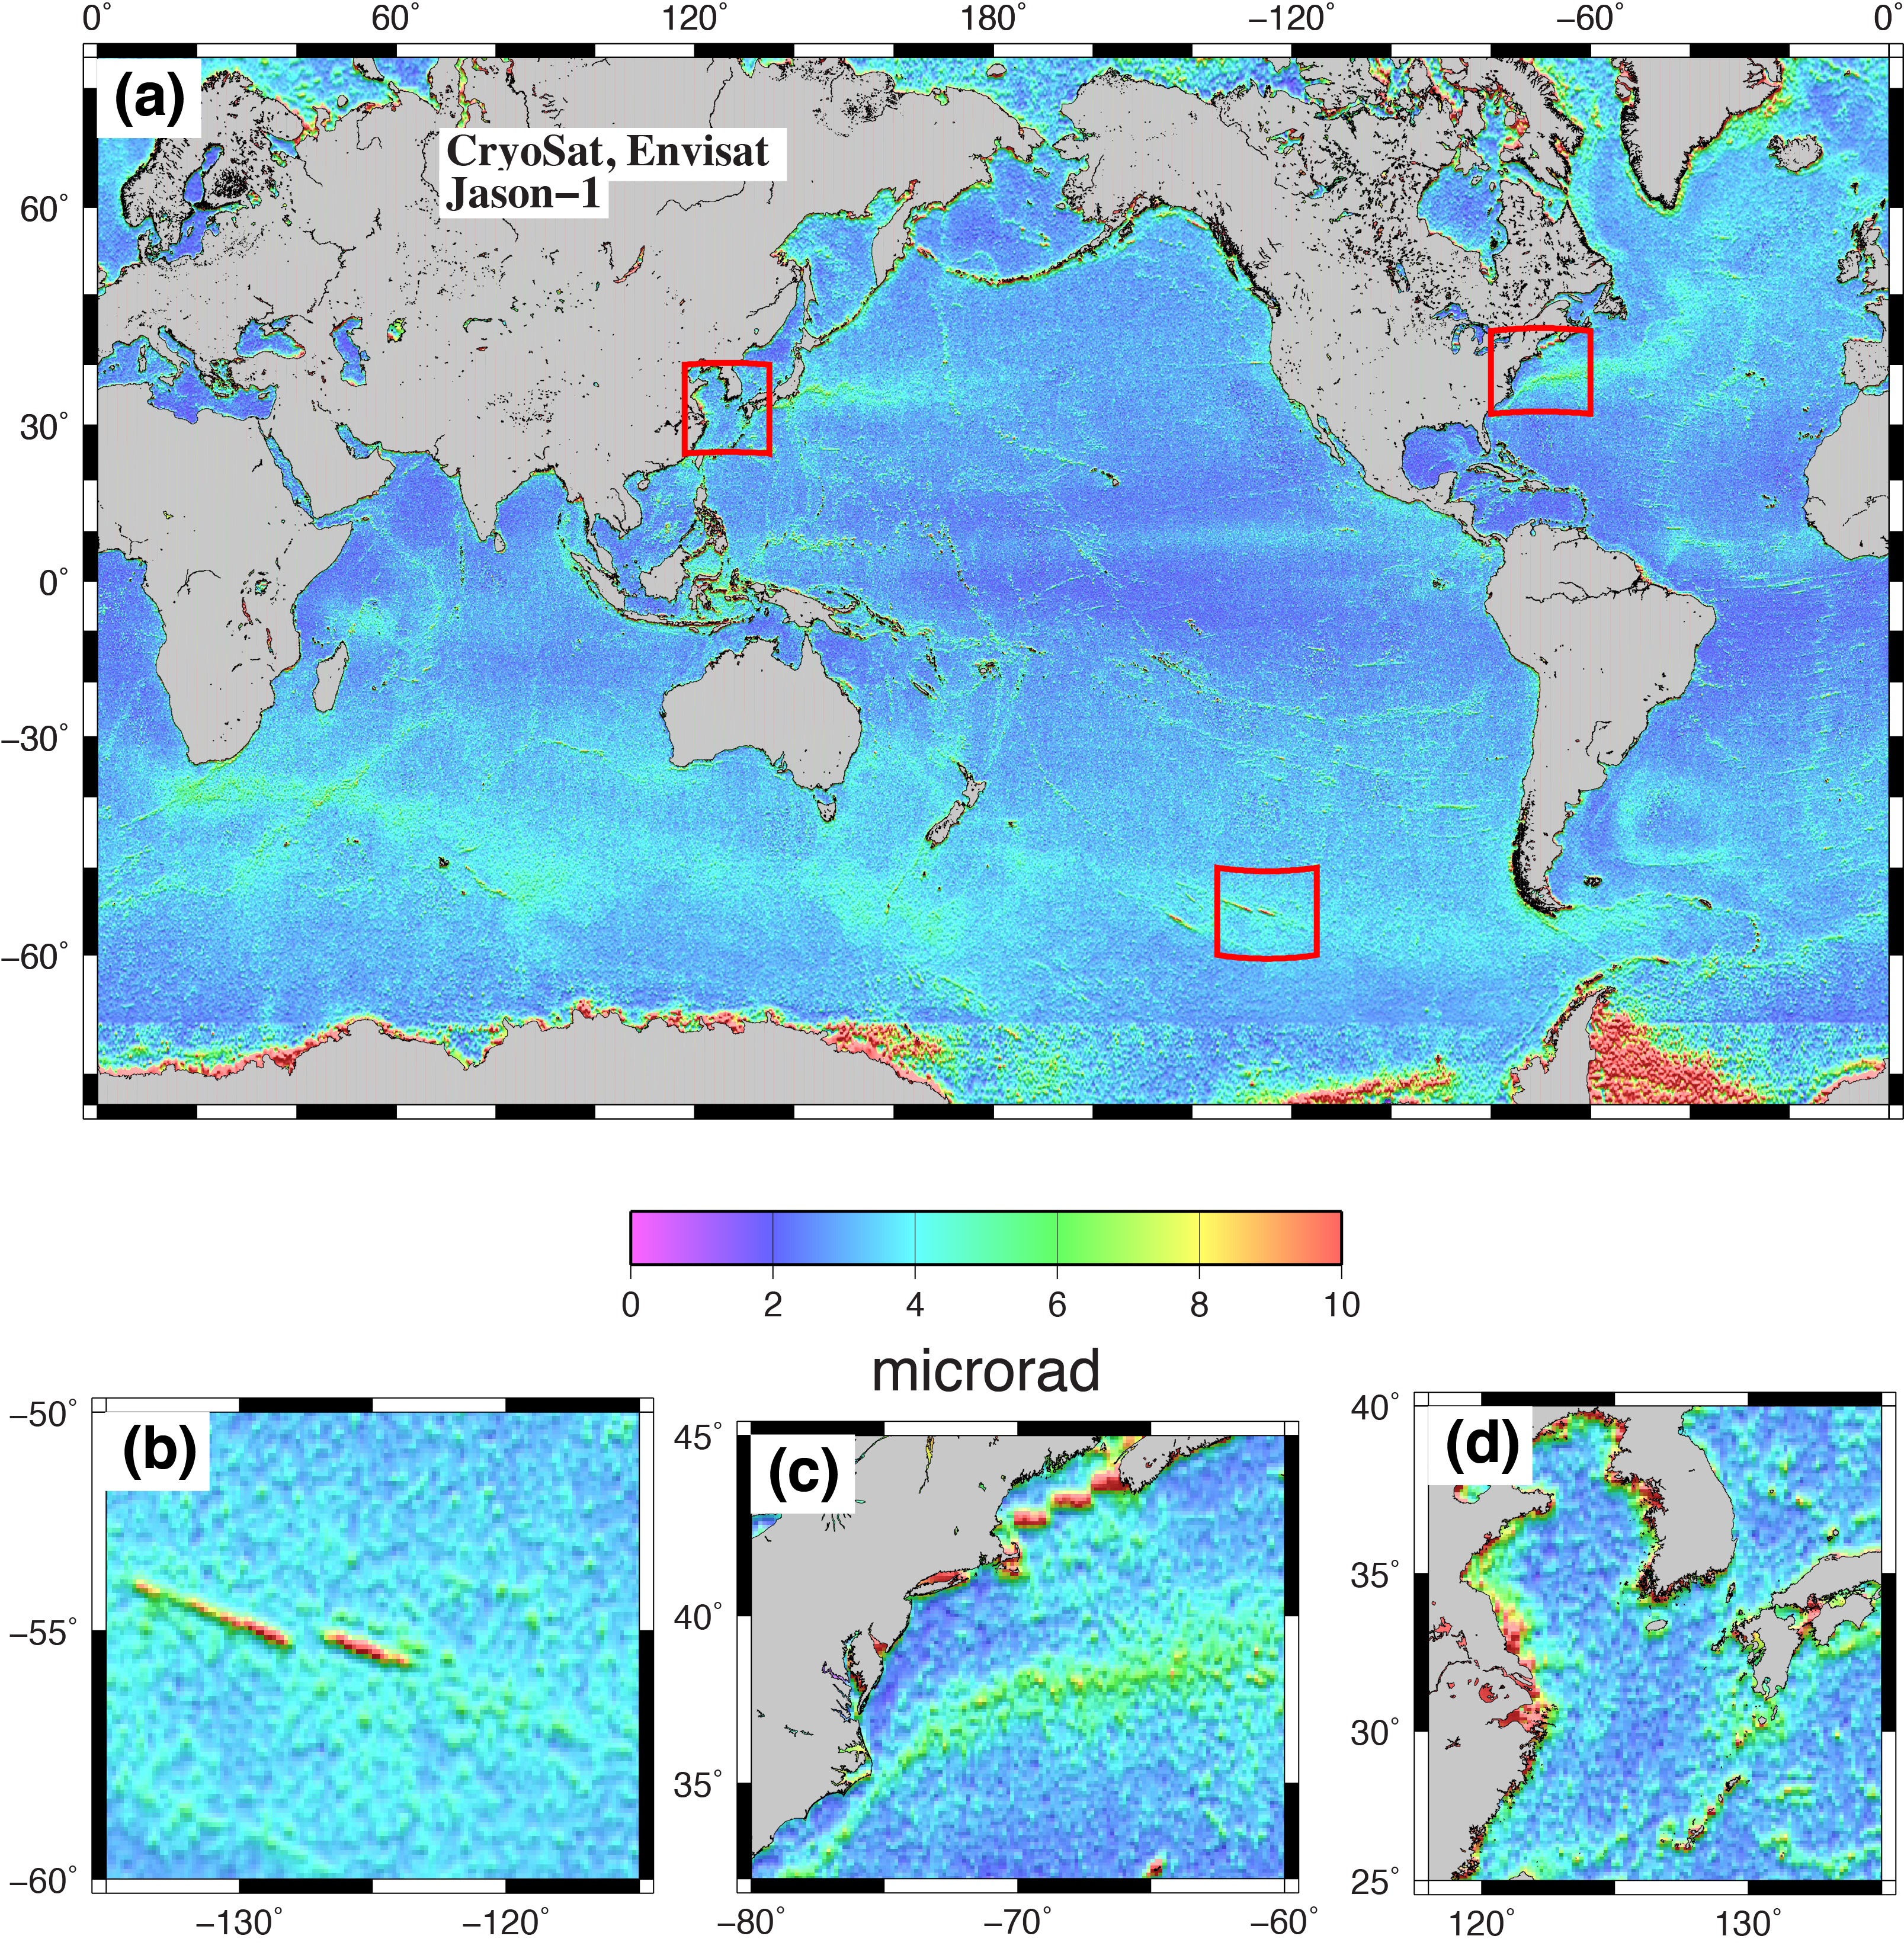
geographic distribution of errors
difference from EGM2008

Slide 30
First attempt at comparing
all academic fleet ship gravity
(1500 cruises) with V21.1 satellite
gravity courtesy of Paul Wessel.
“Attached is a summary plot (0.5 mGal bin histogram and cumulative distribution) of the MAD. The most frequently occurring MAD is 2.75 mGal as 11 % of the tracks report a MAD in the 2.5-3.5 mGal range. You can see we have a long tail.”

Slide 31
Conclusions
David Sandwell, Emmanuel Garcia, Kahlid Soofi,
Paul Wessel, and Walter H. F. Smith
“newer” altimeters have 1.4 times better range precision and 2 times better coverage
marine gravity accuracy is currently 1.5 – 3.5 mGal and could approach 1 – 2.5 mGal if Jason-1 completes its mission
V20.1 gravity available on topex.ucsd.edu site. V21.1 will be available September, 2013.
Is ship gravity from the academic fleet less accurate than satellite gravity?
expect some major discoveries from these non-repeat altimeter data
funding from: ConocoPhillips, NSF, and ONR

