Slide 1
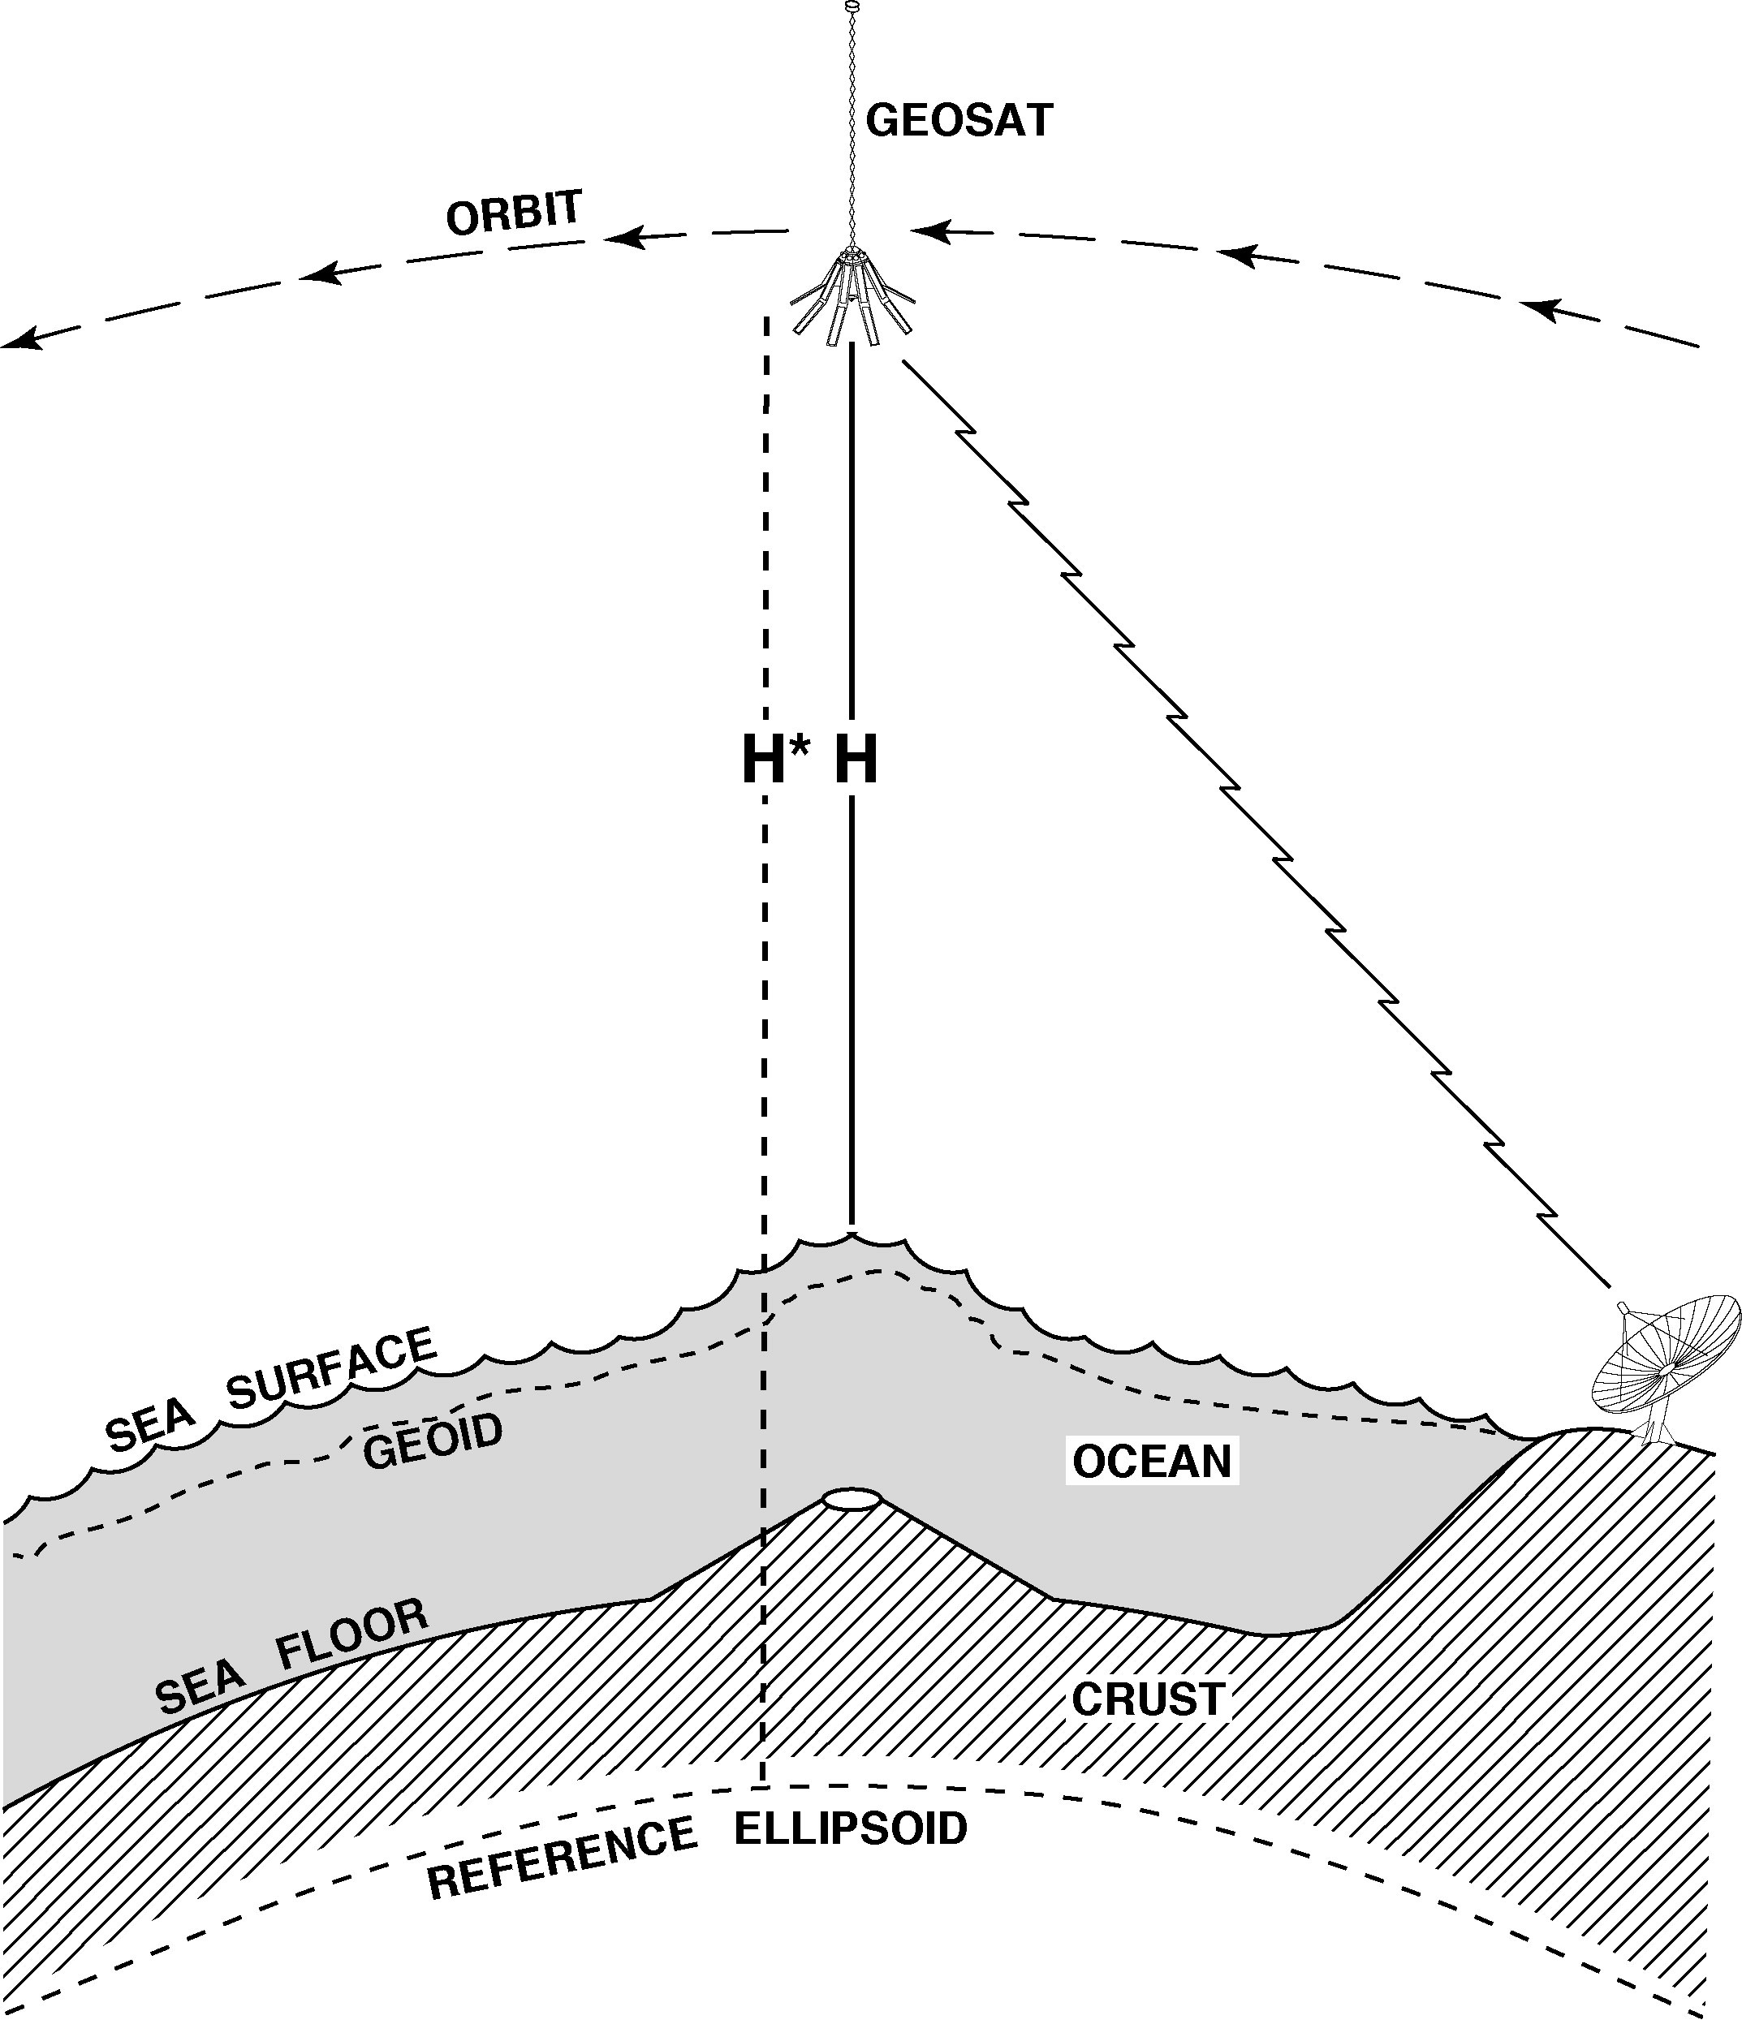
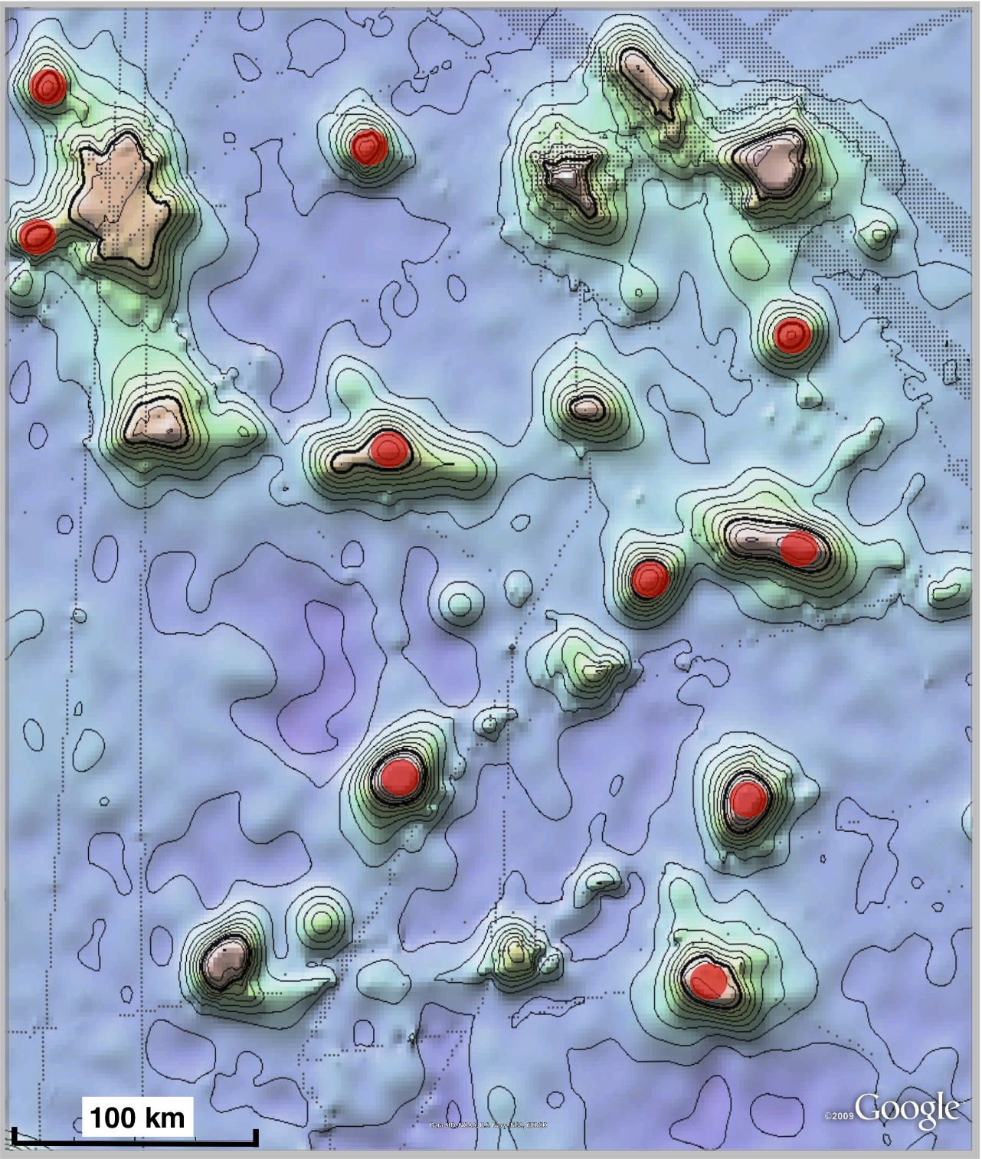
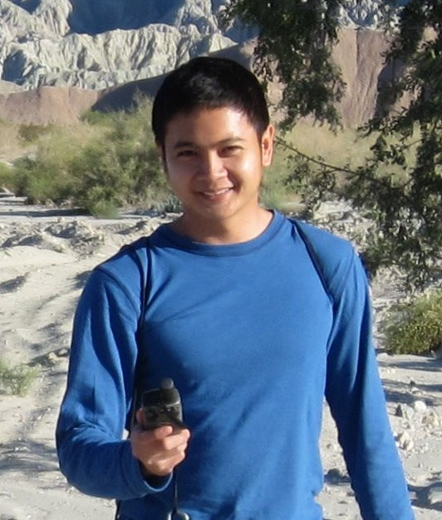
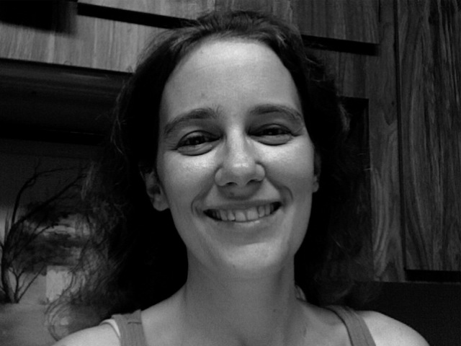
Constraints on Absolute Stress at
Ridges and Transforms from
New Global Marine Gravity
David Sandwell, Emmanuel Garcia, and
Karen Luttrell
needs for higher accuracy and resolution gravity/bathymetry
new altimetry and optimized waveform retracking
towards 1 mGal global marine gravity
morphology and compensation of ridges vs. spreading rate
constraints on absolute stress at ridges and transforms
Soli Garcia
Karen
Luttrell

Slide 2
radar altimetry

Slide 3
applications of radar altimetry
(non-repeat orbit)
gravity:
plate tectonics
planning ship surveys
inertial guidance (mostly military)
petroleum exploration
topography:
seafloor roughness
linear volcanic chains
tsunami models
tide models, tidal friction, thermohaline circulation
planning undersea cables
law of the sea
education and outreach

Slide 4
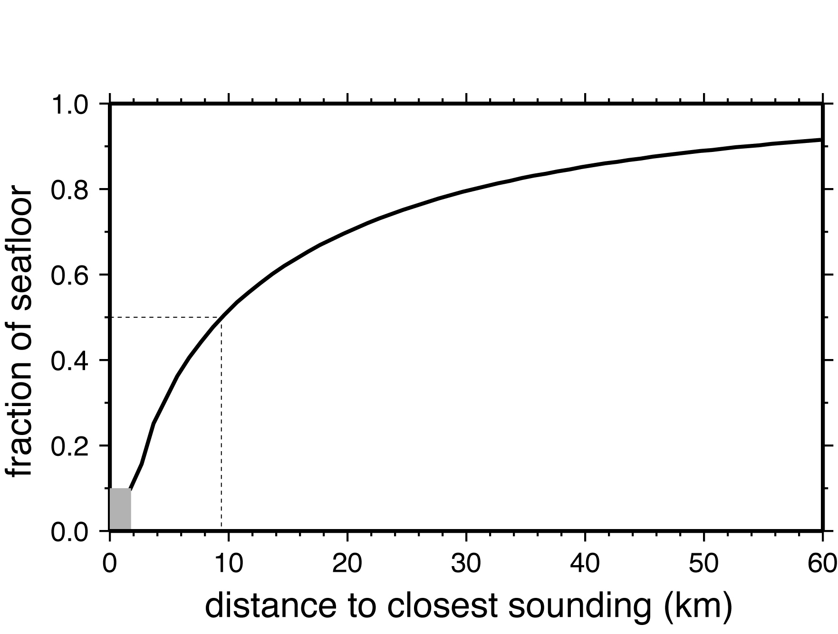
1/2 of global seafloor bathymetry not resolved at 10 km
[Smith and Marks, 2009]
Notes:
4

Slide 5
uncharted
seamounts
> 3 km tall

Slide 6
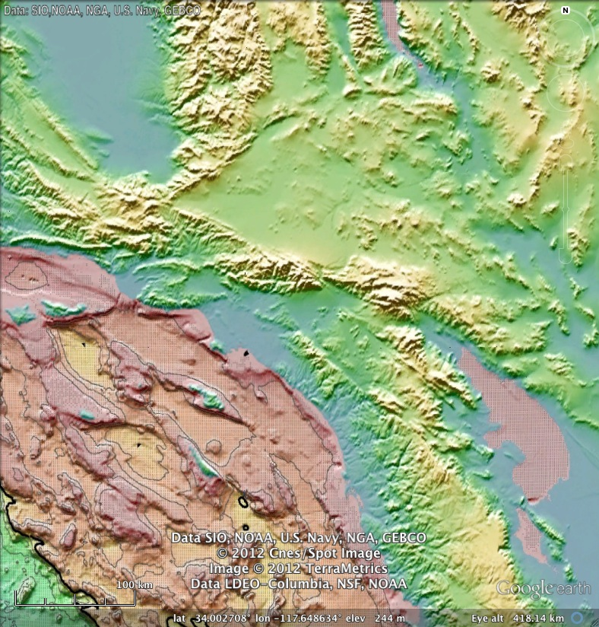
Southern
California

Slide 7
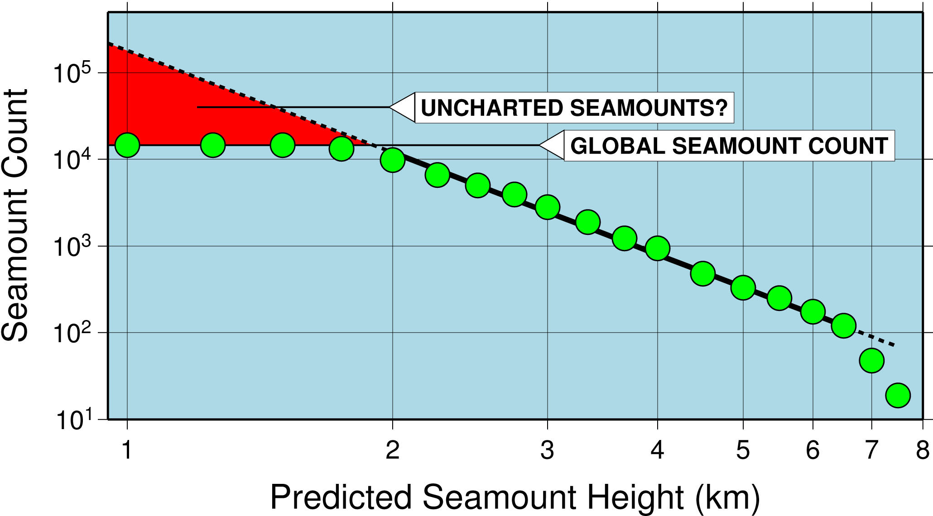
size distribution of seamounts
Wessel JGR, 2001

Slide 8
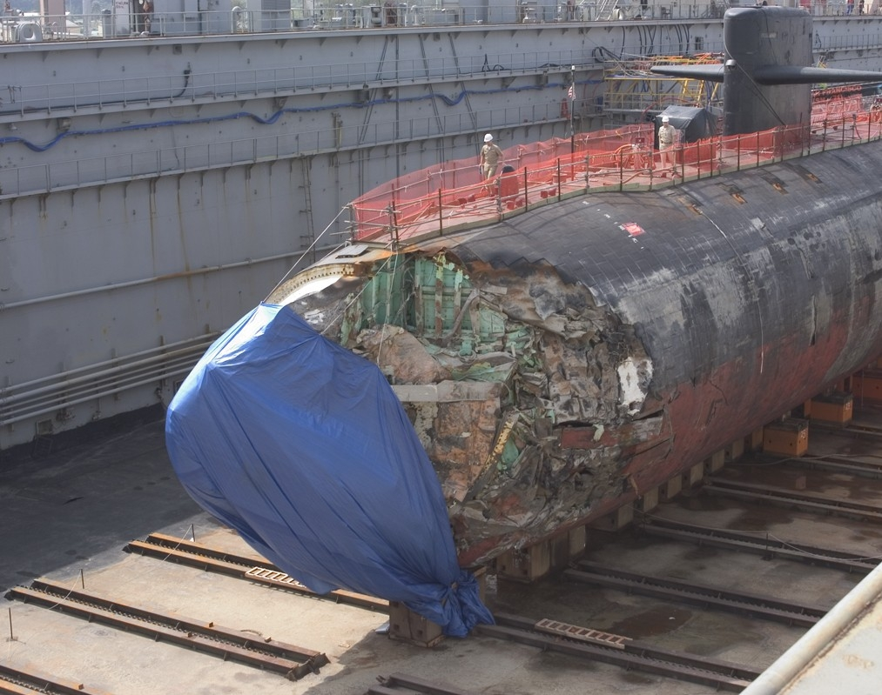
Crash of USS San Francisco into uncharted seamount
Los Angeles class Submarine ran aground in route from Guam to Brisbane, Australia - 8 January, 2005
One sailor killed, 120 injured
Crash depth ~500 ft, speed 33 kn, Sonar measured a depth of 6000 feet, 4 minutes before crash
30-hour trip back to Guam, crew managed to keep the sub from sinking
Area of discolored water noted on navigational chart 3 mi, south of crash site
Navy began basing attack submarines in Guam in 2002

Slide 9
slope requirement

Slide 10
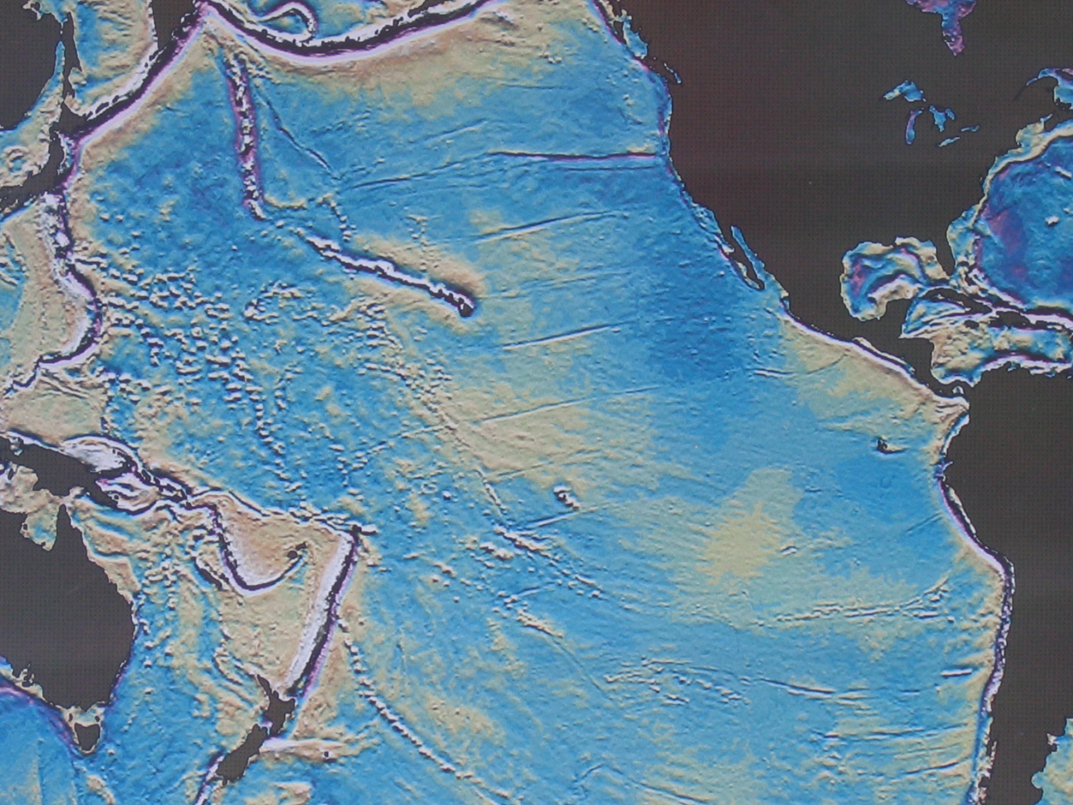
Global Gravity from Seasat [ Haxby, 1987]

Slide 11
Global Gravity from Seasat [ Haxby, 1987]
Discoveries from Seasat:
first uniform mapping at ~70 km resolution
discovery of many major tectonic features
  extent of Louisville ridge
  Foundation seamount chain
  extent of Kerguelen Plateau
  gravity lineations
first assessment of seamounts taller than 3 km
thermal isostasy at ridge, FZ’s, and thermal swells
  .
  .

Slide 12
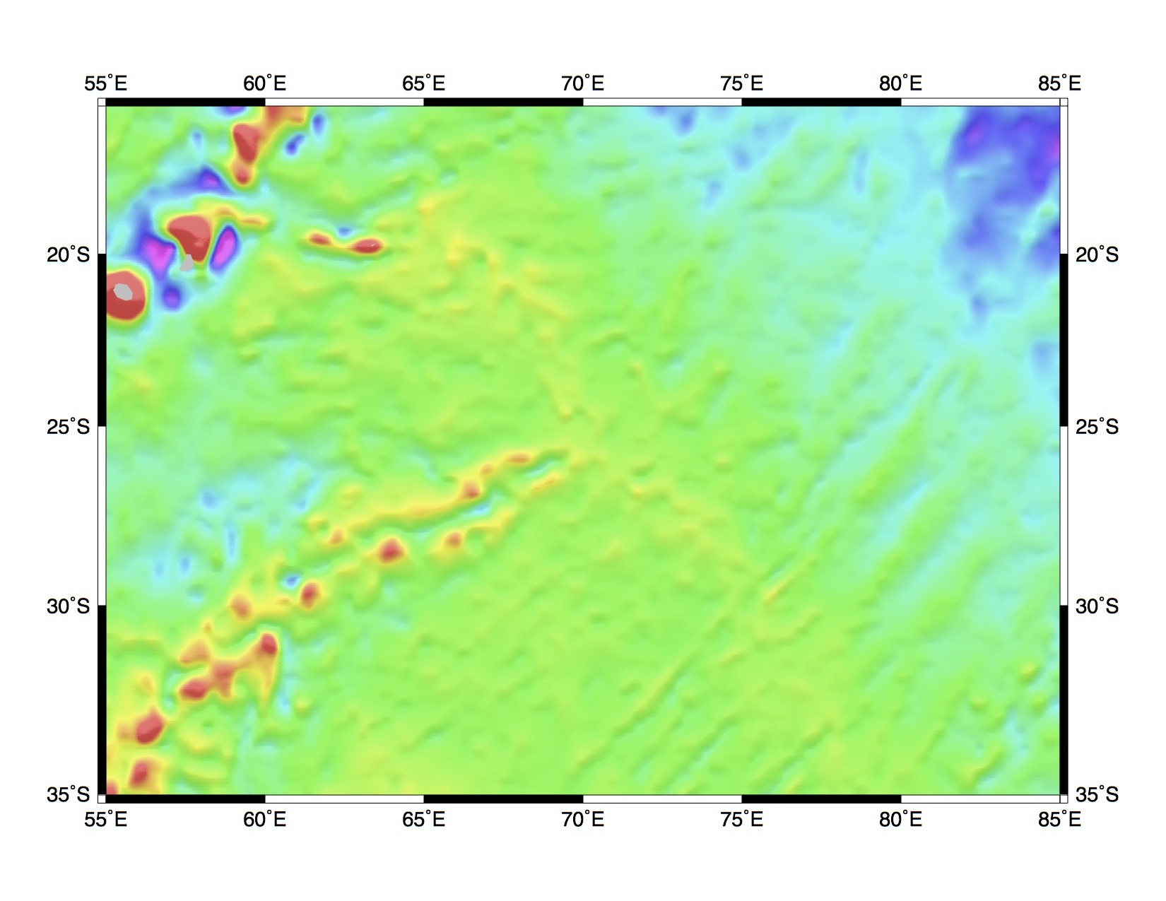
Indian Ocean Triple Junction- Haxby, 1987

Slide 13
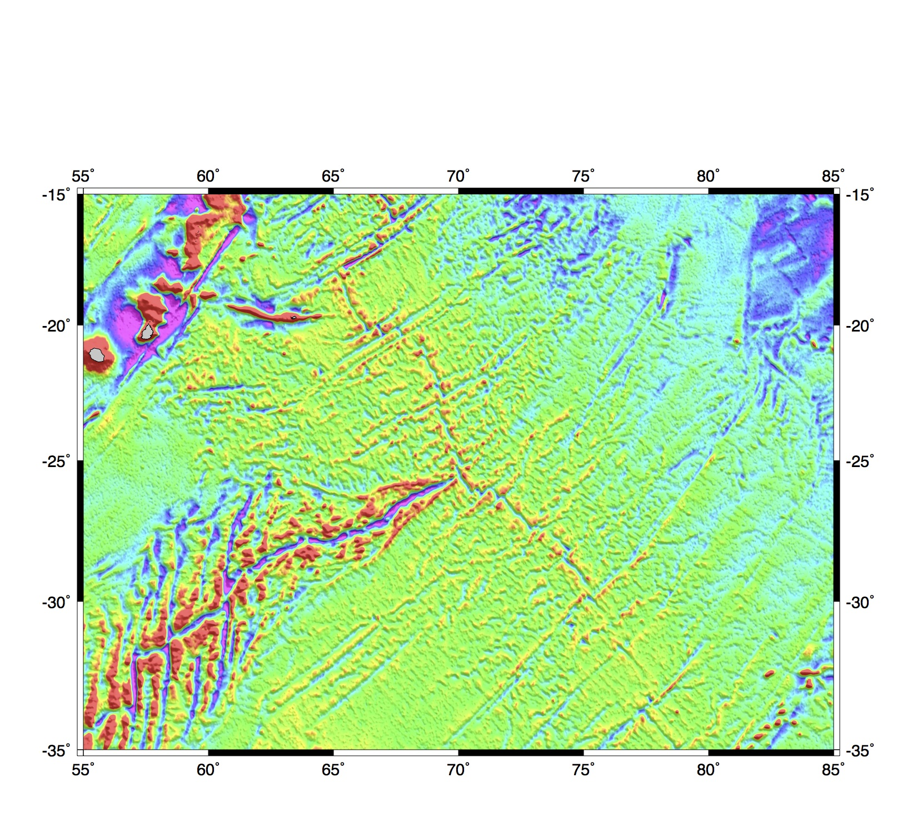
Indian Ocean Triple Junction V22.1

Slide 14
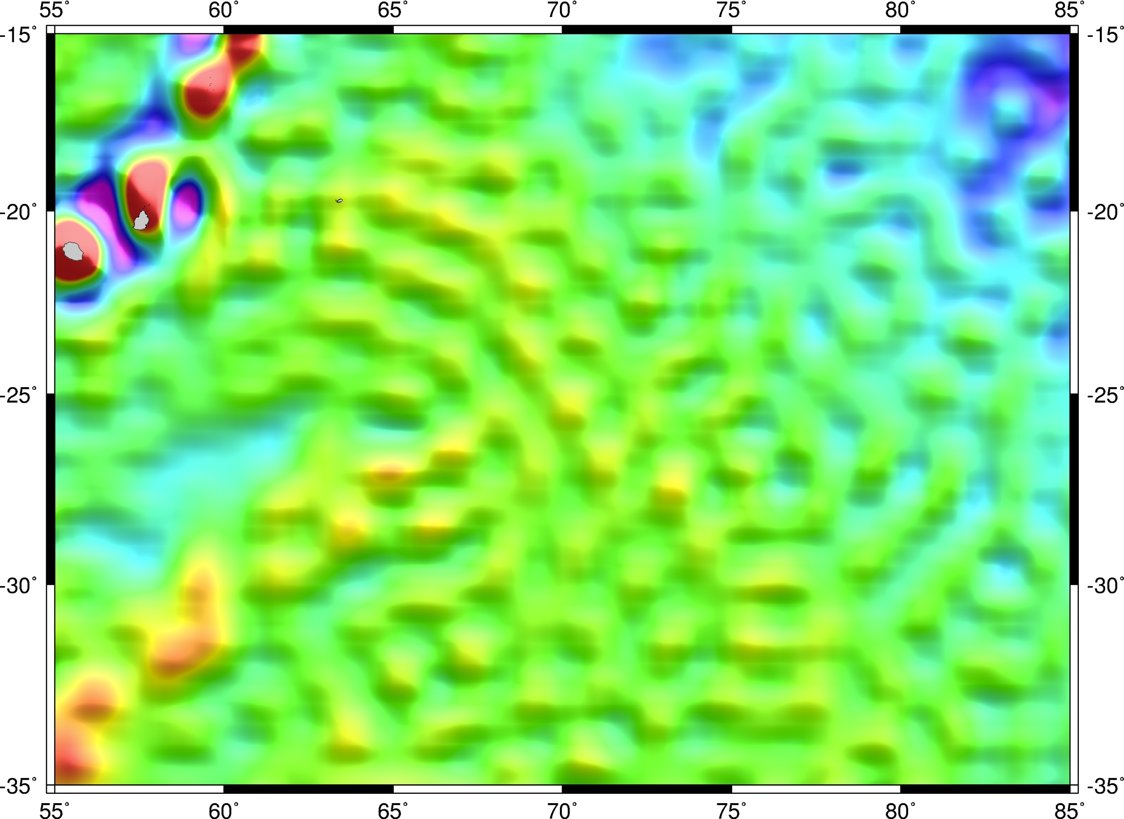
Indian Ocean Triple Junction
Gravity anomaly at sea level according to the CHAMP, GRACE, GOCE gravity missions [combined model GOCO-03S, 2012].
Gravity anomaly at sea level according to altimetry. [V22.1].
The gravity signal of sea floor structure can only be sensed by an altimeter mission.

Slide 15
Achieving 1 mGal Gravity Accuracy
Improved range precision -- A factor of 2 or more improvement in altimeter range precision, with respect to Geosat and ERS-1, is needed to reduce the noise due to ocean waves.
Fine cross-track spacing and long mission duration -- A ground track spacing of 6 km or less is required.
Moderate inclination -- Current non-repeat-orbit altimeter data have high inclination and thus poor accuracy of the E-W slope at the equator.
Near-shore tracking -- For applications near coastlines, the ability to track the ocean surface close to shore is desirable.

Slide 16
Constraints on Absolute Stress at Ridges and Transforms from New Global Marine Gravity
David Sandwell, Emmanuel Garcia, and
Karen Luttrell
needs for higher accuracy and resolution gravity/bathymetry
new altimetry and optimized waveform retracking
towards 1 mGal global marine gravity
morphology and compensation of ridges vs. spreading rate
constraints on absolute stress at ridges and transforms

Slide 17
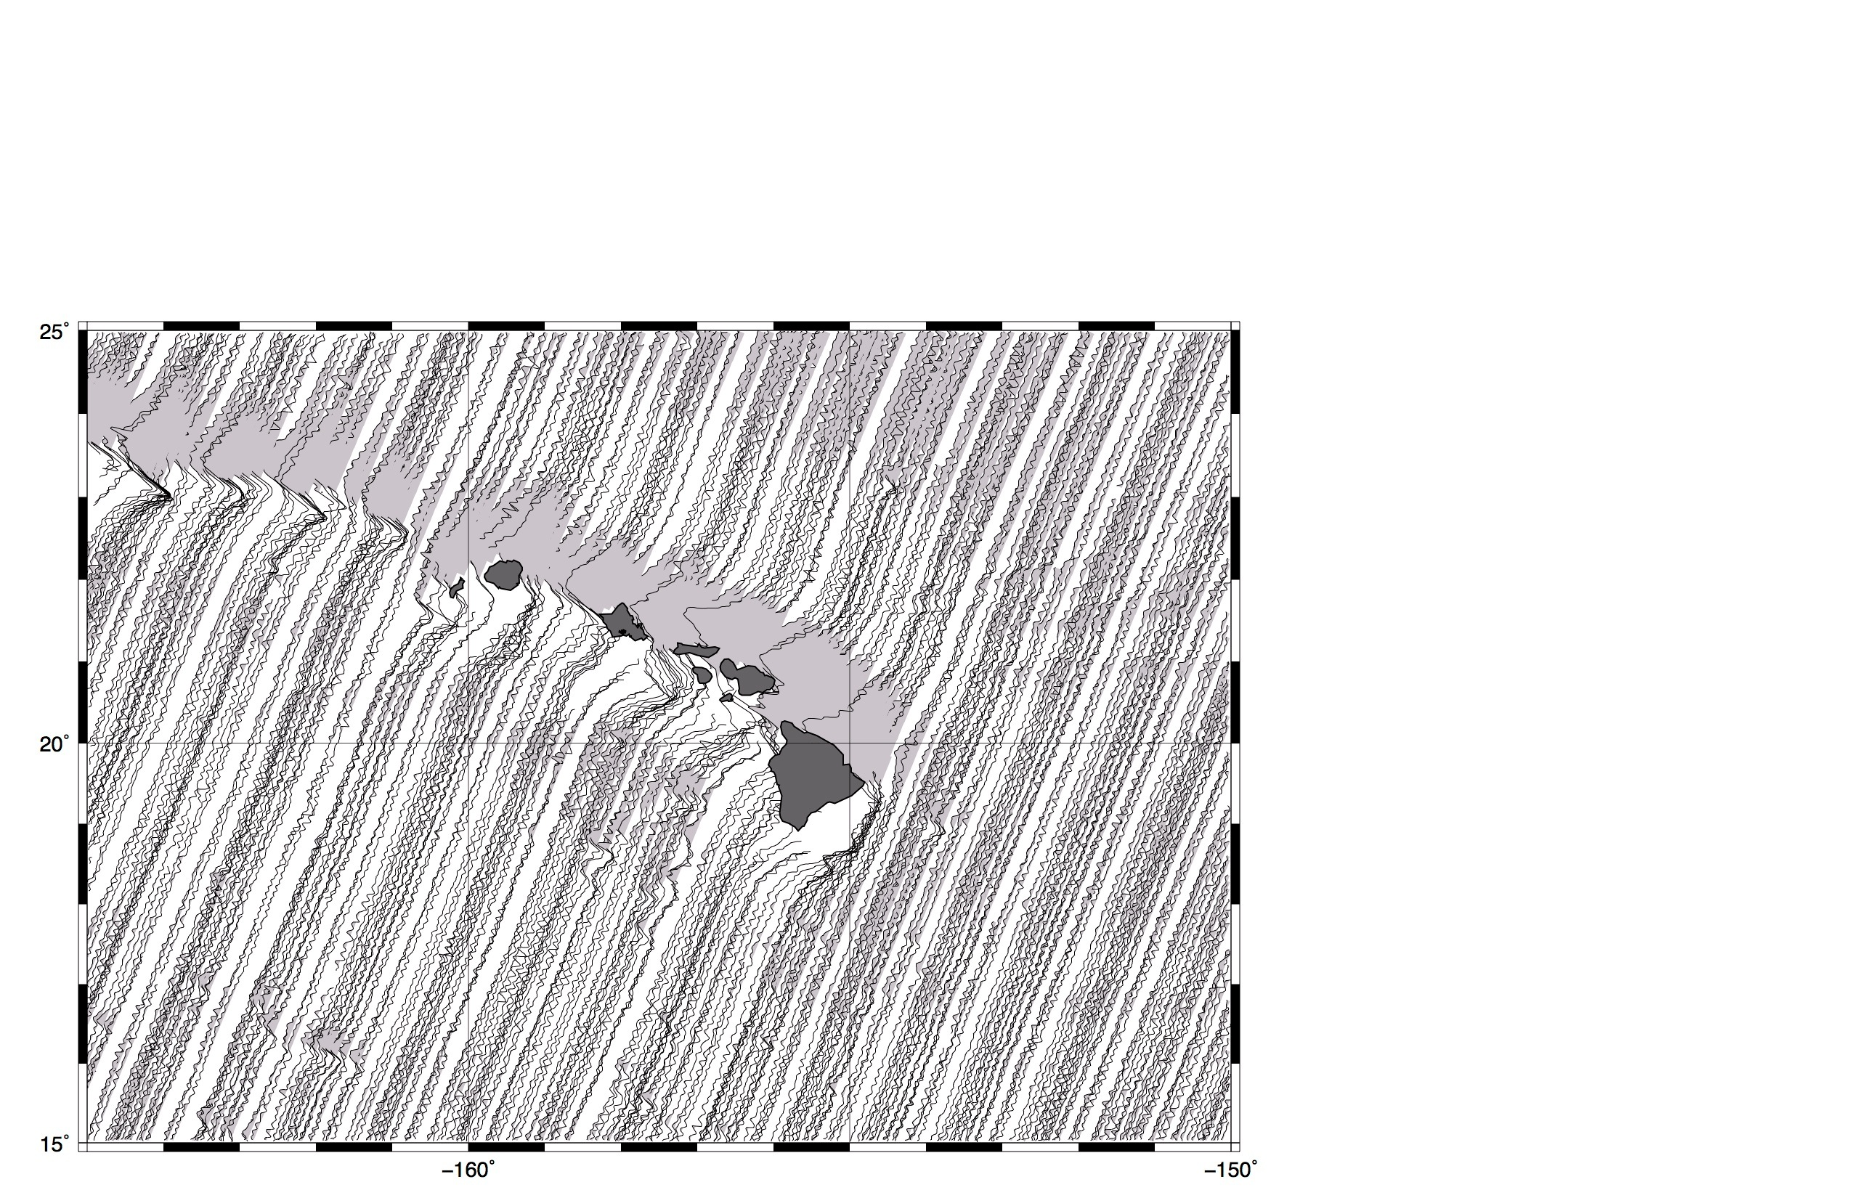
Geosat – descending (18 mo. old)

Slide 18
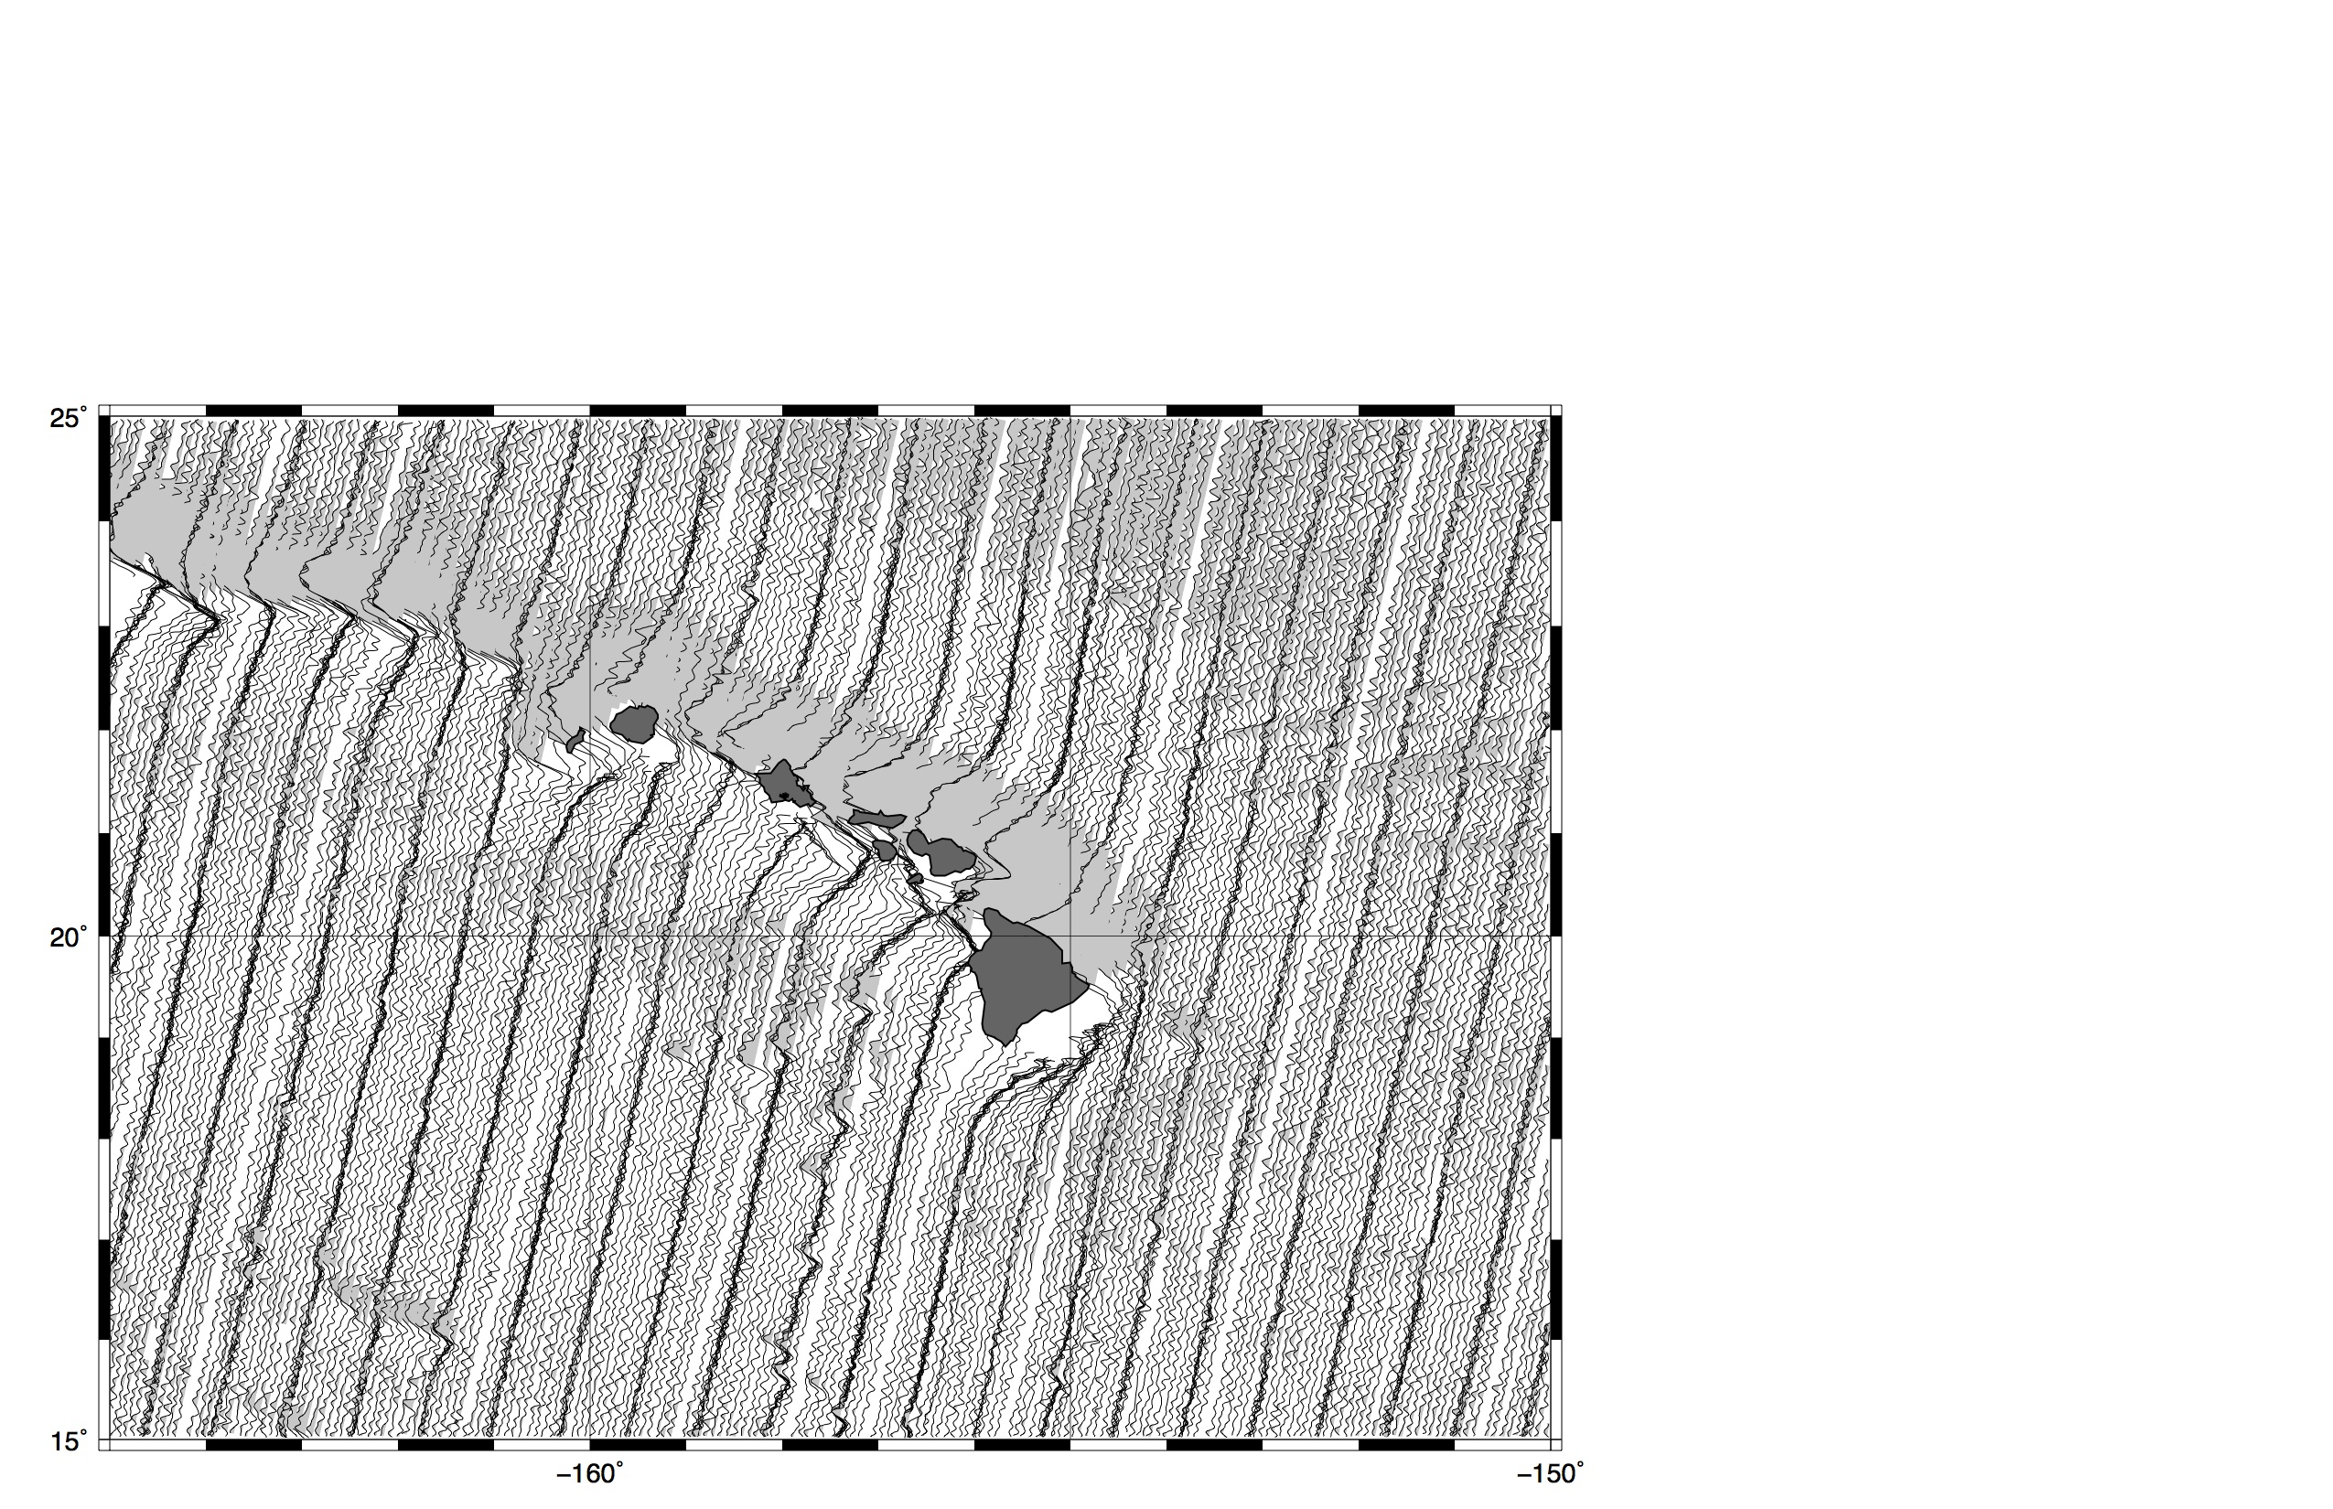
ERS-1 – descending (12 mo. old)

Slide 19
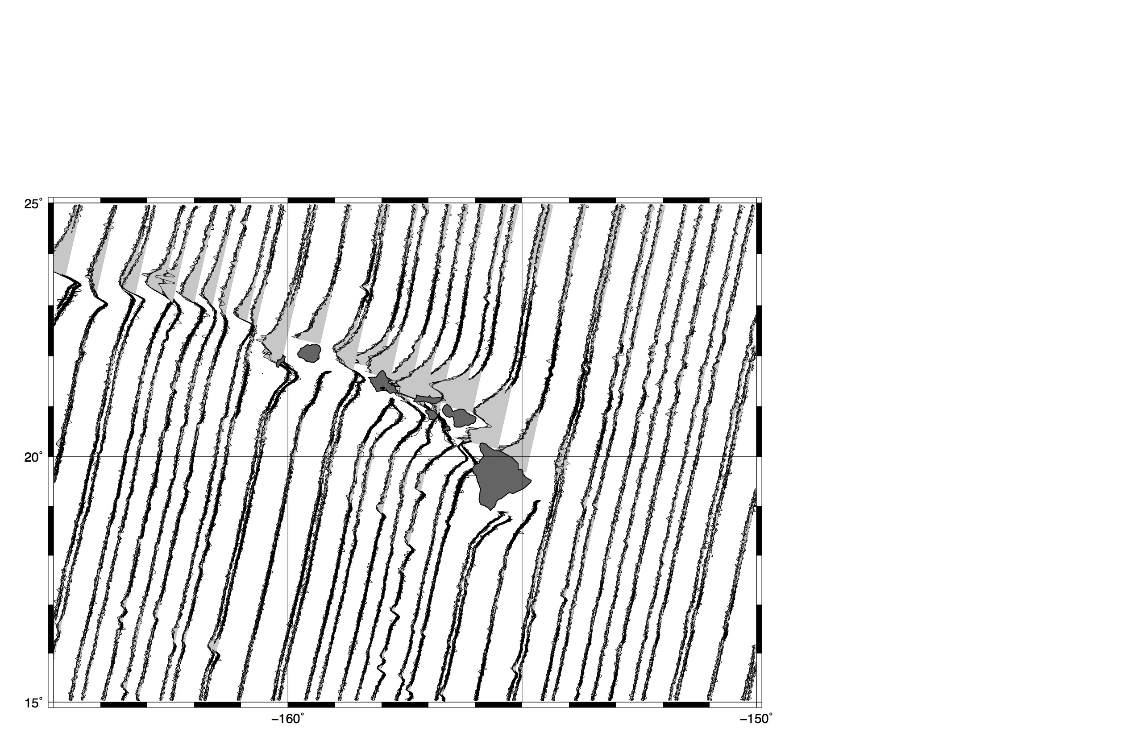
Envisat – descending (new)

Slide 20
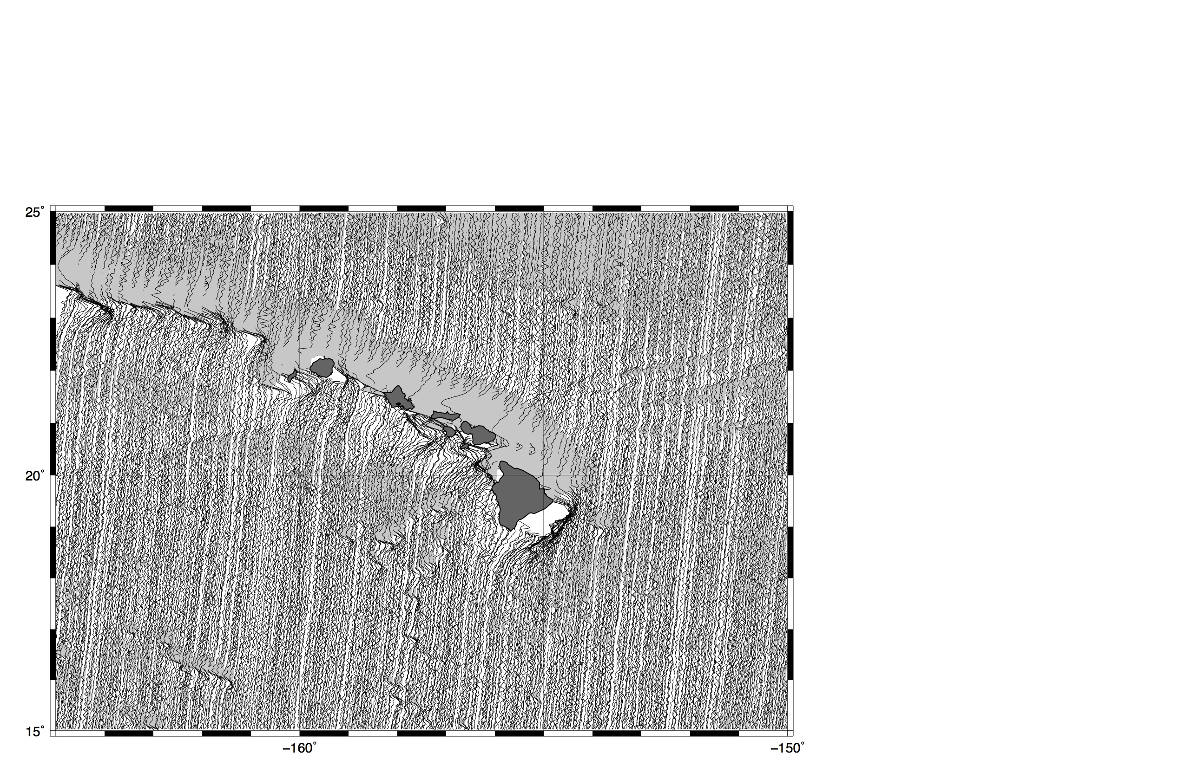
CryoSat-2 – descending (34 mo. new)

Slide 21
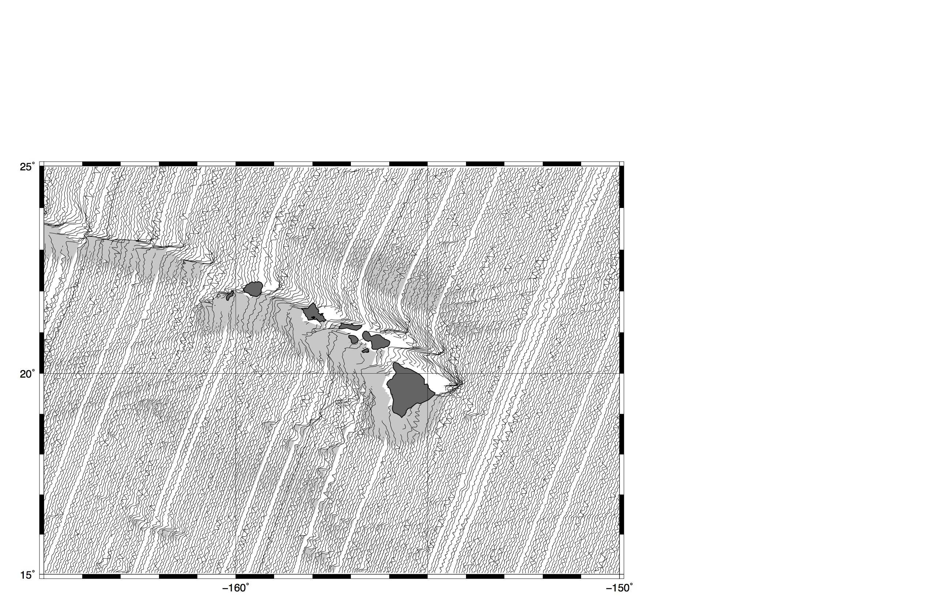
Jason-1 – ascending (14 mo. new)

Slide 22
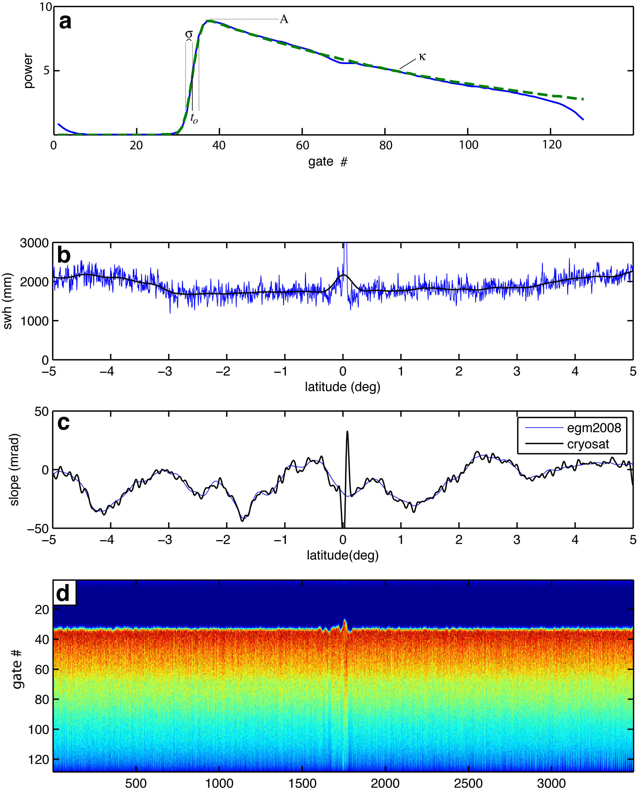
2-pass retracking to improve range precision
retrack waveforms with standard 3-parameter model
smooth wave height and amplitude over 40-km
retrack waveforms with 2-parameter model
Note: this assumes wave height varies smoothly along track.
[Sandwell and Smith, GJI, 2005]

Slide 23
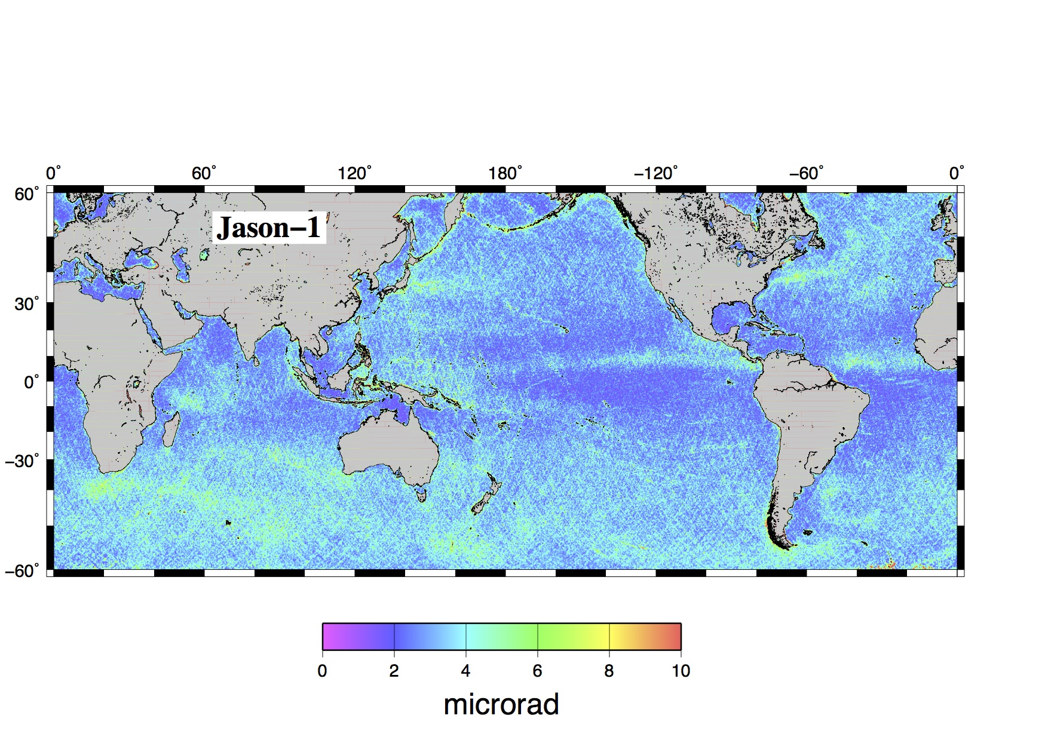
jason w.r.t. V22 - 3par

Slide 24
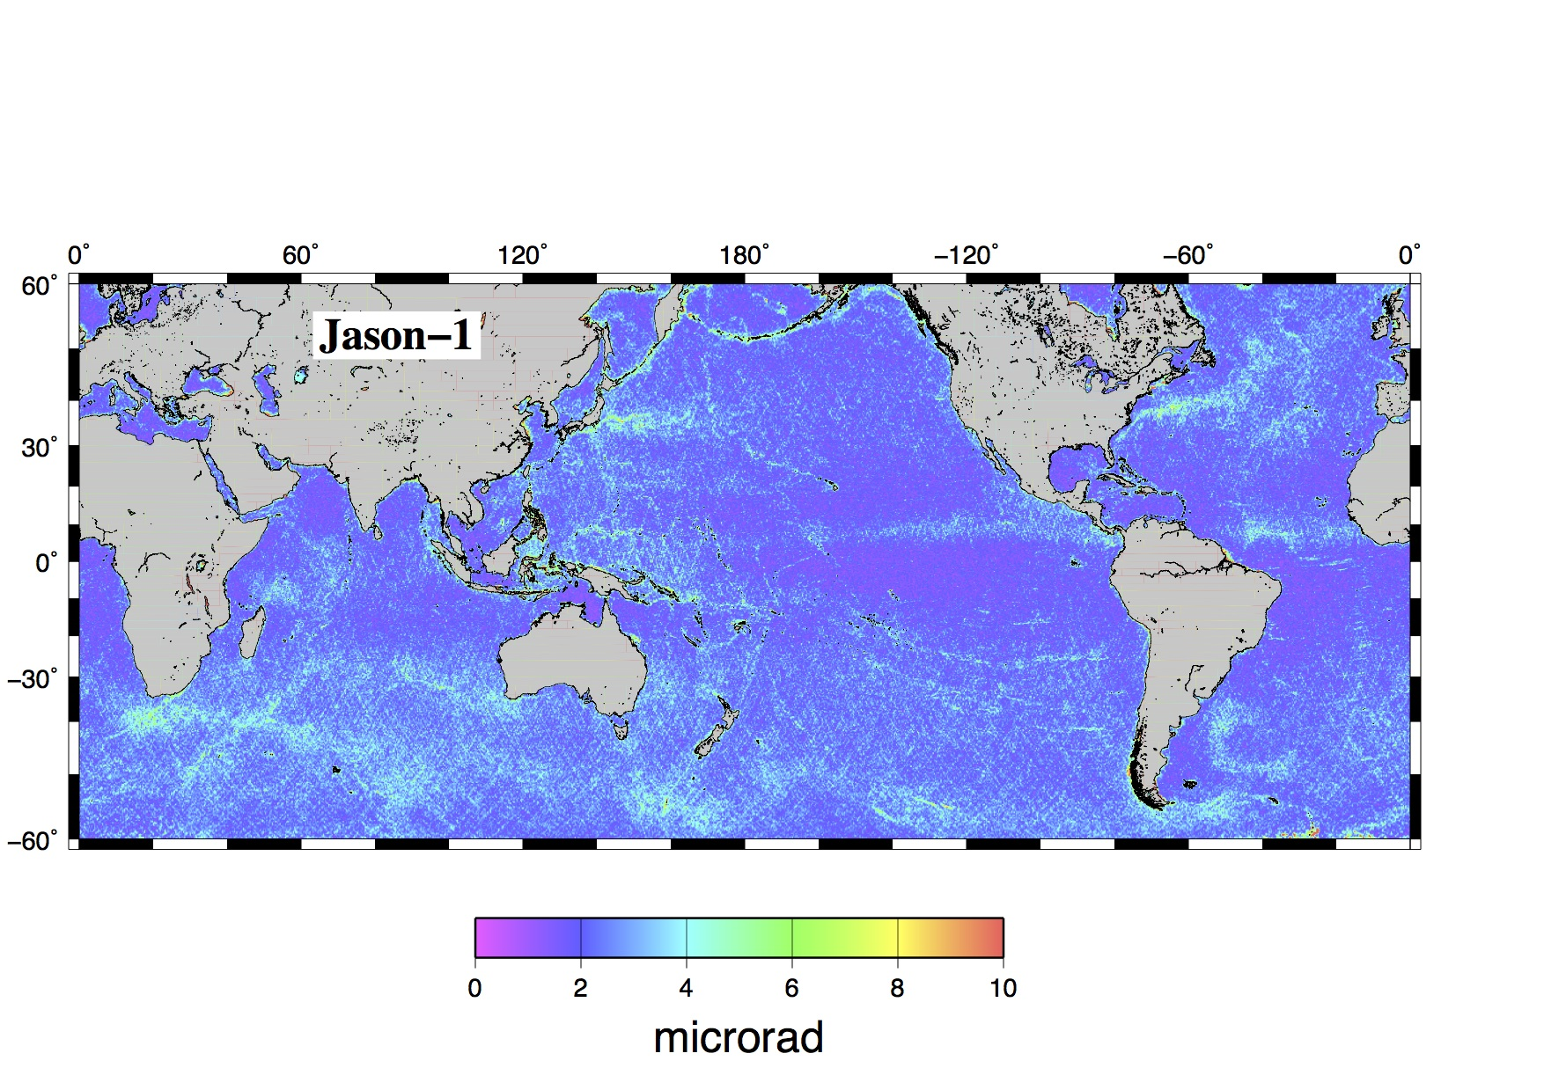
jason w.r.t. V22 - 2par

Slide 25
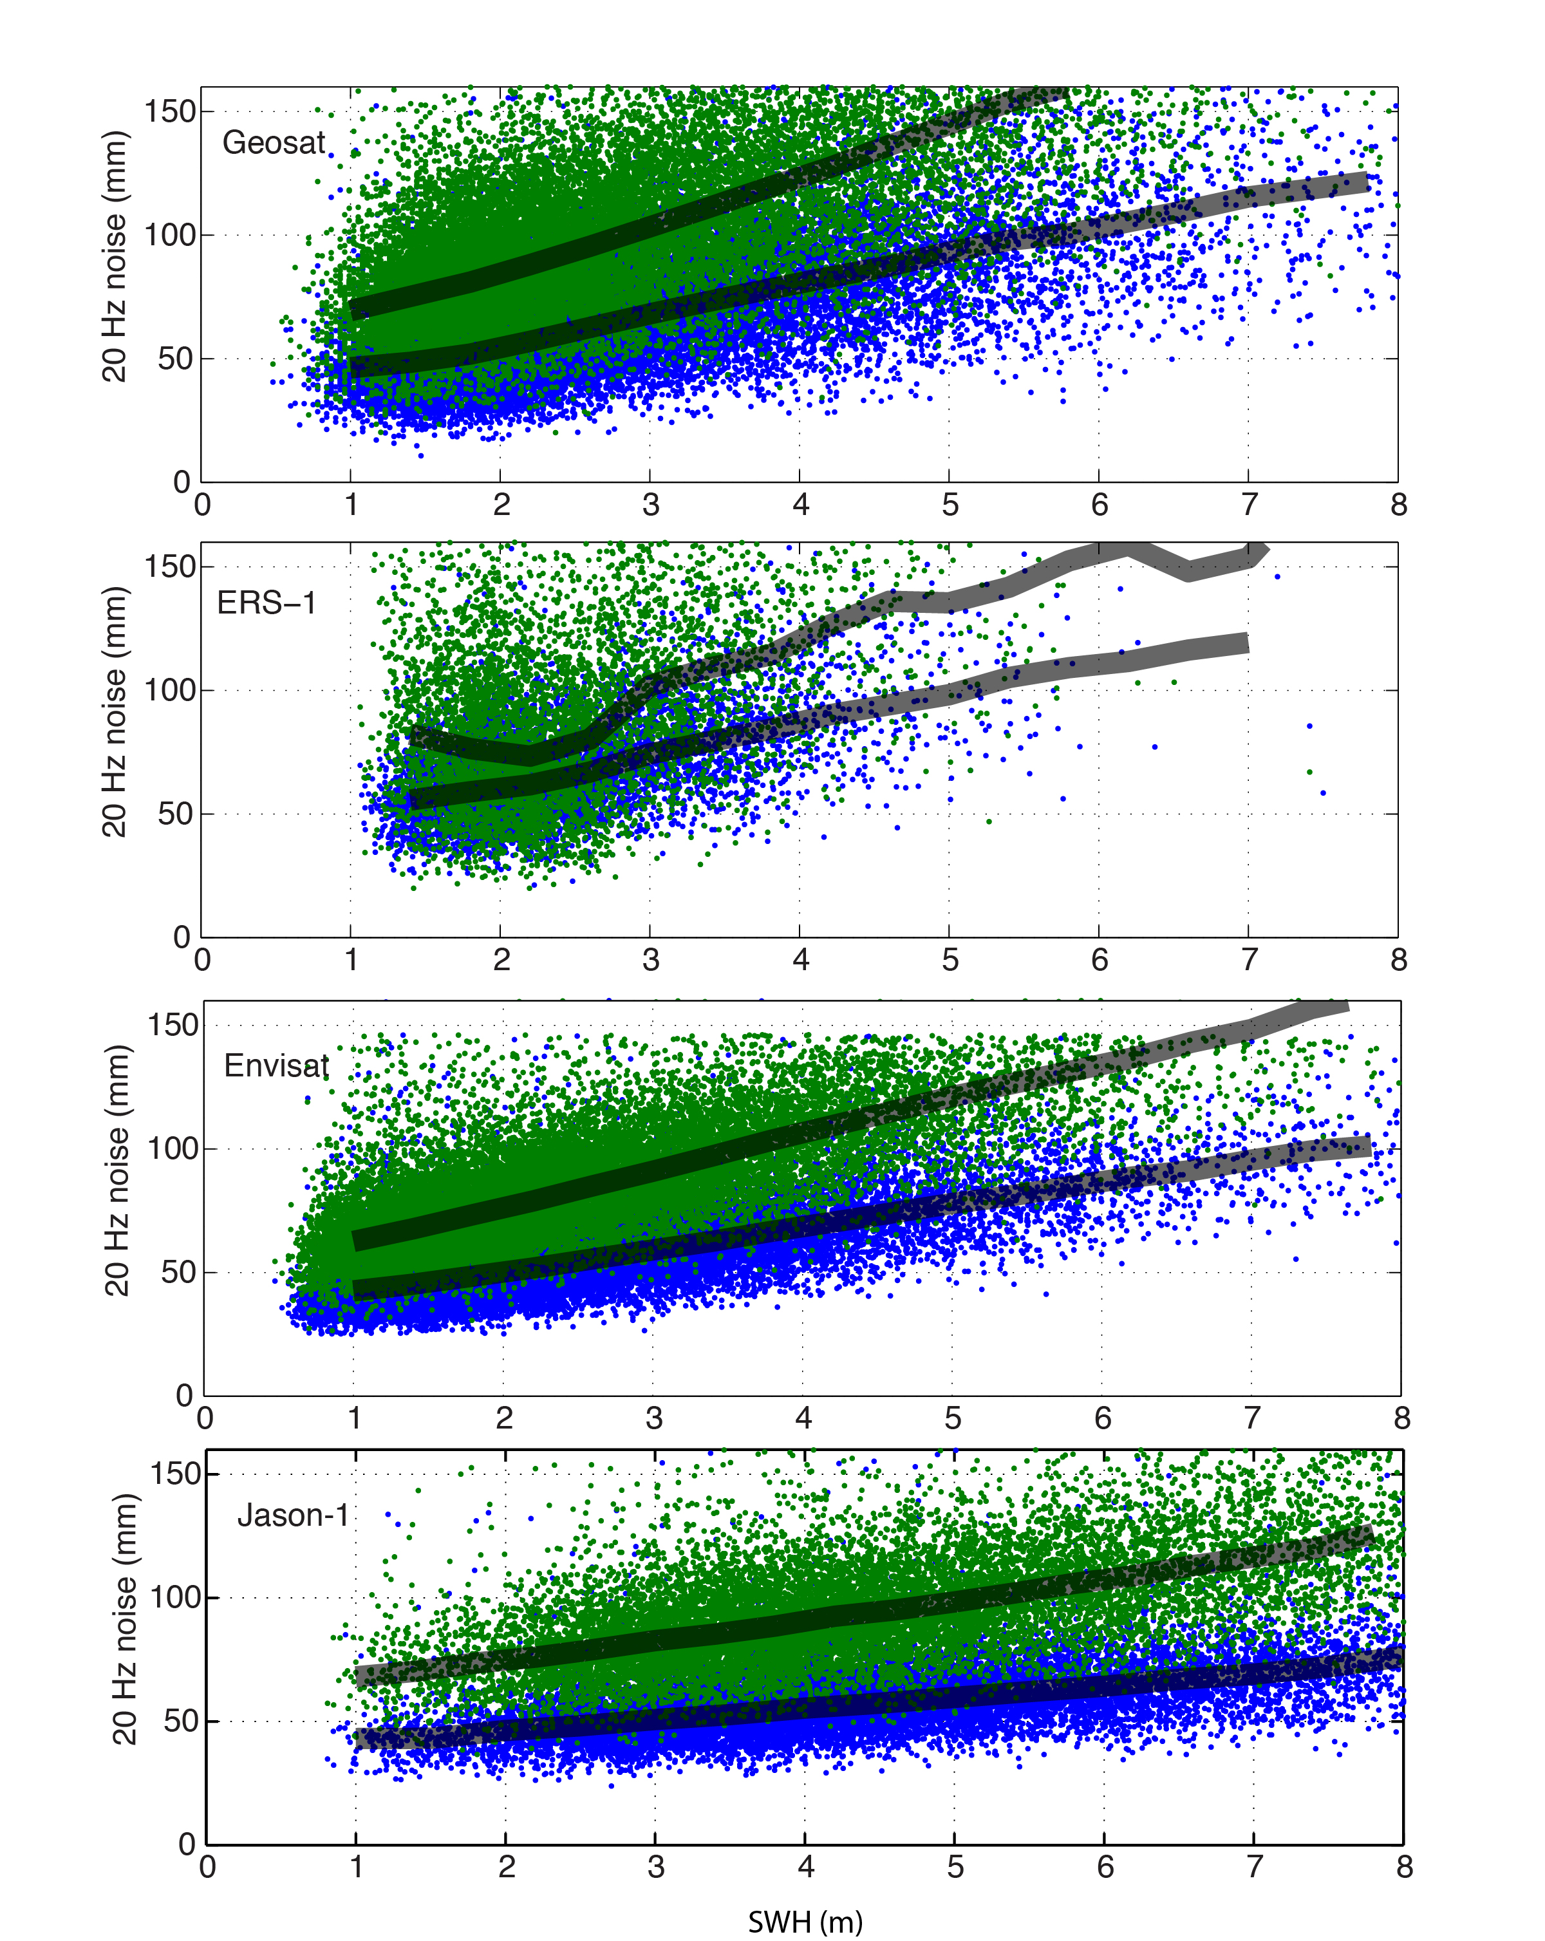
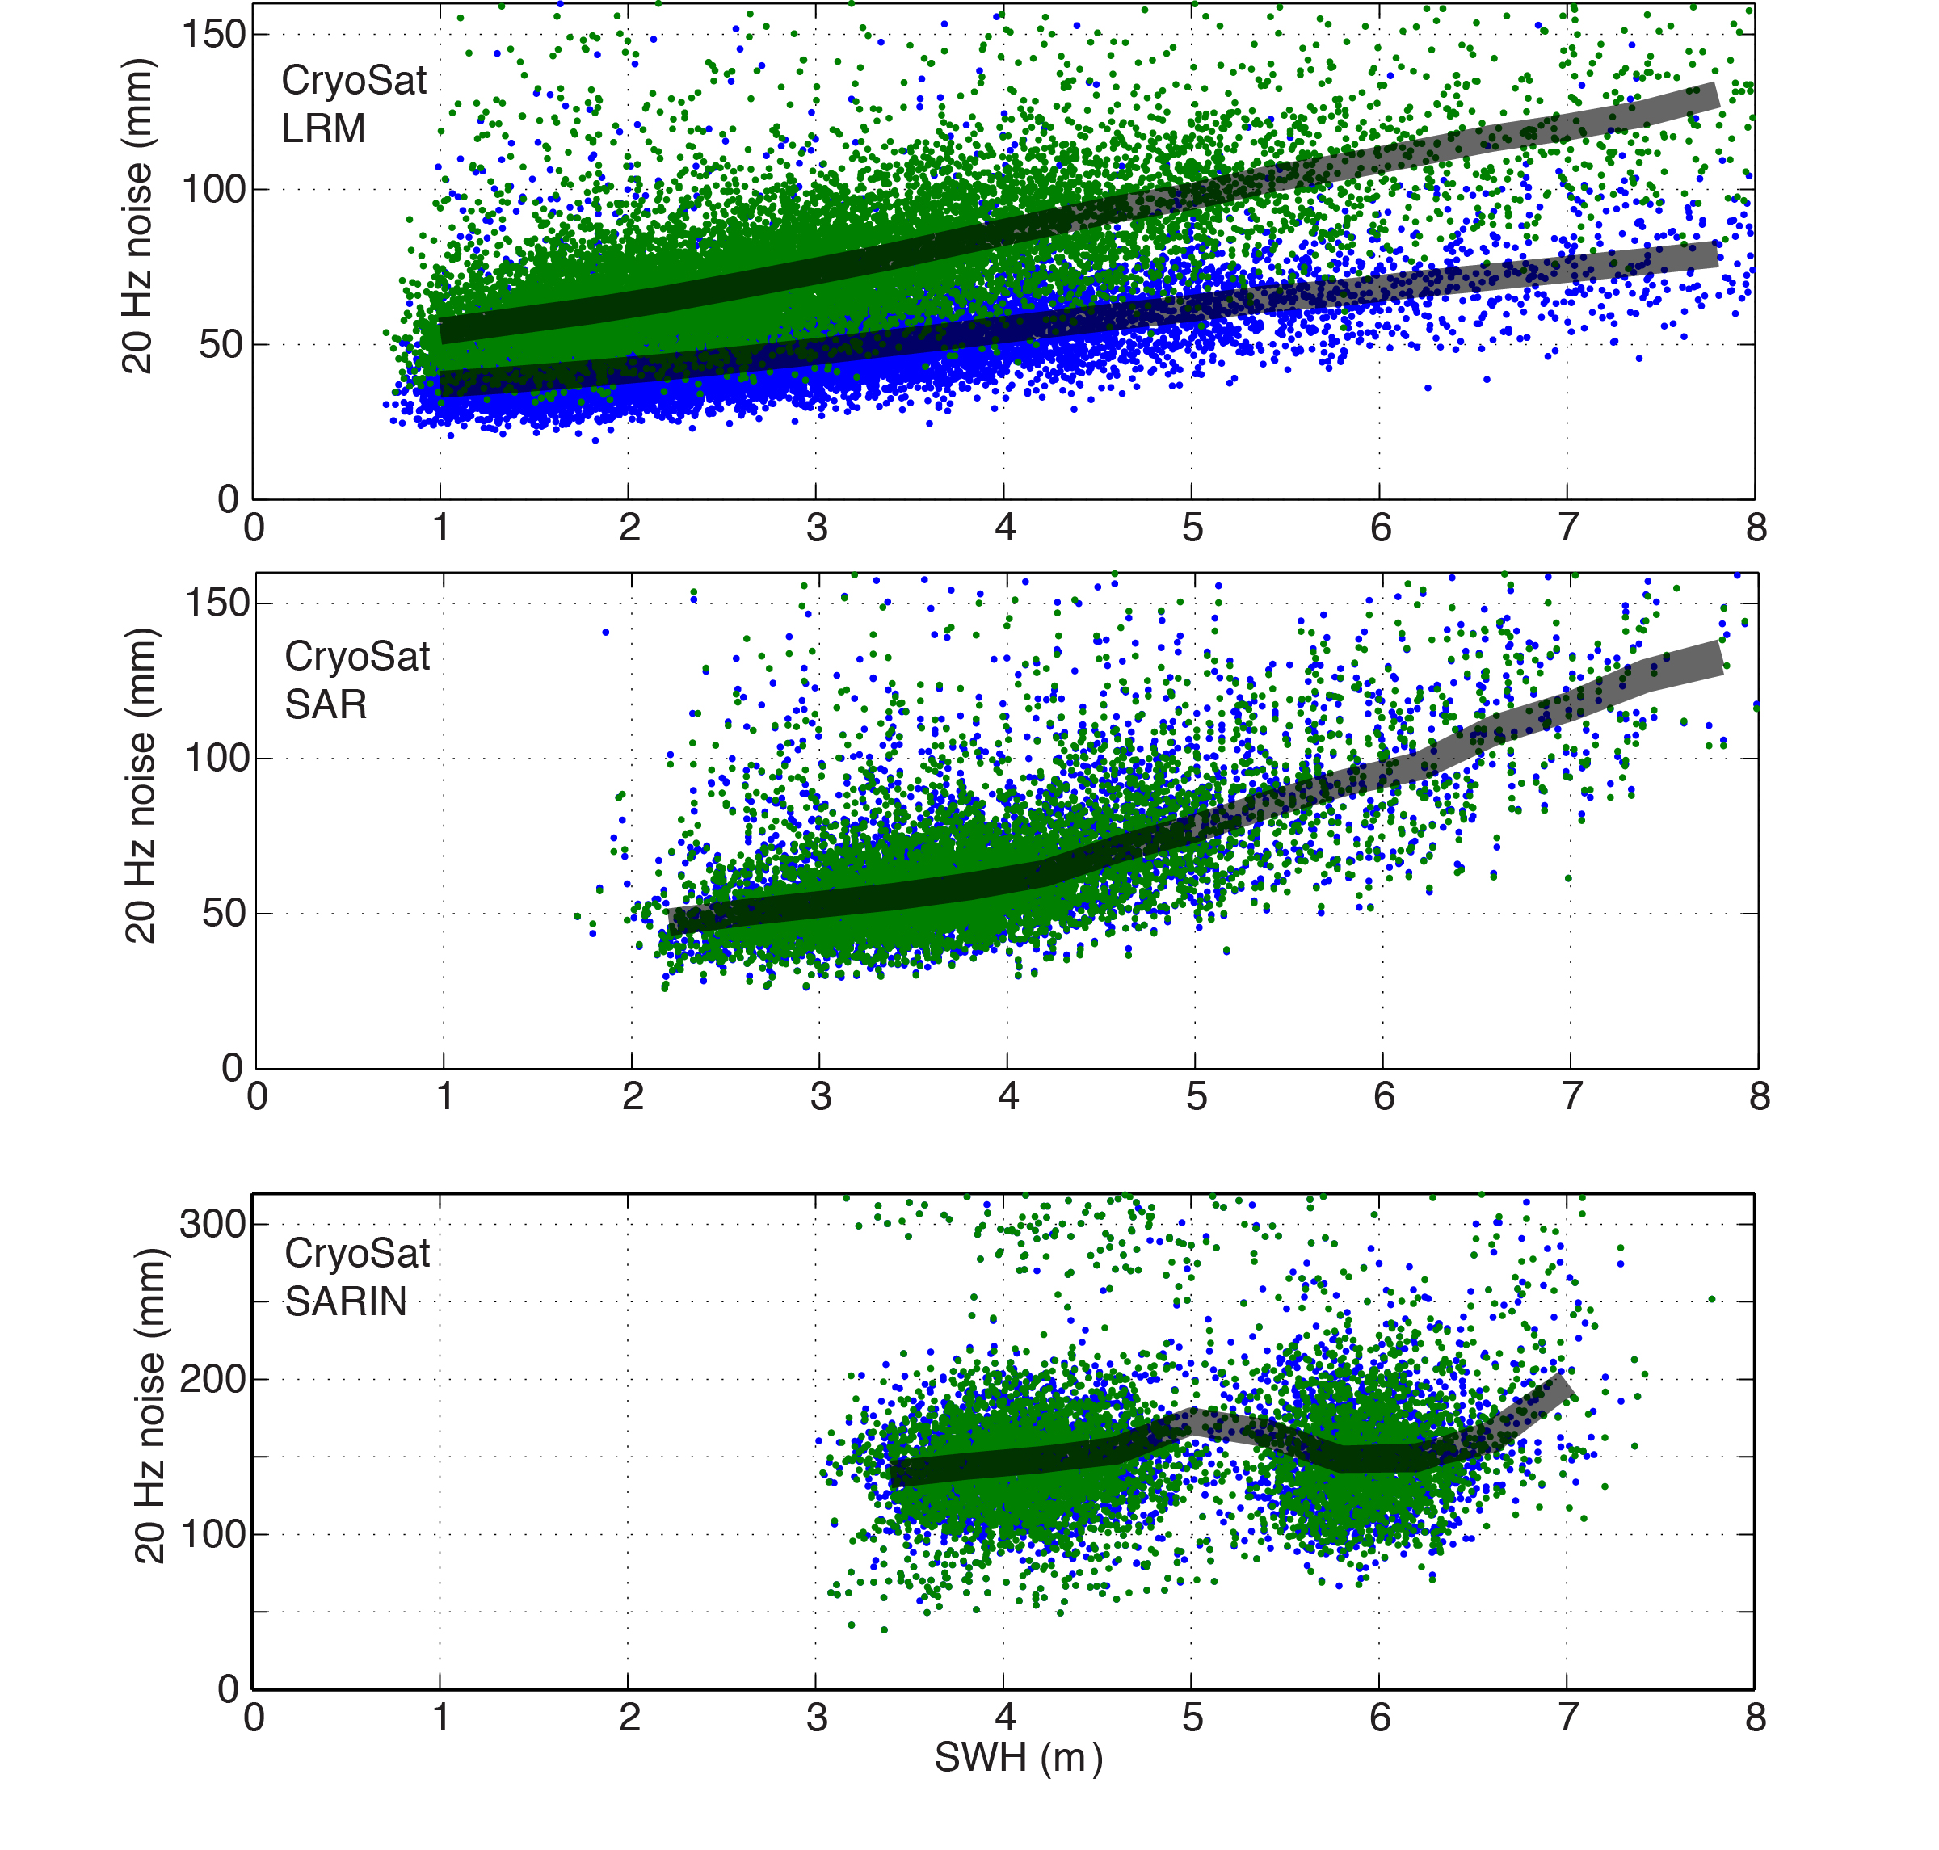
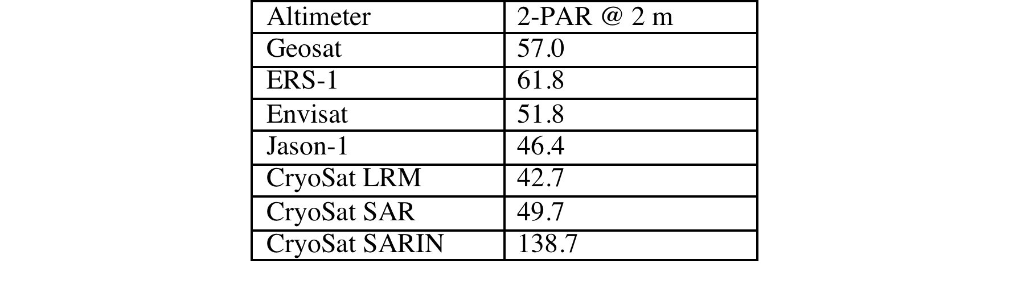
20 Hz range precision of all altimeters
3-parameter
2-parameter

Slide 26
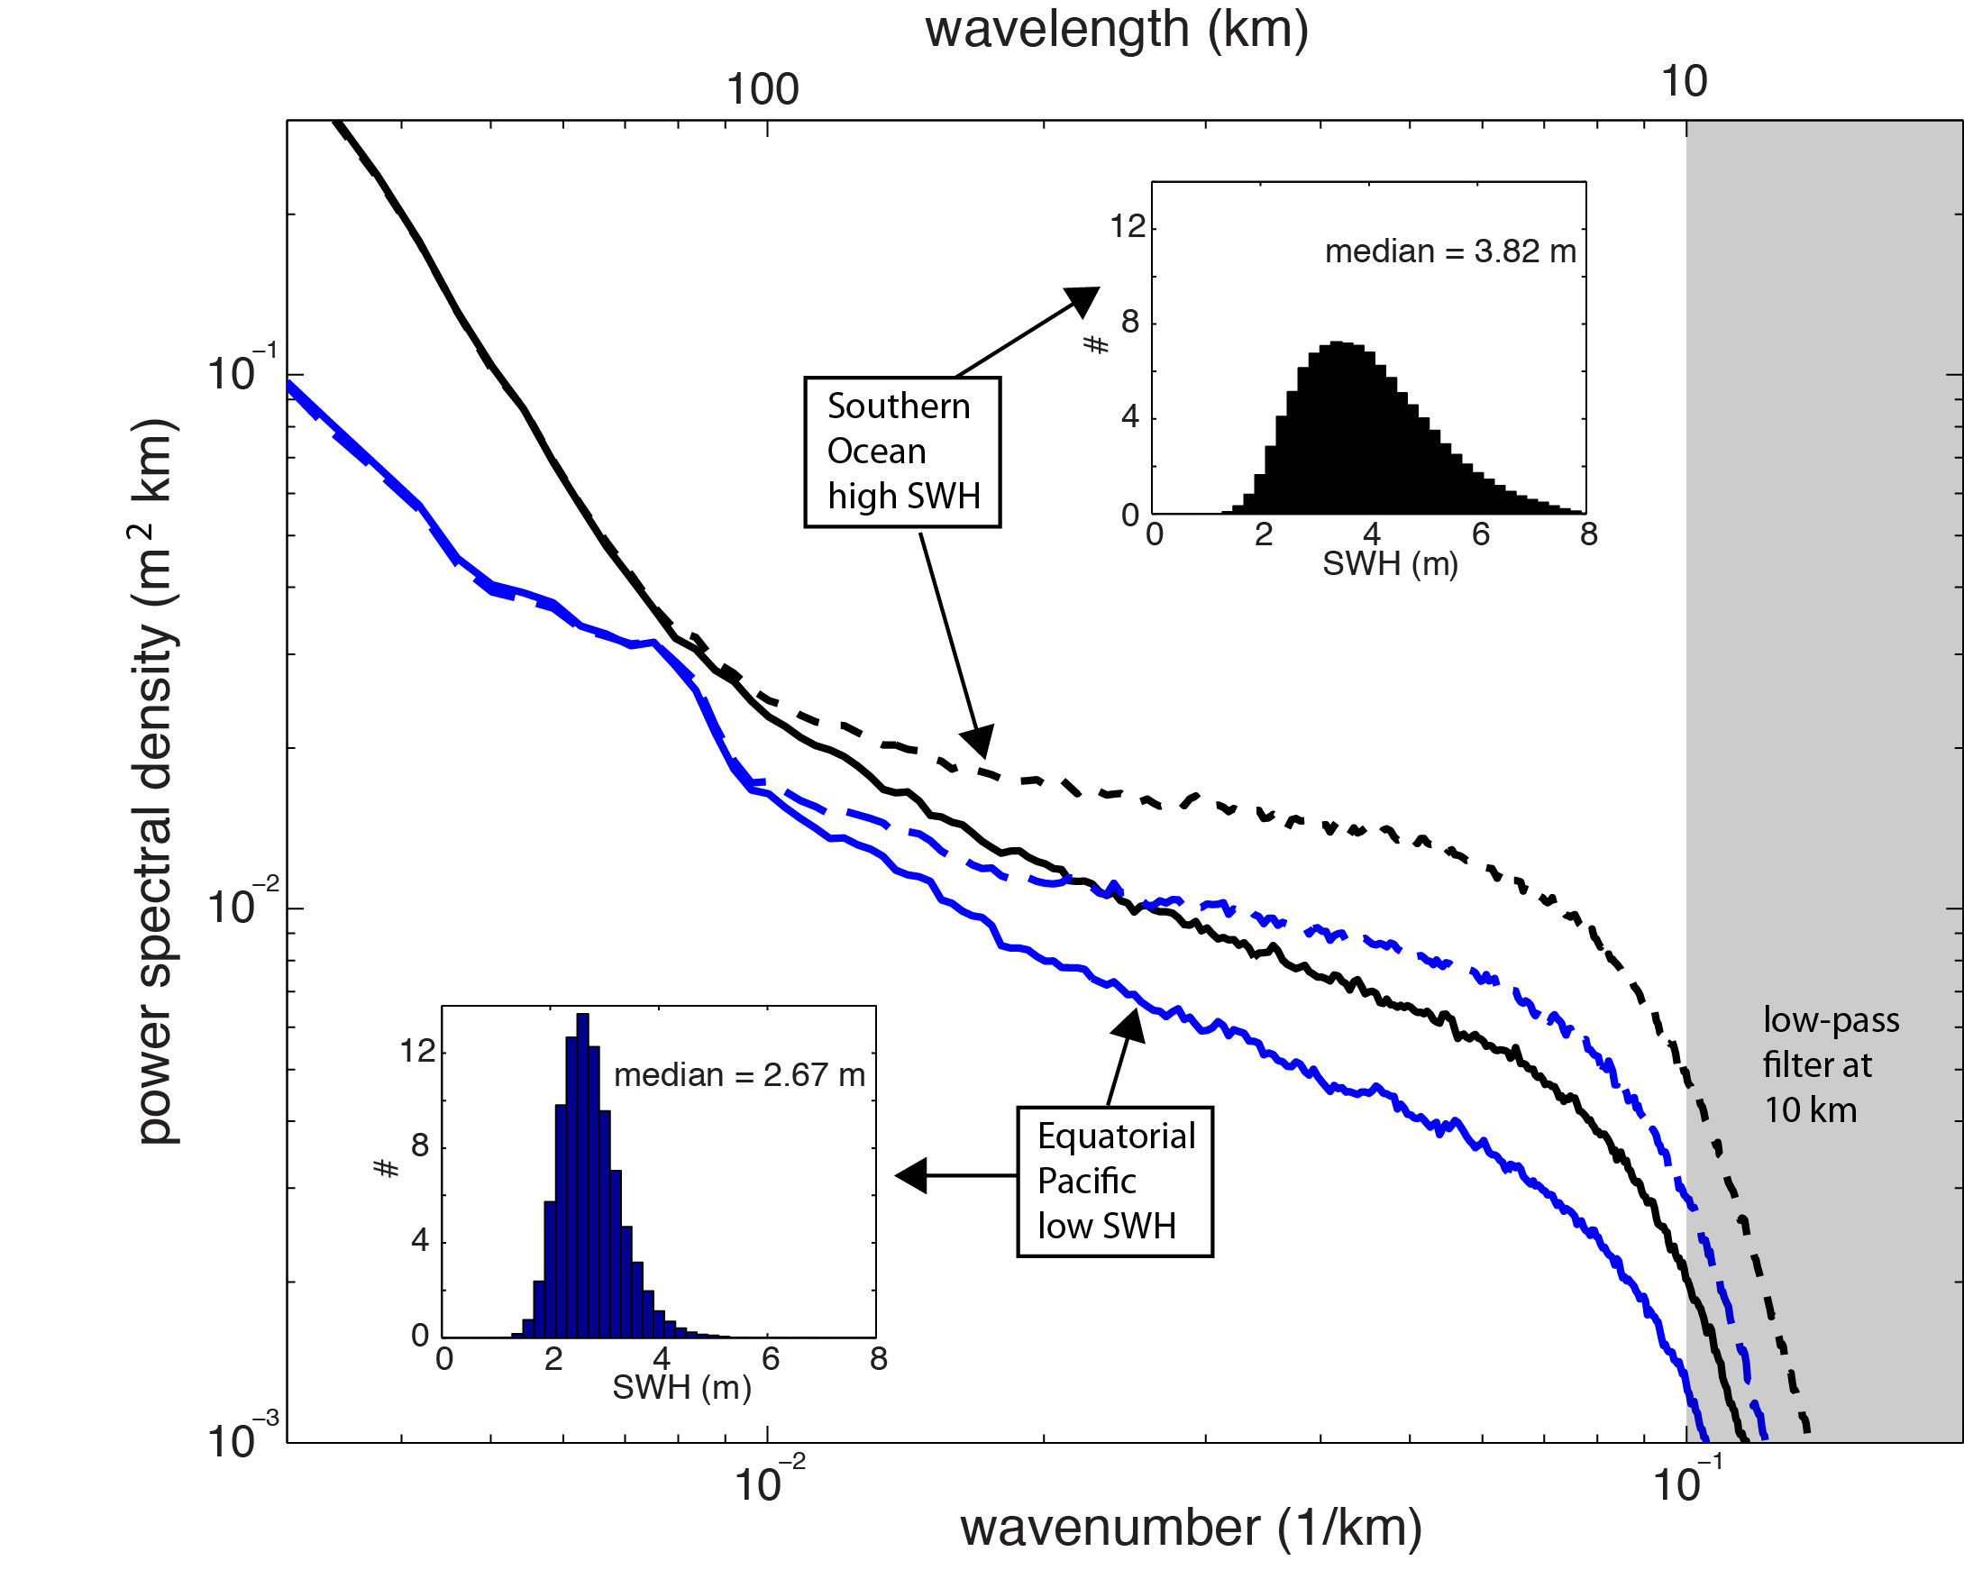
2-pass retracking reduces “spectral hump”

Slide 27
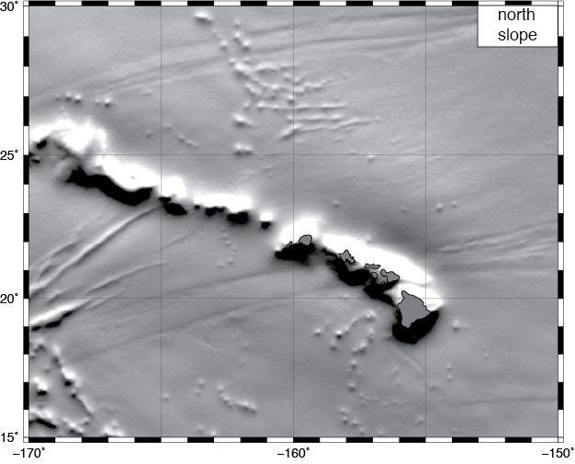
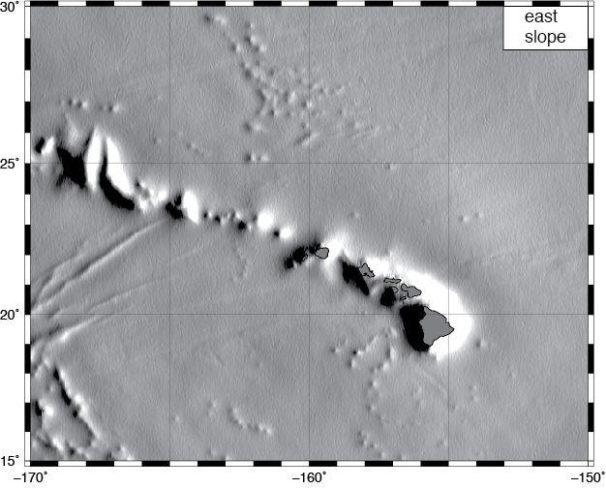
north and east slope
  combine along-track slopes from all available satellite altimeters to form north and east slope grids.
current altimeters provide ~2 x higher noise in the east slope than in the north slope because of their high inclination orbits.

Slide 28
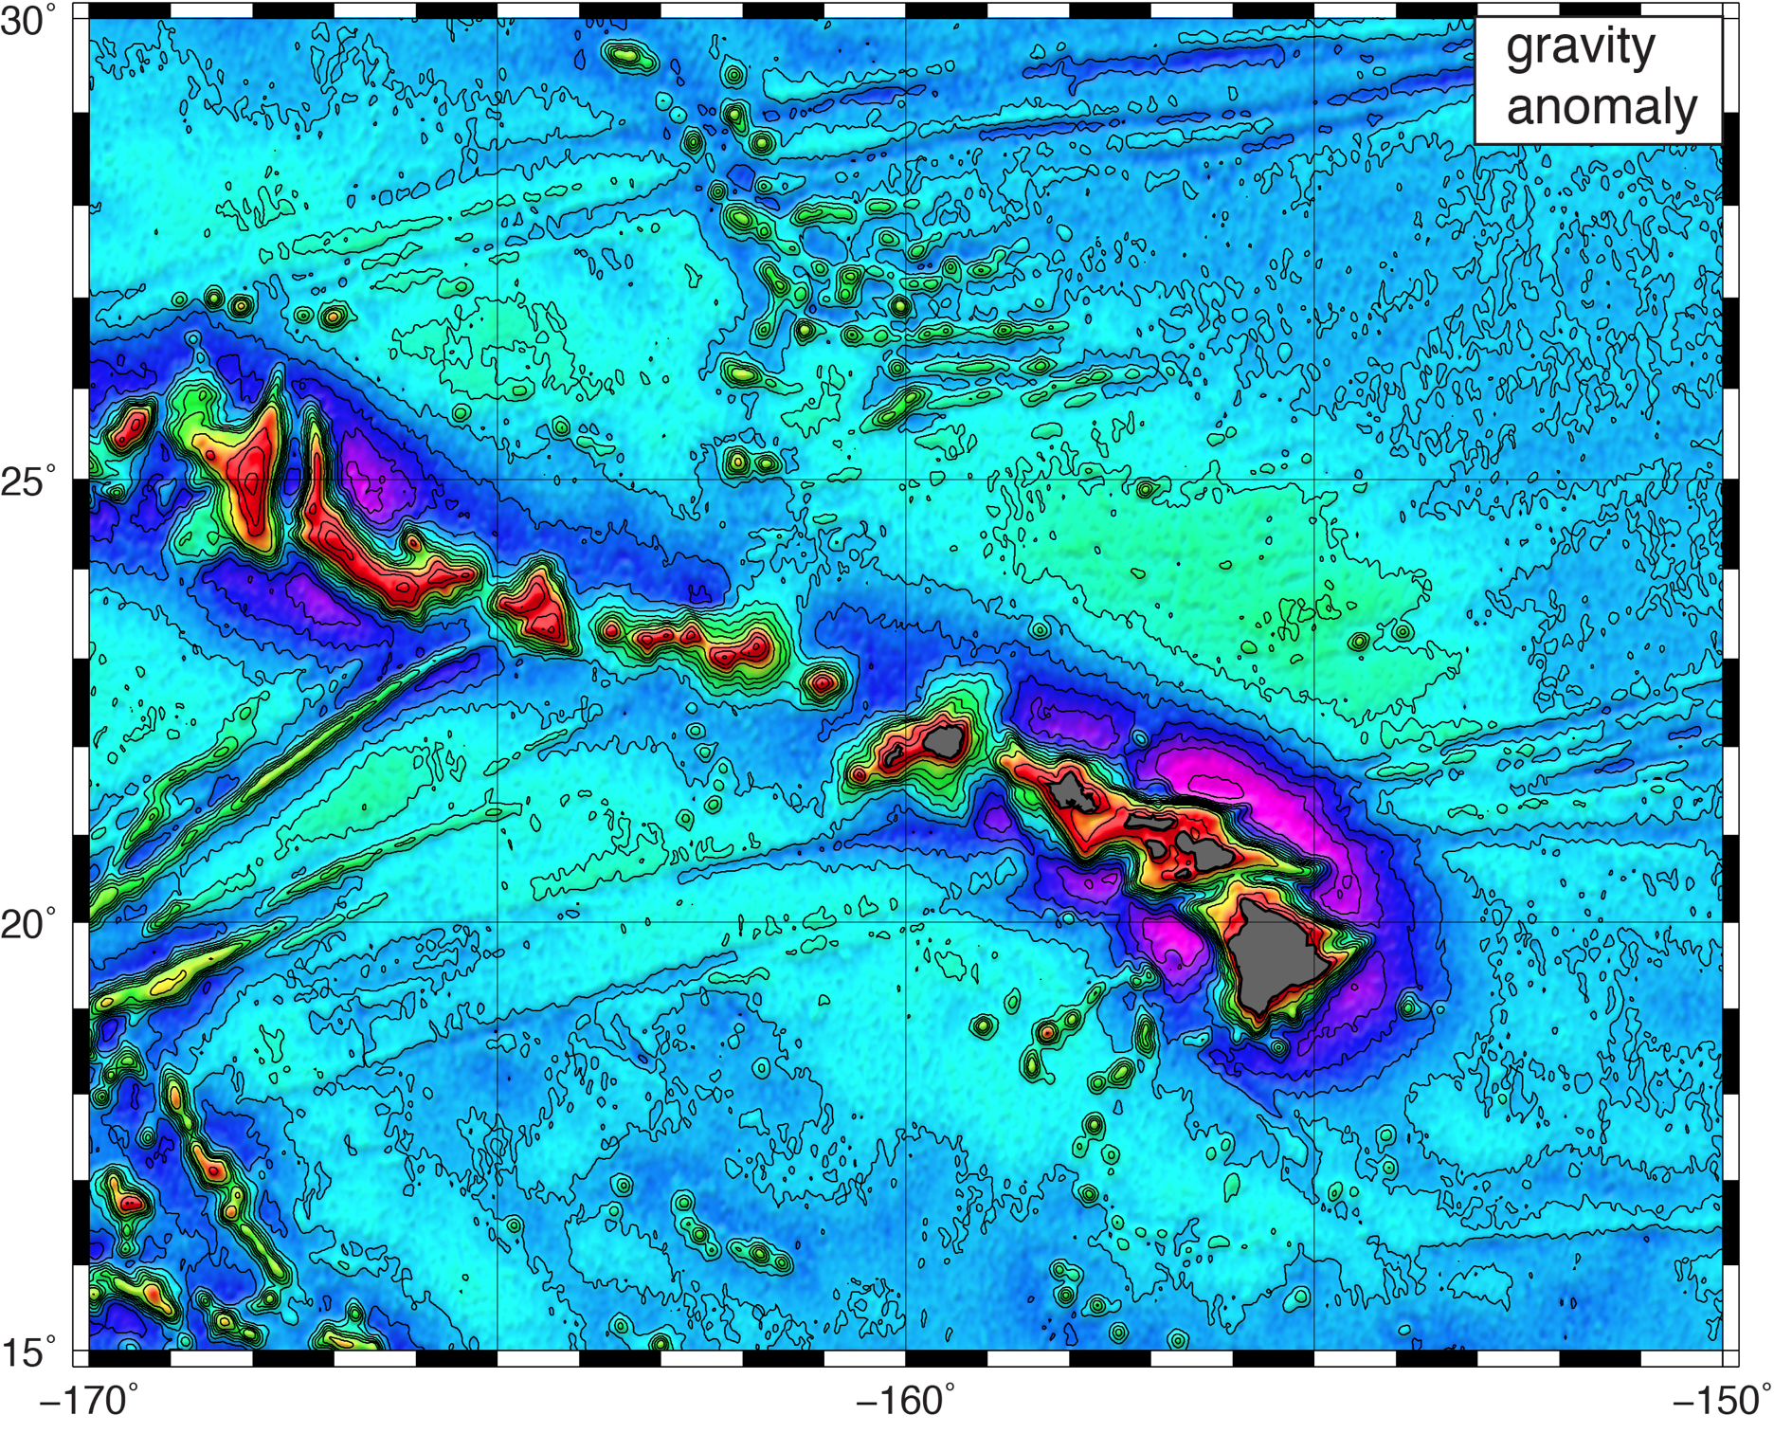
gravity anomaly
  use Laplace equation to convert slopes to gravity anomaly.
  restore long-λ gravity model.

Slide 29
Constraints on Absolute Stress at Ridges and Transforms from New Global Marine Gravity
David Sandwell, Emmanuel Garcia, and
Karen Luttrell
needs for higher accuracy and resolution gravity/bathymetry
new altimetry and optimized waveform retracking
towards 1 mGal global marine gravity
morphology and compensation of ridges vs. spreading rate
constraints on absolute stress at ridges and transforms

Slide 30
Global Gravity Anomaly V22.1

Slide 31
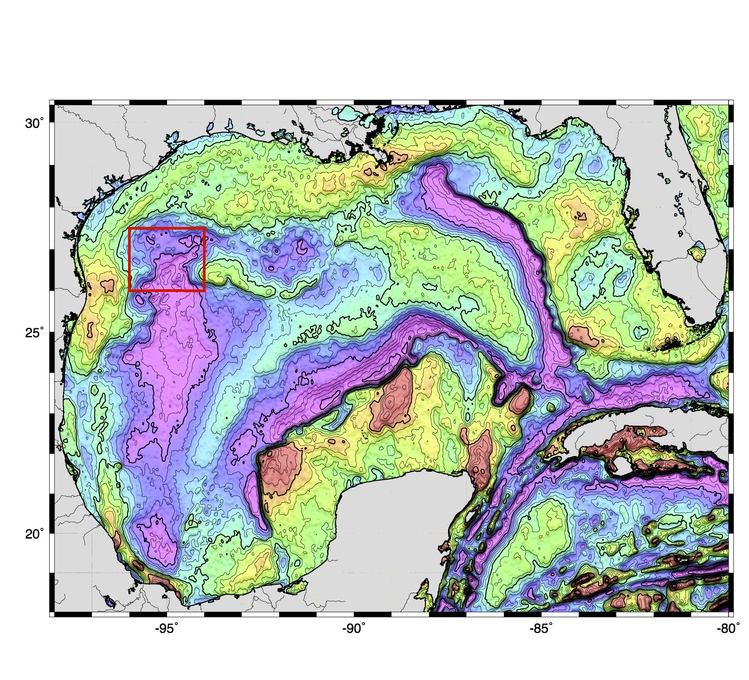
Gravity Anomaly V22.1 (10 mGal contours)

Slide 32
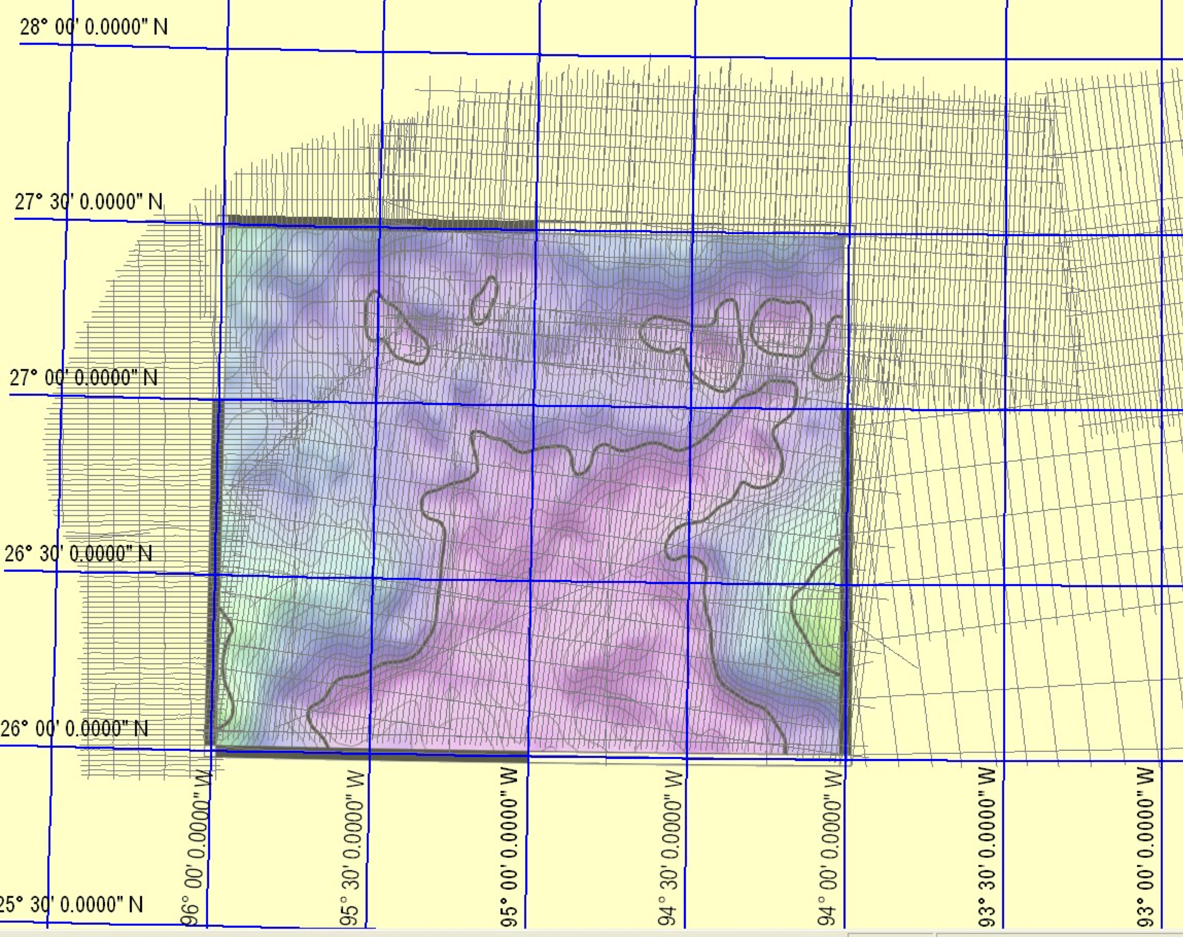
GPS Navigated Gravity survey of Alaminos Canyon
(Alan Herring, personal communication, Dec. 2011.)

Slide 33
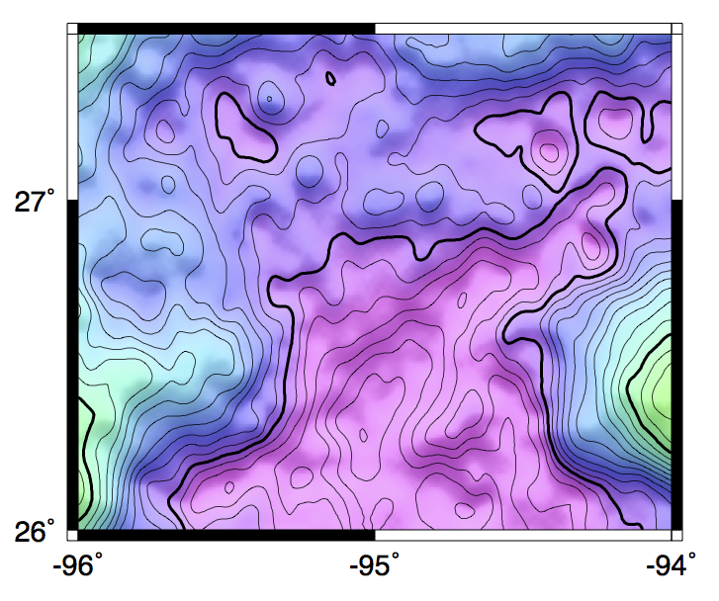
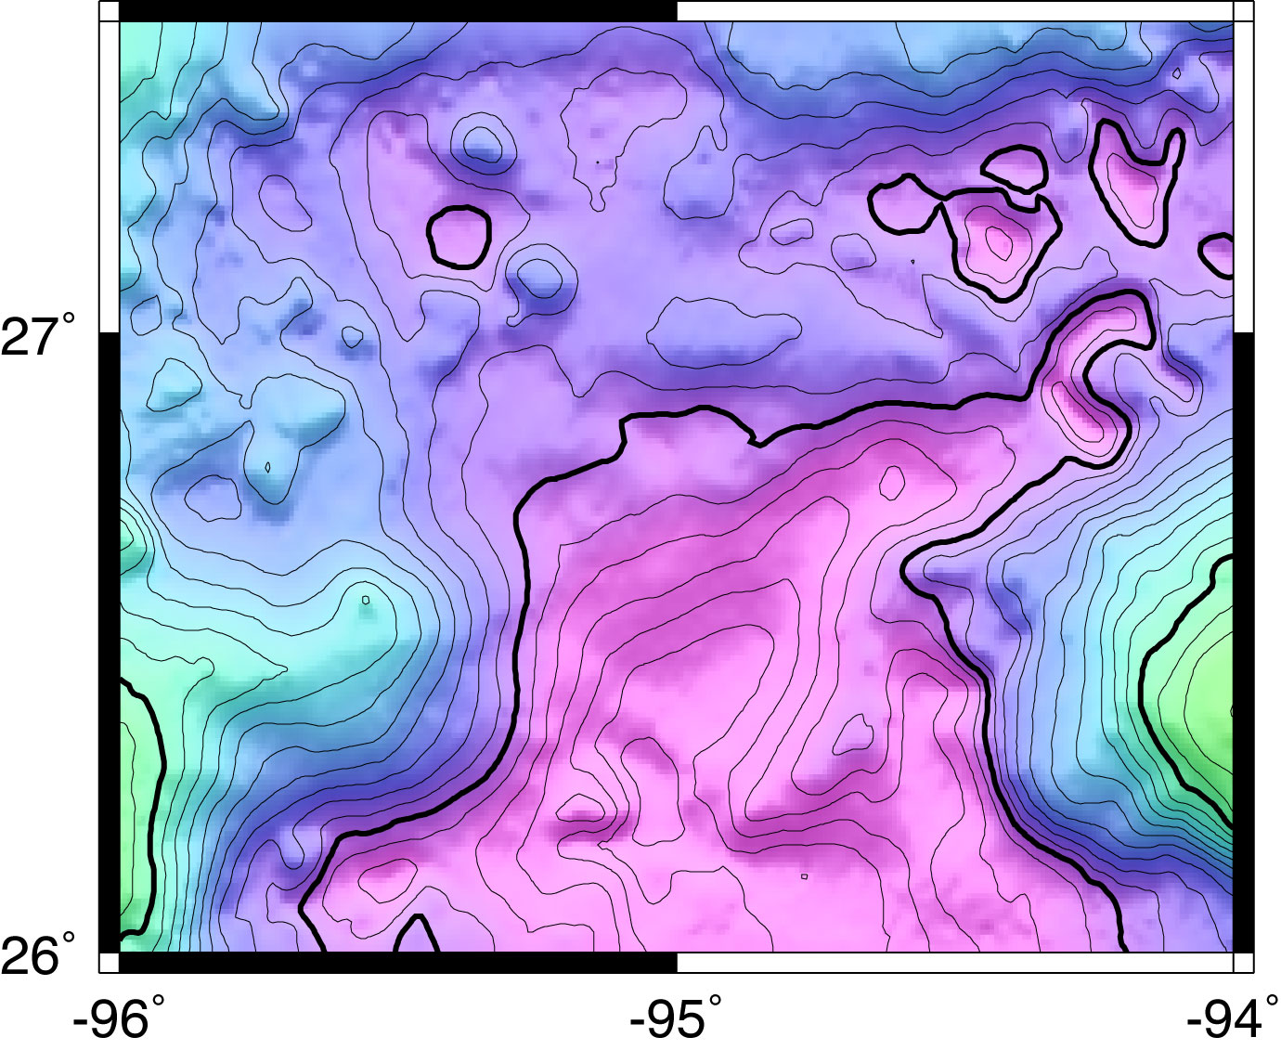
comparisons in the Gulf of Mexico
satellite gravity
with CryoSat LRM, Envisat and Jason-1
ship gravity
source: EDCON
5 mGal contour interval

Slide 34
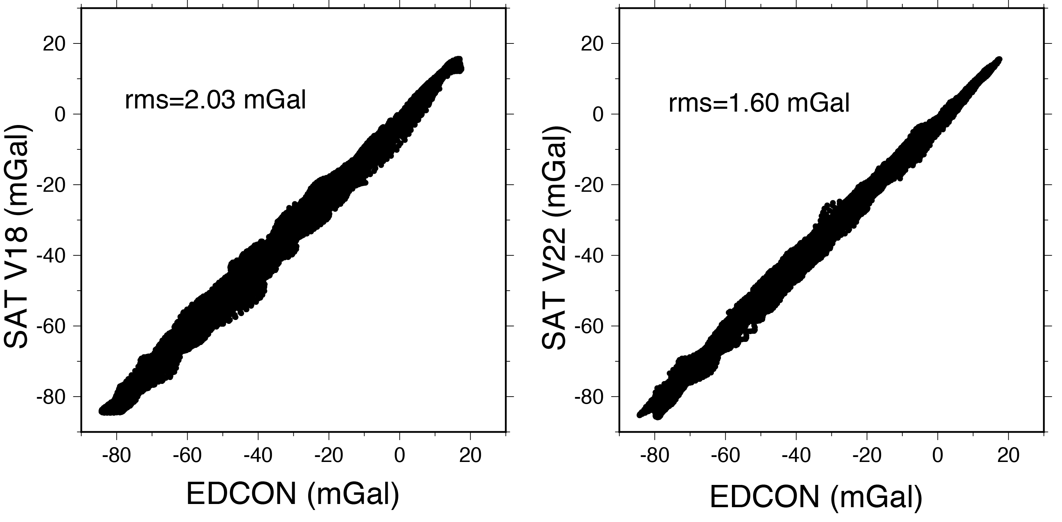
spatial comparisons in the Gulf of Mexico
V22
CryoSat-2
Jason-1
Envisat
Geosat ERS-1
V18
Geosat ERS-1
Noise contribution from the EDCON data is 0.51 mGal.

Slide 35
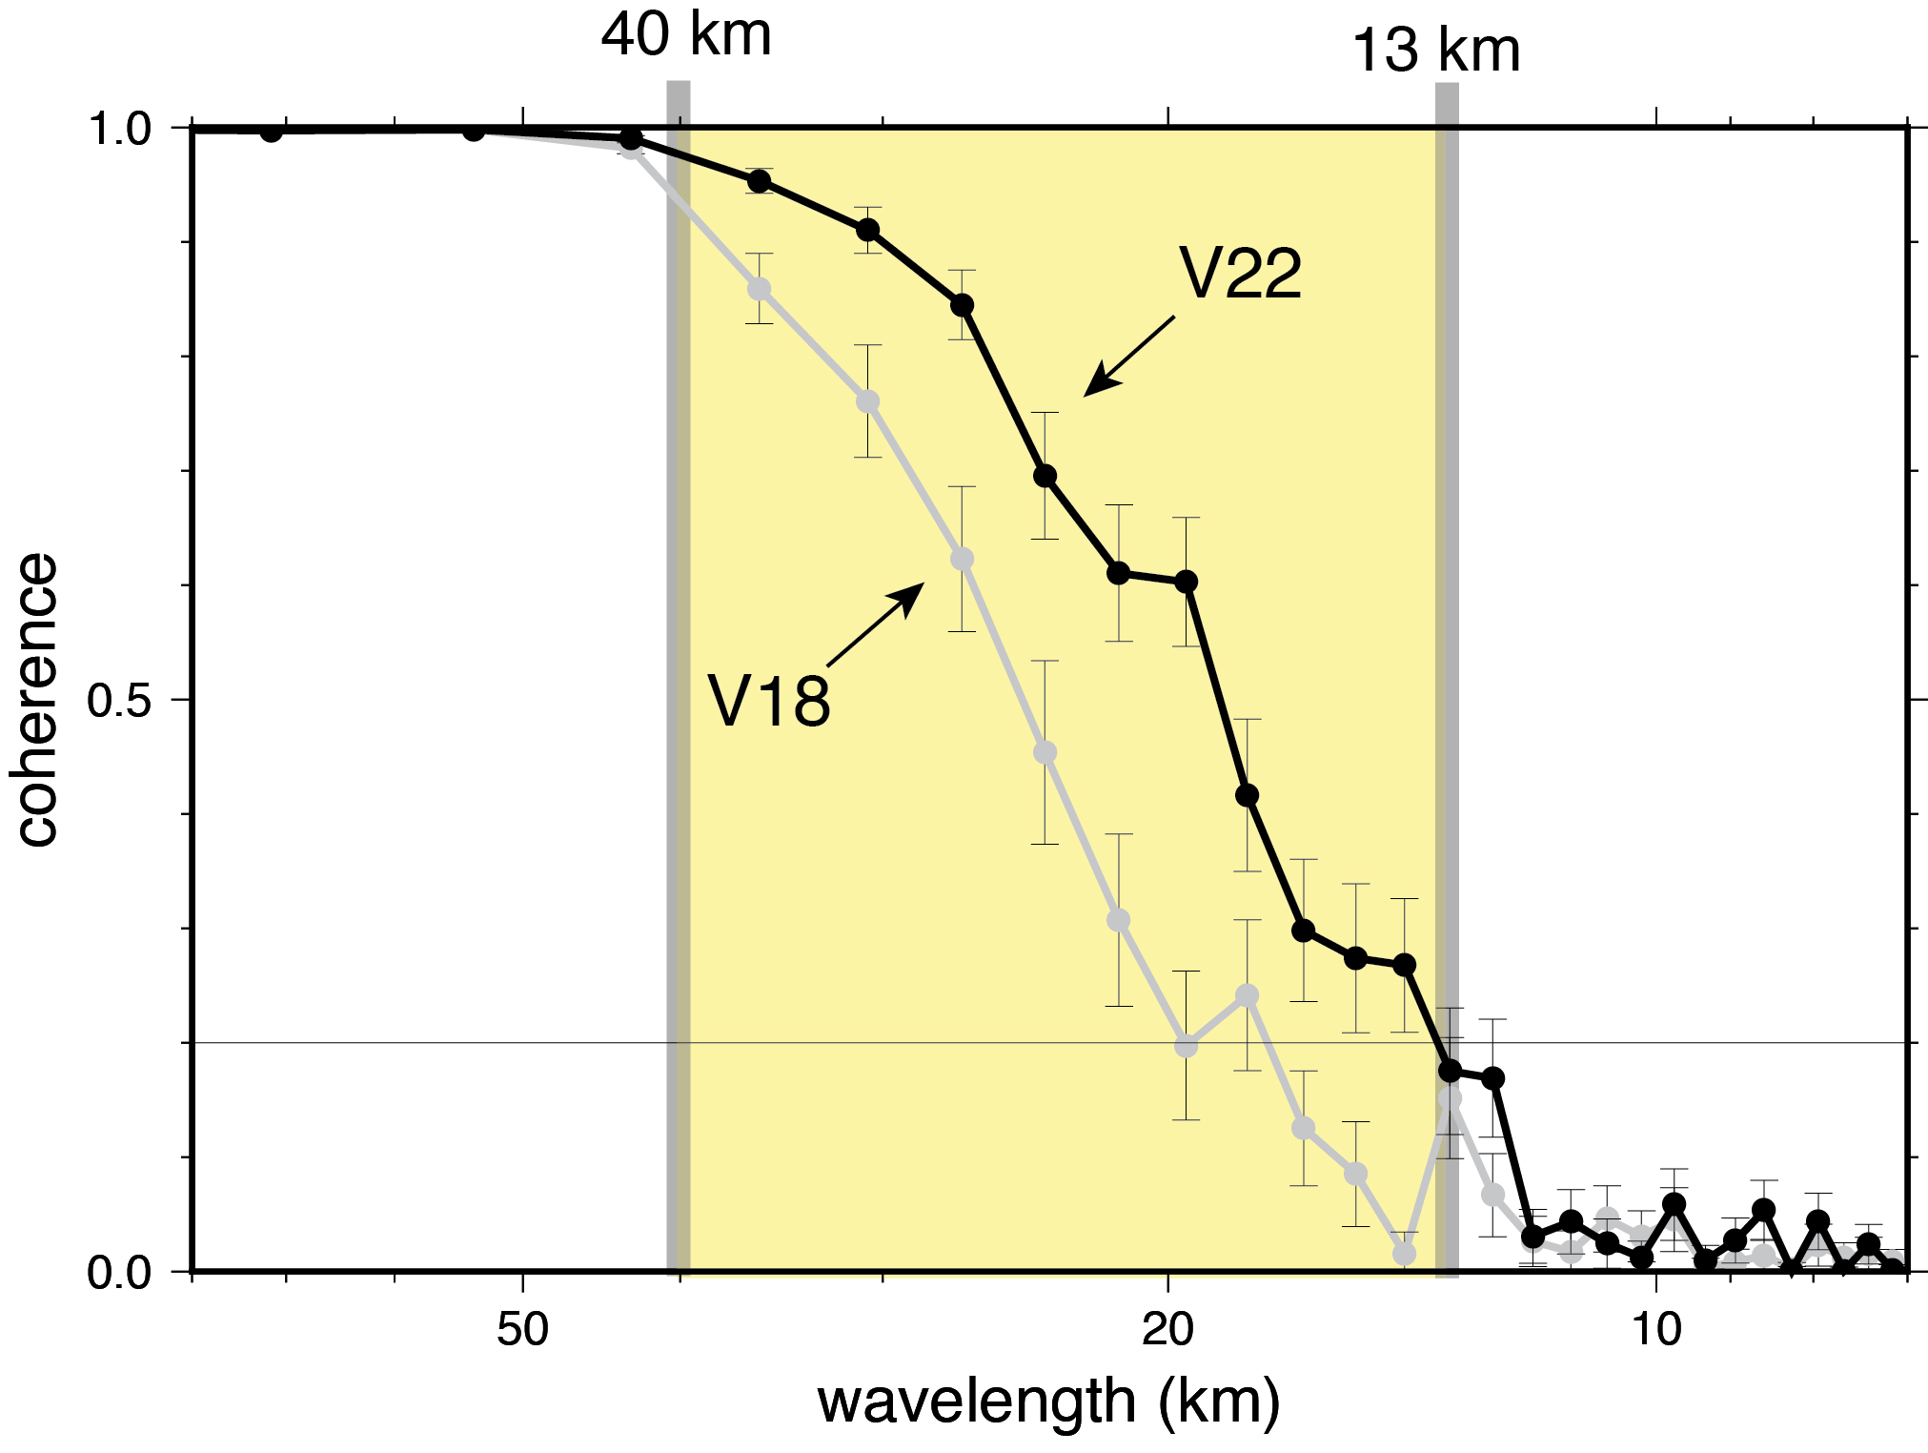
spectral comparisons in the Gulf of Mexico

Slide 36
Global Gravity Anomaly V20.1

Slide 37
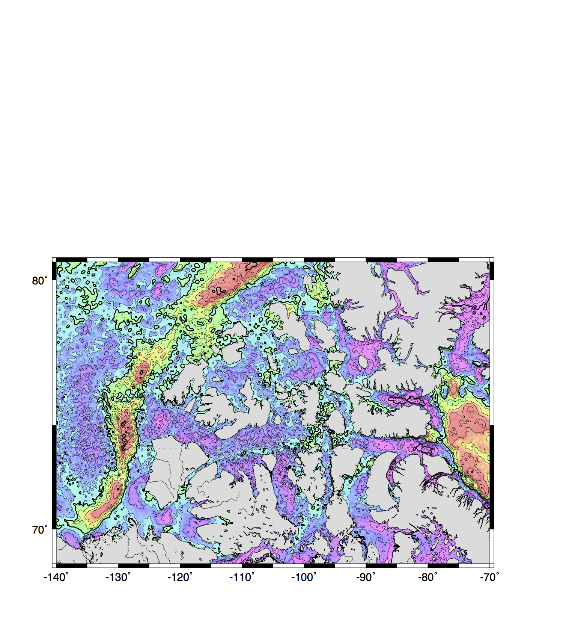
Canadian Arctic - V18.1
Geosat, ERS-1 (old)
Canadian Arctic
Geosat and ERS-1

Slide 38
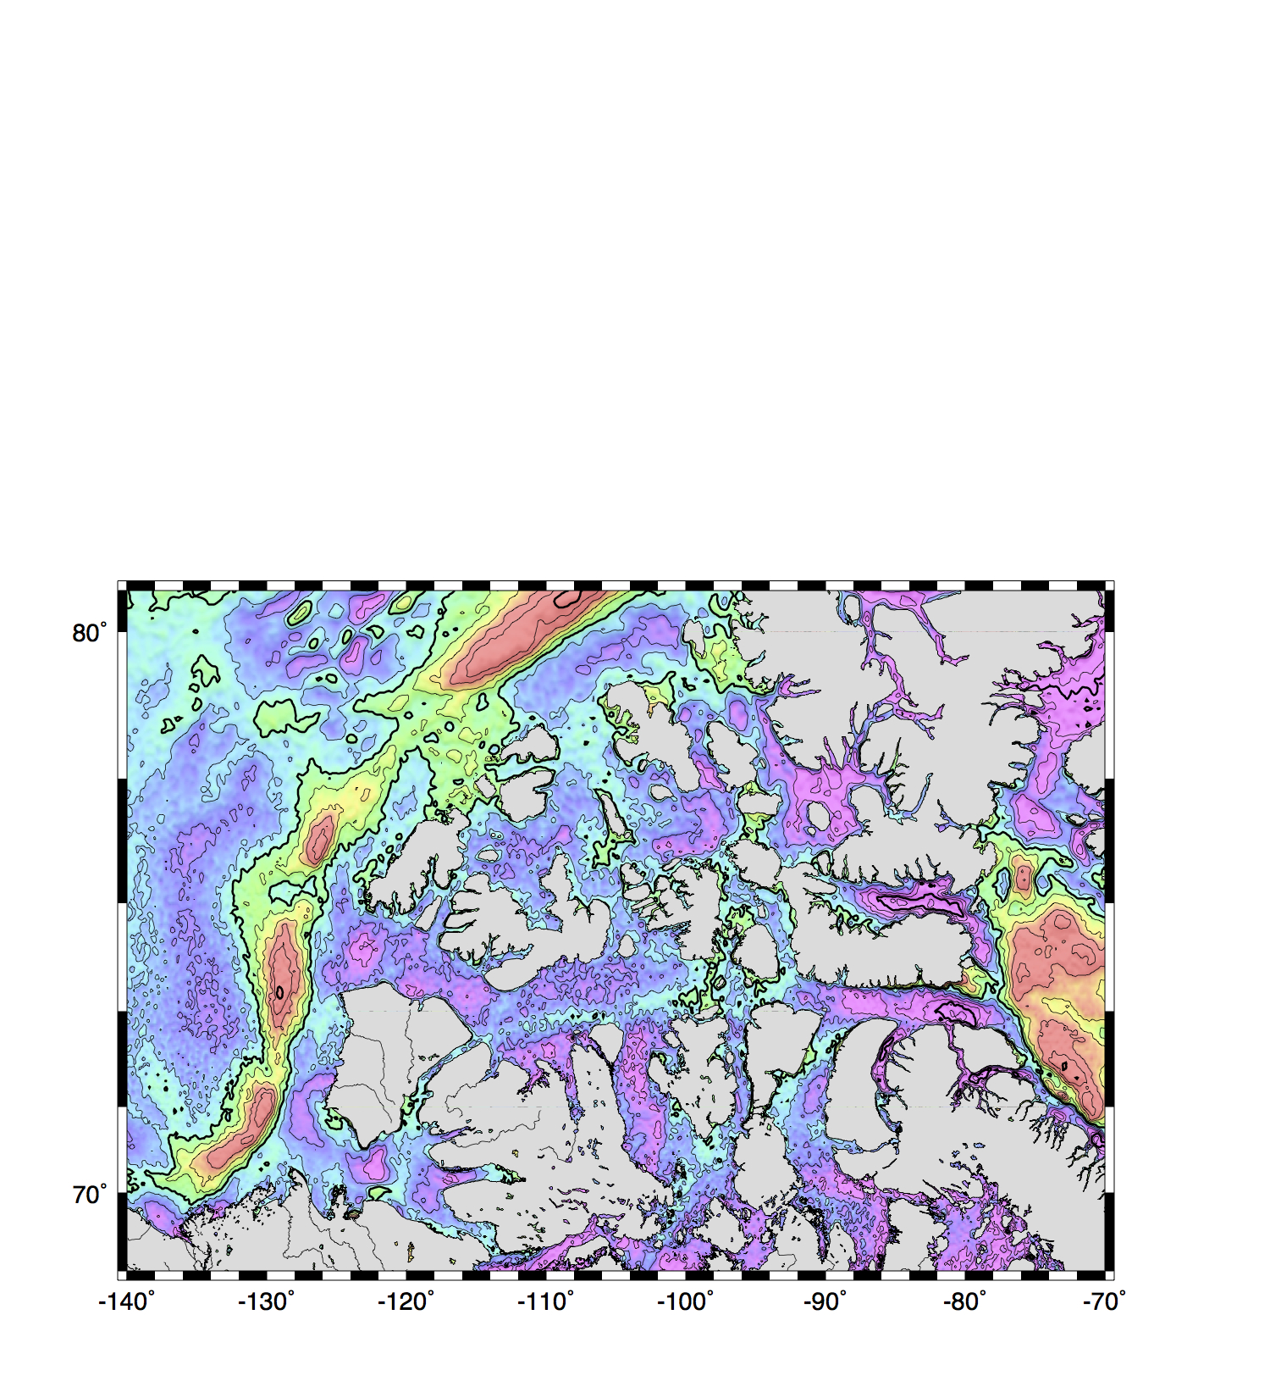
Canadian Arctic – V20.1
Geosat, ERS-1 (old) + CryoSat, Envisat (new)

Slide 39
First attempt at comparing
all academic fleet ship gravity
(1500 cruises) with V21.1 satellite
gravity courtesy of Paul Wessel.
The median absolute deviation between academic fleet gravity and satellite gravity is 2.75 mGal.
Most academic fleet cruises are less accurate than the satellite gravity.

Slide 40
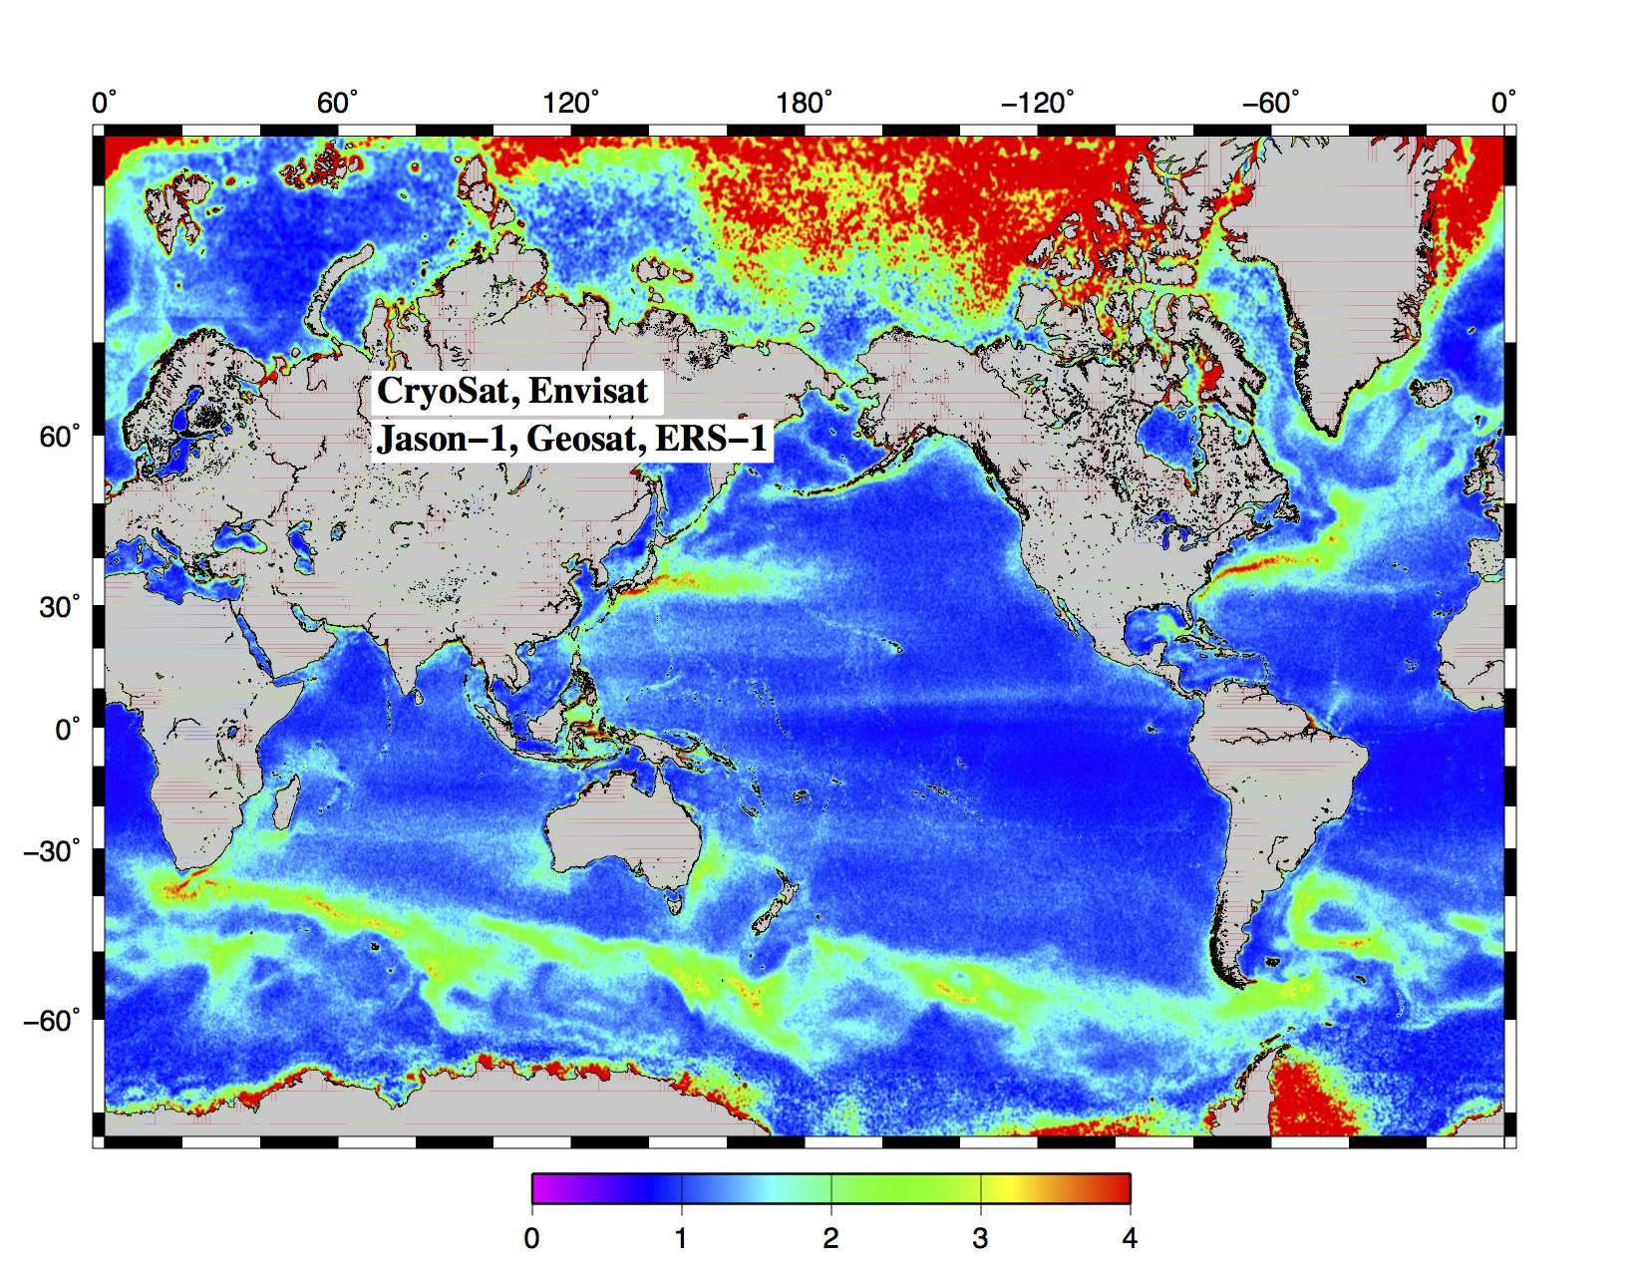
median along track slope difference in microradian (0.98 mGal)

Slide 41
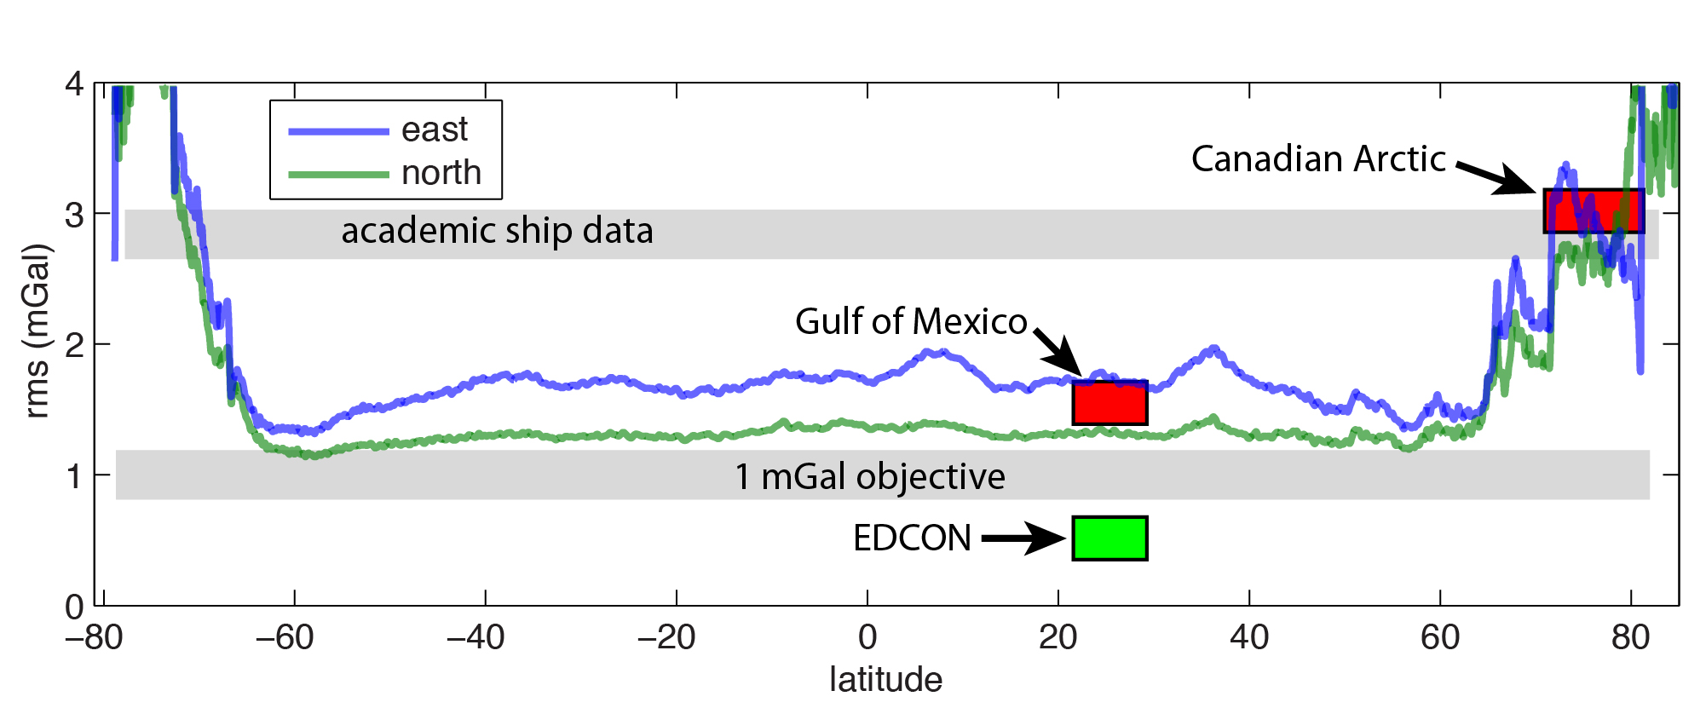
current gravity accuracy
accuracy ~1.6 mGal latitudes < 66˚
accuracy ~3.5 mGal in Arctic

Slide 42
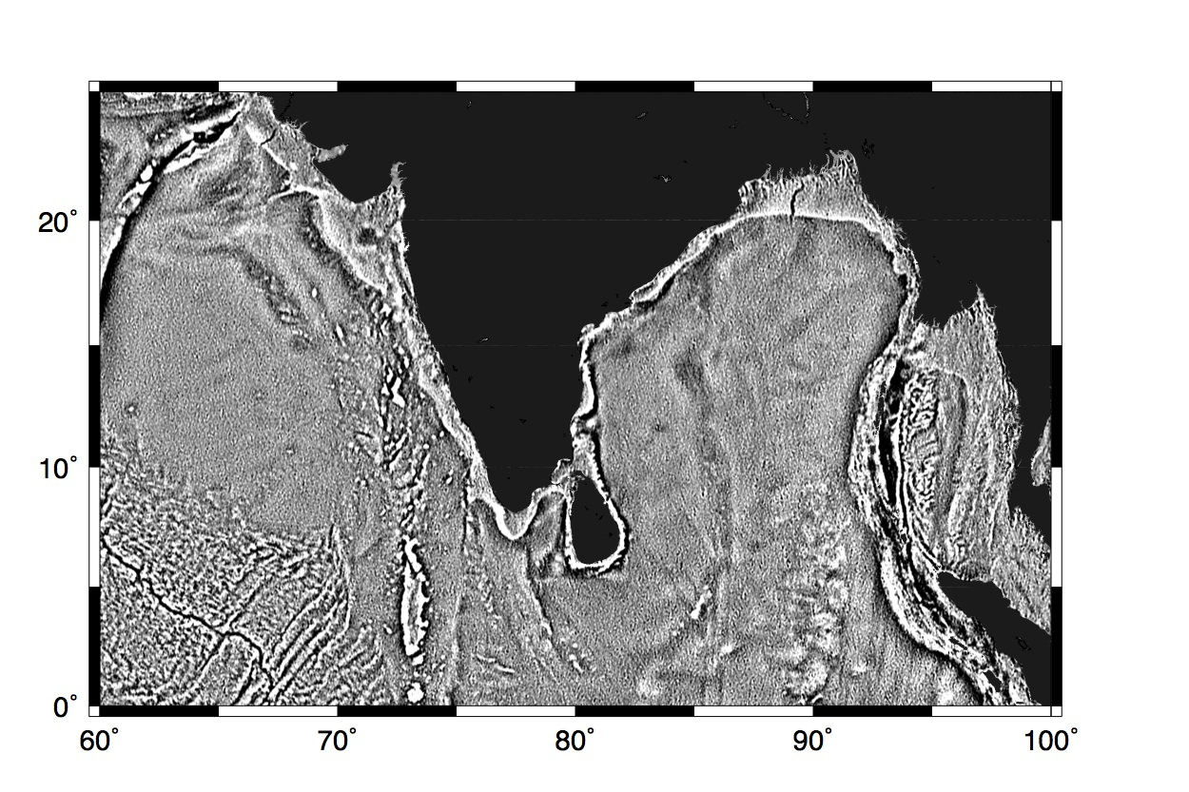
tectonics buried by sediments
old
V18

Slide 43

tectonics buried by sediments
new
V22

Slide 44
tectonics buried by sediments
new
V22

Slide 45
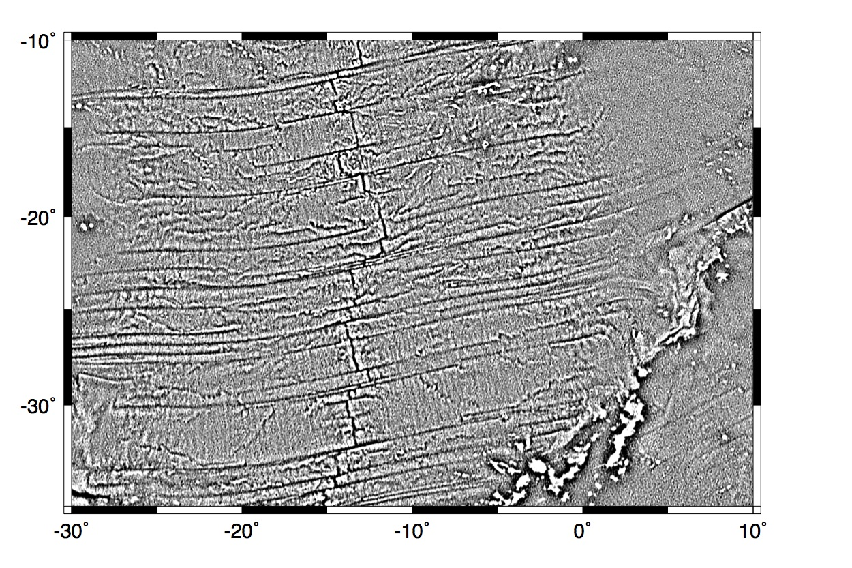
abyssal hills
old
V18

Slide 46
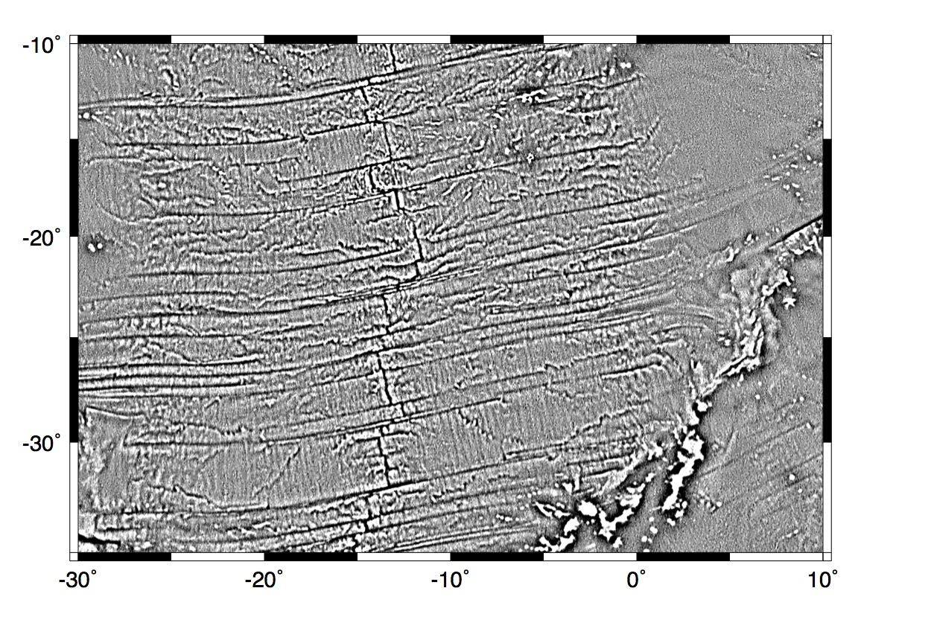
abyssal hills
new
V22

Slide 47
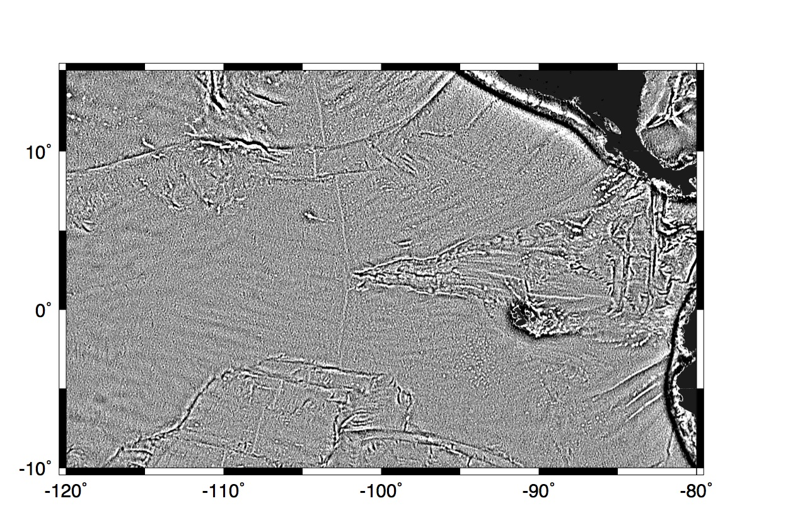
small seamounts
old
V18

Slide 48

small seamounts
new
V22

