Slide 1
GMT
Applications
&
Future Improvement Suggestions

Slide 2
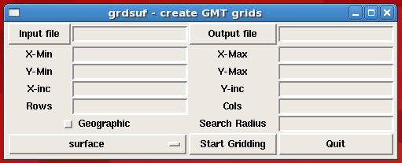
GMT Applications Launcher

Slide 3
GUI is in standard Tcl/Tk

Slide 5
Various Modules in open state

Slide 6
GMTSAR

Slide 7
“My” Work Flow
Preparing data for GMT
Topography, bathymetry, gravity, magnetics, seismic, SAR images etc.
GMT Data Processing
Cleaning, Merging various grids, Filtering, Grid Math, Mapping Projections, InSAR processing etc.
(in general getting it ready for integrating with other data)
Reformatting final grids for ConocoPhillips standard software packages – ESRI ArcGIS, Landmark, GeoSoft, Petrel, ENVI, PCI, Mathworks etc.
All final data integration is done elsewhere
All data plotting and visualization is done mainly in ArcGIS and Landmark System. In particular ESRI provides links to:
Global coastline, country outlines, general basemaps
Google Imagery
Global Wells and infrastructure
Mapping symbols (north arrows, scales, legends etc.)

Slide 8
Desired Improvements
More annotated examples
Not just basic use of each module, but examples that show proper usage of key “required” and “optional arguments”
Data Links to other commercial programs
GMT Grids to GeoTIFF with full mapping tags
Current work flow is GMT grid -> to ERMapper -> ArcGIS raster import
GMT Vectors to ArcGIS Shape Files
No workflow in place
Expand Mapping Projection capabilities
Mapping projection tag in GRID header
Easier definition of Mapping Projections
Auto detection of different mapping projection (Grid Math)
Handle different Datums and Datum Transformation (currently handled outside GMT)
Provide an easy API for easier customized code
(seems to be addressed already)

