Slide 1
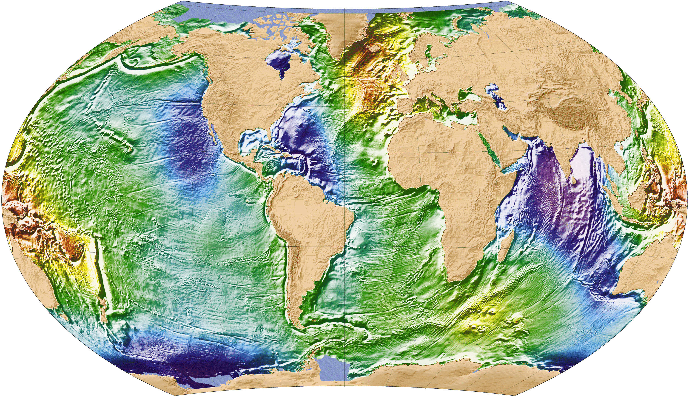
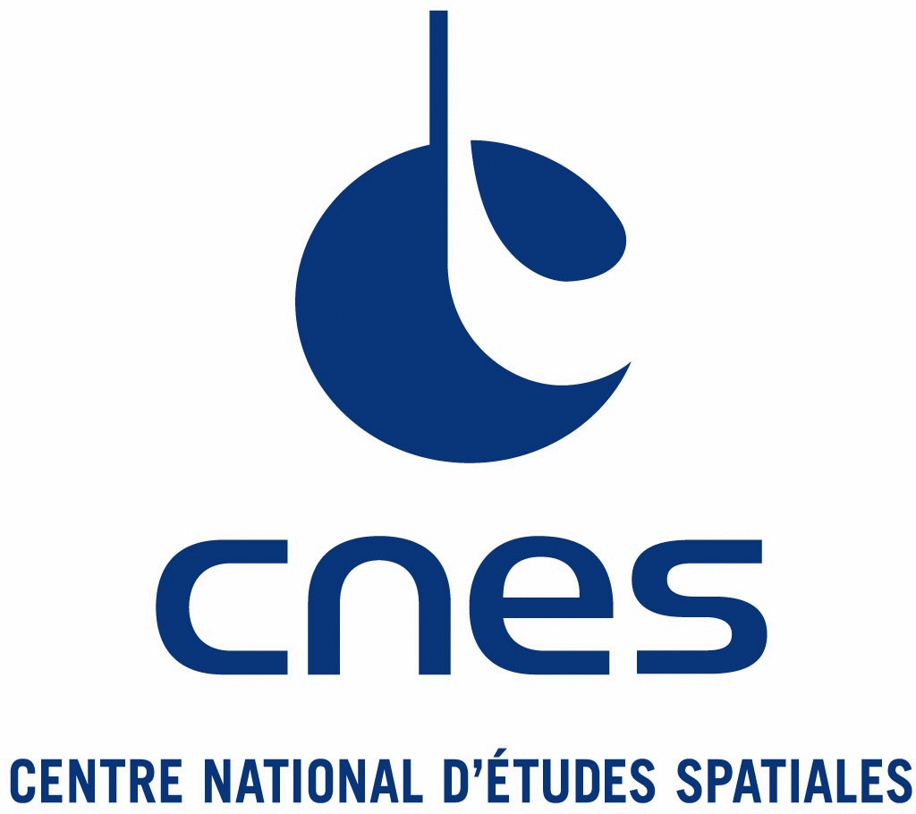
Mean Sea Surfaces errors characterization
MSS SCRIPPS2017 assessment

Slide 2
Overview
3 MSSs considered:
MSS_DTU15
Use geodetic mission for small scales (< ~250km) information :
Geosat ; ERS-1; J1G ; C2[2011-2014]; ENN
MSS_CNES_CLS15
(Schaeffer et al, OSTST 2016)
geodesic mission used (1 Hz/ “classical” retracking)): ERS-1; J1G, C2[2011,2014]
MSS_SCRIPPS2017
MSS CNES_CLS2015 (if error <2 cm)
20Hz data used / gradients not SSH : C2[2011 ?,2014 ?] +J1GM with double retracking

Slide 3
Methodology
MSS errors signature on SLA PSD
We consider :
H = SLA signal including the MSS errors (e) and the SLA signal free from MSS errors (h)
A and B = two different cycles
3 main assumptions:
1) We use a mission/period independent from MSS computation: S3PP/CNES Sentinel-3A (20Hz); PEACHI SARAL/AltiKa (40Hz)
1) There is no covariance between the SLA signal and the MSS errors
2) The SLA signal is completely decorrelated between the two cycles considered
2) We chose A and B far enough from each other
3) The MSS error is the same whatever the cycle considered
3) We use a repetitive mission
0.5 V(H_{A} - H_{B}) – 0.5 V(H_{A} + H_{B}) = 2 V(e)
Mean spectral content of the h signal
Mean spectral content of the h+e signal

Slide 4
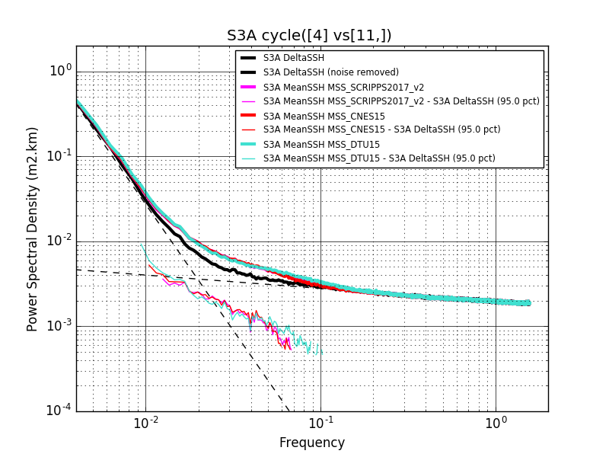
results
Old version discussed during SWOT meeting

Slide 5
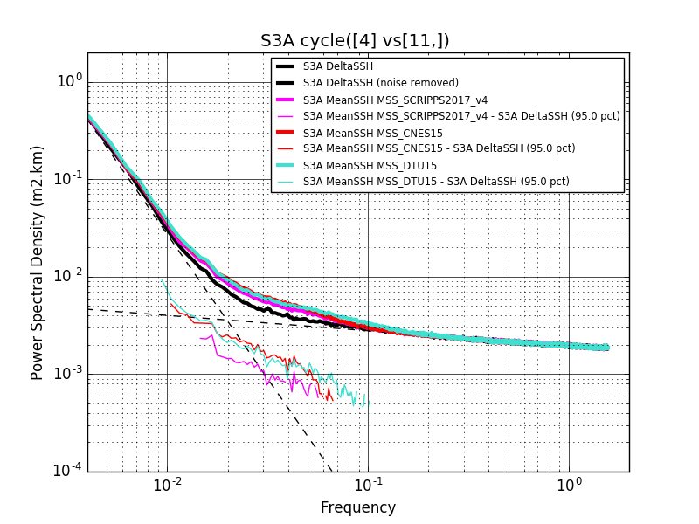
results
New version

Slide 6
results
Mean Global MSSs errors estimation along Sentinel-3A tracks for wavelengths ranging [100, 30 km], expressed in cm and percent of the SLA signal variance.
 | MSS error (cm) | MSS error (%)
CNES_CLS15 | 0.55 | 30.3
DTU15 | 0.55 | 30.3
SCRIPPS17 (v4) | 0.44 | 19.7

Slide 7
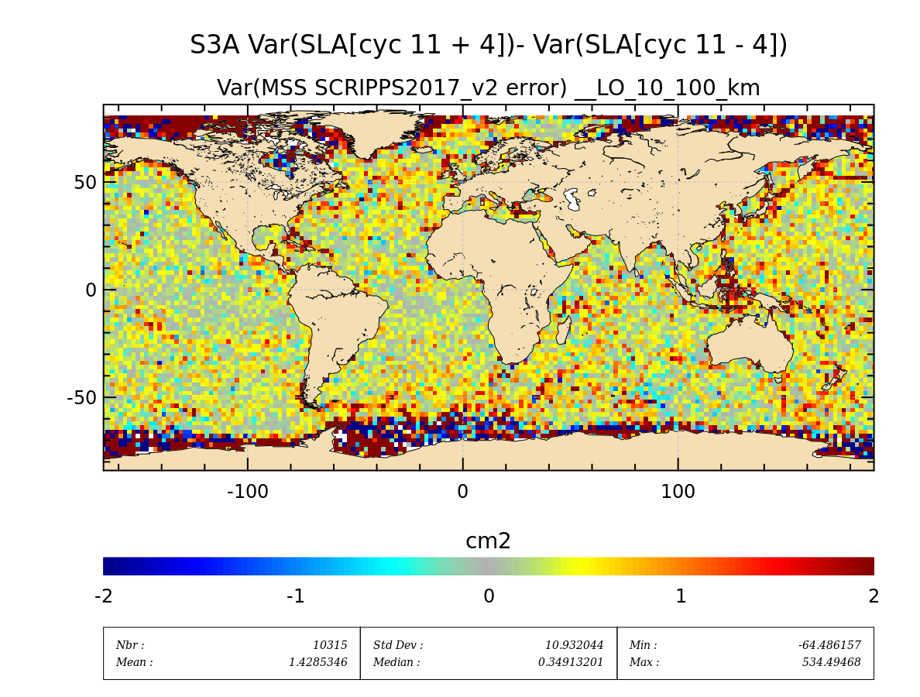
results
Old version discussed during SWOT meeting

Slide 8
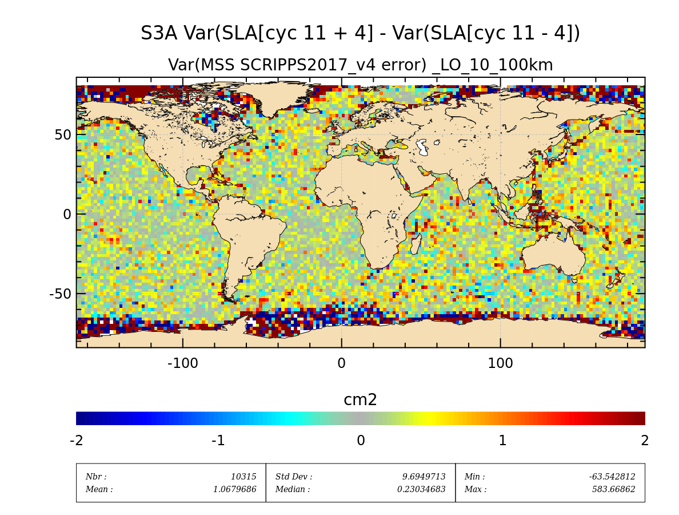
results
New version

Slide 9
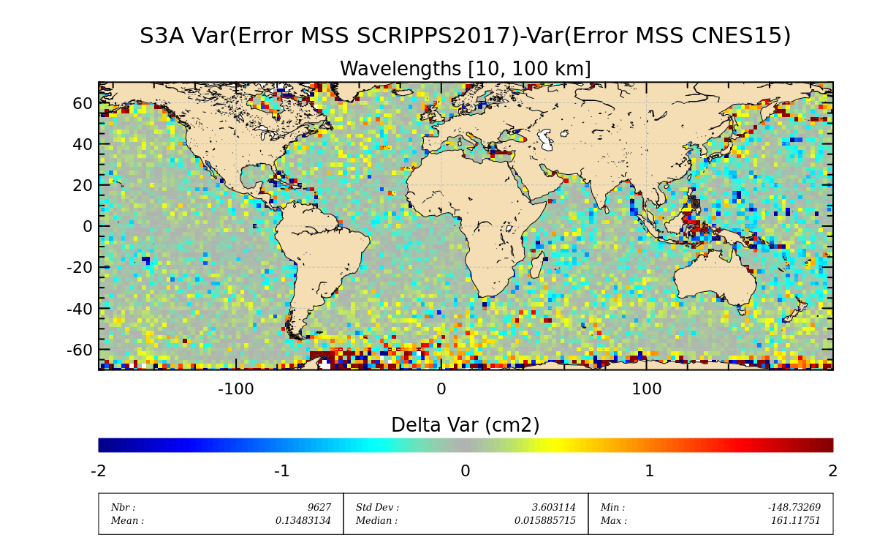
results
Old version discussed during SWOT meeting

Slide 10
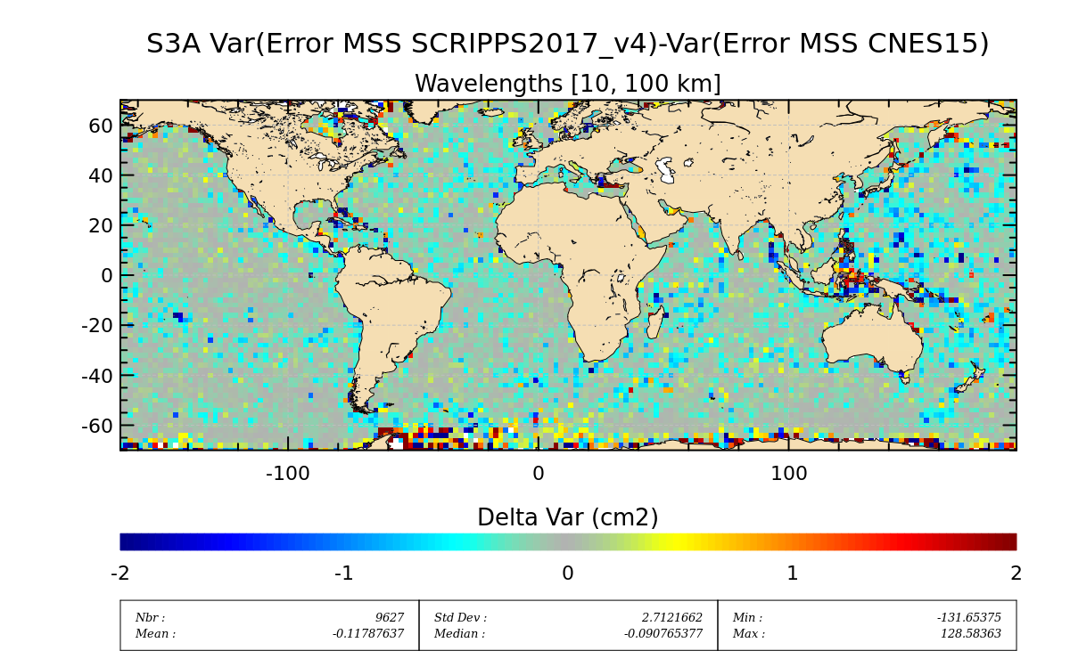
results
New version

Slide 11
Next slides show differences beeteween CLS15, Scripps V3 and Scripps V4
Shading effect (Az=45°) correspond to the short wavelengths of MSS CLS 15 (λ< 100 km)

Slide 12
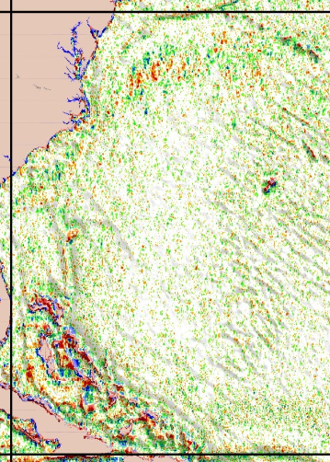
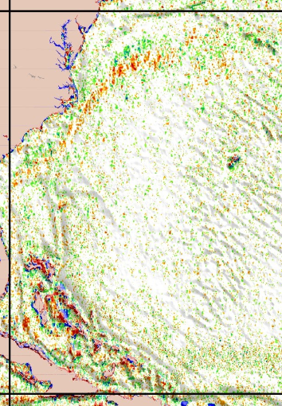
Apparently, SIO 4 has more residual effect of ocean variability ?
Nevertheless: this concerns essentially the Gulf Stream (to be seen in 2 slides in Kuroshio)
Rem: in comparison this same effect on DTU15 is greater than 7 cm (next slide)
Scripps V3 – CLS15
Scripps V4 –CLS15

Slide 13
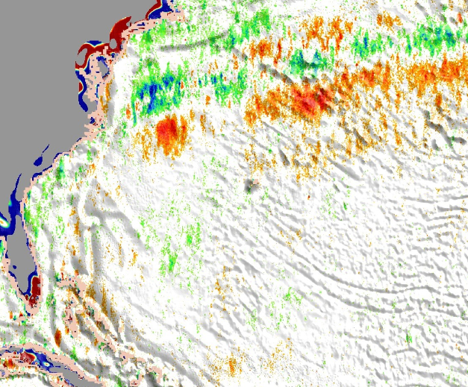
DTU15 – CLS15
Scripps V4 – CLS15

Slide 14
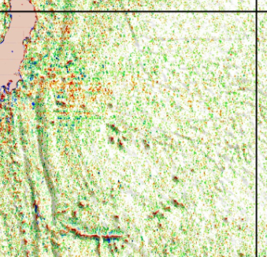
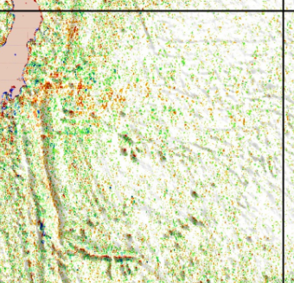
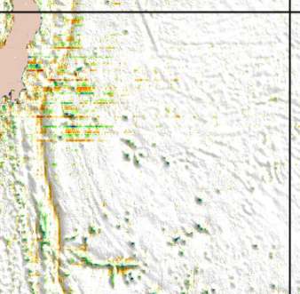
Scripps V3
Zoom in Kuroshio
Scripps V4 (less affected by variability)
Here is not only variability ?
Apparently, this aliasing is more included in V3 !
Scripps V4-V3

Slide 15
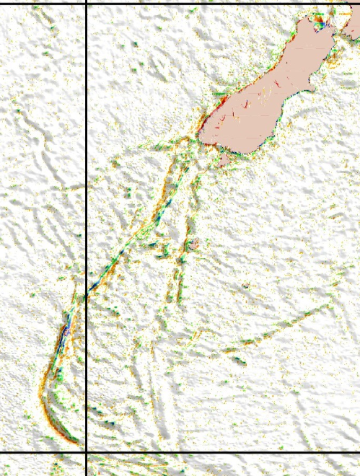
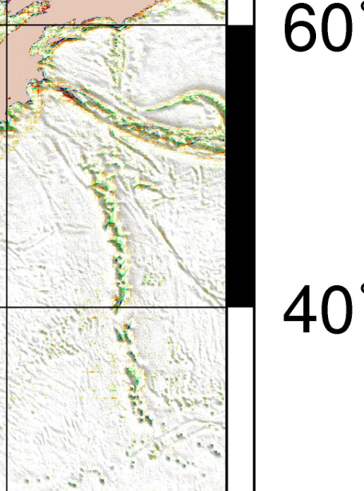
Despite that validations with S3A shows strong improvements, I think that the min/max of the topographic structures are smoothed in new V4 ?
Can this be consistent with (or a consequence of) your modifications (ie. the filtering at 5 km) ?
New-Zealand
Scripps V4 – V3
Dh (m)

Slide 16
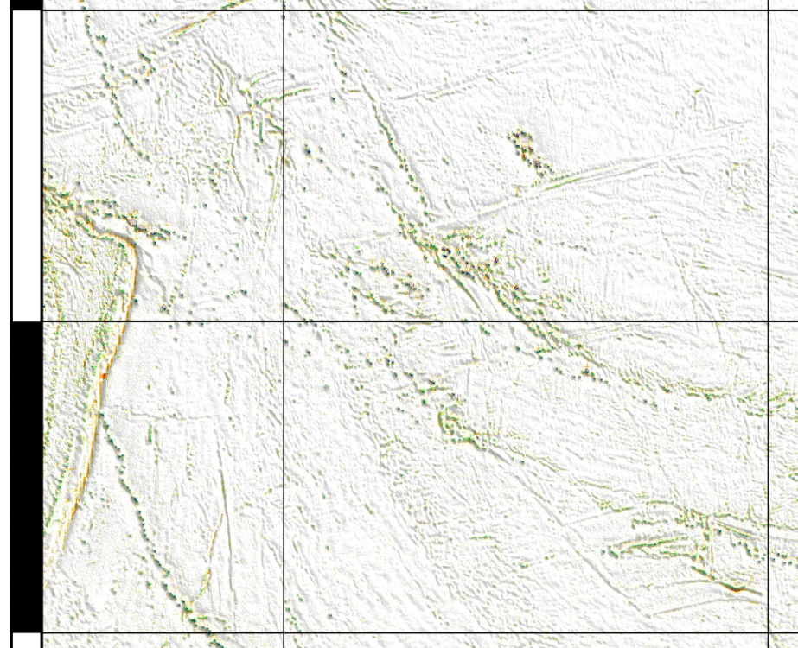
The summits of seamounts are lower, and bottom of faults appears higher ?
Scripps V4 – V3

