Slide 1
plots of ground tracks for V22.1 gravity
available August 15, 2013
all filtered 0.5 gain at 10 km wavelength
complete geosat/gm
ers-1/gm
envisat/35/30
cryosat/lrm/36 mo.
complete jason/ers/gm

Slide 2
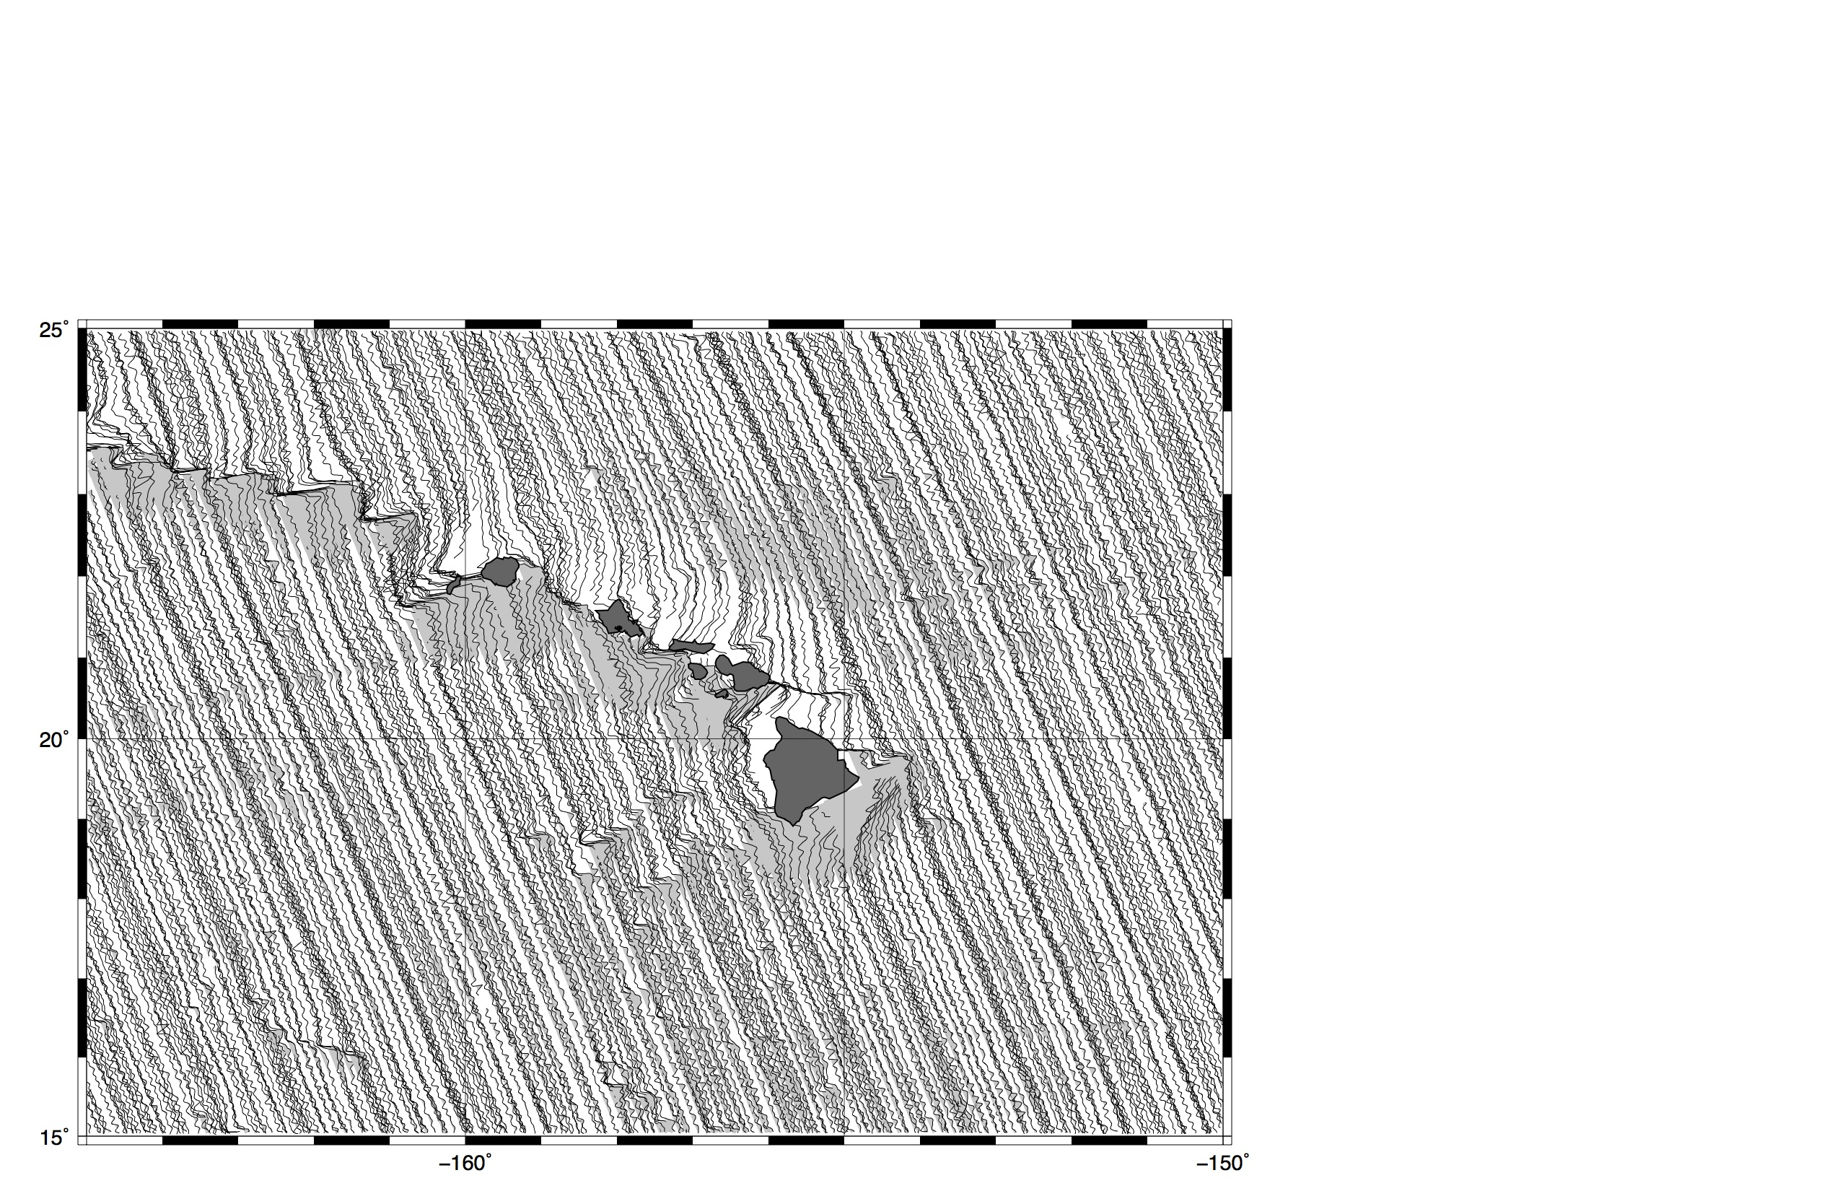
geosat – ascending (old)

Slide 3
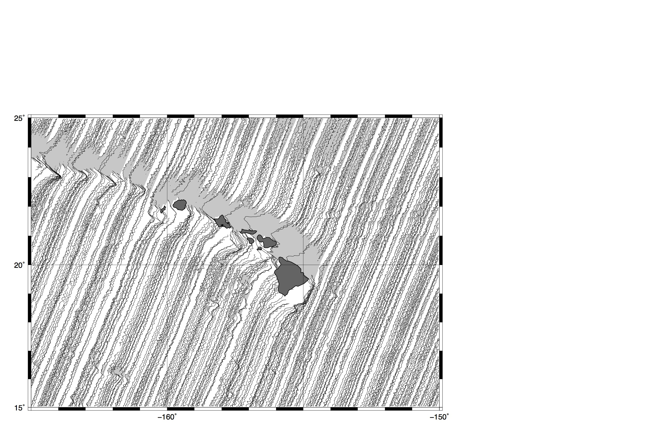
geosat – descending (old)

Slide 4
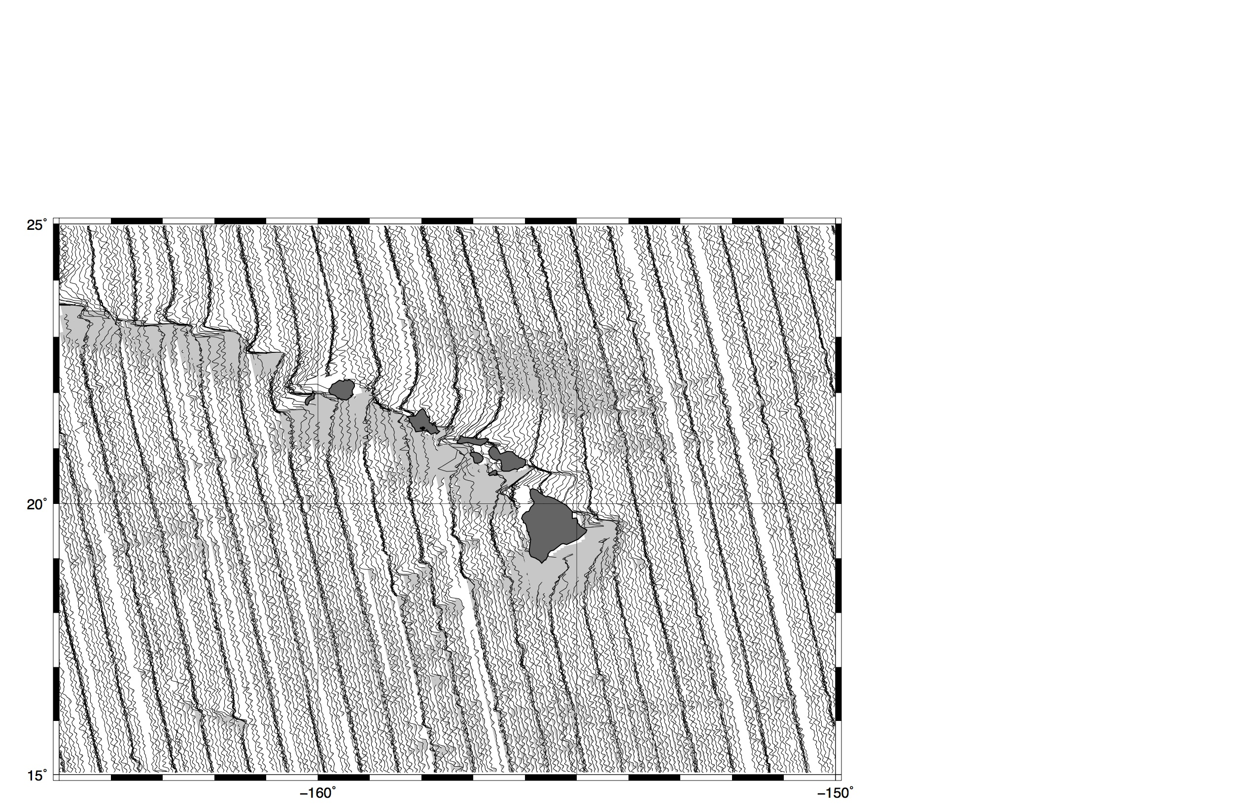
ers-1 – ascending (old)

Slide 5
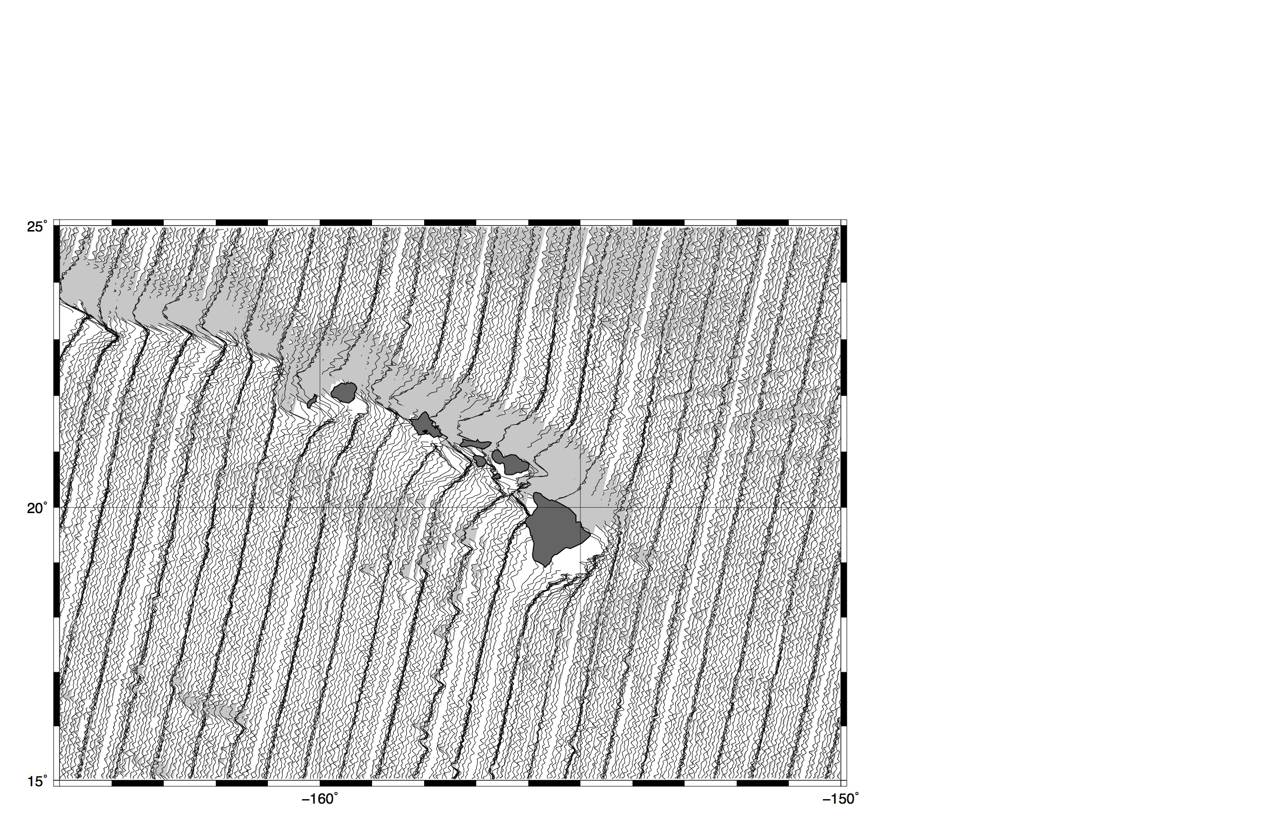
ers-1 – descending (old)

Slide 6
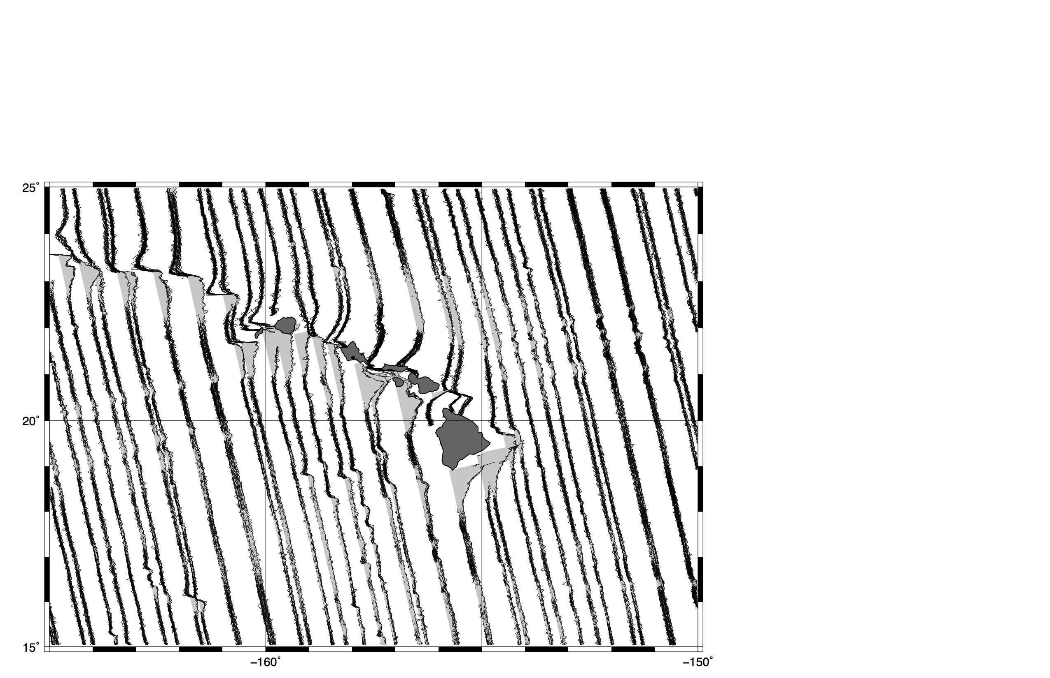
envisat – ascending (new)

Slide 7
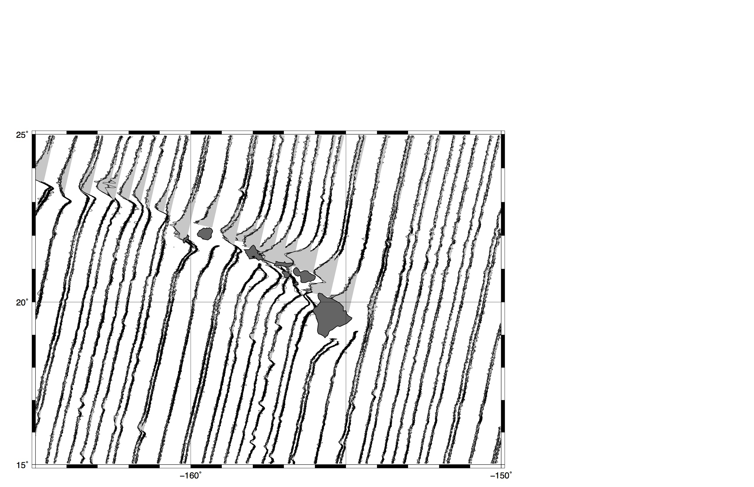
envisat – descending (new)

Slide 8
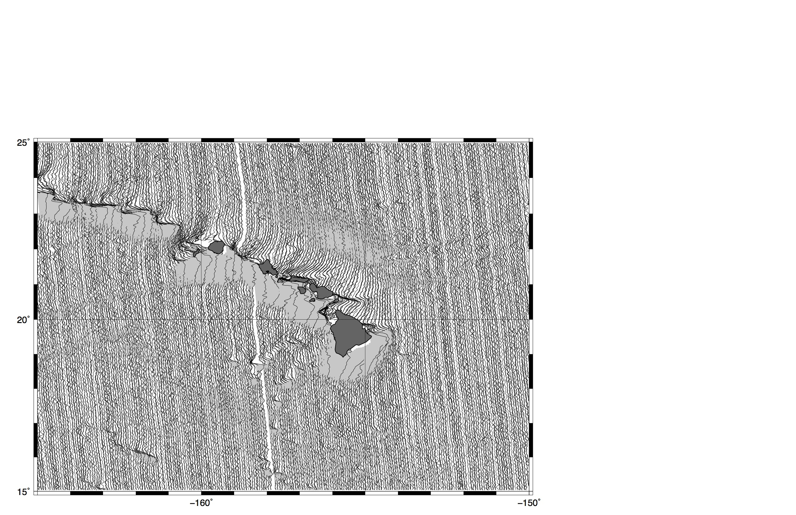
cryosat – ascending (new)

Slide 9
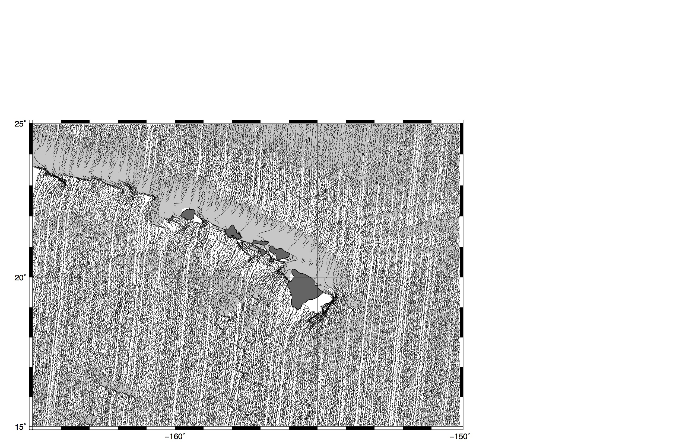
cryosat – descending (new)

Slide 10
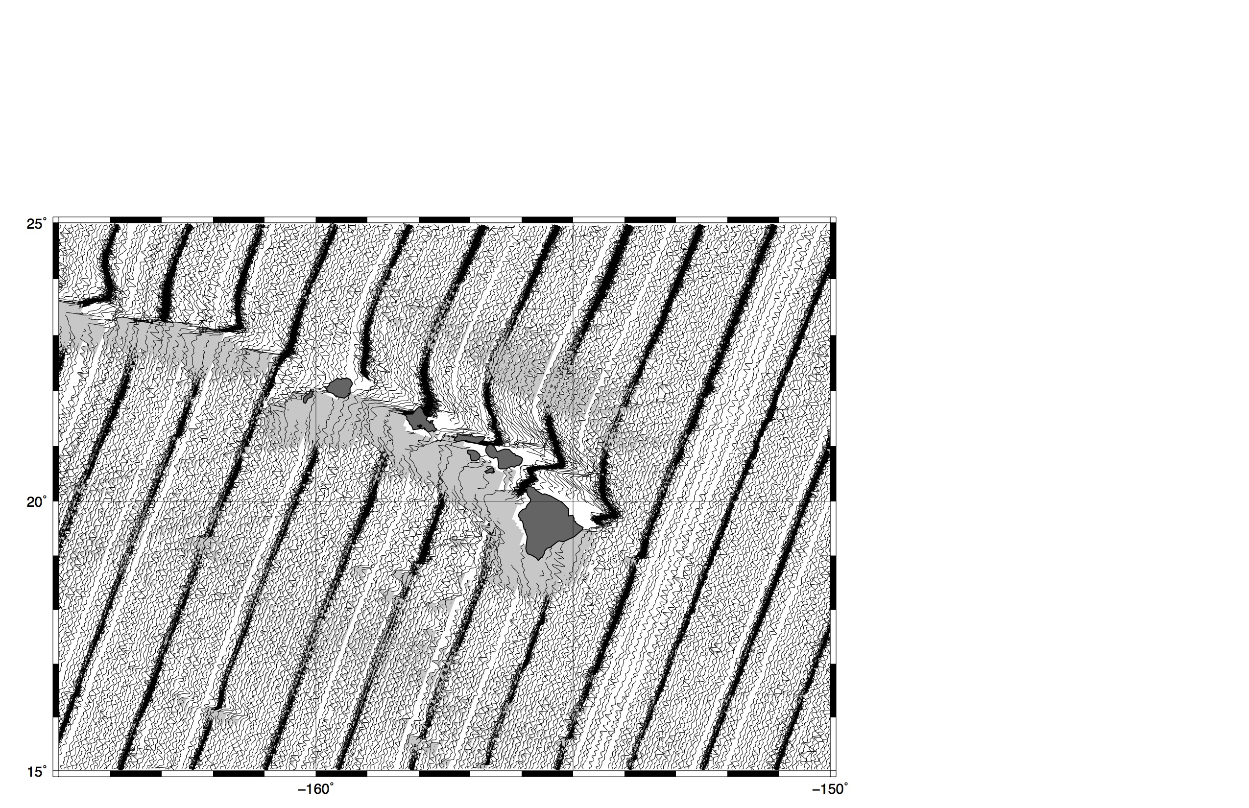
jason – ascending (new) – 3par

Slide 11
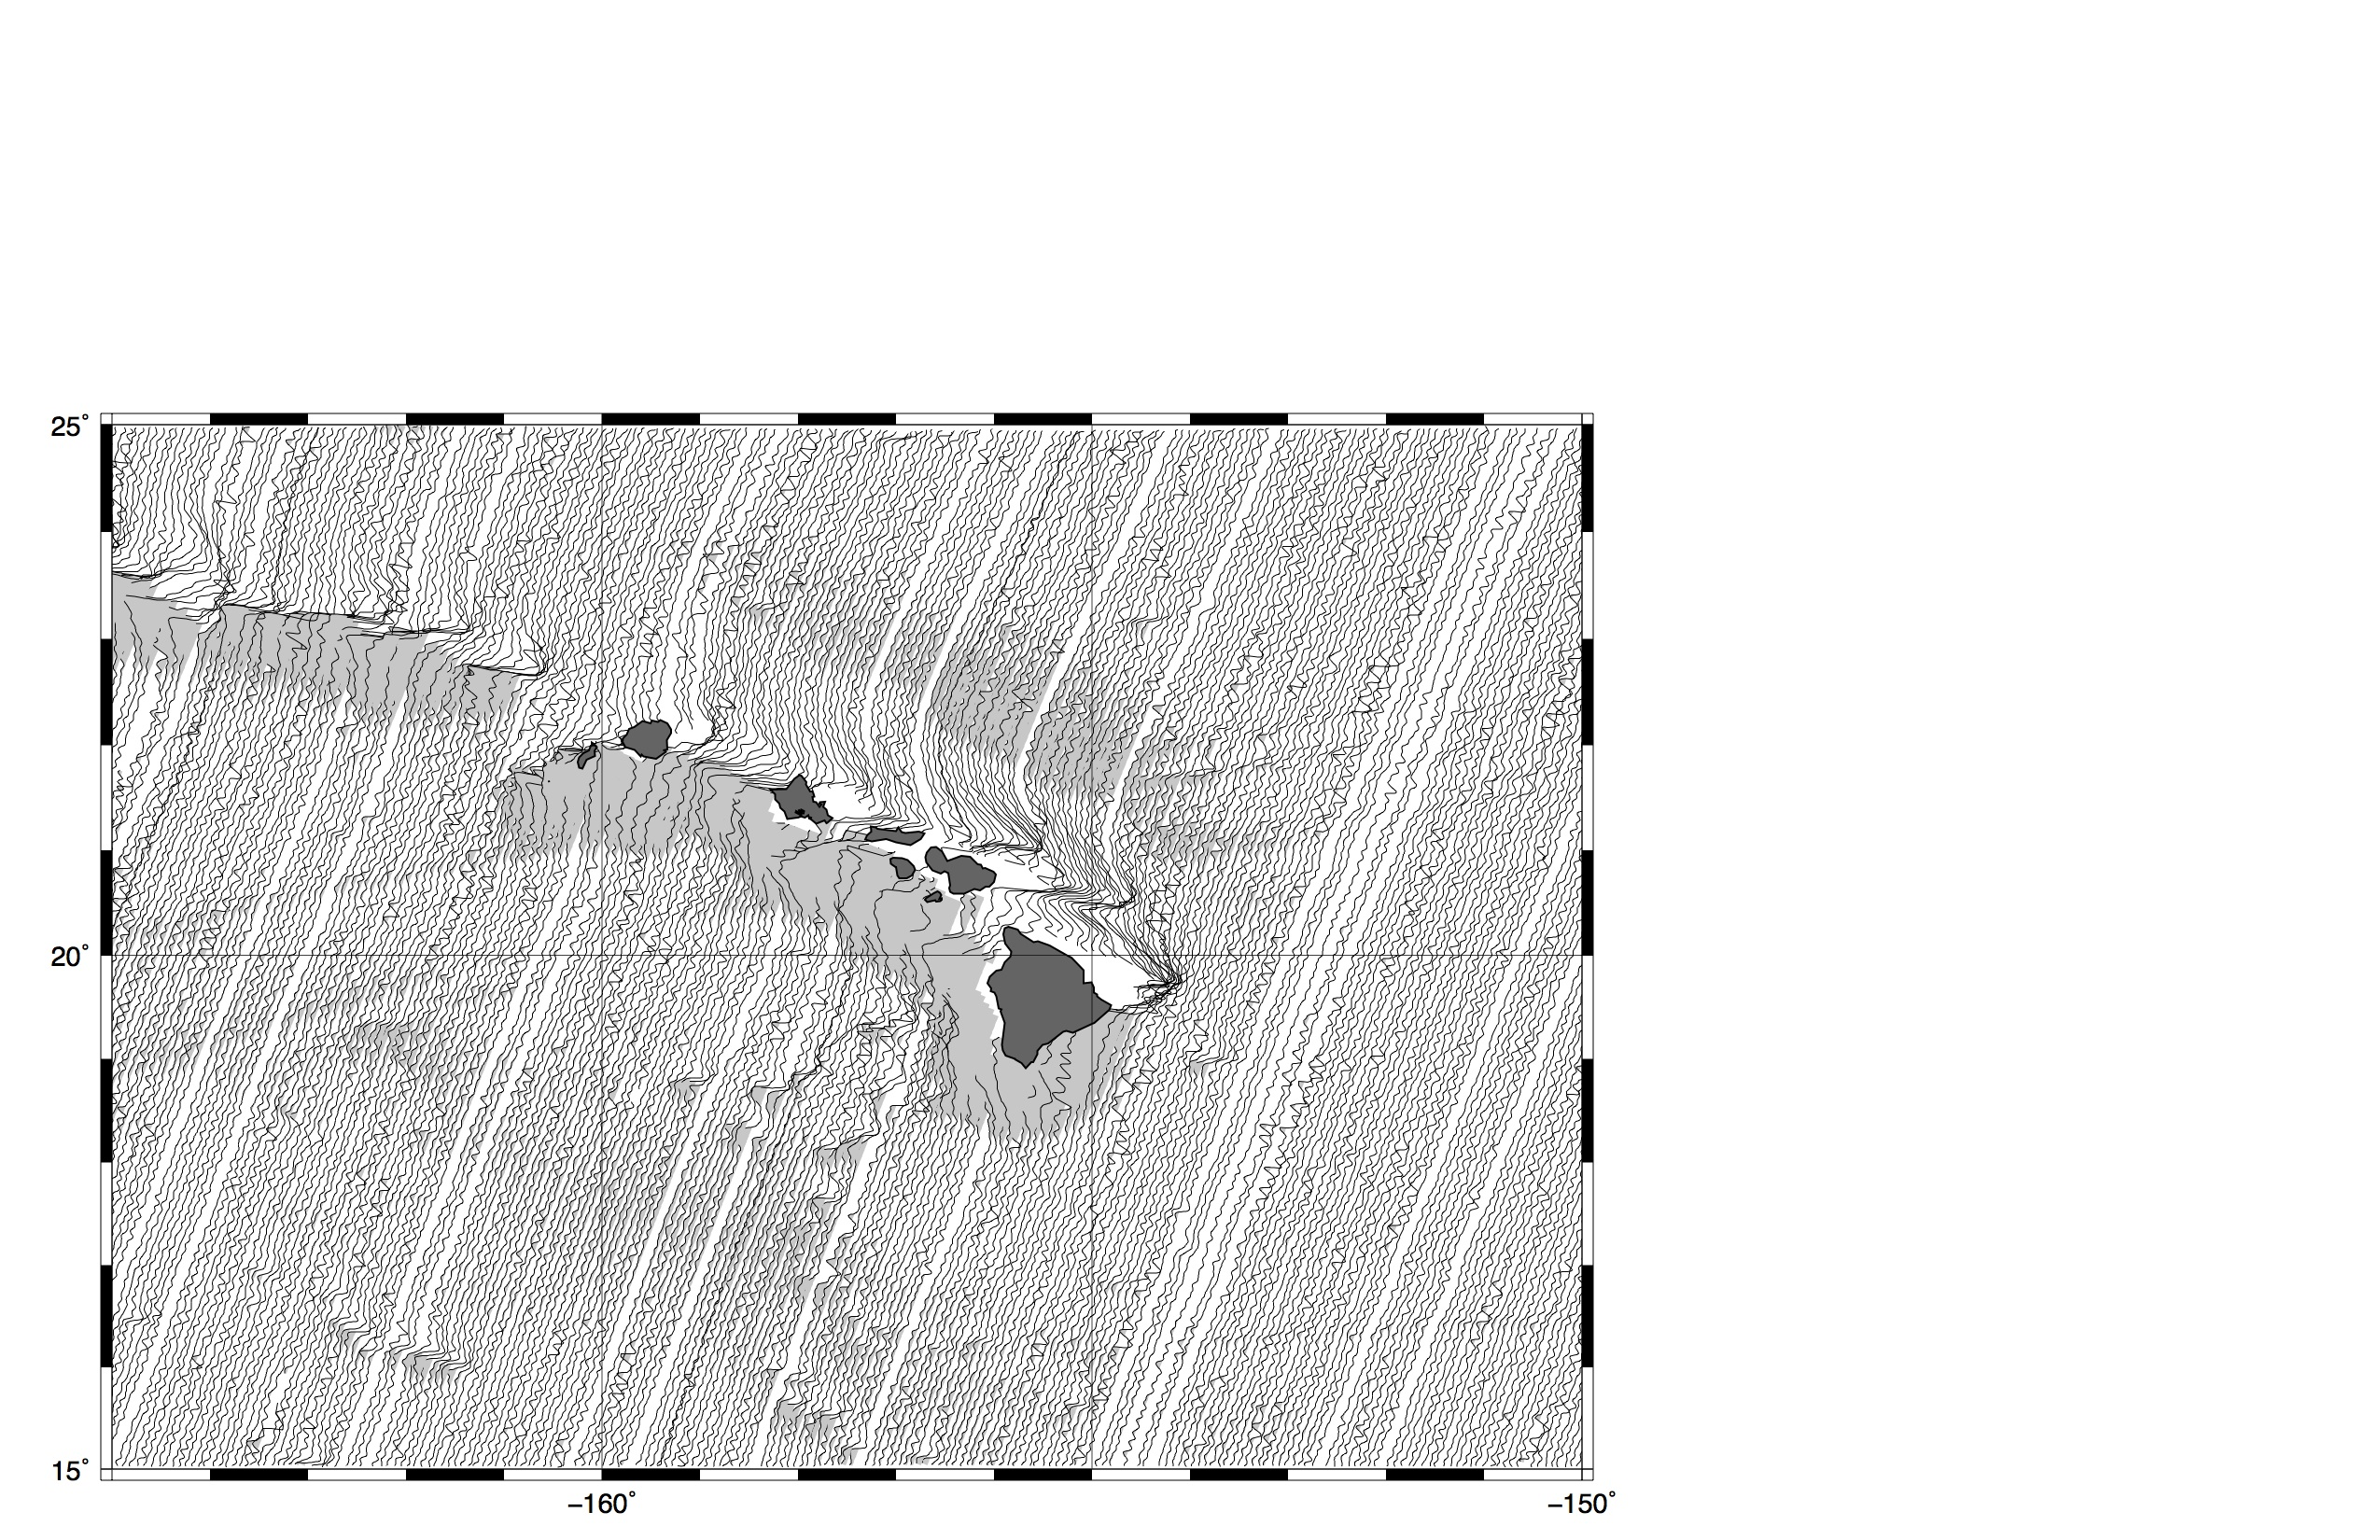
jason – ascending (new) – 2par

Slide 12
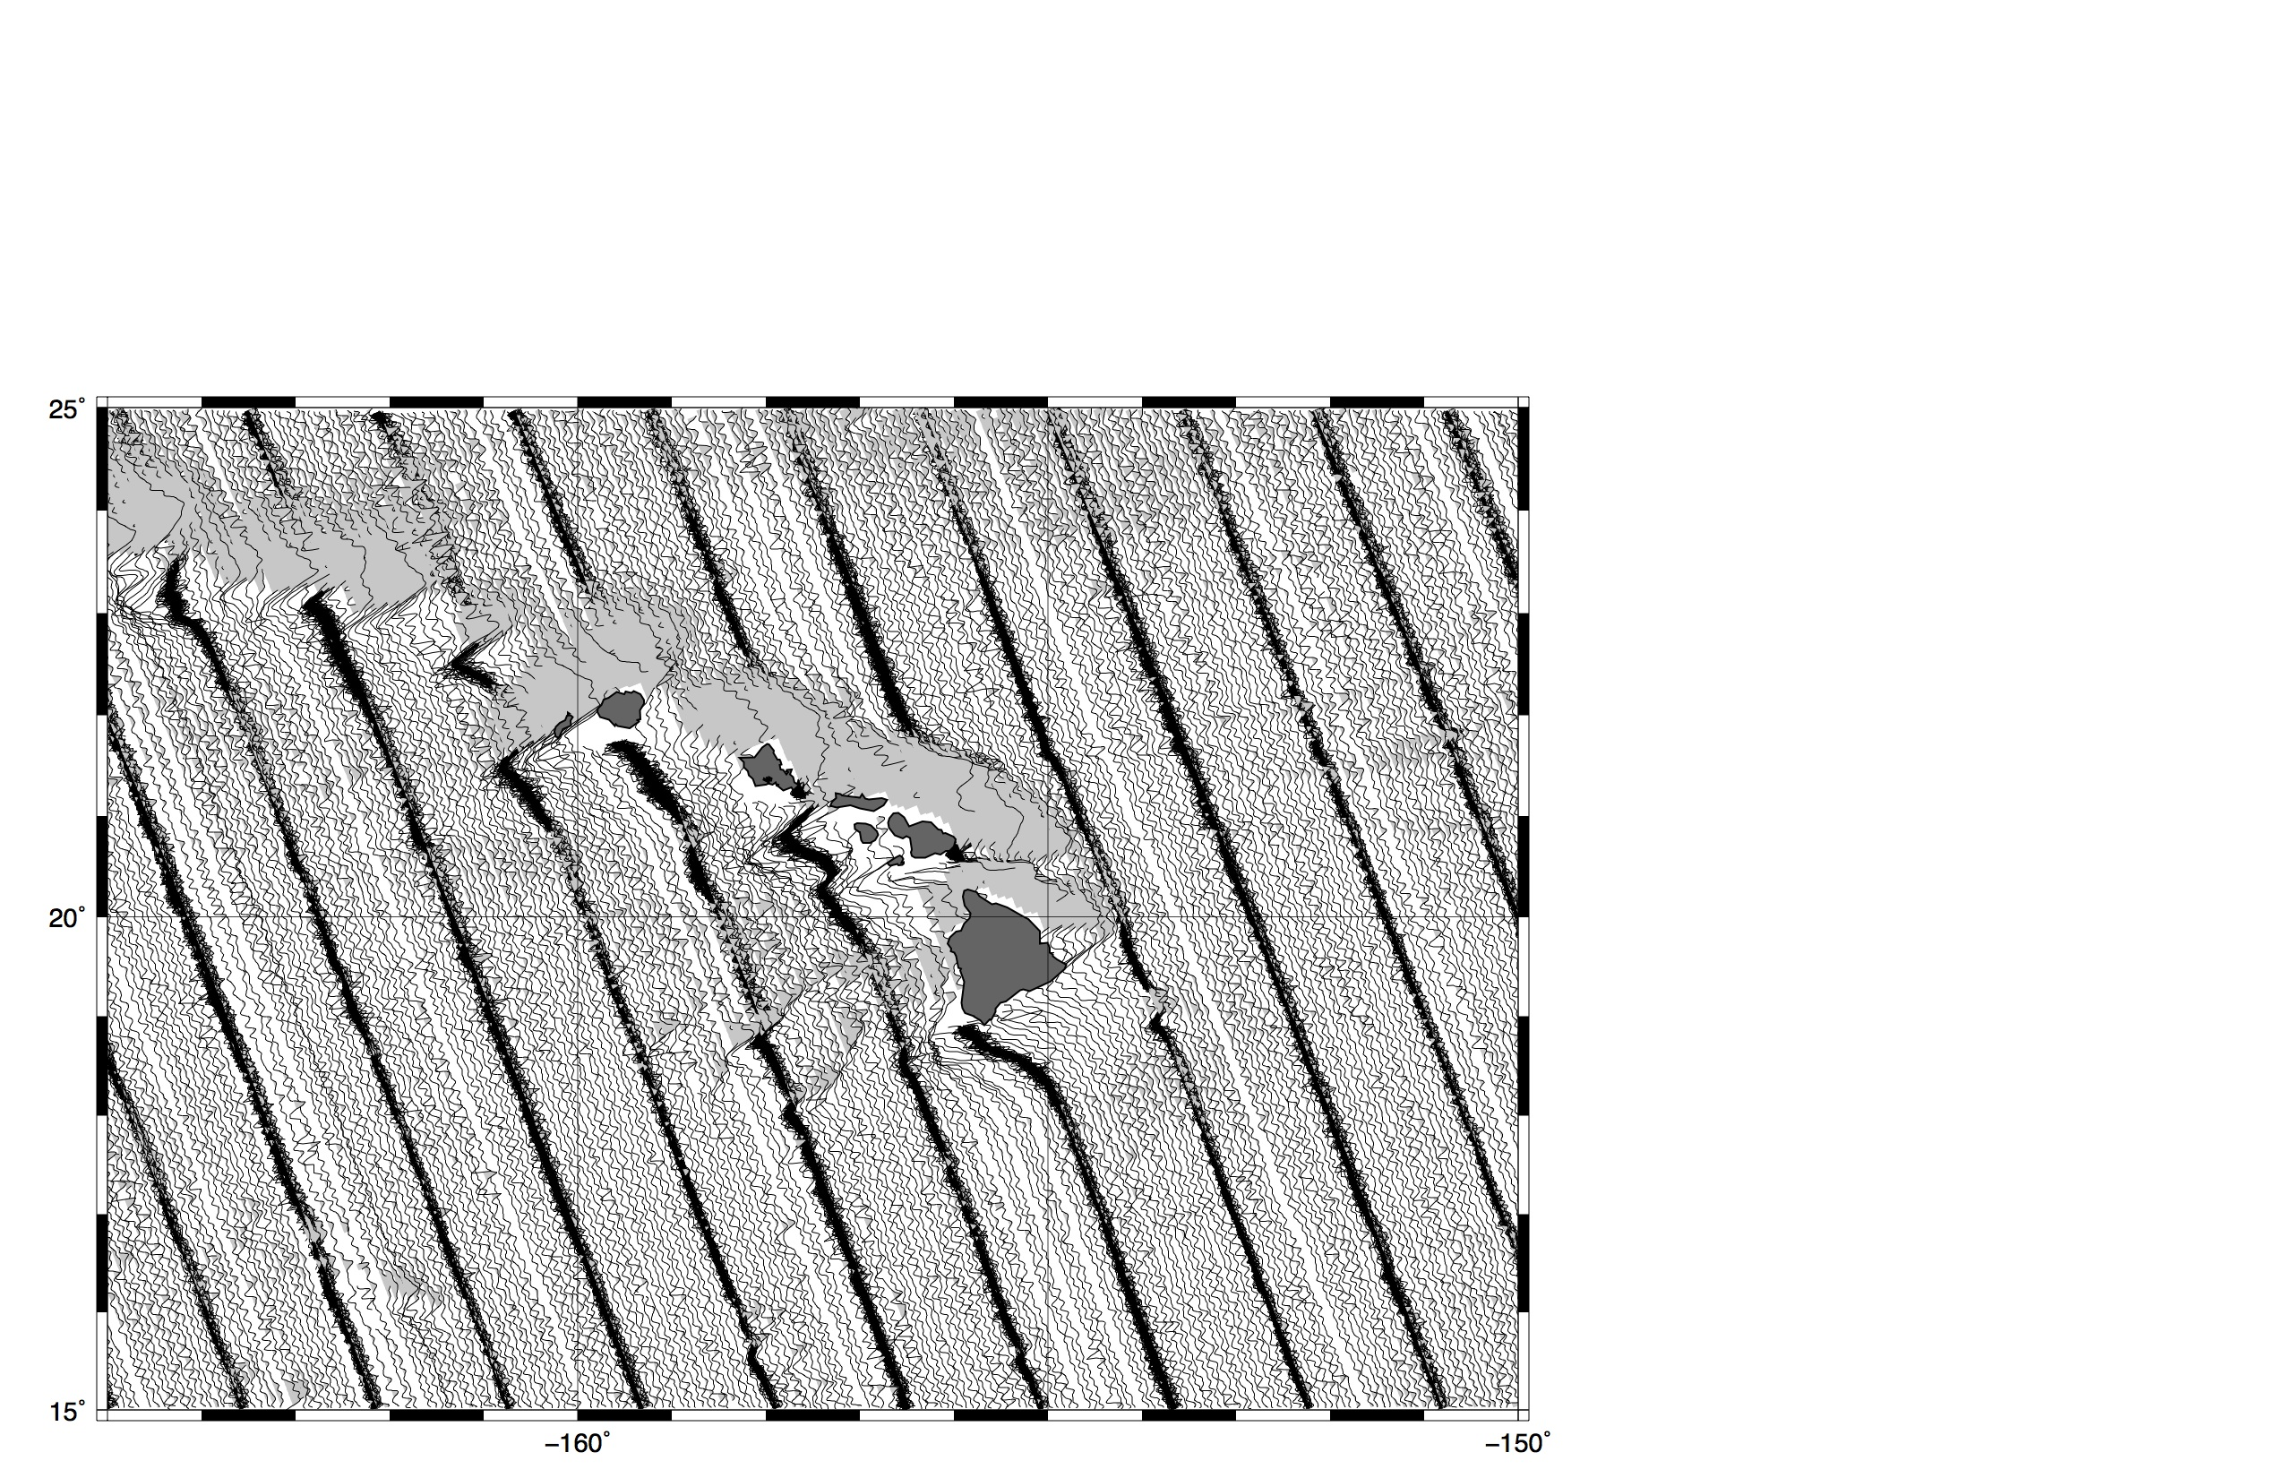
jason – descending (new)-3par

Slide 13
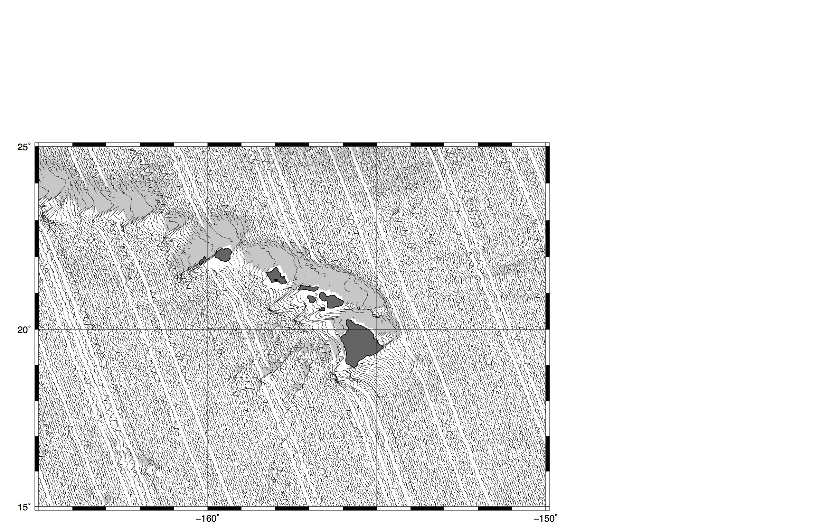
jason – descending (new)-2par

Slide 14
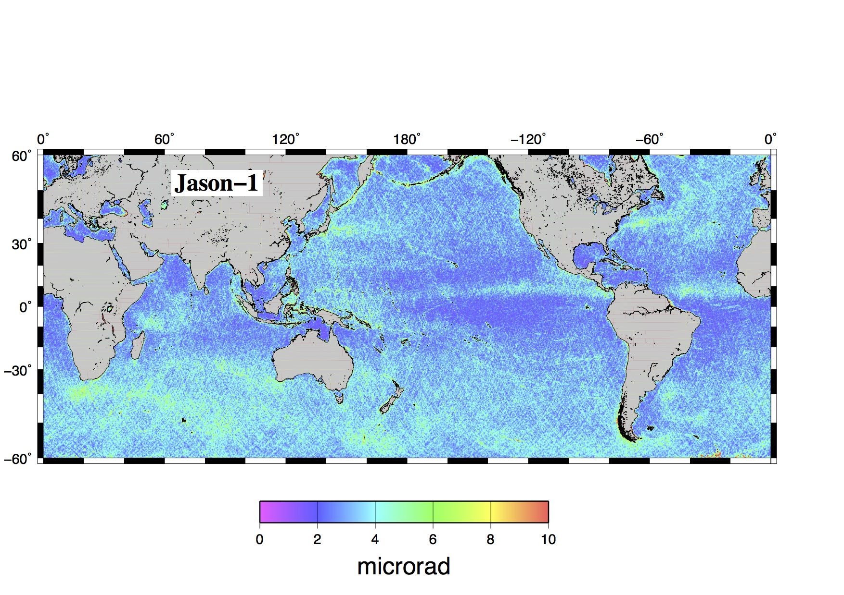
jason w.r.t. V21 - 3par

Slide 15
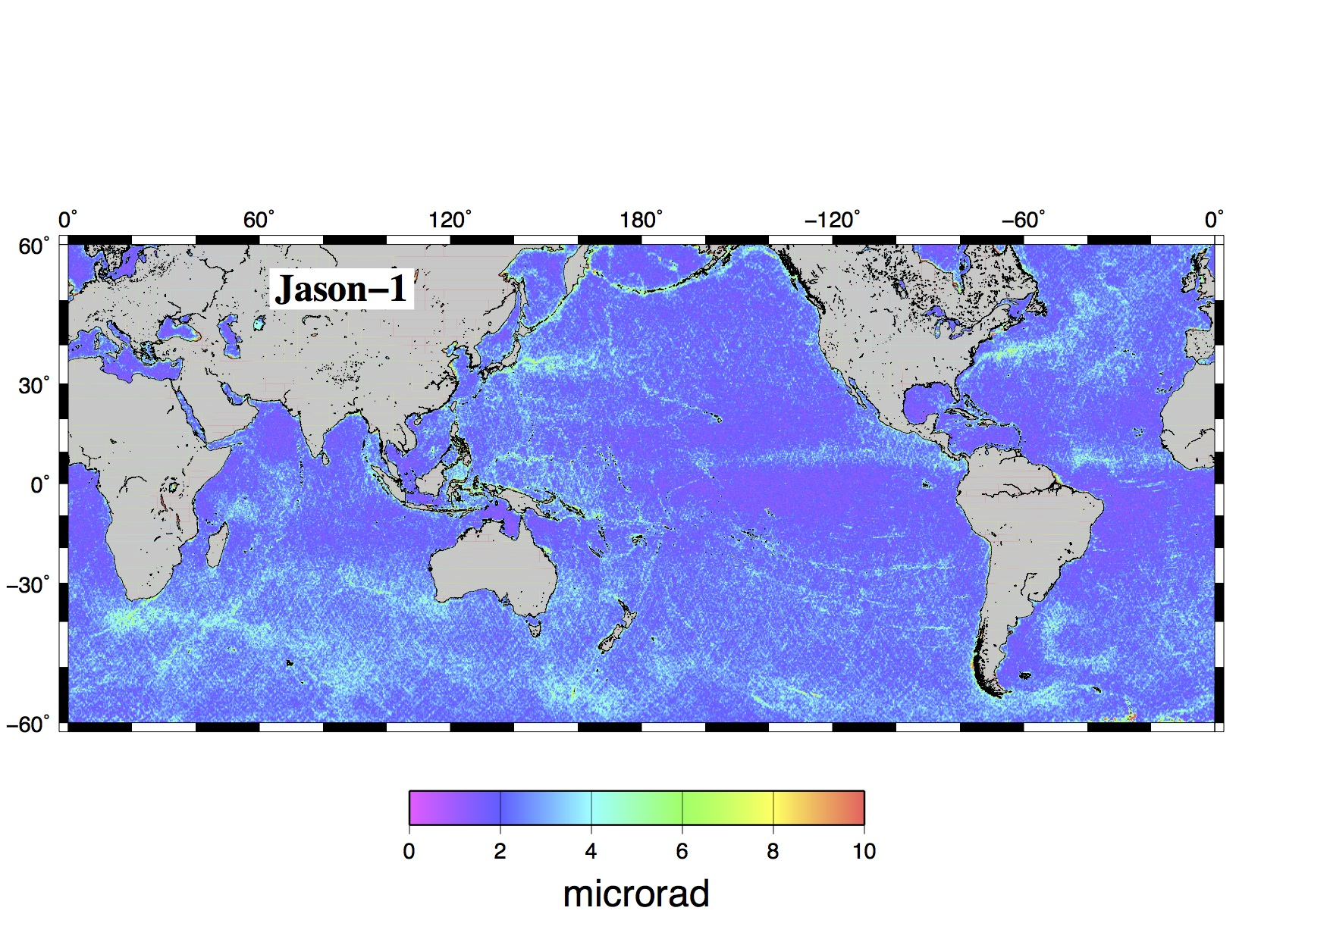
jason w.r.t. V21 - 2par

