Slide 1
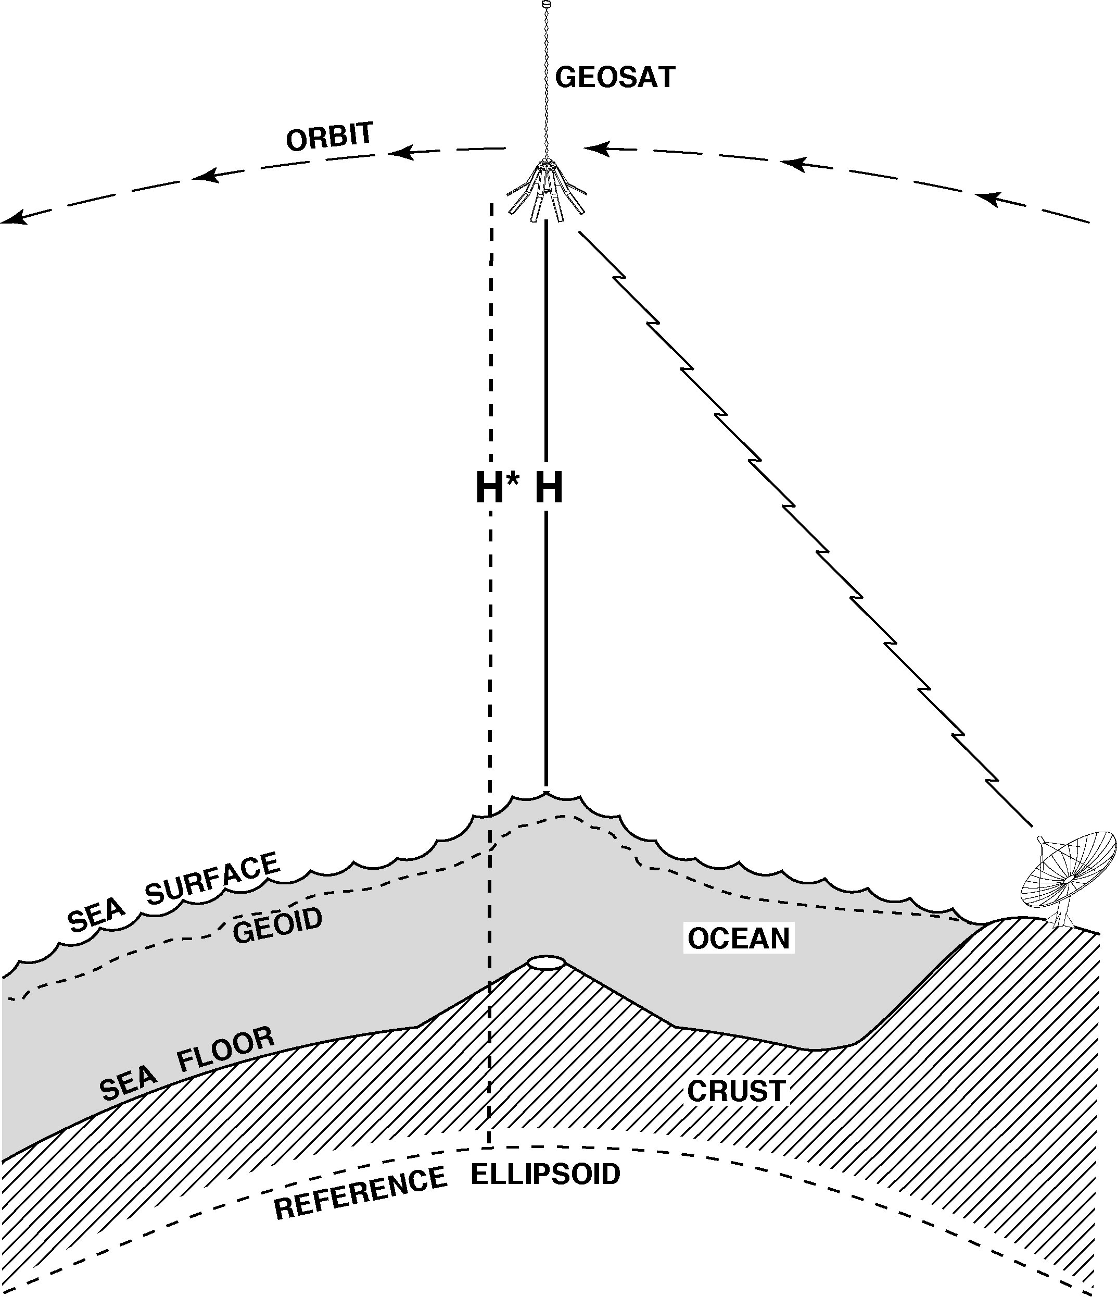
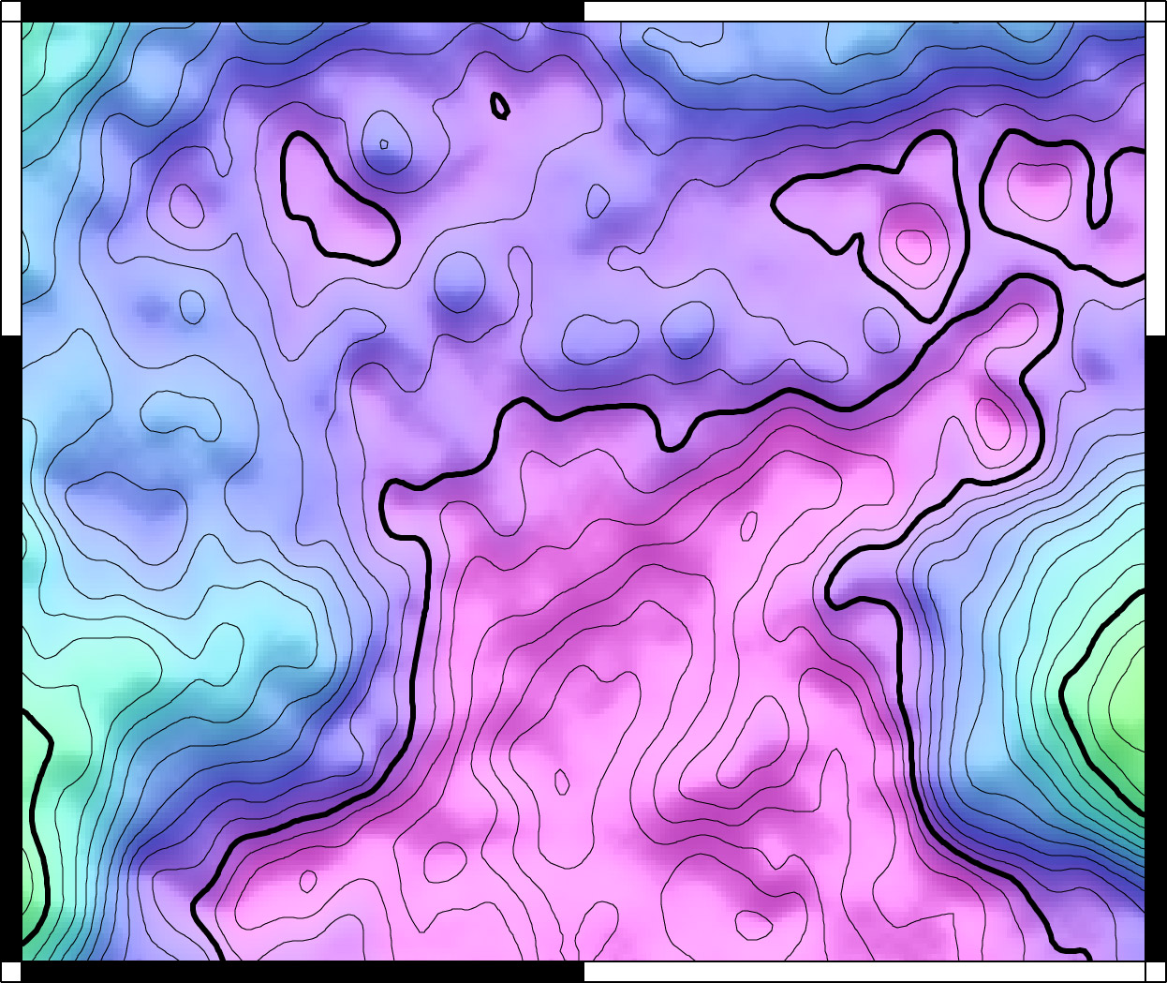
Improving Global Marine Gravity David Sandwell – Scripps Inst. of Oceanography
new non-repeat satellite altimetry data
waveform retracking
current gravity accuracy and resolution
discoveries

Slide 2
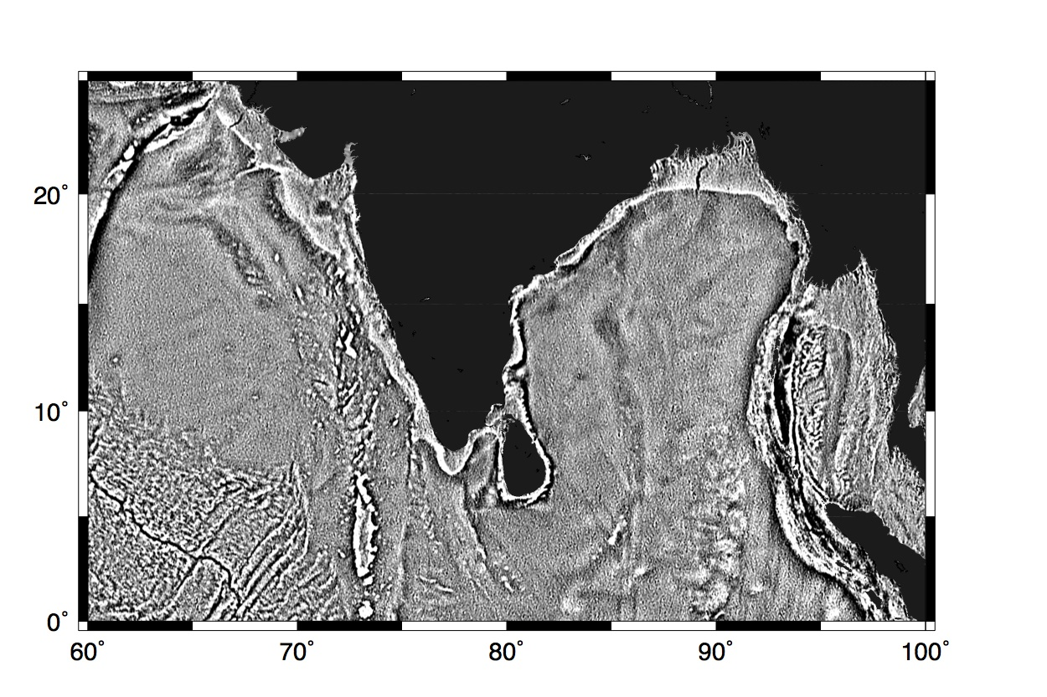
tectonics buried by sediments
old
V18

Slide 3
tectonics buried by sediments
new
V22

Slide 4
tectonics buried by sediments
new
V22

Slide 5
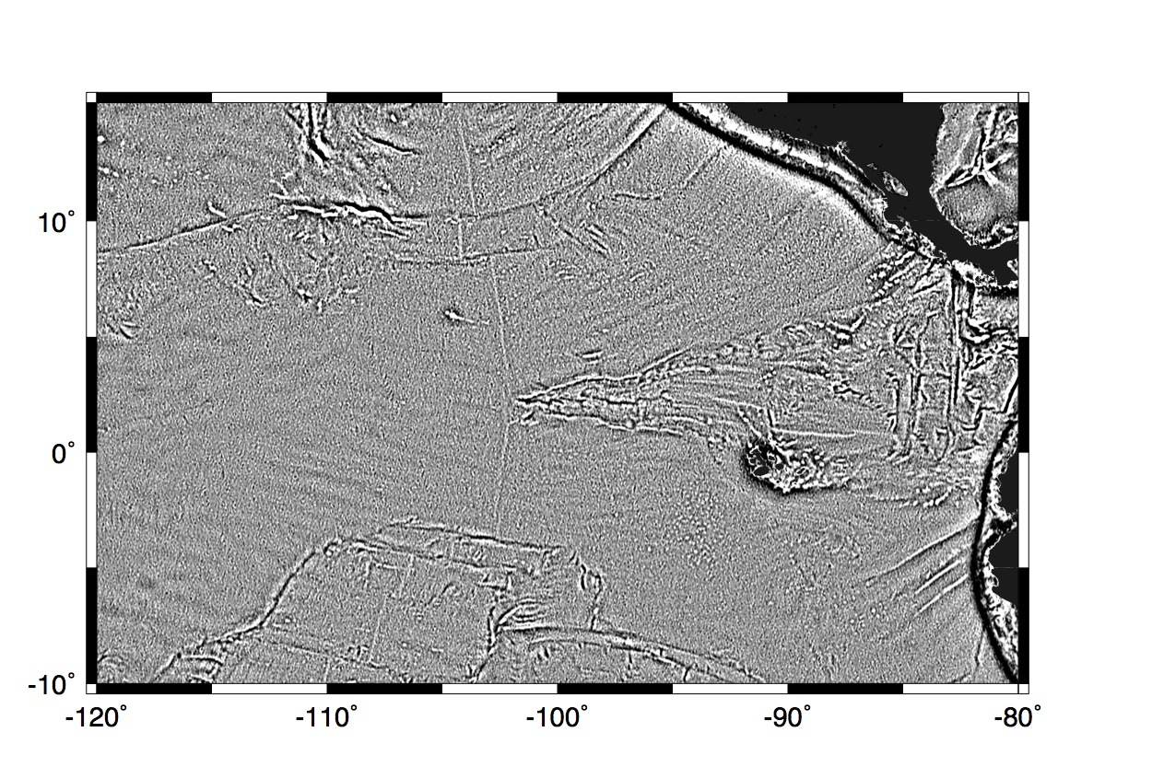
small seamounts
old
V18

Slide 6
small seamounts
new
V22

Slide 7
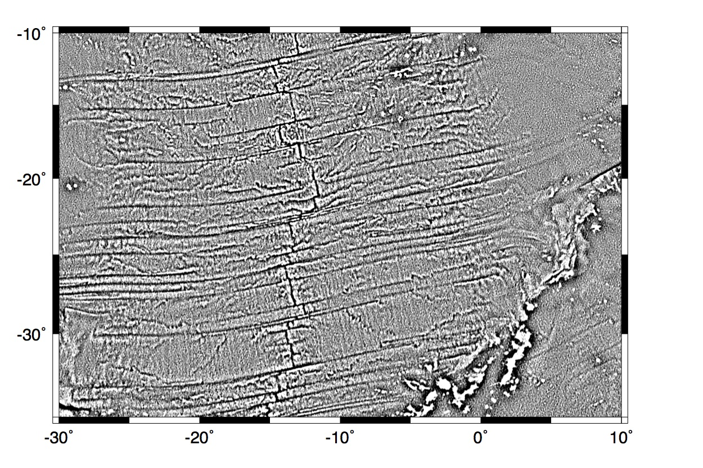
abyssal hills
old
V18

Slide 8
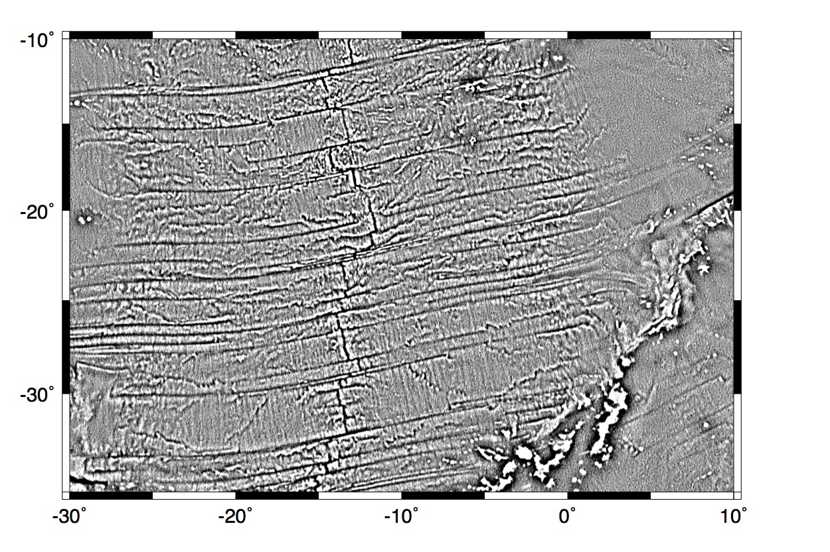
abyssal hills
new
V22

Slide 10
