Slide 1
CryoSat-2 SAR Waveform Retracking Over the Ocean: Does Multilooking Distort the Leading Edge?
Emmanuel Garcia, David Sandwell, Salvatore Dinardo, Christine Gommenginger,
Cristina Martin-Puig, David Cotton, Jérôme Benveniste
6th Coastal Altimetry Workshop, Friday September 21, 2012
marine gravity requires high range precision
analytic expression for SAR waveform (single-look)
SAMOSA simulations, single- and multi-looked
fits of analytical model to SAMOSA waveforms
20Hz noise – LRM, SAR, SARIN
recommendations for ocean processing
Soli Garcia

Slide 2
Achieving 1 mGal Gravity Accuracy
Improved range precision -- A factor of 2 or more improvement in altimeter range precision, with respect to Geosat and ERS-1, is needed to reduce the noise due to ocean waves.
Fine cross-track spacing and long mission duration -- A ground track spacing of 6 km or less is required.
Moderate inclination -- Current non-repeat-orbit altimeter data have high inclination and thus poor accuracy of the E-W slope at the equator.
Near-shore tracking -- For applications near coastlines, the ability to track the ocean surface close to shore is desirable.

Slide 3
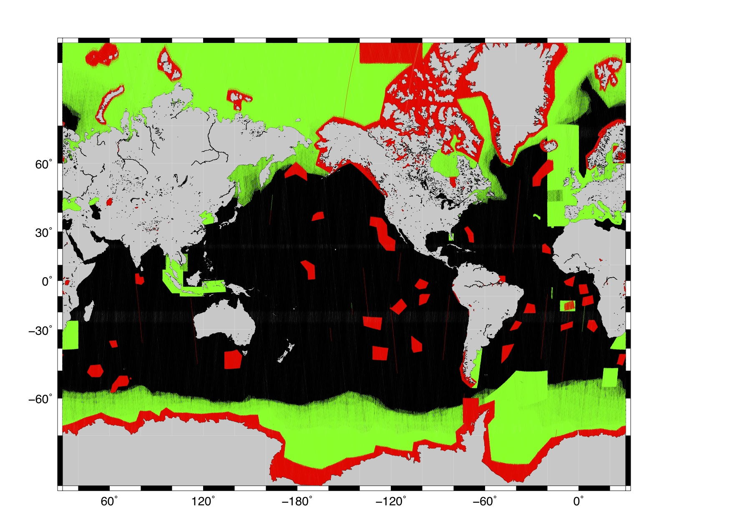
CryoSat Data Acquisition over 13 Months
LRM
SAR
SARIN
[CryoSat L1b data
provided by ESA
ESRIN]

Slide 4
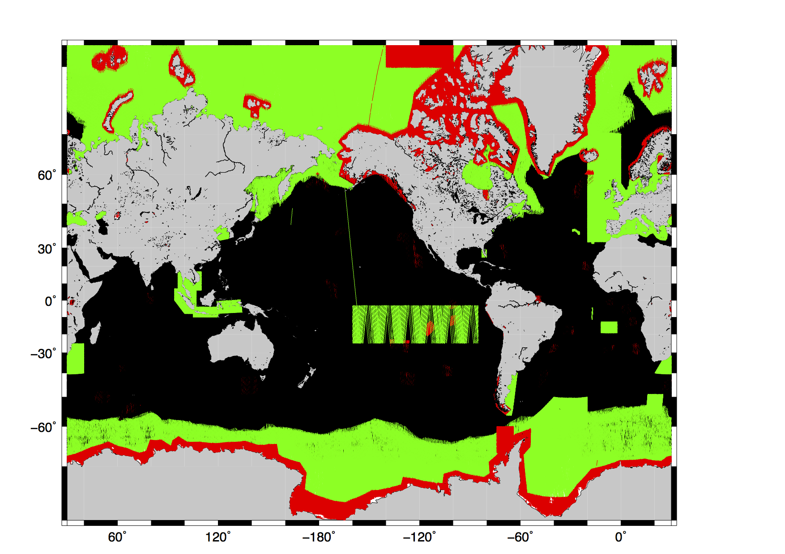
CryoSat Data Acquisition over 24 Months
LRM
SAR
SARIN
[CryoSat L1b data
provided by ESA
ESRIN]

Slide 5
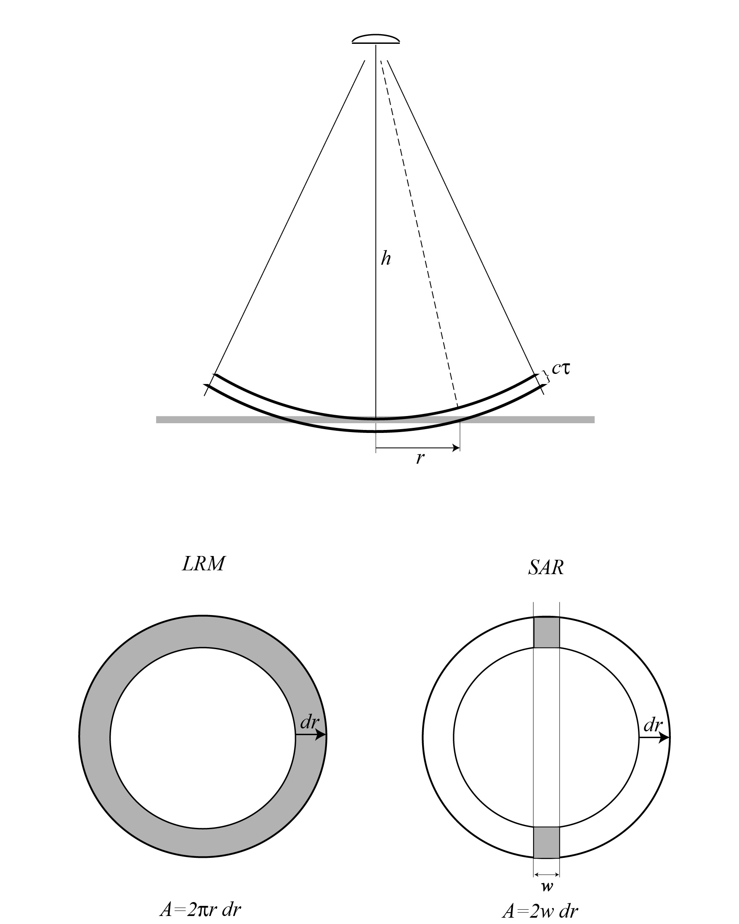
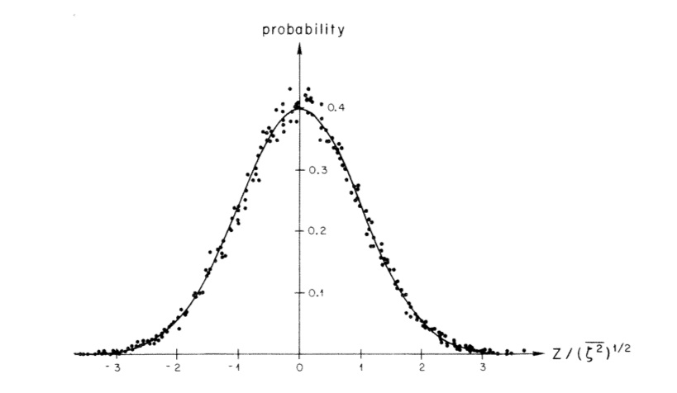
Waveform Model
outgoing
pulse
(assume
Gaussian)
flat
surface
response
Gaussian
waves

Slide 6
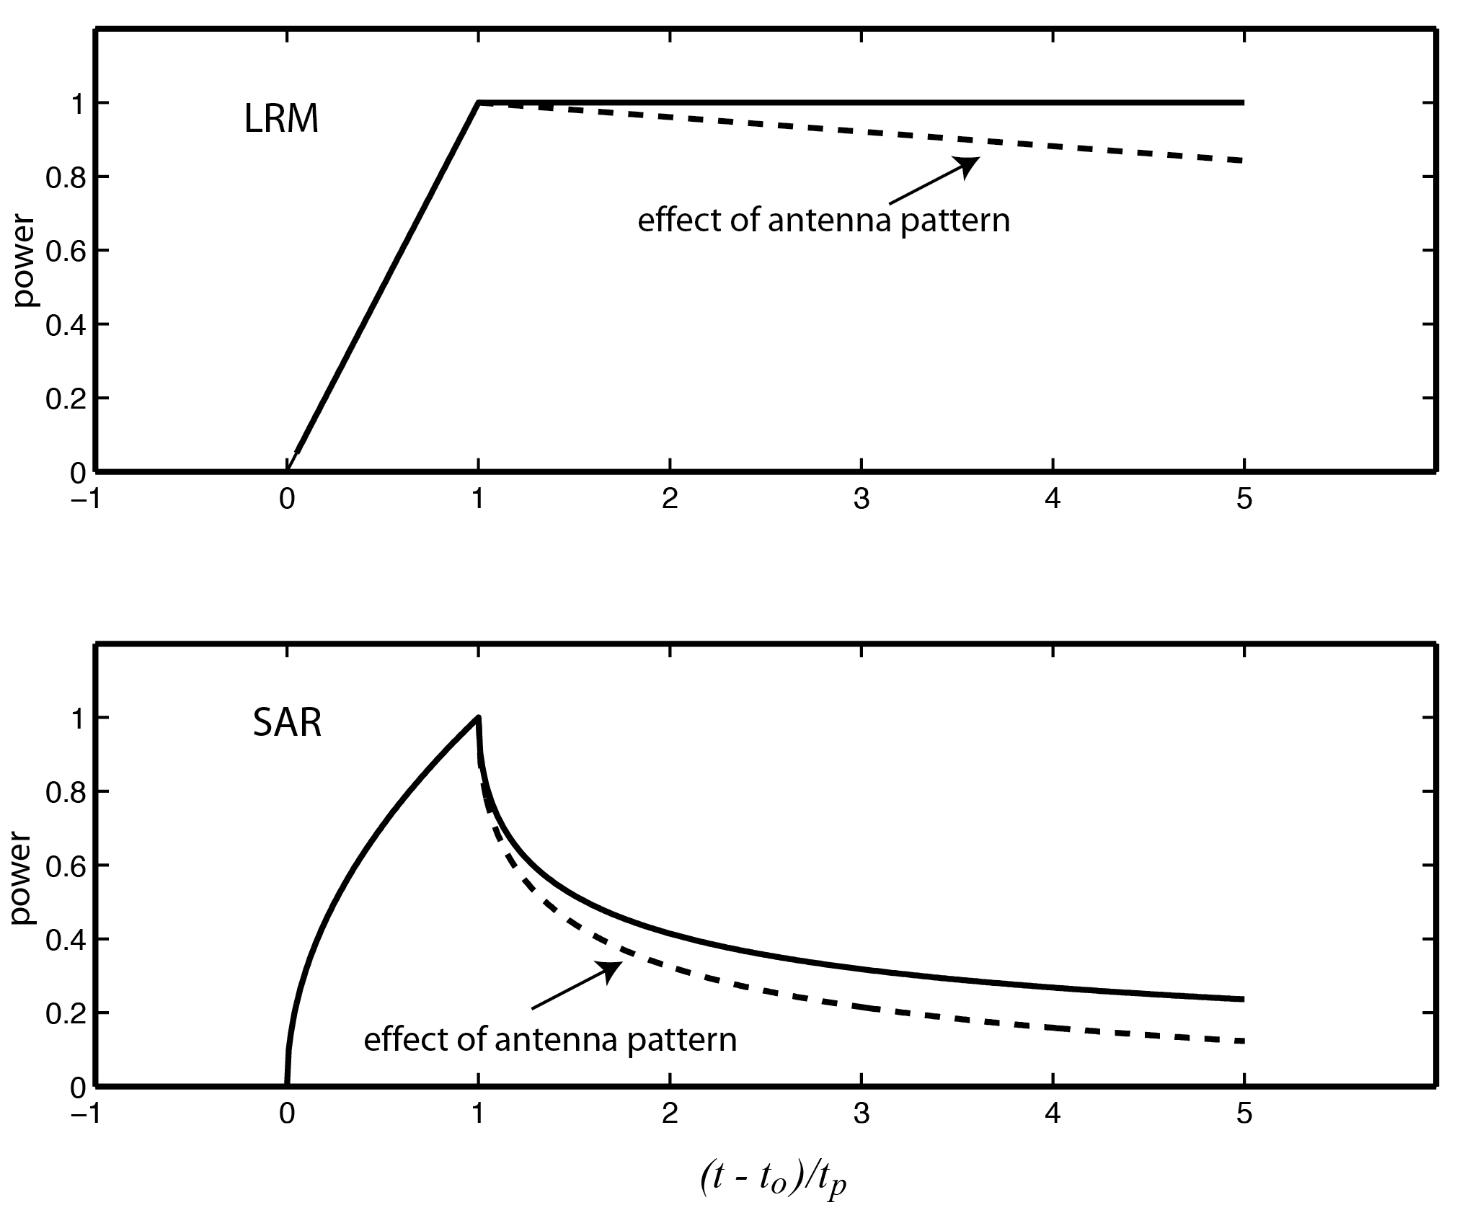
flat surface response – LRM vs. SAR

Slide 7
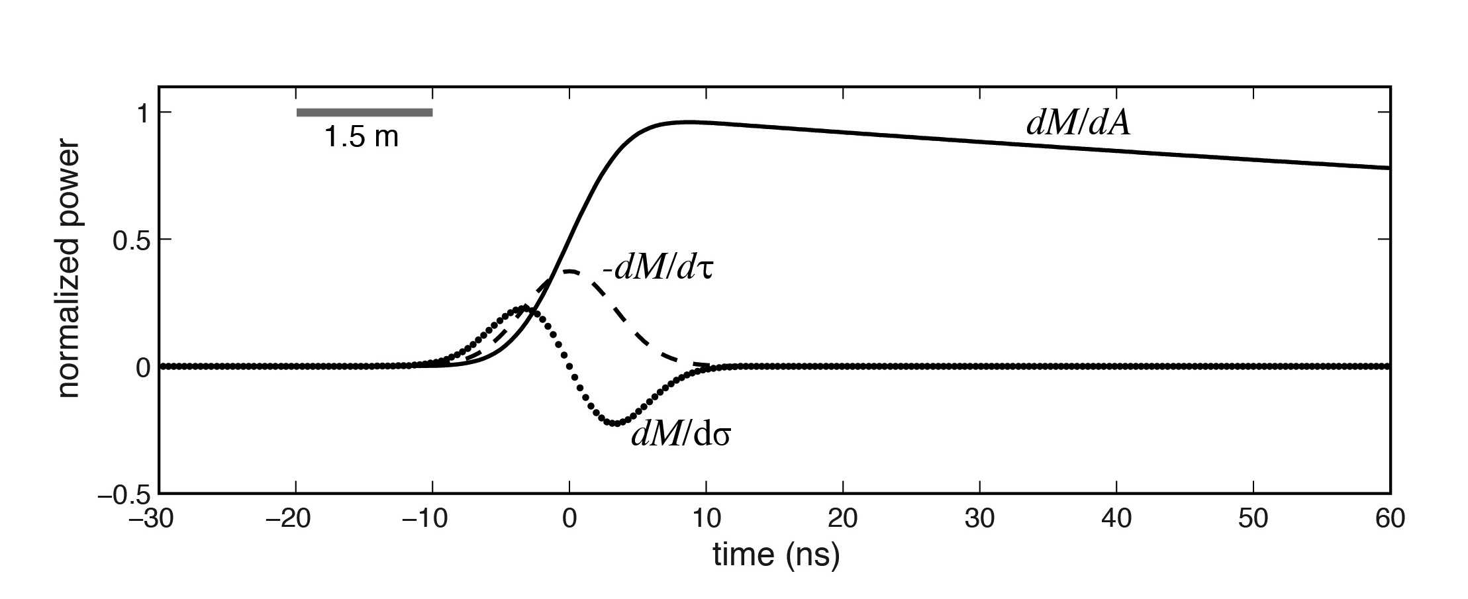
LRM waveform
Estimate 3 parameters: arrival time (τ), rise time (σ), and power (A).

Slide 8
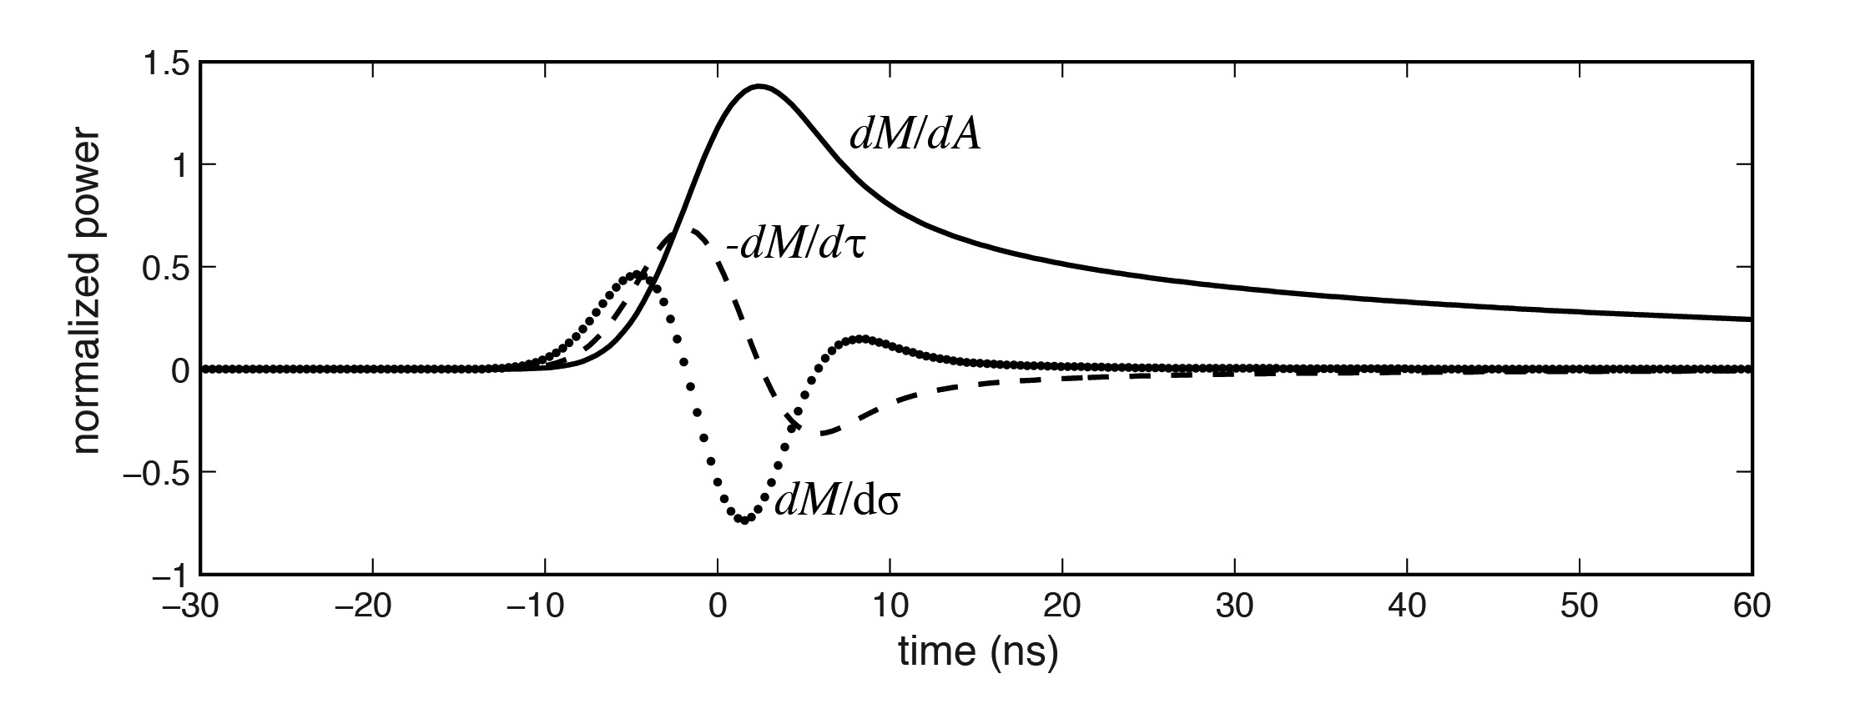
SAR waveform
Estimate 3 parameters: arrival time (τ), rise time (σ), and power (A).
D – parabolic cylinder function

Slide 9
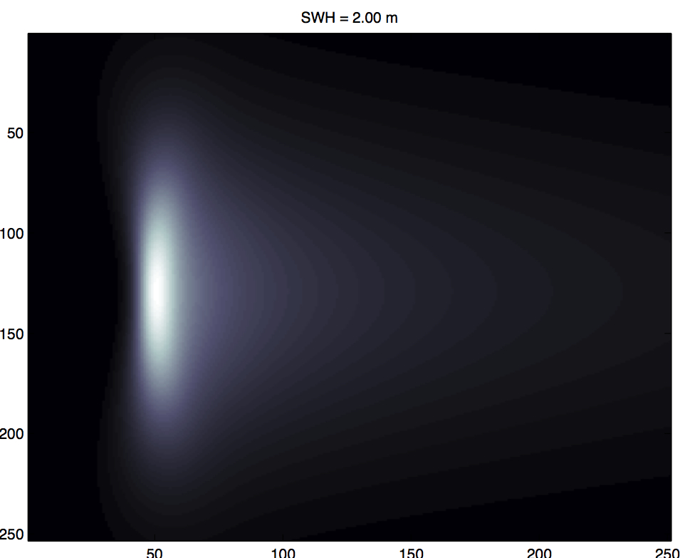
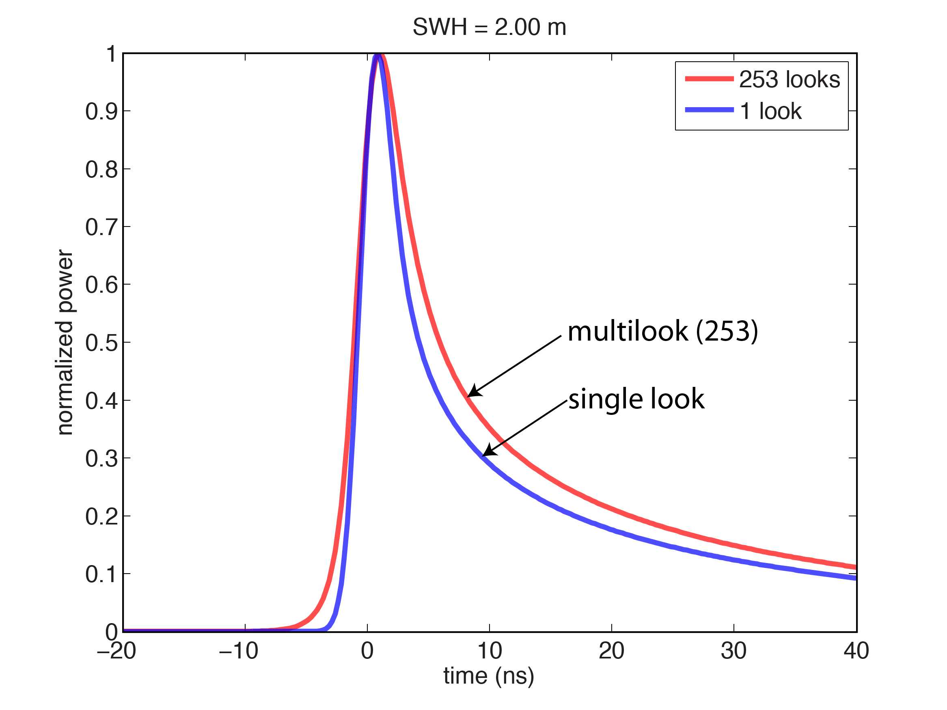
SAMOSA Simulated SAR Waveforms

Slide 10
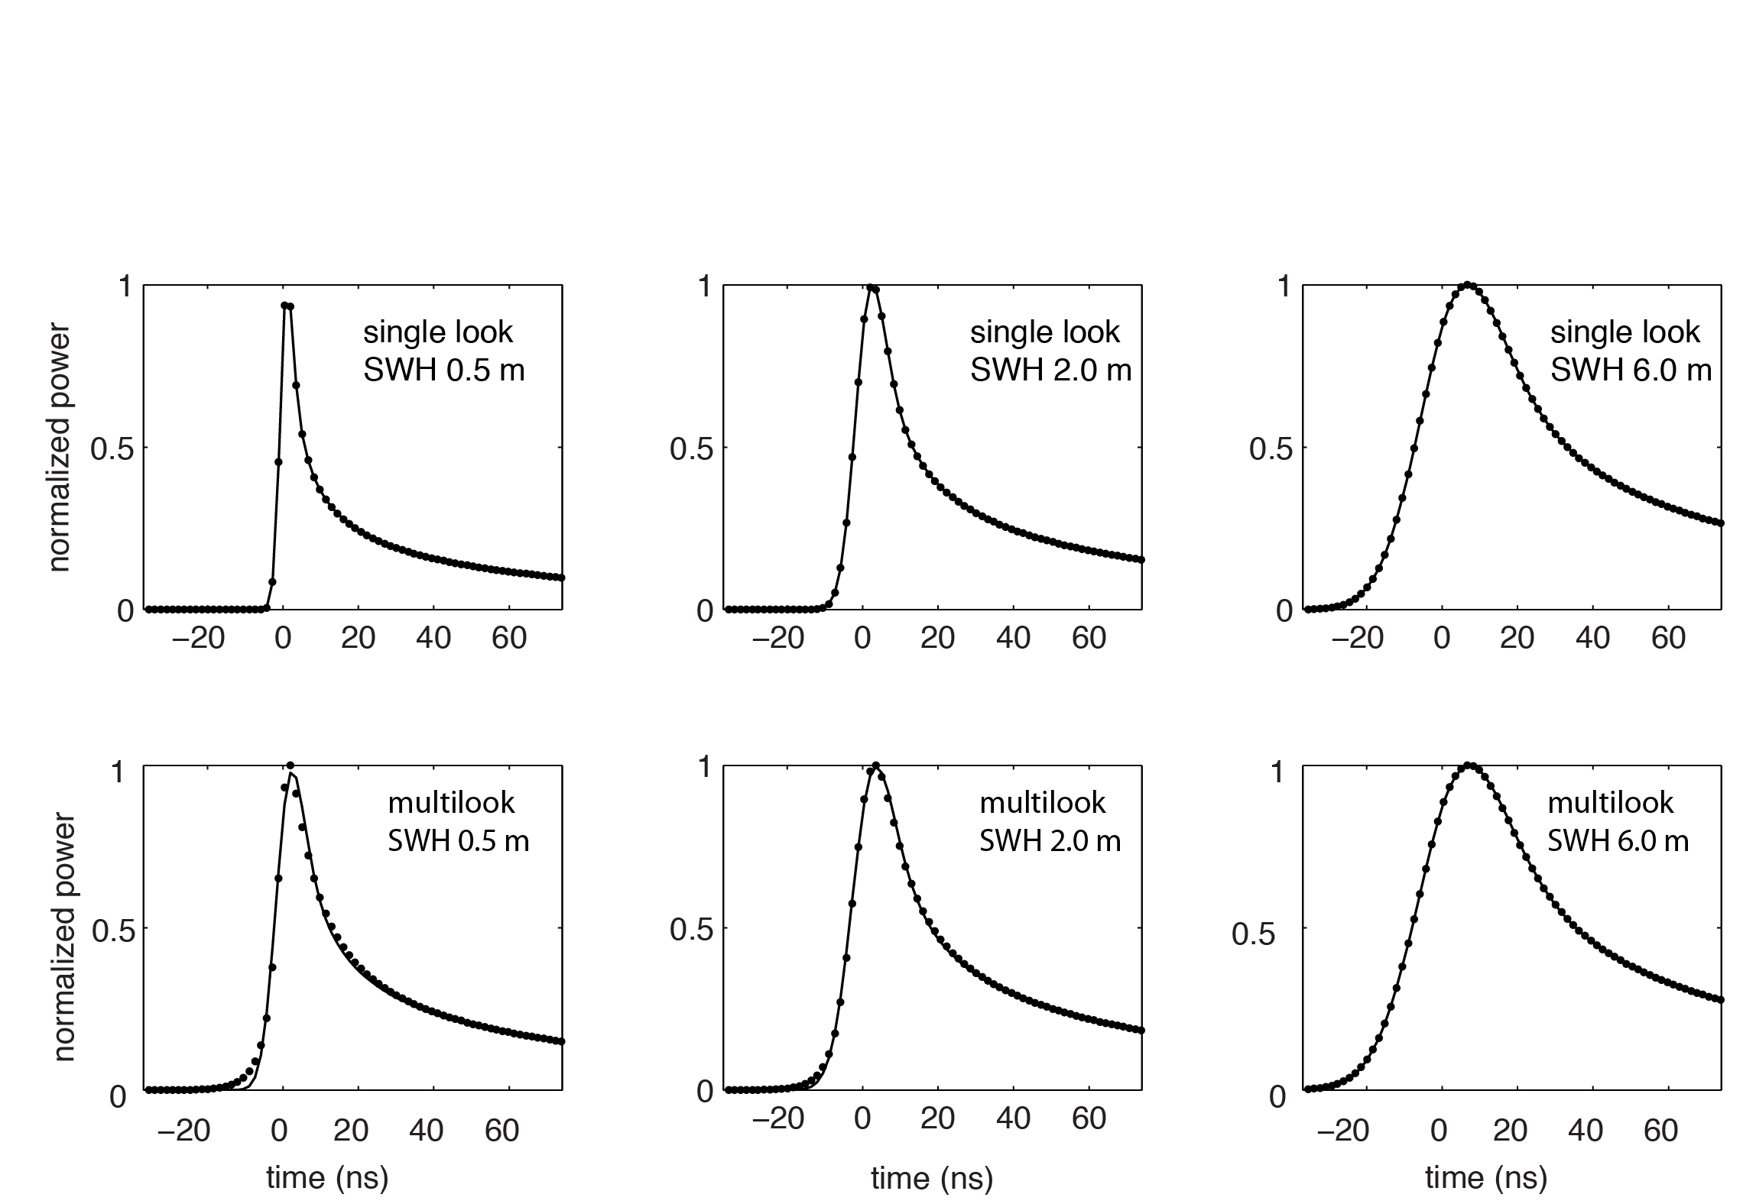
Fits to SAMOSA Waveforms
perfect fit to single-look data
misfit at “toe” for multilooked waveforms

Slide 11
Fits to SAMOSA Waveforms
perfect fit to single-look data
misfit at “toe” for multilooked waveforms

Slide 12
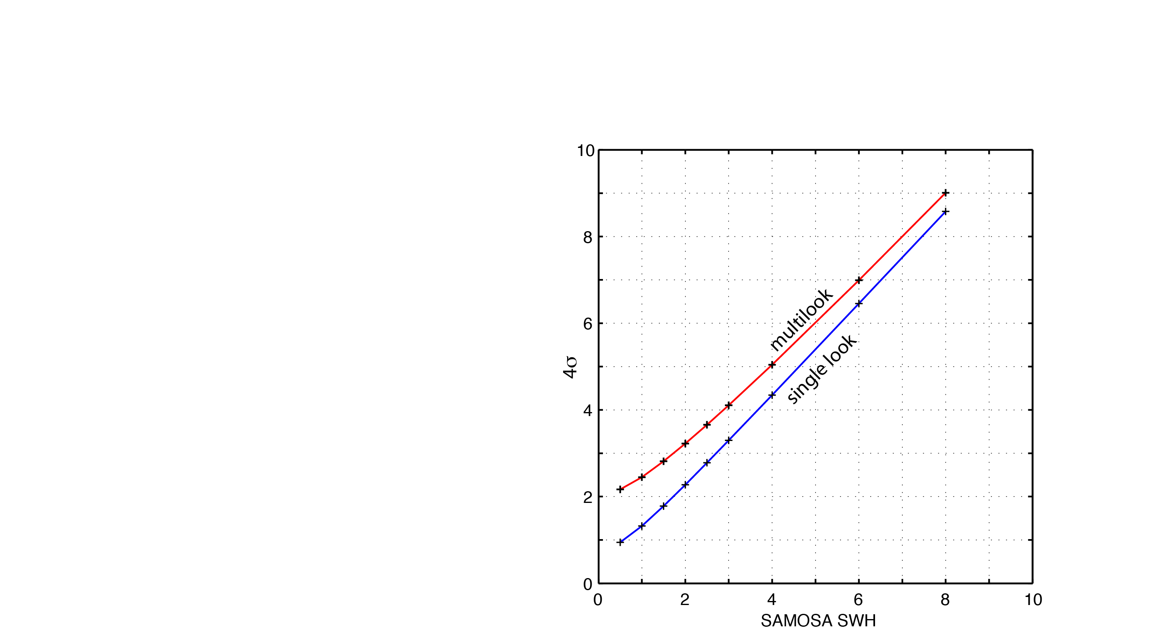
Fits to SAMOSA Waveforms
analytic model overestimates
SWH from multilook
SAMOSA
analytic model provides correct
estimate of SWH from single look
SAMOSA

Slide 13
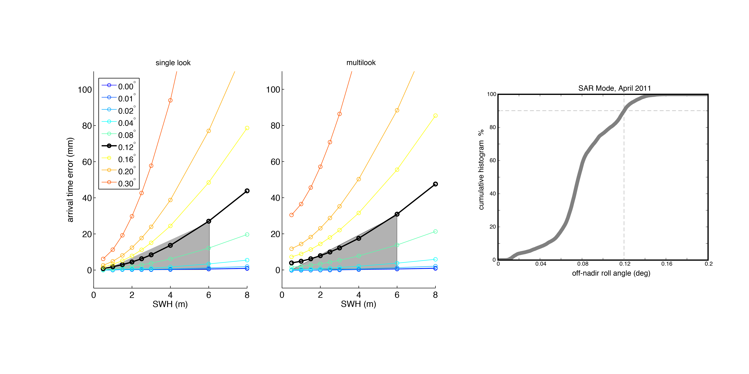
Bias due off-nadir pointing
typical off-nadir
roll angle < 0.12˚
Bias due to off-nadir pointing will cause insignificant
errors in slope but perhaps significant errors in height.

Slide 14
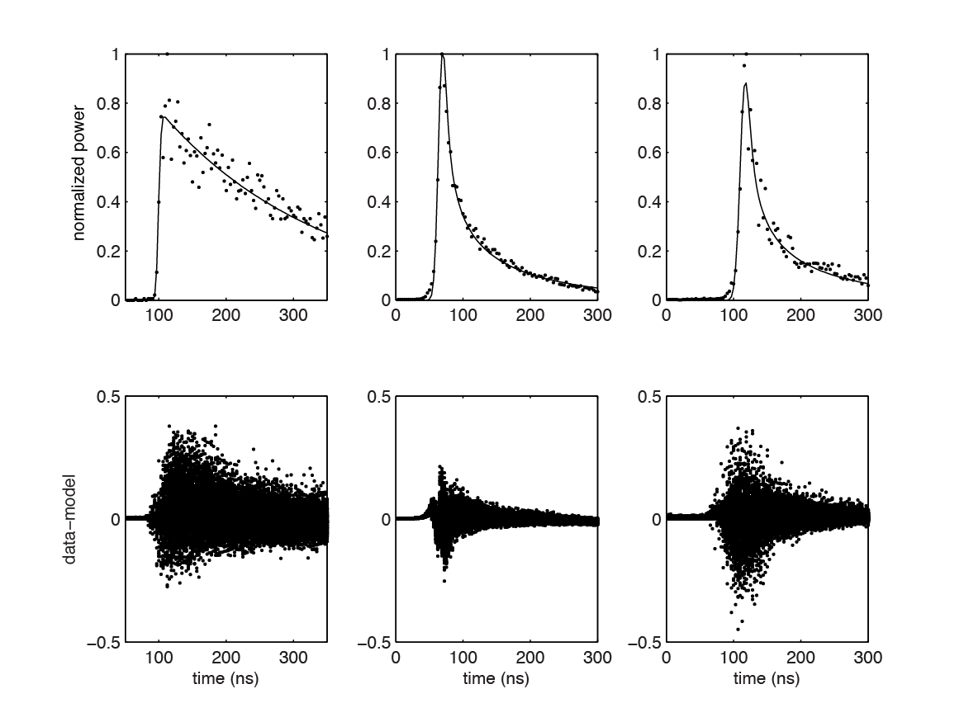
Example Model Fits to CryoSat Data
LRM
SAR
SARIN

Slide 15
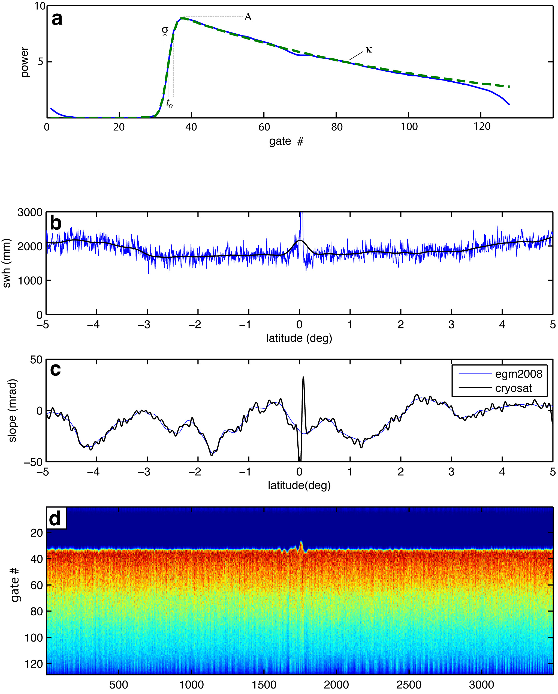
Double retracking to improve range precision - LRM
retrack waveforms with standard 3-parameter model
smooth wave height and amplitude over 40-km
retrack waveforms with 2-parameter model
Note: this assumes wave height varies smoothly along track.

Slide 16
Atlantic Region for Noise Analysis
LRM
SAR
SARIN
[CryoSat L1b data
provided by ESA
ESRIN]

Slide 17
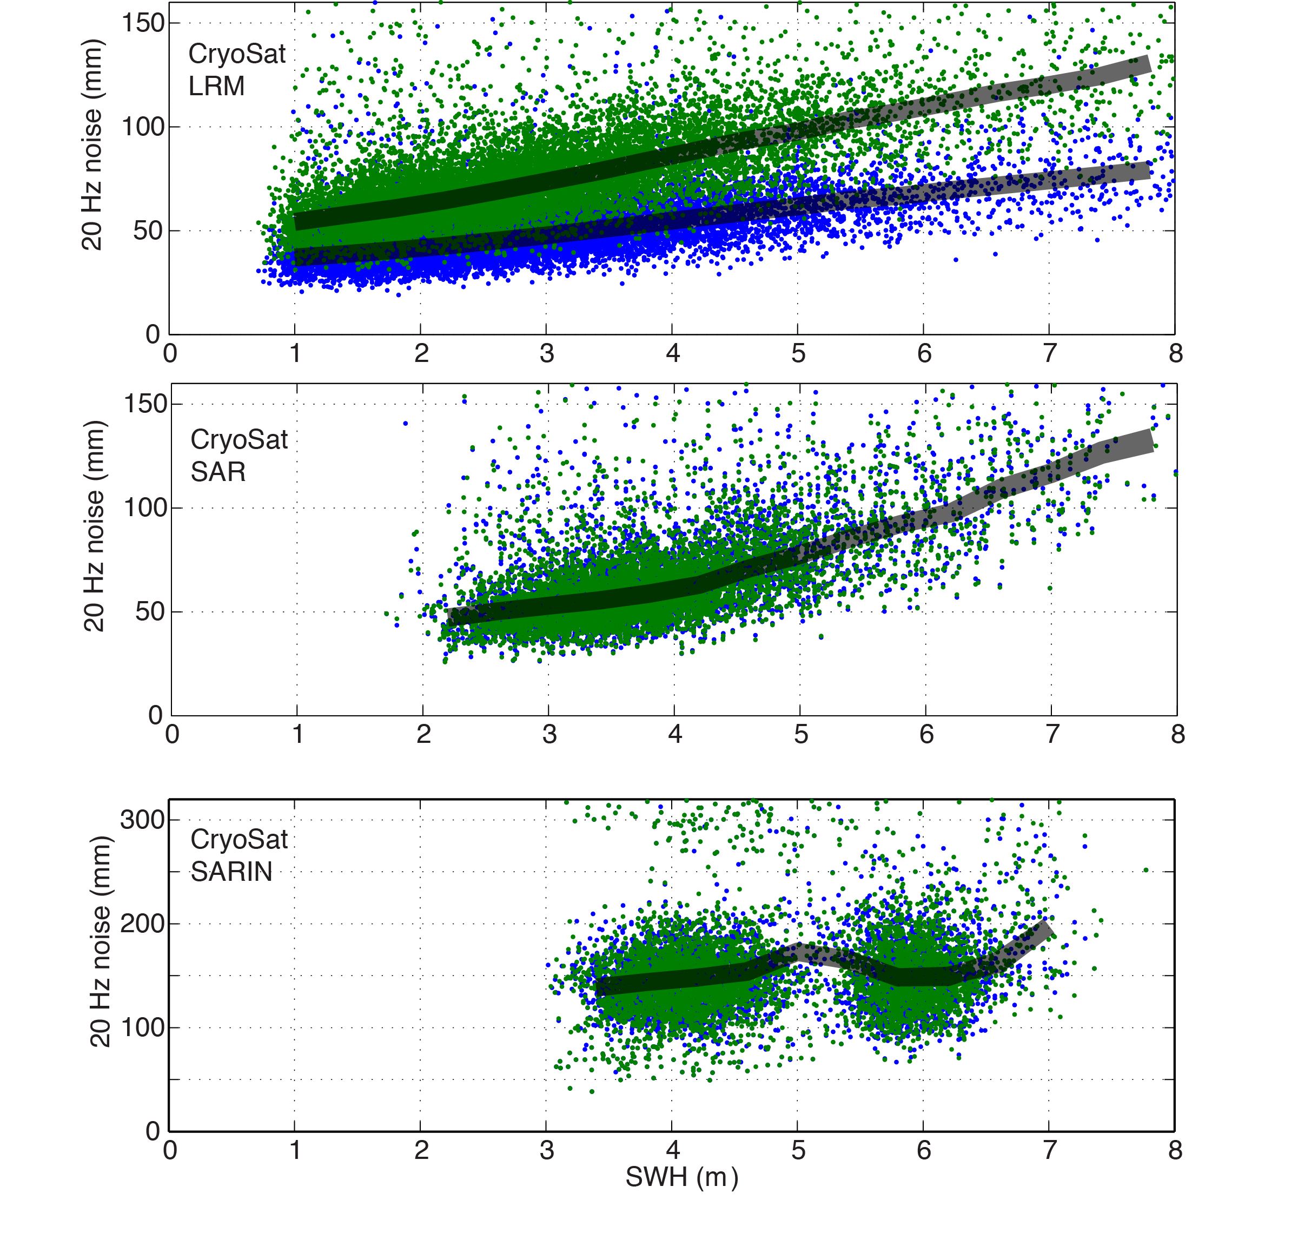
Noise vs SWH for LRM, SAR, SARIN
3-parameter
2-parameter
SAR noise level is 1.3 times lower than
LRM noise level when both are retracked
using 3 parameters.
LRM noise level is slightly lower than
SAR noise level when LRM is double
retracked.
SARIN noise level is 3.3 times higher than
LRM or SAR (preliminary result).

Slide 18
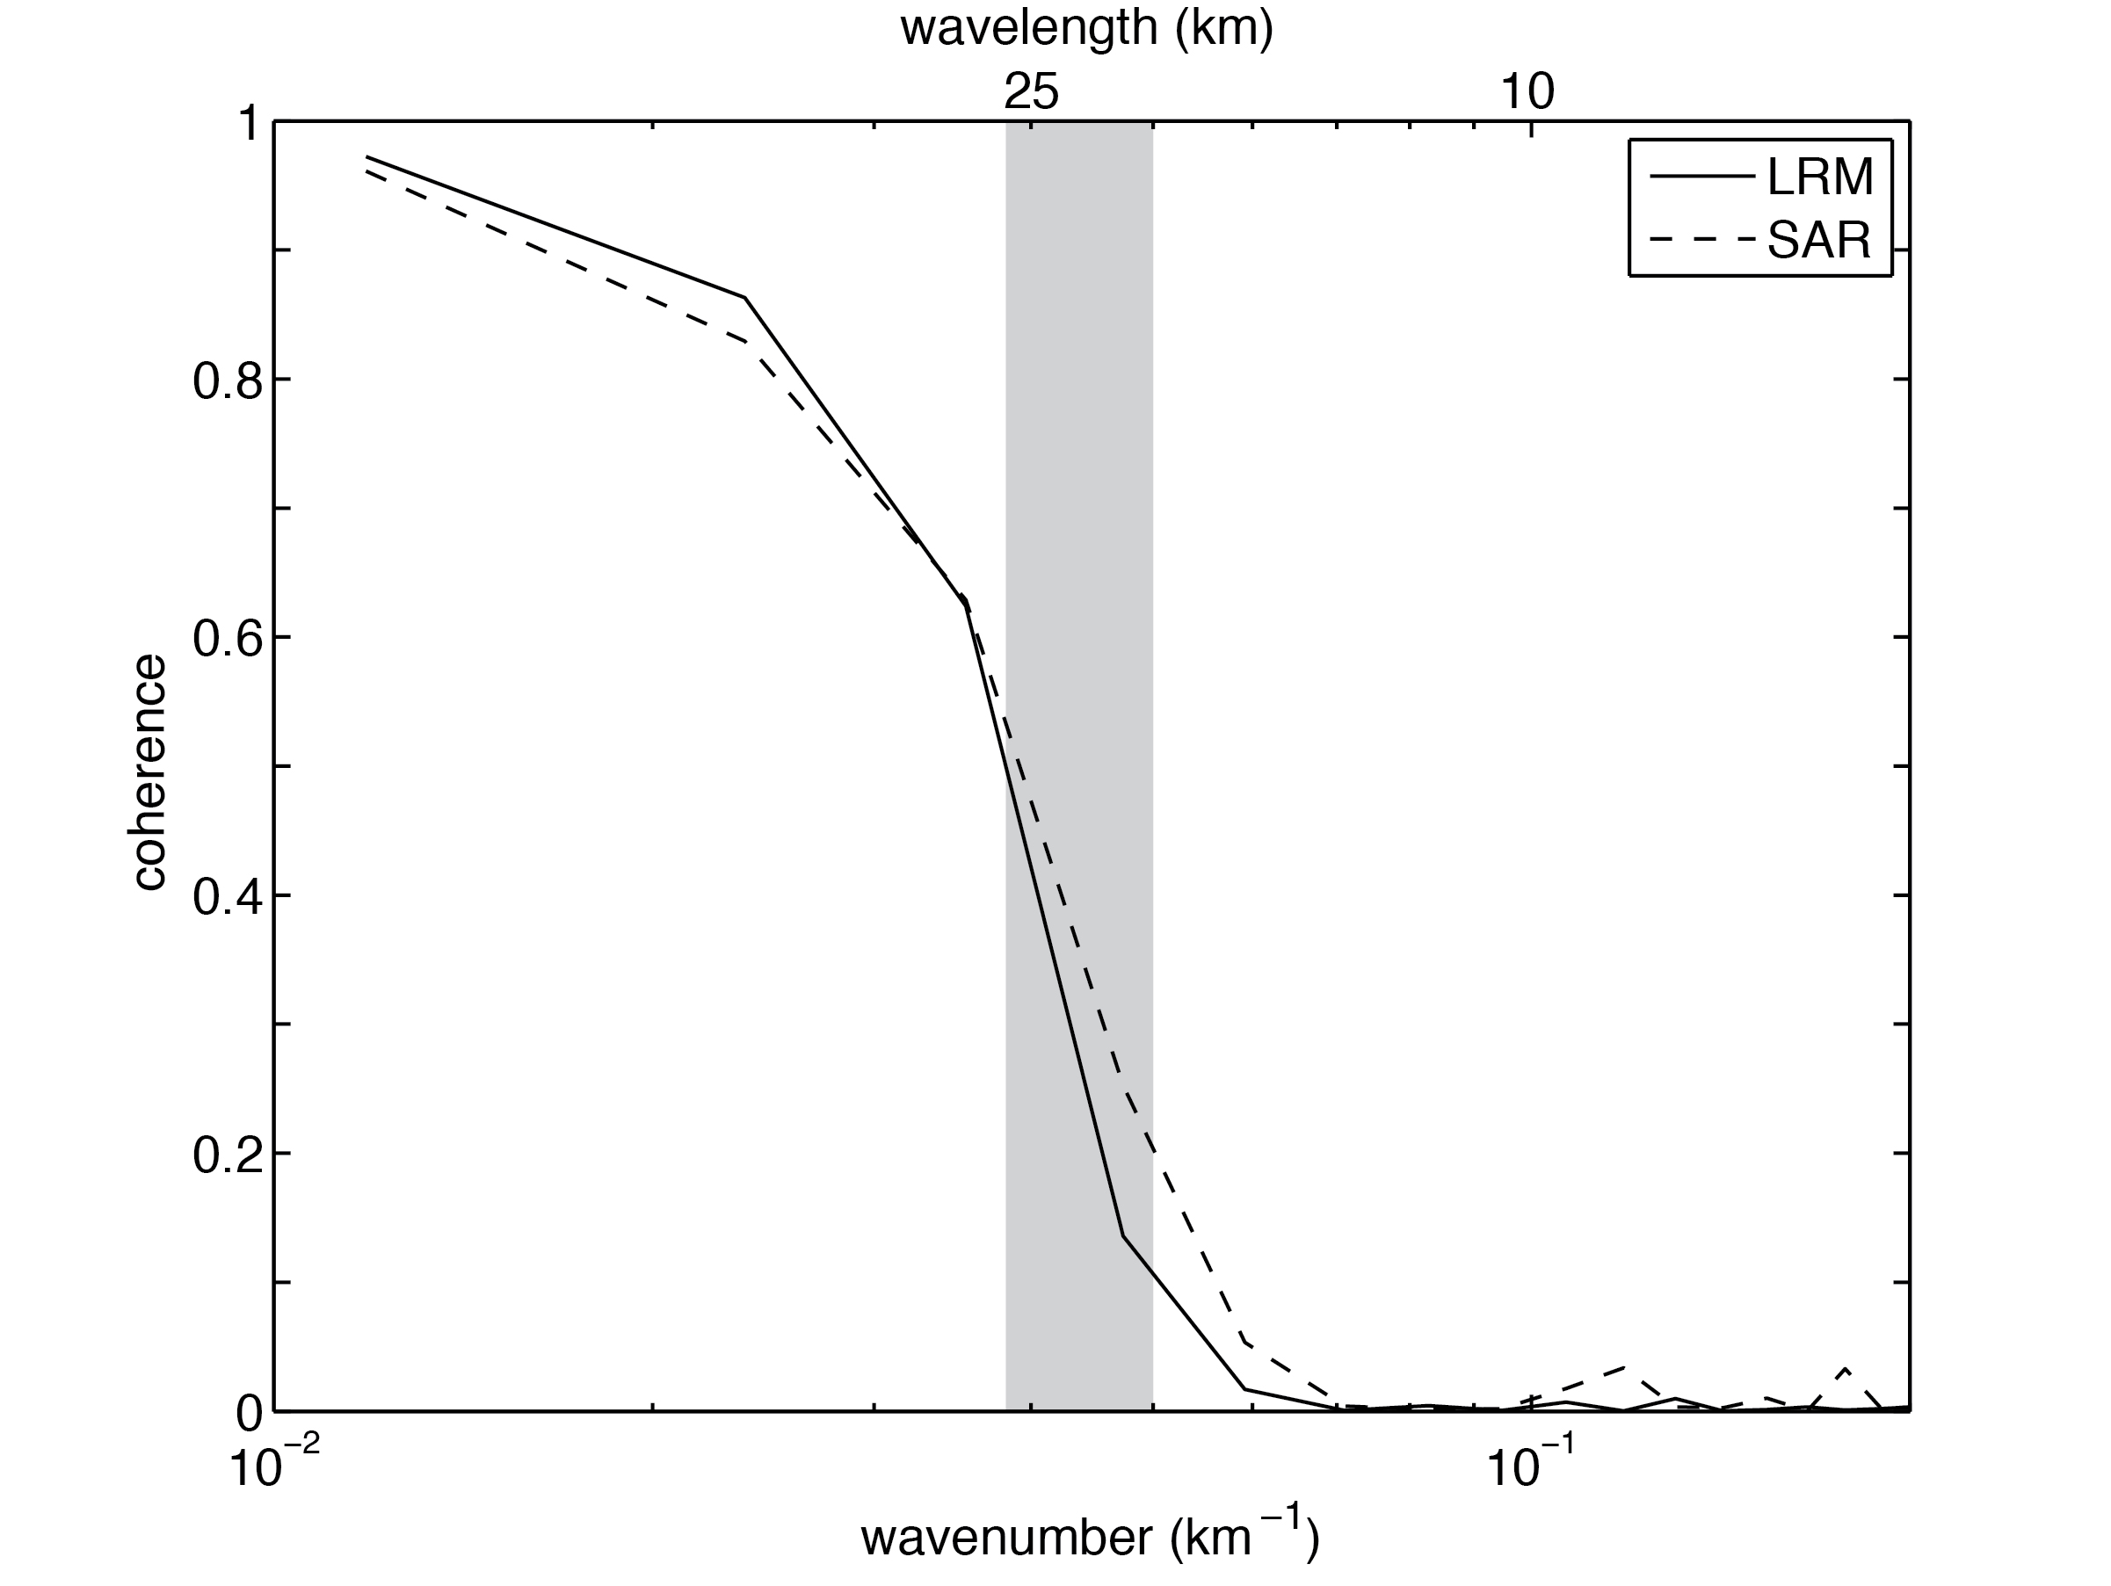
Coherence Analysis: LRM / SAR

Slide 19
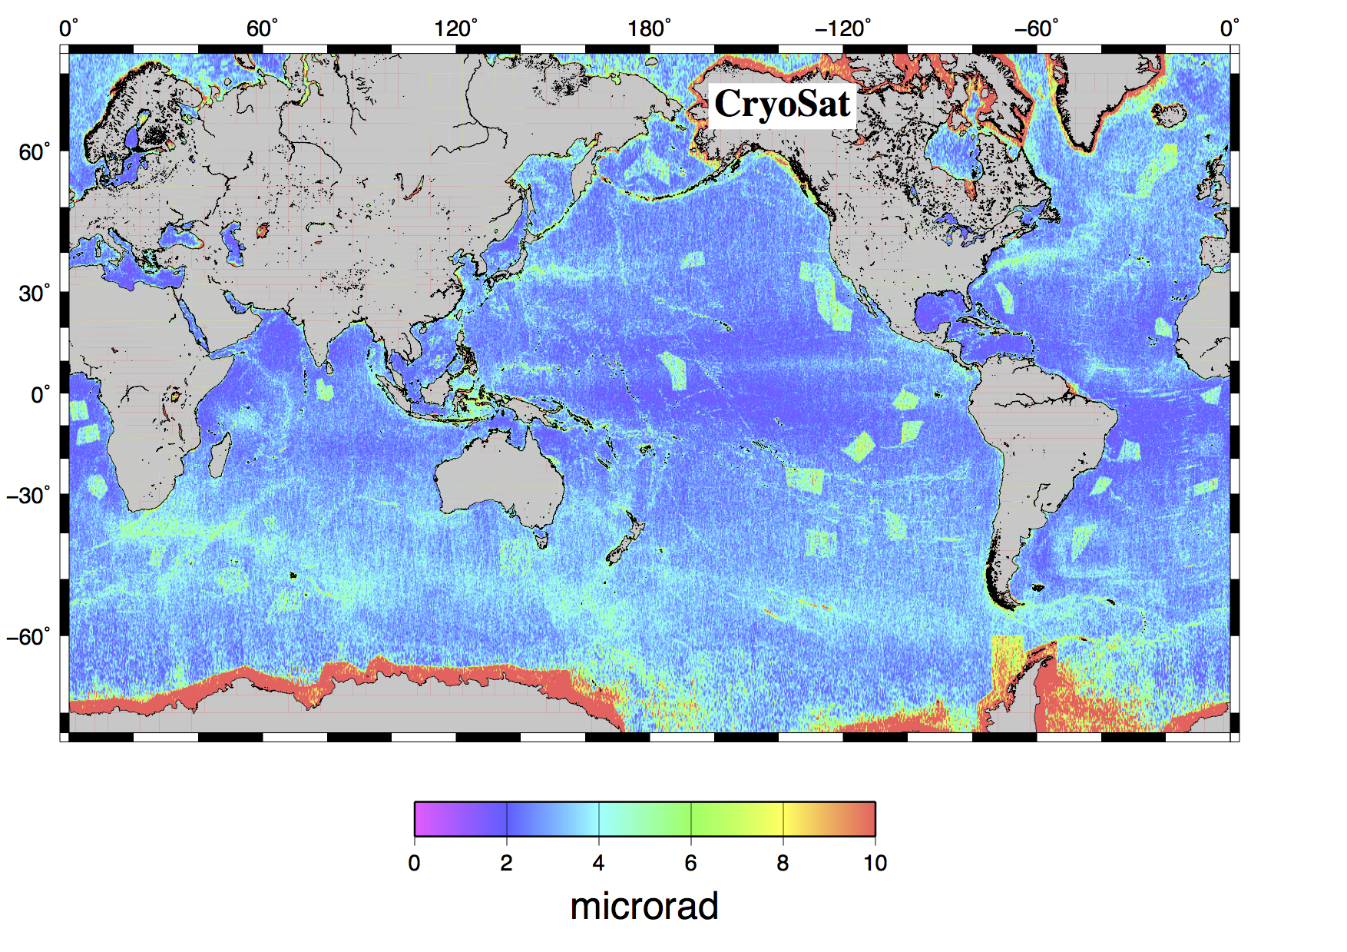
CryoSat vs. EGM2008

Slide 20
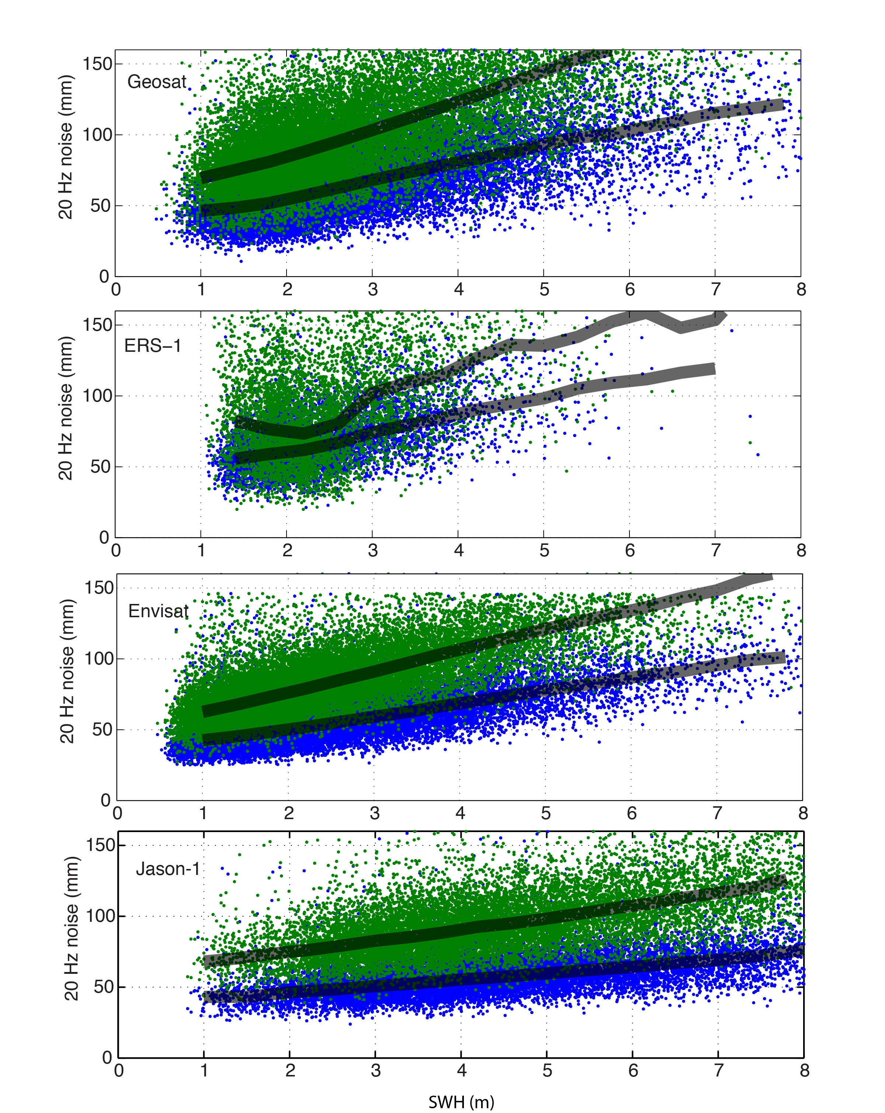
20 Hz noise of all altimeters
3-parameter
2-parameter

Slide 21
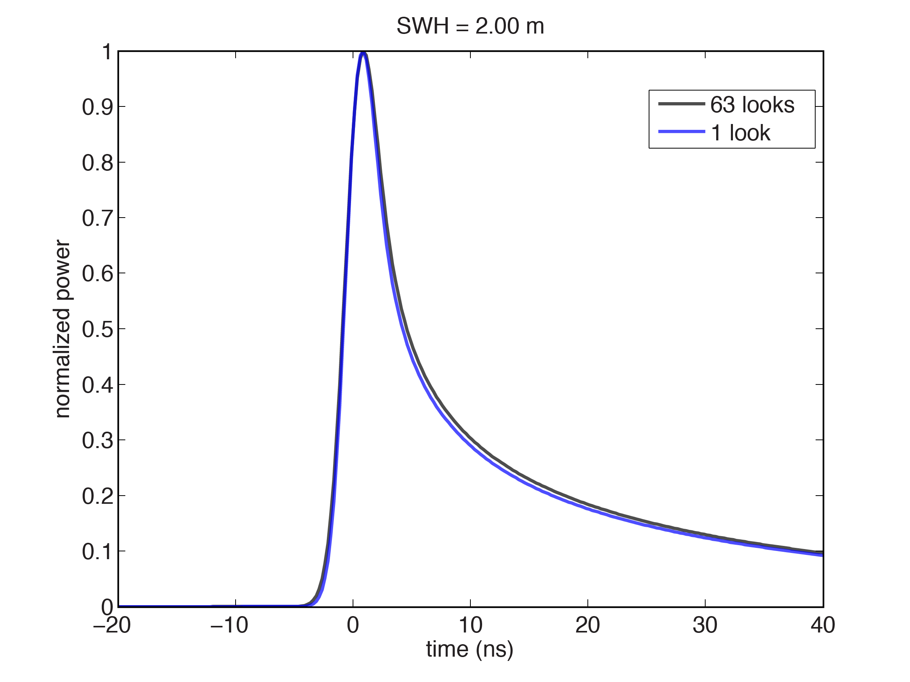
SAMOSA Simulated SAR Waveforms
63 looks
The leading edge of the SAR waveform may become sharper by
reducing the number of looks.
Generate waveforms at 87.5 Hz rather than 22 Hz to retain full
echo return power.

Slide 22
Conclusions for Ocean Waveforms
We have developed an analytic expression for a single-looked SAR waveform assuming nadir pointing.
Off-nadir pointing will affect height accuracy but not slope precision.
The analytic formulation overestimates SWH for multilooked waveforms.
CryoSat Range Precision for SAR and LRM is significantly better than the older altimeters (Geosat and ERS) and comparable to Envisat and Jason-1. SARIN data have low range precision over the ocean.
CryoSat SAR ocean waveforms may be assembled from a fewer number of looks to sharpen the leading edge.

