Slide 1
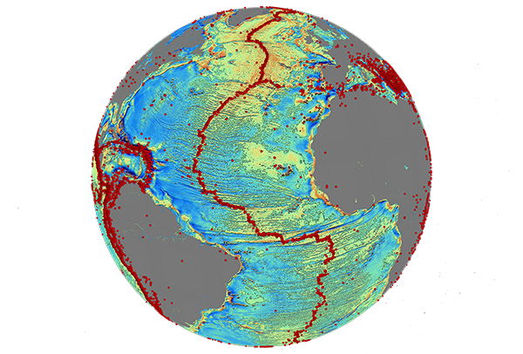
New Radar Altimeter Missions are Providing a Dramatically Sharper Image of Global Marine Tectonics
David Sandwell, Dietmar Mueller, Emmanuel (Soli) Garcia,
Kara Matthews, Walter Smith, Edward Zaron, Shengjun Zhang,
Dan Bassett, and Richard Francis
seafloor mapping tools and coverage
new marine gravity from Envisat, Jason-1, and CryoSat-2
sample of new tectonic structures
AltiKa and SWOT may improve gravity by 1.5 to 5 times
topex.ucsd.edu/grav_outreach
Notes:
This work has contributions from many co-authors:
Richard Francis and many engineers at ESA led the development of Envisat and CryoSat-2,
Dietmar Mueller, Kara Matthews, and Dan Basset provided much of the tectonic interpretation,
David Sandwell, me Walter Smith, and Shengjun Zhang are developing the radar processing and gravity field construction methods
Go over outline of talk.

Slide 2
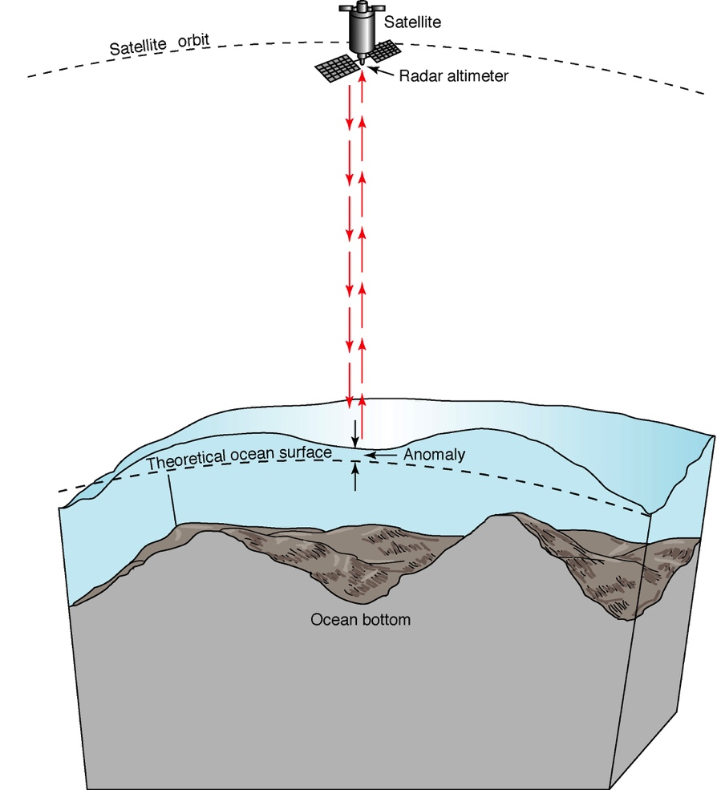
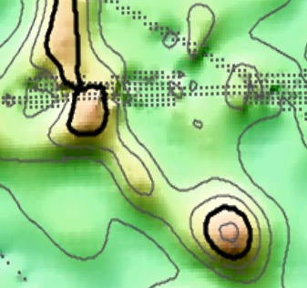
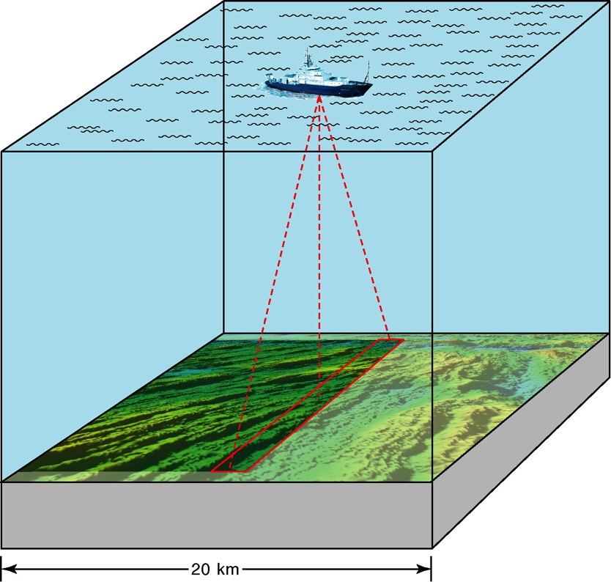
Modern Seafloor Mapping Tools
nadir-looking
satellite altimeter
shipboard
echo sounder
multi-beam sonar
bathymetry
bathymetry predicted
from gravity
Notes:
Multibeam echo sounders provide ~200 m spatial resolution but only 12% of the oceans have been mapped with this approach. Satellite altimeters provide complete ocean coverage but at a much lower resolution ~6000 m.

Slide 3
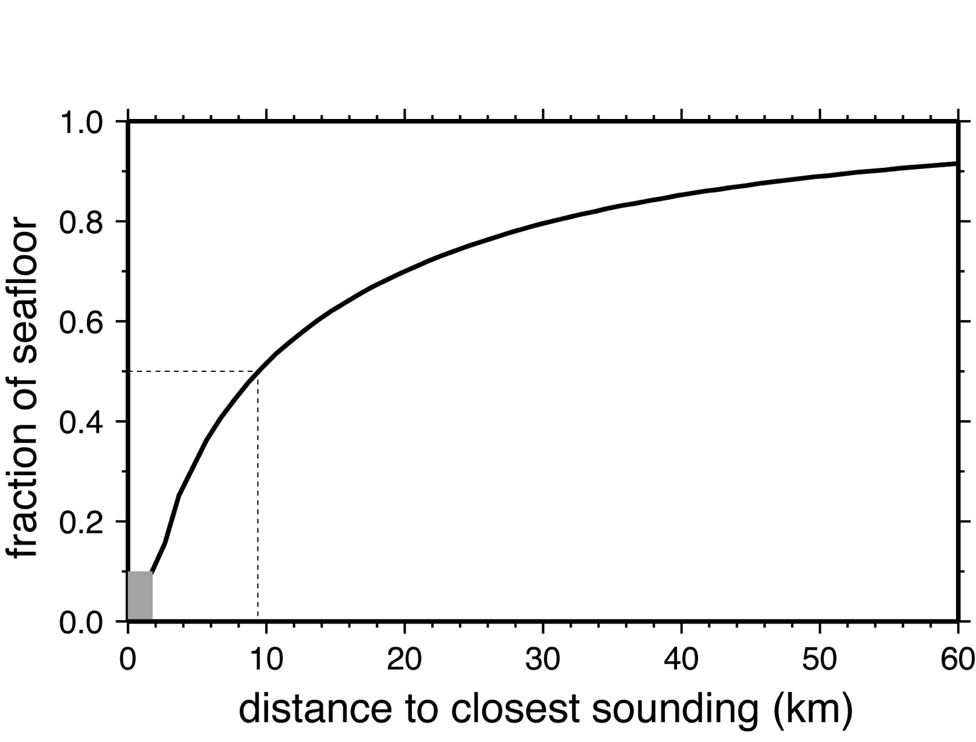
½ of Seafloor Unmapped at 10 km Resolution
[Smith & Marks, 2009]

Slide 4
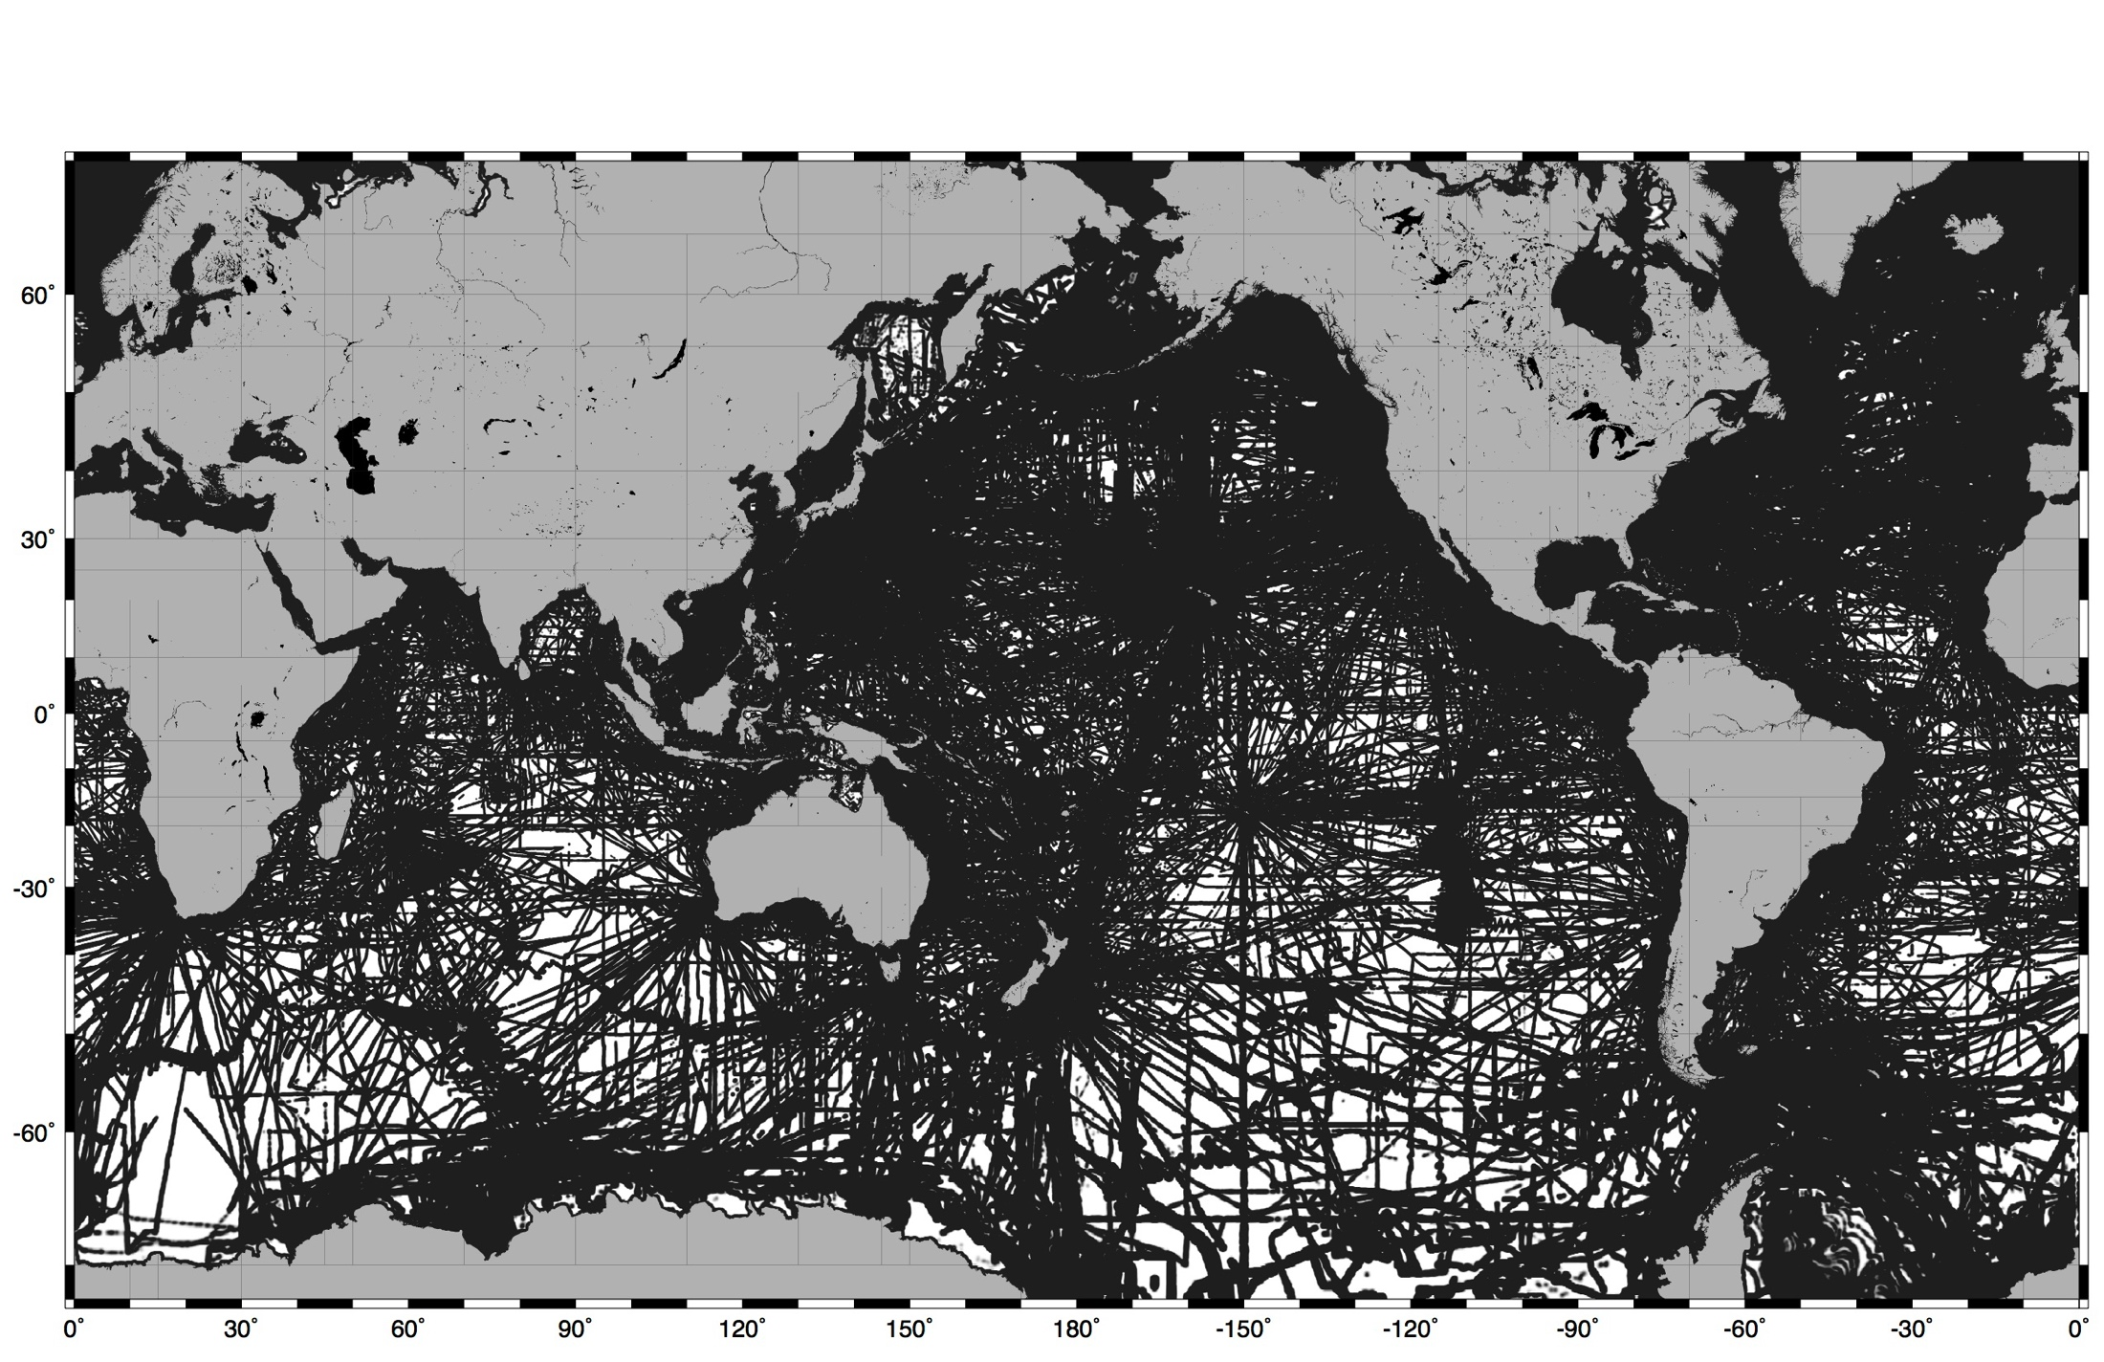
½ of Seafloor Unmapped at 10 km Resolution
seafloor areas
< 10 km away
from a sounding
Notes:
How do we will in these gaps?

Slide 5
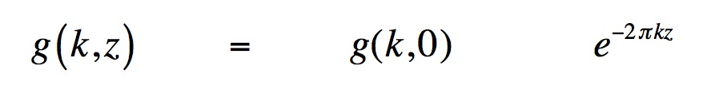
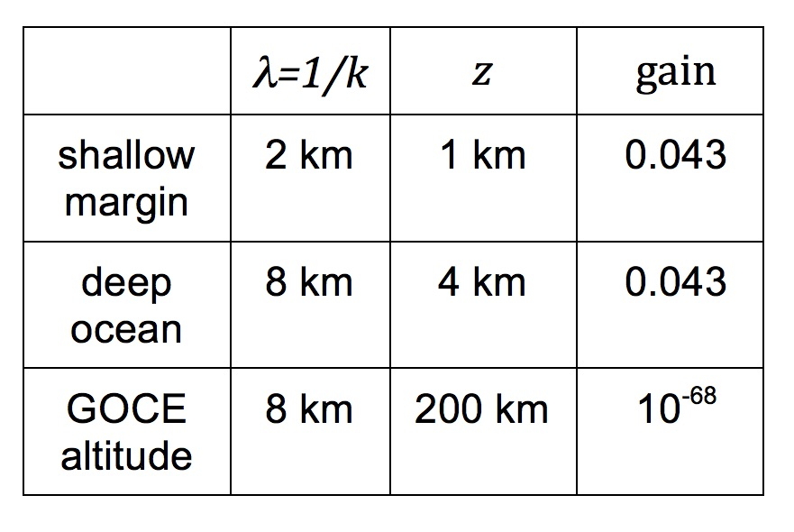
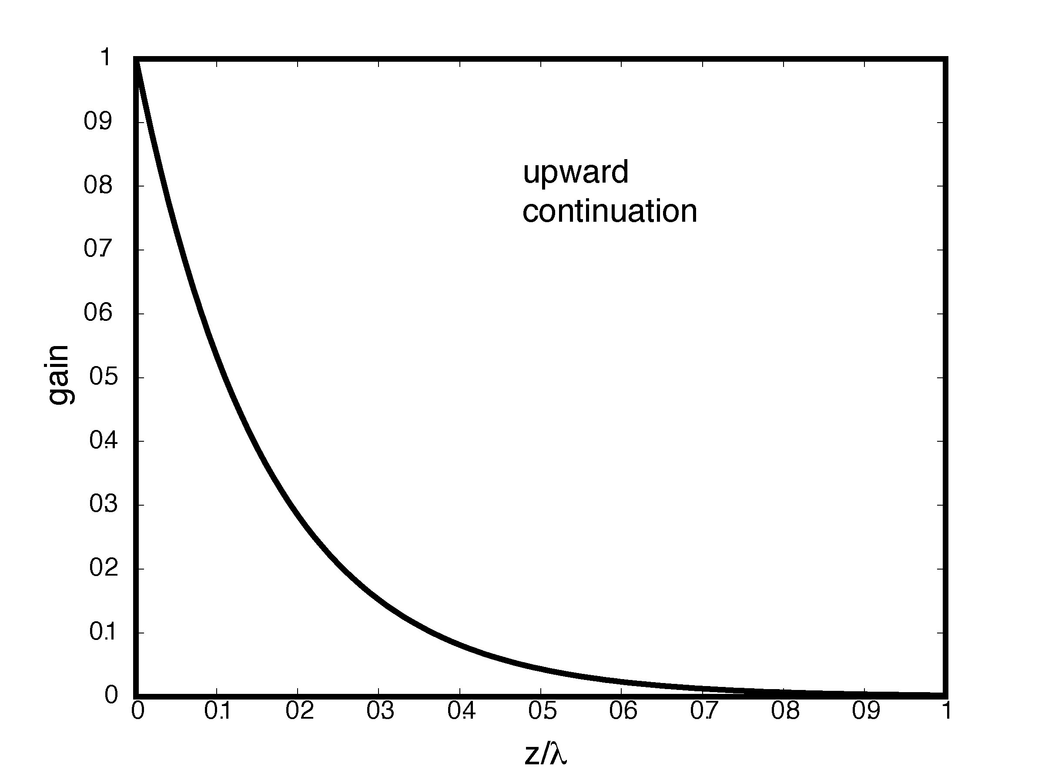
What is the expected signal at altitude?
gravity at
altitude
gravity at
seafloor
upward
continuation
X
Notes:
How do we will in these gaps?

Slide 6
Ideal Geodetic Mission Objectives
high altimeter range precision
  measure sea surface slopes to an accuracy of < 1 microradian
  (1 μrad: 1 cm elevation change over 10 km distance)
  1 μrad slope precision ⟶ 0.98 mGal gravity accuracy
dense ground track spacing
< 5 km separation at the equator OR swath coverage

Slide 7
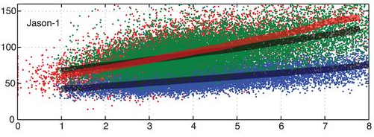
Waveform retracking to improve range precision
[Garcia et al., GJI 2014]
Satellite altimeters measure the range to sea surface.
Reprocessing Jason-1 and CryoSat-2 radar returns improves range precision over data products provided by space agencies.
Jason-1 Tracks in North Atlantic
Range Noise (mm)
Significant Wave Height (m)
CNES/CLS/NASA JPL MLE4 processor
SIO/NOAA regular retracking
(64 mm at 2 m SWH)
SIO/NOAA double retracking
(46 mm at 2 m SWH)

Slide 8
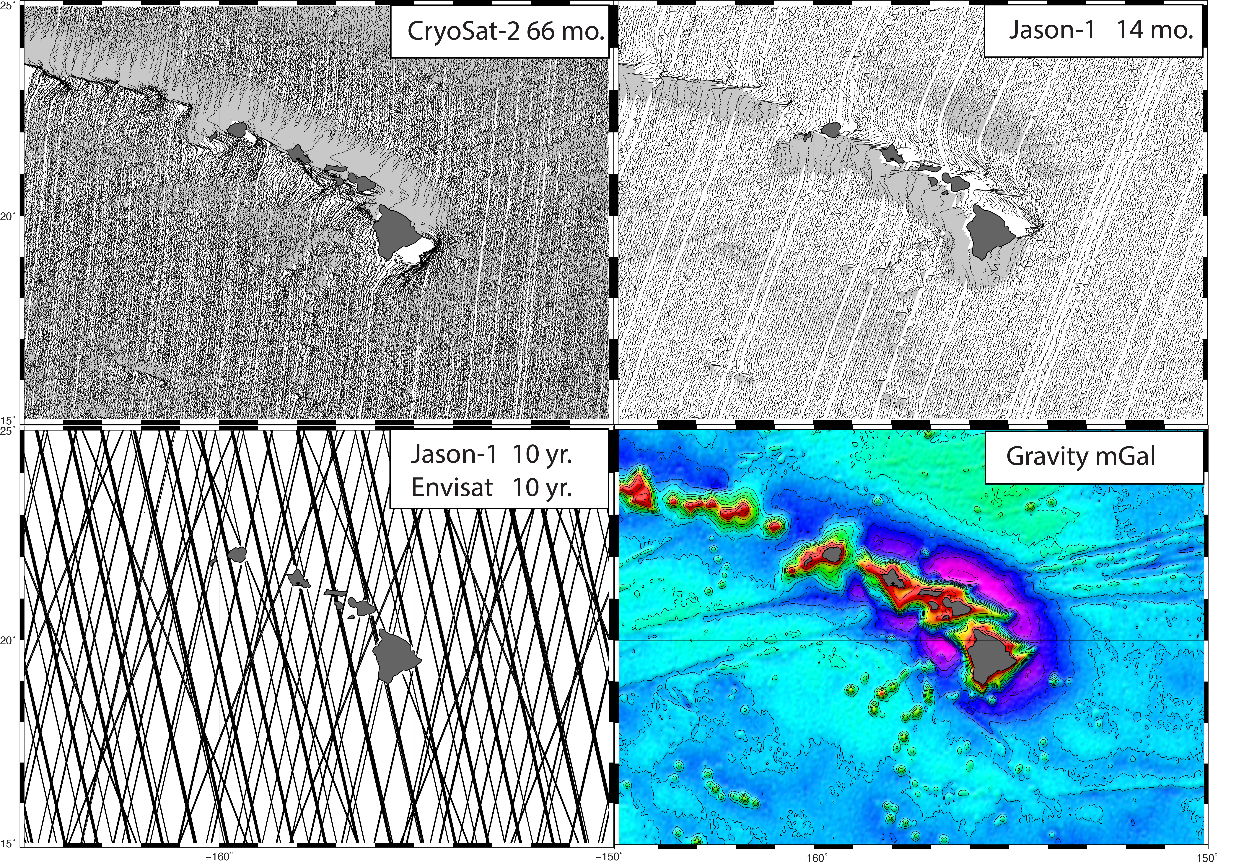
Dense track coverage for high spatial resolution
Notes:
By 2020,
The global grids of ocean bathymetry that Walter Smith, my advisor, JJ Becker, and their collaborators distribute are based on a combination of altimetry and echosounder data collected aboard ships.

Slide 9
New Radar Altimeter Missions are Providing a Dramatically Sharper Image of Global Marine Tectonics
David Sandwell, Dietmar Mueller, Emmanuel (Soli) Garcia,
Kara Matthews, Walter Smith, Edward Zaron, Shengjun Zhang,
Dan Bassett, and Richard Francis
seafloor mapping tools and coverage
new marine gravity from Envisat, Jason-1, and CryoSat-2
sample of new tectonic structures
AltiKa and SWOT may improve gravity by 1.5 to 5 times
topex.ucsd.edu/grav_outreach
Notes:
This work has contributions from many co-authors:
Richard Francis and many engineers at ESA led the development of Envisat and CryoSat-2,
Dietmar Mueller, Kara Matthews, and Dan Basset provided much of the tectonic interpretation,
David Sandwell, me Walter Smith, and Shengjun Zhang are developing the radar processing and gravity field construction methods
Go over outline of talk.

Slide 10
Extinct Spreading Ridge and Continent Ocean Boundary, Gulf of Mexico
[Sandwell et al., Science, 2014]
Offshore
Sedimentary
Basins

Slide 11
Extinct Spreading Ridge and Continent Ocean Boundary, Gulf of Mexico
[Sandwell et al., Science, 2014]
Offshore
Sedimentary
Basins

Slide 12
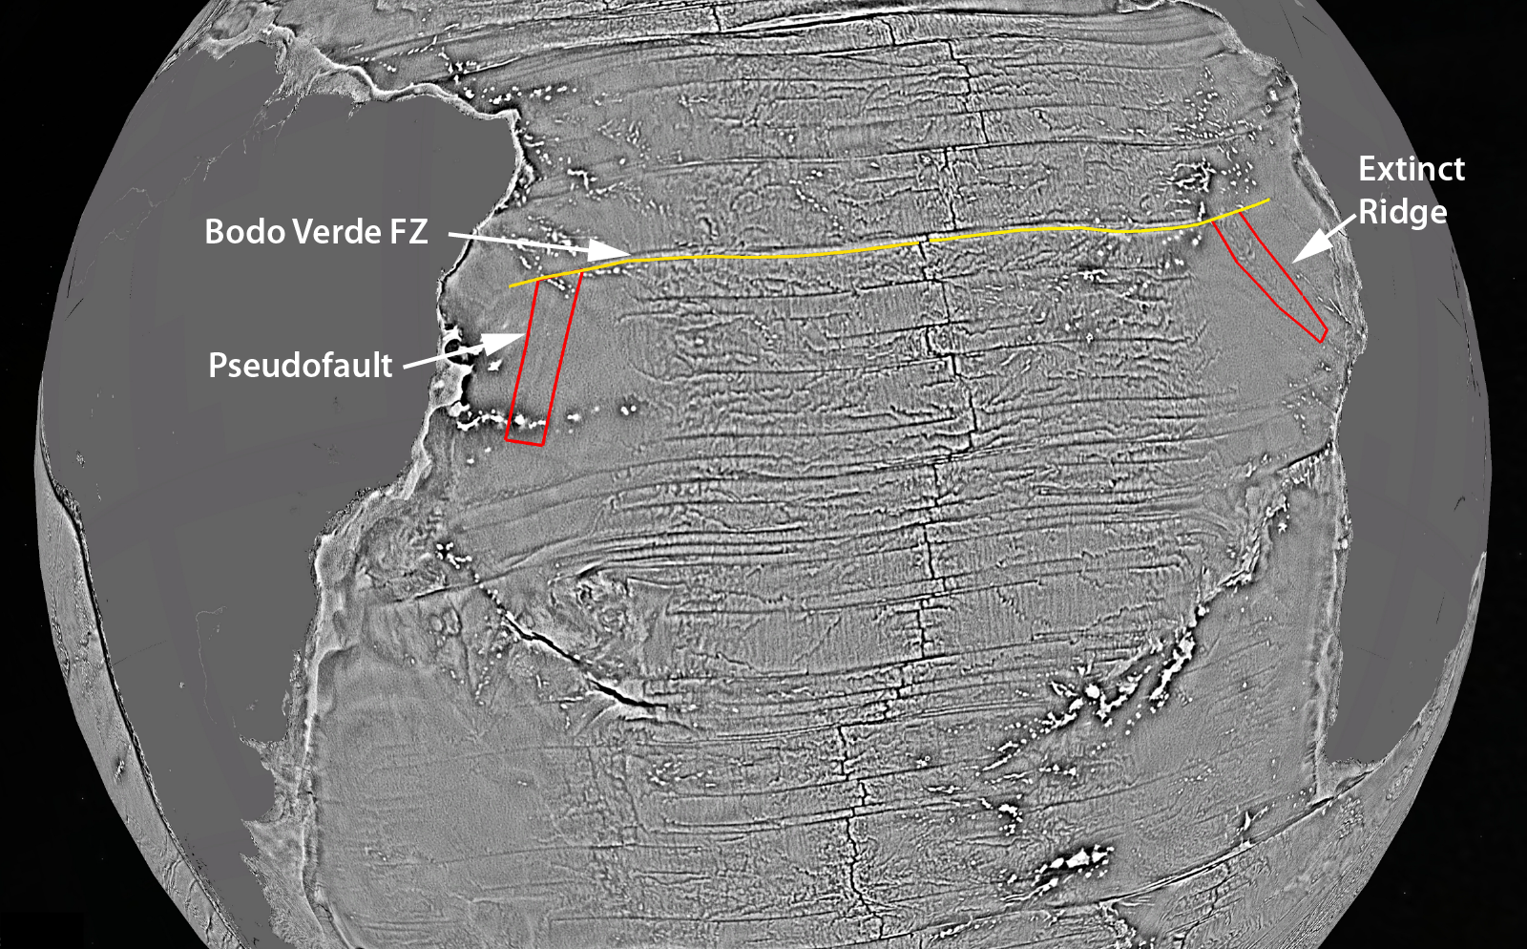
Propagating Ridge, South Atlantic
[Sandwell et al., Science, 2016]
Offshore
Sedimentary
Basins

Slide 13
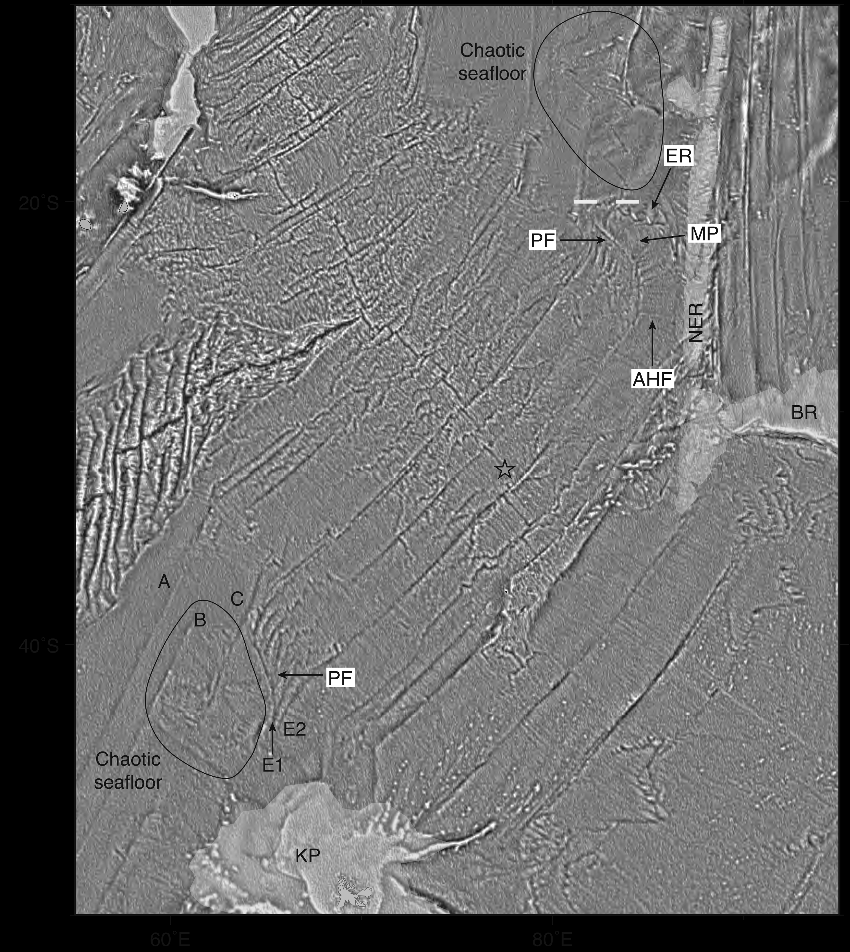
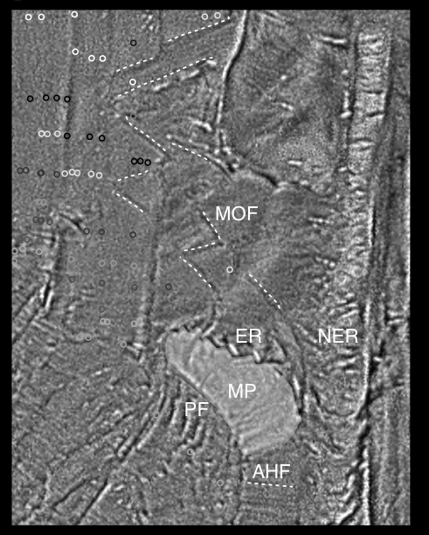
Mammerickx Microplate, Indian Ocean
[Matthews et al. , EPSL, 2015]
Offshore
Sedimentary
Basins
previously uncharted
microplate the size of
West Virginia

Slide 14
Future Contributions to Gravity Maps from AltiKa
Conventional Altimeter – Ku λ = 22 cm
AltiKa Altimeter - Ka λ = 9 mm
Improvements with AltiKa [Raney et al., 2011]
  - larger radar bandwidth
  - decreased antenna beamwidth
  double pulse repetition frequency
  2X improvemnent in range precision for standard product [Smith, Marine Geodesy, 2015]
  Can one achieve an additional 1.5 X improvement with double retracking?

Slide 15
1.5 X Better Gravity Maps are possible from AltiKa
[Garcia et al., GJI, 2014; Zhang and Sandwell, in prep.]

Slide 16
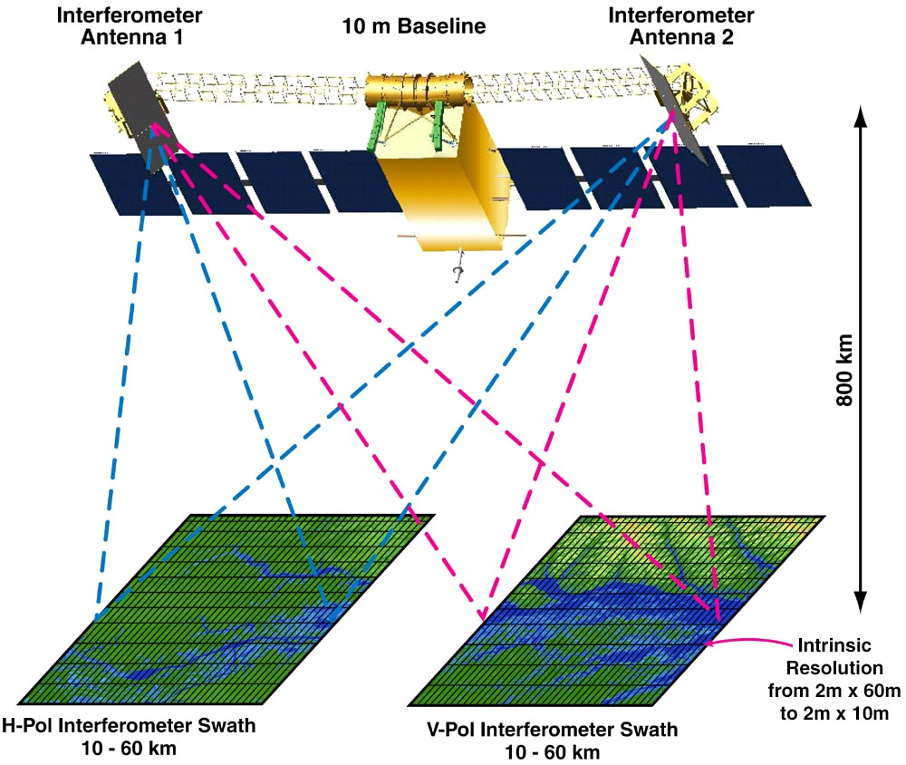
Surface Water & Ocean Topography (SWOT)
Nearly complete swath coverage every 22 days
Along-track and cross-track slope measurement
Improved coastal tide models
Mean sea surface slope accuracy could be 0.4 microradian
A 2020 launch date would provide a major gravity improvement by 2023
interferometric
swath altimeter

Slide 17
Conclusions
Gravity from satellite altimetry provides low-resolution seafloor images in the 83% of the ocean unmapped by ships.
Recent non-repeat data from CryoSat-2 and Jason-1 have provide a 2-4X improvement in gravity accuracy.
Numerous seafloor tectonic structures have been discovered with these data.
New Google Earth bathymetry based on this gravity became available yesterday.
A 2X improvement in spatial resolution will require a 5X improvement in accuracy that may be provided by SWOT.

Slide 18
Extra Slides

Slide 19
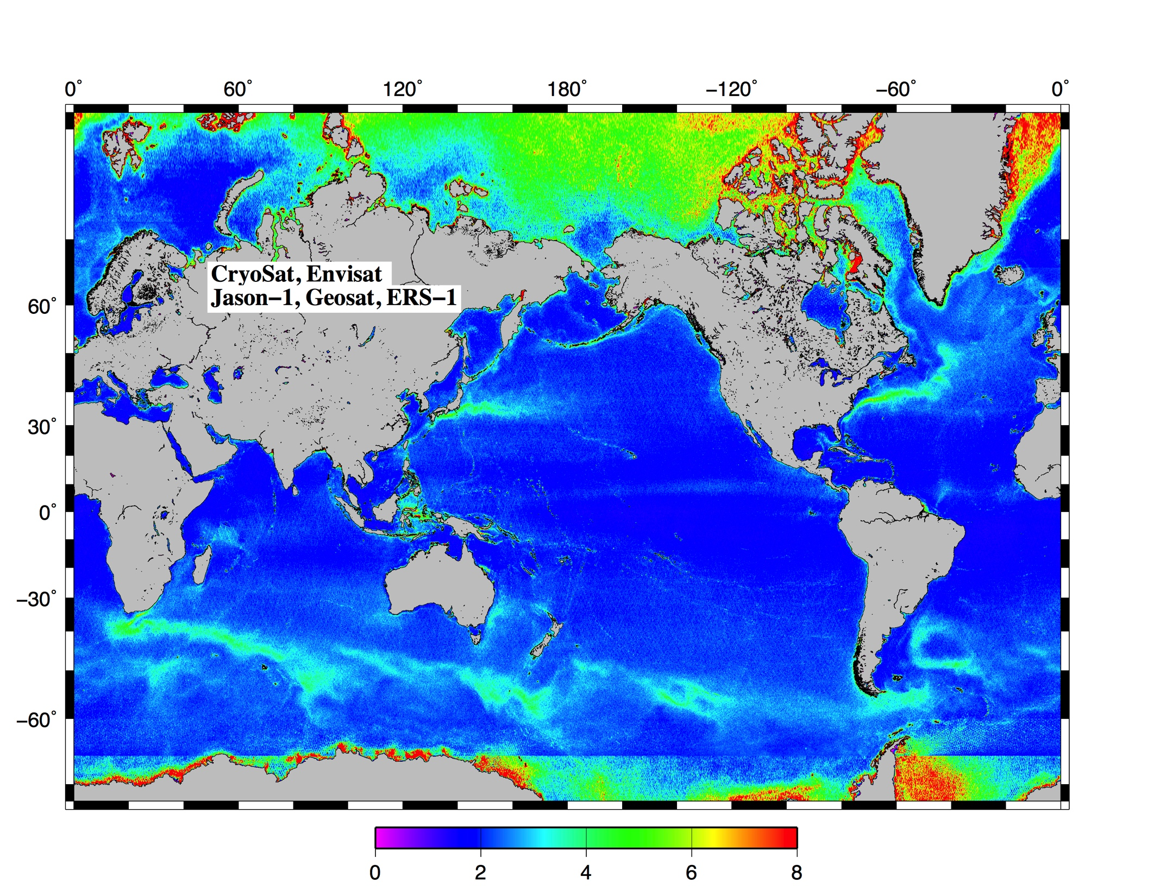
median along track slope difference in microradian (0.98 mGal)
sea ice

Slide 20
median along track slope difference in microradian (0.98 mGal)
ocean
variability

Slide 21
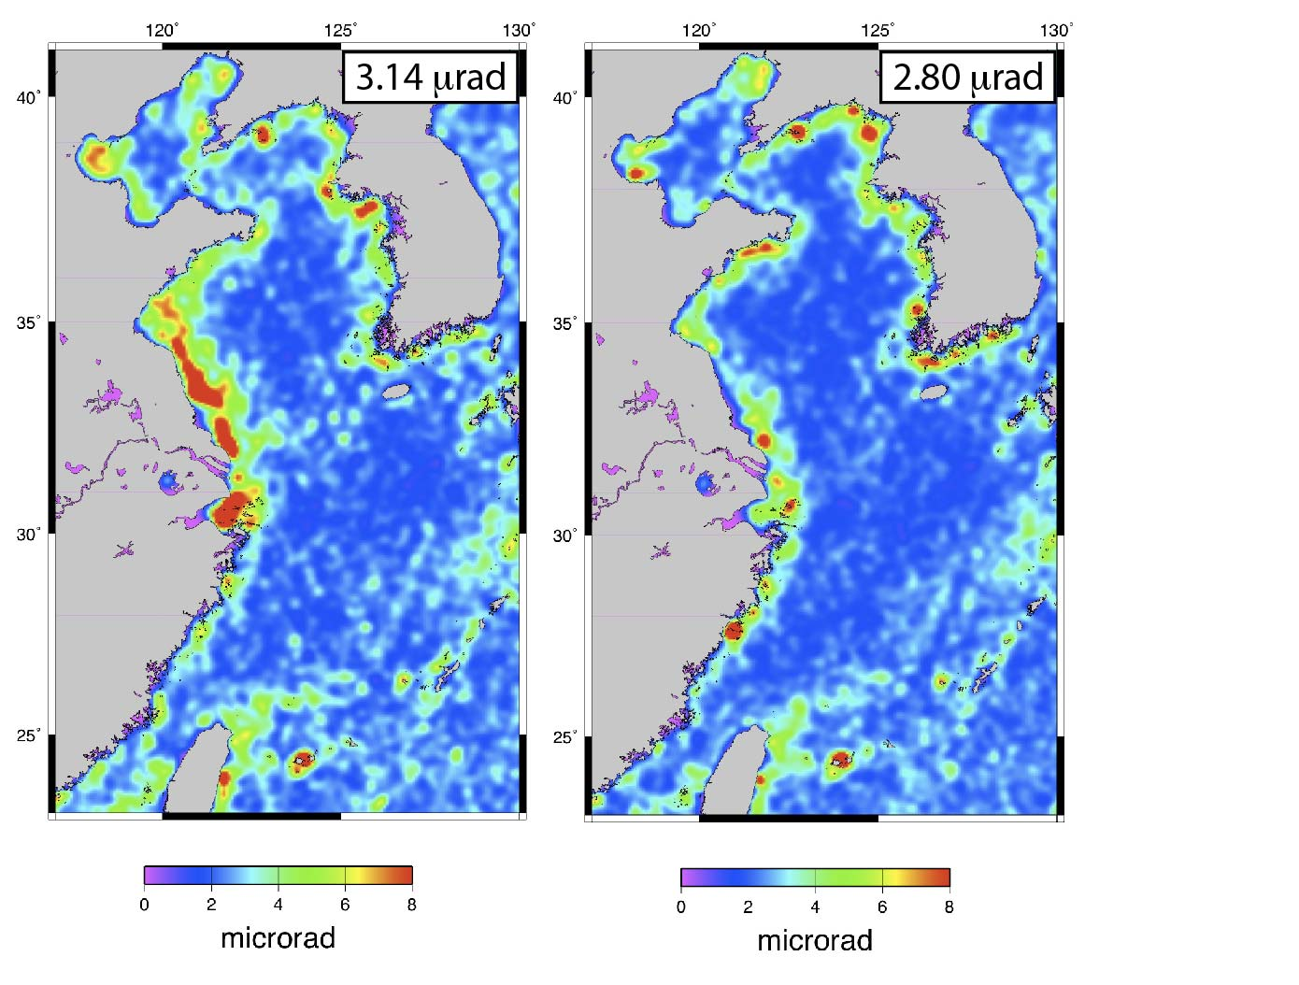
Marine Gravity Errors from Coastal Tide Models
ongoing work with Ed Zaron
to improve coastal tide
models for correcting sea
surface slope measurements

Slide 22
Offshore Extension of Median Tectonic Line, Japan
[Bassett et al., Nature, 2016]
Offshore
Sedimentary
Basins

