Slide 1
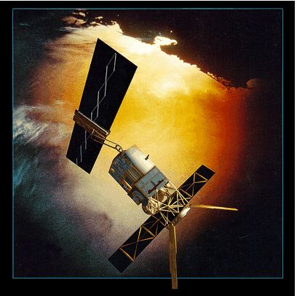
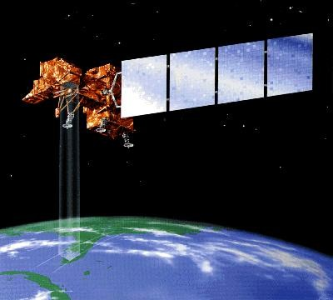
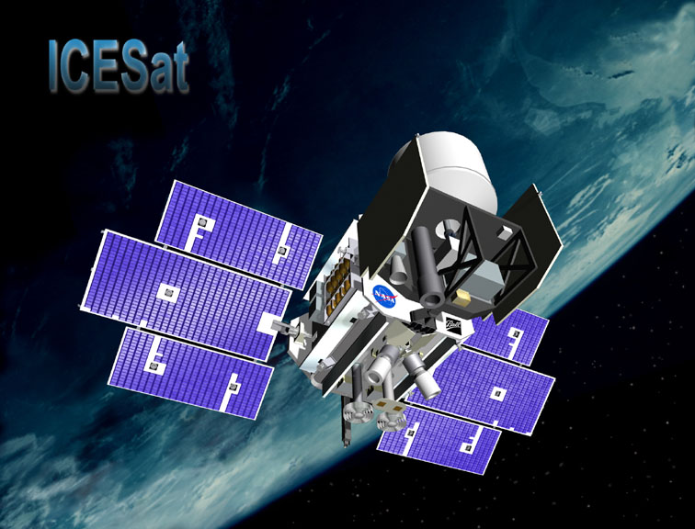
Satellite Remote Sensing SIO 135/SIO 236 Thermal Radiation
Notes:
http://www.evitherm.org/default.asp?ID=221

Slide 2
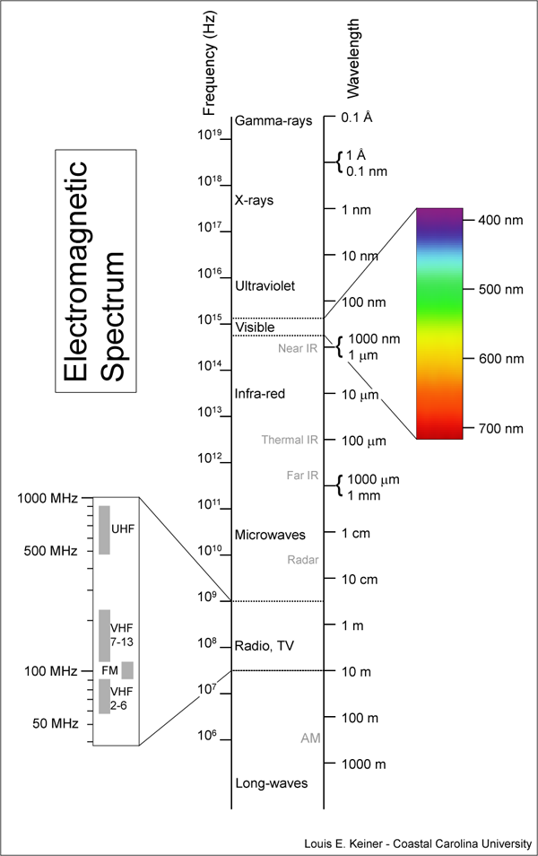
EM radiation generation
Radio generated by periodic currents of electric charges in wires.
Microwave generated by electron tubes that use the motion of high speed electrons in specially designed structure to generate E/B fields
Visible high frequency wave in the infrared and visible are generated by molecular excitation (vibrational or orbital) followed by decay. The emitted frequency is exactly related to the energy difference between the two energy level of the molecules.
Heat kinetic energy of random motion of particles of matter. The random motion results in excitation (electronic, vibrational, rotational) due to collisions followed by random emission of EM wave during the decay. Because of its random nature this type of energy transformation leads to emission over a wide spectral band.

Slide 3
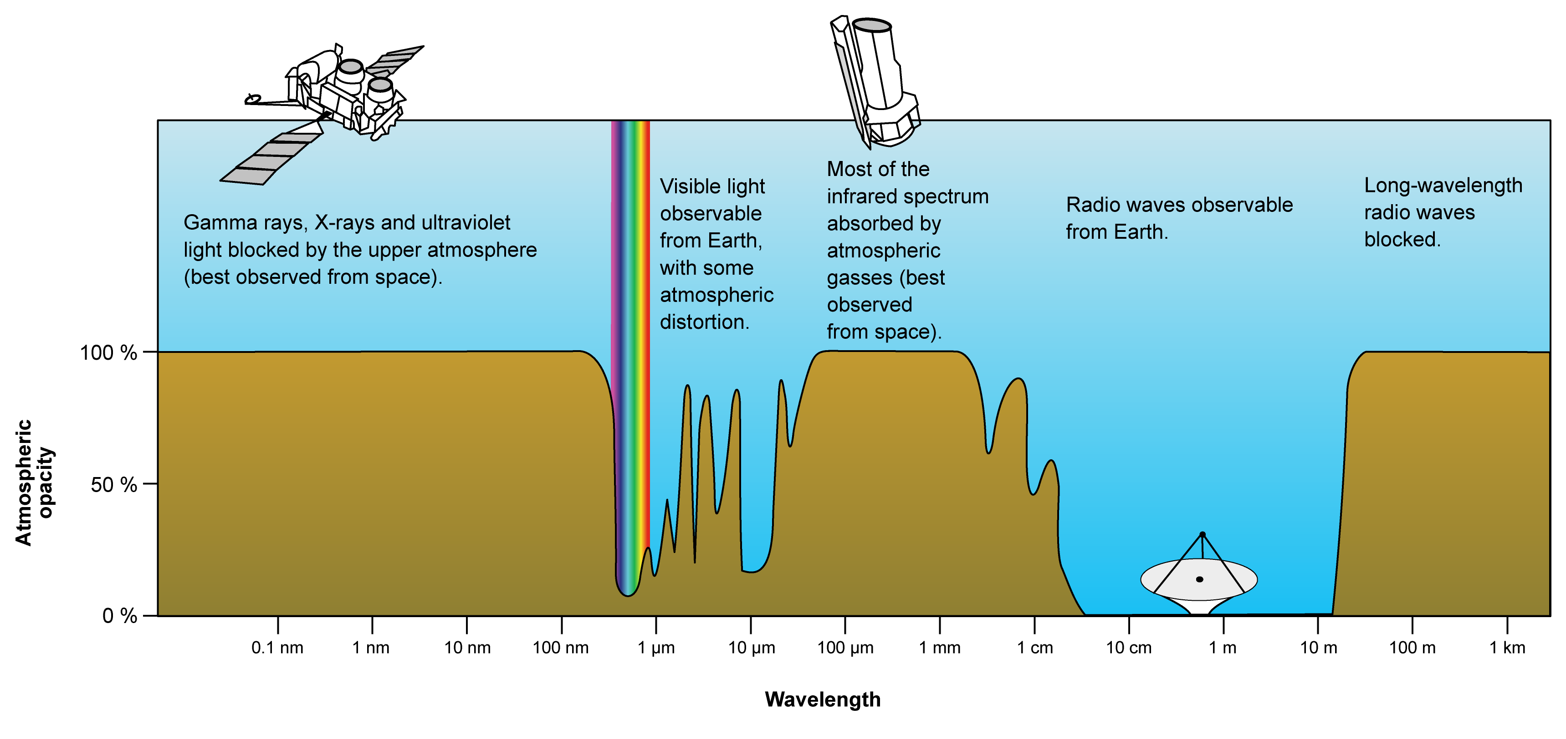
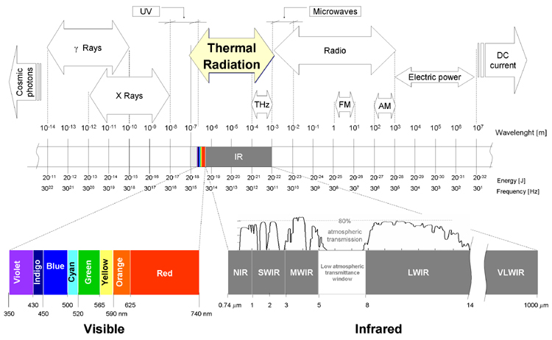
Thermal channels of the EM spectrum
In general a hot object distribute its EM emission over a range of wavelengths in a continuous spectrum.

Slide 4
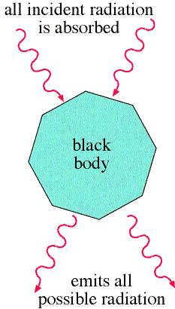
What is a “black body*”?
A black body is an idealized object that absorbs all EMR that falls on it -- no EMR passes through it and none is reflected (perfect emitter and perfect absorber)
Because no light (visible EMR) is reflected or transmitted, the object appears black when it is cold.
* Term “introduced by Gustav Kirchhoff in 1860.
Notes:
CIE 1931 x,y space Planckian locus

Slide 5
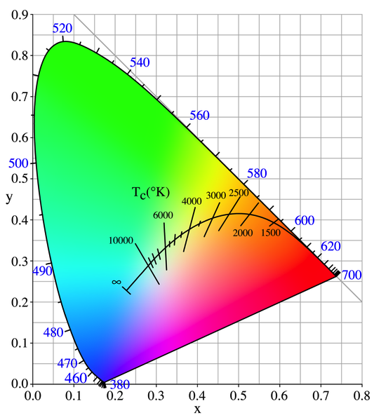
“Black body” radiation
A black body (BB) emits a temperature-dependent spectrum of light
Thermal radiation from a black body is termed black-body radiation
At room temperature, BBs emit mostly infrared light, but as the temperature increases past a few hundred ºC, BBs start to emit visible wavelengths (shorter and shorter)
red ➔ orange➔ yellow➔ white ➔blue beyond this the emission includes increasing amounts of UV.
wavelengths in nm
Wavelength (color) of BB radiation depends on the temperature of the BB.
Notes:
CIE 1931 x,y space Planckian locus

Slide 6
Black body lab experiment
An object of controlled temperature T contains a cavity, joined to the outside by a small hole.
If the hole is small, the radiation in the cavity comes to equilibrium with the walls.
The hole allows a small fraction of the radiation to pass to a spectrometer -- the radiation coming out has the same spectrum as what is inside
Notes:
Left: sketch of the experimental apparatus used to observe black body radiation.

Slide 7
Black body lab experiment
Plot of Planck's radiation law for two temperatures. Note that the peak of the curve moves to the left as the temperature increases: hotter objects output a larger fraction of their EMR at shorter wavelengths.
Note also the strong dependence on temperature of the total emission. The radiancy is the power emitted per unit area per increment of wavelength and so has units of W m⁻³.

Slide 8
Black body lab experiment
The spectral radiance from the hole is independent of the material used and only depends on the temperature

Slide 9
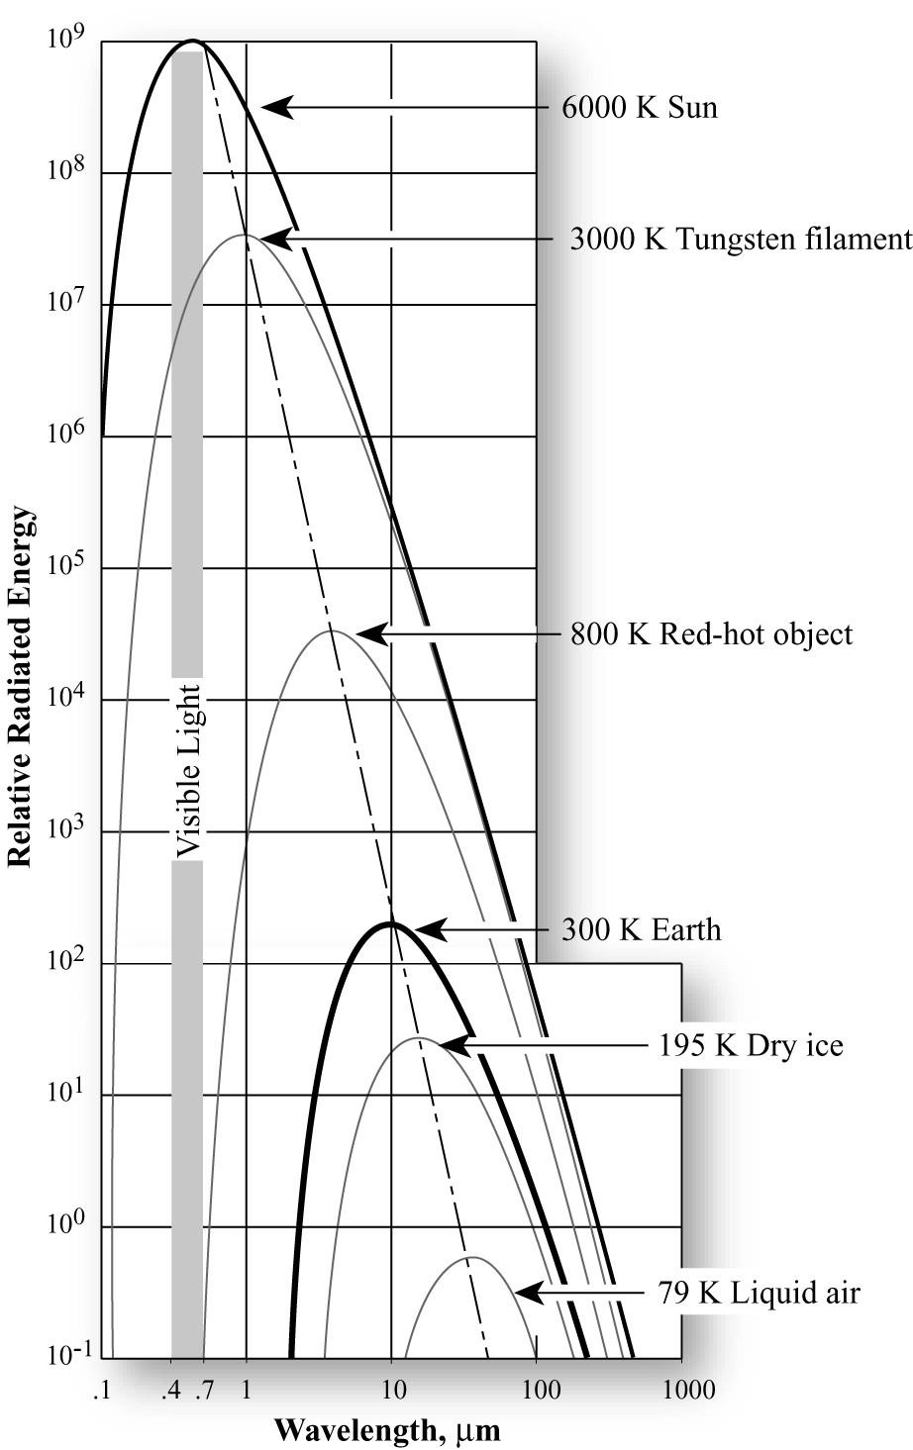
Thermal Radiation
Thermal radiation is emitted by all objects above absolute zero (-273.15 °C)
Spectrum of this radiation (i.e. intensity vs wavelength) usually follows the idealized black-body radiation curve
Stefan-Boltzmann law: Total energy emitted over time by a black body is proportional to T⁴
Wiens displacement law: The wavelength of the spectral peak is proportional to T⁻¹

Slide 10
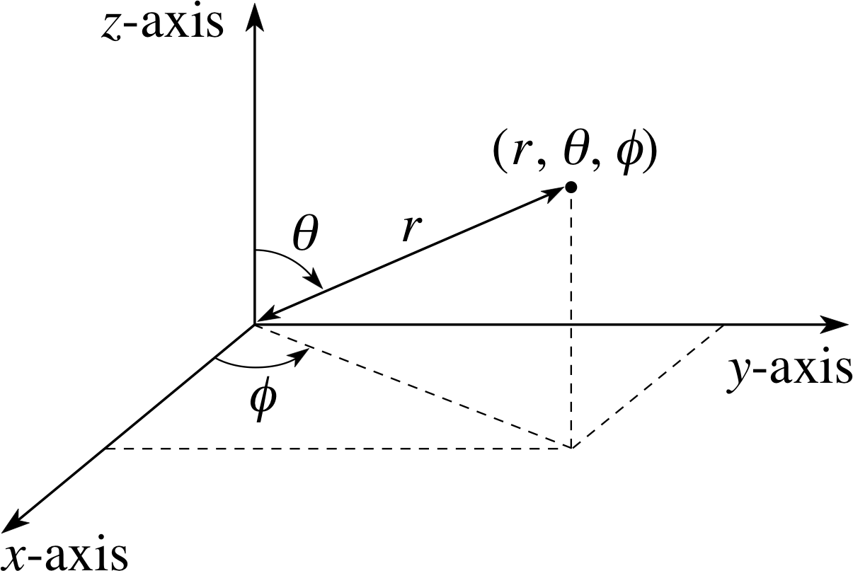
Describing angular distributions of radiation
Consider a plane surface illuminated by EMR from a variety of directions
Two angles are needed to specify a particular direction of incident radiation:
θ - angle between incident ray and normal to surface
φ - azimuthal angle, measured around normal in place of surface

Slide 11
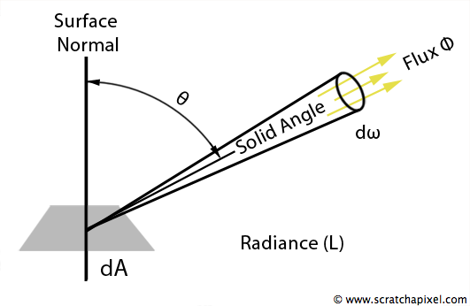
Describing angular distributions of radiation
Consider element dA of the surface, and radiation incident over range of angles θ to θ+dθ and φ to φ + dφ
dΩ
Solid angle dΩ = sinθ dθ dφ
Power incident on the element dA from this range of directions is proportional to dA & dΩ, and a term L which gives the strength of radiation
dP = L cosθ dΑ dΩ
L is radiance - SI unit is W m⁻² sr ⁻¹

Slide 12
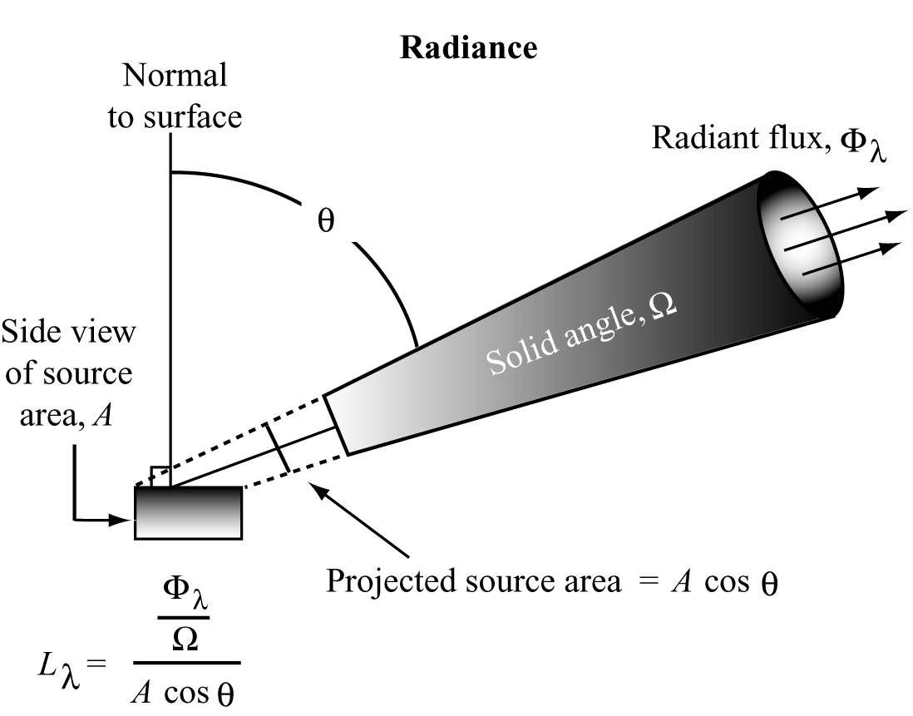
Spectral radiance
Spectral radiance Lλ is defined as the radiance ΔL contained in a small range of wavelengths Δλ and given by:
ΔL = Lλ Δλ
Lλ is the differential of L wrt λ
Lλ = | δL/δλ|
Spectral radiance - SI unit is W m⁻² sr⁻¹ m⁻¹
= W m⁻³ sr ⁻¹

Slide 13
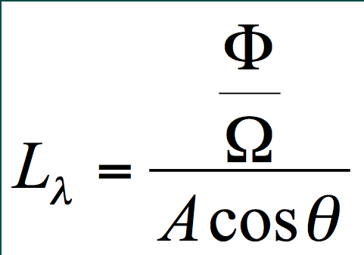
Radiance
Spectral radiance (Lλ) is the radiant flux per unit solid angle leaving an extended source in a given direction per unit projected source area in that direction
Radiant flux in certain wavelengths (Lλ) leaving the projected source area (A) within a certain direction (θ) and solid angle (Ω):
Jensen 2005
units W m⁻³ sr ⁻¹

Slide 14
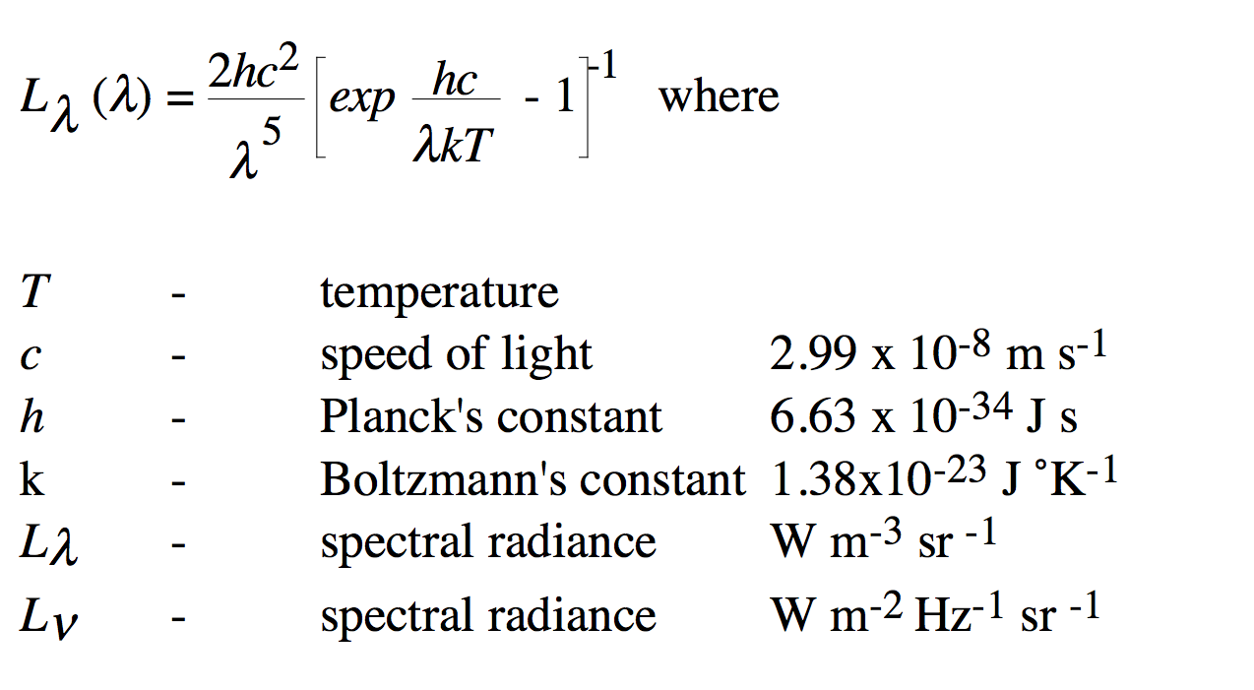
Planck’s law
Describes the amplitude of radiation emitted (i.e., spectral radiance) from a black body. It is generally provided in one of two forms:
1) Lλ(λ) is the radiance per unit wavelength as a function of wavelength λ 2) Lν(ν) is the radiance per unit frequency as a function of frequency ν.
1)
Notes:
See Rees Page 35

Slide 15
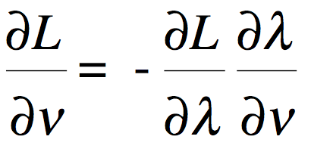
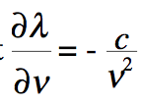
Planck’s law
To relate the two forms and establish L ν(ν), we take the derivative of L with respect to ν using the chain rule:
Since λ = c/ν, so that
which gives:

Slide 16
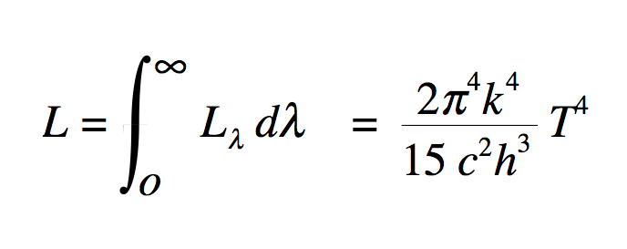
Stefan-Boltzmann Law
The total emitted radiation (Mλ) from a black body is proportional to the fourth power of its absolute temperature.
where σ is the Stefan-Boltzmann constant, 5.6697 x 10⁻⁸ W m⁻² ºK ⁻⁴.
the amount of energy emitted by an object such as the Sun or the Earth is a function of its temperature.
This can be derived by integrating the spectral radiance over the entire spectrum
or M=πL=σT⁴

Slide 17
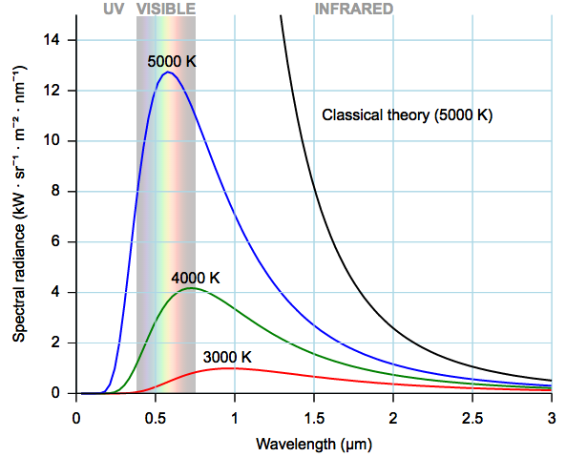
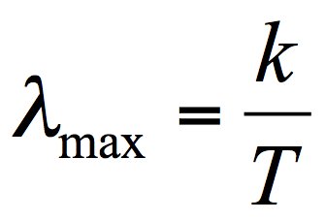
Wien’s displacement law
In addition to computing the total amount of energy exiting a theoretical blackbody such as the Sun, we can determine its dominant wavelength
(λmax) based on Wien's displacement law:
where k is Wien's displacement constant
= 2.898 x 10⁻³ K m, and T is the absolute
temperature in K.
i.e. there is an inverse relationship between the wavelength of the peak of the emission of a black body and its temperature.
Therefore, as the Sun approximates a 6000 K blackbody, its dominant wavelength (λmax ) is 0.48 μm.

Slide 18
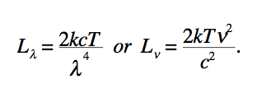
Rayleigh-Jeans approximation
Convenient and accurate description for spectral radiance for long wavelengths (i.e. λ >> λmax -- much longer than the wavelength of the peak in the black body radiation formula)
Approximation is better than 1% when hc/λkT << 1
or λT > 0.77 m K.
E.g. for a body at 300˚K, the approximation is valid when λ > 2.57 mm, i.e. when viewing thermal emissions from the Earth over the microwave band.

Slide 19
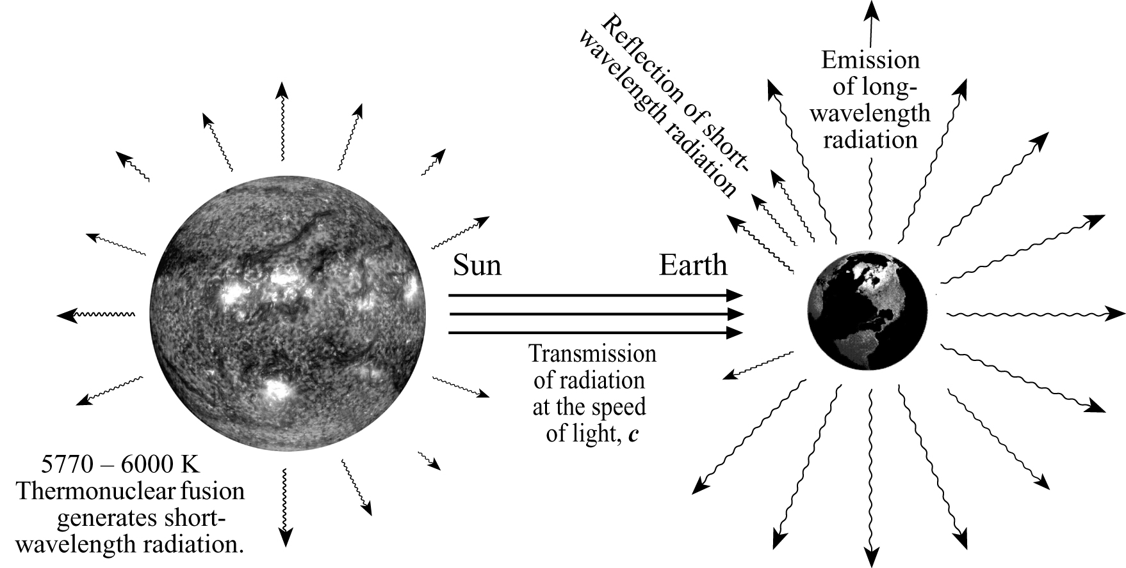
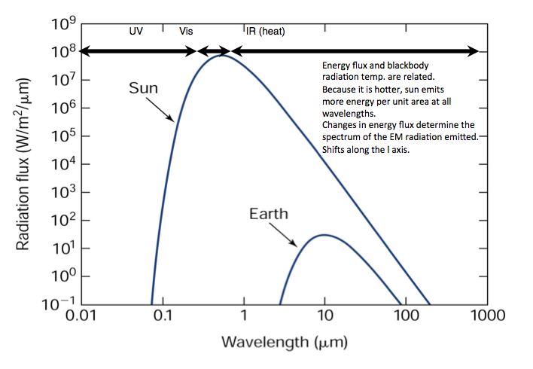
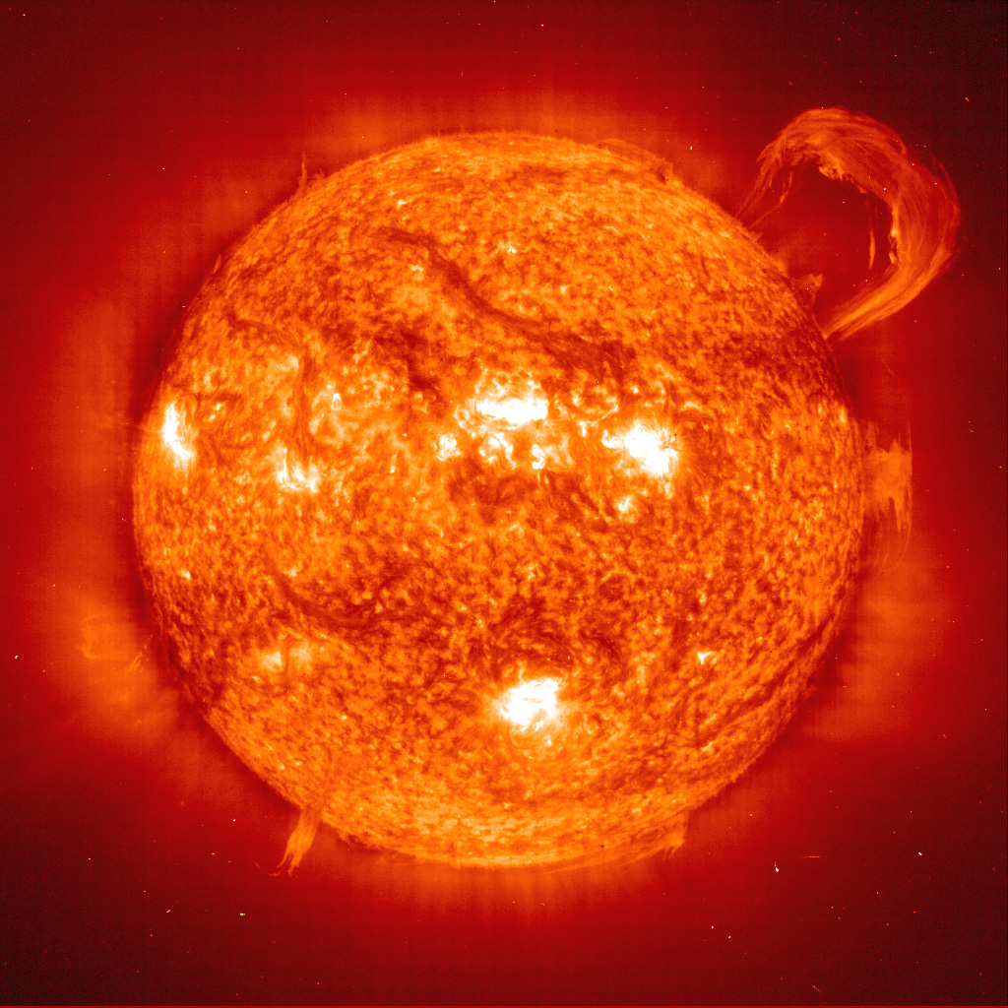
EM Energy from the Sun
Thermonuclear fusion on the surface of the Sun (temp 5770 – 6000 K) yields a continuous spectrum of EM energy ranging from short, high frequency gamma & cosmic waves to long, low frequency radio waves; majority of the energy is relatively short wavelength
Travels through space at the speed of light & takes 8 minutes reach Earth (150 million km)
Some energy is intercepted by the Earth, where it interacts with the atmosphere and surface materials; some is reflected directly back out to space; and some is absorbed and then re-emitted it at a longer wavelength
Earth approximates a 300 K (27˚C) blackbody, dominant wavelength is ~ 9.7 mm
Notes:
Sun produces 41% of its energy in the visible region from 0.4-0.7 μm (blue, green, and red light).
The other 59% of the energy is in wavelengths shorter than blue light (<0.4 μm) and longer than red light (>0.7 μm).
Remote sensing detectors can be made sensitive to energy in the non-visible regions of the spectrum.

Slide 20
EM Energy from the Sun
Max radiation emission (41%) is in the visible (0.4 – 0.7 μm)
59% of the energy is in wavelengths shorter than blue light (<0.4 μm) and longer than red light (>0.7 μm).
Large component of high energy UV
Remote sensing detectors can be made sensitive to energy in the non-visible regions of the spectrum.

Slide 21
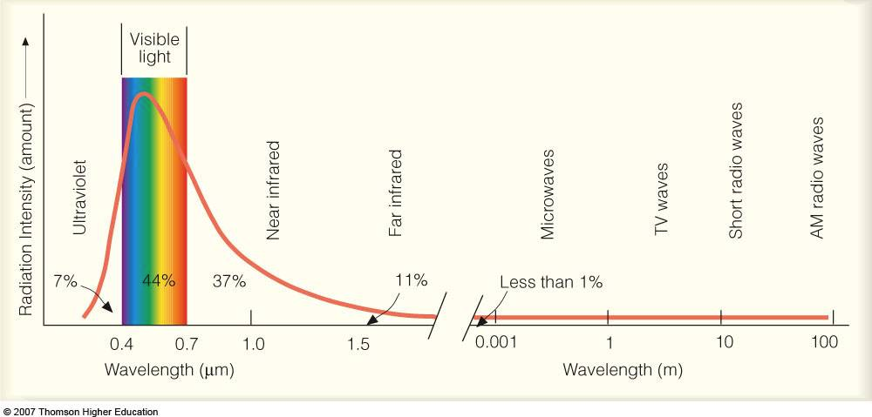
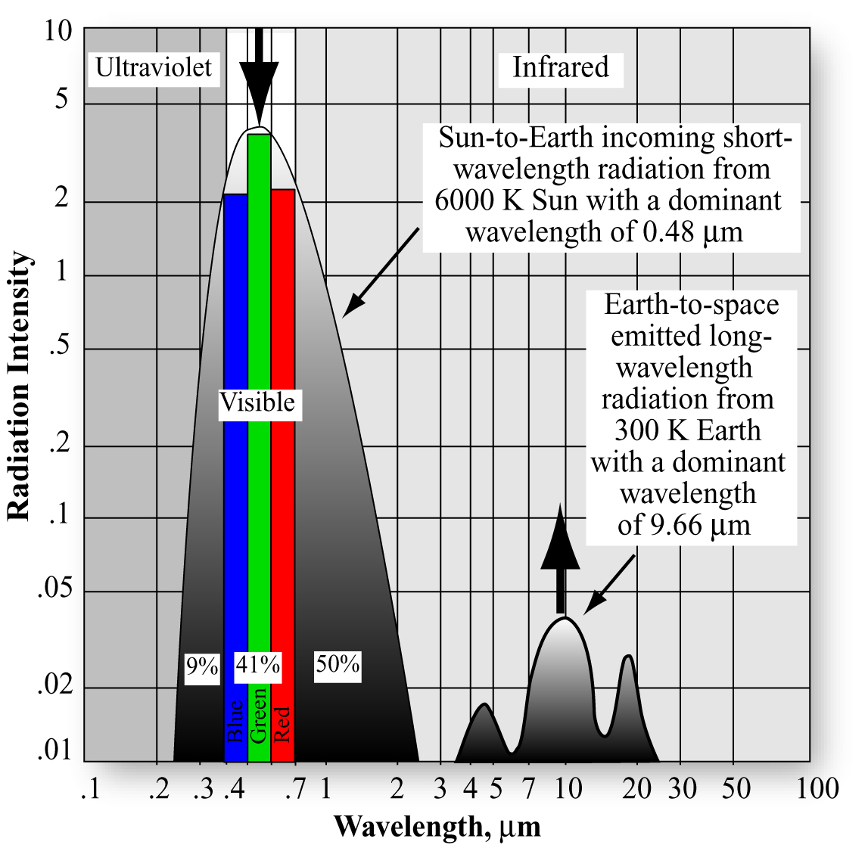
EM Energy from the Sun

Slide 22
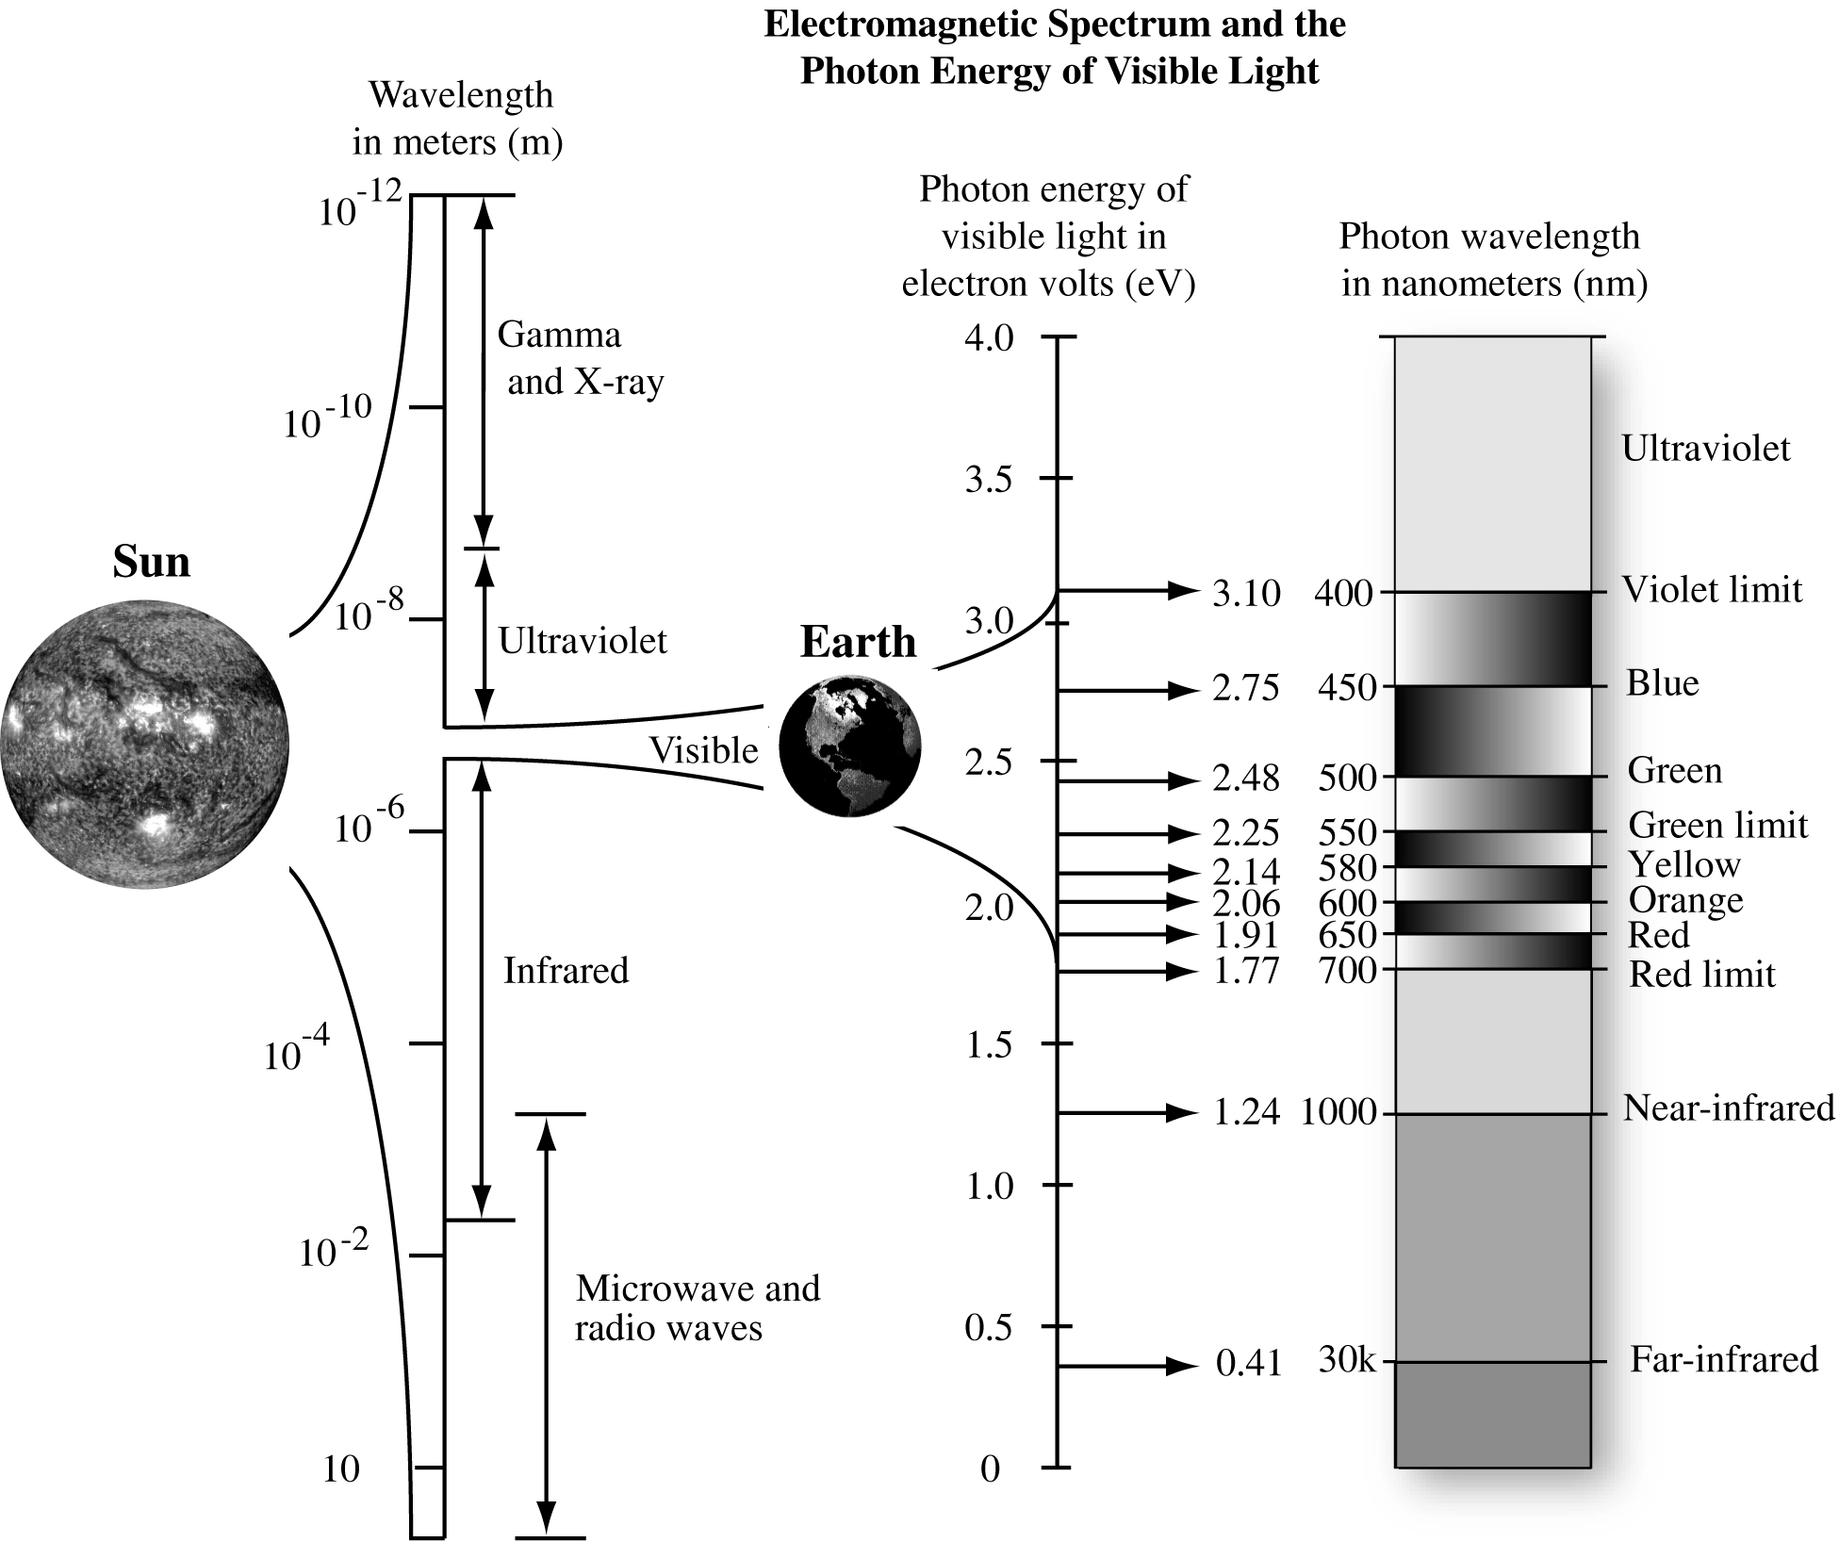
EM Energy from the Sun

Slide 23
Blackbody Radiation Curves
Blackbody radiation curves for several objects including Sun & Earth (approximate 6,000 K and 300 K blackbodies).
As the temperature increases, dominant wavelength (λmax ) shifts toward shorter wavelengths.
Area under each curve may be summed to compute the total radiant energy (Ml) exiting each object.

Slide 24
Real materials
Real materials are not black bodies, so we introduce a property, emissivity ε:
describes the actual absorption and emission properties of real objects, or gray bodies.
is wavelength dependent ε(λ)
is the ratio of the energy radiated (emitted) by the material to the energy radiated by a black body at the same temperature
is a measure of a material's ability to absorb and radiate energy
has a value from 0 to 1
Lλ = ε(λ) Lλ,p
Black-body radiance
Graybody: an object that reflects a fraction of the incident radiation
Reflectivity is 1- ε(λ)
Notes:
Page 26 Rees
Simple thermodynamic argument shows that a body that is a good emitter (high e) must also be a good abosorber of radiation.

Slide 25
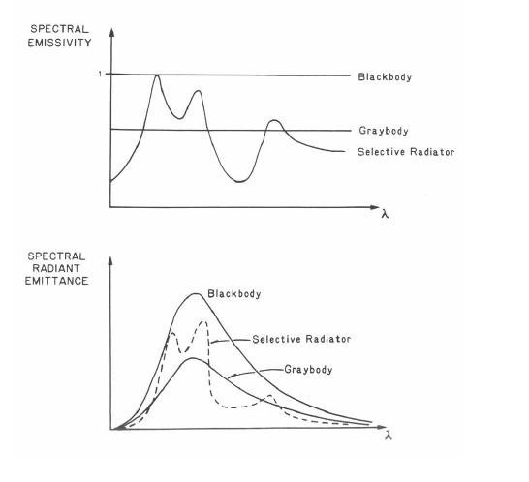
Real materials
Notes:
Page 26 Rees
Simple thermodynamic argument shows that a body that is a good emitter (high e) must also be a good abosorber of radiation.

Slide 26
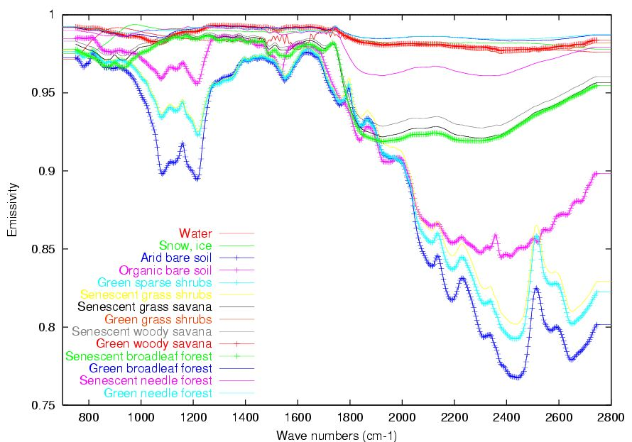
Real materials
Notes:
Page 26 Rees
Simple thermodynamic argument shows that a body that is a good emitter (high e) must also be a good abosorber of radiation.

Slide 27
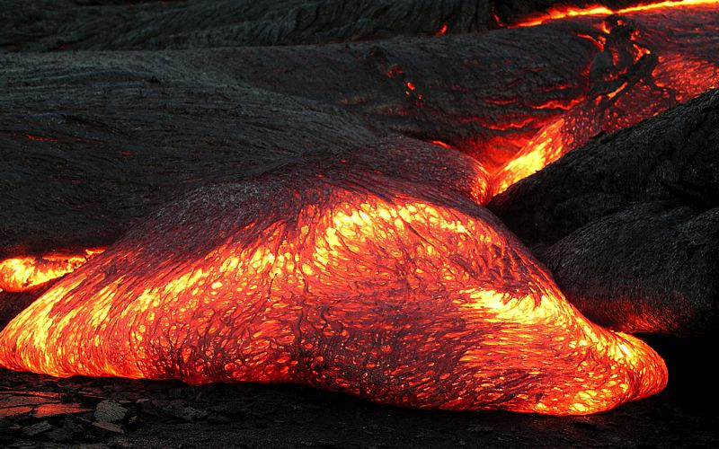
Temperature of lava flow
The temperature of a Pāhoehoe lava flow can be estimated just by observing its colour. The result agrees well with the measured temperatures of lava flows at about 1000 to 1200°C.

Slide 28
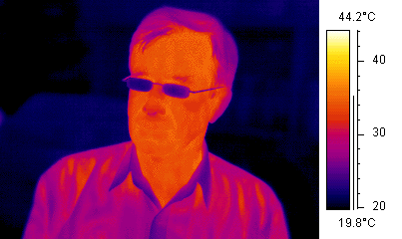
Thermal radiation
Thermal cameras and imaging systems respond to infra-red radiation and, suitably calibrated for emissivity, can produce images of the surface temperatures of bodies.
In this picture, false colour is used in the display.

Slide 29
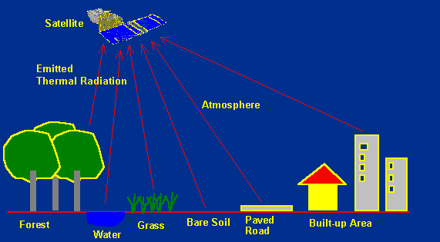
Thermal remote sensing
Strengths
Good resolution and accuracy.
Long heritage (~ 20 years)
Weaknesses
Obscured by clouds.
Atmospheric corrections required.

Slide 30
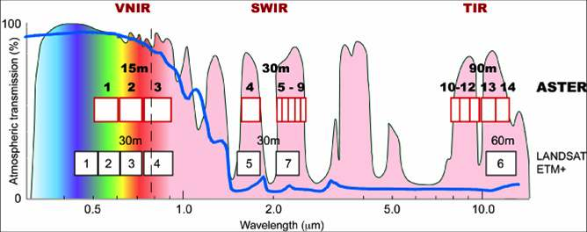
Thermal satellite sensors
ASTER (Advanced Spaceborne Thermal Emission and Reflection Radiometer) on Terra (launched 1999)
The broad spectral coverage and high spectral resolution of ASTER provides critical information for surface mapping, and monitoring of dynamic conditions and temporal change.
Used for: monitoring glaciers and ice sheets; monitoring volcanoes; identifying crop stress; determining cloud morphology and physical properties; wetlands evaluation; thermal pollution monitoring; coral reef degradation; surface temperature mapping of soils and geology; measuring surface heat balance.

Slide 31
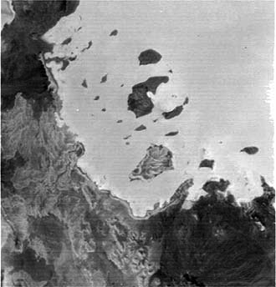
Some Applications of Thermal Remote Sensing
ASTER thermal IR image taken at night, showing (in light tones signifying warmer temperatures) the Red Sea and a small land area (dark; cooler) in Eritrea in eastern Africa.

Slide 32
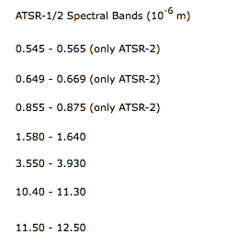
Thermal satellite sensors
Along-Track Scanning Radiometer ATSR
ATSR on ERS-1 (1991-19
ATSR-2 on ERS-2
AATSR on Envisat
ATSR consists of two instruments, an Infra-Red Radiometer (IRR) and a Microwave Sounder (MWS). On board ERS-1 the IRR is a four-channel infra-red radiometer used for measuring sea-surface temperatures (SST) and cloud-top temperatures, whereas on board ERS-2 the IRR is equipped with additional visible channels for vegetation monitoring. The MWS is a two channel passive radiometer.
ATSR nighttime false color image of Typhoon Saomai over the East China Sea.

Slide 33
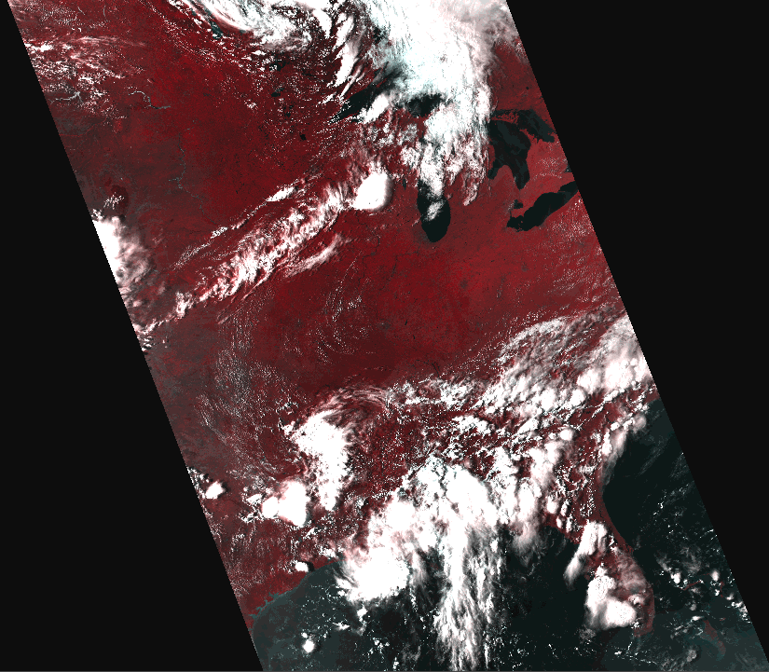
Thermal satellite sensors
Bands are carefully chosen!
AVHRR 3.7μm window sits in the small overlap region between reflected solar radiation & emitted radiation from the earth and clouds.
At night there is no solar radiation component & the radiation in this channel comes from the earth.
By day there is a mixture of radiation of solar & terrestrial origin, but the solar radiation dominates.
At night, enhancing the resolution at the warm end of the grey scale can provide better discrimination of the low cloud cover than can be obtained from other IR images.
Advanced Very High Resolution Radiometer (AVHRR)
AVHRR is a broad-band, 4 or 5 channel (depending on model) scanner, sensing in the visible, near-infrared, and thermal infrared portions of EMS.
Carried on the NOAA's Polar Orbiting Environmental Satellites (POES), beginning with TIROS-N in 1978.
Resolution: 1.1 km at nadir

Slide 34
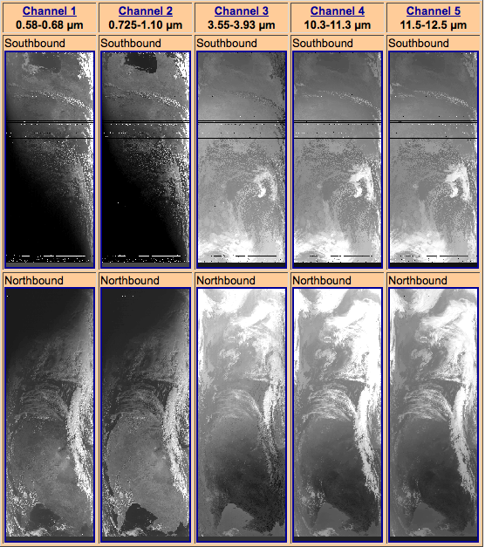
Thermal satellite sensors
Advanced Very High Resolution Radiometer (AVHRR)
AVHRR is a broad-band, 4 or 5 channel (depending on model) scanner, sensing in the visible, near-infrared, and thermal infrared portions of EMS.
Carried on the NOAA's Polar Orbiting Environmental Satellites (POES), beginning with TIROS-N in 1978.

Slide 35
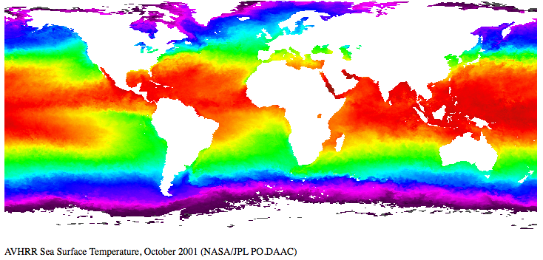
Sea surface temperature
Sea surface temperature (SST) is an important geophysical parameter, providing the boundary condition used in the estimation of heat flux at the air-sea interface.
Important for climate modeling, earth's heat balance, and insight into atmospheric and oceanic circulation patterns & anomalies (e.g. El Niño).
On a local scale, SST can be used operationally to assess eddies, fronts and upwellings for marine navigation and to track biological productivity.
Calibration is very important for trends in SST!

Slide 36
Sea surface temperature
https://svs.gsfc.nasa.gov/3652

Slide 37
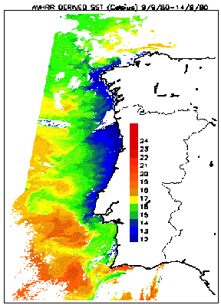
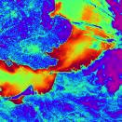
Sea surface temperature

Slide 38
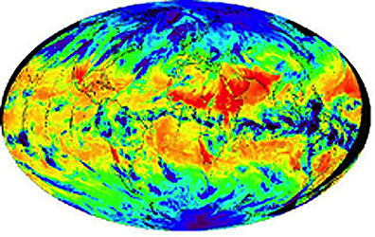
Thermal radiation from Earth
Emitted thermal radiation from both the atmosphere and land surfaces (with color assignments of red/yellow to warm and green/blue to cooler). From MODIS on Terra.

Slide 39
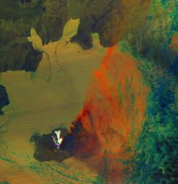
Thermal satellite sensors
ASTER (Advanced Spaceborne Thermal Emission and Reflection Radiometer) on Terra (launched 1999)
The broad spectral coverage and high spectral resolution of ASTER provides critical information for surface mapping, and monitoring of dynamic conditions and temporal change.
Applications: monitoring glaciers; monitoring volcanoes; identifying crop stress; determining cloud morphology and physical properties; wetlands evaluation; thermal pollution monitoring; coral reef degradation; surface temperature mapping of soils and geology; measuring surface heat balance.
Augustine Volcano, Cook Inlet, Alaska (22:50 AST January 31, 2006).
This ASTER thermal image was acquired at night during an eruptive phase.

Slide 40
Monitor the ice sheets during polar winter
During polar darkness, cannot get visible images from Antarctica
Thermal helps to lengthen time series (although lower resolution) λ/d!
MODIS Terra visible 13 March 2009
MODIS Aqua thermal 6 April 2009

Slide 41
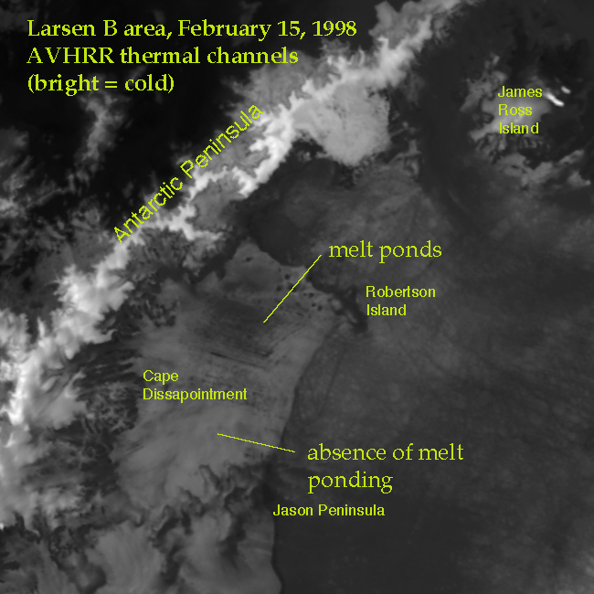
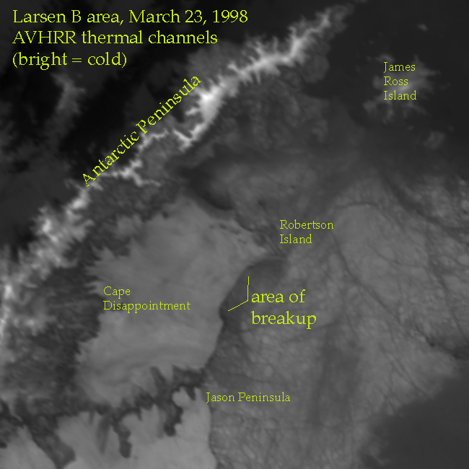
Monitor the ice sheets during polar winter
During polar darkness, cannot get visible images from Antarctica
Thermal helps to lengthen time series (although lower resolution) λ/d!

Slide 42
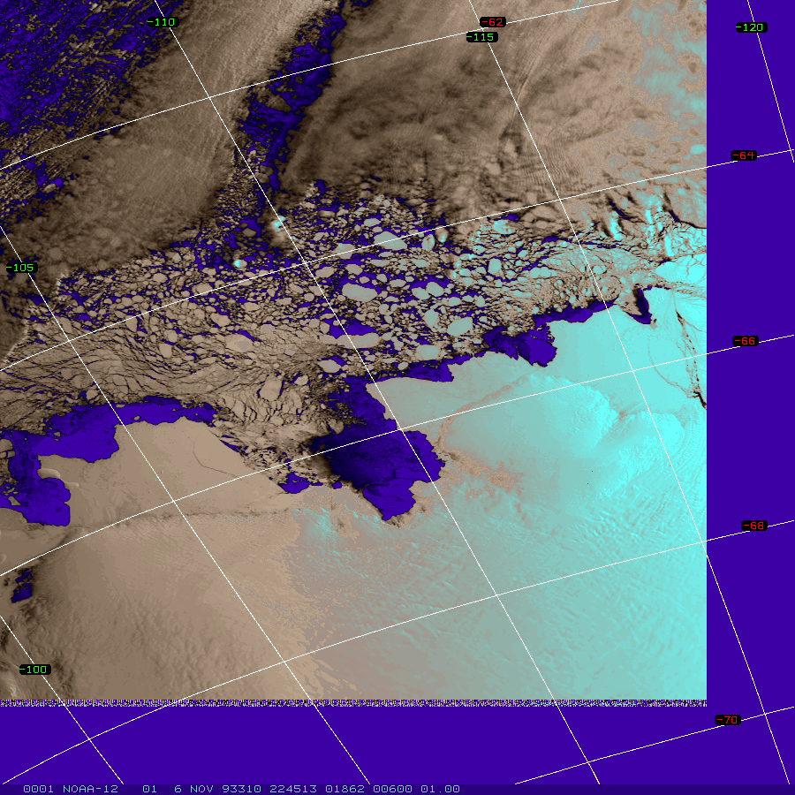
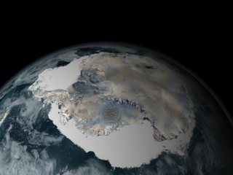
Sea-ice mapping
Monitor extent of sea-ice in the Arctic and Antarctic
Thermal remote sensing can distinguish between the sea-ice and “leads” (open water between the sea-ice) -- useful for navigation and for science

Slide 43
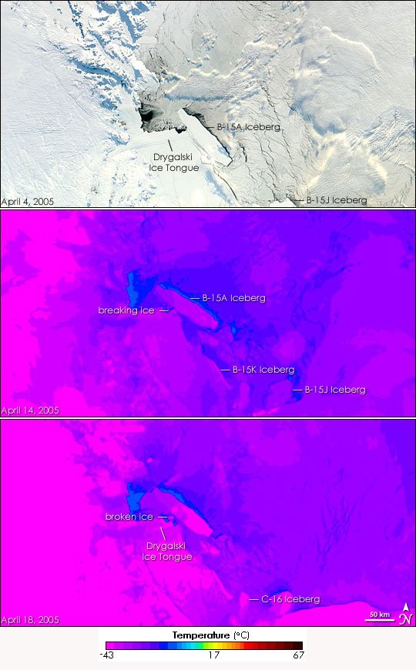
Thermal satellite sensors
NASA’s Moderate Resolution Imaging Spectroradiometer (MODIS) has several bands in the thermal IR

Slide 44
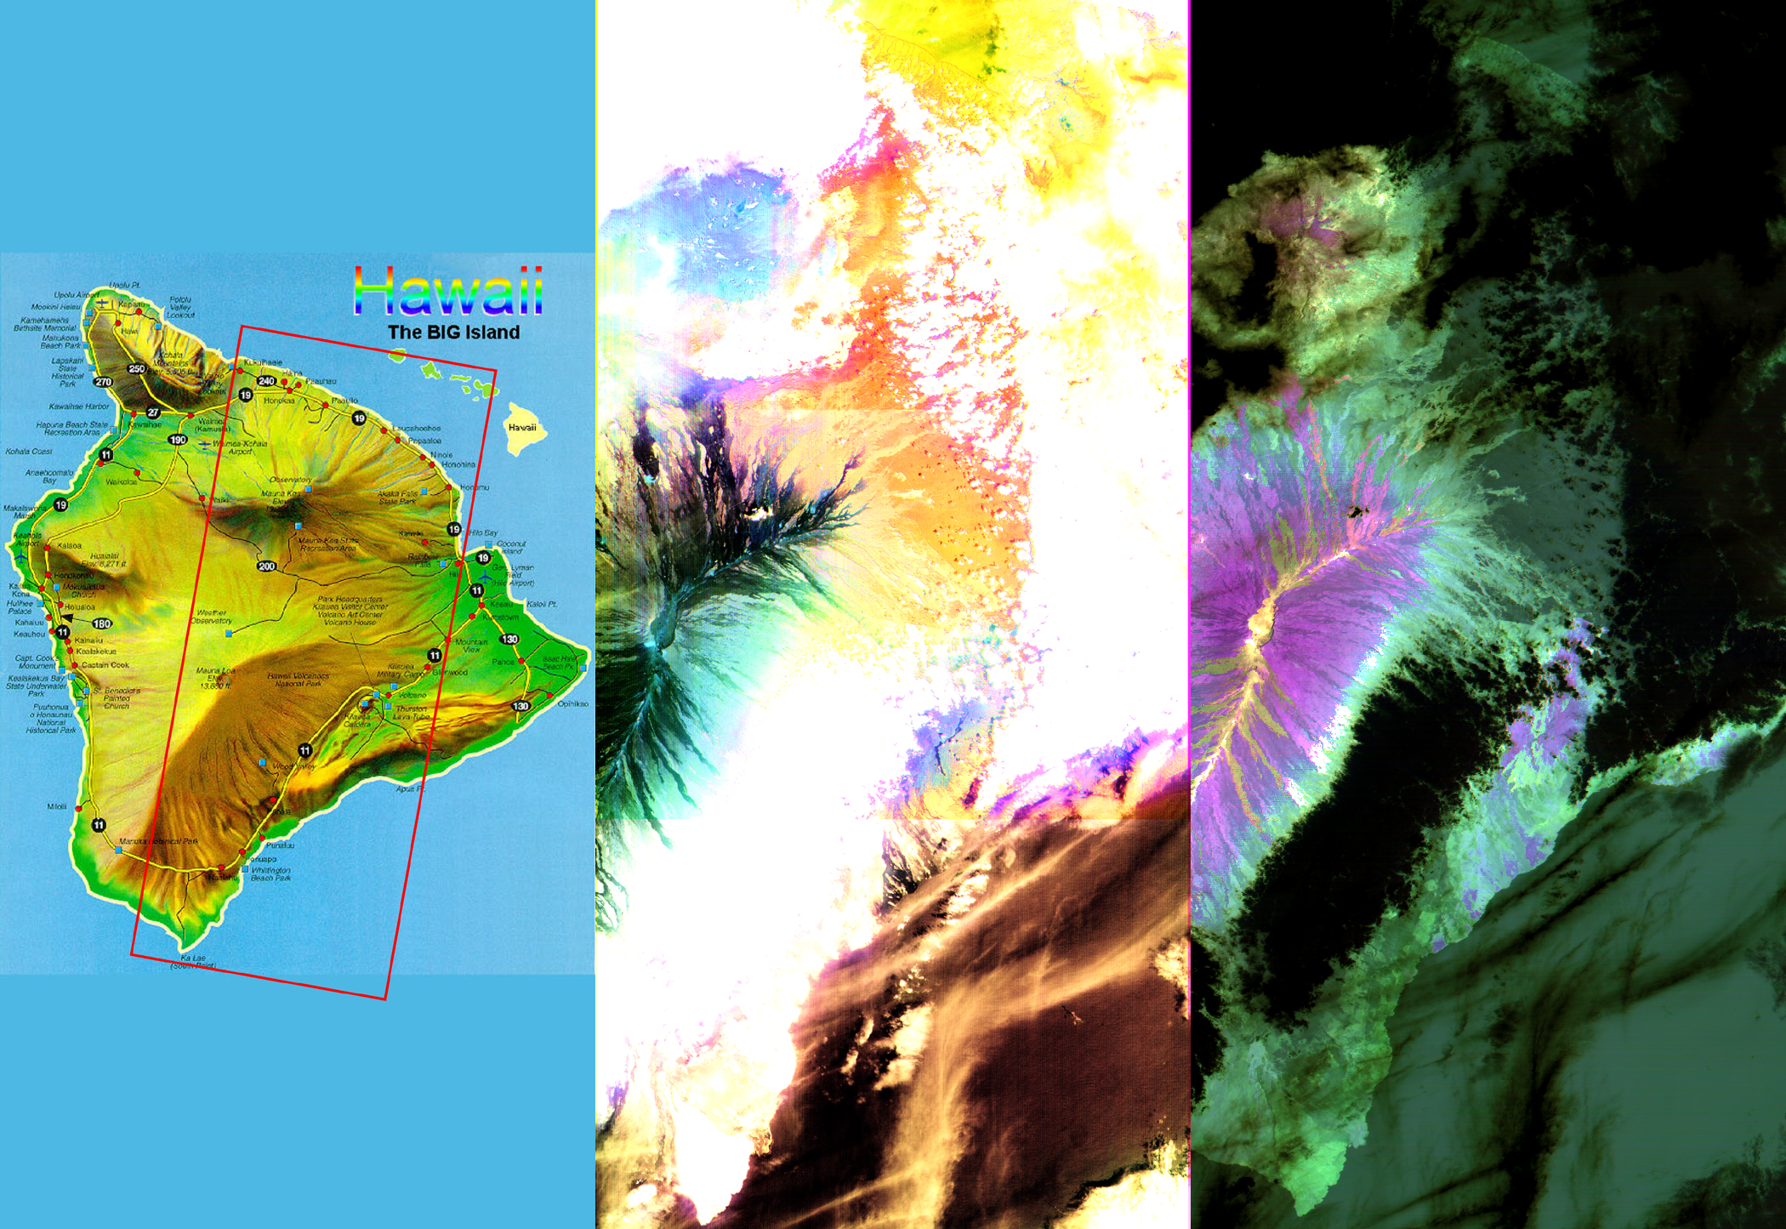
Advanced Spaceborne Thermal Emission and Reflection Radiometer (ASTER)
Hawaii March 19, 2000
Notes:
These images of the Island of Hawaii were acquired on March 19, 2000 by the Advanced Spaceborne Thermal Emission and Reflection Radiometer (ASTER) on NASA's Terra satellite. With its 14 spectral bands from the visible to the thermal infrared wavelength region, and its high spatial resolution of 15 to 90meters (about 50 to 300 feet), ASTER will image Earth for the next 6 years to map and monitor the changing surface of our planet. Data are shown from the short wavelength and thermal infrared spectral regions, illustrating how different and complementary information is contained in different parts of the spectrum.
Left image: This false-color image covers an area 60 kilometers (37 miles) wide and 120 kilometers (75 miles) long in three bands of the short wavelength infrared region. While ,much of the island was covered in clouds, the dominant central Mauna Loa volcano, rising to an altitude of 4115 meters (13,500 feet), is cloud-free. Lava flows can be seen radiating from the central crater in green and black tones. As they reach lower elevations, the flows become covered with vegetation, and their image color changes to yellow and orange. Mauna Kea volcano to the north of Mauna Loa has a thin cloud-cover, producing a bluish tone on the image. The ocean in the lower right appears brown due to the color processing.
Right image: This image is a false-color composite of three thermal infrared bands. The brightness of the colors is proportional to the temperature, and the hues display differences in rock composition. Clouds are black, because they are the coldest objects in the scene. The ocean and thick vegetation appear dark green because they are colder than bare rock surfaces, and have no thermal spectral features. Lava flows are shades of magenta, green, pink and yellow, reflecting chemical changes due to weathering and relative age differences.

Slide 45
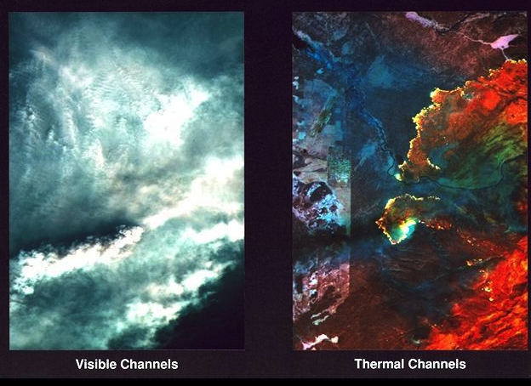
Fire monitoring
Images of 1988 Yellowstone fires. Visible image is what you'd see flying over a forest fire - smoke! Right image combines several infrared bands (reflective and thermal infrared) to cut through the smoke. Bright yellow areas are actively burning fire lines.

Slide 46
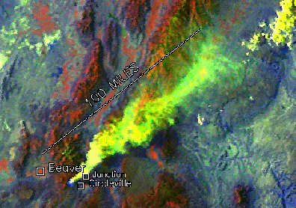
Fire monitoring
Major fires are commonly imaged by satellites, and the extent of the burn damage is easily assessed afterwards by the dark patterns in the visible bands.
“False color” AVHRR composite (made by assigning channel 1 image to red, channel 2 to green, and channel 3 to blue). In this version, the smoke shows as yellow and the fire, at the head of the smoke column, appears as bright blue.

Slide 47
Clouds and the Earth's Radiant Energy System (CERES)
CERES is a scanning broadband radiometer
Measures the reflected sunlight and emitted thermal energy from the surface of the Earth and the atmosphere.
The radiometer is made up of three sensors, each with its own telescope mounted on a gimbaled platform that scans across the Earth in a 6.6-second cycle.
Notes:
Clouds and the Earth's Radiant Energy System (CERES) will measure the Earth's energy balance–comparing the amount of energy from the sun that reaches the Earth's surface vs. the amount of heat energy emitted by the Earth and its atmosphere. This animation shows the pattern of CERES' scanning mirrors (there are two instruments on Terra).

Slide 48
Thermal satellite sensors
Landsat Multi-spectral scanner (Landsat-1 to 5)
MSS were the first global monitoring systems capable of producing multispectral data in digital format.
Landsat MSS collects reflected and/or radiated energy from the Earth in four bands or channels of the electromagnetic spectrum: two in the visible spectrum and two in the near-infrared spectrum

Slide 49
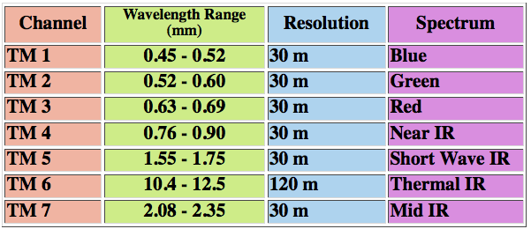
Thermal satellite sensors
Landsat Thematic Mapper (Landsat-4 onwards)
Advanced, multispectral scanning, with improvements over MSS:
higher spatial and radiometric resolution
finer spectral bands
seven vs four spectral bands acquired simultaneously.
Band 6 senses thermal (heat) infrared radiation. Landsat can only acquire night scenes in Band 6.
TM replaced MSS completely after Landsat-5

Slide 50
Temperature of Saturn's moon Phoebe
taken by the composite infrared spectrometer onboard Cassini
Notes:
Thermal radiation from the day and night sides of Saturn's moon Phoebe, taken by the composite infrared spectrometer onboard Cassini 1.8 hours before the spacecraft's closest approach to Phoebe on June 11, 2004. The left-hand panel displays the image in grayscale format, showing the brightness of Phoebe's radiation in the wavelength range 15-17 microns, which is about 25 times the longest wavelength visible to the naked eye. In the middle panel this brightness is used to estimate the surface temperature distribution across Phoebe. Temperatures vary from a relatively toasty 107 Kelvin (-267 Fahrenheit), in the late morning near the equator (white, lower right), to less than 75 Kelvin (-324 Fahrenheit) in the northern hemisphere in the pre-dawn hours (dark blue, upper left). The "ragged edge" of Phoebe in this region is an instrumental artifact.
Temperatures are affected strongly by topography, as can be seen by comparison with the visible-wavelength image (right). Some of the coldest temperatures are found in the shadowed region inside the large depression in the northern hemisphere (upper right).

